Slide 1

ERS-6 at Austrian Institute of Technology
Andrej Sipaj
20/11/2012

Slide 2
Resume
    University of Ontario Institute of Technology
    Bachelor of Engineering (2007-2011)
    Mechanical Engineering (Energy option)
    Master of Applied Science (2011-2012)
    Nuclear Engineering (Radiation science)

Slide 3
Previous Work (1/2)
Simulation, design and construction of a gas electron multiplier for particle tracking
    Detector for the energy deposition (stopping power) measurements of an alpha particle
    Single GEM detector with a segmented collection plate
      10 segments, each 4.8 mm wide
    Simulation of the GEM gain under different electric field strengths (drift, GEM and induction region) by the Garfield++ toolkit

Slide 4
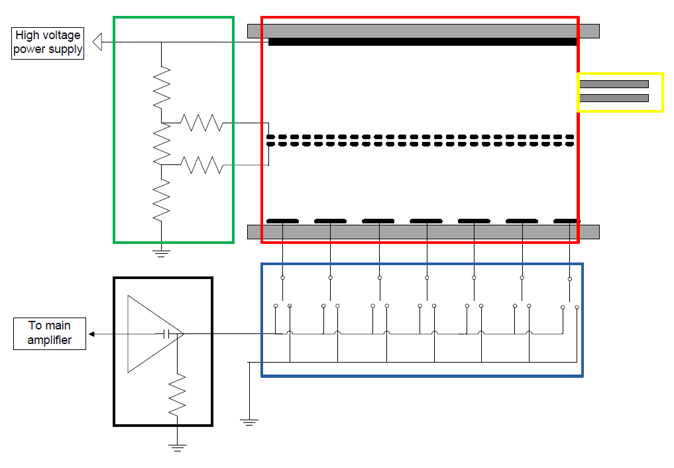
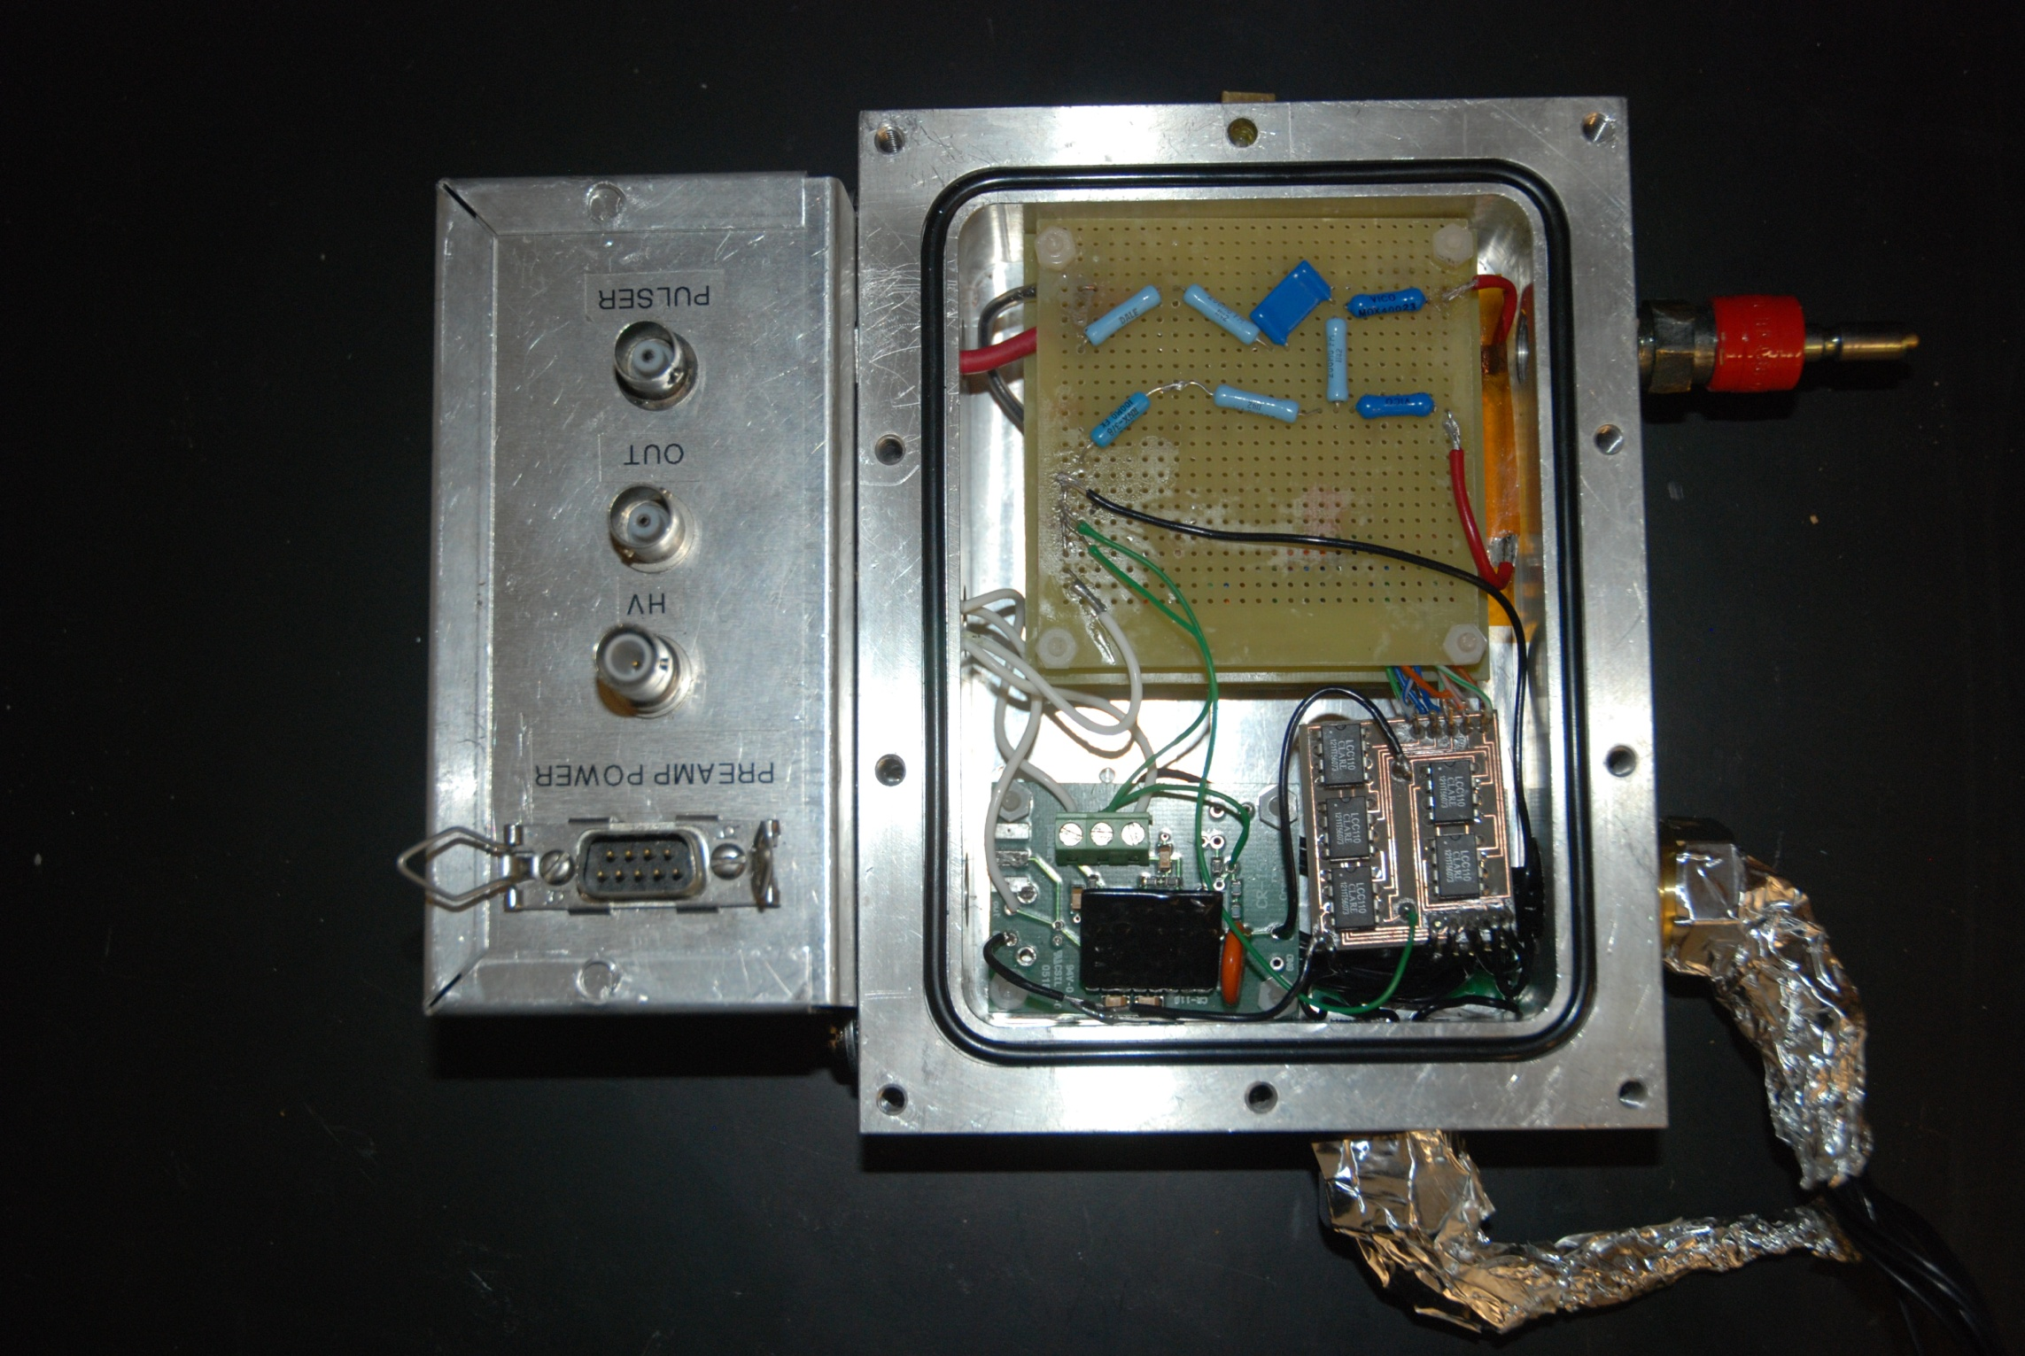
Previous Work (2/2)
Schema of the GEM detector
The green box represents the voltage divider, red the sensitive volume, yellow the collimator, blue the collection plate switch and black the main board with pre‐amplifier
Detector prototype

Slide 5
Early Stage Researcher 6
ESR position for the evaluation of advanced
detectors for in-vivo dosimetry in an animal phantom in order to provide a dose validation system for clinical treatment planning systems in radiation therapy
    AIT Vienna and Seibersdorf
    Dr. Sofia Rollet (supervisor)
  Project can be divided into 3 phases
    Detector selection and animal phantom development
    Animal phantom irradiation and computer simulation
    Healthy animal irradiation and treatment simulation

Slide 6
Detector Selection and Animal Phantom Development
Main criteria:
    Size
    Sensitivity
    Simplicity ( to avoid substantial perturbation)
Some possibilities:
    Silicon or diamond detectors (neutron)
    TLDs or OSLs (neutron and gamma)
    Miniature active detectors

Slide 7
Animal Phantom Irradiation and Computer Simulation
Detectors will be placed inside the animal phantom
  Precise location obtained by microMR and microPET
  Undergo irradiation
Simulation of the animal phantom with detector
  Geometry construction based on microMR and microPET
  Simulate the same irradiation
Comparison and adjustment of the results will be conducted

Slide 8
Animal Phantom Irradiation and Computer Simulation
Healthy animal experiment
  Detectors will be implanted into a healthy animal
  Undergo microPET and microMR scans to find detector location and tissue distribution for treatment planning
  Irradiation
Radiation therapy Monte Carlo simulation
  Treatment simulation based on treatment planning
Data from the treatment and the MC simulation will be compared and evaluated

Slide 9
Thank you for your attention

