Slide 1
Overview of Dosimetry and its Applications
,.
Professor Anatoly B. Rozenfeld
Centre for Medical Radiation Physics
Australia
ARDENT Workshop, Vienna 19-23 November , 2012

Slide 2
Outline
Introduction-What is it Dosimetry?
Medical Dosimetry-Applications
  Dosimetry in radiation therapy
  Internal dosimetry
  Dosimetry in radiology
Radiation Protection Dosimetry-Applications
  Dosimetry in mixed fields (accelerators, avionic, space)
  Biological dosimetry
  Microdosimetry
  Nanodosimetry
  Simulation dosimetry

Slide 3
What is it dosimetry?
Dosimetry is the determination of the delivery of energy to matter
Radiation dose (absorbed dose)has a specific meaning which is connected to the absorbed energy per unit mass, Gy
Dosimetry is possible only if one knows relation between the dosimetric quantity and measurable quantities (e.g. spectra and composition of radiation field)
Ionizing energy impartation can be described as stochastic or deterministic quantity depends on object size and time delivery (e.g.energy delivered to kidney is deterministic while to the cell in a kidney is probabilistic)

Slide 4
Why do we need dosimetry?
Radiation Protection Goals:
NCRP Report No. 116
prevent the occurrence of clinically significant radiation-induced deterministic effects by adhering to dose limits that are below the apparent threshold levels; and
limit the risk of stochastic effects, cancer and genetic effects, to a reasonable level in relation to societal needs, values, benefits gained and economic factors

Slide 5
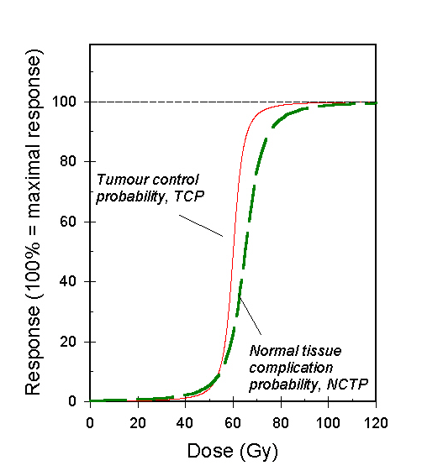
Required dose uncertainty in radiotherapy
Depends on steepness of the dose response curve
5% difference in dose make a 15% difference in tumour control probability in head and neck patients - this is clinically detectable
Notes:
The lecturer should point out that this is an example only - the dose scale is in dose delivered in 2Gy fractions. The shape of dose response curve in practice depends on tumor type.

Slide 6
Dose should be accurate
To target:
  5% too low - may result in clinically detectable reduction in tumour control (eg. Head and neck cancer: 15%)
To normal tissues:
  5% too high - significant increase in normal tissue complication probability = morbidity = unacceptable side effects

Slide 7
Delivery of dose within +/-5%
Sources of uncertainty:
  Absolute dosimetry/calibration
  Relative dosimetry (%depth dose, profiles, output factors)
  Treatment planning (estimated uncertainty of the order of +/- 2%)
  Machine performance on the day (+/- 2%)
  Patient set-up and movement (+/- 3%)
Not much room for error in dosimetry...
Notes:
Purposely, there is no % estimate given for the first two sources. The others are only estimates as well and allow the participants to estimate how much uncertainty is allowed for the two first areas which relate to dosimetry.
Assuming all uncertainties are independent and normally distributed they can be added in quadrature:
Total = sqrt(a^2 + b^2 + c^2 + …)
This leaves about 3% for dosimetry...

Slide 8
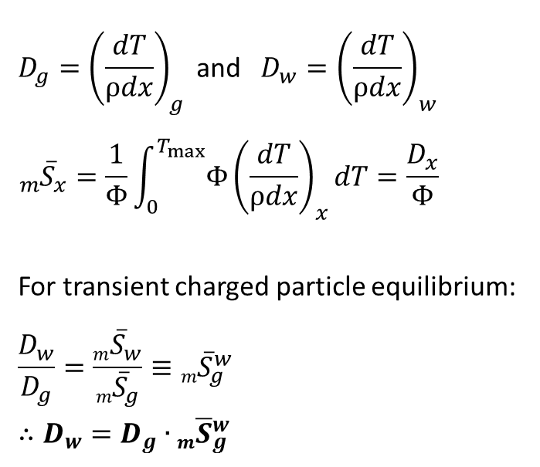
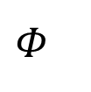
Bragg-Gray Cavity Theory
For a sufficiently small cavity g, within a different medium w and incident flux Φ, the dose to the water, D_{w} may be determined through use of the mean mass-stopping power ratio:
w
g

Slide 9
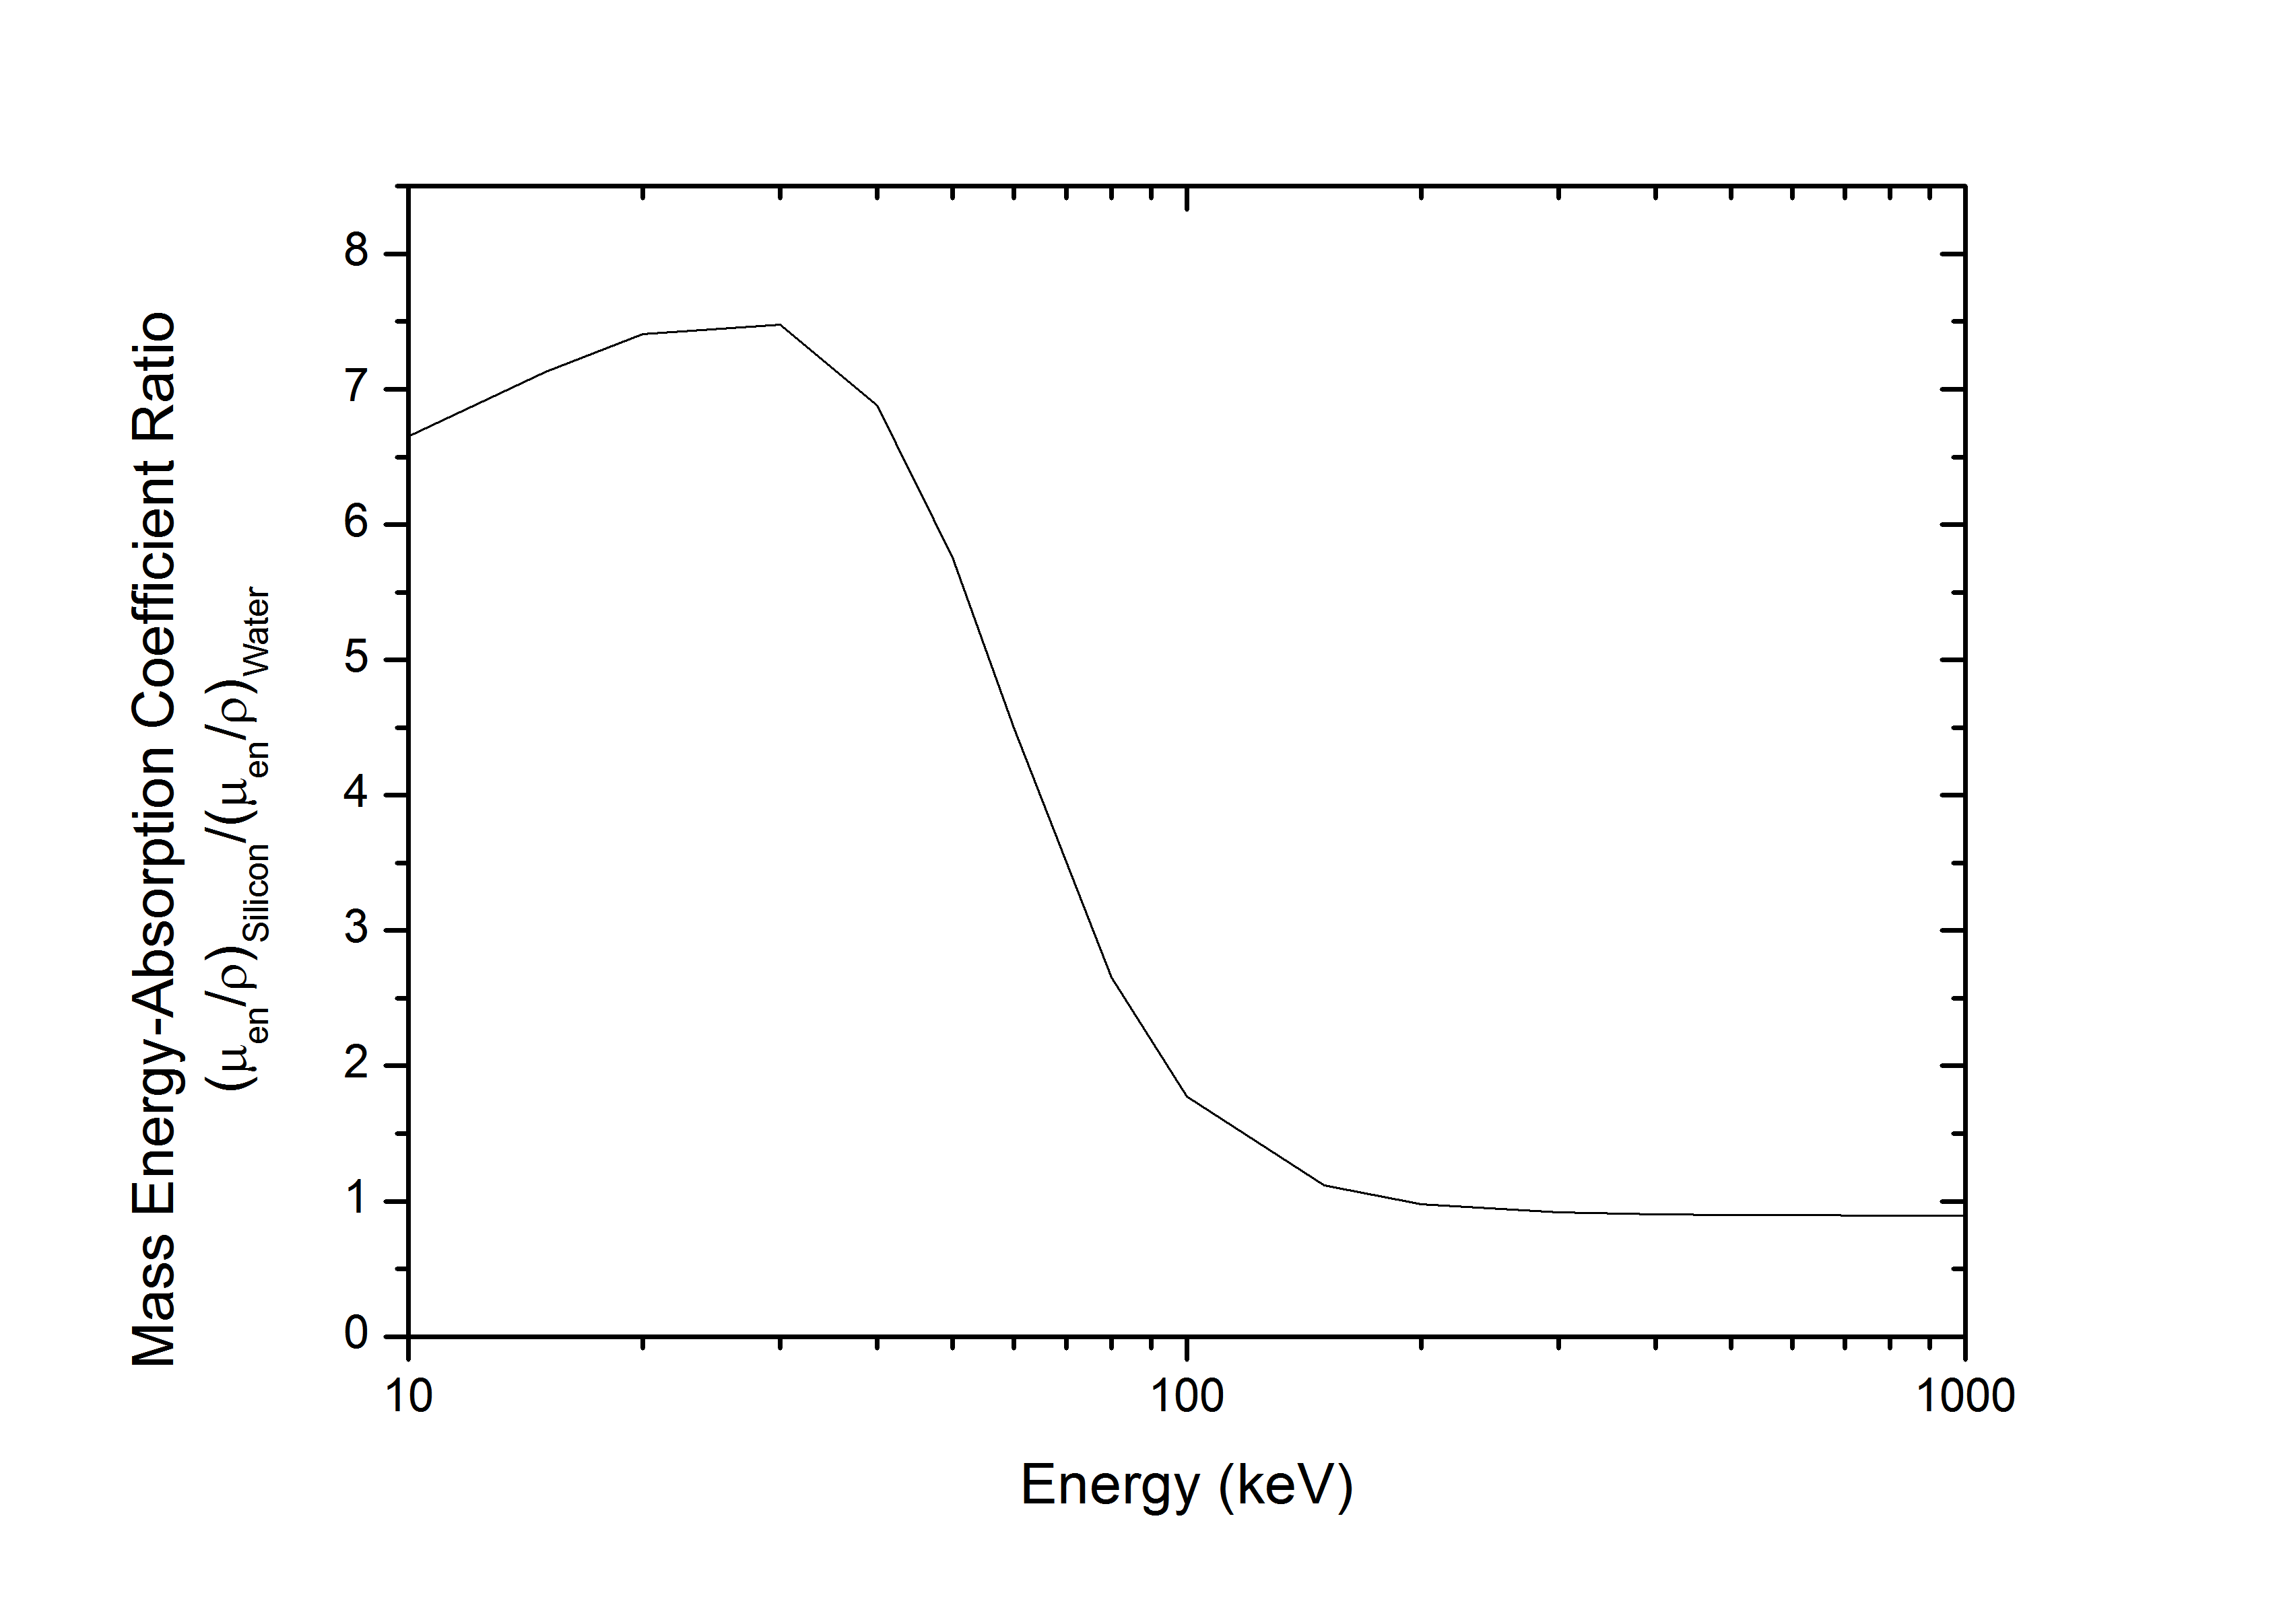
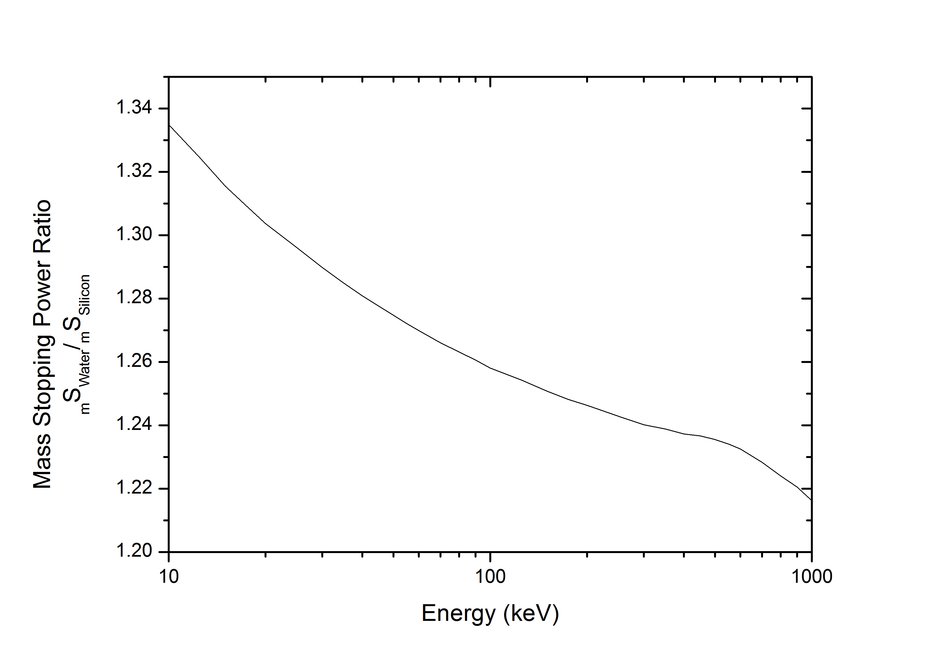
Dosimetric Ratios of Silicon-to-Water
Mass-Energy Absorption Coefficient Ratio for Silicon to Water
Mass Stopping Power
Ratio for Silicon to Water
The energy response of Si detector which is satisfying B-G cavity theory and placed in water will be relatively flat in a wide energy range
Silicon is not water equivalent in free air geometry or in case of a range of
secondary electrons in Si is smaller than Si cavity

Slide 10
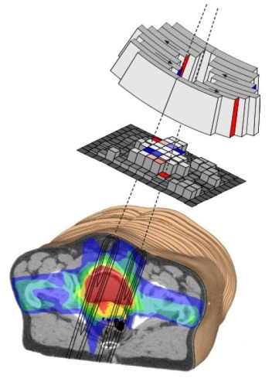
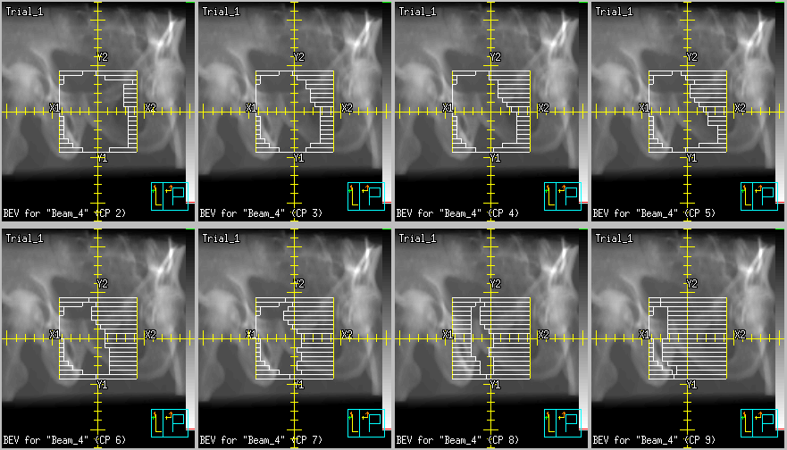
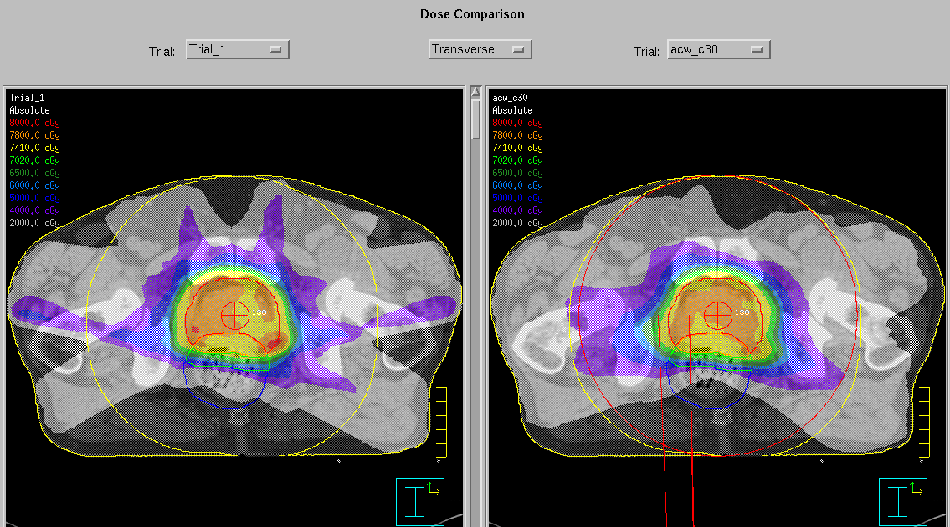
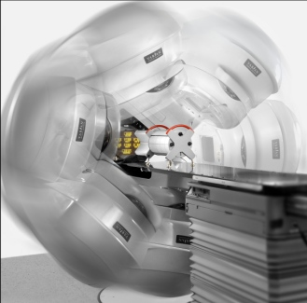
Static Gantry Modulation
“Static gantry modulation”
(sg-IMRT)
Courtesy
Ahnesjo
PMB 06

Slide 11

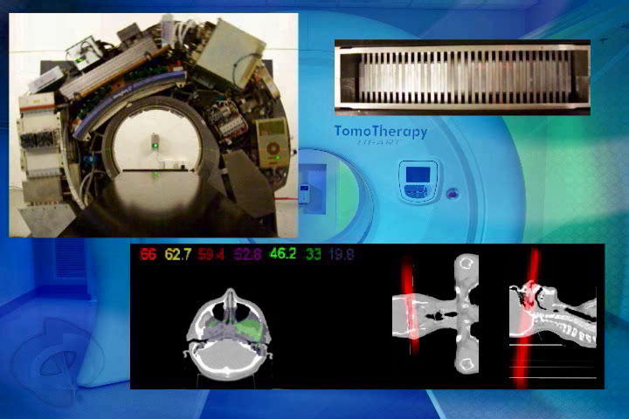
Arc Gantry Modulation
Static gantry-IMRT
VMAT
Tomotherapy

Slide 12
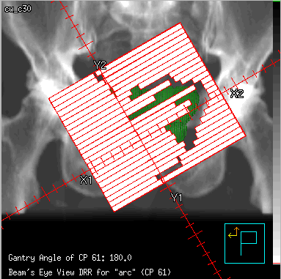
Arc Gantry Modulation
Arc Gantry Modulation
“Volumetric Modulated Arc Therapy”
(VMAT)
Beams Eye View

Slide 13
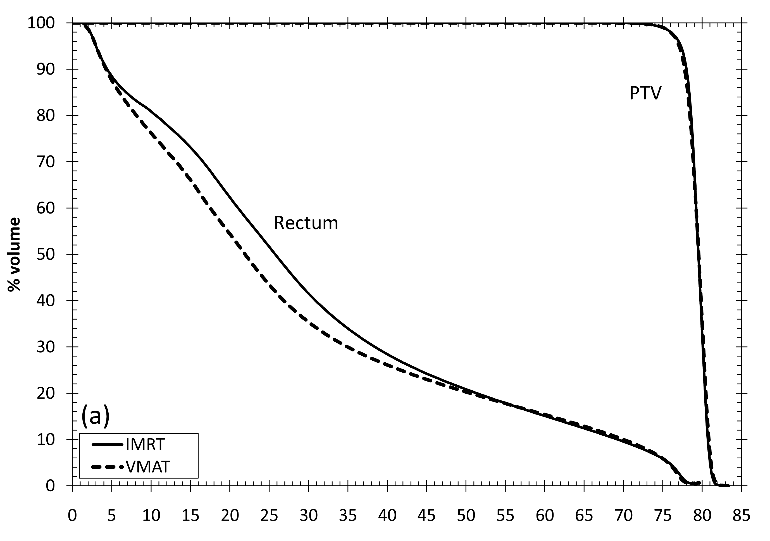
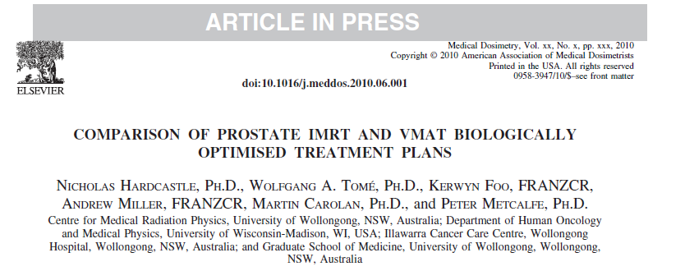
Plan Comparisons
Arc modulation vs static gantry modulation
Dose Volume Histogram
Normal Tissue Complication
VMAT
Dose (Gy)
*average over 10 patients

Slide 14
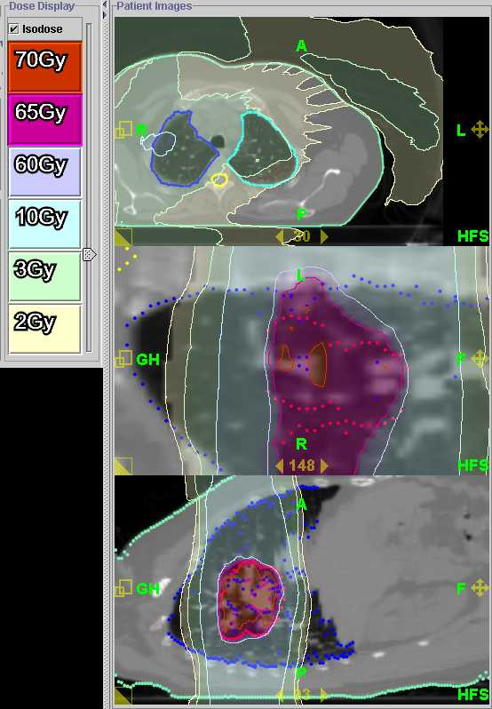
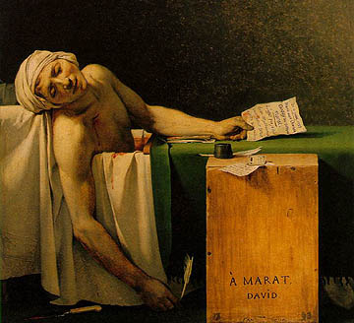
The dose bath...
Due to increased MU per Gray there is more leakage
Due to more beams dose is spread through larger volume
Out of field dosimetry is important
David

Slide 15
The dosimetric environment:
Phantoms:
  A phantom represents the radiation properties of the patient and allows the introduction of a radiation detector into this environment, a task that would be difficult in a real patient.
  A very important example is the scanning water phantom.
  Alternatively, the phantom can be made of slabs of tissue mimicking material or even shaped as a human body.

Slide 16
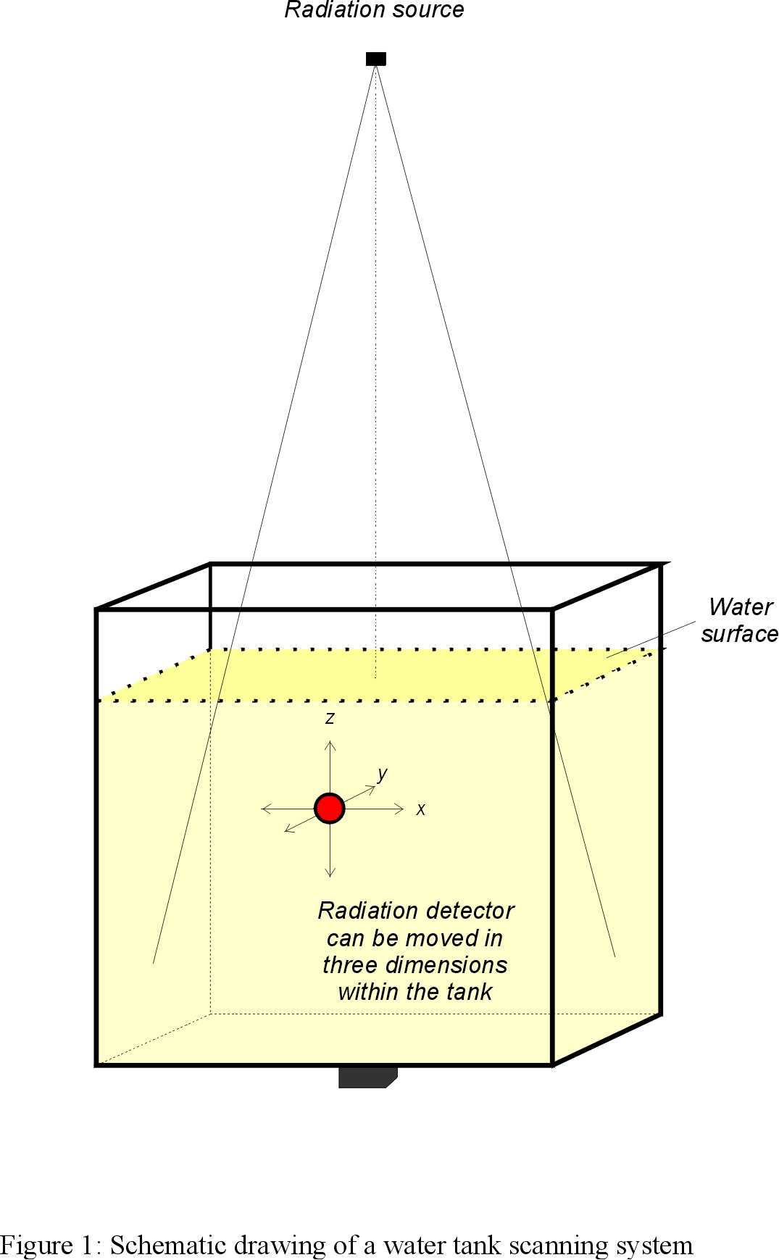
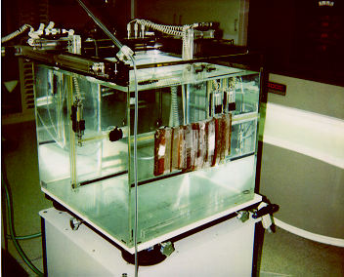
Scanning water phantom
Notes:
Shown is a Wellhoeffer waterphantom (cost > $US 100,000.-)
The waterphantom is an essential part of a radiotherapy physics set-up. It is used for beam scanning and required for commissioning of radiation equipment as well as treatment planning systems. Water is convenient to use - it is readily available, cheap and clear.

Slide 17
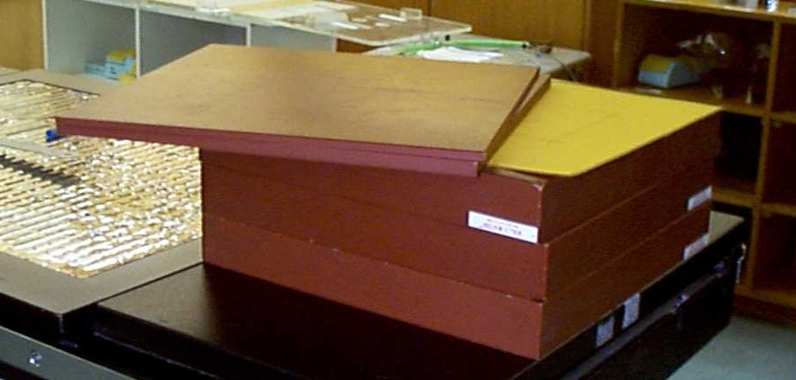
Slab Solid Water phantom
Notes:
Shown is solid water, a water equivalent polyraisin material specifically developed for radiotherapy aplications.

Slide 18
Tissue equivalent materials
Many specifically manufacturer materials such as solid water (previous slide), white water, plastic water, …
Polystyrene (good for megavoltage beams, not ideal for low energy photons)
Perspex (other names: PMMA, plexiglass) - tissue equivalent (TE) composition, but with higher physical density - correction is necessary.
TE for X-ray not necessary TE for other radiation fields
Notes:
The custom made materials are typically quite expensive - a set of slabs of different thickness in total 20cm costs around $US 10,000.-

Slide 19
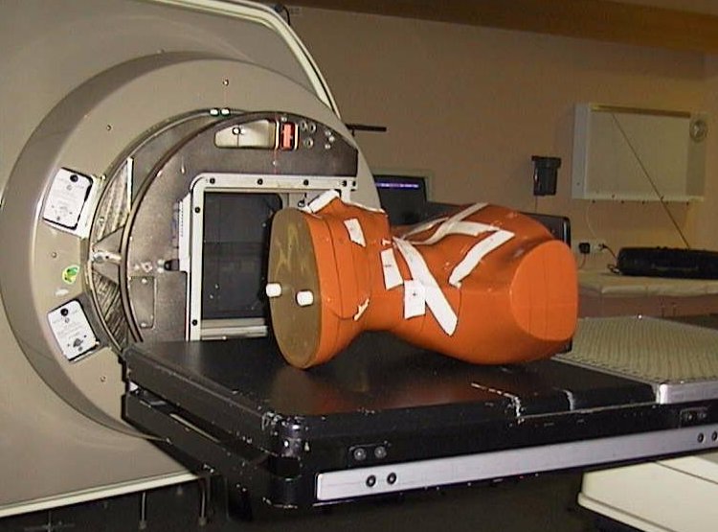
Anthropomorphic phantom
Whole body
phantom: ART
Notes:
Again ther are many types of anthropomorphic phantoms available. Some older designs contain real human bone which is undesirable as they dry out.

Slide 20
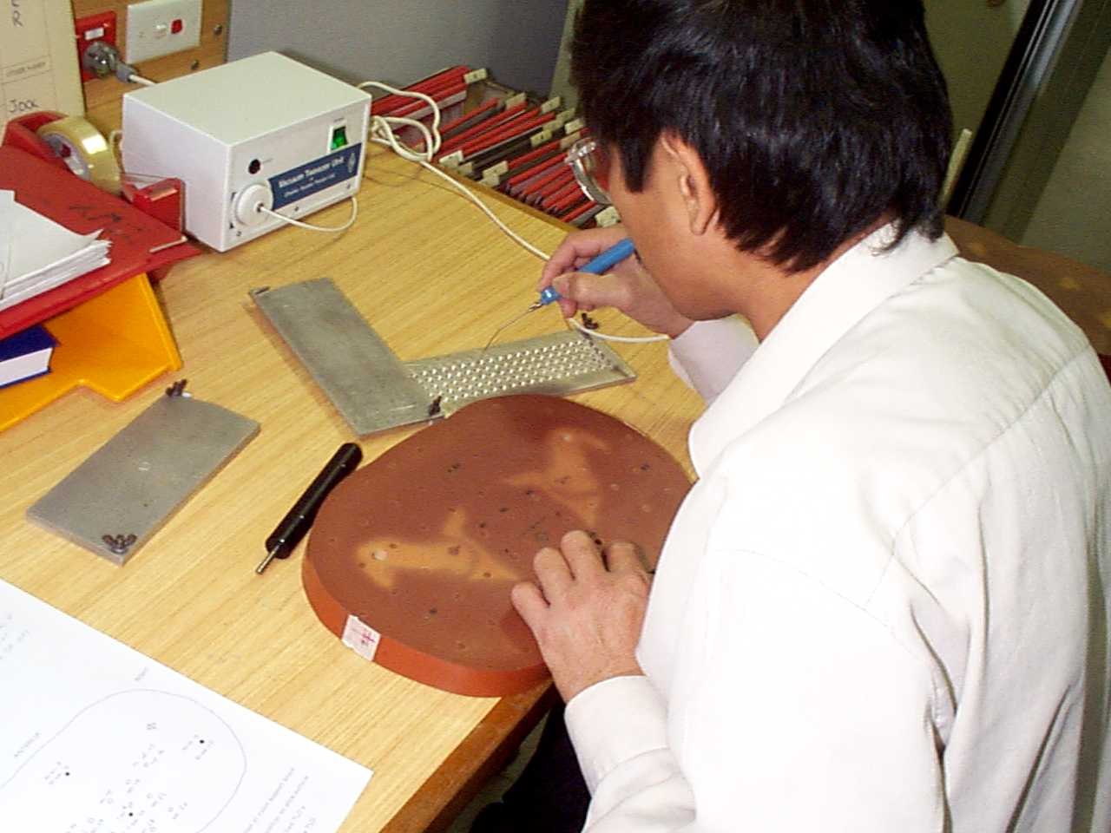
Allows placement of radiation detectors in the phantom
Includes
inhomogeneities

Slide 21
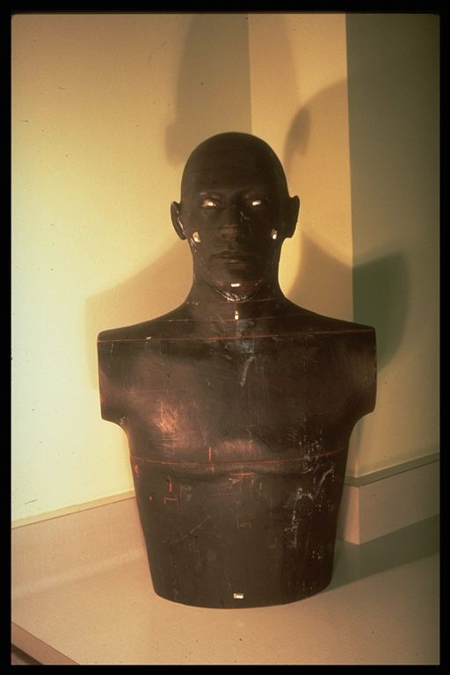
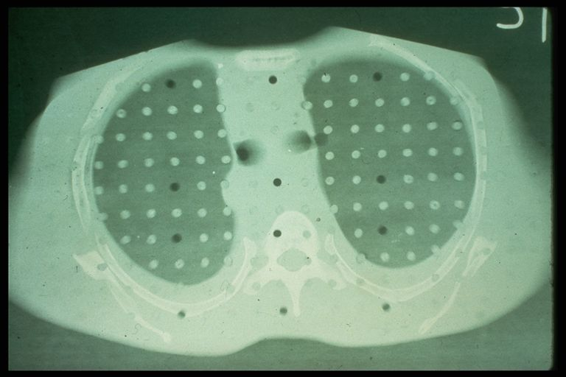
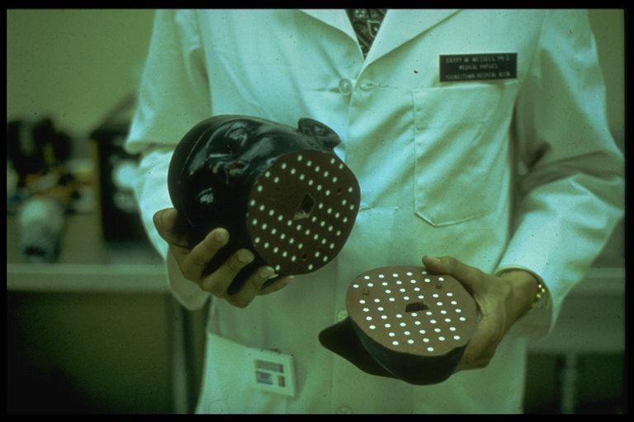
RANDO phantom
torso
CT slice
through lung
Head with
TLD holes

Slide 22
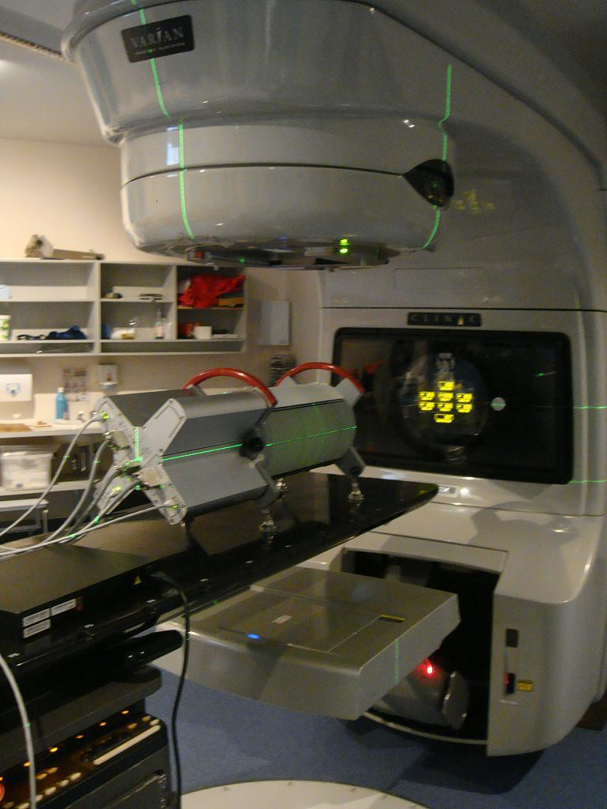
Physics Dosimetry Options for QA
Fluence array detector
- Magic Plate (CMRP)
Phantom on couch
-2D diode array (Delta4)
Exit detector – e.g. EPID

Slide 23
Dosimetry Media- Delta⁴
2D diode array 1069 detectors
Angle offset 90 degree
Detector spatial resolution 1mm
Diode separation 5mm, 10mm
Acrylic Phantom 20cm Cylinder

Slide 24
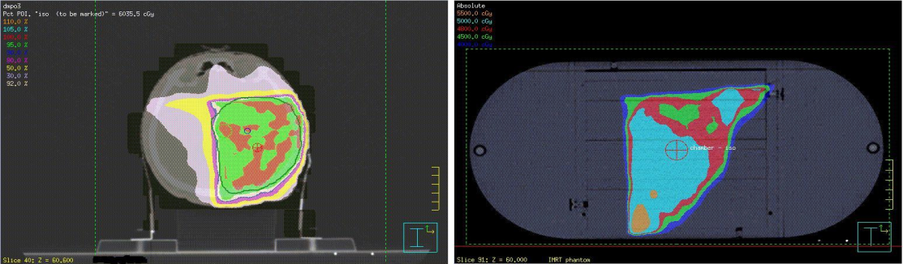
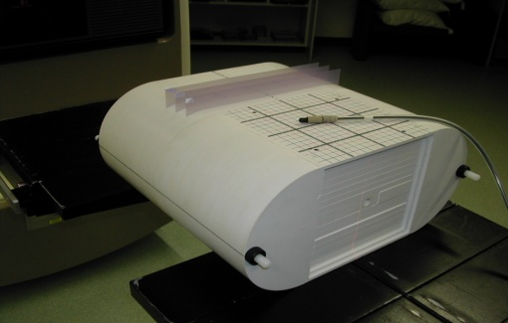
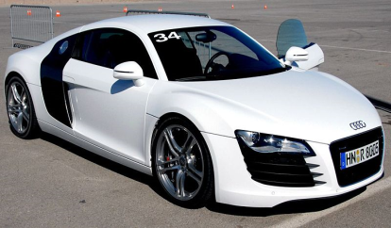
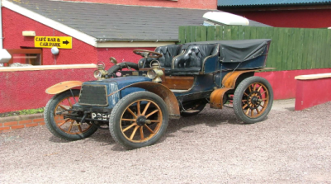
Physics Dosimetry Process
Deemed requirement for all “modulation” methods
These checks not required for conformal (3DCRT)
Research question what does Delta⁴ bring to... party?
Treat

Slide 25
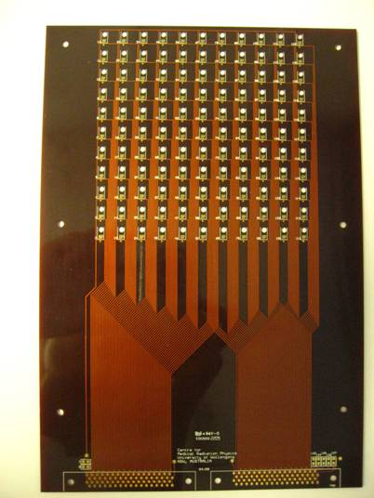
Magic Plate (MP)
Two dimensional 11 x 11 cm Si diode array
50 μm thick Si
Area: 0.5 x 0.5 mm²
Pitch 1 cm and 0.5cm
Transmission 99.8%

Slide 26
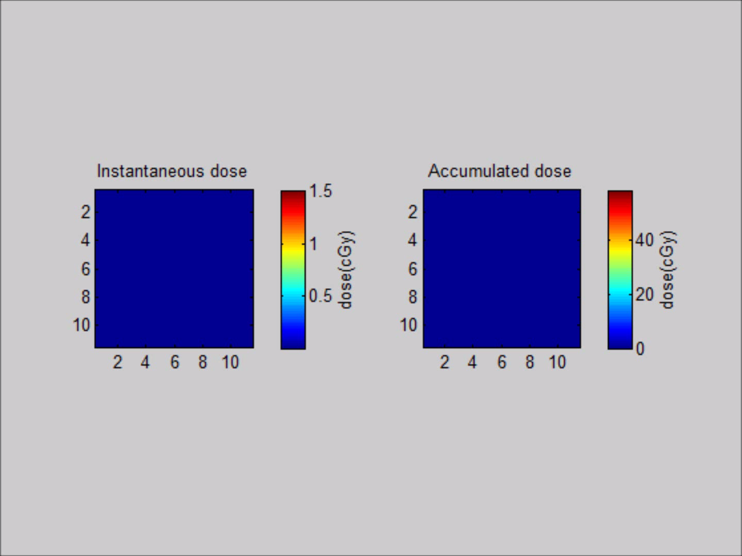
Real-time dose display

Slide 27
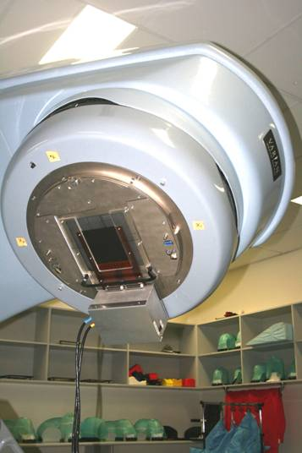
Magic Plate mounting on a Linac gantry
From in a phantom QA
to
In vivo real time fluence
verification
in RapidArc RT and IMRT

Slide 28
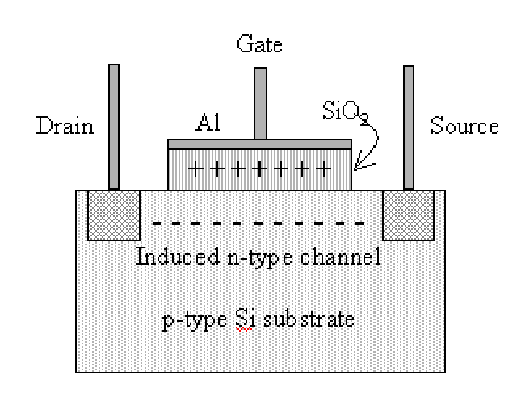
Advanced MOSFET Dosimetry-Principle of Operation
Generation of electron-hole pairs in silicon oxide by ionizing radiation
Trapping of holes on the SiO₂-Si interface
Shift in the IV characteristics leading to a change in the threshold voltage under constant channel current
t_{ox}
I
Passive mode - ΔV_{th} ~ 0.0022 D^{0.4} t_{ox}² f
Active mode - ΔV_{th} ~ 0.04 D t_{ox}² f
Active mode has a positive bias on the gate during operation

Slide 29
MOSFET Chips
Advantage of MOSFET detectors-Extremely thin sensitive volume (<1mm)
Quadruple MOSFET detector
RADFET REM Oxford
Single CMRP MOSFET detector

Slide 30
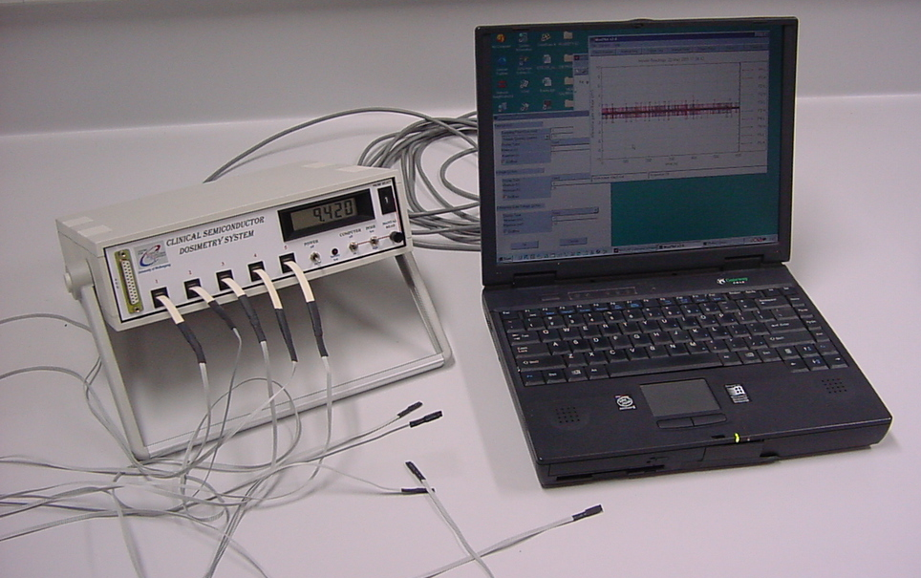
Online MOSFET Dosimetry System
MOSFET Clinical Dosimetry System with MOSPLOT DAQ: designed and distributed by CMRP

Slide 31
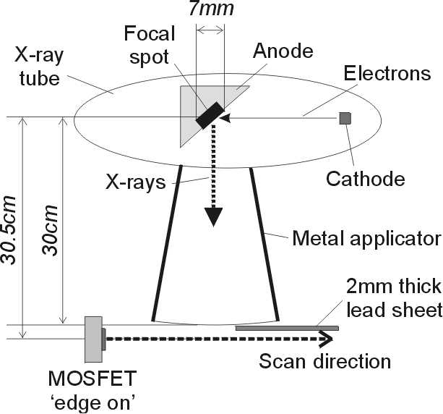
Applications of High Spatial Resolution MOSFETs
Verification of spatial resolution of edge on MOSFET detector in scanning mode using a standard water tank and electronics
Mosfet Gate Voltage - ~30.5cm SSD
13.9
0.03
Dose rate and accumulated dose, online scanning with an edge on MOSFET detector
13.8
0.025
13.7
0.02
V
13.6
0.015
V
V
13.5
Δ
dV
13.4
0.01
13.3
0.005
13.2
0
0
1
2
3
4
5
Distance (mm)

Slide 32
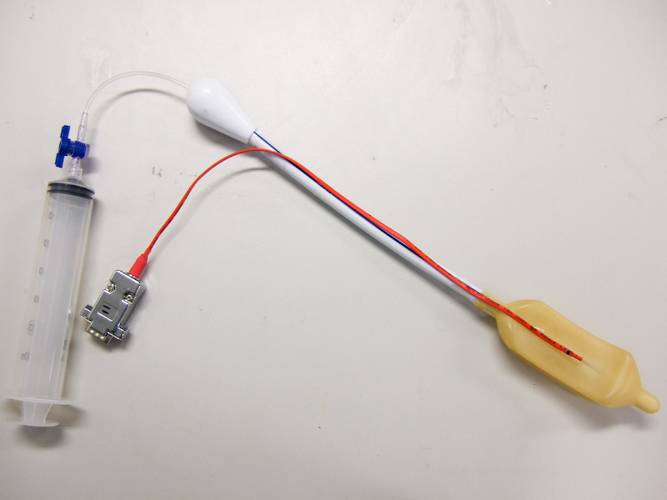
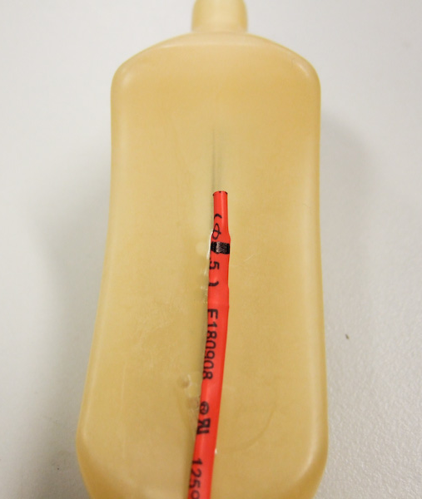
PDR Brachytherapy: Clinical Trials
Telesis 5 silicone adhesive is used to secure the MOSkin against the balloon.
Two condoms are placed over the balloon before 60 ml of air is injected into the balloon.
The trial has gained TGA approval.
The MOSkin has earned sterilization approval, which encompasses all the materials used in the detector, the type of sterilization performed, and the handling procedures.

Slide 33
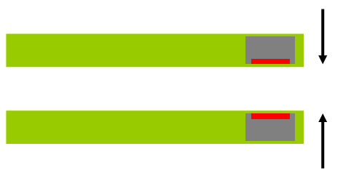
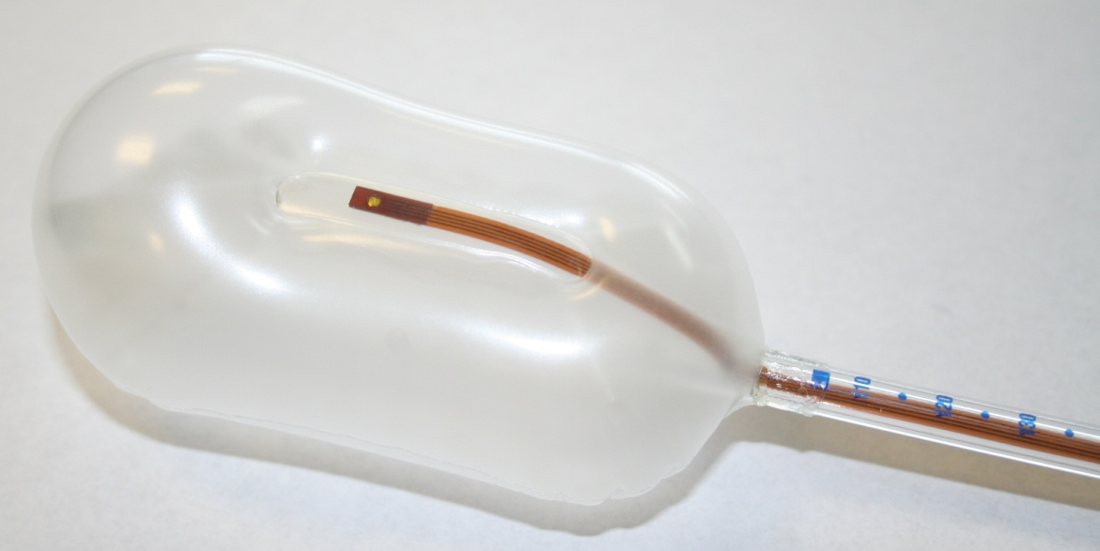
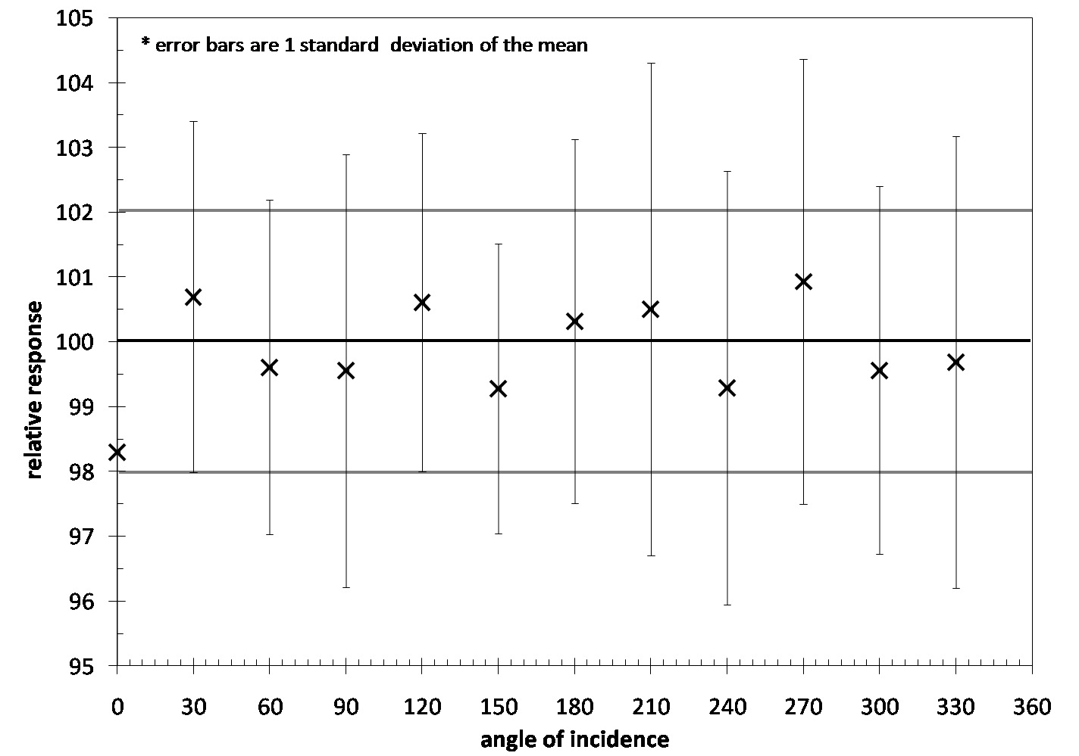
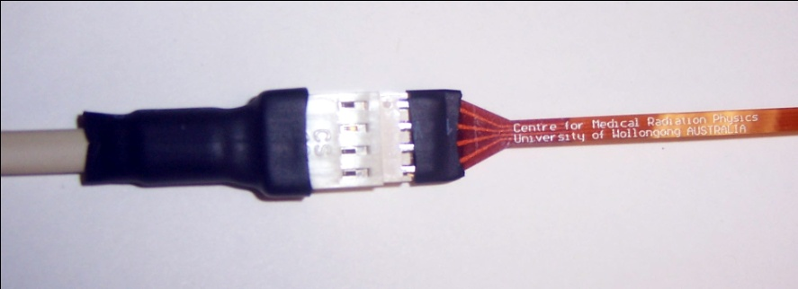
Dual MOSkin + rectal balloon
The MOSkinTM Dosimeter angular response has been greatly improved through the use of a dual FET design
Angular response
* Error bars are 2 standard deviations of the mean

Slide 34
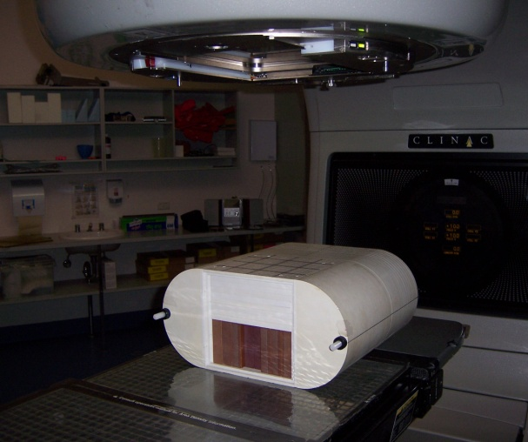
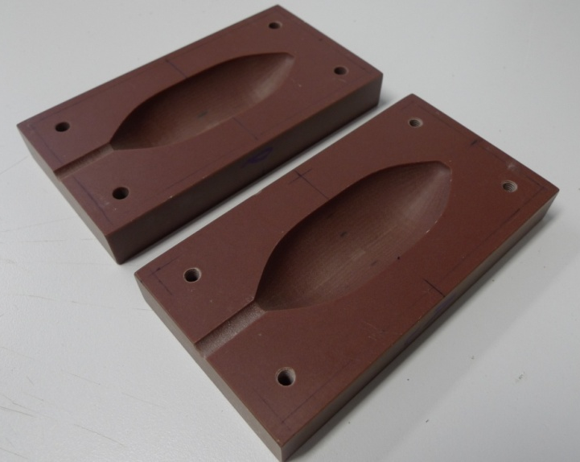
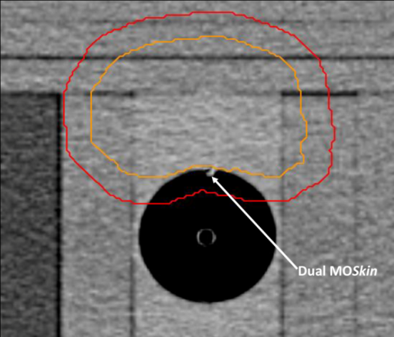
Real-time rectal wall dosimetry: dual MOSkin
- Seven field 3DCRT and IMRT plans:
Prostate
Balloon
Cavity

Slide 35
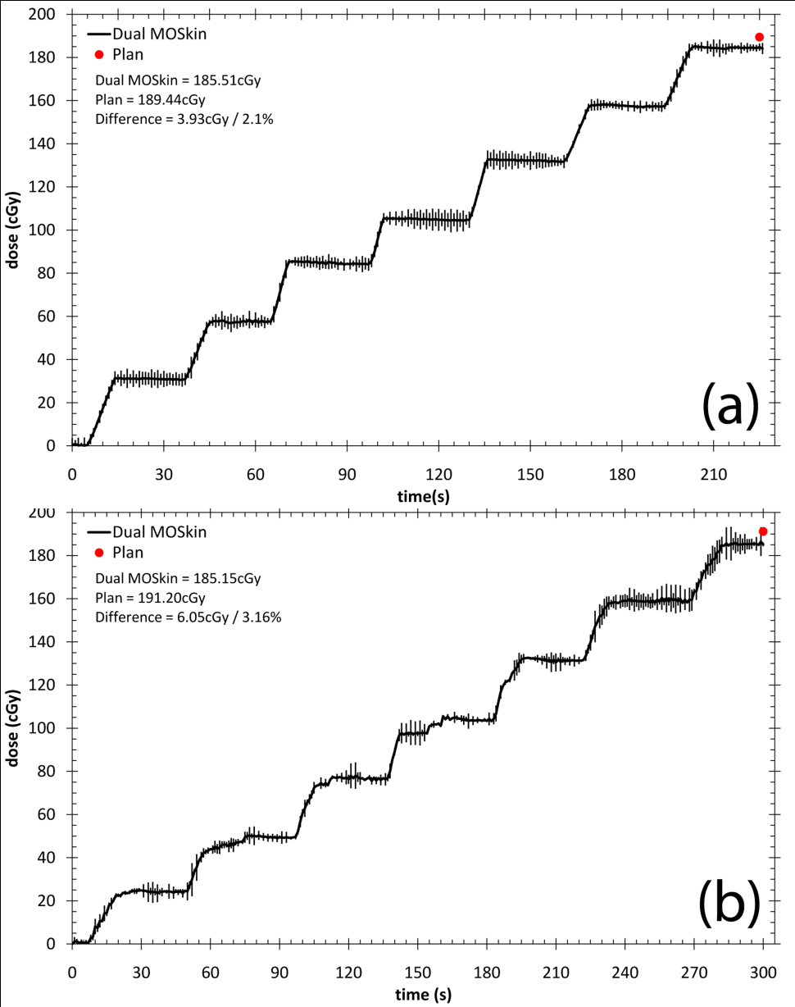
Dual MOSkin
- Seven field 3DCRT plan:
Beam 7
Beam 6
Beam 5
Beam 4
Beam 3
3DCRT - measured dose 2.6 % less than the planned dose
Beam 2
Beam 1

Slide 36
Dual MOSkin + rectal balloon
- Seven field IMRT (modulated delivery) plan:
Beam 7
Beam 6
Beam 5
Beam 4
Beam 3
IMRT - measured dose 3.2 % less than the planned dose
Beam 2
Beam 1

Slide 37
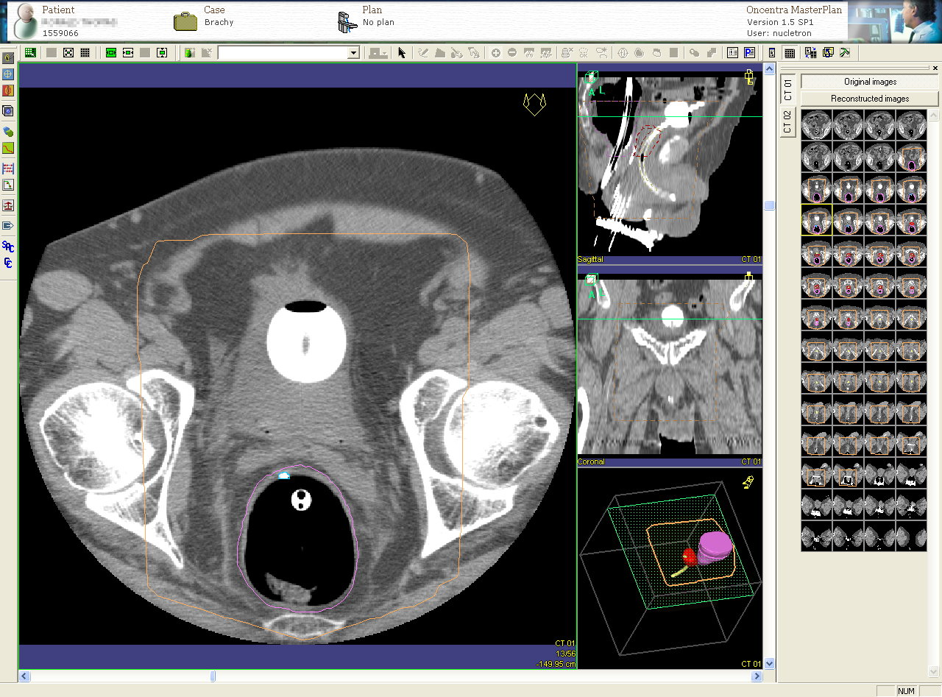
Visualization of MOSkin using CT
In vivo QA point dosimetry
MOSkin

Slide 38
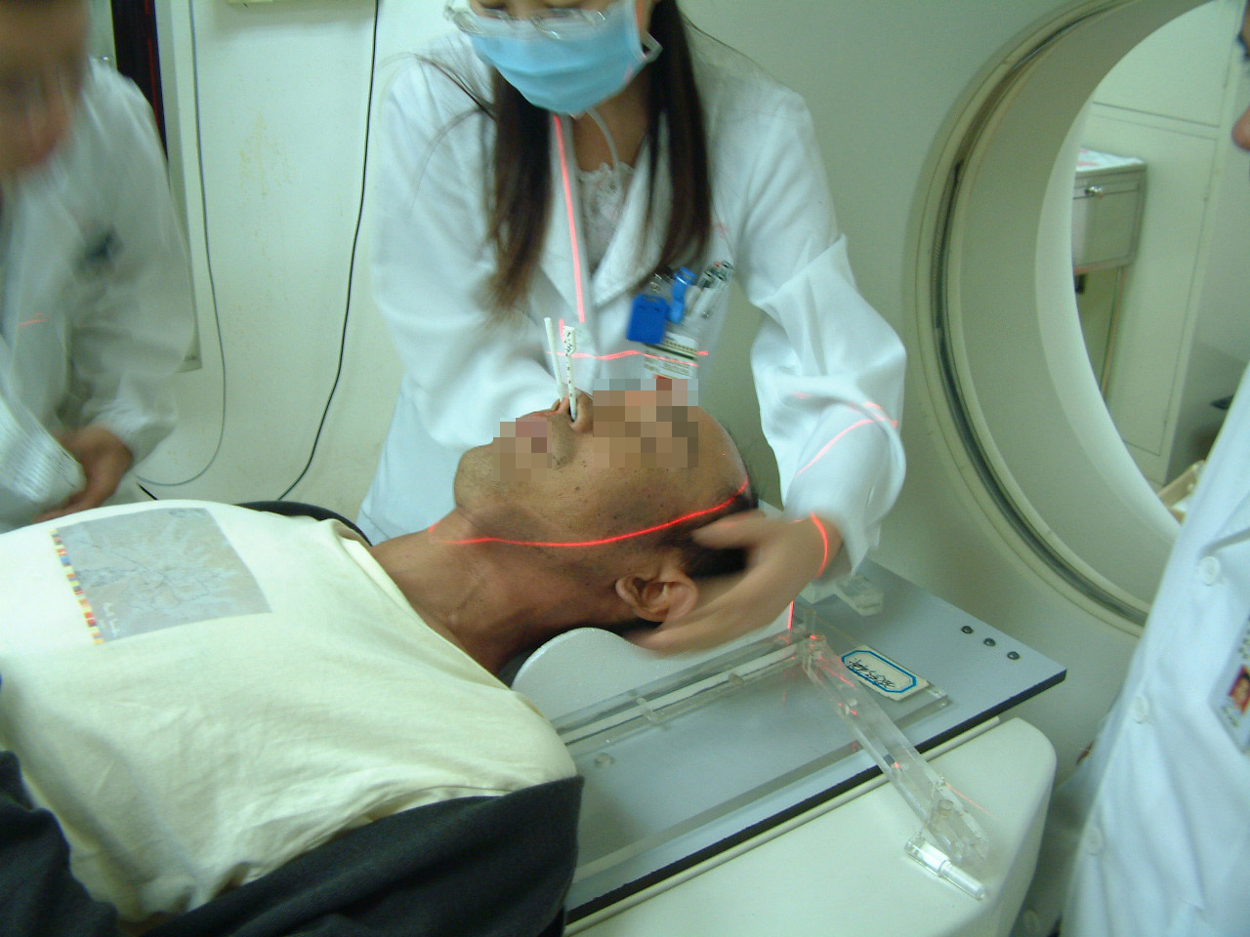
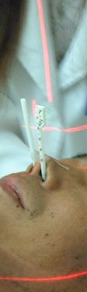
QA in HDR for Nasopharyngeal Carcinoma
MOSkin detectors are placed inside the left nostril whilst an Ir-192 source is stepped through the right nostril

Slide 39
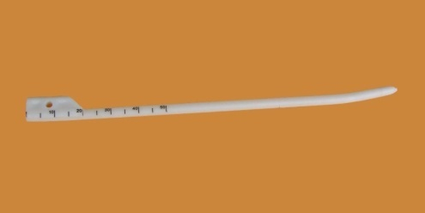
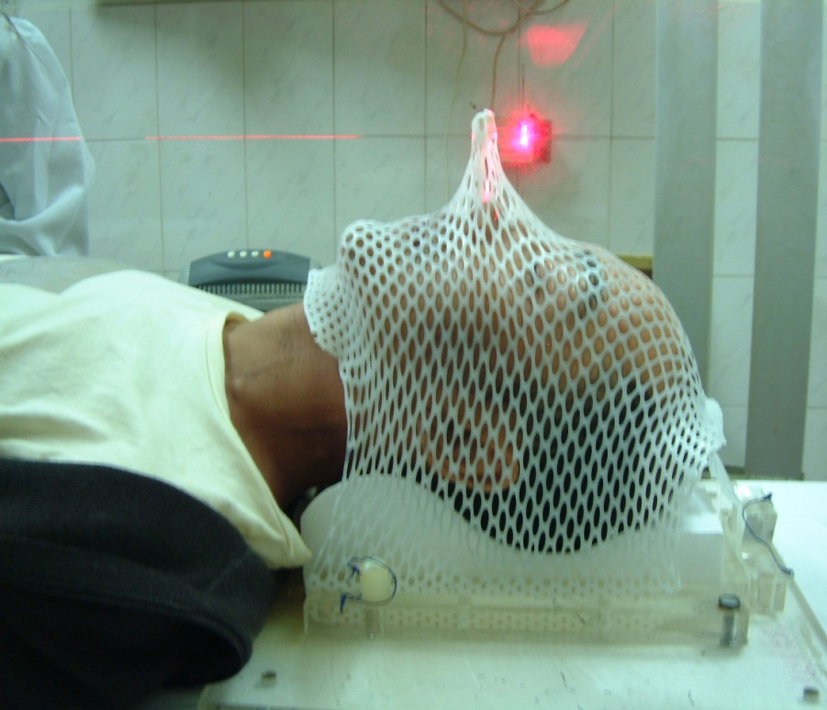
QA in HDR for Nasopharyngeal Carcinoma
A thermoplastic mask was used for patient immobilization and was also used to fix the applicator
nasopharyngeal applicator
A CT scan is used to identify the MOSkin detector locations
In vivo real time dose measurements were performed using MOSkin detectors during treatment.

Slide 40
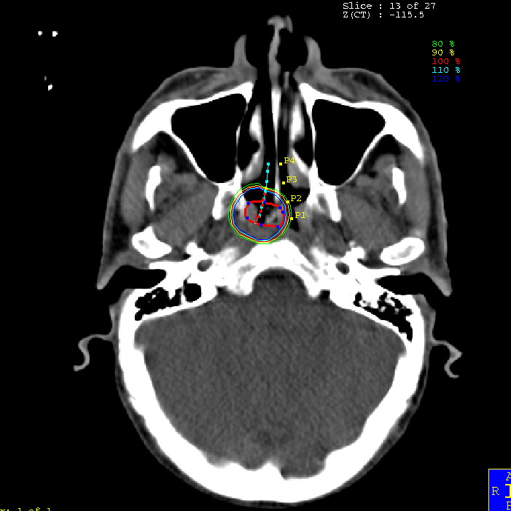

QA in HDR for Nasopharyngeal Carcinoma
CT images were acquired with the carriers inserted -- 3mm slice thickness.
Point P1 represents the location of the MOSkin, while P2, P3, and P4 are opaque markers. The Ir-192 source is inserted down the carrier and through the other nostril.

Slide 41

QA in HDR for Nasopharyngeal Carcinoma
A total of 7 patients were measured using the MOSkin detector. The average deviation was within ±5% of the predicted dose, with the maximum deviation less than 10%.
The relative deviation (%) of the measured doses from the treatment plan for four fractions is shown for one patient.
Real-time comparison of in vivo measurements
with TPS in agreement within 5%

Slide 42


MOSkin: Dose verification in serial IMRT treatment (NPC)
Taste dysfunction and oral mucous reaction are major radiation sequel in NPC patients
receiving radiotherapy.
Clinical trial is ongoing to explore the role of a molded oral plate in sparing the normal oral tissues
by pushing tongue away from radiation field during radiotherapy for some NPC cases.
Total dose 68Gy, 30 fractions.
Real time measurements were carried out of surface dose on a tongue with 2 MOSkins placed on interface
tongue -plate, MOSkin dose was readout each second during IMRT delivery with MOSPLOT4.1
software
Measurements were usually performed during the first treatment session and once a week thereafter.
A total of 8 NPC patients and 48 dose points have been currently measured in vivo.
a
b
The custom-made oral plate produced for each patient to keep MOSkin on a surface of the tongue .
a: top view b: bottom view

Slide 43


Dosimetry in IMRT
MOSkin has also been used for dose verification during IMRT
A special mouth plate was designed by a dentist to keep the MOSkin detector against the surface of the mouth.

Slide 44


MOSkin: Dose verification in serial IMRT treatment (NPC)
In vivo MOSkin in differential readout mode provide each second temporary map of IMRT delivery ( 1 cGy is corresponding to 2.45mV)
In vivo MOSkin in integral mode provide total dose immediately after delivery
Measured total dose on a surface of the tongue for particular treatment fraction and patient was 48.96 cGy while TPS predicted dose was 47.90 cGy and agreed within 2.2%

Slide 45
Conclusion 1
While the ionizing chamber is always the gold standard in radiation therapy, semiconductors diode and MOSkin are the future of online in vivo dosimetry
MOSFET dosimetry is unique for skin and surface dosimetry
MOSkin is a new MOSFET suitable for many RT applications where skin dose is an issue
Design of diodes and its packaging is critical
for their response and not trivial

Slide 46



Strip Si detectors: from HEP to Radiation Oncology
Strip detectors are used in HEP in
Vertex Detectors for m.i.p. tracking
with micron spatial resolution 1D and 2 D.
Charge deposited by particle is shared
between strips (p-n junctions) allowing
determination “centre of mass” and
particle coordinate
Technology exist for Mega-strips readout

Slide 47


Dose Magnifying Glass (DMG)
128 channels Si strip detector
Area: 20 x 5000 μm
Thickness: < 0.4 mm
Kapton thickness: 0.1 mm

Slide 48


Dosimetry of small radiation fields-SRS
Lucy Phantom from Standard Imaging
+DMG is an optimal QA for real time dose verification in SRS
SRS dose verification in Real Time

Slide 49
DMG: SRS delivery verification
4 SRS arcs of 180º angles
Couch angles: 270º, 300º, 330º, 360º.
average difference = 4.1 ± 6.7%.
DMG-fast and accurate
QA in SRS with 0.2 mm
spatial resolution

Slide 50

MOSkin dosimetry in diagnostic radiology : C-arm
Interventional radiology procedures associated with
high skin doses up to 4Gy
Real time in vivo dosimetry for Maximum Skin
Dose (MSD) monitoring is required
Detector on a patient should not obstruct the image

Slide 51
Interventional Radiology- Skin reactions
Skin damage
from prolonged
fluoroscopic
exposure

Slide 52




MOSkin Dosimetry in Interventional Radiology
“Invisible MOSkin”
X-ray beam 78KVp, 15 frames/s
MOSkin do not change C-arm
parameters
C.Chida et al. Acta Radiologica, 2009

Slide 53
Radiation Exposure to the Australian Population - Medical Exposures
Multidetector (multislice) computed tomography (MDCT) procedures have become the dominant contributor to the radiation dose to the population from diagnostic radiology.
ARPANSA surveyed radiation doses from MDCT in 1994, 2002 and estimated contemporary doses in 2008 for standard MDCT procedures.
  In Australia the per head radiation dose from CT for 2002 was approximately 0.9 mSv, in 2008 this has increased to an estimated 1.2 mSv, a growth of 50 %.
ARPANSA is planning a national web based survey of common MDCT procedures and doses to start in early 2010, which will reflect the dose impact of new MDCT platforms and new types of procedures.
A major aim of the survey is to measure the impact of new technologies and procedures on patient doses in CT. The survey of doses will be put to practical use in the development of national DRLs.

Slide 54



Application of the MOSkin in the assessment of breast dose
Findings
MOSkin and film results were comparable to within +/-5 mGy
Up to 64% breast dose savings with tube current modulation and use of the bismuth breast shield
A MOSkin study on the effect of dose reduction strategies (tube current modulation and breast shield) on breast dose

Slide 55


Dosimetry in Microbeam RT, ESRF , France
ID17 is a medical beam line dedicated to MRT and imaging.

Slide 56

Multislit collimator
Two stacks of foils: Al (50 mm thick) and Au (155 mm thick)
Beam width control by translation of a stack (from 1 mm to 50 mm)
Courtesy of ESRF

Slide 57




Edge-on Microstrip SingleDetector
Side-view of detector in phantom
Top-view
Lateral scan of 25mm microbeam array in 10 micron increments
Detailed view of microbeams

Slide 58
What is Electron Paramagnetic Resonance (EPR) ?
Biological Retrospective Dosimetry
Non-destructive magnetic resonance technique used to detect and quantify unpaired electrons.
Absorption of ionizing radiation generates unpaired electrons (i.e., paramagnetic centers).
The concentration of radiation-induced paramagnetic centers is proportional to the absorbed dose.

Slide 59


EPR Biodosimetry (Teeth)
Biopsy
Whole Tooth
Hydroxyapatite constitutes:
  ~95% by weight of tooth enamel
  70-75% of dentin
  60-70% of compact bones
Romanyukha, et. al, Appl. Radiat. Isot. (2000) and IAEA-TECDOC-1331

Slide 60






Clinical EPR Spectrometers

Slide 61


In Vivo EPR Radiation Dosimetry
Under practical conditions with an irradiated tooth in the mouth of a volunteer, the dose dependent signal amplitude is clearly observed. (Acq. time = 4.5 minutes/spectrum)

Slide 62
.
.
Low energy delta
electron
.
.
.
.
.
.
.
.
.
.
.
.
.
.
.
.
.
End of track
.
.
.
.
.
.
.
.
.
.
.
.
.
.
.
.
.
1 Gy of electrons
corresponds to 100s of tracks
.
.
.
.
cell
1 Gy of alpha particles
corresponds to 4 tracks
Interactions sites are less than 1nm apart
1 um

Slide 63
Concept of Microdosimetry
Energy per unit mass vs mass for constant dose.
Reducing of the target is changing deterministic deposition of energy to stochastic. Each radiation type has own signature.
E/m= specific energy

Slide 64


Microdosimetry and Equivalent Dose
Microdosimetry
  Assumes the weighting factor is related to the energy deposited in the cell nucleus: ε
  Measure this for each particle that crosses detector
  Formulate dose distribution: d(ε)
  Integrate with weighting factor to give Equivalent Dose: H = ∫ Q(ε)d(ε) dε
  Equivalent Dose can be used to accurately predict biological effect of radiation
We require detectors with dimensions commensurate with cell nuclei
Ionising particle tracks
From Garret and Grisham, "Biochemistry" Copyright 1995 by Sauders College Publishing
Small Detector (um)
Biological Cell (um)

Slide 65
Microdosimetry and Fluence approach for stochastic events
Microdosimetry
  Measure distribution of ionisation events in microscopic volume
  Derive quality factor and equivalent dose estimate
Fluence based approach
  Measure types and energy distribution of all particles
  Integrate product of risk cross section a fluence over energy
  Sum over all particles to directly obtain risk estimate
Q(y), Q(L) and σ(Ε) were modified recently , ICRU 92 and NCRP 137
Quality coefficient for low doses neutrons is still uncertain
All above characteristics are relevant to Radiation Protection only

Slide 66
Si microdosimetry
Microdosimeter measures the energy deposition events in a small
(cell-sized) volume due to radiation interactions.
  Produces spectra of counts versus energy (E).
  Divide energy by mean chord length (l) gives lineal energy spectra f(y)
  Dose distribution d(y)  yf(y) where y=lineal energy=E/l
Motivation:
  Radiobiological effectiveness depends upon LET or lineal energy
  Distribution of dose (d(y)) with lineal energy gives dose equivalent (H)
l=10um
Protons
Alpha, Heavy ions

Slide 67


Tissue Equivalent Proportional Counter and Silicon Microdosimeter
Ionising Charge Particle
E-field
Al
Al
1 um
N+
P+
2 um
-
+
E-field
Si Substrate
SiO₂
0.1-1 kV
~ 5-10 cm
~ 10-20 um
Rossi Tissue Equivalent Proportional Counter
Silicon Microdosimeter
Oak Ridge Associated Universities, www.orau.org

Slide 68



3D SOI silicon microdosimetry
3D silicon cell array for modeling of energy deposited in biological cells event by event by secondaries
Each Si cell is 6x10 microns

Slide 69


SOI Microdosimertry on 100 MeV Proton Therapy
Microdosimetric spectra from 10 mm SOI micro at consecutive positions in a Bragg Peak
Possibility to estimate Q of the beam
For more details see: A Rosenfeld “Electronic Dosimetry in Radiotherapy”,
Rad. Meas., 41, 134-153, 2007

Slide 70


Particle Accelerators
Accelerator | Colliding Particles | Total Energy | Major Accomplishment
Stanford Linear Collider (SLC) in Palo Alto | electron, positron | 100 Gev | provided first look at Z⁰
Large Electron Positron Collider (CERN-LEP) in Geneva | electron, positron | 200 Gev | discovered Z⁰, W in 1983; shut down in 2002
Relativistic Heavy Ion Collider (BNL-RHIC) in Brookhaven | heavy ions | 200 Gev | created quark-gluon plasma (Mini Big Bang)
Tevatron (FNAL) in Chicago | proton, antiproton | 2 Tev | confirmed Z⁰, W, discovered top quark
Large Hadron Collider (CERN-LHC) in Geneva | proton-proton; ion-ion | 14 Tev | planned for 2008 - LEP replacement

Slide 71


Mixed radiation field in workplace in research high energy accelerator
Radiation field in electron accelerator in unshielded condition (Vylet. et al, 2002)
Interaction of the primary beam with accelerator structure generates photons and neutrons field especially :
with injection sections
collimators
large angle bending magnets
scrapers and beam stoppers…
Ambient dose equivalent rate per unit beam power at 1m from high Z target

Slide 72


The Electromagnetic Cascade Processes
Electromagnetic cascade: Interaction of electrons striking target material at energy of 100MeV
E: electron energy
dE: energy decrement
dx: infinitesimal material thickness
X_{o}: const of attenuation process

Slide 73


Photon Field
Photon field: produced when electron beam striking high Z target
Rules of thumb (Swanson 1979)
dD/dt: Absorbed dose rate at 1m (Gy/h.kW)
1)
2)
3)
Thick target bremmstrahlung yield from high Z target . For incidence angles of 0○ and 90 ○ (NCRP, 2004)

Slide 74

Neutron Field
Neutron field: produced by photonuclear reactions :
(γ,n) (γ,2n)
(γ,pn)
Electro –nuclear (e,e’n)
At energies > 100MeV , neutron production is energy independent (saturation effect) for medium-high Z materials(Z >50)
Lighter material reach saturation at energies >500MeV
Photo-neutron yield of electromagnetic cascade on thick targets. (NCRP, 2004)

Slide 75



Nuclear Reactor
²³⁵U + n → [²³⁶U] → ^{A}X + ^{B}Y + 2 to 3 n + Energy
Neutrons released further interact with fissile element ➔ to chain (fission) reaction with energy release
Low n flux: <10¹³ ²⁴Na, ³²P, ⁸²Br
Medium n flux: 2-8 X 10¹³ ⁸²Br, ⁹⁹Mo, ¹²⁵I, ³⁵S, ¹³¹I, ¹⁵³Sm, ¹⁷⁷Lu, ^{186/188}Re, ¹⁹²Ir
High n flux: >10¹⁴ ⁶⁰Co, ¹⁹²Ir, ⁷⁵Se, ⁸⁹Sr, ¹⁷⁷Lu, ⁹⁹Mo, ¹⁸⁸W

Slide 76



Nuclear safety in workplaces in Nuclear Reactor
Monitoring system in control room
Management of nuclear waste
Monitoring system in laboratory

Slide 77


Neutron Dosimetry with CR-39
Neutron
n
n
Proton
Radiator
p
polyethylene （-CH₂-）_{n}
p
Track
Latent track
Detctor
CR-39(-C₁₂H₁₈O₇ -)_{n}
Optical Microscope
Etching
θ
p
Initial Surface
Critical angle condition
V_{B}<V_{T}COSθ
V_{B}
V_{T}
V_{T}cosθ
Etched Surface
V_{T}：Track etching velocity
V_{B}：Bulk etching velocity
Notes:
Next,
This is how to detect neutron using CR-39.
CR39 is one of the plastic.
First, neutron elastic scattering to hydrogen atom occur in PE radiator, and generate recoil proton.
Recoil protons go into CR-39 having many incident angles, and make radiation damage called latent track.
Next, we do chemical etching to melt surface of CR-39.
To detect latent track Critical angle condition is important.
This inequation is critical angle condition to make countable tracks using optical microscope.
Vt called track etching velocity, this is melting velocity follow the latent track.
Vb called bulk etching velocity, this is melting velocity without latent track.
That is the method of neutron detection using CR-39.

Slide 78

Principle of OSL Dosimetry
Optical stimulation

Slide 79

Novel Fluorescent Nuclear Track Detector Technology for measuring neutrons, photons and HCP
Problems of dosimetry of protons and neutrons
Optical properties of novel Al₂O₃:C,Mg crystals
Optical technique and instrumentation
Performance of FNTD in mixed neutron-gamma fields
Preliminary results after irradiations with protons
Courtesy of Dr M Akselrod
Fluorescent image of neutron induced recoil protons

Slide 80
Optical diagram of imaging system
Imaging lens
Avalanche photodiode
Dichroic mirror
Confocal pinhole
XY scanner
750 nm fluorescence
695 nm LWP filter
Front relay lens
Photodiode
Shutter
635 nm laser light
Rear relay lens
Laser collimator
1-D stepper stage
Piezo positioner
Z-axis
Objective lens
FNTD
XY stepper stages
The imaging system is based on a concept of a confocal laser scanning microscope.
The system is designed for fast scanning and nondestructive readout of the detector.
Courtesy of Dr M Akselrod

Slide 81

Recoil protons propagating through the crystal detector
Courtesy of Dr M Akselrod

Slide 82

Radiation protection in space and avionics
Protect astronauts from harmful effects of space radiation is crucial
ESA Courtesy

Slide 83

Space Radiation Environment

Slide 84

Space Radiation Environment
Galactic Cosmic Rays (GCR) for proton and alpha at 1AU. Taken from CREME96 database

Slide 85



Space Radiation Environment
Integral proton fluences for several major SPEs over the last four solar cycles
This figure illustrates the rise and fall of fluxes of solar energetic particles during an SPE.

Slide 86

Human missions in space
ISS
Long journeys aboard the ISS occur more frequently
Human missions to Mars are envisaged in the future

Slide 87

The amount of radiation received by astronauts depends on several factors including orbital inclination, altitude, position in the solar cycle, and mission duration.
The figure above shows the radiation dosages encountered by Space Shuttle astronauts during various missions indicated by the numbers near the bottom of the graph. The average altitude of space shuttle orbits is 170 Nautical Miles corresponding to 9 milliRad/day.

Slide 88
Limits on Occupational Doses (ICRP)
 | Annual Dose Limit (mSv)
Effective dose, worker | 20
Equivalent dose to lens of eye | 150
Equivalent dose to skin | 500
Equivalent dose to hands and feet | 500
Effective dose to embryo or fetus | 1
Effective dose, public | 1
Effective dose of 20 mSv per year— averaged over a period of 5 years
Should not exceed 50 mSv in any one year
Equivalent skin dose of 500 mSv per year—Limit is set on basis of avoiding deterministic effects
Dose limits do not apply to radiation dose employee receives as part of personal healthcare

Slide 89




Dosimeters for spacecraft crew
The Pille dosimeter system
the first and to date only TLD system designed specifically for use by
cosmonauts and astronauts while travelling in space.

Slide 90
The most critical health risks for astronauts , those classified by NASA as ranked as 1(I), are:
Hazards in Space and Avionics
______________________________________________
Carcinogenesis caused by radiation
Loss of bone mass or density
Human Performance: Poor psychosocial adaptation
Clinical Manifestations: Trauma or acute medical problems
NASA’s Critical Path Roadmap (April, 2003)

Slide 91


Radiation protection in aviation
Mixed Radiation Field: Protons, Neutrons, Electrons, Gammas, Muons, Pions.
Doses are affected by…
Altitude,
Latitude and
Solar activity
Typical dose rate: 5-6µSv/h at 10.67 km (35.000 ft)
Dose limits for aircraft crew members:
Considering usual total annual flight times of crew members (≤1000 hours).
DOSIMETRY and RECORDS
are REQUIRED

Slide 92



Atmospheric depths (g cm ⁻² )Aircraft heights
(km)
25
30
Private jet (15 km)
20
100
15
SST (18-20 km)
Commercial (10 km)
10
300
5
Tibet (3.7 km)
1000
Kendall et al, 2000
Notes:
Exposure to cosmic radiation may also vary by the type of aircraft flown. Different aircraft tend to fly at different levels in the sky. Most major airline jetliners fly at close to 30-33,000 feet. Smaller planes fly at lower altitudes. Conversely, supersonic transport, including the Concorde, fly at higher altitudes. This illustrates that studies of the health effects of cosmic radiation should also consider exposure levels by identifying the types of aircraft flown.

Slide 93


Dosimetry in aviation – Neutron flux (1-10MeV)
1-10MeV atmospheric neutron flux as a function of altitude based on aircraft and balloon measurements
1-10MeV neutron flux as a function of geographical latitude based on aircraft measurements
0 10 20 30 40 50 60 70 80
Altitude, Thousands of feet
0 10 20 30 40 50 60 70 80
Latitude, Degrees
A. Taber, et al, IEEE 1993

Slide 94


Dosimetry in aviation – proton and ion flux
Comparison of measured atmospheric proton flux 100<E<750MeV as function of depth)
Fall-off verticle ion flux with depth for ions of energy>200MeV/nucleon)
Proton Flux 100<E<750 MeV p/cm²sec
Z=6-9
Particles /cm²sec
5Z=3-
MacDonald, Webber-Baloon
Fit to McDonald, Webber
Neutrons
Z=20-28
Z=10-14
Atmospheric depth, g/cm²
Atmospheric depth, g/cm²
H. B. Barber, T. Brown et al, Phys. Review 1980

Slide 95
Leukemia or Cancer risk for aircrew
 | < 1000hours | 1000-5000 hours | >5000hours
Leukemia | 0 | 0 | 1.9
Acute Myeloid Leukemia | 0 | 0 | 5.1
CLL | 0 | 0 | 1.3
Melanoma | 0 | 0 | 2.8
Other Skin | 0 | 0 | 3.0
Gundestrup et al, 1999
Notes:
Increased incidence ratios of cancer and leukemia were only observed in cockpit crew members flying more than 5000 hours. Significantly increased ratios were observed for acute myeloid leukemia, melanoma, and other skin cancers. Do you think that the melanoma and skin cancers are related to cosmic radiation or some other factor? Many postulate that these cancers may be related to higher sun exposures among the crew compared to the general population.
Overall, there appears to be inconsistent evidence of a link between cancer and cosmic radiation.

Slide 96



Dosimetry in aviation
Ground based neutron monitoring stations:
provides data for analysis of solar and cosmic events
but it is not clear if this type of monitoring provides
sufficient protection for airborne aircrew in significant events.
Personal real time Dose Equivalent dosimetry is required for air crew
Ground based neutron monitoring station at the South Pole
Measurement of neutrons on aircraft with TEPC and Brookhaven National Laboratory dose equivalent meter (DEM) with two sets of Bonner sphere moderators.
[NASA ,1976]

Slide 97




Spectrometers and detectors for dosimetry in aviation
TEPC (Hawk2)
Luilin
Bubble detector
Detector | Capabilities | Weight [g] | Battery Requirement
TEPC | Dosimetry Information | 5000 | 6V DC D-Cells
Luilin | Spectral Information | 550 | 12V pack (15h)
FH41B | Gamma and Protons | 200 | 19V (5months)
Bubble Detector | Neutrons | ---- | -----

Slide 98

Nanodosimetry vs Microdosimetry
Volume of interest:
  Cell versus DNA
Statistical Fluctuations:
  much larger in ND
Empty Events
  common in ND
  uncommon in MD
Choice of Gas
  unrestricted in ND
  restricted in MD

Slide 99
Why Nanodosimetry?
Ending point in cell desactivation is DNA damage
Clustered DNA lesions are difficult to measure in vivo
Relative number of clustered lesions probably determines RBE
RBE changes with depth of therapeutic hadron beams are usually subtle (for protons)
Increasing number of patients treated with hadrons requires better definition of RBE values

Slide 100
Efforts in Nanodosimetry
Significant effort has been invested into the development of numerical simulation codes modeling particle track structure on the nanometer scale
Experimental validation is an important step for such codes
Experimental efforts in this direction are scarce but one such option is low pressure gas counter which measures individual ionisations of charged particle tracks

Slide 101


Low-Pressure Gas Nanodosimetry
Loma Linda Uni Medical Centre nano-dosimetry facility
Millimeter size TE gas volume represent nm
size /DNA fragment due to low gas pressure

Slide 102

Cluster Size Definition
Cluster size is the number of ionizations detected or simulated within a SV representative of a segment of double-stranded DNA that occur within 10nm of one another.

Slide 103
Cluster size measured for different ions
Using radiobiological model based on a cluster size and simulating by MC GEANT 4 secondary ions possible improvement of RT planning. Experimental cluster sizes will be used

Slide 104

Monte Carlo computational Nano-Dosimetry
Nanodosimetric approach
  Study the spatial distribution of interactions on a DNA scale
DNA segment ~10 base pairs long
  Size of a Double Strand Break (DSB)
  Represents direct DNA damage
“Nucleosome” represents distance free radicals can diffuse into DNA
  Represents indirect DNA damage
Liquid water medium
  Commonly used to represent biological materials
Geant4-DNA and PTra for nanodosimetry
  Lazarakis et al., Phys. Med. Biol. 57 (2012) 1231–1250
Monte Carlo is a powerful method in radiation dosimetry

Slide 105

Dosimetry of Radiopharmaceuticals for Diagnostic and Therapeutic Nuclear Medicine
MIRD DOSIMETRY
A standard formalism for internal dosimetry in nuclear
medicine was developed in the 1960’s and became known as the
MIRD System of internal absorbed dose calculation
The absorbed dose to a target organ from a radionuclide located within \
a source organ can be calculated as:
D_{T} = Ã_{S} Σ_{i} n_{i} E_{i} φ_{i} / m_{T}
n_{i} is the number of radiations with energy E_{i} per disintegration,
φ_{i} is fraction of energy emitted by the source region that is absorbed
in the target)
m_{T} is the mass of the target organ,
Ã is the cumulative activity, changing with time
The absorbed fractions were calculated from
an anthropomorphic mathematical model of the human
body which has become known as the MIRD phantom
Ã =
Ã =
The mathematical phantom used by the MIRD
http://www.doseinfo-radar.com/RADARphan.html

Slide 106


Dosimetry of Radiopharmaceuticals for Diagnostic and Therapeutic Nuclear Medicine
There are now more than 50 voxel CT based phantoms available representing
Chinese, Japanese and Korean persons as well as Caucasian,
and representing babies, children as well as both male and female adults.
The University of Florida
family of reference voxel
phantoms
Anterior whole body images obtained after intravenous
administration of ^{99m}Tc jn female subject over a 24 hour
period.
Effective dose was found to be 8.6 mSv and 9.4 mSv
for males and females respectively, for an administered
activity of 750 MBq

Slide 107
Conclusion
Radiation Dosimetry is a very interesting field of research with multiple range of applications from Occupational Radiation Protection to advanced Radiation Therapy Quality Assurance
Too many questions are still to be answered and major is “do we know what parameter of radiation field can predict accurately biological effect”
Development of dosimetry instrumentation with response to predict biological effect in any radiation field is a challenge to be addressed by ARDENT

Slide 108
Acknowledgement
ARDENT
CMRP colleagues and PhD students
Prof Tomas Kron ,Dr Alex Romanyukha and Dr David Schauer for sharing some slides
Recommended Reading.
Rosenfeld A.B. Kron T. ,. d’Errico F, and. Moscovitch M. editors “Concepts and trends in medical radiation dosimetry”, American Institute of Physics ,ISBN:978-0-7354-0901-9 (2011)
    Metcalfe P.; Kron T.; Hoban P. The physics of radiotherapy X-rays from linear accelerators. 1997.

Slide 109


MMND and IPCT 2012
Mini-Micro-Nano-Dosimetry Workshop and
Modern Technologies of Prostate Cancer Treatment
Centre for Medical Radiation Physics
University of Wollongong
6-9 December, 2012

