Slide 1














TRAINING COURSE on radiation dosimetry
Quantities and units in radiation dosimetry
Marco SILARI, CERN
1th Annual ARDENT Workshop, Vienna, 20-23 November 2012

Slide 2
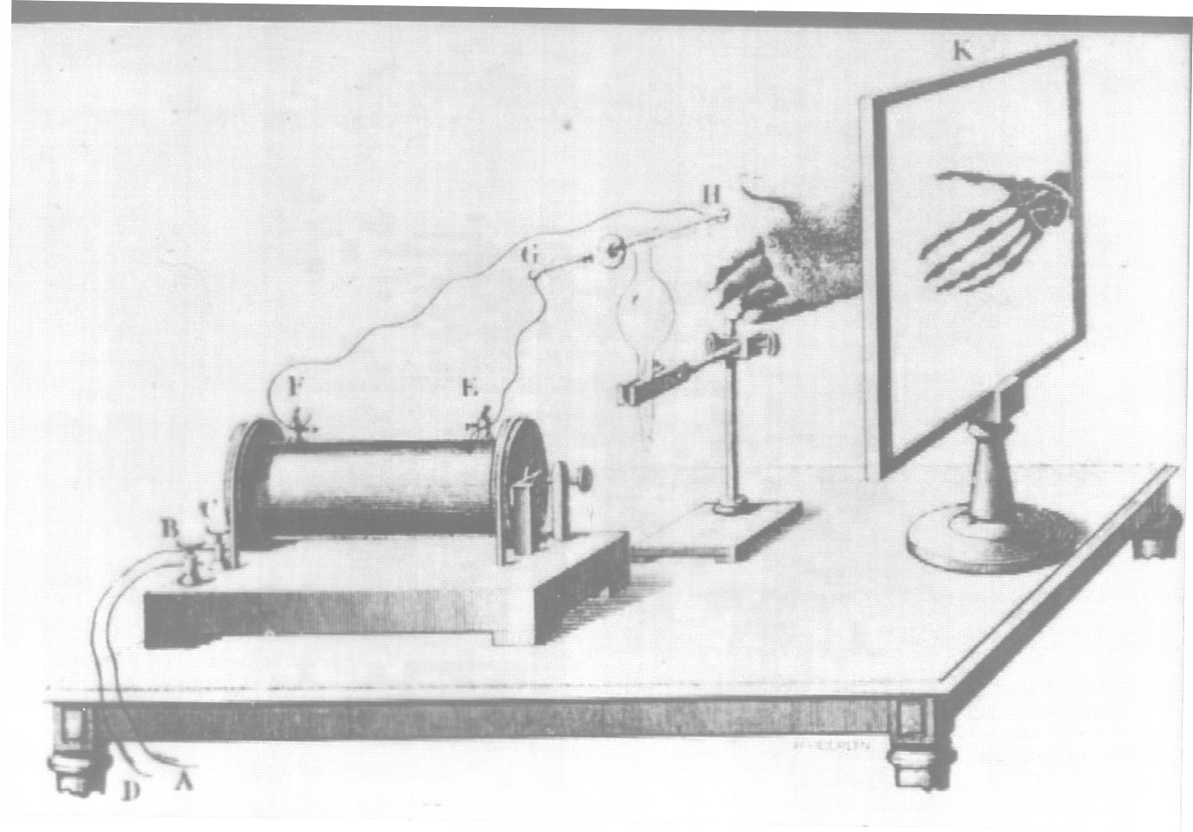
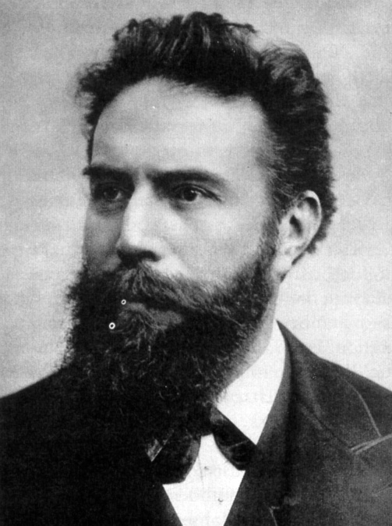
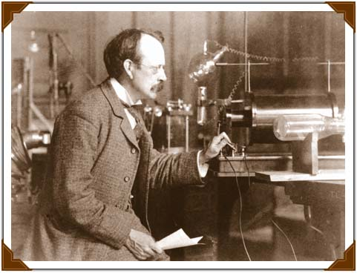
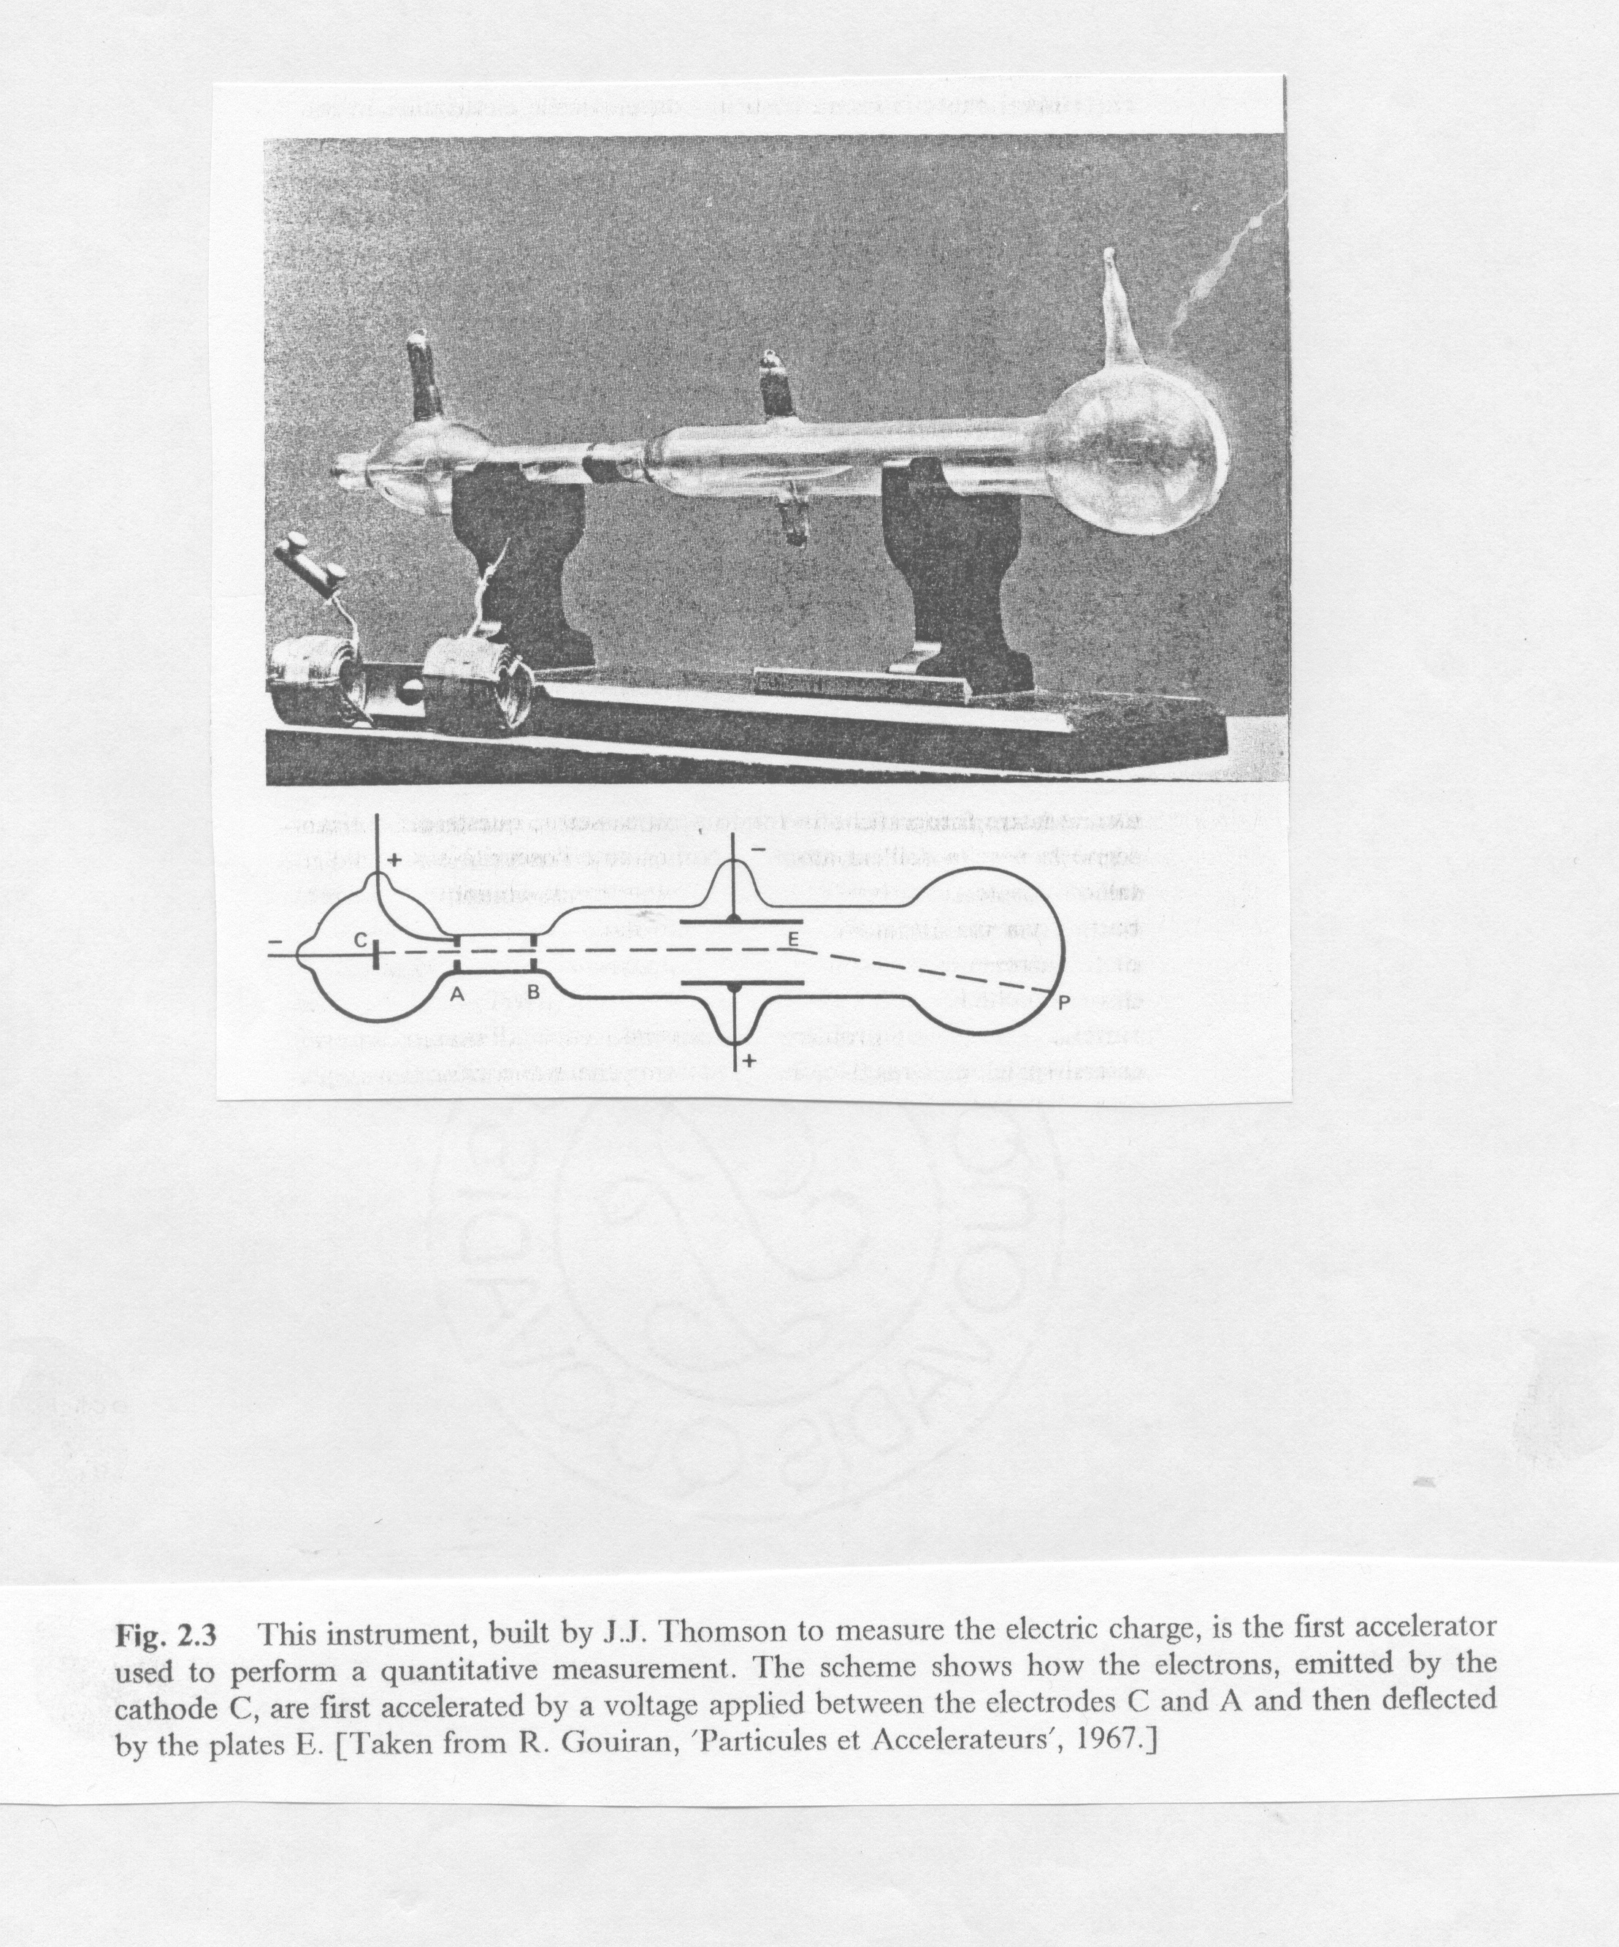
The beginnings of modern physics and of medical physics
1895
Discovery of X rays
Wilhelm C. Röntgen
1897
First treatment of tissue with X rays
Leopold Freund
J.J. Thompson
1897
“Discovery” of the electron

Slide 3
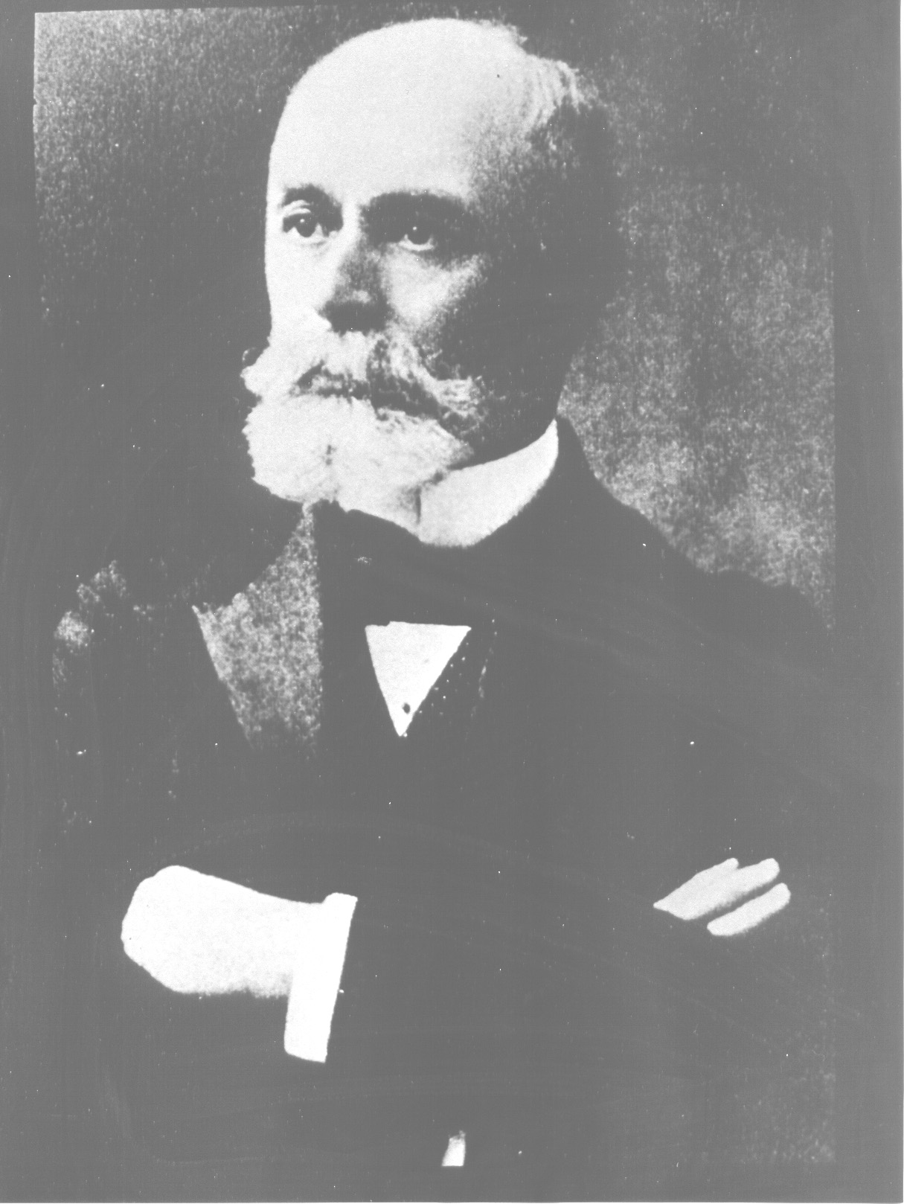
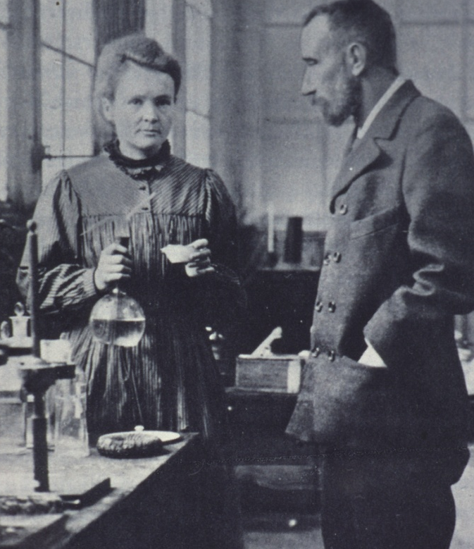
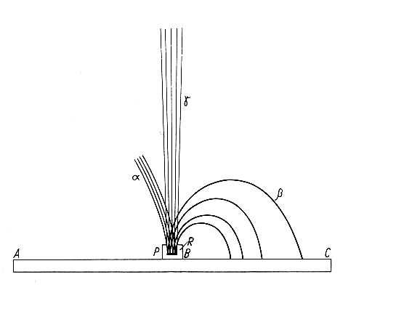
The beginnings of modern physics and of medical physics
Henri Becquerel (1852-1908)
1896
Discovery of natural
radioactivity
Thesis of Mme. Curie – 1904
α, β, γ in magnetic field
1898
Discovery of polonium and radium
Hundred years ago
Marie Curie Pierre Curie
(1867 – 1934) (1859 – 1906)

Slide 4
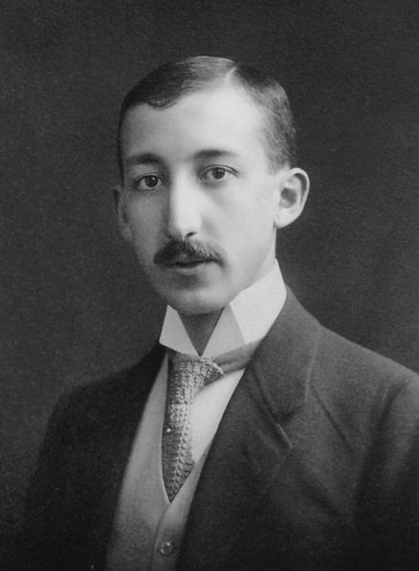
First practical application of a radioisotope
1911: first practical application of a radioisotope (as radiotracer) by G. de Hevesy, a young Hungarian student working with naturally radioactive materials in Manchester
1924: de Hevesy, who had become a physician, used radioactive isotopes of lead as tracers in bone studies

Slide 5
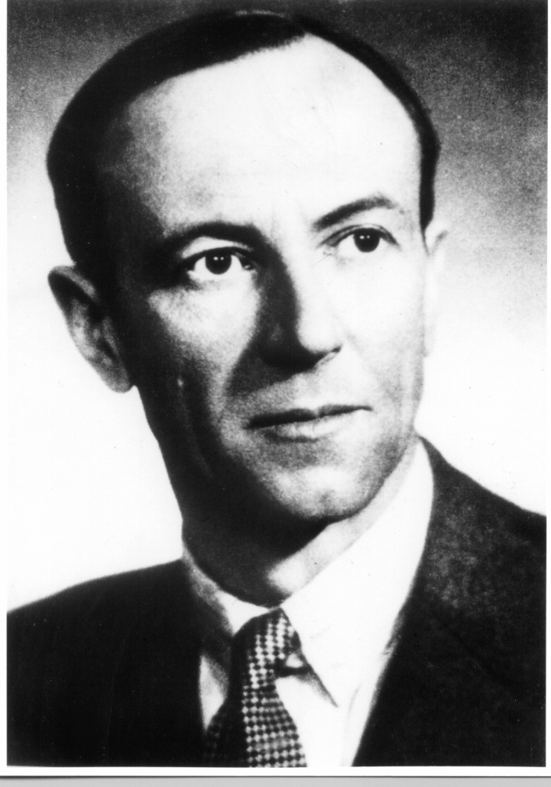
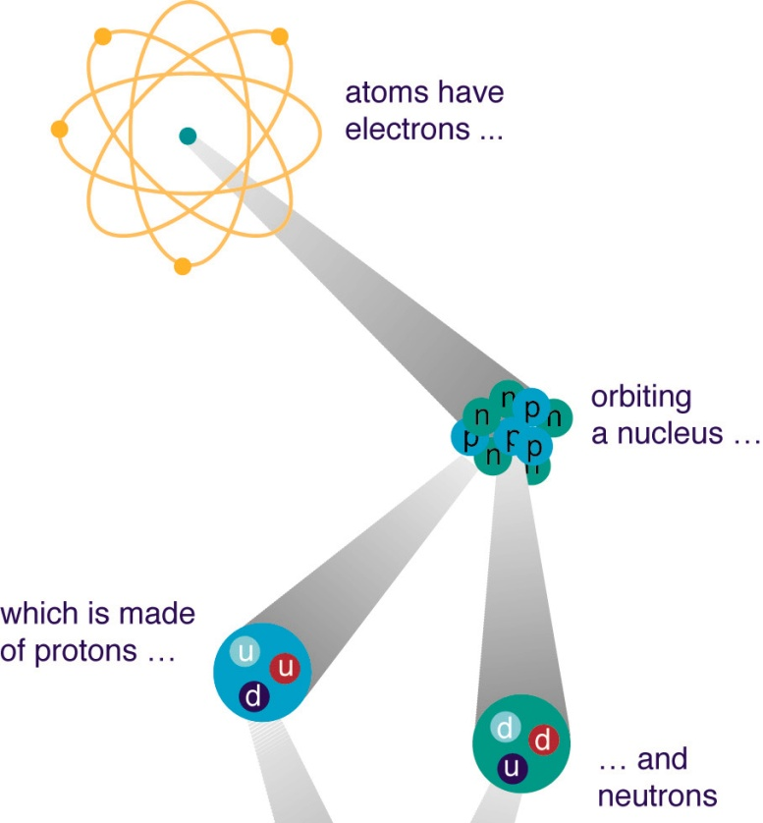
The beginnings of modern physics and of medical physics
1932
Discovery of the neutron
James Chadwick
(1891 – 1974)
Cyclotron + neutrons = first attempt of radiation therapy with fast neutrons at LBL (R. Stone and J. Lawrence, 1938)

Slide 6
Directly and indirectly ionizing radiation
Directly ionizing radiation:
fast charged particles (e.g., electrons, protons, alpha particles), which deliver their energy to matter directly, through many small Coulomb-force interactions along the particle’s track
Indirectly ionizing radiation:
X- or γ-rays photons or neutrons (i.e., uncharged particles), which first transfer their energy to charged particles in the matter through which they pass in a relatively few large interactions, or cause nuclear reactions
The resulting fast charged particles then in turn deliver the energy in matter
The deposition of energy in matter by indirectly ionizing radiation is a two-step process
photon → electron
neutron → proton or recoiling nuclei

Slide 7
Why is radiation dosimetry important?
Unique effects of interaction of ionizing radiation with matter
Biological systems (humans in particular) are particularly susceptible to damage by ionizing radiation
The expenditure of a trivial amount of energy (~4 J/kg or Gy) to the whole body is likely to cause death
Even if this amount of energy can only raise the gross temperature by about 0.001 °C
This is because of the ability of ionizing radiation to impart their energy to individual atoms and molecules
The resulting high local concentration of absorbed energy can kill a cell either directly or through the formation of highly reactive chemical species such as free radicals (atom or compound in which there is an unpaired electron, such as H or CH₃) in the water medium that constitutes the bulk of the biological material
Main aim of dosimetry = measurement of the absorbed dose (energy/mass)
Notes:
Ionizing radiation can also produce gross changes, either desirable or deleterious, in organic compounds by breaking molecular bonds, or in crystalline materials by causing defects in the lattice structure. Even steel can be damaged by large fluxes of fast neutrons, suffering embrittlement and possible fracture under mechanical stress (e.g., ITER)

Slide 8
DNA damage
Ionization event (formation of water radicals)
Light damage - reparable
Primary particle track
delta rays
e⁻
Water radicals attack the DNA
OH•
Clustered damage - irreparable
The mean diffusion distance of OH radicals before they react is only 2-3 nm
Courtesy R. Schulte

Slide 9
Radiobiological effectiveness (RBE)

Slide 10
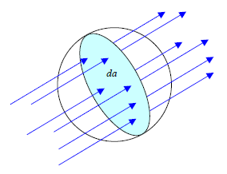
The random nature of radiation
How many rays (i.e. photons or particles) will strike a point P in radiation field?
The answer is zero, since a point has no cross-sectional area with which the rays can collide
So: how can we describe the radiation field at P?
Associate some nonzero volume to the point P
Simplest volume is a sphere centered at P (it presents the same cross-sectional area to rays incident from all directions)
How large should this imaginary sphere be?
  It depends on whether the physical quantities we wish to define w.r.t. the radiation field are:
    Stochastic
    Non-stochastic
P

Slide 11
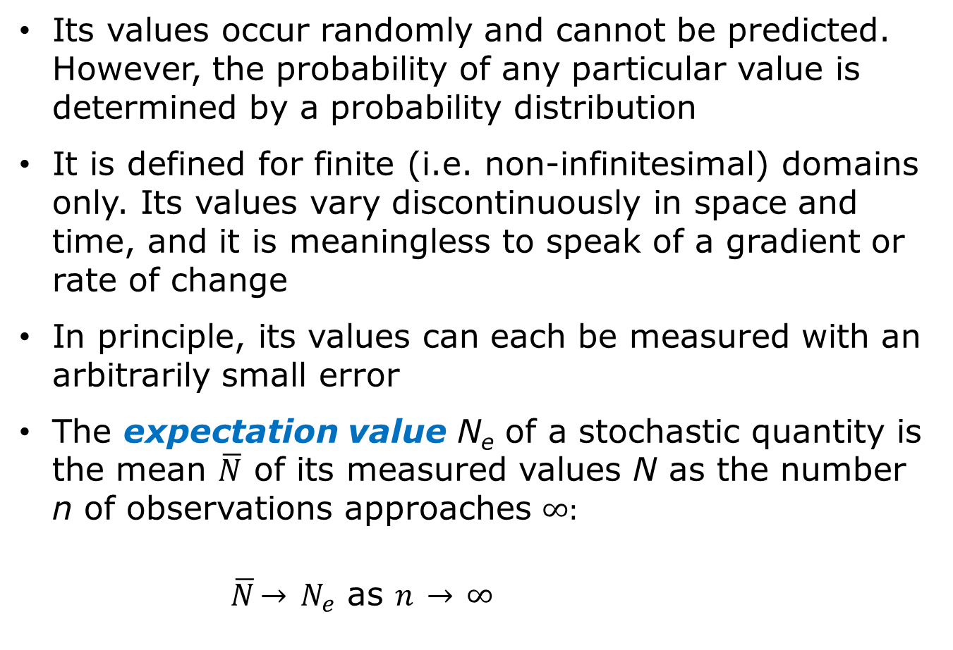
Stochastic quantity
Its values occur randomly and cannot be predicted. However, the probability of any particular value is determined by a probability distribution
It is defined for finite (i.e. non-infinitesimal) domains only. Its values vary discontinuously in space and time, and it is meaningless to speak of a gradient or rate of change
In principle, its values can each be measured with an arbitrarily small error
The expectation value N_{e} of a stochastic quantity is the mean $\overline{N}$ of its measured values N as the number n of observations approaches $∞:$
$\overline{N}\overset{→}{} N_{e}$ as $n \overset{→}{} ∞$

Slide 12
Non-stochastic quantity
For given conditions its value can, in principle, be predicted by calculations
It is, in general, a “point function” defined for infinitesimal volumes; hence it is a continuous and differentiable function of space and time, and one may speak of its spatial gradient and time rate of change
Its value is equal to, or based upon, the expectation value of a related stochastic quantity, if one exists. Although non-stochastic quantities in general need not be related to stochastic quantities, they are so related in the context of ionizing radiation

Slide 13
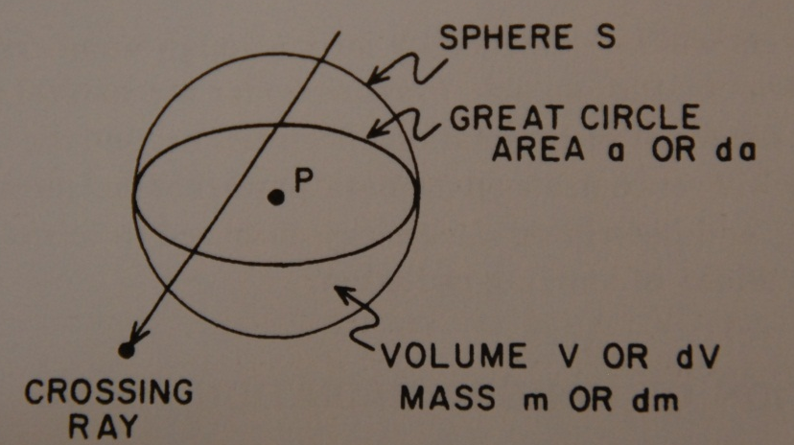
Stochastic and non-stochastic quantities
The volume of the imaginary sphere surrounding P may be small but must be finite if dealing with stochastic quantities
This volume may be infinitesimal, dV, in reference to non-stochastic quantities
Likewise the great-circle area da and contained mass dm, as well as the irradiation time dt may be expressed as infinitesimal with non-stochastic quantities
Most common and useful quantities for describing radiation fields and their interaction with matter are non-stochastic
Stochastic quantities are mostly involved with microdosimetry (the determination of energy spent in a small but finite volume) → next year workshop at the Politecnico of Milano, October 2013
Microdosimetry is of particular interest in relation to biological cell damage → T. Waker’s lecture

Slide 14
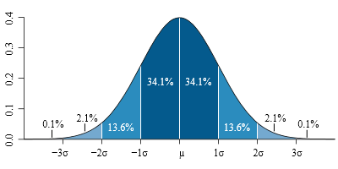

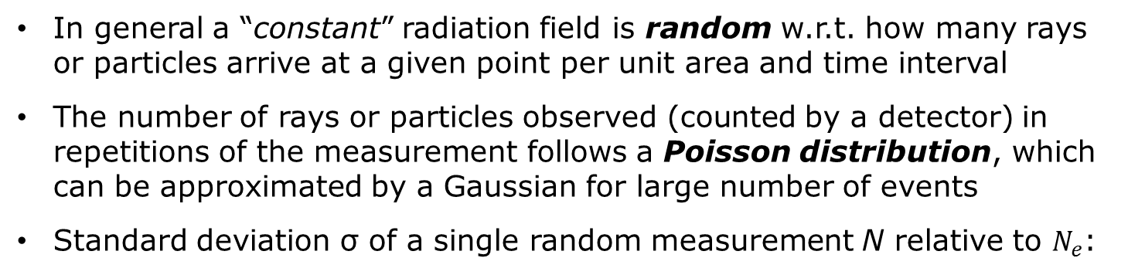


Counting statistics
In general a “constant” radiation field is random w.r.t. how many rays or particles arrive at a given point per unit area and time interval
The number of rays or particles observed (counted by a detector) in repetitions of the measurement follows a Poisson distribution, which can be approximated by a Gaussian for large number of events
Standard deviation σ of a single random measurement N relative to $N_{e}$:
$$σ= \sqrt{N_{e}}≅\sqrt{\overline{N}}$$
(Remember that $\overline{N} \text{∀} N_{e}$ as $n \text{∀} ∞$)
$N_{e}$ = expectation value of the number of rays detected per measurement
Percent standard deviation S:
$S= \frac{100σ}{N_{e}}$ = $\frac{100}{\sqrt{N_{e}}} ≅ \frac{100}{\sqrt{\overline{N}}}$
A single measurement N has 68.3% chance of lying within ±σ of N_{e}, 95.5% chance of lying within ±2σ of N_{e} and 99.7% chance within ±3σ

Slide 15
Radiation dosimetry
In radiation dosimetry we have:
Quantities describing the radiation field (e.g., fluence)
Quantities describing the medium with which the radiation field interacts (e.g., stopping power)
Dosimetric quantity =
= quantity describing the field x constant of the medium
Radiation fields can be described by a set of non-stochastic quantities

Slide 16
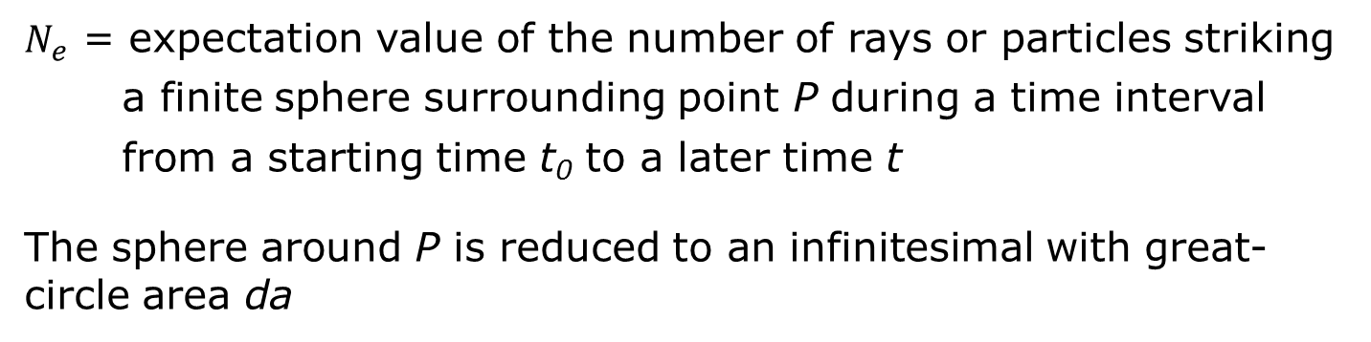
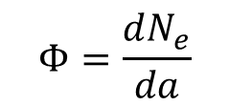
Fluence
FLUENCE at a point P
$$Φ=\frac{dN_{e}}{da}$$
( m⁻² or cm⁻²)
$N_{e}$ = expectation value of the number of rays or particles striking a finite sphere surrounding point P during a time interval from a starting time t₀ to a later time t
The sphere around P is reduced to an infinitesimal with great-circle area da

Slide 17
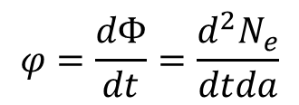
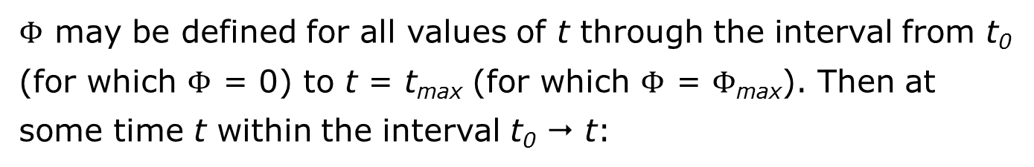
Flux density or fluence rate
FLUX DENSITY OR FLUENCE RATE at a point P
$Φ$ may be defined for all values of t through the interval from t₀ (for which $Φ$ = 0) to t = t_{max} (for which $Φ$ = $Φ$_{max}). Then at some time t within the interval t₀  t:
$$φ=\frac{dΦ}{dt}=\frac{d^{2}N_{e}}{dtda}$$
( m⁻² s⁻¹ or cm⁻² s⁻¹)
$dΦ$ is the increment of fluence during the infinitesimal time interval dt at time t

Slide 18
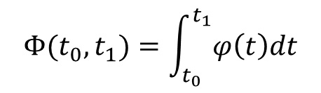
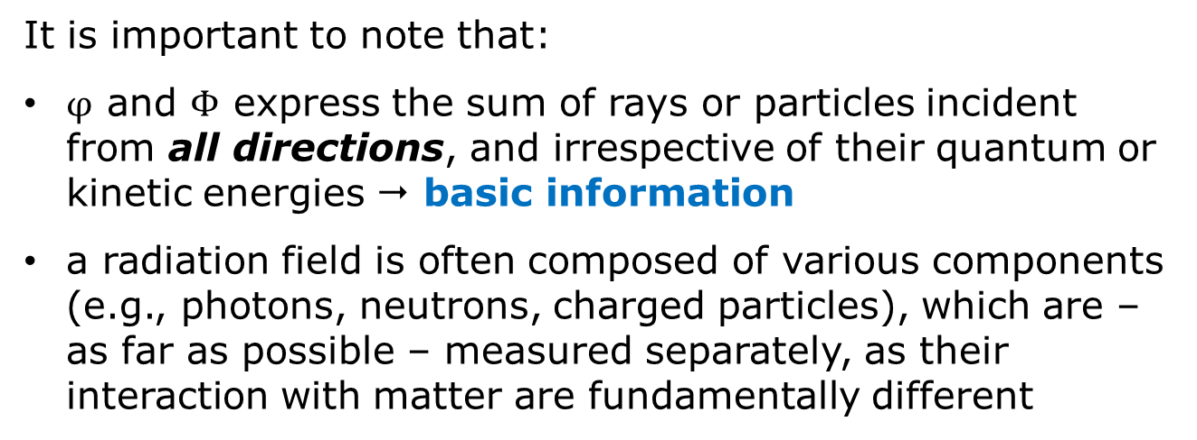

Fluence and fluence rate
The fluence at P for the time interval t₀  t₁
$${Φ(t}_{0},t_{1})=\int_{t_{0}}^{t_{1}}{φ\left(t\right)dt}$$
For a time-independent radiation field, $φ\left(t\right)$ = constant and
$${Φ(t}_{0},t_{1})=φ∙\left(t_{1}−t_{0}\right)=φ Δt$$
It is important to note that:
$φ$ and $Φ$ express the sum of rays or particles incident from all directions, and irrespective of their quantum or kinetic energies  basic information
a radiation field is often composed of various components (e.g., photons, neutrons, charged particles), which are – as far as possible – measured separately, as their interaction with matter are fundamentally different

Slide 19
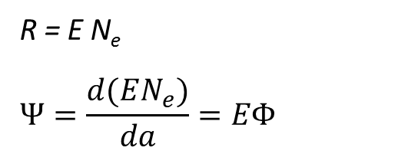
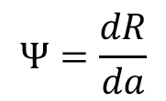
Energy fluence
The energy fluence $Ψ$ sums the energy of all individual rays or particles
$$Ψ=\frac{dR}{da}$$
(J m⁻² or erg cm⁻²)
1 eV = 1.602 x 10⁻¹⁹ J
R = expectation value of the total energy (exclusive of rest-mass energy) carried by all the N_{e} rays striking a finite sphere surrounding point P during a time interval from t₀ to t
The sphere around P is reduced to an infinitesimal with great-circle area da
For the special case where only a single energy E of rays is present:
R = E N_{e}
$$Ψ=\frac{d(EN_{e})}{da}=EΦ$$
Notes:
Individual particle or photon energies are usually given in keV or MeV, which is the kinetic energy acquired by a single charged particle in falling through a potential difference of one thousand or one million volts

Slide 20
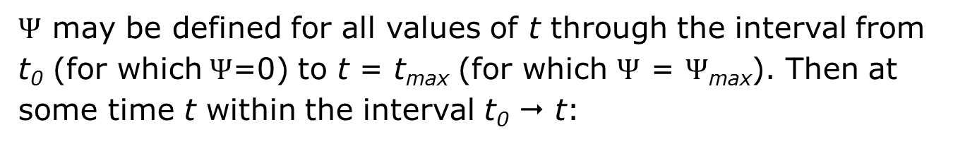
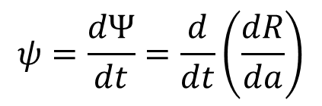
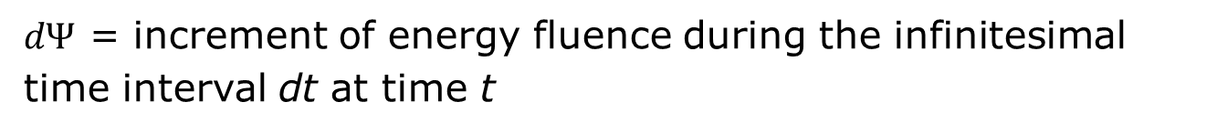
Energy flux density or energy fluence rate
ENERGY FLUX DENSITY OR ENERGY FLUENCE RATE at a point P
$Ψ$ may be defined for all values of t through the interval from t₀ (for which$Ψ$=0) to t = t_{max} (for which $Ψ$ = $Ψ$_{max}). Then at some time t within the interval t₀  t:
$$ψ=\frac{dΨ}{dt}=\frac{d}{dt}\left(\frac{dR}{da}\right)$$
(J m⁻² s⁻¹ or erg cm⁻² s⁻¹)
$dΨ$ = increment of energy fluence during the infinitesimal time interval dt at time t

Slide 21
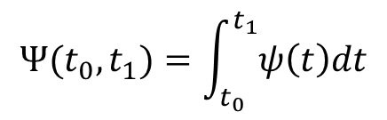
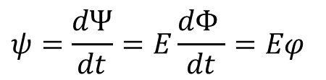


Energy fluence and energy fluence rate
Similarly to what written above for the fluence rate:
$${Ψ(t}_{0},t_{1})=\int_{t_{0}}^{t_{1}}{ψ\left(t\right)dt}$$
and for constant$ψ\left(t\right)$
$${Ψ(t}_{0},t_{1})=ψ∙\left(t_{1}−t_{0}\right)=ψ Δt$$
For monoenergetic rays of energy E (for which$Ψ=EΦ)$the energy flux density $ψ$ may be related to the flux density $φ$ by:
$$ψ=\frac{dΨ}{dt}=E\frac{dΦ }{dt}=Eφ$$

Slide 22
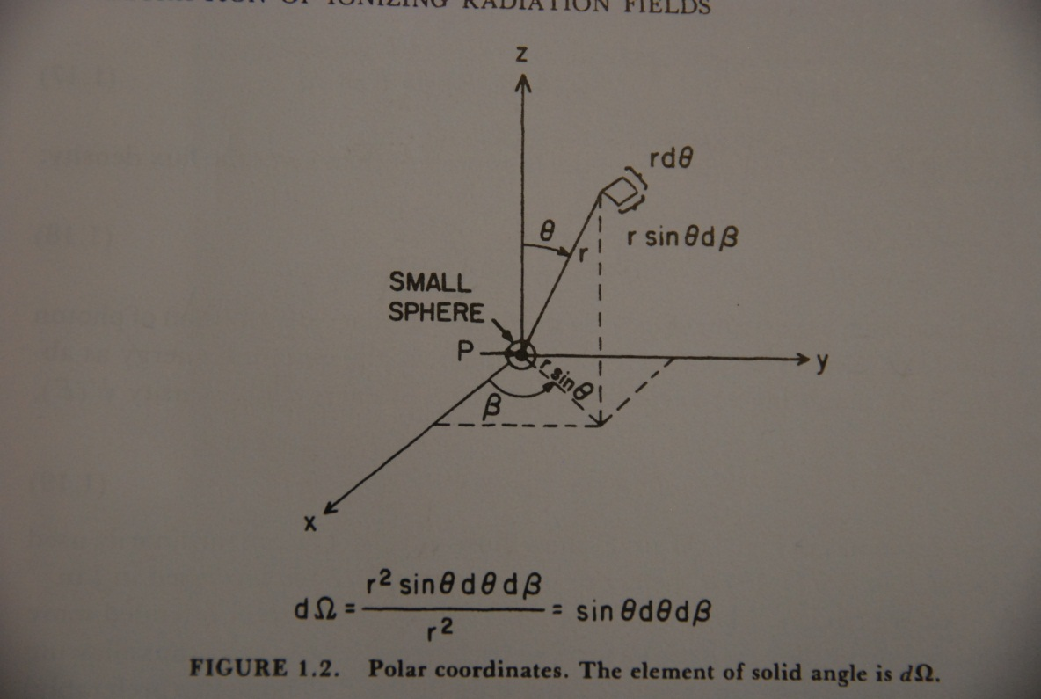
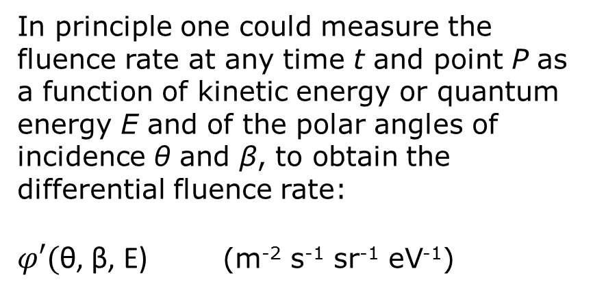
Differential distributions versus energy and angle of incidence
Most radiation interactions are dependent upon the energy of the ray as well as its type, and the sensitivity of radiation detectors typically depends on the direction of incidence of the rays striking it
The radiation field must usually be described in terms of its energy and angular distributions
In principle one could measure the fluence rate at any time t and point P as a function of kinetic energy or quantum energy E and of the polar angles of incidence θ and β, to obtain the differential fluence rate:
$φ′($θ, β, E) (m⁻² s⁻¹ sr⁻¹ eV⁻¹)
(According to the energy range, one uses keV⁻¹ or MeV⁻¹ instead of eV⁻¹)
Notes:
Polar coordinates. The element of solid angle is $dΩ$

Slide 23
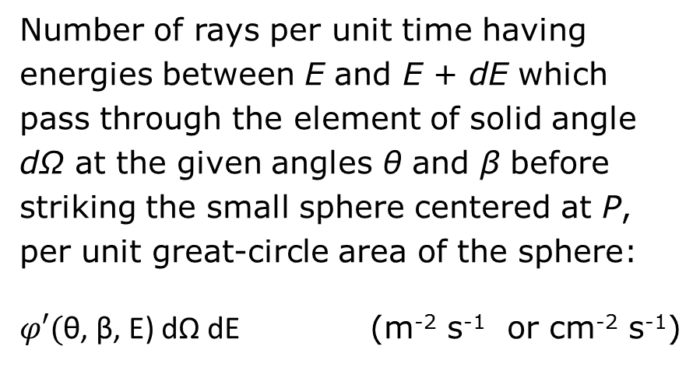
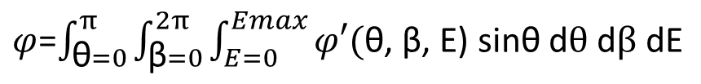

Differential distributions versus energy and angle of incidence
Number of rays per unit time having energies between E and E + dE which pass through the element of solid angle dΩ at the given angles θ and β before striking the small sphere centered at P, per unit great-circle area of the sphere:
$φ′($θ, β, E) dΩ dE (m⁻² s⁻¹ or cm⁻² s⁻¹)
Integrating over all angles and energies, one obtains the flux density $φ$:
$φ$=$\int_{\text{θ}=0}^{π}{\int_{\text{β}=0}^{2π}{\int_{E=0}^{Emax}{φ′(\text{θ}\text{, }\text{β}\text{, }\text{E}\text{) }\text{sin}\text{θ} \text{d}θ \text{d}β \text{dE}}}}$
(m⁻² s⁻¹ or cm⁻² s⁻¹)
Similar expressions are valid for the energy fluence rate, fluence and energy fluence

Slide 24
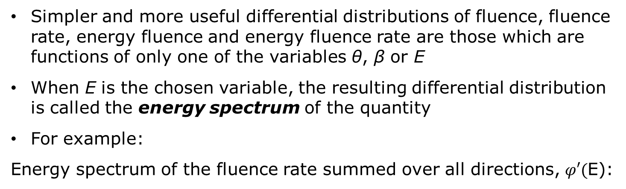
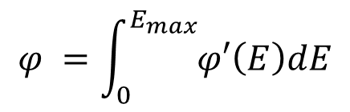
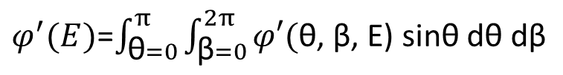
Energy spectra
Simpler and more useful differential distributions of fluence, fluence rate, energy fluence and energy fluence rate are those which are functions of only one of the variables θ, β or E
When E is the chosen variable, the resulting differential distribution is called the energy spectrum of the quantity
For example:
Energy spectrum of the fluence rate summed over all directions, $φ′($E):
$φ^{′}(E)$=$\int_{\text{θ}=0}^{π}{\int_{\text{β}=0}^{2π}{φ′(\text{θ}\text{, }\text{β}\text{, }\text{E}\text{) }\text{sin}\text{θ} \text{d}\text{θ} \text{d}\text{β}}}$
(m⁻² s⁻¹ keV⁻¹ or cm⁻² s⁻¹ keV⁻¹)
and integrating over all energies of the rays gives of course
$$φ =\int_{0}^{E_{max}}{φ′\left(E\right)dE}$$

Slide 25
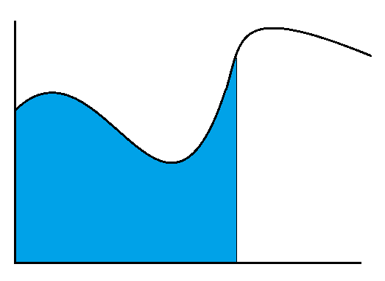
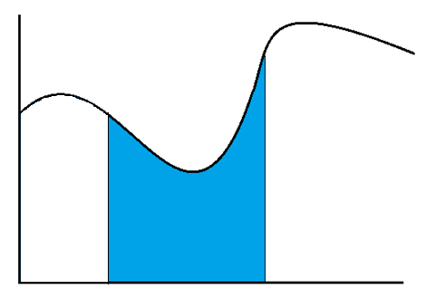
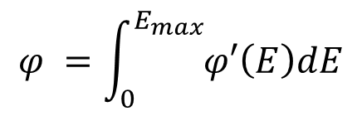




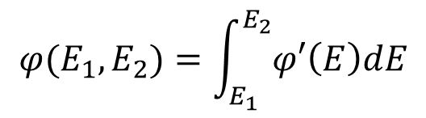
Energy spectra
$$φ′(E′)$$
$$φ =\int_{0}^{E_{max}}{φ′\left(E\right)dE}$$
$$φ(E)$$
$$φ′(E′)$$
0
E
E’
$$φ(E_{1},E_{2})$$
$$φ(E_{1}, E_{2})=\int_{E_{1}}^{E_{2}}{φ′\left(E\right)dE}$$
0
E₁
E₂
E’

Slide 26
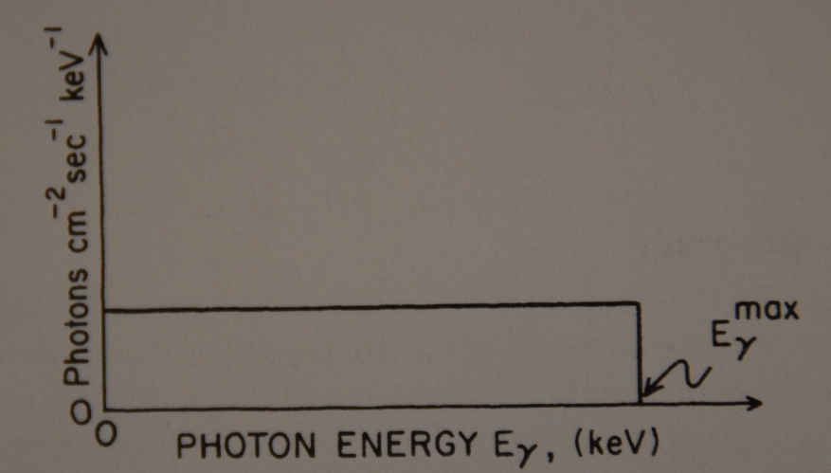
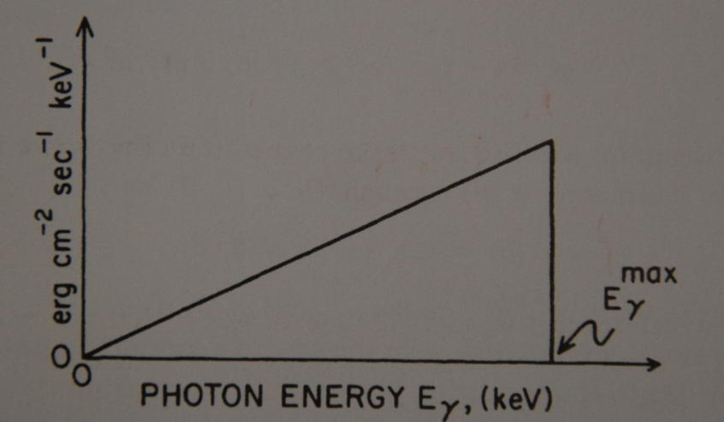
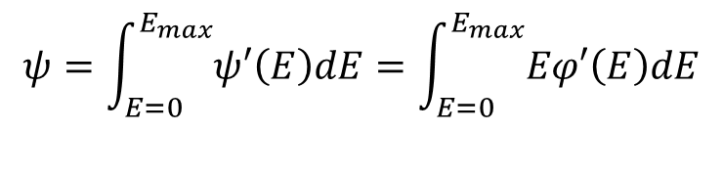

Energy spectra
Example
Flat spectrum of photon fluence rate $φ′\left(E\right)$ versus photon energy E
Corresponding spectrum of energy fluence rate $ψ$’(E)
$ψ$’(E) = E $φ′\left(E\right)$
$$ψ=\int_{E=0}^{E_{max}}{ψ′\left(E\right)dE}=\int_{E=0}^{E_{max}}{Eφ′\left(E\right)dE}$$

Slide 27
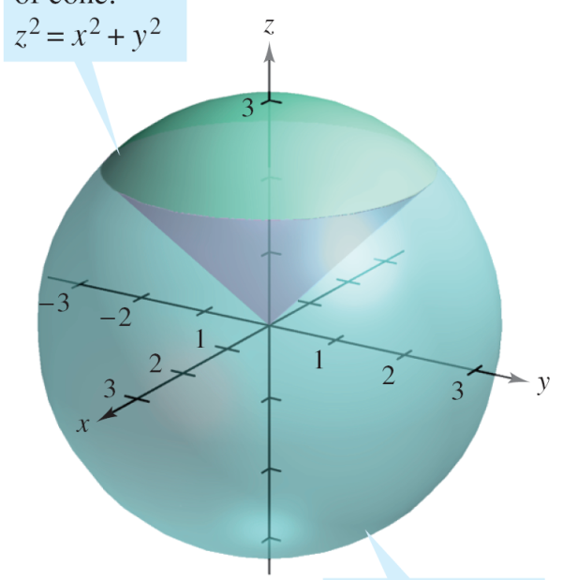
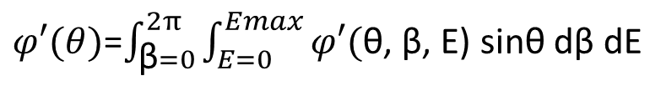

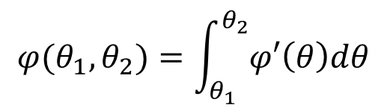
Angular distributions
If the radiation field is symmetrical w.r.t. the vertical axis z, it can be described in terms of the differential distribution of e.g. the fluence rate as a function of polar angle θ
$φ′(θ)$=$\int_{\text{β}=0}^{2π}{\int_{E=0}^{Emax}{φ′(\text{θ}\text{, }\text{β}\text{, }\text{E}\text{) }\text{sin}\text{θ} \text{d}\text{β} \text{dE}}}$
The component of the fluence rate consisting of the particles of all energies arriving at P through the annulus lying between the two polar angles θ₁ and θ₂ is:
$$φ(θ_{1}, θ_{2})=\int_{θ_{1}}^{θ_{2}}{φ′\left(θ\right)dθ}$$
$φ′\left(θ\right)$ is expressed e.g. in m⁻² s⁻¹ radian⁻¹
If $θ_{1}=0 and θ_{2}= π → φ\left(θ_{1}, θ_{2}\right)=φ$

Slide 28
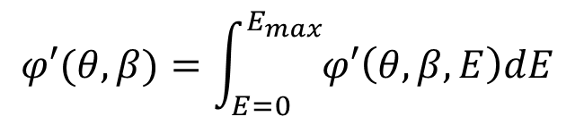

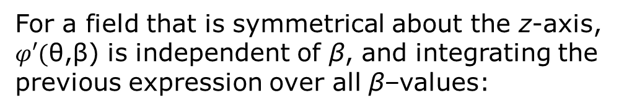
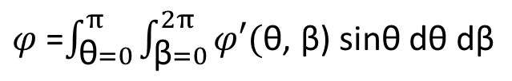
Angular distributions
Differential distribution of fluence rate per unit solid angle, for particles of all energies:
$$φ′(θ, β)=\int_{E=0}^{E_{max}}{φ′\left(θ,β, E\right)dE}$$
(m⁻² s⁻¹ sr⁻¹)
and integrating over all directions:
$φ$=$\int_{\text{θ}=0}^{π}{\int_{\text{β}=0}^{2π}{φ′(\text{θ}\text{, }\text{β}\text{) }\text{sin}\text{θ} \text{d}\text{θ} \text{d}\text{β}}}$
For a field that is symmetrical about the z-axis, $φ′(\text{θ}\text{,}\text{β}\text{) }$is independent of β, and integrating the previous expression over all β–values:
$φ$= 2$π\int_{\text{θ}=0}^{π}{φ′(\text{θ}\text{, }\text{β}\text{) }\text{sin}\text{θ} \text{d}\text{θ}}$

Slide 29
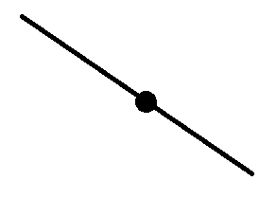
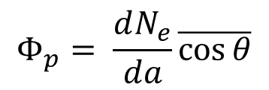




Planar fluence
PLANAR FLUENCE: the number of particles crossing a fixed plane in either direction (=summed by scalar addition) per unit area of the plane
$$Φ_{p}= \frac{dN_{e}}{da}\overline{\cos{θ}}$$
da
P
θ = angle of incidence of rays or particles on surface da
If the angular distribution of the rays or particles is isotropic:
$\overline{\cos{θ}}$= 1/2
$$Φ_{p}= \frac{1}{2}\frac{dN_{e}}{da}= \frac{1}{2}Φ$$
$$ψ_{p}=\frac{1}{2}ψ$$
If the radiation field is unidirectional:
da
P
$$Φ_{p}= \frac{dN_{e}}{da}\cos{θ}$$

Slide 30

Planar fluence
Spherical and flat detectors of equal cross-sectional areas
Particles scattered through the same angle θ
No of scattered particles striking spherical detector = (1/cos θ) x no of particles striking flat detector
Same fluence
Notes:
This increase in fluence by the (1/cos θ) factor contributes to an effect sometimes seen in broad-beam geometry, in which the fluence behind an attenuation layer can be greater that that incident on it

Slide 31

Interaction of ionizing radiation with matter
In radiation dosimetry three non-stochastic quantities describe the interaction of a radiation field with matter:
the kerma K, describing the first step in energy dissipation by indirectly ionizing radiation = energy transfer to charged particles
the absorbed dose D, describing the energy imparted to matter by all kinds of ionizing radiations, but delivered by the charged particles
the exposure X, which describes x- and γ-fields in terms of their ability to ionize air
  A related quantity is the mean energy expended per ion par production in a gas, $\overline{W}$

Slide 32
Interaction of ionizing radiation with matter
Uncharged ionizing radiation lose their energy in relatively few large interactions, whereas charged particles typically undergo many small collisions, losing their kinetic energy gradually
An uncharged particle has no limiting range in matter, beyond which it cannot go
Charge particles encounter such a range limit as they run out of kinetic energy
For comparable energies, uncharged particles penetrate much farther through matter, on the average, than charged particles, although this difference gradually decreases at energies above 1 MeV

Slide 33



Total coefficients for attenuation, energy transfer and energy absorption
$$\frac{μ}{ρ}=\frac{1}{ρN}\frac{dN}{dl}$$
mass attenuation coefficient
σ = cross section
N_{A} = Avogadro’s constant (6.022·10²³ mol⁻¹)
A = atomic weight
$$\frac{μ}{ρ}=σ\frac{N_{A}}{A}$$
Total mass attenuation coefficient for γ-ray interactions (neglecting photonuclear reactions):
$$\frac{μ}{ρ}=\frac{τ}{ρ}+\frac{σ}{ρ}+\frac{k}{ρ}+\frac{σ_{R}}{ρ}$$
(cm² g⁻¹ or m² kg⁻¹)
Rayleigh scattering
pair production
Compton effect
photoelectric effect

Slide 34




Total coefficients for attenuation, energy transfer and energy absorption
Mass energy-transfer coefficient
$$\frac{μ_{tr}}{ρ}=\frac{1}{ρEN}\frac{dε_{tr}}{dl}$$
$$\frac{dε_{tr}}{EN}$$
= fraction of energy of incident particles transferred to kinetic energy of secondary particles
For photons:
$$\frac{μ_{tr}}{ρ}=\frac{τ_{tr}}{ρ}+\frac{σ_{tr}}{ρ}+\frac{k_{tr}}{ρ}$$
Mass energy-absorption coefficient
$$\frac{μ_{en}}{ρ}=\frac{μ_{tr}}{ρ}(1−g)$$
average fraction of secondary electron energy lost in radiative interactions (bremsstrahlung and β⁺ annihilation)
For low Z and low hν, g  0
Notes:
NOTE: while $μ$/$ρ$ and $μ$tr/$ρ$ are based only on the hν and Z actually present at the point of photon interaction, $μ$en/$ρ$ must also be based on an assumption about the medium through which the secondary electrons pass in slowing down. Usually the interaction point is assumed to be surrounded by the same homogenous medium, at least to a distance equal to the max electron range. Exception: near an interface between two media

Slide 35

Total coefficients for attenuation, energy transfer and energy absorption
Example: mass attenuation coefficient for soft tissue (Z = 7)

Slide 36








Exponential attenuation of uncharged ionizing radiation (γ and neutrons)
$$dN=−μNdl$$
$$\frac{dN}{N}=−μdl$$
$$\int_{N=N_{0}}^{N_{L}}{\frac{dN}{N}=−\int_{l=0}^{L}{μdl}}$$
$μdl$ = probability of interaction in an infinitesimal thickness $dl$
$$lnN_{L}−lnN_{0}=ln\frac{N_{L}}{N_{0}}=−μL$$
μ = linear attenuation coefficient
(narrow beam) (cm⁻¹ or m⁻¹)
$$\frac{N_{L}}{N_{0}}=e^{−μL}$$
1/μ = mean free path = average distance a single particle travels in a medium before interacting
A distance of 3/μ reduces the beam intensity to 5%, 5/μ to <1%
$$\frac{N_{L}}{N_{0}}=e^{−\left(μ_{1}+μ_{2}+μ_{3}+…\right)L}$$
Notes:
Uncharged ionizing radiation lose their energy in relatively few large interactions, whereas charged particles typically undergo many small collisions, losing their kinetic energy gradually
An uncharged particle has no limiting range in matter, beyond which it cannot go; charge particle encounter such a range limit as they run out of kinetic energy
For comparable energies, uncharged particles penetrate much farther through matter, on the average, than charged particles, although this difference gradually decreases at energies above 1 MeV

Slide 37




Stopping power and LET
$$S=\frac{dE}{dl}$$
$$\frac{S}{ρ}=\frac{dE}{ρdl}$$
$$\frac{S}{ρ}={\left(\frac{dE}{ρdl}\right)}_{collision}+{\left(\frac{dE}{ρdl}\right)}_{radiative}$$
dE = energy lost by the particle in path-length $dl$
$$L_{Δ}={\left(\frac{dE}{dl}\right)}_{Δ}$$
dE = energy locally imparted to the medium in collision events
= cut-off on energy of δ-rays
The expression “locally” can be more or less restrictive

Slide 38

Narrow- and broad-beam attenuation
Strictly speaking, exponential attenuation is only observed for a monoenergetic beam of identical uncharged particles that are absorbed without producing scattered secondary radiation
In broad-beam geometry, the effective attenuation coefficient μ’ > μ
Notes:
The value of attenuation coefficient $μ$ includes the partial coefficients for all types of interactions by the primary particles, since a particle ceases to be primary when it undergoes its first interaction of any kind

Slide 39

Narrow-beam geometry
Two methods to achieve narrow-beam attenuation:
Discrimination against all scattered and secondary particles that reach the detector
(on the basis of particle energy, penetrating ability, direction, etc)
Narrow-beam geometry, which prevents any scattered or secondary particle from reaching the detector

Slide 40



The build-up factor
$$B=\frac{Quantity due to primary+scattered and secondary radiation}{Quantity due to primary alone}$$
For narrow-beam geometry B = 1
For broad-beam geometry B > 1
B is a function of radiation type and energy, attenuation medium and depth, geometry and measured quantity (e.g. energy fluence, kerma, dose)
For example, for energy fluence $Ψ$:
$$\frac{Ψ_{L}}{Ψ_{0}}=Be^{−μL}$$
$Ψ_{0}$ = unattenuated primary energy fluence
$Ψ_{L}$ = total energy fluence at the detector behind a medium thickness L
$μ$ = narrow-beam attenuation coefficient

Slide 41



The build-up factor
$$If L=0 \text{∀} B=B_{0}≡\frac{Ψ_{L}}{Ψ_{0}}=1$$
for most broad-beam geometries,
except when detector on phantom surface
No attenuation between source and detector
phantom
L = 0
Here $Ψ_{L}$ > $Ψ_{0}$ and $B_{0}$ > 1
$B_{0}$ is called backscatter factor
For ⁶⁰Co photons on a water phantom $\text{}$ $B_{0}$ = 1.06 for tissue dose

Slide 42


Energy transferred
The energy transferred is a stochastic quantity defined as:
$ε_{tr}= {\left(R_{in}\right)}_{u}$ - ${\left(R_{out}\right)u}_{}^{nonr}$ + $\sum{Q}$
where:
${\left(R_{in}\right)}_{u}$ = radiant energy of uncharged particles entering the volume V
${\left(R_{out}\right)u}_{}^{nonr}$= radiant energy of uncharged particles leaving V, except that which originated from radioactive losses of kinetic energy by charged particles while in V
$\sum{Q}$ = net energy derived from rest mass in V (m E positive, E m negative)
The radiant energy is the energy of particles (except rest energy) emitted, transferred or received
The energy transferred is just the kinetic energy received by charged particles in V (regardless of where or how they in turn spend that energy)
Notes:
Radiative losses = conversion of charged-particle kinetic energy to photon energy, through either bremsstrahlung x-ray production or in-flight annihilation of positrons

Slide 43


Kerma (Kinetic Energy Released to Matter)
Relevant only for indirectly ionizing radiation (photons and neutrons)
$$K= \frac{d{\left(ε_{tr}\right)}_{e}}{dm}≡ \frac{dε_{tr}}{dm}$$
(Gy) (1 Gy = 1 J/kg = 100 rad)
${\left(ε_{tr}\right)}_{e}$ = expectation value of the energy transferred in the finite volume V (the sum of the initial kinetic energies of all charged particles produced by the indirectly ionizing particles in V)
${d\left(ε_{tr}\right)}_{e}$ = expectation value for the infinitesimal volume dv at point P
dm = mass of dv
The average value of K in a volume V of mass m is ${\left(ε_{tr}\right)}_{e}$ /m

Slide 44




Relation of kerma to energy fluence for photons
For monoenergetic photons, the kerma is related to the energy fluence by:
$$K= Ψ⋅{\left(\frac{μ_{tr}}{ρ}\right)}_{E,Z}$$
(Gy)
$μ_{tr}$ is the linear energy-transfer coefficient (m⁻¹ or cm⁻¹) and $μ_{tr}$ /$ρ$ is the mass energy-transfer coefficient (function of the photon energy E and atomic number Z of the medium)
For a spectrum of photons:
$$K=\int_{E=0}^{E_{max}}{Ψ′\left(E\right)⋅{\left(\frac{μ_{tr}}{ρ}\right)}_{E,Z}dE}$$
$Ψ^{′}\left(E\right)=$ differential distribution of photon energy fluence
$μ_{tr}$ /$ρ$ are numerical values tabulated for selected photon energies and materials

Slide 45

Relation of kerma to energy fluence for photons
Average value of $μ_{tr}$ / $ρ$ for the spectrum $Ψ^{′}\left(E\right)$:
$${\left(\frac{{\overline{μ}}_{tr}}{ρ}\right)}_{Ψ^{′}\left(E\right),Z}=\frac{K}{Ψ}=\frac{\int_{E}{Ψ′\left(E\right)⋅{\left(\frac{μ_{tr}}{ρ}\right)}_{E,Z}dE}}{\int_{E}{Ψ′\left(E\right)}dE}$$

Slide 46



Relation of kerma to fluence for neutrons
Neutron fields are usually described in terms of flux density (or fluence) instead of energy flux density (or energy fluence)
Kerma factor (F_{n})_{E,Z}:
$${\left(F_{n}\right)}_{E,Z}={\left(\frac{μ_{tr}}{ρ}\right)}_{E,Z}⋅E$$
(Gy cm²)
and:
$$K=Φ⋅{\left(F_{n}\right)}_{E,Z}$$
(Gy)
For neutrons with energy spectrum $Φ^{′}\left(E\right)$[cm⁻² MeV⁻¹] of particle fluence:
$$K=\int_{E=0}^{E_{max}}{Φ′\left(E\right)⋅{\left(F_{n}\right)}_{E,Z}dE}$$
(Gy)
${\left(F_{n}\right)}_{E,Z}$ are numerical values tabulated for selected neutron energies and materials

Slide 47


Relation of kerma to fluence for neutrons
Average value of F_{n} for a neutron spectrum $Φ^{′}\left(E\right)$:
$${\overline{\left(F_{n}\right)}}_{Φ^{′}\left(E\right),Z}=\frac{K}{Φ}=\frac{\int_{E}{Φ′(E)⋅{\left(F_{n}\right)}_{E,Z} dE}}{\int_{E}{Φ′\left(E\right)}dE}$$
Kerma factors are used to convert dose or kerma measured in a tissue-equivalent material to absorbed dose or kerma in tissue $⇒$ the correction to be applied is the ratio of the kerma factors

Slide 48
Components of kerma
For photons, the kerma consists of energy transferred to electrons and positrons per unit mass of medium
K = Kc + Kr
Kc = collision kerma = energy spent by the electrons in collisions (ionization and excitation in or near the electron track)
Kr = radiative kerma = energy spent by the electrons in radiative-type interactions or by positrons through in-flight annihilation
For neutrons, the resulting charged particles are protons and heavier recoiling nuclei:
Kr << Kc → K = Kc

Slide 49



Net energy transferred
The net energy transferred is a stochastic quantity defined for a volume V as:
${ε_{tr}}_{}^{n}= {\left(R_{in}\right)}_{u}$ $−$ ${\left(R_{out}\right)u}_{}^{nonr}$ $−$ ${R′}_{u}$+ $\sum{Q}= ε_{tr} −{R′}_{u}$
${R′}_{u}$ = radiant energy emitted as radiative losses by the charged particles which originated in the volume V, regardless of where the radiative loss event occur
$ε_{tr}$ and K include energy that goes to radiative losses
${ε_{tr}}_{}^{n}$ and Kc do not include such losses

Slide 50




Collision kerma Kc
$$Kc= \frac{d{ε_{tr}}_{}^{n}}{dm}$$
= expectation value of the net energy transferred to charged particles per unit mass at the point of interest, excluding both the radiative-loss energy and the energy passed from one charged particle to another.
Average value of collision kerma throughout a volume of mass m:
$$Kc= \frac{{\left(ε_{tr}^{}n\right)}_{e}}{m}$$
For monoenergetic photons, Kc is related to the energy fluence $Ψ$via the mass energy-absorption coefficient ${(μ}_{en}$ /$ρ)E,Z$ :
$$Kc= Ψ⋅{\left(\frac{μ_{en}}{ρ}\right)}_{E,Z}$$
$$K= Ψ⋅{\left(\frac{μ_{tr}}{ρ}\right)}_{E,Z}$$
(similarly to
)

Slide 51



Collision kerma Kc
And similar as seen above for an energy spectrum $Ψ^{′}(E)$
$$Kc=\int_{E=0}^{E_{max}}{Ψ′\left(E\right)⋅{\left(\frac{μ_{en}}{ρ}\right)}_{E,Z}dE}$$
For a low-Z medium and small photon energy E (small radiative losses):
${(μ}_{en}$ /$ρ)E,Z$ $≈{(μ}_{tr}\text{ /}ρ)E,Z$
Kc $≈$ K
Percentage by which ${(μ}_{en}$ /$ρ)E,Z$ is less than ${(μ}_{tr}\text{ /}ρ)E,Z$

Slide 52



Kerma rate
Kerma rate at point P and time t
$$\dot{K}=\frac{dK}{dt}=\frac{d}{dt}\left(\frac{dε_{tr}}{dm}\right)$$
(Gy s⁻¹ or Gy h⁻¹)
Integrated kerma between times t₀ and t₁:
$$K\left(t_{0},t_{1}\right)=\int_{t_{0}}^{t_{1}}{\dot{K}\left(t\right) dt}$$
and for constant kerma rate:
$$K\left(t_{0},t_{1}\right)=\dot{K}\left(t_{1}−t_{2}\right)$$

Slide 53


Energy imparted
The energy imparted is a stochastic quantity defined as:
$ε= {\left(R_{in}\right)}_{u}−\left(R_{out}\right)u$ + ${\left(R_{in}\right)}_{c}−\left(R_{out}\right)c$ +$\sum{Q}$
where:
${\left(R_{in}\right)}_{u}$ = radiant energy of uncharged particles entering the volume V
$\left(R_{out}\right)u$ = radiant energy of all uncharged radiation leaving V
${\left(R_{in}\right)}_{c}$ = radiant energy of the charged particles entering V
$\left(R_{out}\right)c$ = radiant energy of the charged particles leaving V
$\sum{Q}$ = net energy derived from rest mass in V
(m  E positive, E  m negative)

Slide 54




Absorbed dose and dose rate
The absorbed dose is relevant to all types of ionizing radiation fields and to any ionizing radiation source distributed within an absorbing medium
$$D=\frac{dε}{dm}$$
$$\dot{D}=\frac{dD}{dt}=\frac{d}{dt}\left(\frac{dε}{dm}\right)$$
(Gy)
$ε$ = expectation value of the energy imparted in the finite volume V during a given time interval
d$ε$ = expectation value of the energy imparted in an infinitesimal volume dV at point P
dm = mass of dV
D is the expectation value of the energy imparted to matter per unit mass at point P
Average absorbed dose in a volume of mass m: $\overline{D}={(ε)}_{e}/m$
Notes:
D represent the energy per unit mass which remains in the matter at P to produce any effect attributable to the radiation.
If D = 0 there can be no radiation effect.
Thus, the absorbed dose is the most important quantity in radiological physics.

Slide 55







Energy imparted, energy transferred and net energy transferred
$ε= {\left(R_{in}\right)}_{u}−\left(R_{out}\right)u$ + ${\left(R_{in}\right)}_{c}−\left(R_{out}\right)c$ +$\sum{Q}$
$$ε=hυ_{1}−\left(hυ_{2}+hυ_{3}+T^{′}\right)+0$$
$ε_{tr}= {\left(R_{in}\right)}_{u}$ - ${\left(R_{out}\right)u}_{}^{nonr}$ + $\sum{Q}$
$$ε_{tr}=hυ_{1}−hυ_{2}+0=T$$
The energy transferred is just the kinetic energy received by charged particles in V (regardless of where or how they in turn spend that energy)
${ε_{tr}}_{}^{n}= {\left(R_{in}\right)}_{u}$ $−$ ${\left(R_{out}\right)u}_{}^{nonr}$ $−$ ${R′}_{u}$+ $\sum{Q}= ε_{tr} −{R′}_{u}$
$$ε_{tr}n=hυ_{1}−hυ_{2}−\left(hυ_{3}+hυ_{4}\right)+0$$
$=T−\left(hυ_{3}+hυ_{4}\right)$
Compton interaction followed by bremsstrahlung emission
Notes:
${\left(R_{out}\right)u}_{}^{nonr}$ = radiant energy of uncharged particles leaving V, except that which originated from radioactive losses of kinetic energy by charged particles while in V
${R′}_{u}$ = radiant energy emitted as radiative losses by the charged particles which originated in the volume V, regardless of where the radiative loss event occur

Slide 56





Energy imparted, energy transferred and net energy transferred
γ-ray emitted by a radioactive atom
$$ε=ε_{tr}=ε_{tr}n=0−1.022 MeV+∑Q$$
$∑Q=$ $hυ_{1}−2m_{0}c^{2}+2m_{0}c^{2}=hυ_{1}$
$$ε=ε_{tr}=ε_{tr}n=hυ_{1}−1.022 MeV=$$
$=$ $T_{1}+T_{2}$
$\sum{Q}$ = net energy derived from rest mass in V (m E positive, E m negative)
Example involving γ-ray emission, pair production and β⁺annihilation

Slide 57



The exposure X
Only defined for x-ray and γ-ray photons
$$X=\frac{dQ}{dm}$$
(C/kg)
$dQ$ = absolute value of the total charge of the ions of one sign produced in air when all the electrons and positrons liberated by photons in air of mass $dm$ are completely stopped in air
the ionization arising from the absorption of bremsstrahlung emitted by the electrons is not to be included in $dQ$ (only relevant at high energies)
$\overline{W}=$ $mean energy expended in a gas per ion pair formed$
$$\frac{{\overline{W}}_{air}}{e}≃34 eV per ion pair=34 J/C$$
Notes:
The ionization arising from the absorption of bremsstrahlung emitted by the electrons is not to be included in $dQ$ (only relevant at high energies).
A part for this difference, the exposure X coincides with the ionization equivalent to kerma in air

Slide 58

Relation of exposure X to energy fluence $Ψ$
The exposure X is the ionization equivalent of the collision kerma in air, for x- and γ-rays
Exposure X at a point P due to an energy fluence $Ψ$ of monoenergetic photons of energy E:
$$X=Ψ⋅{\left(\frac{μ_{en}}{ρ}\right)}_{E,air}{\left(\frac{e}{\overline{W}}\right)}_{air}={\left(K_{c}\right)}_{air}{\left(\frac{e}{\overline{W}}\right)}_{air}={\left(K_{c}\right)}_{air}/34$$
(C kg⁻¹)
1 R (roentgen) is the exposure that produces in air one esu of charge of either sign per 0.001293 g of air (the mass contained in 1 cm³ at 760 Torr and 0°C)
1 R = 2.58 x 10⁻⁴ C kg⁻¹

Slide 59



Exposure rate
For a photon spectrum with energy fluence $Ψ′\left(E\right)$:
$$X=\int_{E=0}^{E_{max}}{{\left(μ_{en}/ρ\right)}_{E,air}{\left(e/\overline{W}\right)}_{air}Ψ′\left(E\right)dE}$$
$$\dot{X}=\frac{dX}{dt}$$
(C kg⁻¹ s⁻¹ or R s⁻¹)
Exposure occurring between times t₀ and t₁:
$$X=\int_{t_{0}}^{t_{1}}{\dot{X}\left(t\right) dt}$$

Slide 60



Characterization of x- or γ-fields by the exposure X
The energy fluence $Ψ$ is proportional to X for any given photon energy or spectrum
Air is similar to soft tissue (muscle) in effective atomic number, so that it is “tissue-equivalent” w.r.t. x- or γ-ray energy absorption
If one is interested in the effect of x- or γ-radiation in tissue, air may be substituted as a reference medium in a measuring instrument
X α ${\left(μ_{en}/ρ\right)}_{E,air}$
Kc in muscle α ${\left(μ_{en}/ρ\right)}_{E,muscle}$
${\left(μ_{en}/ρ\right)}_{E,muscle}$ / ${\left(μ_{en}/ρ\right)}_{E,air}$
$≈1.07±3\%$ for E = 4 keV – 10 MeV

Slide 61


Charged-particle and radiation equilibrium
Generally, the transfer of energy (kerma) from a photon beam to charged particles at a particular location does not lead to the absorption of energy by the medium (absorbed dose) at the same location
(e.g., a 10 MeV electron has a range in water of about 5 cm)
All energy transferred by photons to electrons is deposited in M $⇒$ D = K
Electrons originates outside M but deposit part of their energy in M$⇒$ D > K
Electrons originates in M but deposit part of their energy outside M$⇒$ D < K
If (b) and (c) compensate each other$⇒$CPE$⇒$ D = K

Slide 62






Radiation equilibrium
The dimensions of the volume are much larger than the mean free path of the radiation
Medium of homogeneous atomic composition
Medium of homogeneous density
Radioactive source uniformly distributed
No electric and magnetic fields present to perturb the charged-particle paths
$\overline{t}$ = mean free path of the photons
r = radius to the edge of the volume
Radiation equilibrium
${\left(R_{in}\right)}_{u}=\left(R_{out}\right)u$ and ${\left(R_{in}\right)}_{c}=\left(R_{out}\right)c$
$ε=$ $\sum{Q}$
$$D=\frac{d\left(\sum{Q}\right)}{dm}$$
Sketch courtesy M. Kissick

Slide 63





Charged-particle equilibrium
The dimensions of the volume are much larger than the mean free path of the secondary charged-particles
Medium of homogeneous atomic composition
Medium of homogeneous density
Radioactive source uniformly distributed
No inhomogeneous electric and magnetic fields present
Charged-particle equilibrium
$${\left(R_{in}\right)}_{c}=\left(R_{out}\right)c$$
$ε= {\left(R_{in}\right)}_{u}−\left(R_{out}\right)u$ +$\sum{Q=ε_{tr}}$
$$D=\frac{dε}{dm}=\frac{dε_{tr}}{dm}=K and Ψ=\frac{D}{\left(μ_{tr}/ρ\right)}$$
$$K= Ψ⋅\left(μ_{tr}/ρ\right)$$

Slide 64

Charged-particle and radiation equilibrium
muscle
air
bone
Photon energy (MeV)
Conversion coefficients from energy fluence to absorbed dose
(for CPE and negligible radiative losses)

Slide 65



Charged-particle equilibrium
β = D / Kc
$K=Kc$ if radiative losses are negligible
$$K= Ψ⋅\left(μ_{tr}/ρ\right)$$
Notes:
As a high-energy photon beam penetrates the medium, collisional kerma is maximal at the surface of the irradiated material because photon fluence is greatest at the surface. Initially, the charged particle fluence, and hence the absorbed dose, increases as a function of depth until the depth of dose maximum (zmax) is attained. This build-up of absorbed dose is responsible for the skin sparing effect in the case of high energy photon beams. However, in practice the surface dose is small but does not equal zero, because of the electron contamination in the beam due to photon interactions in the media upstream from the phantom or due to charged particles generated in the accelerator head and beam modifying devices.

Slide 66



Transient charged-particle equilibrium
Point at which CPE exists
K₀
B = build-up factor
μ = attenuation coefficient
$$K=K_{0}Be^{−μx}$$
Relative energy per unit mass
$$D=K \left(1+μ′\overline{x}\right)$$
TCPE region
Depth in medium
Build-up region
Notes:
In the more realistic situation, however, due to photon attenuation and scattering in the medium, a region of TCPE occurs, where there exists an essentially constant relation between collisional kerma and absorbed dose. This relation is practically constant since, in high energy photon beams, the average energy of the generated electrons and hence their range, do not change appreciably with depth in the medium.
Kerma stays slightly lower than absorbed dose, since the secondary charged particles that contribute to kerma at a given depth x also contribute to dose at depth x + δx

Slide 67


Charged-particle equilibrium
Radiative losses are negligible (and K = Kc) for low energy photons and neutrons (secondaries are protons and nuclei)
CPE exists (no CP enter or exit)
hν’’ is included in K
hν’’ in not included in D and Kc
$⇒$ D = Kc < K
K – D = Kr
Compton
If the electron would not radiate part of its energy $⇒$ Kr = 0
In carbon, water, air and other low-Z media, Kr = K - Kc < 1% for photons up to 3 MeV

Slide 68





Dose, kerma and collision kerma
Uncollimated beam of high-energy photons impinging perpendicularly on a semi-infinite slab of absorbing material
At the surface:
(a.u.)
$K_{0}$=$Ψ_{0}\left(\frac{μ_{tr}}{ρ}\right)$
$$K=K_{0}Be^{−μx}=Ψ_{0}\left(\frac{μ_{tr}}{ρ}\right)Be^{−μx}$$
$$Kc=Ψ\left(\frac{μ_{en}}{ρ}\right)=\frac{μ_{en}}{μ_{tr}}K$$
For e.g. 6 MeV photons on Al:
$${\left(\frac{μ_{en}}{μ_{tr}}\right)}_{6 MeV}=0.95$$
Depth (a.u.)
Notes:
The maximum of dose occurs at the point where the increment of dose deposited by the electrons equal the increment of the attenuation of the primaries

Slide 69







Dosimetry fundamentals
For photons
CPE
TCPE
$$D=Kc=Ψ\left(\frac{μ_{en}}{ρ}\right)$$
$$D=Kc \left(1+μ′\overline{x}\right)=Ψ\left(\frac{μ_{en}}{ρ}\right)\left(1+μ′\overline{x}\right)$$
CPE
$$\frac{D_{A}}{D_{B}}=\frac{{\left(Kc\right)}_{A}}{{\left(Kc\right)}_{B}}=\frac{{\overline{\left(μ_{en}/ρ\right)}}_{A}}{{\overline{\left(μ_{en}/ρ\right)}}_{B}}$$
μ’ is the common slope of the K, D and Kc curves
$\overline{x}$ is the mean distance the secondary charged particles carry they kinetic energy in the direction of the primary rays while depositing it as dose
For neutrons
CPE
TCPE
$$D=K=ΦF_{n}$$
$$D=K \left(1+μ′\overline{x}\right)=ΦF_{n}\left(1+μ′\overline{x}\right)$$
CPE
$$\frac{D_{A}}{D_{B}}=\frac{{\left(K\right)}_{A}}{{\left(K\right)}_{B}}=\frac{{\overline{\left(F_{n}\right)}}_{A}}{{\overline{\left(F_{n}\right)}}_{B}}$$

Slide 70


Relating absorbed dose D in air to exposure X for x- or γ-fields
CPE
$$D_{air}={(Kc)}_{air}=X⋅{\left(\frac{\overline{W}}{e}\right)}_{air}$$
J/kg
J/kg
C/kg
34 J/C
If D is in Gy and X is in Roentgen, remembering that:
$$X=Ψ⋅{\left(\frac{μ_{en}}{ρ}\right)}_{E,air}{\left(\frac{e}{\overline{W}}\right)}_{air}={\left(K_{c}\right)}_{air}{\left(\frac{e}{\overline{W}}\right)}_{air}={\left(K_{c}\right)}_{air}/34$$
and 1 R = 2.58 x 10⁻⁴ C kg⁻¹
$$D_{air}={(Kc)}_{air}=2.58x{10}^{−4}x 34 X \left(Gy\right)=8.76x{10}^{−3}X (Gy)=0.876 X (rad)$$

Slide 71
Bibliography
F. H. Attix, Introduction to radiological physics and radiation dosimetry, Wiley-VCH (2004)
International Commission on Radiation Units and Measurements, ICRU Report 33, Radiation quantities and units (1980)
F.H. Attix , W.C. Roesch and E. Tochilin, Radiation dosimetry, 2nd edition, Vols. I-III, Academic Press (1966-1969)
In Italian
M. Pelliccioni, Elementi di dosimetria delle radiazioni, ENEA (1983)
R.F. Laitano, Fondamenti di dosimetria delle radiazioni ionizzanti, 2ª edizione, ENEA (2011)

