Slide 1














TRAINING COURSE on radiation dosimetry:
Instrumentation 1 –
Gas detectors / Part 1
Anthony WAKER,
University of Ontario Instutute of Technology
Wed. 21/11/2012, 15:00 – 16:00 pm, and 16:30 – 17:30 pm

Slide 2
Gas-Filled Detectors
One of the oldest and most widely used radiation detectors
Gas-filled detectors sense the direct ionization created by the passage of charged particles caused by the interaction of the radiation with the chamber gas
      Ion Chambers
      Proportional Counters
      Geiger-Mueller Counters

Slide 3
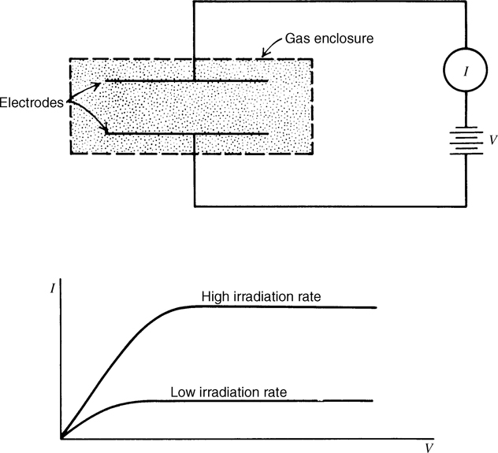
Basic Components of AN Ionization chamber
Common Fill Gases: Ar, He, H₂, N₂, Air, O₂, CH_{4,} TE
Notes:
Basic elements of I.C. - enclosed volume of gas in region where E-field is applied by an external voltage.
Basic process – radiation interacts with gas molecules generating e-ion pairs. E-field separates positive and negative (e) ions and are collected at the electrodes. Measuring the current generated by these pairs – IONIZATION CURRENT due to radiation interaction with sensitive gas volume.

Slide 4
Ionization in Gases
  To create an ion pair, a minimum energy equal to the ionization energy of the gas molecule must be transferred
  Ionization energy between 10 to 25 eV for least tightly bound electron shells for gases of interest
    Competing mechanisms such as excitation leads to incident particle energy loss without the creation of ion pair
  W-value: average energy lost by incident particle per ion pair formed
  Typical W-values are in the range of 25 – 35 eV/ion pair
Notes:
b/c incident particle also loses energy by other mechanisms, ex. excitation

Slide 5
Charge Collection
  Under steady-state irradiation, rate of ion-pair formation is constant
  For a small test volume, rate of formation will be exactly balanced by rate at which ion pairs are lost from volume due to recombination, diffusion or migration from the volume.

Slide 6
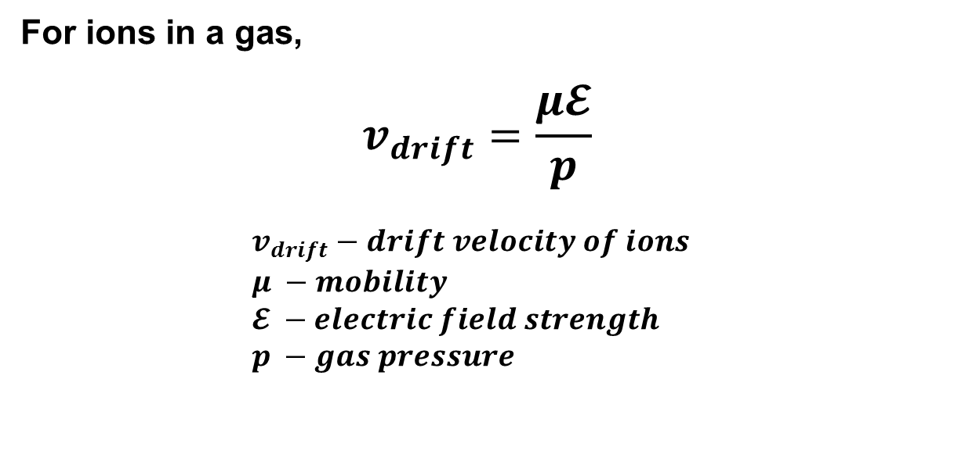
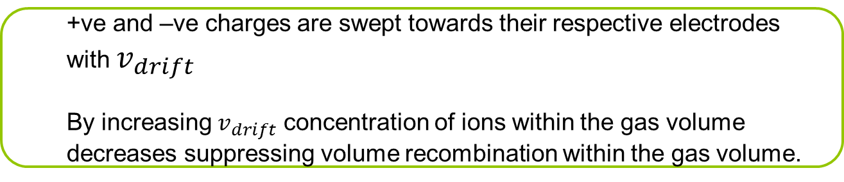
Charge Collection
For ions in a gas,
$$v_{drift}=\frac{μ𝓔}{p}$$
$$v_{drift}−drift velocity of ions \\ μ −mobility \\ 𝓔 −electric field strength \\ p −gas pressure$$
  +ve and –ve charges are swept towards their respective electrodes with $v_{drift}$
  By increasing $v_{drift}$ concentration of ions within the gas volume decreases suppressing volume recombination within the gas volume.
Notes:
E/p – reduced electric field
Ex. At 1 atm, E=10^4 V/m, v_drift ~1m/s This is a very long transit time in a detector volume with cm range, Transit time = 10 ms.
So what can we do? - Collect electrons – much faster drift velocities.

Slide 7
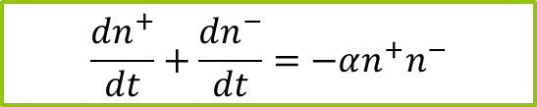
Recombination
Two types of recombination:
  Columnar (or initial) recombination
      Increases with LET of Radiation
  Volume recombination
      Increases with dose-rate
$$\frac{{dn}^{+}}{dt}+\frac{{dn}^{−}}{dt}=−αn^{+}n^{−}$$
Notes:
Recombination rate, alpha – recombination coefficient, n+ density of +ve ions, n- density of –ve ions
Columnar – at incident particle track
Volume – after diffuse away from track location.

Slide 8
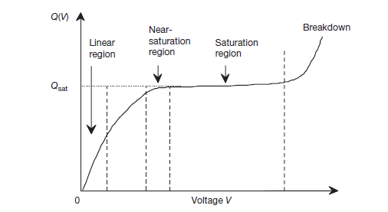
Charge collection

Slide 9
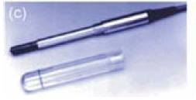
Ionization Chamber – FARMER Chamber

Slide 10
Ionization Chambers
What ionization current would we expect to measure in a Farmer chamber placed in a high energy photon radiotherapy beam where the dose rate to air is 10 Gy per minute.

Slide 11
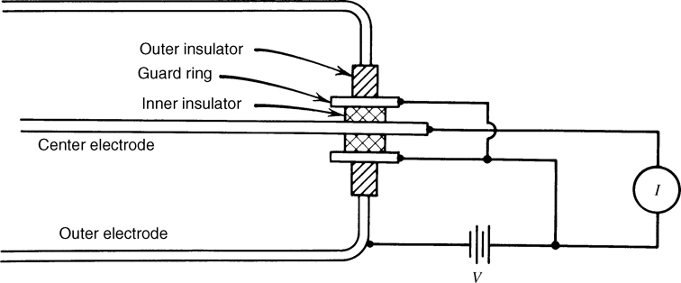
Insulators and Guard Rings
  Typical ionization currents are extremely small.
  Require good insulation and guard rings to ensure leakage current does not interfere with ionization current
Notes:
Insulators – high resistivity synthetic plastics
Radiation damage can occur when exposed to high radiation fields – use ceramics in detector design b/c ceramics have a higher resistance to radiation damage.

Slide 12
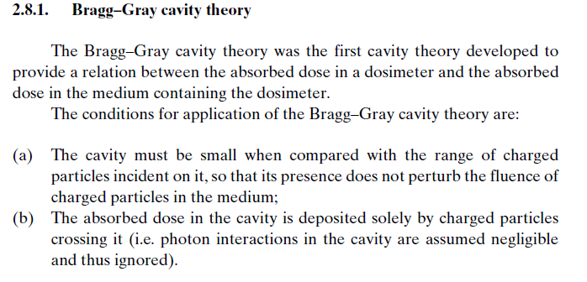
Ionization chamber dosimetry

Slide 13
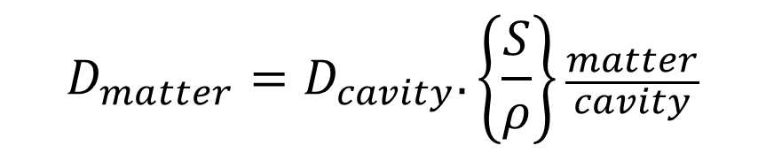
Dosimetry with ionization chambers
$$D_{matter}=D_{cavity}.\left\{\frac{S}{ρ}\right\}\frac{matter}{cavity}$$

Slide 14
Fano’s Theorem
In an infinite medium of given atomic composition exposed to a uniform field of indirectly ionizing radiation, the field of secondary radiation is also uniform and independent of density of the medium, as well as density variations from point to point.
This means that if an ionization chamber is constructed of a wall material and filled with gas of the same atomic composition the dose to the wall material will be the same as the dose measured to the gas regardless of the size of the chamber

Slide 15
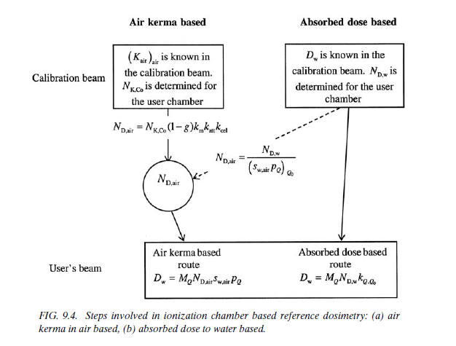
Ionization Chamber Dosimetry - calibration

Slide 16
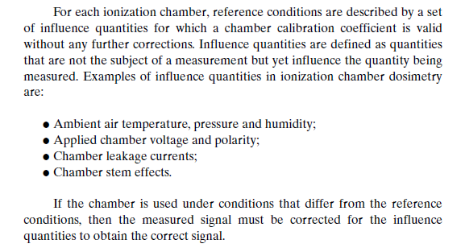
Ionization Chamber Dosimetry

Slide 17
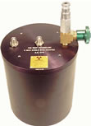
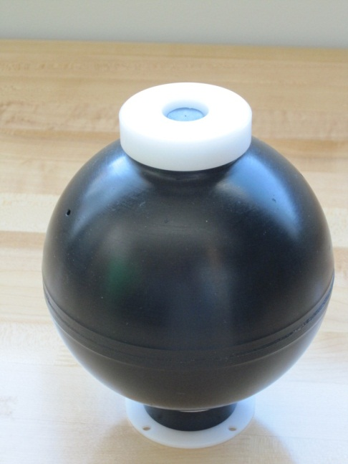
Dosimetry with gas ionization devises
TISSUE EQUIVALENT PROPORTIONAL COUNTERS TEPC

Slide 18
Atomic Composition of tissue and TE gas
Methane based
  CH₄ (64.4% partial pressure)
  CO₂ (32.4% partial pressure)
  N₂ (3.2% partial pressure)
  By %weight: H (10.2); C (45.6); N (3.5); O (40.7)
Propane based
  C₃H₈ (% partial pressure)
  CO₂ (% partial pressure)
  N₂ (%partial pressure)
  By %weight: H (10.3); C (56.9); N (3.5); O (29.3)
H | C | N | O
10.2 | 12.3 | 3.5 | 72.9
  ICRU Tissue (Muscle) atomic composition by % weight

Slide 19
Tissue equivalent plastic
  The main tissue equivalent plastic used in dosimetry is A150.
  The atomic composition of A150 is close to tissue but has a higher percentage by weight of carbon, which makes it conductive.
A150 TE-plastic atomic composition by % weight
H | C | N | O
muscle (10.2) | muscle (12.3) | muscle (3.5) | muscle (72.9)
10.1 | 77.6 | 3.5 | 5.2

Slide 20
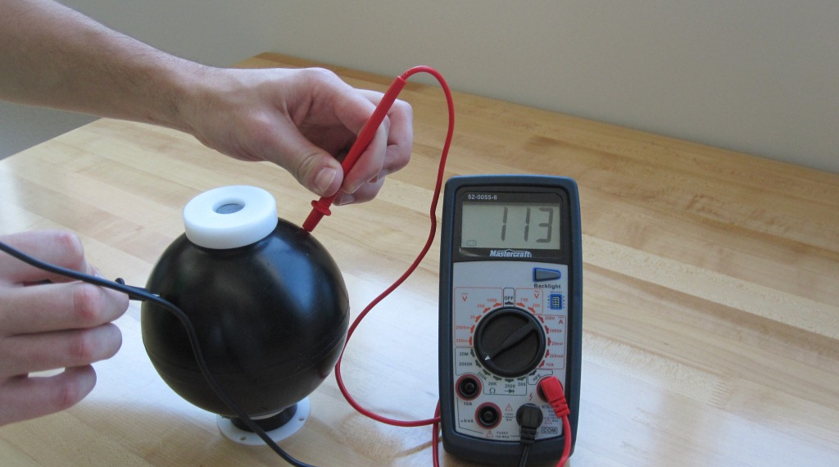

Slide 21
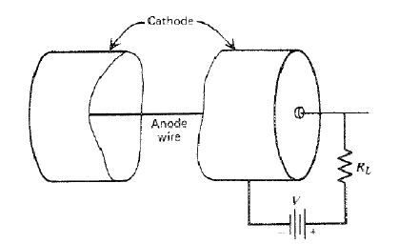
Gas-gain in proportional counters
  A proportional counter is a gas-ionization device consisting of a cathode, thin anode wire and fill-gas. Ionization in the fill gas is multiplied providing an amplified signal proportional to the original amount of ionization.

Slide 22
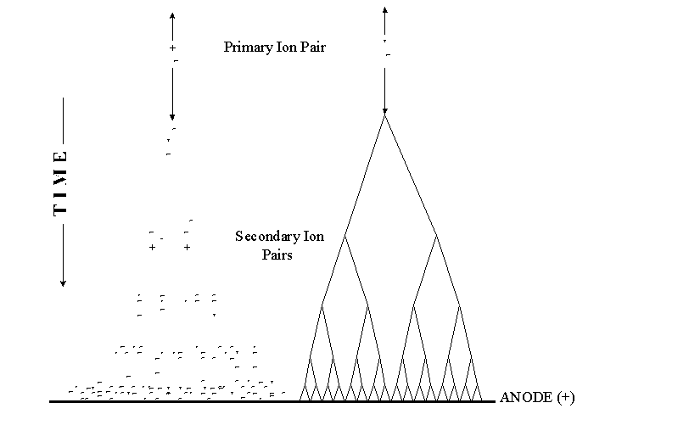
Gas Gain
  The gas-gain achievable in a proportional counter is determined by the first Townsend coefficient α for the counter fill gas used
  α itself depends on the reduced electric field in the counter, which is determined by the applied voltage and counter geometry

Slide 23
Gas Gain
  To a first approximation the relationship between the logarithm of gas-gain and applied anode voltage is linear

Slide 24
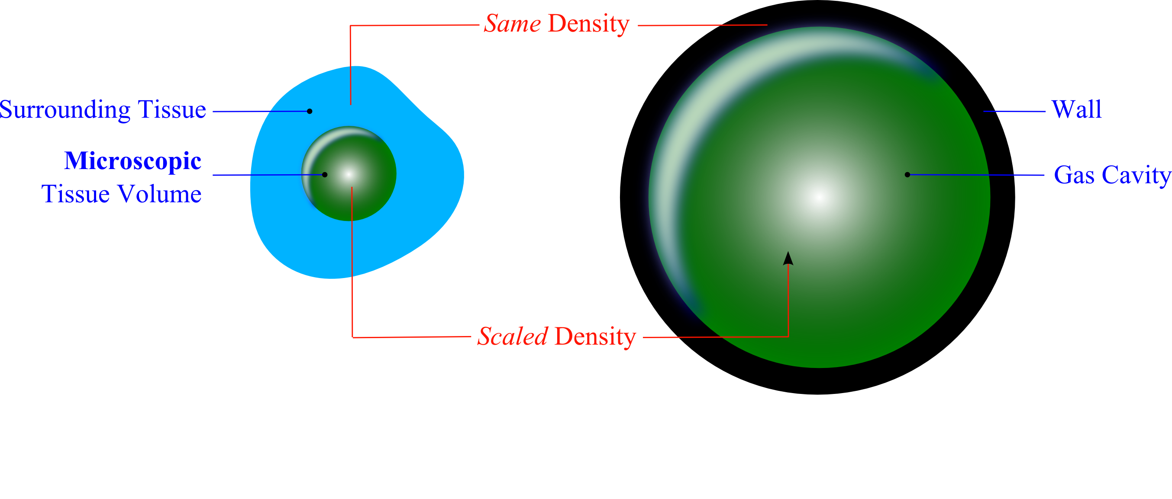
Simulation using a gas cavity

Slide 25
Site-size simulation
  Energy deposited in the gas cavity by a charged particle crossing the cavity equals energy deposited in tissue site by an identical particle
E_{t}
E_{g}

Slide 26
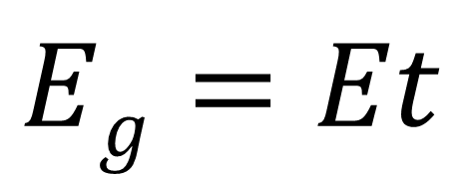
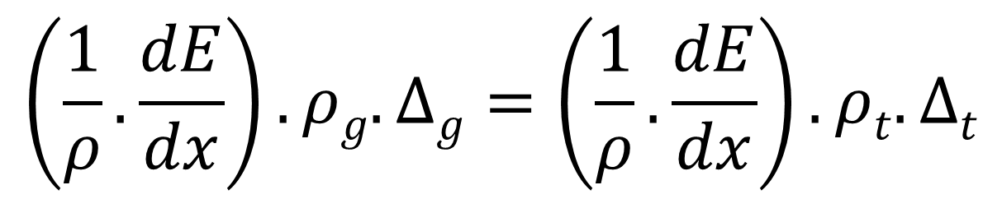
Site-size simulation
$$Eg=Et$$
$$\left(\frac{1}{ρ}.\frac{dE}{dx}\right). ρg.∆g=\left(\frac{1}{ρ}.\frac{dE}{dx}\right).ρt.∆t$$
gas
tissue

Slide 27
Site-size simulation
Diameter of Tissue Site
  The density of the gas in the cavity is adjusted to equal the ratio of the tissue site diameter to the gas cavity diameter
Density of Tissue Site (1000 kg.m⁻³)
Density of Gas
Diameter of Gas Cavity

Slide 28
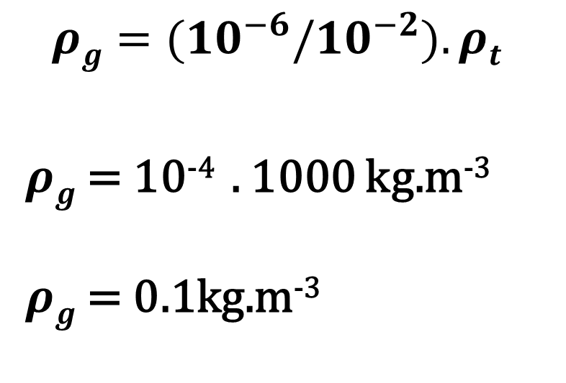
example
$$ρg={(10}^{−6}/{10}^{−2}).ρt$$
$ρg$ = 10⁻⁴ . 1000 kg.m⁻³
$ρg$ = 0.1kg.m⁻³
  What is the density of propane TE gas required for a 1 cm cavity to simulate a tissue sphere of 1 µm.

Slide 29
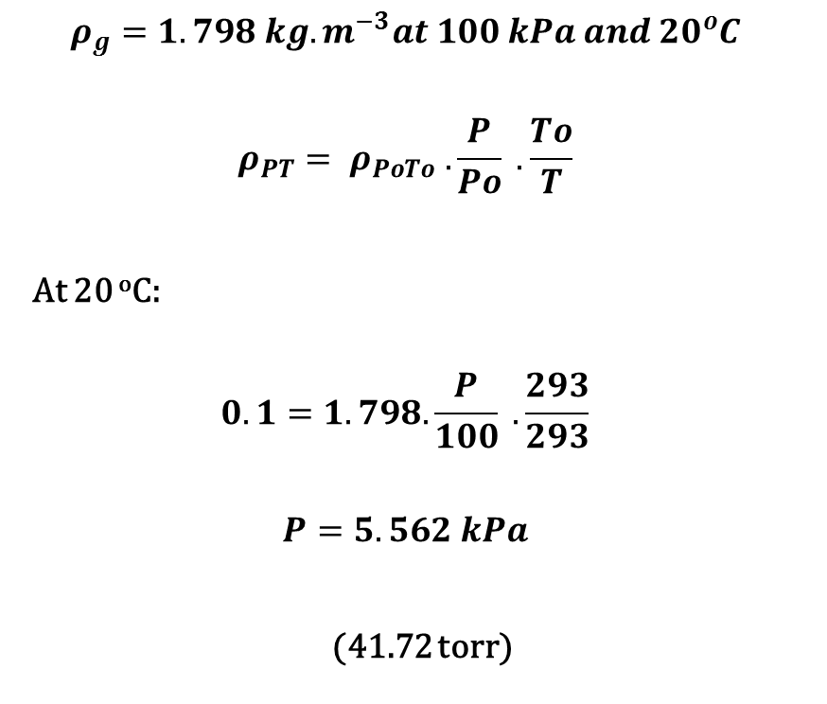
example
$$ρ_{g}=1.798 kg.m^{−3}at 100 kPa and 20{}_{}^{o}C$$
$$ρ_{PT}= ρ_{PoTo} . \frac{P}{Po} . \frac{To}{T}$$
At 20 ºC:
$$0.1=1.798. \frac{P}{100} . \frac{293}{293}$$
$$P=5.562 kPa$$
(41.72 torr)
  What pressure of propane TE gas is required for a density of 0.1 kg.m⁻³

Slide 30
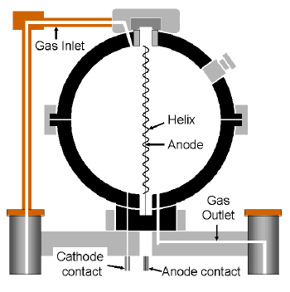
Rossi Counter

Slide 32
Tepc calibration
Internal alpha sources

Slide 33
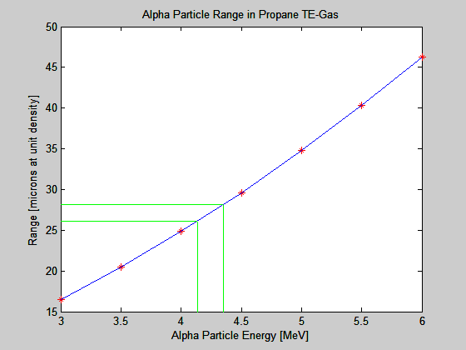
Internal source calibration
  In crossing the TEPC an alpha particle will lose an average amount of energy that can be calculated using range-energy data

Slide 34
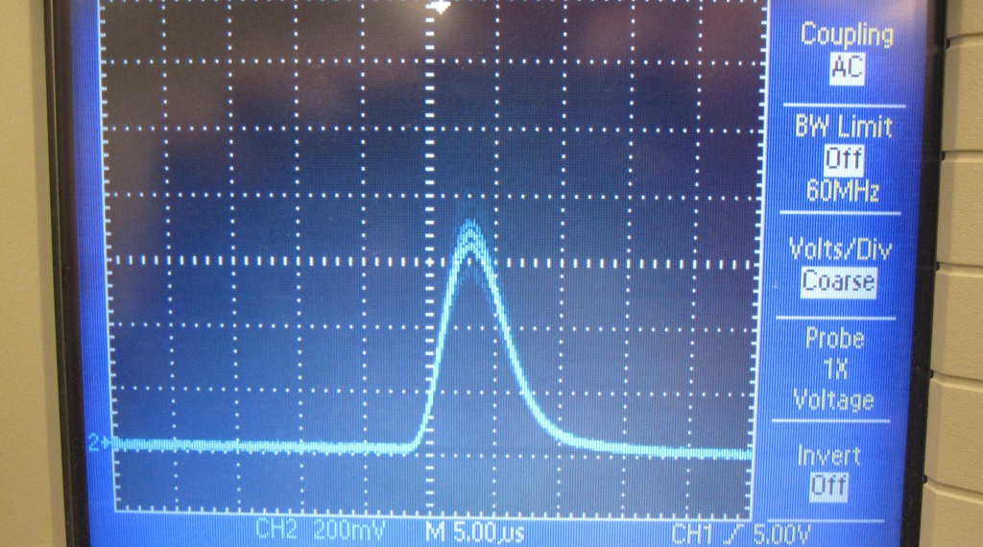
Internal source calibration
  Each alpha particle crossing the counter generates a pulse height proportional to the energy deposited; the mean of this distribution is associated with the mean energy deposited in the counter

Slide 35
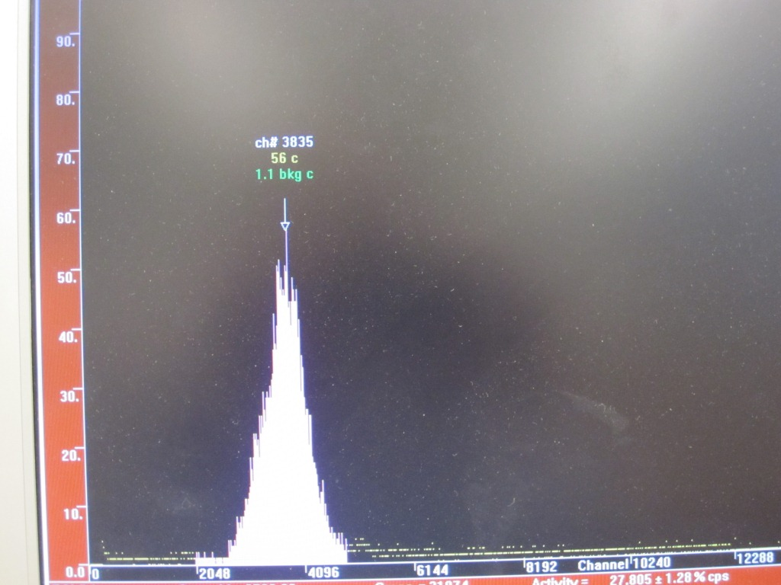

Slide 36
example
Applied Voltage 750V; amplifier gain 10
Mean energy lost 168.48 keV
Mean chord-length 1.33 µm
Channel 3835 corresponds to 126.68 keV/µm
Calibration Factor for amplifier setting of 10 (126.68/3835) = 0.03303 keV/µm/channel
  Using range-energy data for propane based TE gas for a 2 micron simulated diameter and a Cm-244 internal alpha source of energy 5.8 MeV.

Slide 37
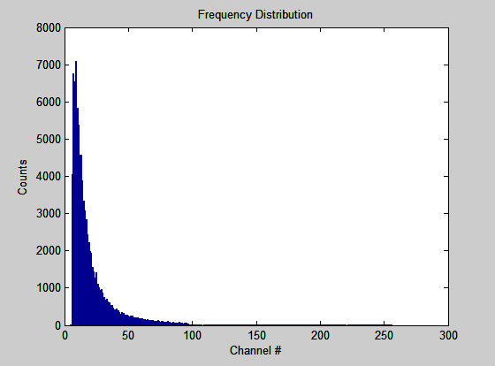
Frequency distribution measured in an Am-Be field with a 2” REM500 TEPC with simulated diameter 2µm and calibration factor 1.641keV/µm/chn

Slide 38
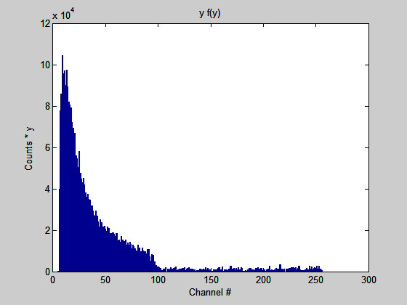
Frequency x lineal energy: Dose Distribution d(y) with calibration factor 1.641keV/µm/chn

Slide 39
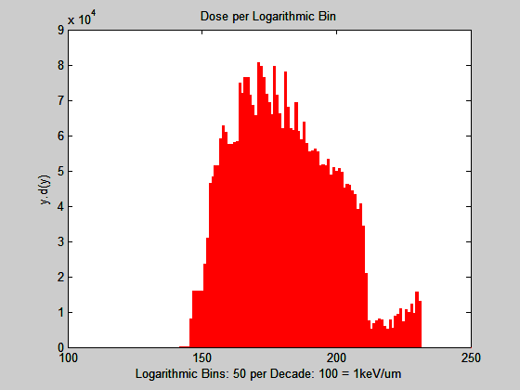
y.f(y) data plotted in equal logarithmic intervals, 50 per decade

Slide 40
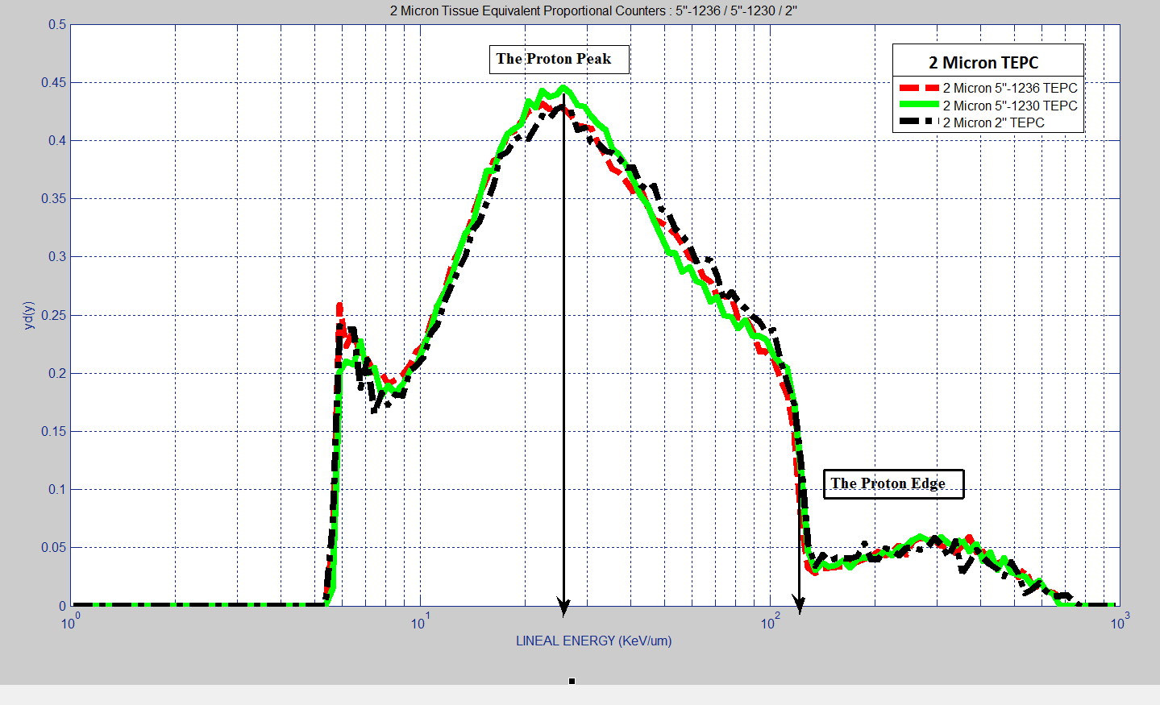

Slide 41
TEPC measurable quantities

Slide 42
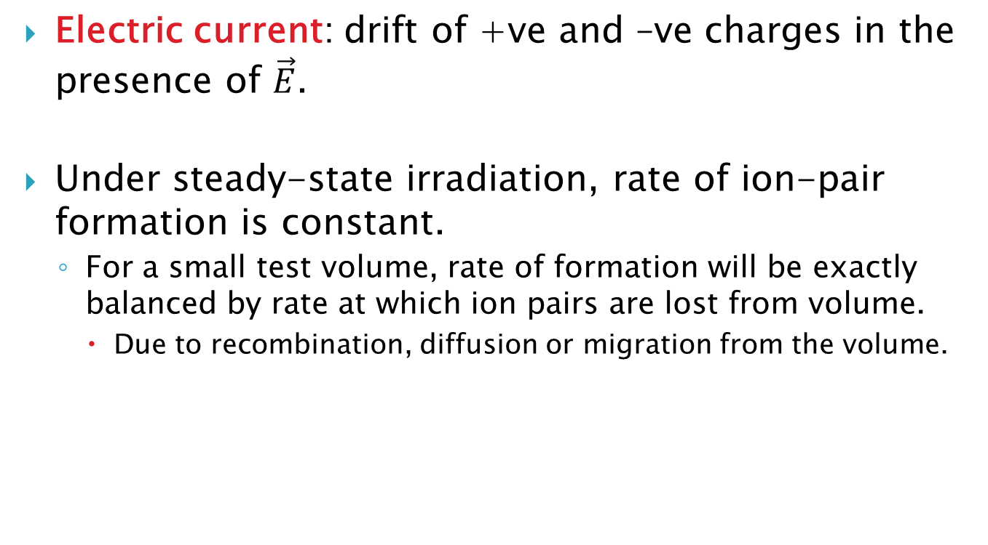
Measureable Quantities – Ambient Dose Equivalent
$$H^{∗}(10)=D^{∗}(10).\overline{Q}$$
Estimated directly from the measured event-size spectrum
Determined from the shape of the event-size spectrum and assuming Q(y) = Q(L)

Slide 43
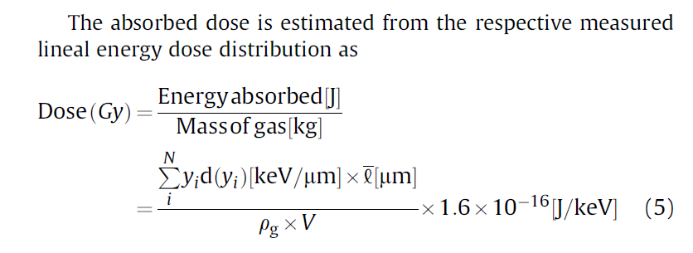
TEPC Measureable Quantities – Absorbed Dose

Slide 44
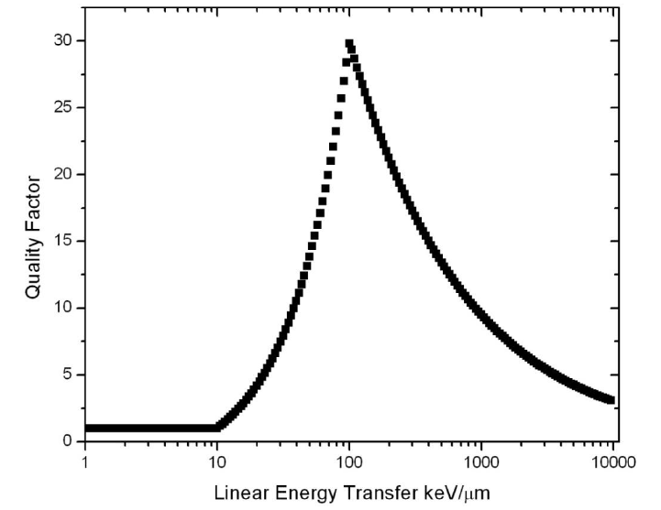
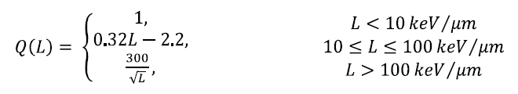
From ICRP 60

Slide 45
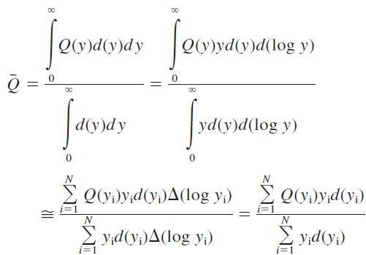
Assuming that Lineal Energy y is equal to Linear Energy Transfer L

Slide 46
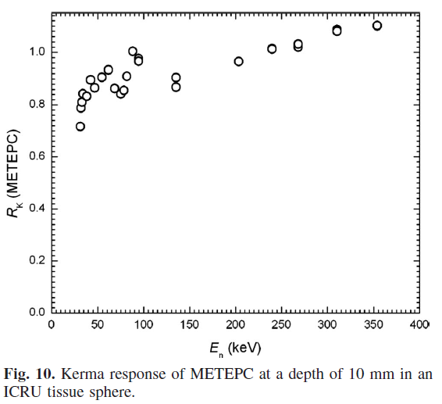
TEPC Response – Kerma

Slide 47
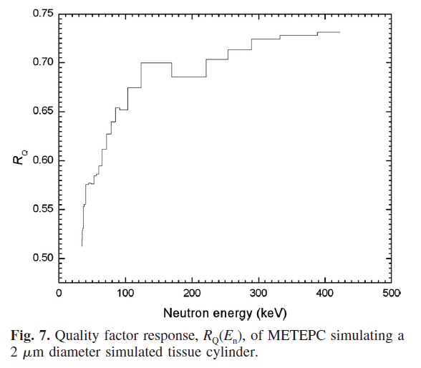
TEPC ENERGY RESPONSE – Quality Factor

Slide 48
Detectors other than tepcs
Gas Electron Multipliers

Slide 49
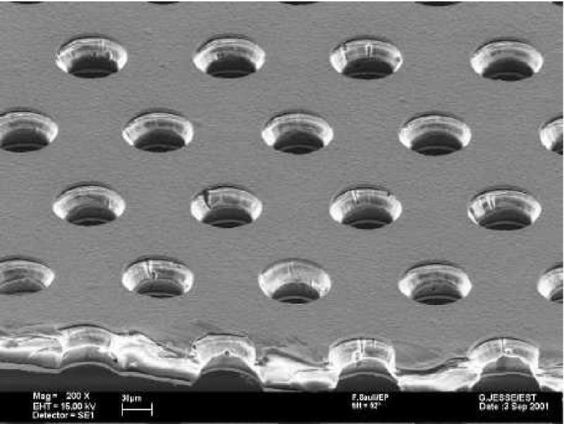
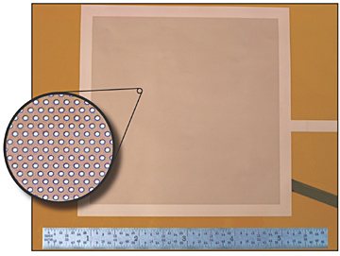
GEMs

Slide 50
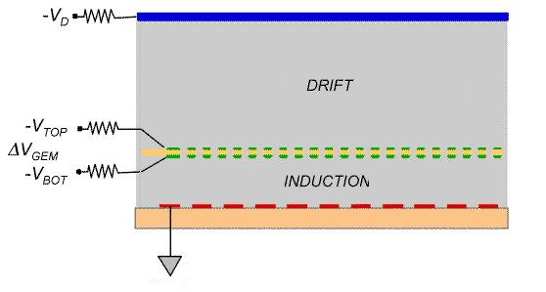
Gas Electron Multiplier
  Operates as proportional counter except multiplication takes place between the top and bottom surfaces of the GEM structure through microscopically etched holes

Slide 51
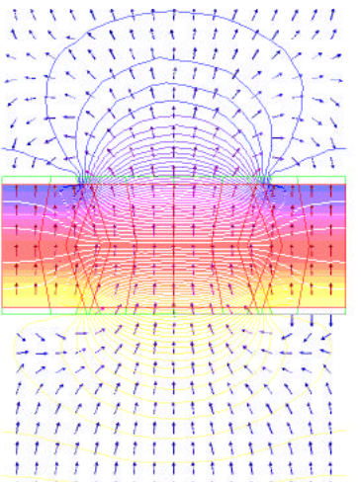
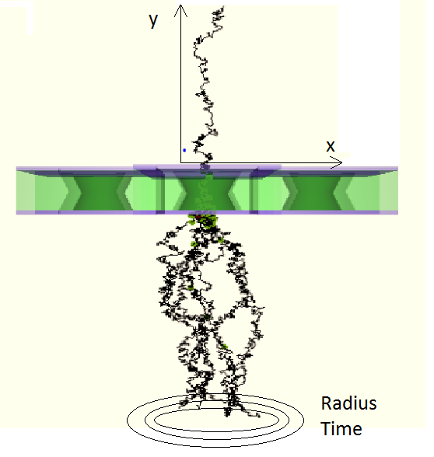

Slide 52
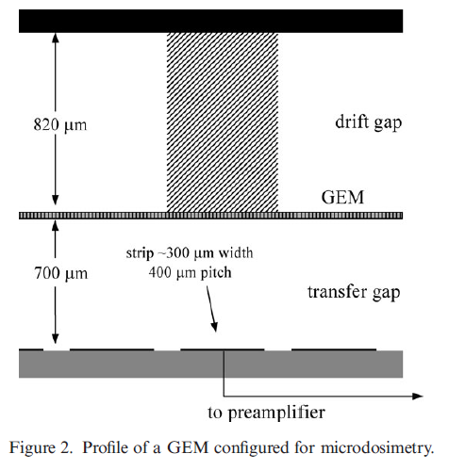
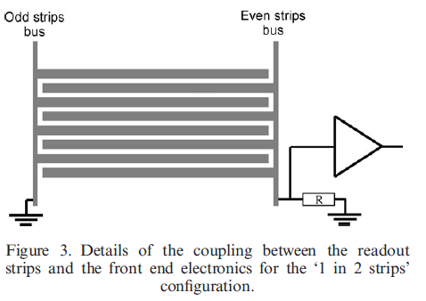
Dubeau and Waker Radiat. Prot. Dosim. 128(4), 2008

Slide 53
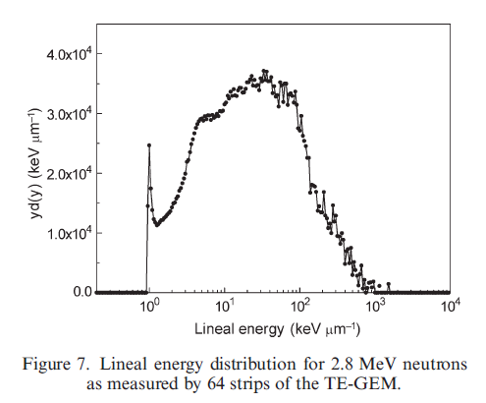
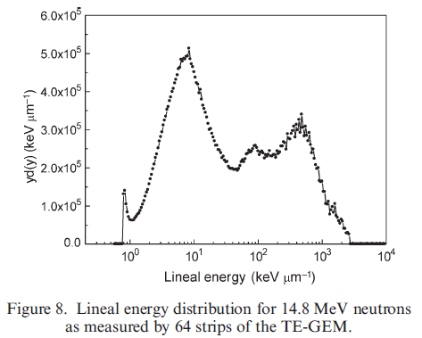
Dubeau and Waker Radiat. Prot. Dosim. 128(4), 2008

Slide 54
Gem summary
  GEMs can be configured to operate as TEPC and have the advantage of
    smaller physical size for each detecting element and smaller simulated diameters for improving dose equivalent response (better LET spectrometers)
    Potential for basis as a personal neutron dosimeter
  Particle tracking capability depending on read-out pattern of anode
  Much work still to be done!

