Slide 1














TRAINING COURSE on radiation dosimetry:
Instrumentation 2 – Solid state detectors
Hybrid pixel detectors and their applications
Thilo MICHEL, University of Erlangen-Nuremberg
Thu. 22/11/2012, 10:00 – 11:00 am

Slide 2
Agenda
The Medipix/Timepix detector
Energy response
Application: Imaging spectroscopy at high flux
Application: Material resolved imaging
Application: Dosimetry
2

Slide 3
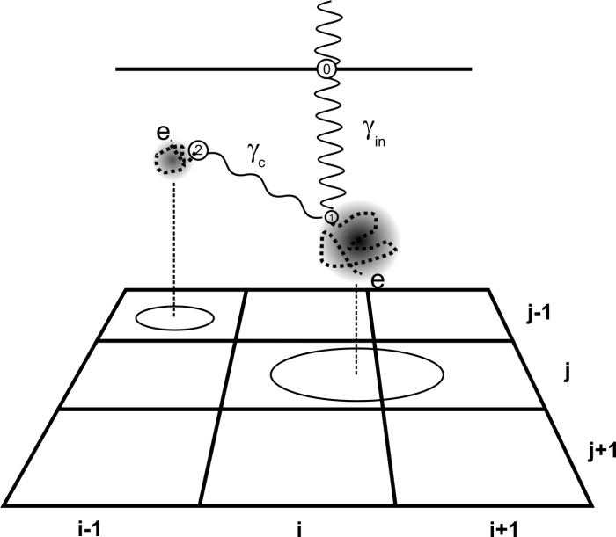
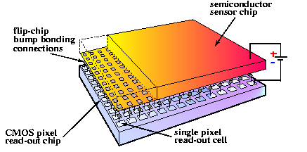
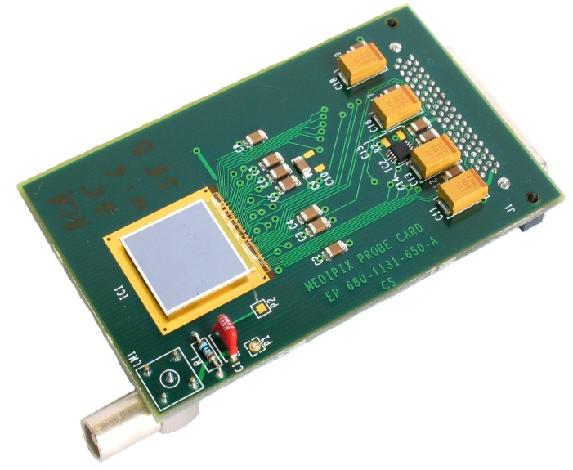
The Medipix2/3 and Timepix detectors: hybrid photon counting pixel detectors
E
ASIC/Sensor:
  Development: International Collaboration
  with seat at CERN
  Bump-bonded with Pb/ Sn
  65536 pixels in 256 columns and 256 rows
  Pixel pitch: 55 µm
  Size of the matrix: 14 mm (2 cm²)
  0.25 µm CMOS
Sensor:
  Materials: Si, GaAs, CdTe
  Bias voltage: 150 V (300 µm Si)
  2x2-version (Quad)
14 mm
3

Slide 4
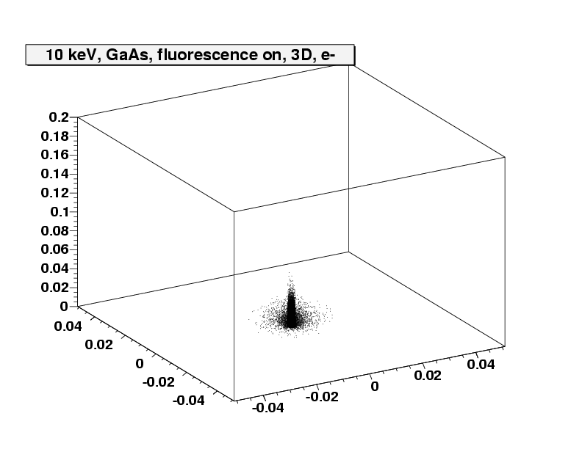
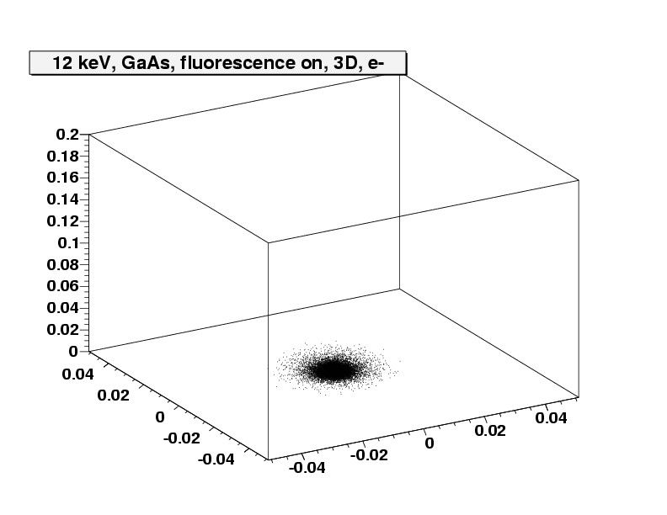
Step 1a: photoabsortion + relaxation
GaAs (Z=31, 33)
10 keV
12 keV
z [mm]
z [mm]
y [mm]
y [mm]
x [mm]
x [mm]
Photon
Energy not suffcient to remove e- from K-shell
Longer penetration depth
Production and detection of fluorescence photons and Auger electron emission
Smaller penetration depth
Broader transversal profile

Slide 5
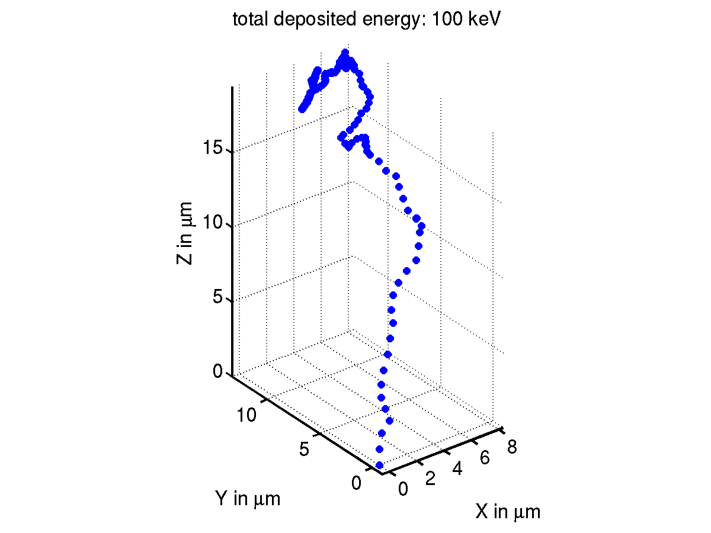
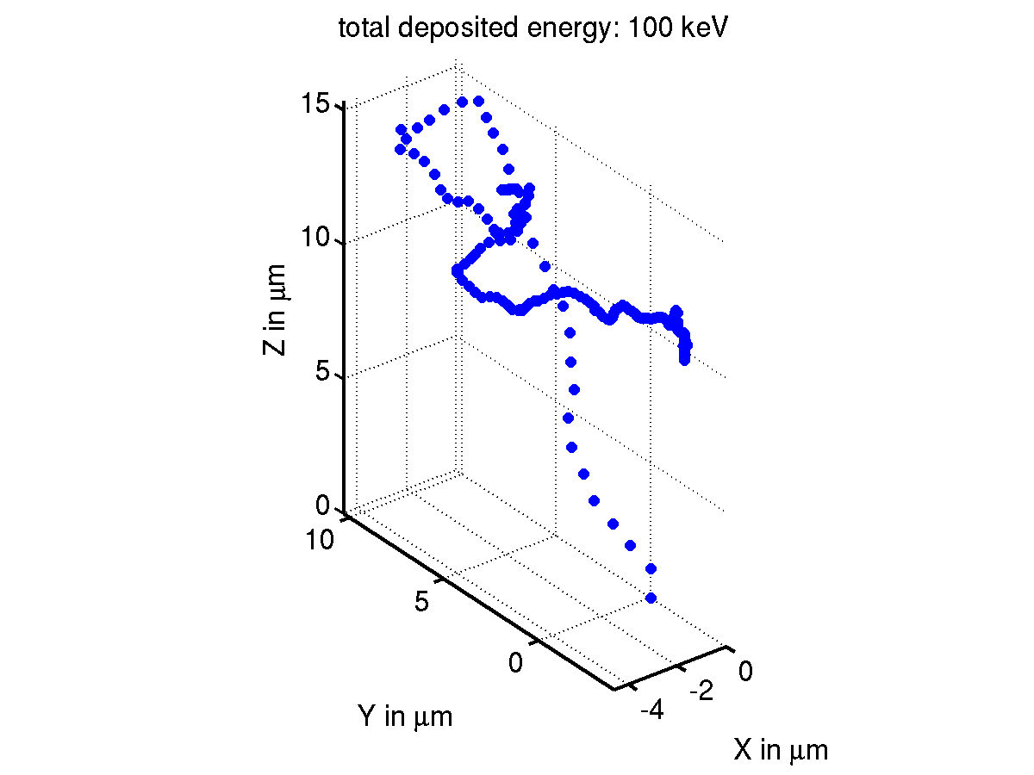
Step 1b: Continuous energy loss of electrons
Electron-hole
pairs are
generated
Contiouous energy loss: Bethe-Bloch-Fomula
For silicon: electron path length approximately

Slide 6
Step 2: Drift and diffusion of released charge carriers in semiconductor
Transport of charge carriers described by differential equation
Charge carrier density
change
Diffusion term
Charge generation
term
Drift term
Limited lifetime term

Slide 7
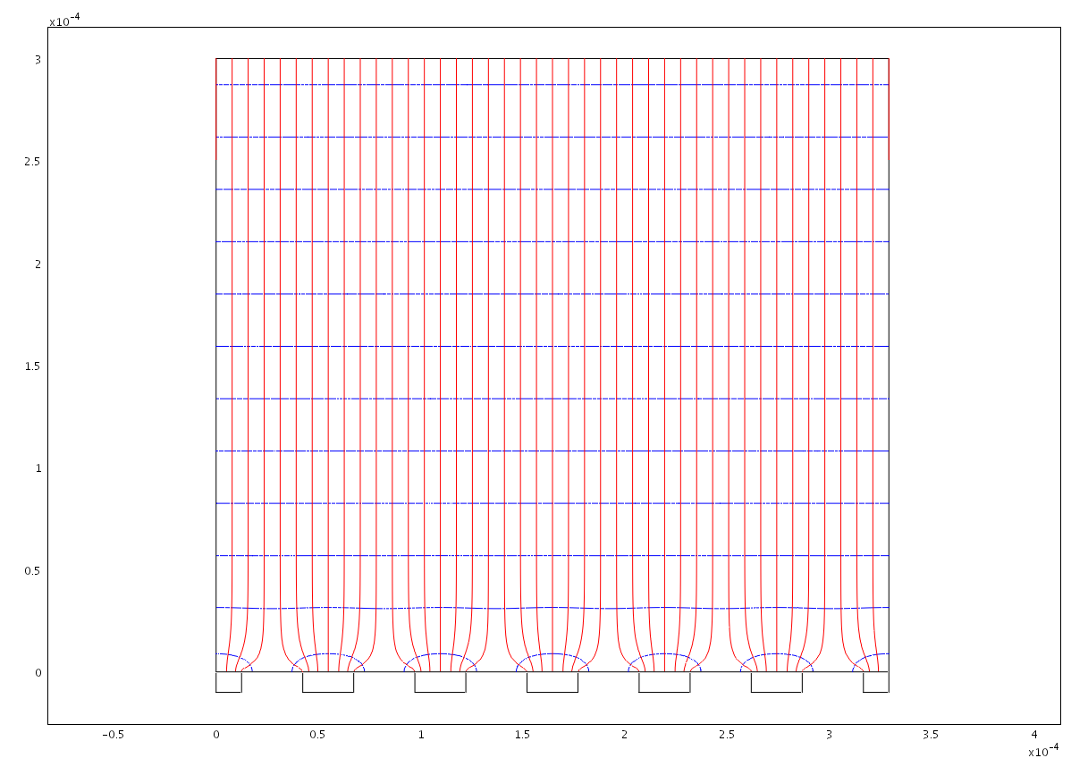
Step 2: Drift and diffusion of charge carriers
+ 150 V (for example)
Electric field lines
Electrons for example
Holes for example
Electric potential
Charge might be shared between
several pixels (charge sharing,
charge splitting)
Pixel electrodes at approx. 0 V
Attention: Do not forget the second charge carrier type

Slide 8
Step 3: signal generation in pixel electrode
Influenced current
Weighting potential
Charge above electrode influences mirror
charge in all pixel electrodes
Charge carrier moves -> mirror charge changes
A current flows in or out the pixel electrode
Pixelelectrode at is put to norm weighting potential
Other electrodes to 0:
Solve Laplace equation:
Obtain weighting-Field:
+
Attention: electrons AND holes influence both a current with same polarity!!!

Slide 9
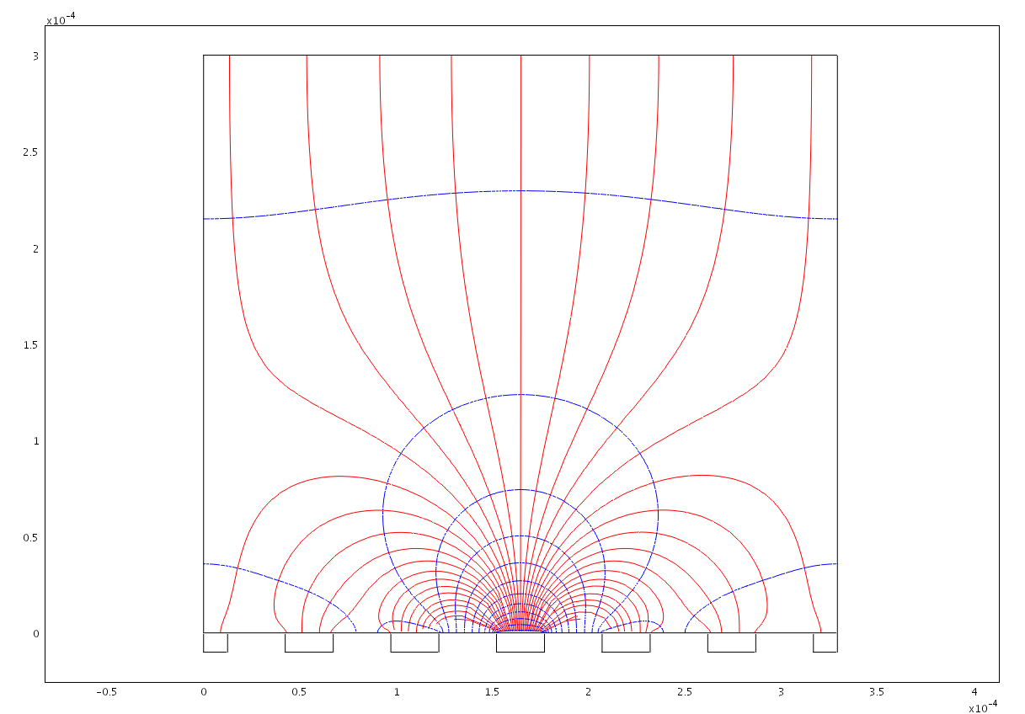
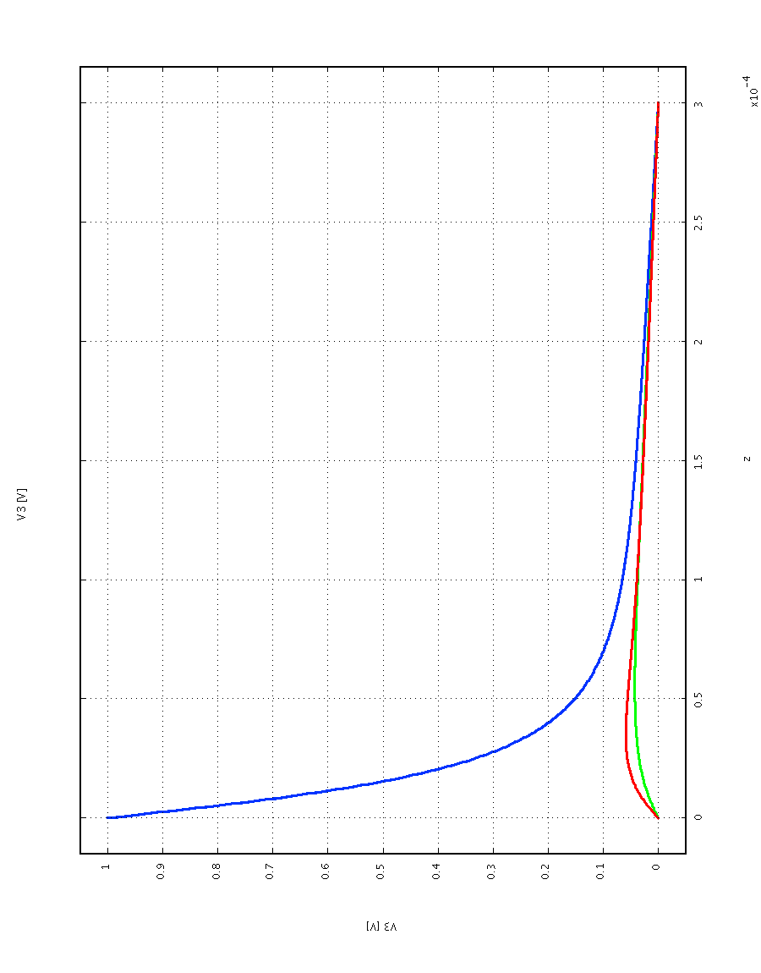
Step 3: The weighting field above a pixel electrode
Electric field
Weighting field
Central pixel
Neighbours
Attention: The charge carrier type drifting to pixels contributes most!!!

Slide 10
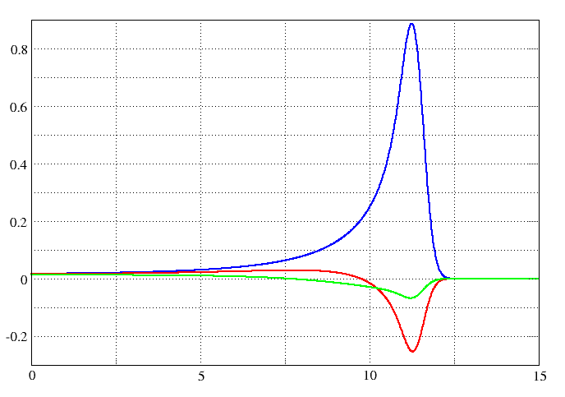
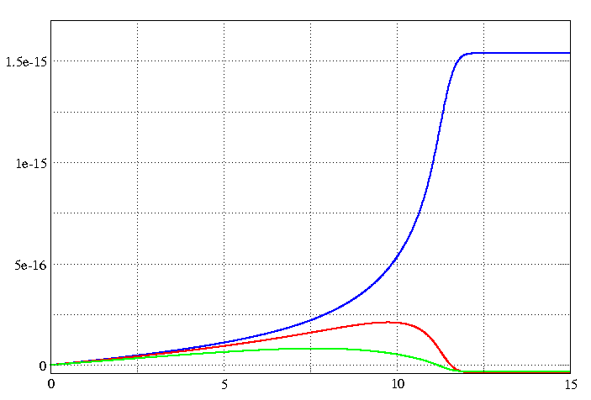
Step 3: the pulse-forms of the influenced currents
Electric field
I [µA]
Q [C]
t [ns]

Slide 11
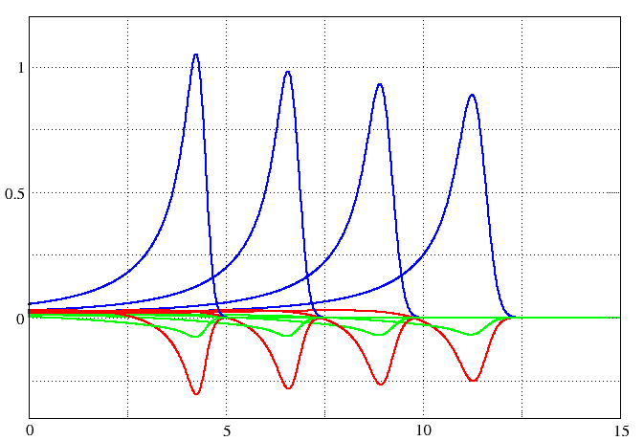
Step 3: Pulseform depends on point of generation of charge carriers
Start near pixel
electrode
Start near common
electrode
I [µA]
Drift time t [ns]

Slide 12
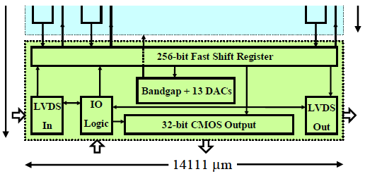
Step 4: integrate current and process digitally
Pixel electronics
Principle
Pixel electronics
  Charge-Sensitive Preamplifier
  1 discriminator
  (minimum threshold approx. 1000 e- = 3.6 keV in Si and
  4.4 keV in CdTe)
  1 counter per pixel
Operation modes
  Counting
  Time-Over-Threshold
  Time-Of-Arrival
14 bits
Pixel cell
Readout zone block diagram
12

Slide 13
Advantages and disadvantages of the Medipix detector in X-ray imaging
Advantages
Disadvantages
Noiseless dark field image
No readout noise
No blooming
No afterglow
Very linear at low rates
High position resolution
High frame rate
Energy sensitive
Small size
Charge-Sharing
Multiple counting reduces DQE
Rate limitations at high flux
(10¹⁰ photons/cm²/sec)
13

Slide 14
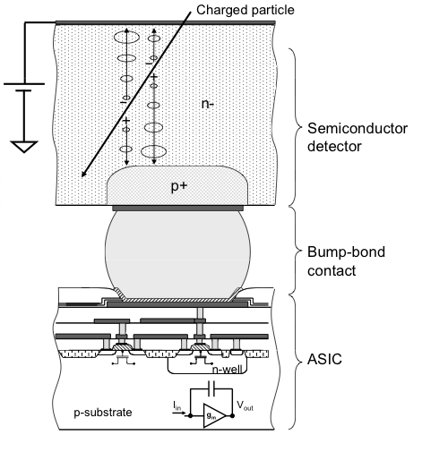
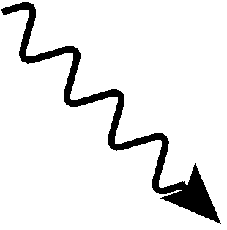
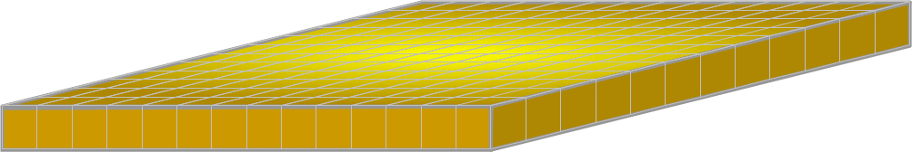
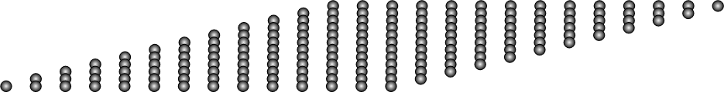
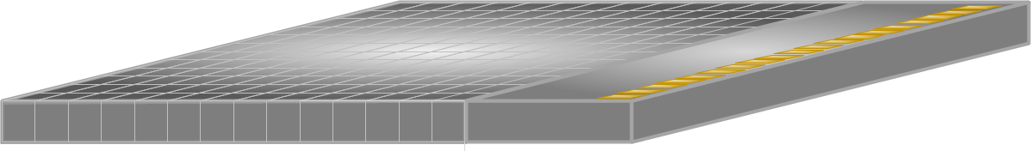



Working principle
V
Analogue
Threshold
t
*by Winnie Wong
14

Slide 15
Working principle
V
Analogue
Threshold
t
Start
Frame
End frame
Counting (Medipix2,3 & Timepix)
Time of Arrival (ToA) (Timepix)
Time over Threshold (ToT) (Timepix)
15

Slide 16
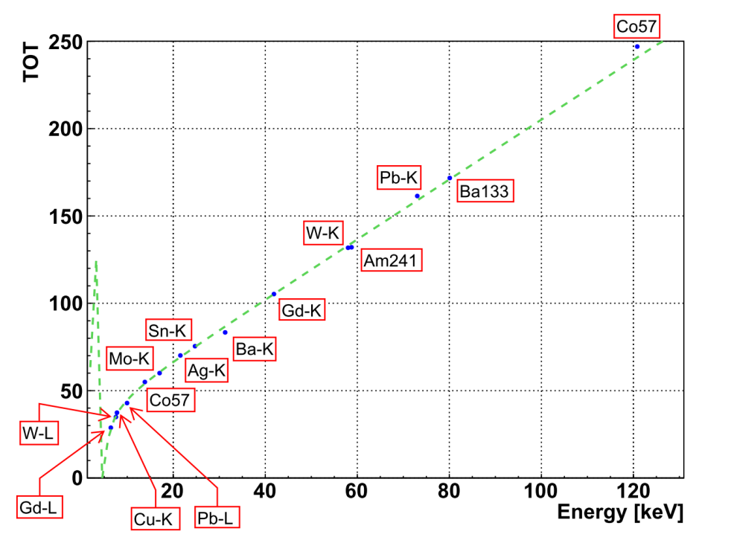
Pixelwise energy calibration for ToT mode necessary
Deposited energy in keV
16
Notes:
16

Slide 17
Agenda
The Medipix/Timepix detector
Energy response
Application: Imaging spectroscopy at high flux
Application: Material resolved imaging
Application: Dosimetry
17

Slide 18

Does it measure the impinging photon energy ?
Intensity
E_{γ}
E_{Fl.}
E_{γ} – E_{Fl.}
(Escape peak)
E_{Fl.}
Collected charge
Detector response affected by
Electronic noise
Fluorescence photon production
Charge Sharing
Compton scattering
18

Slide 19
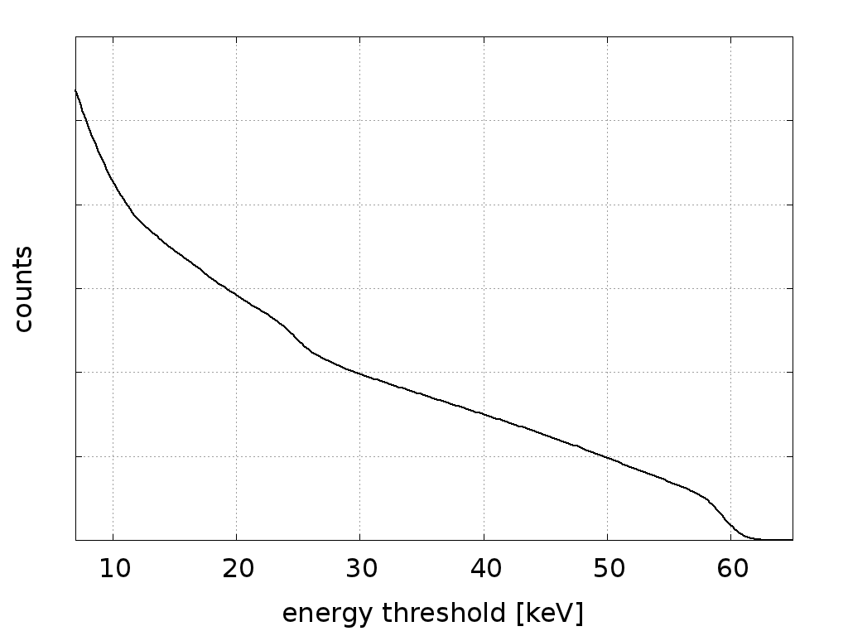
Threshold scan for 60 keV photons onto silicon sensor
19

Slide 20
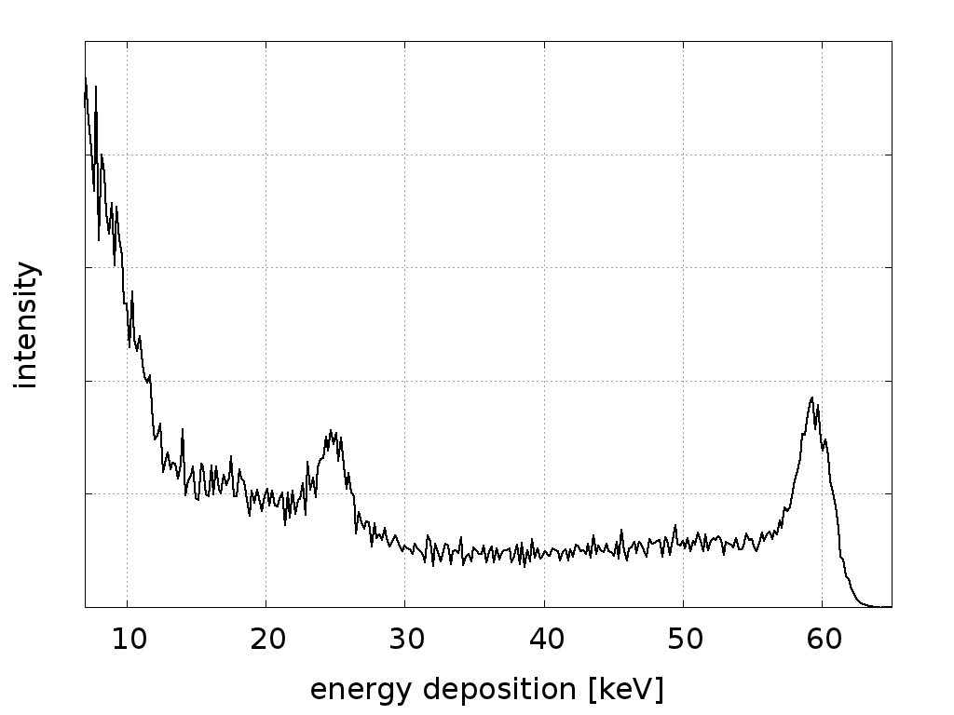
Differentiated threshold-scan = response function
Diffusion, electron track length, Compton scattering
Photoeffect
20

Slide 21
Response of a CdTe Medipix to X-rays
1.6 mm CdTe sensor
(220 µm pitch)
Noise edge
* Measurement
Simulation
Primary photon
energy
Fluorescence lines
of Cd and Te
Escape-
peaks
Number of events
In pixel deposited energy in keV (from tresholdscan)
21

Slide 22
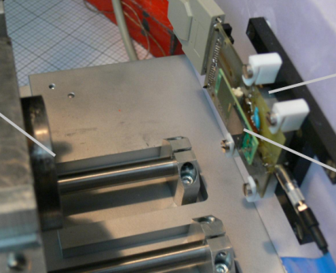
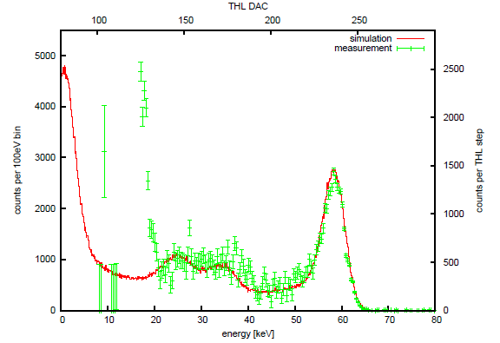
Simulation of response has to take many effects into account
Physics models needed for:
Experiments* / Simulations
Elektromagnetic interactions
Secondary radiation (fluorecences)
Tracking on µm-scale
Fano-Noise
Charge-Carrier respulsion
Isotropic diffusion during drift
Limited charge carrier lifetime
Electron+hole signal contribution
Electric field in doped CdTe
Electrode size, pitch (Weighting potential)
Electronics noise
Threshold dispersion
1.6 mm CdTe, 700 V
*) Experiments are performed with a CdTe detector made by the Freiburger Materialforschungszentrum
22

Slide 23
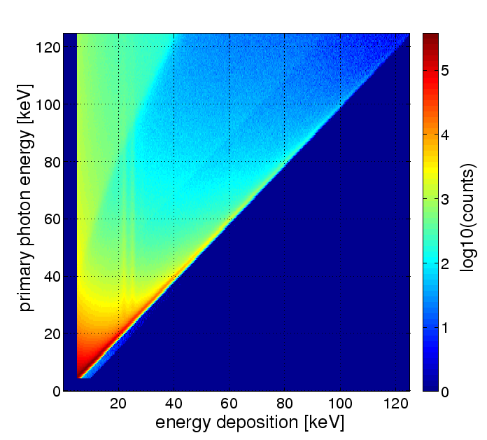
Response matrix for silicon sensor
Complete set of response functions
23

Slide 24
Agenda
The Medipix/Timepix detector
Energy response
Application: Imaging spectroscopy at high flux
Application: Material resolved imaging
Application: Dosimetry
24

Slide 25
Spectrum of deposited energies is a convolution of response with impinging spectrum
Impinging spectrum
Measurement (Threshold scan)
Response-Matrix
Possibilities to get impinging spectrum:
Pseudo Inverse Matrix
Spectrum-Stripping
Bayesian deconvolution
Courtesy: Peter Sievers (Physikalisch Technische Bundesanstalt PTB)
25

Slide 26
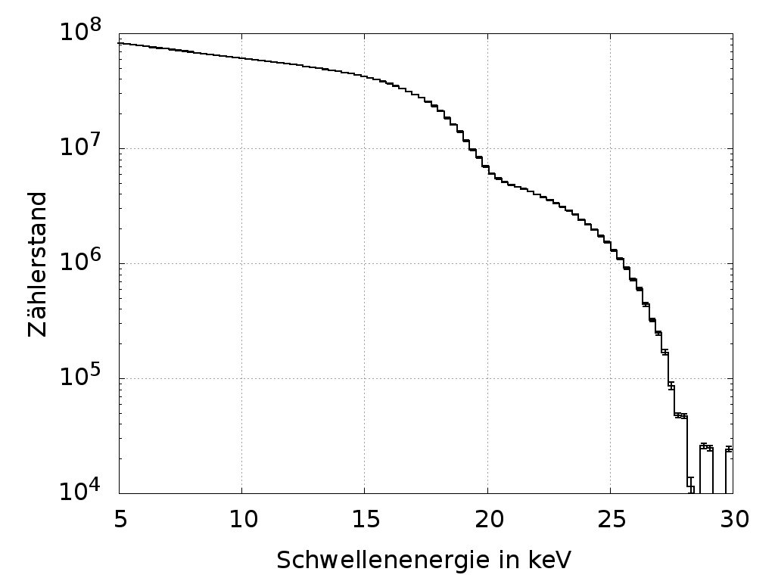
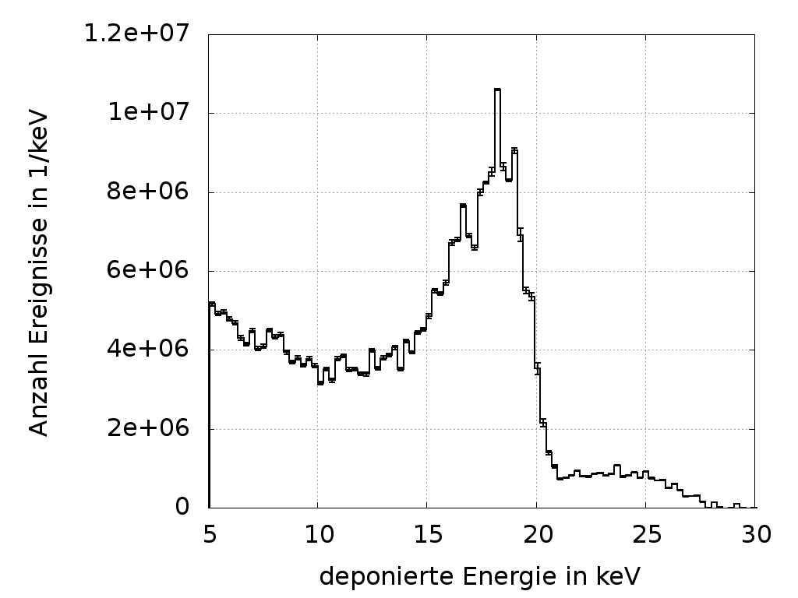
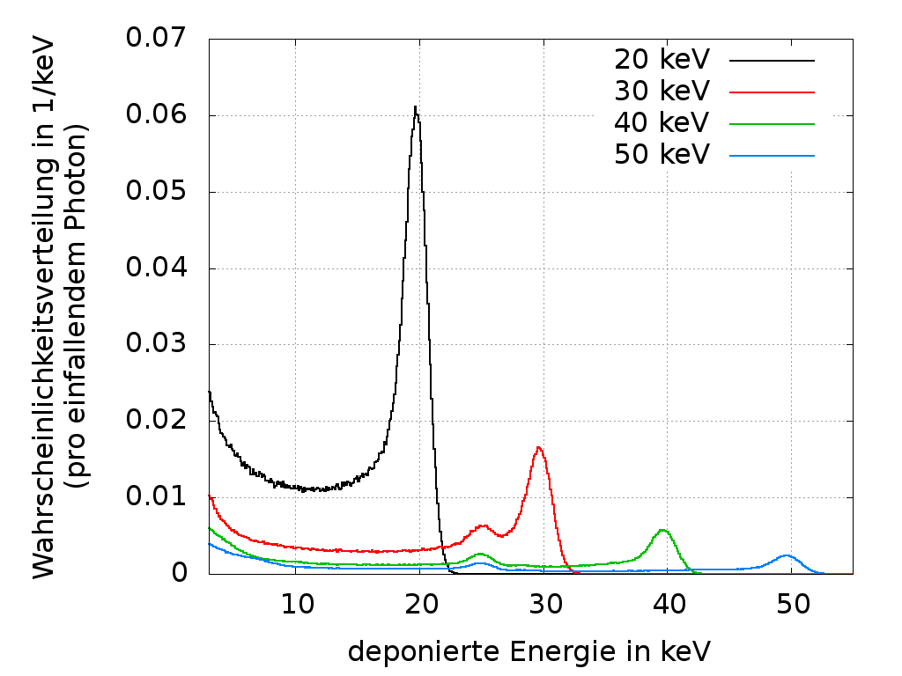
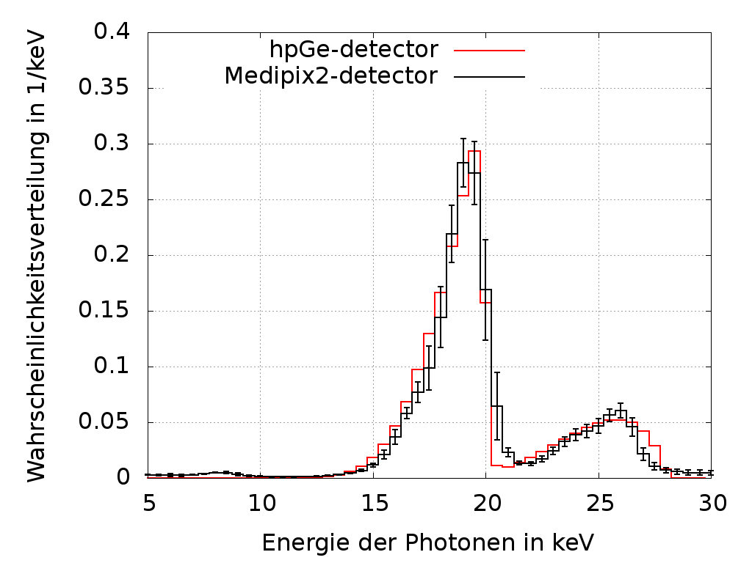
Differentiated threshold scans can be used for deconvolution, BUT ...
Measurement
Differentiate
Deconvolution
Simulation
Result
Courtesy: Peter Sievers (Physikalisch Technische Bundesanstalt PTB)
26

Slide 27
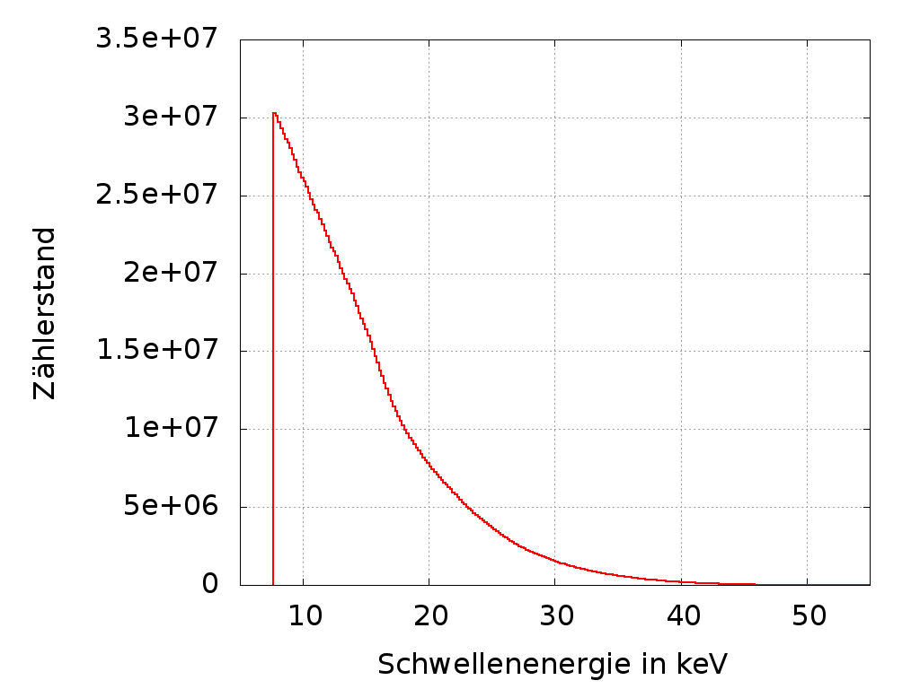
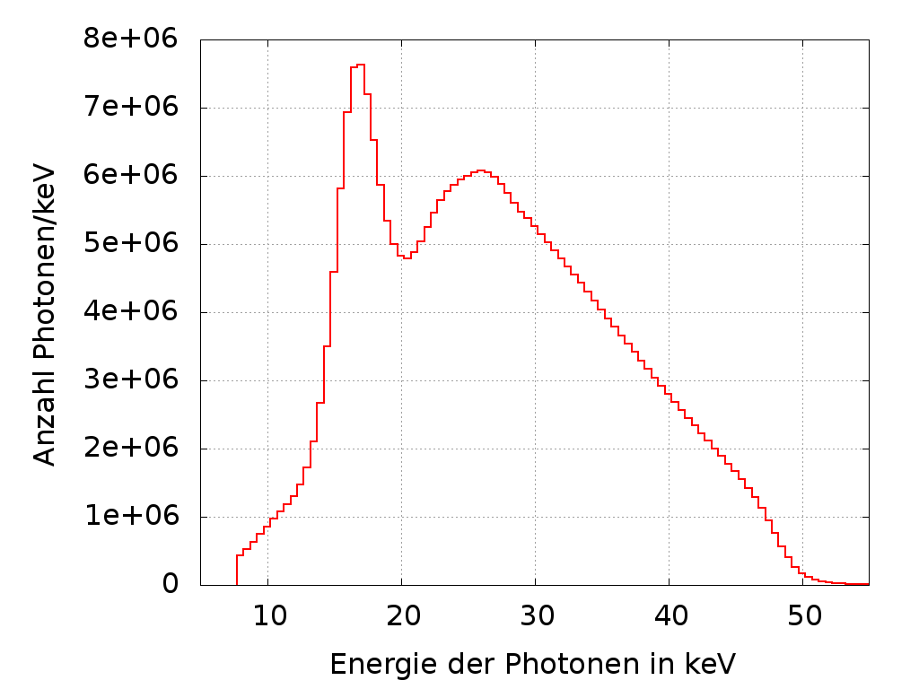
…it is statistically better to use threshold scans directly in Bayesian deconvolution
with
Courtesy: Peter Sievers (Physikalisch Technische Bundesanstalt PTB)
27

Slide 28
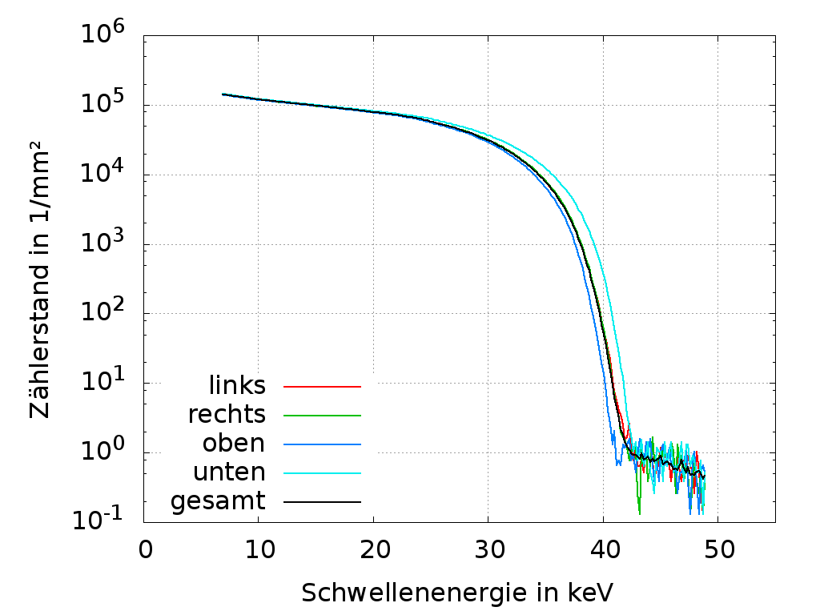
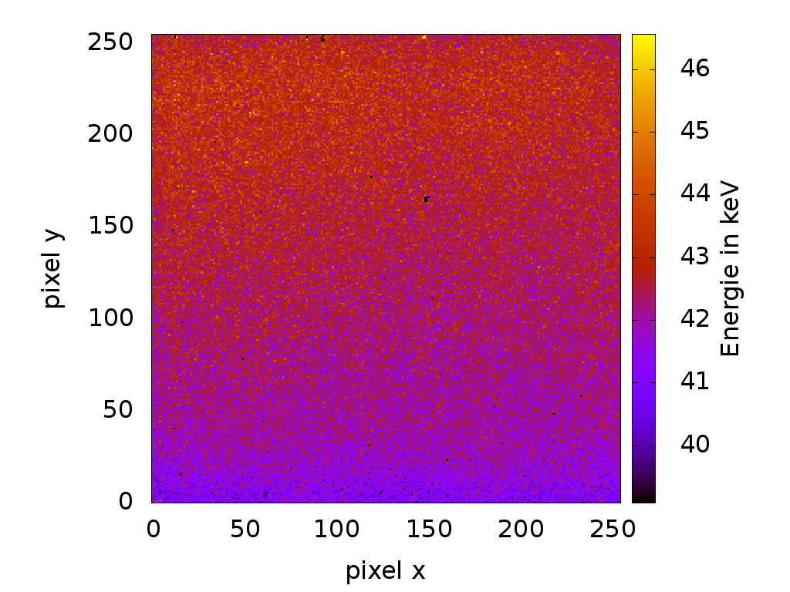
A difficulty: threshold dispersion among pixels
Measurement (N40
X-ray quality)
Global Kalibration of thresholds
Image at
42,5 keV threshold
Courtesy: Peter Sievers (Physikalisch Technische Bundesanstalt PTB)
28

Slide 29
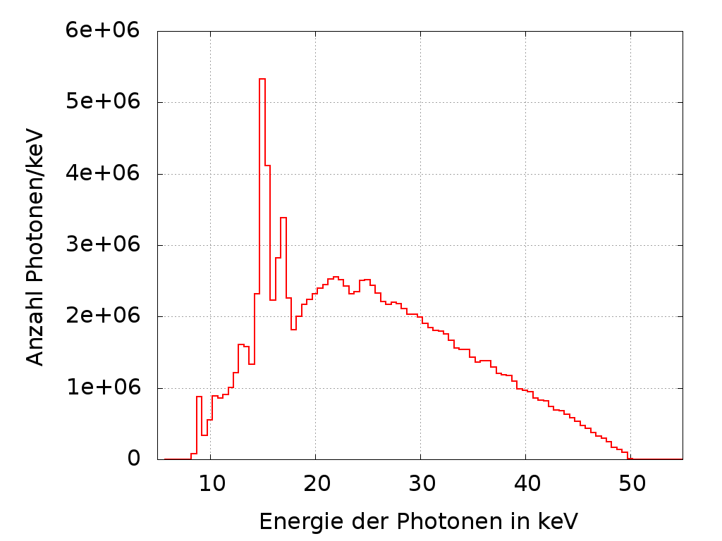
Improvement by pixelwise threshold calibration
Global calibration
(64k pixels and 1 calibration)
Pixelwise calibration
(64k calibrations)
Courtesy: Peter Sievers (Physikalisch Technische Bundesanstalt PTB)
29

Slide 30
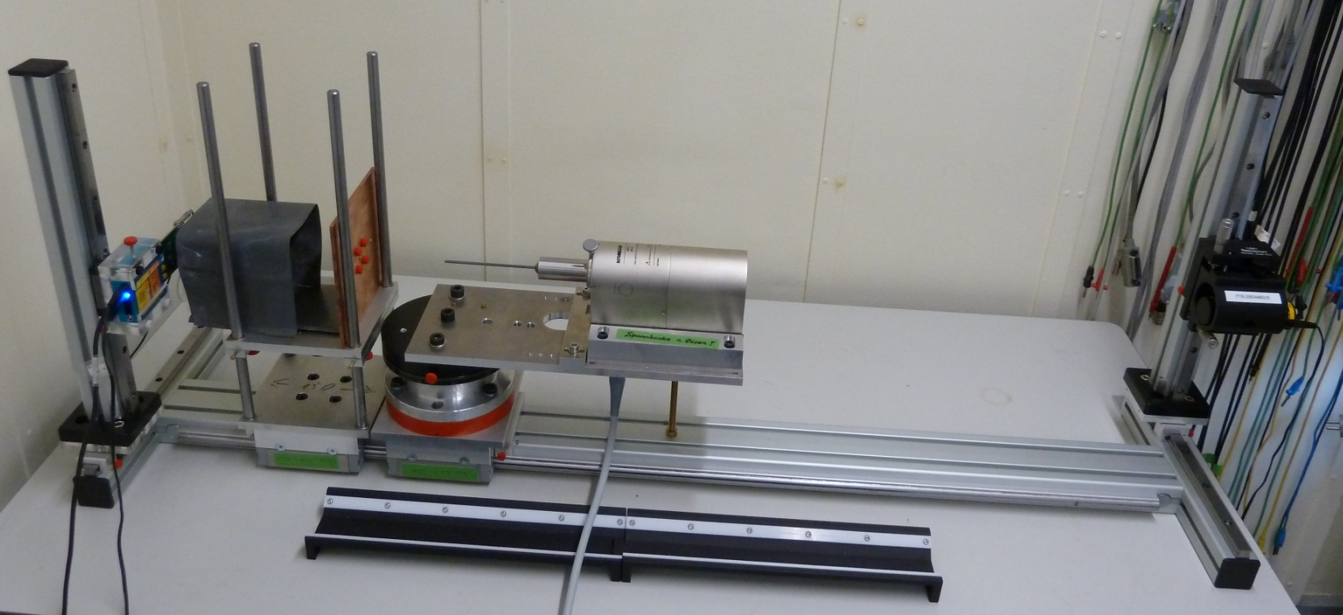
Spectral imaging with a brachytherapy X-ray tube
Tube-collimator: 10 cm
Collimator-detector: 30 cm
Hole in collimator: 50 µm
Collimator thickness: 1 mm
=> Magnification: 2.99
Acc. voltage: 50 kV
Current: 40 µA
Measurement time:
per threshold: 60 s
overall: 4,4 h
Courtesy: Peter Sievers (Physikalisch Technische Bundesanstalt PTB)
30

Slide 31
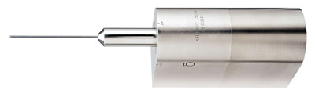
Camera obscura principle
Brachytherapy-
X-ray tube
γ
e⁻
2.8 mm
Timepix
Collimator
Tube
Courtesy: Peter Sievers (Physikalisch Technische Bundesanstalt PTB)
31

Slide 32
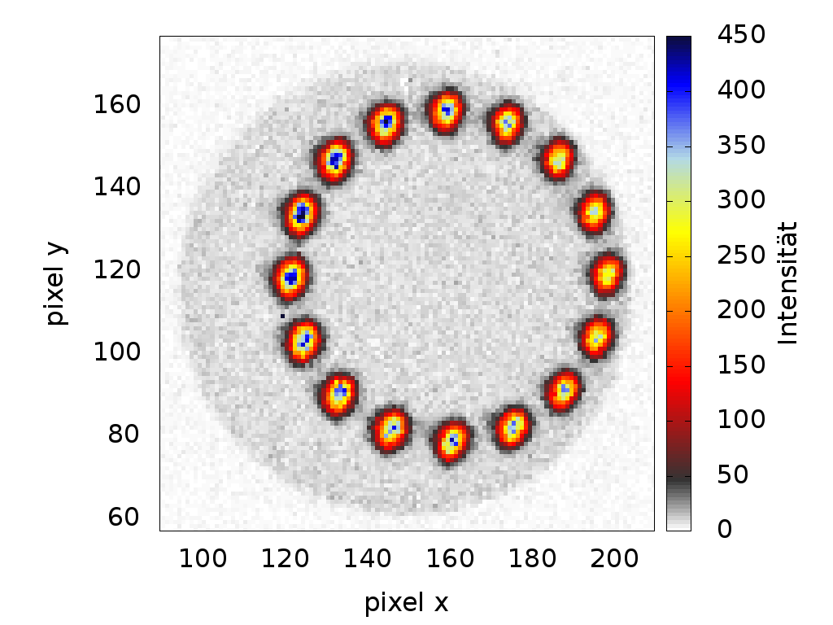
The electron beam moves around
Courtesy: Peter Sievers (Physikalisch Technische Bundesanstalt PTB)
32

Slide 33
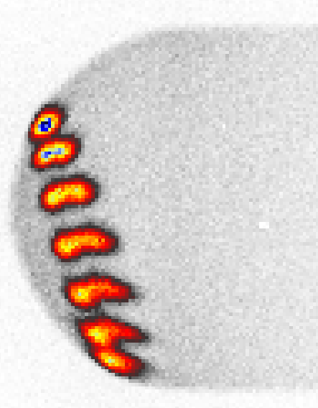
Look from the side: Misalignment of the target …
γ
Courtesy: Peter Sievers (Physikalisch Technische Bundesanstalt PTB)
33

Slide 34
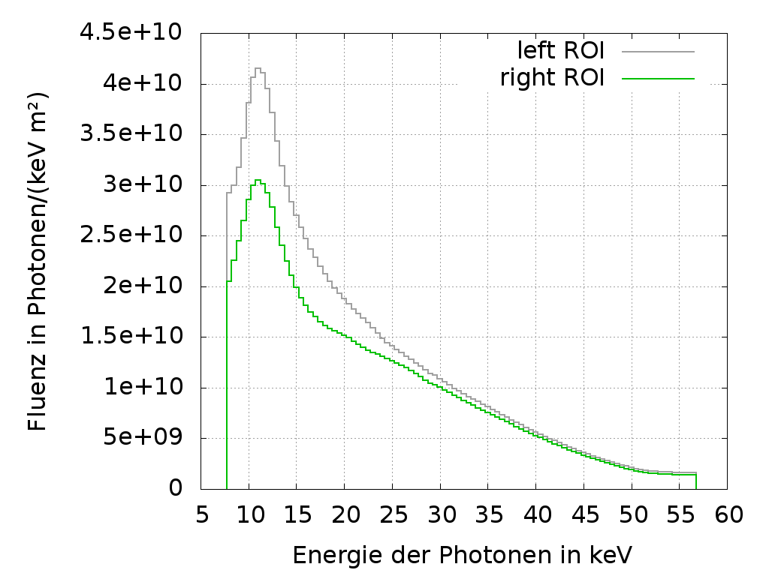
… causes differences in the spectrum
left ROI
right ROI
Courtesy: Peter Sievers (Physikalisch Technische Bundesanstalt PTB)
34

Slide 35
Agenda
The Medipix/Timepix detector
Energy response
Application: Imaging spectroscopy at high flux
Application: Material resolved imaging
Application: Dosimetry
35

Slide 36
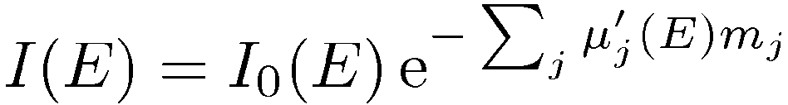





Principle of Material Reconstruction
X-Ray transmission through
a compound object
source
mass attenuation coefficient
areal density
index for basis materials
Detector
36

Slide 37
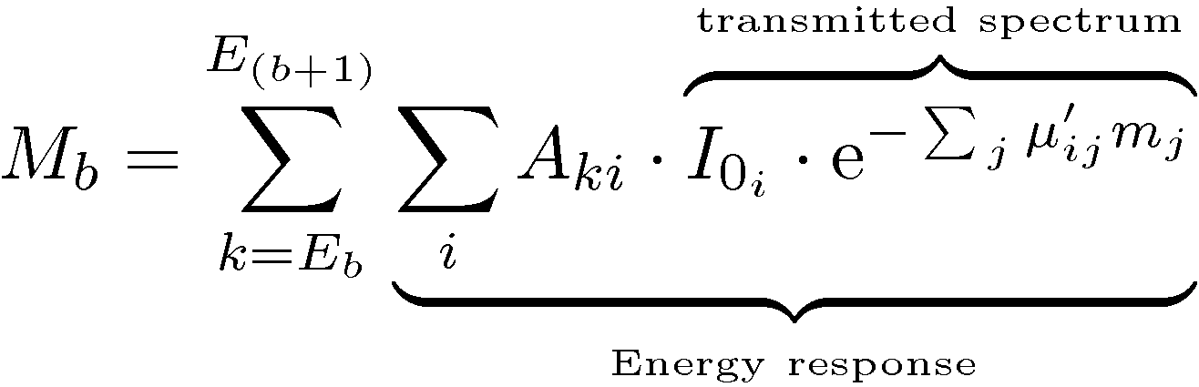
A method of material reconstruction without explicit spectrum reconstruction
Number of
counts in
energy
deposition
interval
Sum over
energy
depositions
in
interval
Sum
over
primary
energies
in
spectrum
Sum
over
materials
Vary to get best
agreement of M_{b}
and measurement
37

Slide 38
Measurement details
Tested with the MARS scanner together with the University of Canterbury, Christchurch, New Zealand
Medipix2 MXR, 300 µm Si sensor
Energy calibration with ²⁴¹Am, Gd- and Mo K-edges
Threshold equalisation mask generated with flatfield at THL approx. 35keV and not at the noise floor
Source: 0.1mA @75kV tungsten anode X-Ray tube
Acquisition at 4 THL values: 8, 20, 33 and 45keV with 2, 3, 4 and 5s duration respectively
3 detector positions and 180 projections (360 degrees)
38

Slide 39
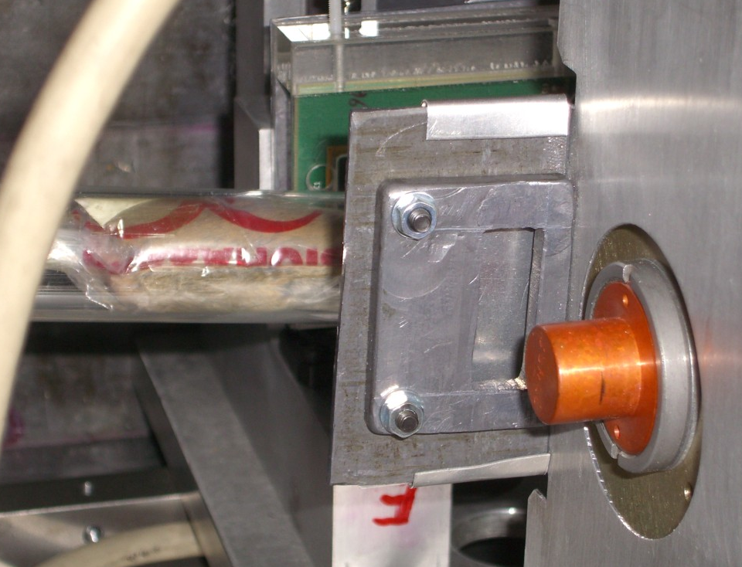
Experimental setup
Medipix2 MXR
Mouse inside
Perspex tube
0.5mm Al Filter
X-Ray source
39

Slide 40
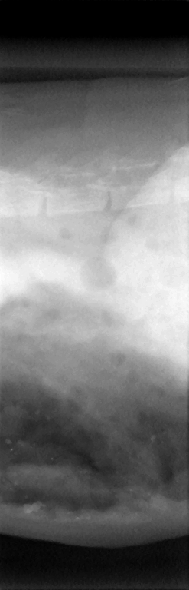
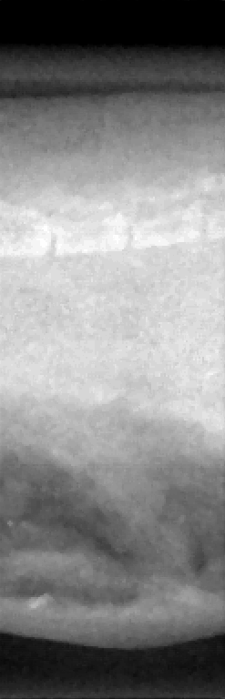
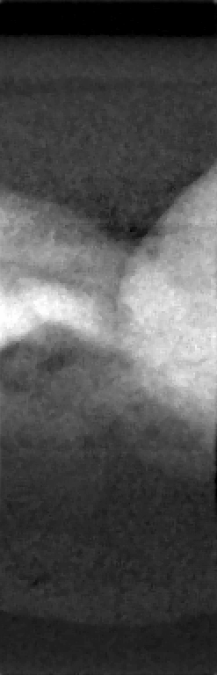
Material Reconstruction: Projections
Photon counting image
Non-iodine (water) image
Iodine image
40

Slide 41
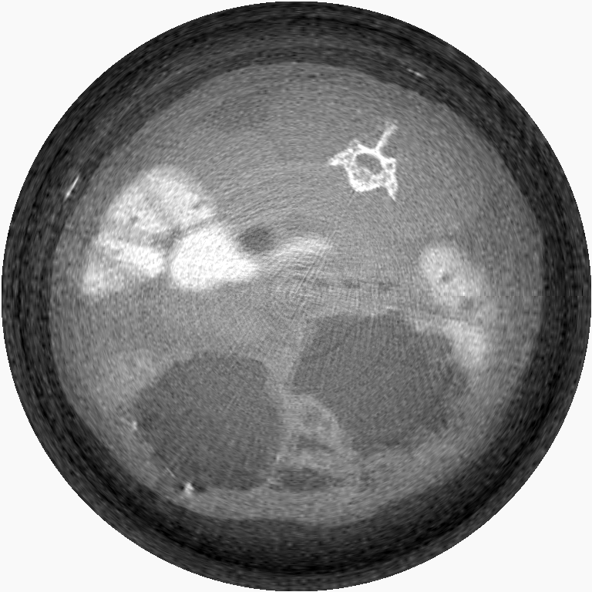
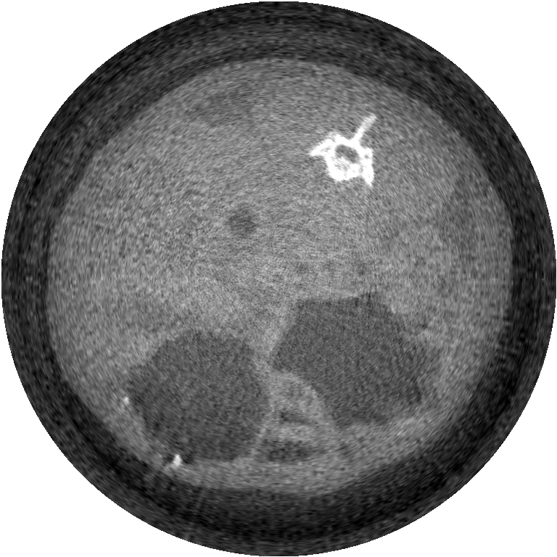
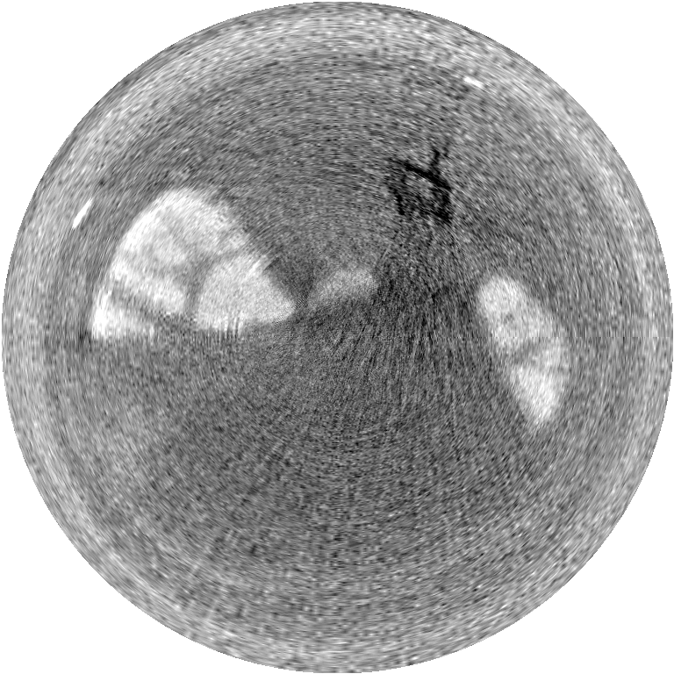
Material Reconstruction in CT: Brightness = density of base materials (g/cm³)
Photon counting at
8 keV threshold
iodine
water /
non iodine
Brightness = areal density of materials
41

Slide 42
Agenda
The Medipix/Timepix detector
Energy response
Application: Imaging spectroscopy at high flux
Application: Material resolved imaging
Application: Dosimetry
42

Slide 43
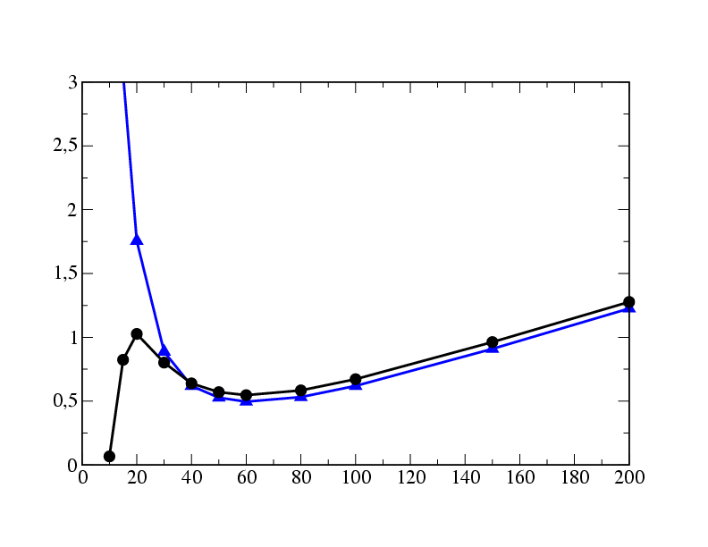
The personal dose equivalents Hp(10) and Hp(0.07)
Definition of
the personal dose equivalents
Photon energy dependence of personal dose equivalents ¹⁾
Dose:
H_{p}(d): dose in soft tissue in a
certain depth d [mm] of the
ICRU slab phantom
(30 x 30 x 15 cm³ PMMA)
To be measured with
an active personal dosemeter:
  H_{p}(10): Deep dose
  H_{p}(0.07): Surface dose
H_{p}(0.07)
H_{p}(d) / Fluence [pGy x cm²]
H_{p}(0.07) / Fluence
H_{p}(10)
Photon energy [keV]
Example: H_{p}(0.07) = 1 nSv
  10 keV: 140 photons/cm²
  60 keV: 2000 photons/cm²
  200 keV: 800 photons/cm²
¹⁾ Data compiled from ICRU-Report 57, 1998
43

Slide 44
44

Slide 45
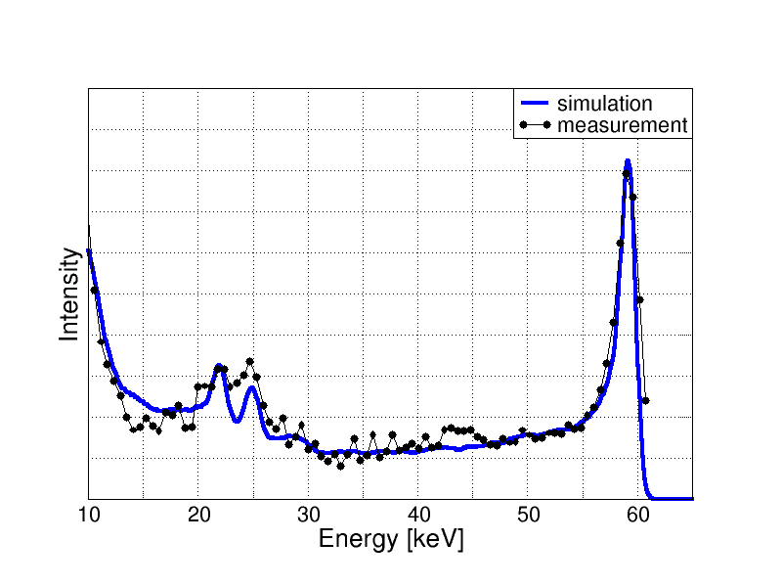
Solution: estimation of the dose equivalent with the measured number of counts in energy intervals
Monochromatic irradiation with E_{j}
Measure/simulate the number of counts in energy deposition intervals
N₁(60)
N₂(60)
N₃(60)
Counts
Energy deposition [keV]
Calibrate with j_{max} different photon energies
Apply pseudoinverse
of the „counts matrix“
Known
doses
Number of counts in
each energy deposition bin
Unknown
calibration
factors from counts to dose
Best estimation (maximum-likelihood) of the calibration factors
45

Slide 46
Calculation of conversion factors and energy bins
Collection of monoenergetic responses
Iterate
E₁
E₁
E₂
E₂
E₃
E₃
E₄
E₄
E₅
E₅
N₁
N₁
N₂
N₂
N₃
N₃
N₄
N₄
N₅
N₅
Assess quality of dose
reconstruction on test spectra
Coupled set of equations
Apply pseudoinverse matrix
46

Slide 47
Extension of energy range beyond 200 keV only possible with filters above pixel detector,
Reason: energy deposition spectra look the same for higher energies due to dominance of Compton scattering in silicon
Uncovered
Filter 1
Filter 2
low energies
medium energies
high energies
47

Slide 48
Response to perpendicular irradiation
3 detectors with 2 filters and 3 x 16 energy bins
IEC limit (+67%)
IEC limit (-29%)
48

Slide 49
Angular dependence of deep dose H_{p}(10; α)
H_{p}(10,0°)/Fluence in pSv*cm²
H_{p}(10, α)/H_{p}(10, 0°) @fixed fluence
49

Slide 50
Under angle of incidence the sensor effectively becomes thicker and smaller
Number of counts at 60 degrees / Number of counts at 0 degrees
Photon energy in keV
50

Slide 51
Dose reconstruction with 220 micron pixel at high dose rates
A
Number of counts /
pixel / μSv
Doserate of 1 Sv/h:
111 kHz @14 keV -> Δt_{mean} = 9 μs
ToT-duration@14 keV = 1.4 μs
-> significant pile up expected
51

Slide 52
Pile-up in preamplifier (analog side of electronics)
Two events above threshold are recorded as one event but with higher energy
Two events originally below threshold are detected by coincidence
52

Slide 53
How does pile-up influence the measured spectrum ?
2 Sv/h
Number of counts
1 Sv/h
0 Sv/h
Deposited energy in keV
53

Slide 54
New pixel detector Dosepix
3.6 mm
Disadvantages Timepix for dosimetry
Non-linear ToT(E)
Feedback from digital to
analog pixel electronics
Dynamic range of test pulsers too small
Sensitive to temperature changes
Power consumption too high
Pixel suffer from charge sharing
(too small)
More functionality needed in pixel
Dead time during readout
3.6 mm
Readout area
New detector:
16 x 16 Pixel with 220 µm x 220 µm area
54
Notes:
54

Slide 55

May 2011: the first sample without sensor
3.5 mm
55

Slide 56
Pixel electronics (CERN, IBA, Uni Erlangen)
Patent: M. Campbell (CERN), W. Wong (CERN), X. Llopart-Cudie (CERN), R. Ballabriga-Sune (CERN), T. Michel, G. Anton, M. Böhnel, : „Radiation Monitoring Device'', EP 07114122.0 (2007)
56

Slide 57
Hybrid photon counting pixel detectors
... have their roots in high energy physics (e.g. ATLAS, CMS, ALICE,...)
... can have intelligent pixel cell electronics
... are used in combination with Si, CdTe, GaAs sensor layers
... can measure energy and time of arrival
... can have high position resolution
... can process events in high flux individually
... allow spectrometry in high flux fields
... allow identification of particle types by track signature
57

