Slide 1














TRAINING COURSE on radiation dosimetry:
Instrumentation 3
Passive detectors Part 1
Antonio PARRAVICINI, MI.AM
Thu. 22/11/2012, 14:00 – 15:00 pm

Slide 2
Passive detectors
Electrets
Track detectors (LR115 - CR-39)
Radon dosimetry
  Neutron dosimetry

Slide 3
Electrets
An electret is a dielectric material (Teflon) that carries a quasi permanent electrical charge.
A disc of few cm diameter and few mm thickness is manufactured by heating the material in the presence of an electric field and than cooling to “freeze” electric dipoles in place.
With proper encapsulation, this stored charge may be stable over periods longer than an year, even in presence of humidity.
The charge is measured using a portable charge reader.
The electret serves both as a source of electric field and as a sensor.

Slide 4
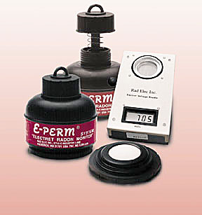
Electrets

Slide 5
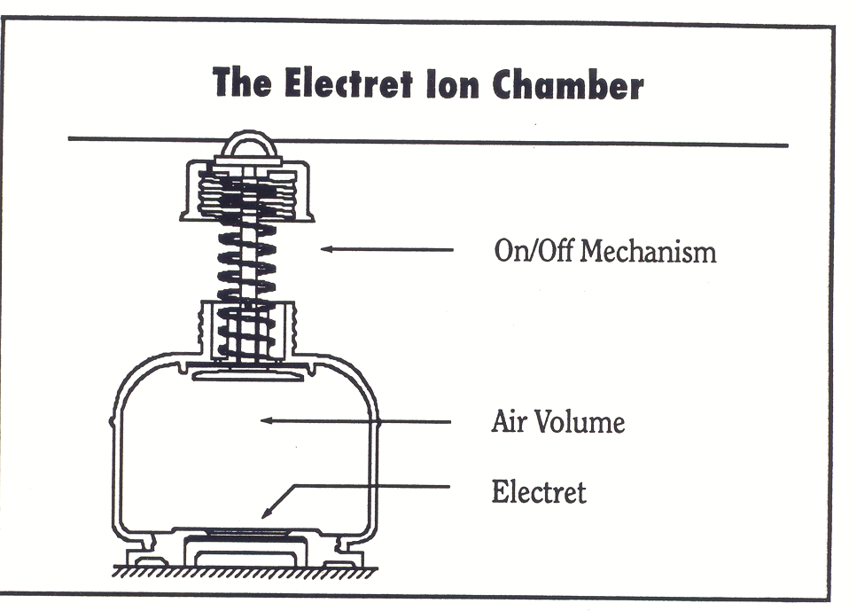
Electrets
RADON MEASUREMENT
Electret is placed in a conductive plastic ionization chamber that acts as a Faraday cage.
The positive charge of the Electret will create an electric field that attracts free ions to its surface.
Radiation entering the chamber causes ionization in the air volume, and the ions produced inside the air volume are collected by the electret.

Slide 6
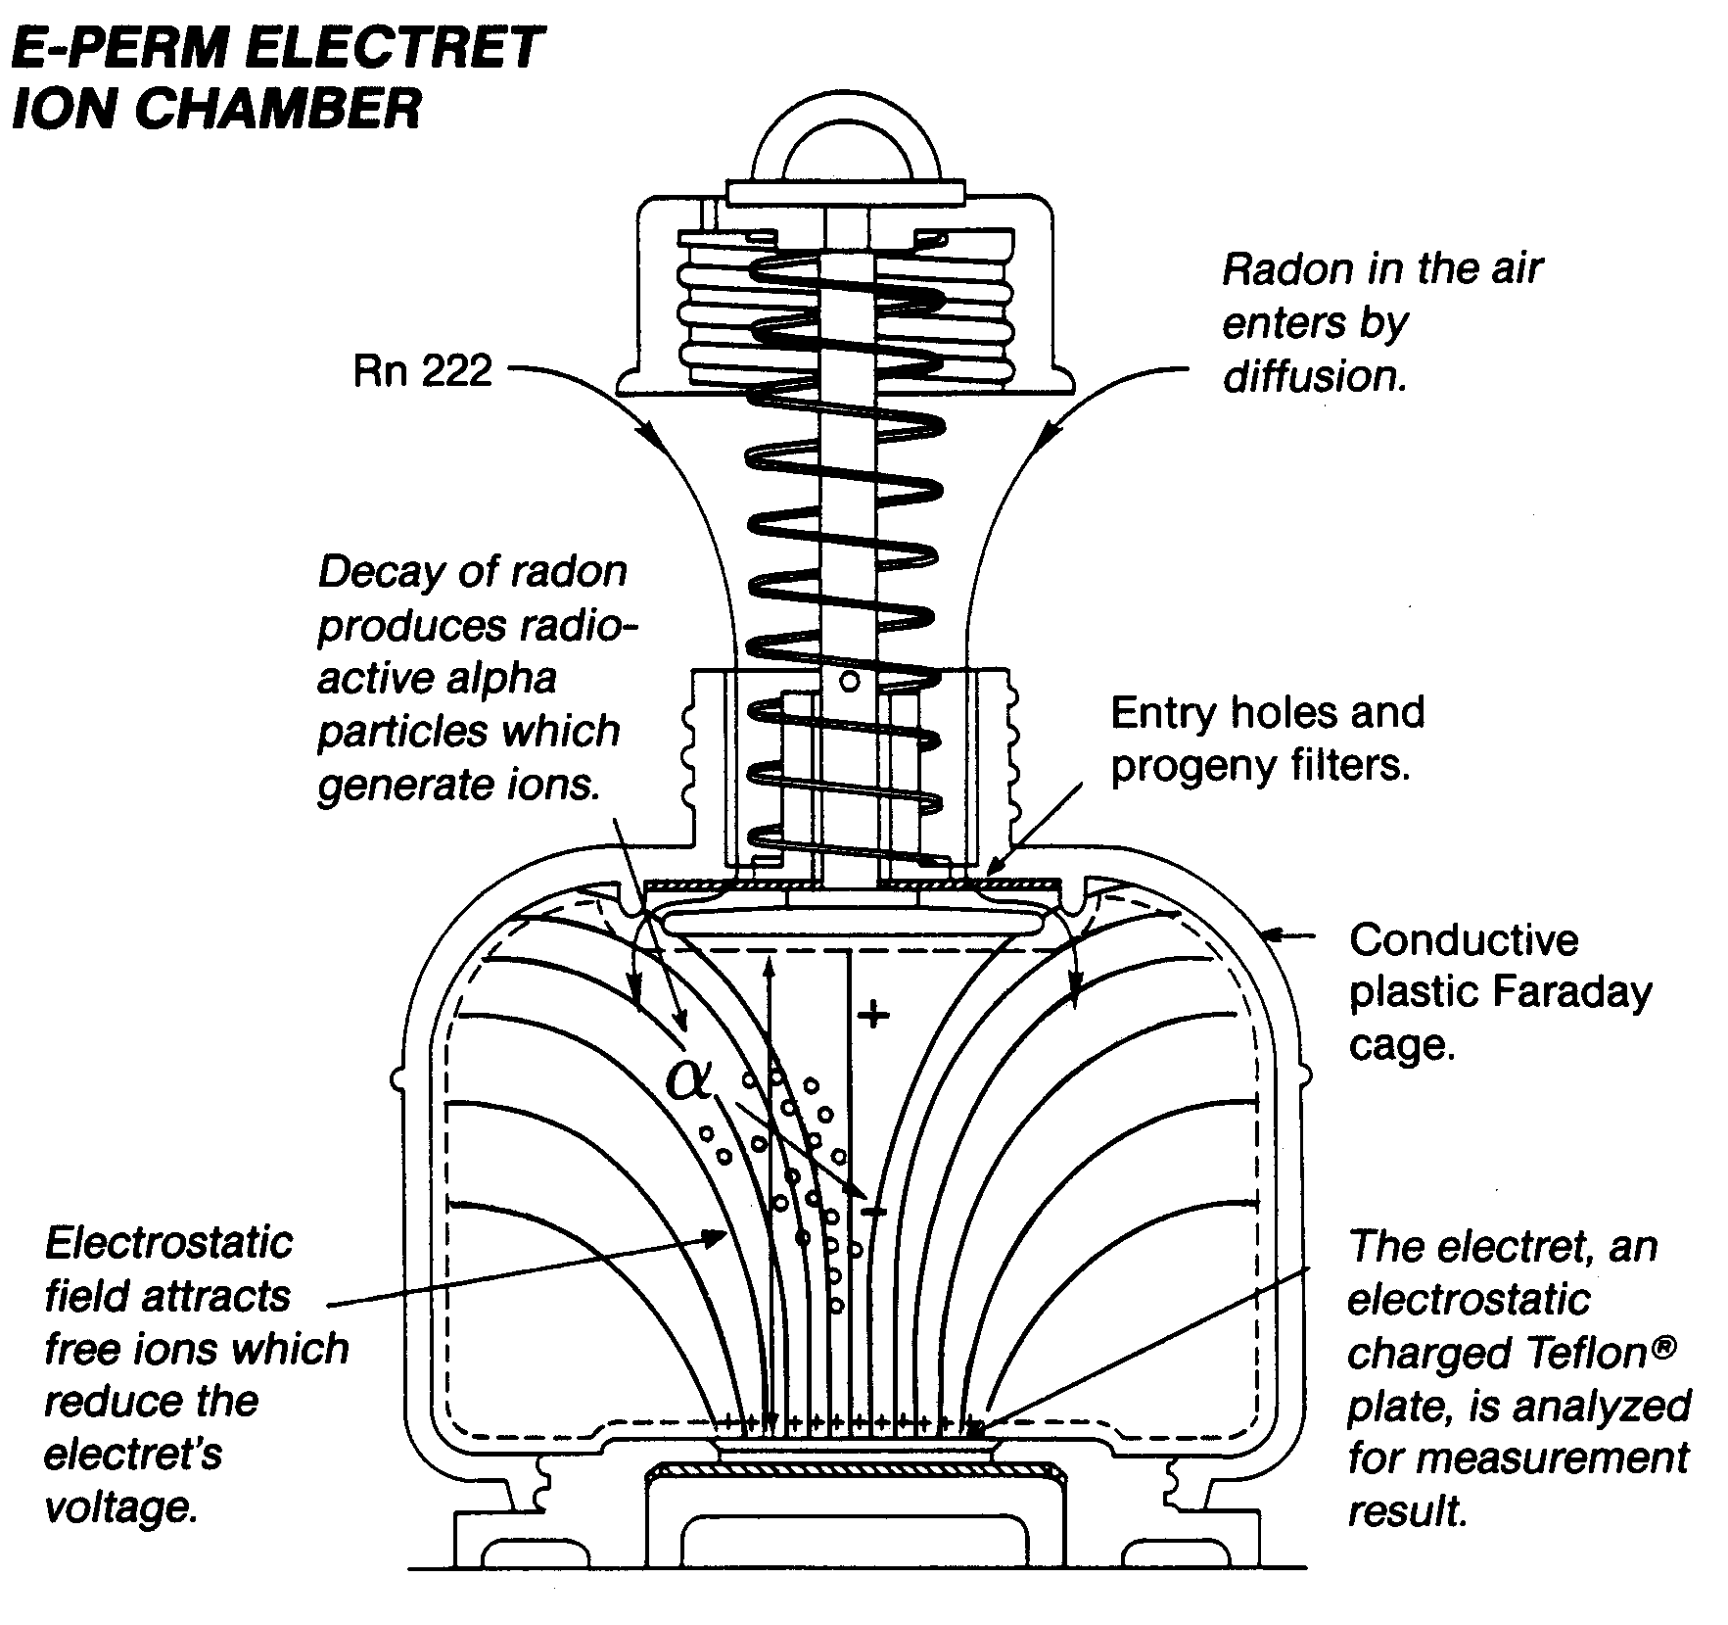
Electrets
The charge change (read as voltage discharge ΔV) is proportional to Rn concentration and background gamma field.
It is the measure of the integrated ionization over the sampling period.
q and m depend on configuration (chamber, electret)
C is radon equivalent due to gamma, D is exposure lenght

Slide 7
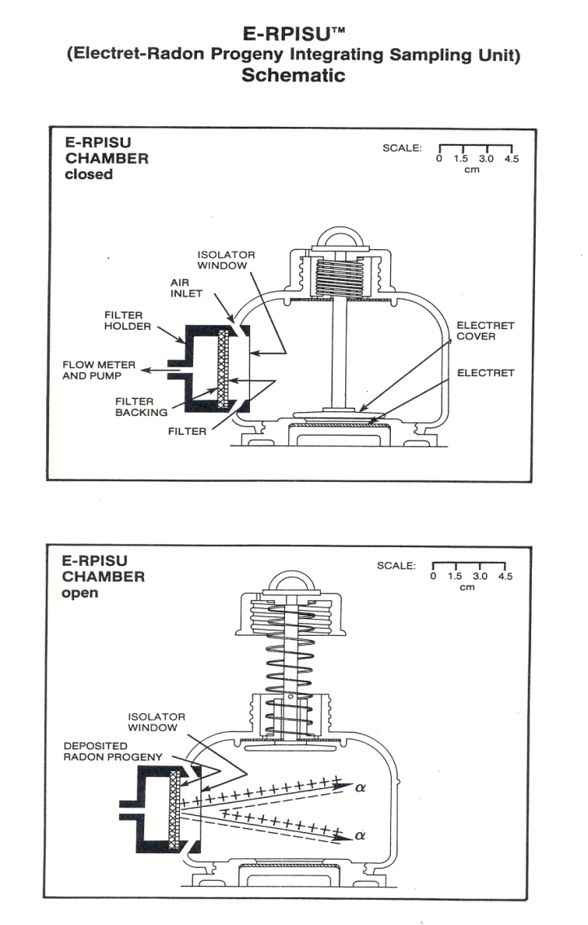
Electrets
RADON PROGENY MEASUREMENT
An air-sampling pump is used to collect the radon progeny for a known sampling time on filter sampler mounted on the side of an electret ion chamber.
The progeny collected emits radiation into the interior of the chamber.
The alpha radiation emitted by the progeny collected on the filter ionizes air in the electret ion chamber.

Slide 8
Track Detectors
Widely used for several applications:
Radon measurement
Fast neutron dosimetry
Thermal neutron dosimetry
Cosmic rays detection
LR115
Cellulose nitrate layer on a clear polyester base
CR-39
PADC- Poly allyl diglycol carbonate

Slide 9
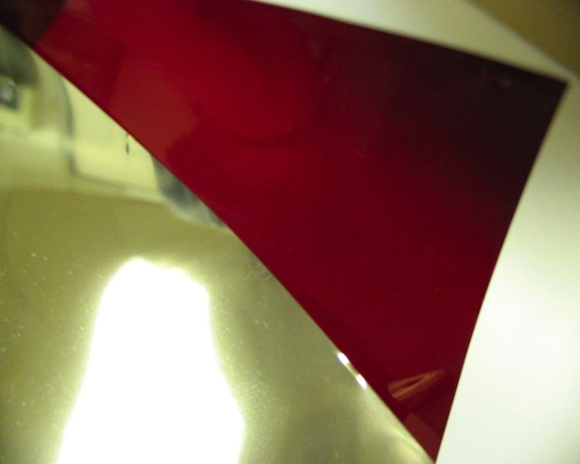
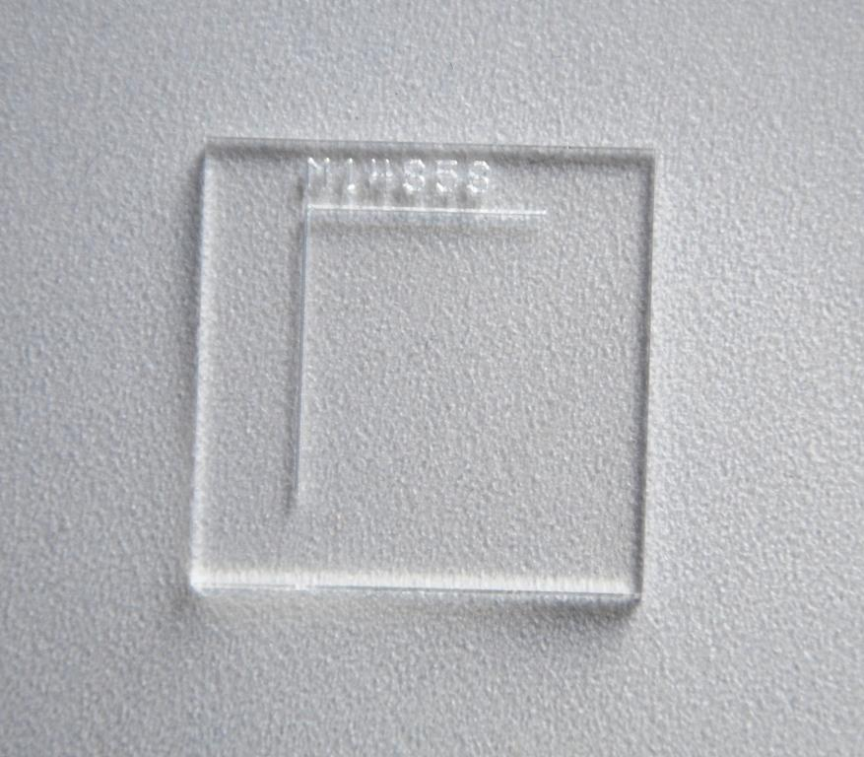
Track Detectors
LR115
CR-39

Slide 10
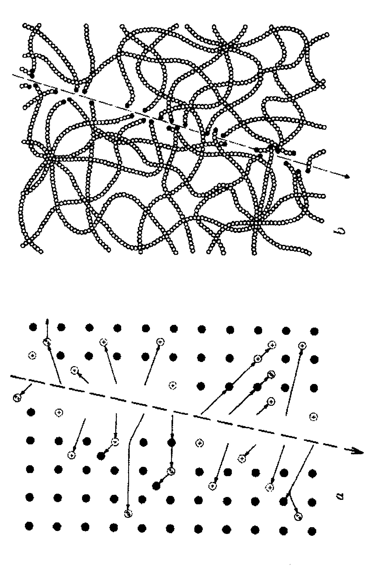
Track Detectors
PRINCIPLE OF TRACK DETECTORS
When a ionizing charged particle pass through a dielectric material the transfer of energy to electrons results in a trail of damaged molecules along the track particle
The track can be made visible by etching in an acid or basic solution

Slide 11
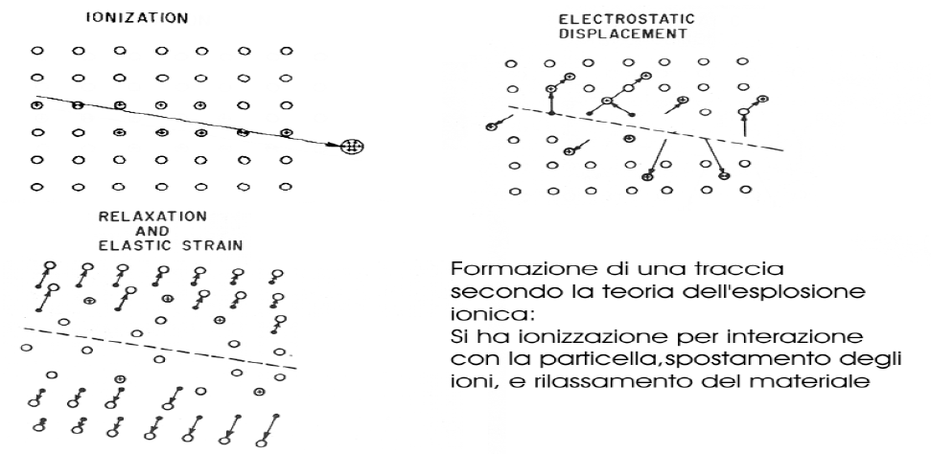
Track Detectors
Ion explosion theory
Ionization
Electrostatic displacement
Relaxation and elastic strain

Slide 12
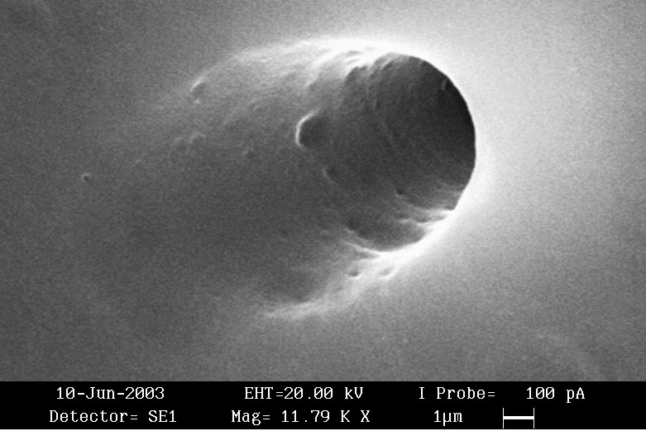
Track Detectors
Example of after etching track in a LR115 film

Slide 13
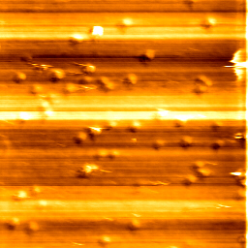
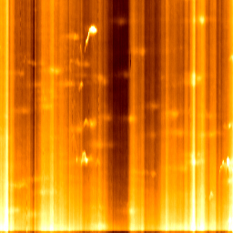
Track Detectors
CR-39 detector irradiated by alfa particles (before etching)
Diameter of latent tracks is 70-100 nm. Frame is 5 micrometer (AFM).

Slide 14
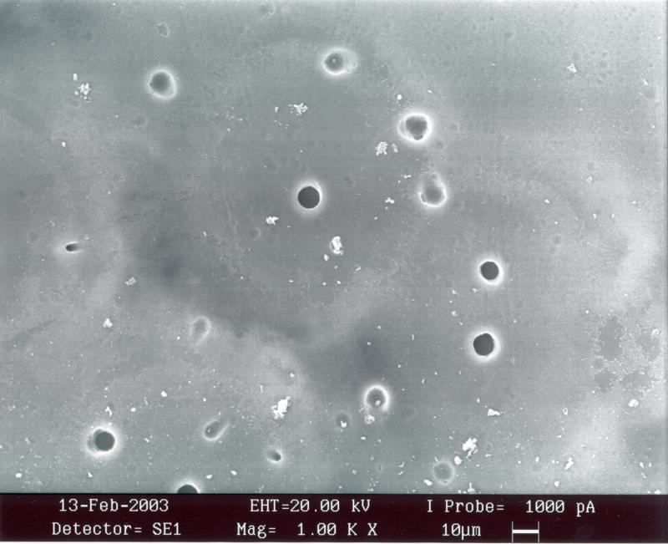
Track Detectors
Example of after etching tracks in a CR-39 detector

Slide 15
Track Detectors
dE/dx threshold for damage production
dE/dx
E

Slide 16
Track Detectors
During the etching, material is removed at Vt velocity along the track
and isotropically at Vb velocity from the bulk material.
Principle of the track detector: Vt (track etch rate) >Vb (bulk etch rate)
The shape of the tracks depends on:
V = Vt (LET)/Vb
Incidence angle
LET = LET(y)
Etching procedure (etchant, temperature, duration)

Slide 17
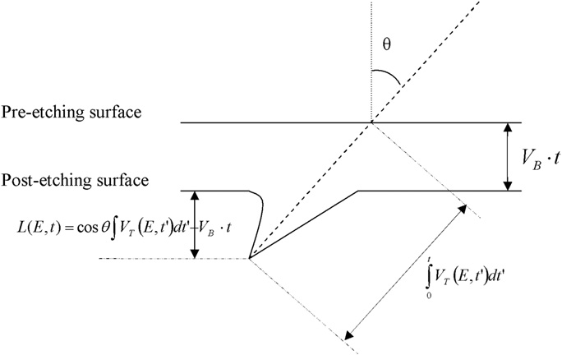
Track Detectors
Track is visible if
There is a limit angle: if θ> limit angle →no track

Slide 18
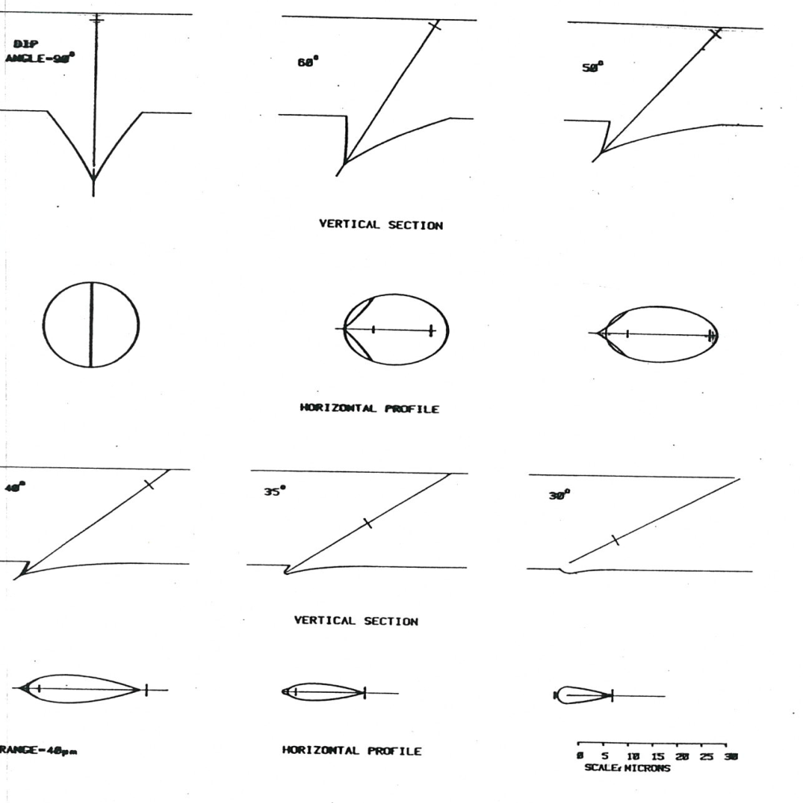
Track Detectors
Shape of the track as funtion of incidence angle

Slide 19
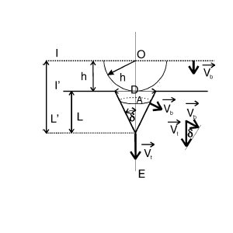
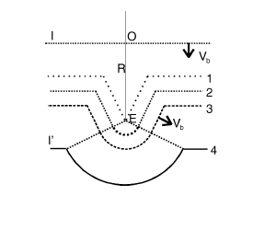
Track Detectors
overetching: round shape

Slide 20
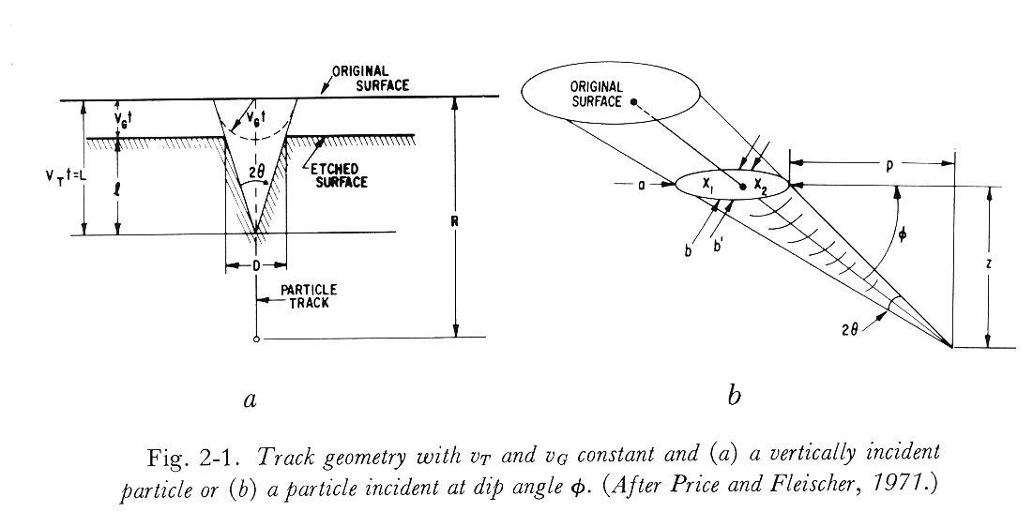
Track Detectors

Slide 21
Track Detectors
Variation of Vt along track path
Vb=1.83 µm/h

Slide 22
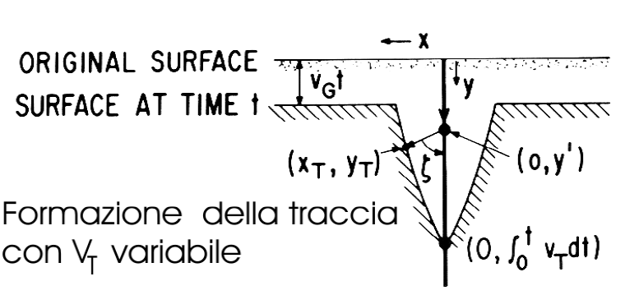
Track Detectors
Variation of the track etch rate along the alpha particle trajectories:
Vt decreasing

Slide 23
Track Detectors
Variation of the track etch rate along the alpha particle trajectories:
Vt increasing

Slide 24
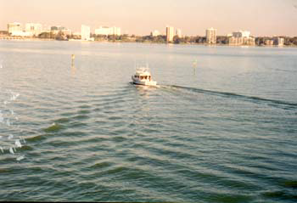
Track Detectors
To understand chemical etching geometry think as Vt is the velocity
of the ship and Vg is the wave motion velocity in water

Slide 25
Track Detectors
Measure of Vb - Bulk velocity
Fission fragments tracks Vt >> Vg
V = Vt/Vg
If V>>1 then
h removed bulk material thickness
D track diameter (dip angle 90°)

Slide 26
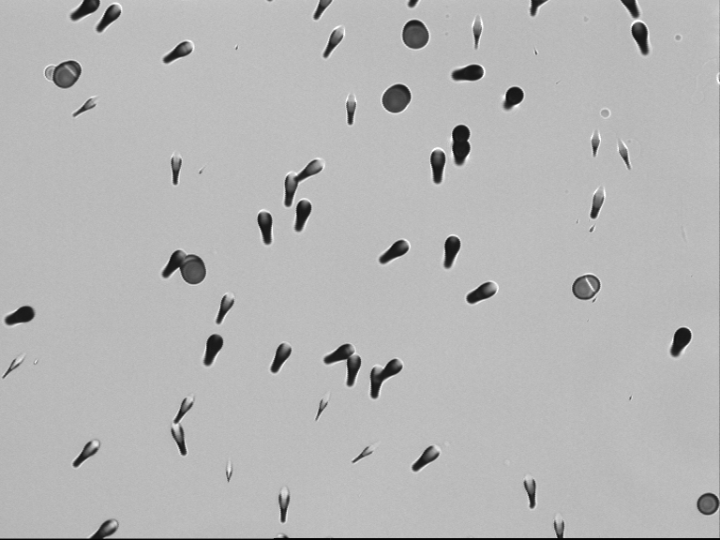
Track Detectors
Alpha and fission fragment tracks in CR-39 exposed to Cf-252 source.

Slide 27
Track Detectors
Track lenght as function
of etching time

Slide 28
Track Detectors
Track lenght as function
of etching time
B. Dorschel et al. / Radiation Measurements 37 (2003) 563 – 571
Fig. 4. Longitudinal section and top view of etched tracks of 90 MeV 7Li ions entering the detectors at = 0◦ (left side) and = 40◦ (right side) for diferent etching times, t (a) t = 3:5 h, (b) t = 4:33 h. Magnification: 950.

Slide 29
Track Detectors
V=V(E,t) and V=V(E,x) functions calculated through the V=V(REL(E,x)) function for 1.2 MeV protons impinging perpendicularly on the detector surface. The simulated etching conditions are Vb=9.8 µm h⁻¹ and 1.5 h of etching time.

Slide 30
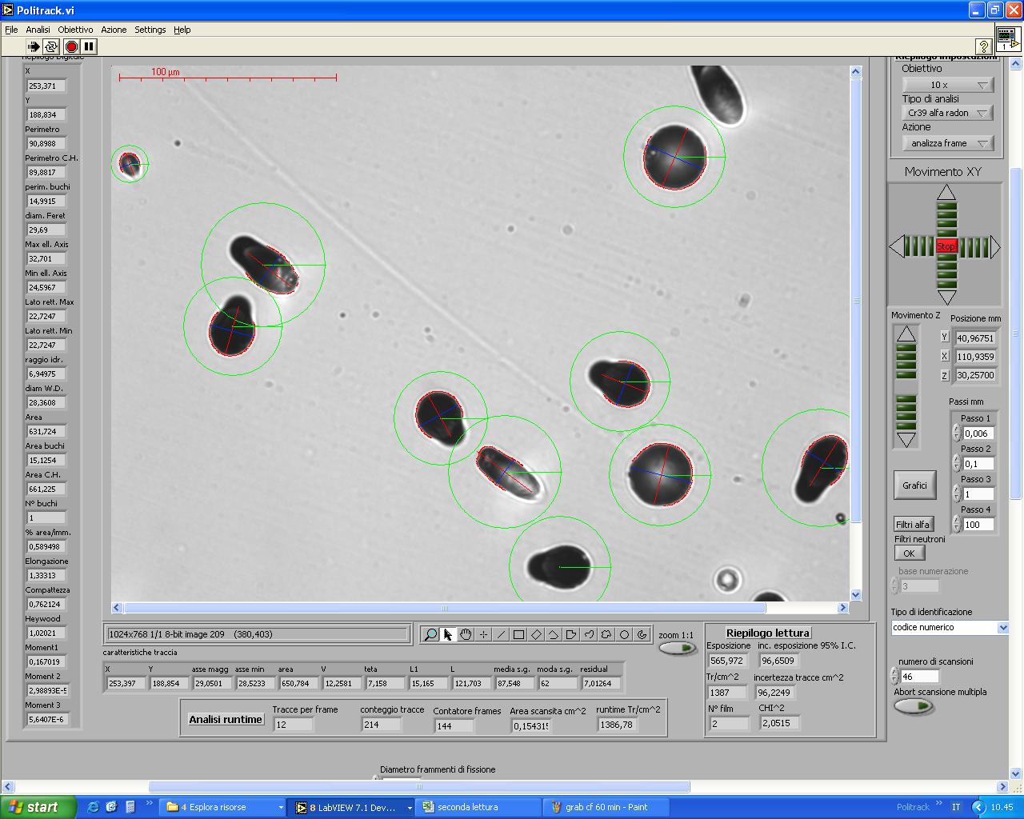
Track Detectors
CR39 detector analysis
Measure of track parameters using automatic systems
Count the tracks
Filter tracks
(reduce background)
Calculate LET
(discriminate the particles) and impinging angle

Slide 31
Track Detectors
RADON DETECTION
Radon concentration measurement must be carried out on a long integration time (several months) to smooth radon concentration variations. The physical quantity measured is exposure (Bq*h/m³)
The most common radon track detectors are:
LR115 track detectors
CR-39 track detector

Slide 32
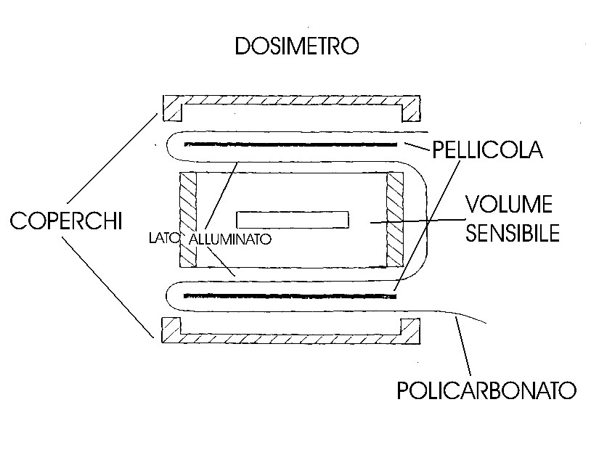
Track Detectors
LR115 radon detector (ANPA type)

Slide 33
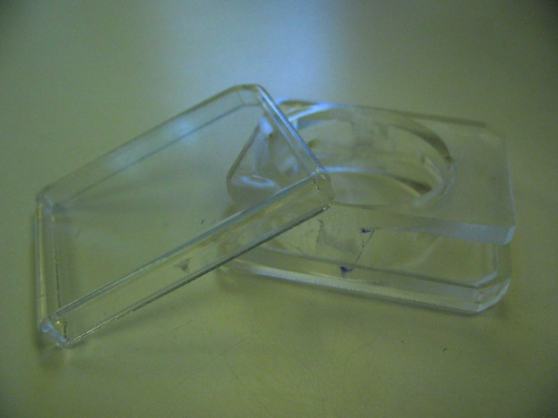
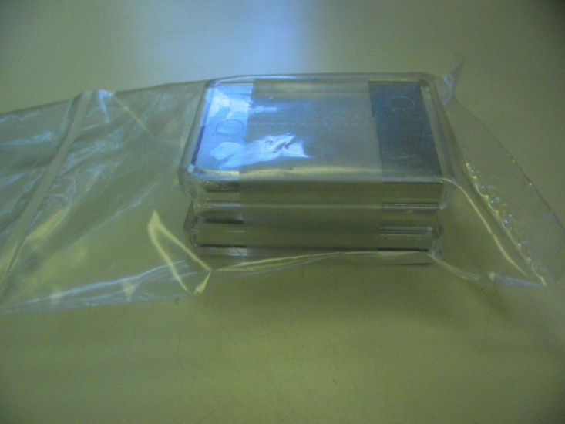
Track Detectors
LR115 radon detector

Slide 34
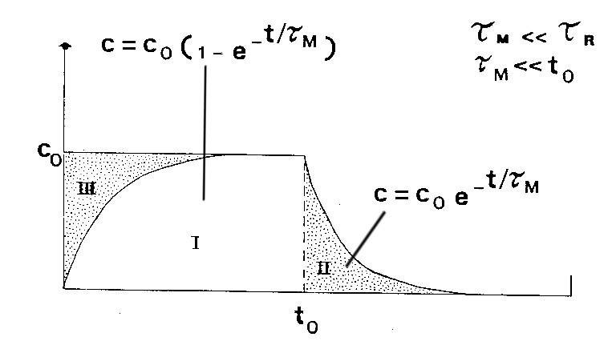
Track Detectors
LR115

Slide 35
Track Detectors
LR115 reading: Spark counter
Aluminum Mylar film
LR115
HV
electrodes

Slide 36
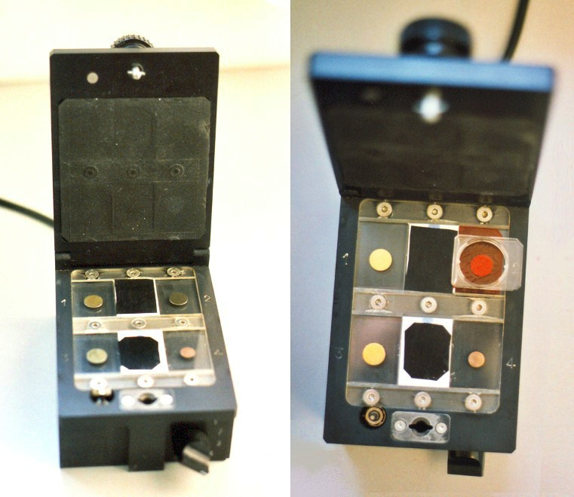
Track Detectors
LR115 reading
Spark counter

Slide 37
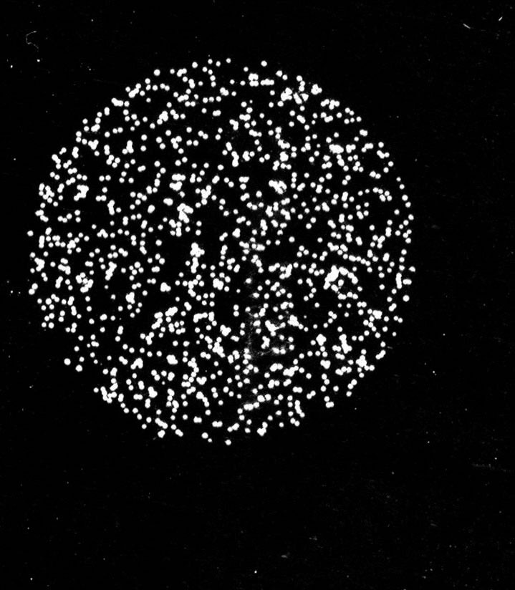
Track Detectors
Spark counter
Aluminum Mylar film after spark counter reading

Slide 38
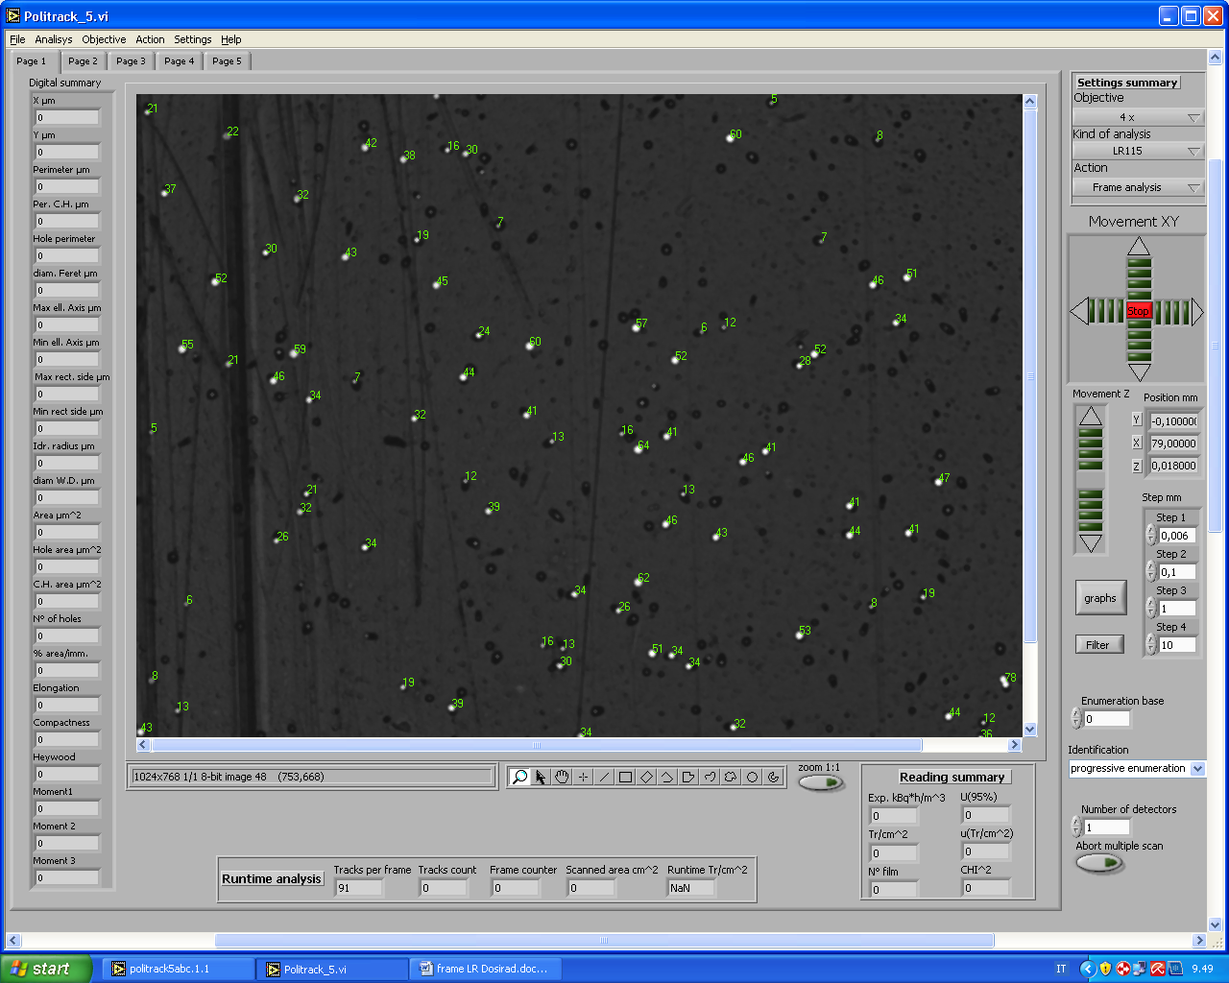
Track Detectors
LR115 reading: optical system
Tracks appear as white holes on dark background
Tracks are automatically counted and area is measured for etching correction

Slide 39
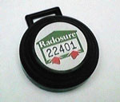

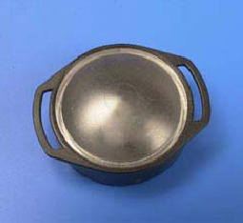
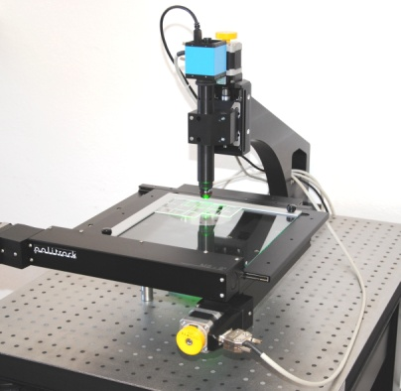
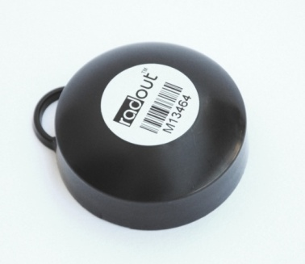
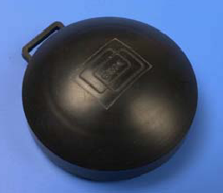
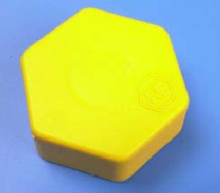
Track Detectors
CR-39 radon detectors and optical reading system

Slide 40
Track Detectors
CR-39 radon detectors
Exposure in ambient
After exposure, the detector is chemically etched.
Detertors are scanned by optical system and morphological analysis of the track is performed
The analysis allows to filter tracks (background reduction)
The number of tracks from radon and daughters (Po-218 and Po-214) is proportional to radon concentration

Slide 41
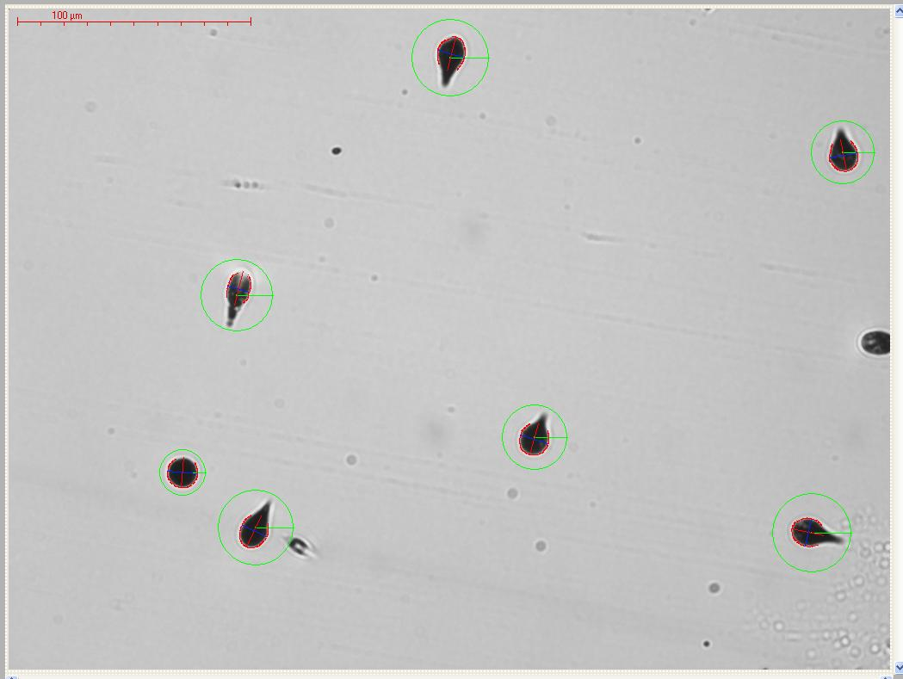
Track Detectors
Alpha tracks from radon and radon daughters in CR39 detector

Slide 42
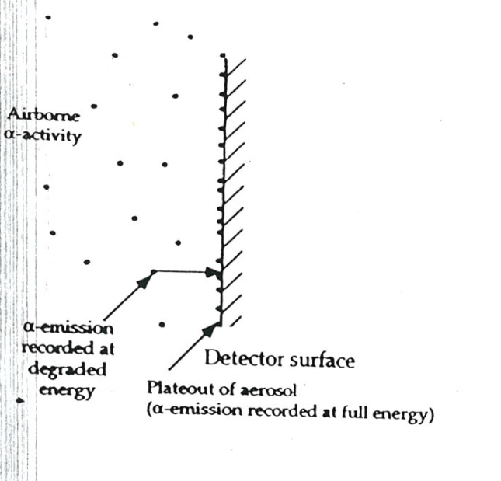
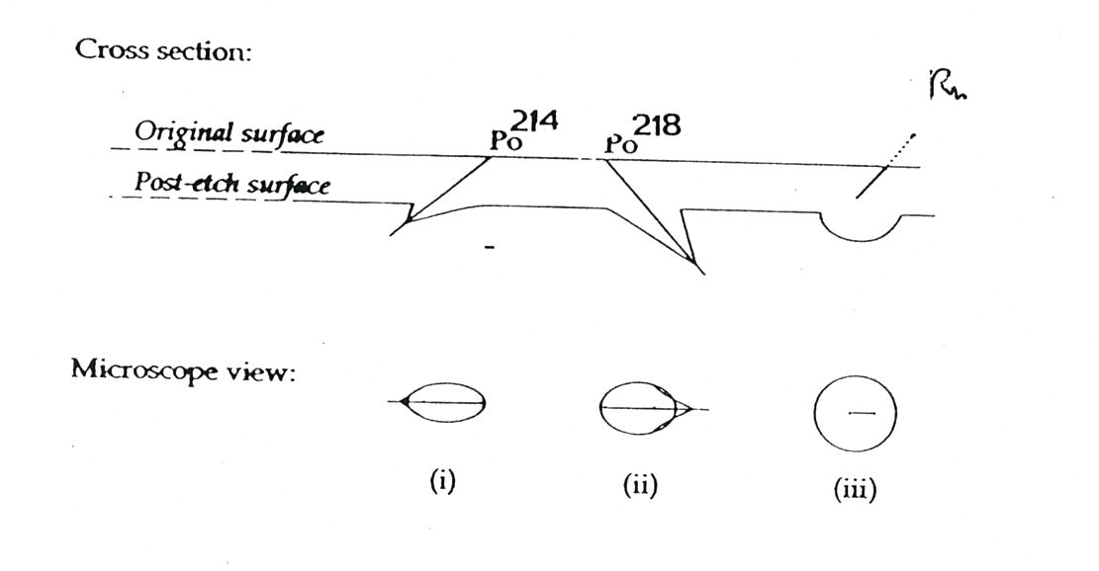
Track Detectors
Alfa tracks from radon and radon daughters in CR39 detector

Slide 43
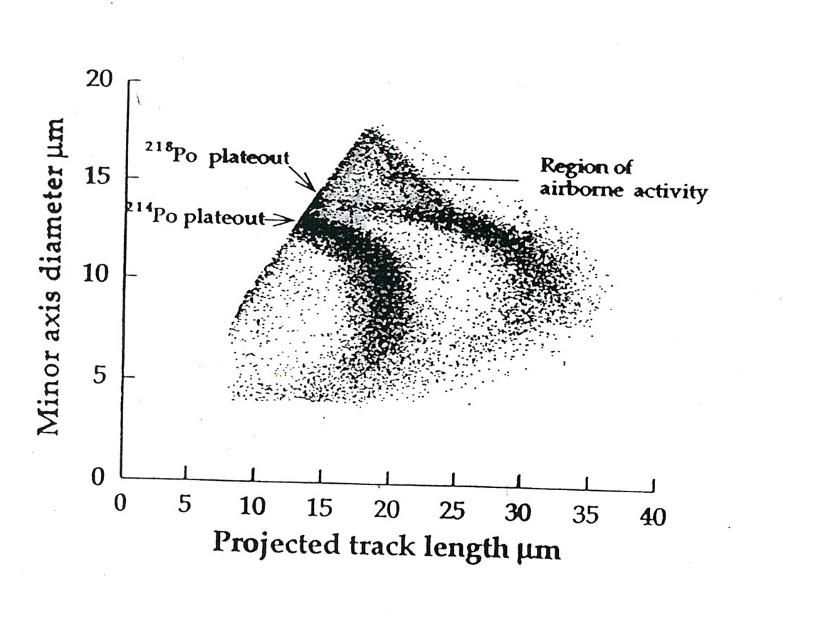
Track Detectors
Tracks from plateout and airborne activity in bare exposed detector
Etching conditions: NaOH 25% w/v, 98°C, 60’

Slide 44
Track Detectors
CR-39 NEUTRON DOSIMETRY AND SPECTROMETRY
CR39 coupled to a Boron converter as thermal neutron detector inside Bonner sphere
Use of recoil protons (radiator-degrader tecnique)
Calculation of particle LET and impinging angle with direct estimation of equivalent dose.

Slide 45
Track Detectors
CR39- neutron dosimetry – Bonner sphere (polyethylene neutron moderator)
The neutron is detected by the 1.47 MeV alfa particle
Number of tracks is proportional to thermal neutron fluence (inside Bonner sphere)
CR39
Bonner sphere
¹⁰B(n,alfa)⁷Li
Boron converter
M. CARESANA ET AL. Radiat Prot Dosimetry (2007) 126(1-4)

Slide 46
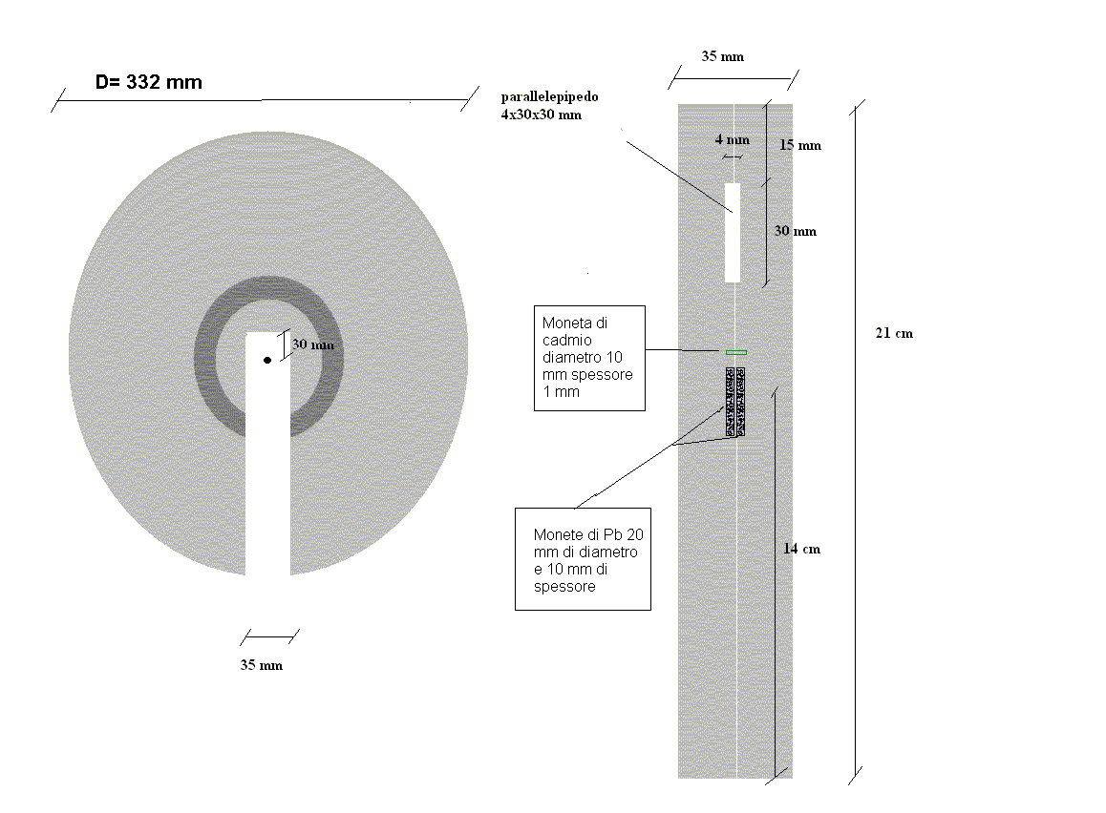
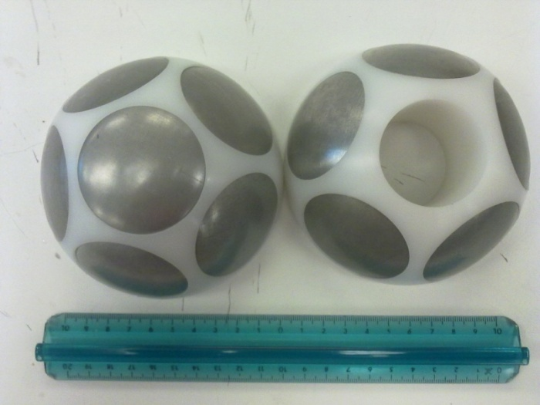
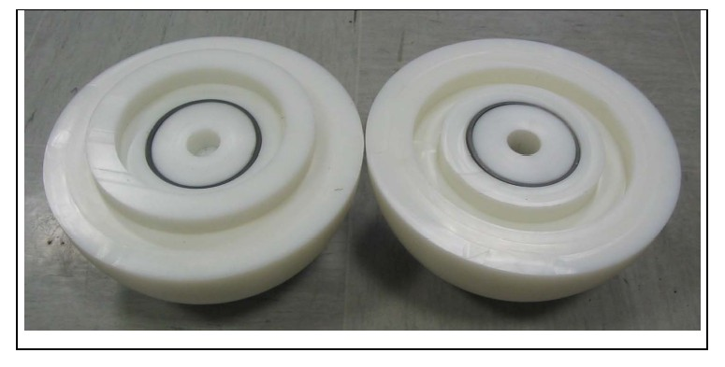
Track Detectors
CR39- neutron dosimetry – Bonner sphere
Versione un rivelatore sensibilità 10 tracce/cm^2 per µSv
Versione 2 rivelatori Sensibilità 6 tracce/cm^2 per µSv

Slide 47
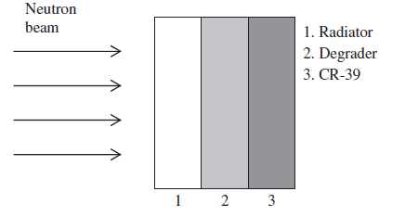
Track Detectors
CR39- radiation degrader neutron spectrometer
(1) Recoil protons generated inside the radiator(external radiation component).
(2) Recoil protons generated inside the detector(proton self
radiator).
(3) Carbon and oxygen recoil nuclei generated inside the detector (ion self radiator).
Radiator: high density polyethylene
Degrader: aluminium (purity 99%)

Slide 48
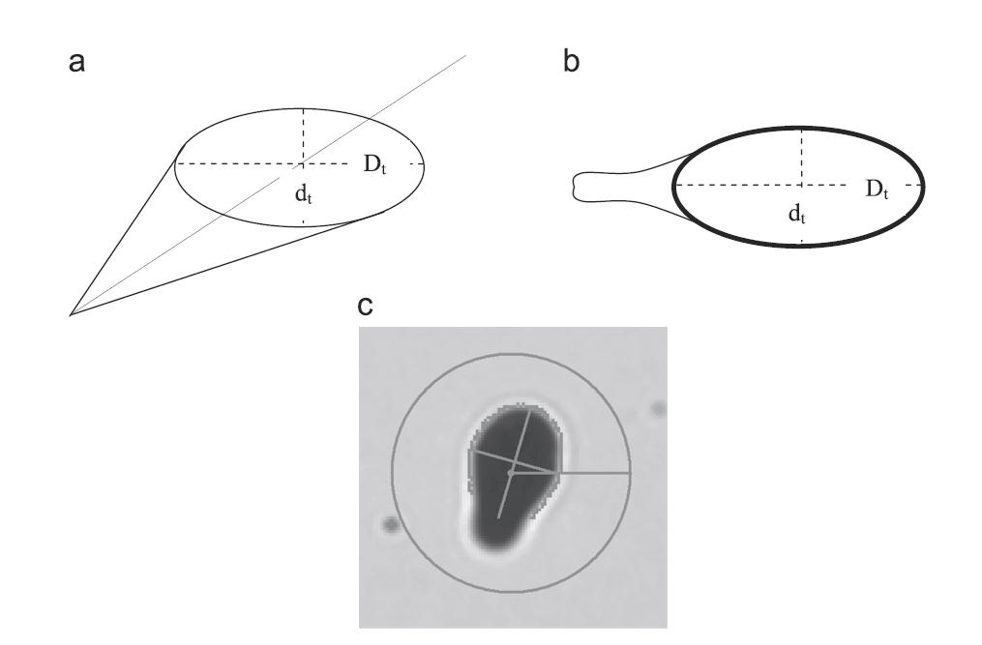
Track Detectors
CR39- neutron dosimetry based on LET spectrometry
D, d and h are measured
d= track opening minor axis
D= track opening major axis
h= removed thickness

Slide 49
Track Detectors
By defining
It possible to calculate V and θ from the track parameters
Since relationship between V and LET is known, from LET and θ we can calculate dose

Slide 50
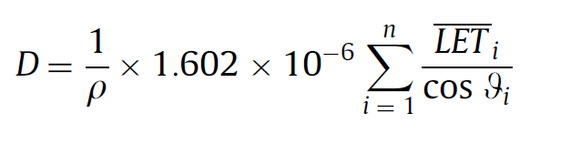
Track Detectors
Assuming n particles impinge on the unit area the dose (mGy) can be calculate using
And the dose equivalent (mSv) can be calculated by
D e H are expressed in mGy e mSv respectively
LET is expressed in keV µm⁻¹ - Q(LET) is the ICRP quality factor
ρ is the density of the material - ρ = 1.31 g·cm⁻³ for CR-39
If a 1 cm PMMA radiator is used, H is a good approximation of H*(10)

Slide 51
Track Detectors
Relationship between V and REL - restricted energy loss (related to LET)
V=Vt /Vb = 0.93+3.14×10−3REL − 7.80×10−6REL²+1.11×10−8REL³−5.27 × 10−12REL⁴
33 MeV/cm <REL< 560 MeV/cm
and
V=Vt /Vb= 1.30+3.80×10−4REL+4.9×10−7REL²
for REL > 560 MeV/cm.
B. Dorschel , et al. 2002 Dependence of the etch rate ratio on the energy loss of light ions in CR-39
Radiat. Meas. 35, 287-292.

Slide 52
Track Detectors
¹⁰B(n,alfa)⁷Li
E_{alpha} =1.47 MeV
E_{lithium} =0.84 MeV
Ion | Mean LET meas | Mean LET calculated
Alfa | 220 keV/µm | 250 keV/µm
Li | 400 keV/µm | 280 keV/µm
M. Caresana et al. Study of a radiator degrader CR39 based neutron spectrometer NIMA 620 (2010), p.368–374

Slide 53
Track Detectors
LET measurement Am-241 and Uranium
Am-241 E=5.5MeV
Etching 60’
Removed thickness 10 µm
Avg LET measured 130 keV/µm
Avg LET calculated 140 keV/µm
Unat E₁=4.2MeV E₂=4.77MeV
Etching 40’
Spessore rimosso 6.7 µm
Source | Mean LET meas | Mean LET calculated
U-234 | 145 keV/µm | 148 keV/µm
U-338 | 170 keV/µm | 187 keV/µm

Slide 54
Passive detectors
THANK YOU FOR YOUR ATTENTION

