Slide 1














TRAINING COURSE on radiation dosimetry:
Radiobiology Basics – RBE, OER, LET
Anthony WAKER
University of Ontario Institute of Technology
Thu. 22/11/2012, 18:30 – 19:30 pm

Slide 2
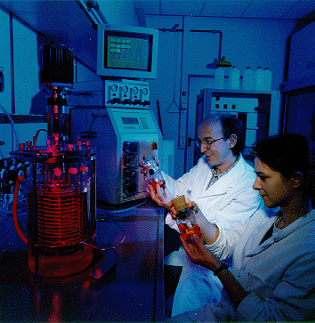
Culturing Mammalian Cells
tissue → trypsin → single cell suspension → seeding →(medium+incubation)
→crisis →established

Slide 3
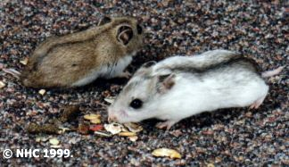
Three Popular Established Cell-Lines
HeLa Cells (human cancer cells)
CHO Cells (Chinese hamster ovary cells)
V79 Cells (Chinese hamster lung fibroblast cells)

Slide 4
Cell Death
For proliferating cells of an established cell-line, death is defined as reproductive death when cells no longer have the capacity for sustained proliferation and colony formation (clonogenic)
Cells may lose reproductive capacity through
  Apoptosis
  Giant cell formation
  Death attempting cell division (mitotic death)
For most cultured cells mitotic death is the dominant mode

Slide 5
The fate of cells exposed to radiation
Nias Chapter 6

Slide 6
The first mammalian cell survival curve
Nias Chapter 8

Slide 7
Over the past 50 years many cell lines have been investigated and, apart from their practical value for improving the therapeutic use of radiation, the shape of the survival curve itself helps our understanding of the mechanisms underlying radiation damage
Hall Chapter 3

Slide 8
Relative Biological Effectiveness (RBE) for Cell Survival
RBE is the ratio of the absorbed dose for a reference radiation, usually 250 kVp X-rays or Co-60 gamma rays to the absorbed dose from a test radiation to give the same level of effect, usually cell survival

Slide 9
Relative Biological Effectiveness (RBE) for Cell Survival
RBE is an experimentally measured quantity
For shouldered survival curves RBE increases with deceasing dose to a maximum value that depends on the initial slope of the reference radiation survival curve
RBE depends on the biological system used (e.g cell line)
RBE depends on the end-point investigated (e.g. survival)

Slide 10
Cell Survival and Linear Energy Transfer
For the same end-point RBE for mammalian cells (and other complex biological systems) is generally seen to increase with increasing ionization density (LET)
Hall Fig. 7.5

Slide 11
Cell Survival and Linear Energy Transfer
Curves labeled 1,2,&3 refer to different levels of survival (0.8,0.1 0.01). For mammalian cells RBE is seen to increase and reach a maximum around 100 keV/μm and then subsequently decrease
Hall Fig. 7.6

Slide 12
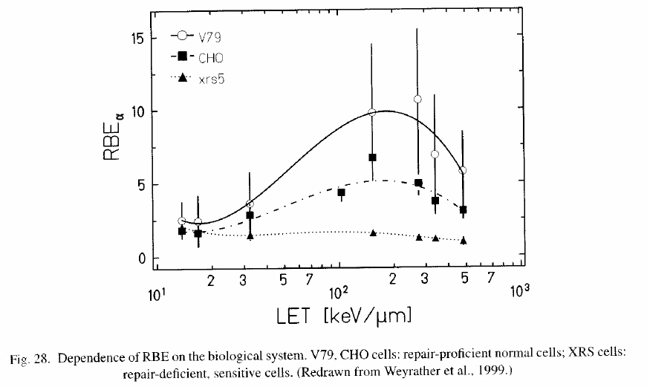
Cell Survival and Linear Energy Transfer
RBE also depends on cell-type and the ability of the cell to repair DNA double strand breaks

Slide 13
The Oxygen Effect
Hall Fig. 6.1

Slide 14
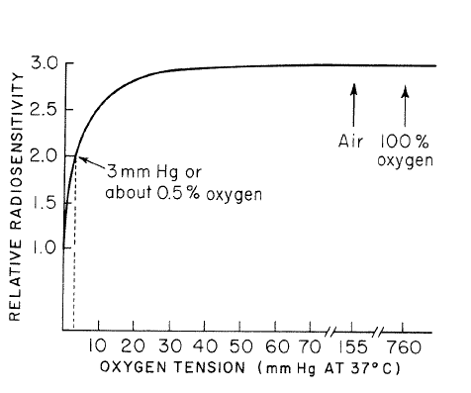
The Oxygen Effect – how much oxygen is needed
Hall Fig. 6.5

Slide 15
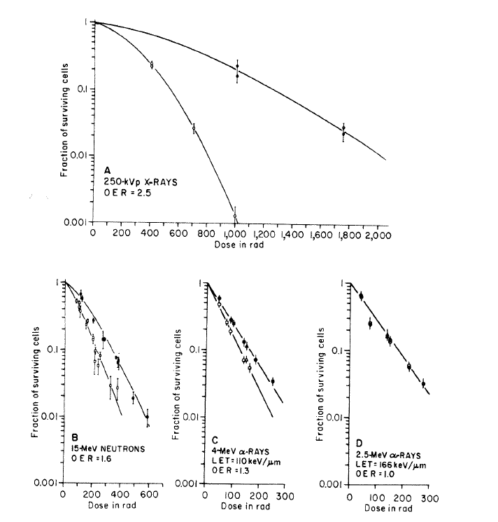
OER and LET
The OER decreases with increasing LET and at high LET (alpha particles ) is 1.0 i.e no oxygen effect.
Why?
Hall Fig. 7.8

Slide 16
OER and LET
Hall Fig. 7.9

Slide 17
RBE, LET and OER Summary
RBE varies according to the tissue or end-point studied. In general RBEs are higher for cells or tissues that can accumulate and repair sublethal damage (X-ray dose-response curve has a broad shoulder)
For organisms with double-stranded DNA the RBE will reach a maximum for radiation of LET around 100 keV/μm, thereafter decreasing with higher LET due to energy ‘wastage’ or overkill
The oxygen enhancement ratio has a value around 3 for low LET radiation, which falls when the LET is around 30 keV/μm and reaches unity (1.0) at an LET of around 200 keV/μm

Slide 18
OER, RBE and LET
Two good reasons to think about using high LET radiation for cancer therapy
Hall Fig. 7.10

Slide 19
High-LET Therapy
Rationale for high-LET therapy
  Increased RBE for cell killing
  Lower OER for dealing with hypoxic tumour cells
  Improved dose distribution for critical tissues
High LET Modalities
  Fast Neutrons
  Negative pi-mesons
  Boron Neutron Capture Therapy
  Protons
  Carbon ions

