Slide 1



Christopher Cassell^{[1,2]} (BSc, Hon)
ESR 15
Supervisors: Prof. Stefano Agosteo^{[1]} Prof. Marco Caresana^{[1]}
Prof. Anatoly Rosenfeld^{[2]} Dr. Susanna Guatelli^{[2]}
[1] Politecnico di Milano, [2] Centre for Medical Radiation Physics, UOW

Slide 2

Contents
Project within ARDENT
Previous work
    DMG Simulation
    LUPIN Measurements at CERN
      The LUPIN detector
      Proton Synchrotron
      Labrynth
      HiRadMat
Current/Future work
    Beam diameter simulations for DMG
    Experimental Measurements with LUPIN
    Simulations of LUPIN geometry
    Secondments

Slide 3
Project within ARDENT
“As an ESR, you will work in the field of neutron detection. The work focuses on the development of a detector sensitive to neutrons in pulsed fields. The basic concept is to develop instrumentations to be used in mixed radiation fields, characterized by a complex time structure. You will investigate both passive and active detectors. As for the active ones you will work with gas detectors (He-3 and BF₃) and/or solid state detectors, coupled with an innovative front end electronic. As for the passive ones you will work in close partnership with the Mi.am’s ESR. The instruments will find their natural application in neutron measurement around particle accelerators. You will work on the design via Monte Carlo simulations. A great attention will be devoted to the characterization of the instrumentation through experimental campaigns at particle accelerator facilities.”
For My project, I will be focusing on the LUPIN detector; an extended range neutron detector

Slide 4
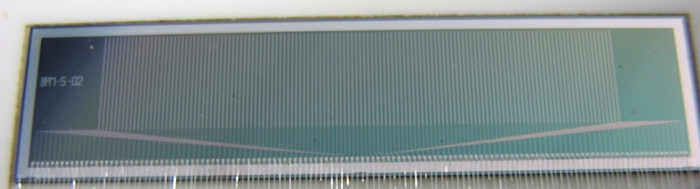
Previous Work
Geant 4 Simulations of the DMG detector:
A Geant4 simulation was built containing a Perspex Phantom and an incident Proton Beam
Bragg peaks were obtained in the phantom for 50, 100 and 200 MeV proton beams, with and without the detector
The Silicon Strip Detector, designated Dose Magnifying Glass^{[14]}

Slide 5
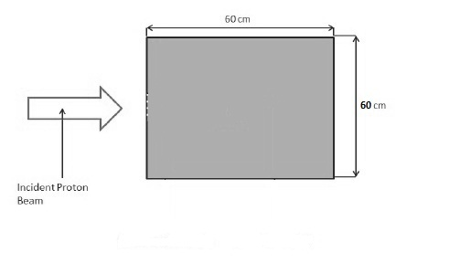
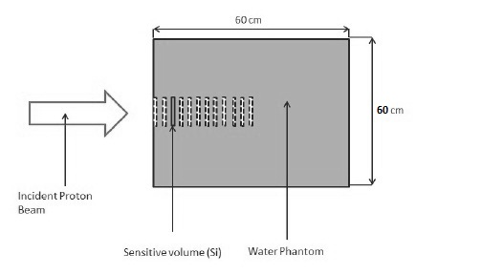
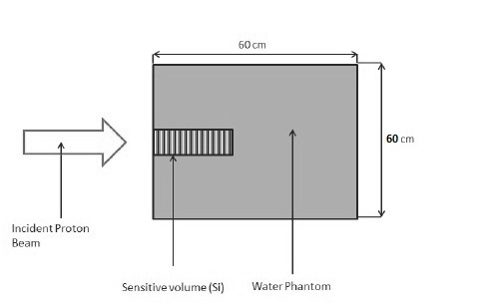
Previous Work
Cross-Sectional view of the Simulation containing no Silicon
Cross-Sectional view of the Simulation containing individiual Silicon Strips
Cross-Sectional view of the Simulation containing the DMG

Slide 6
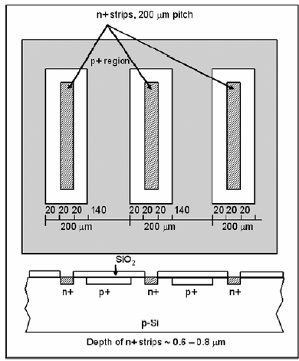
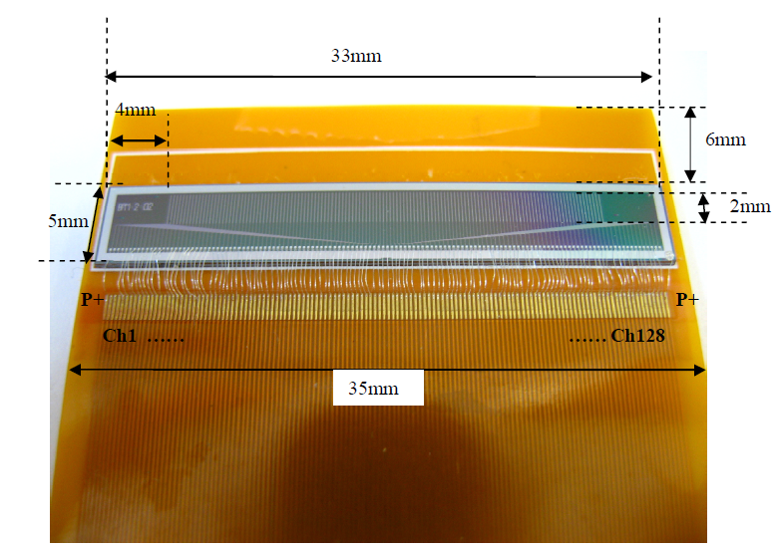
Current/Future Work
The Dose Magnifying Glass, or Silicon Strip Detector^{[14]}

Slide 7
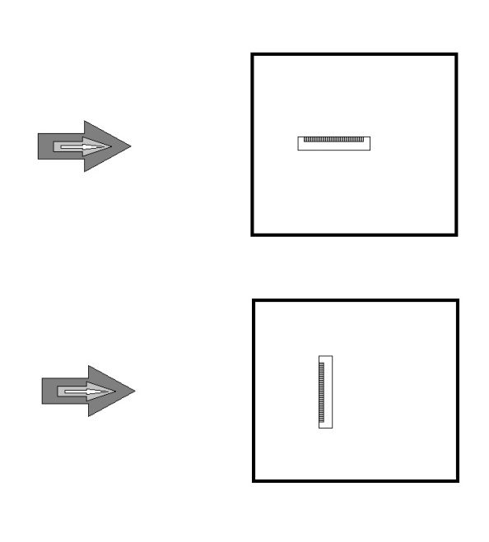
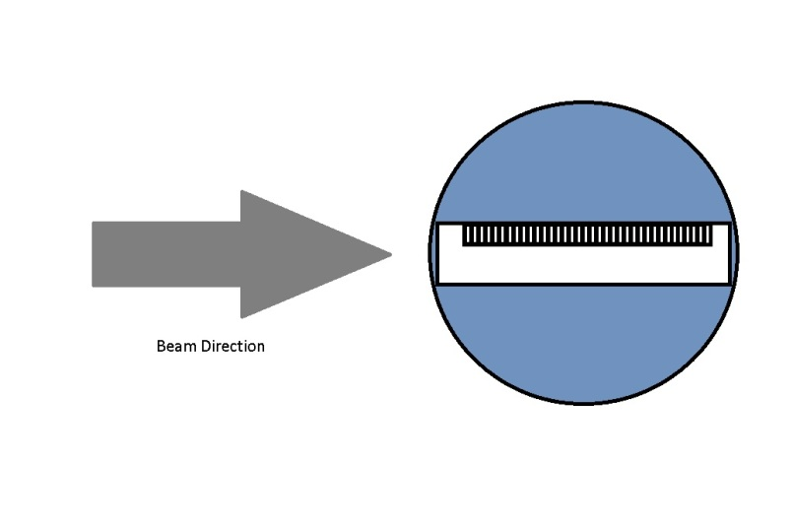
Current/Future Work
Run Geant4 simulations to determine the effect of beam diameter on the observed position of the Bragg peak
Simulate proposed Eye Phantom with embedded DMG, for use in ocular cancer treatment QA

Slide 8
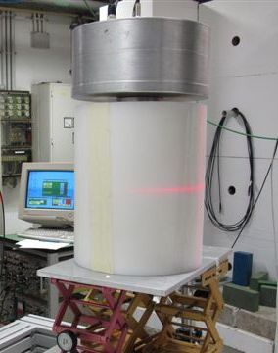
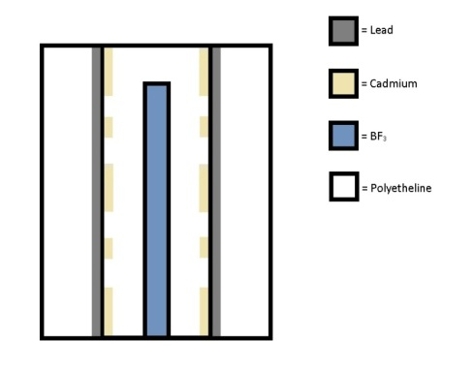
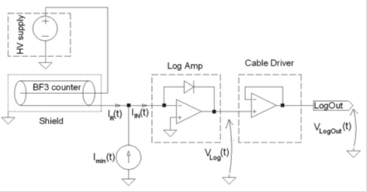
Current/Future Work
The LUPIN (Long interval, Ultra-wide dynamic, PIle-up free, Neutron rem counter) is an Extended Range neutron detector
Designed to work in Pulsed Neutron fields
Front end electronics allows current amplification without shaping the pulse
LUPIN at the Berlin Helmholtz-Zentrum Facility^{[18]}
Cross Sectional schematic of the LUPIN Moderator
Schematic of front-end electronics

Slide 9
Current/Future Work
At CERN, measurements were taken using several different detectors at the Proton Syncrotron
The detectors tested were: LINUS, LUPIN, Wendi, BIOREM, a Hydrogen and an Argon Ionisation Chamber
They were placed in 6 different positions, and measurements were taken with each detector in each position
Detector response was normalised to the PAXP data for each of the measurements, to eliminate dependence on magnitued of beam loss
Detector Response was then compared, to determine the capability of each to cope with the pulsed neutron field

Slide 10
Current/Future Work
As a result of the measurements at the CERN Proton Syncrotron, the following plots were obtained

Slide 11
Current/Future Work

Slide 12
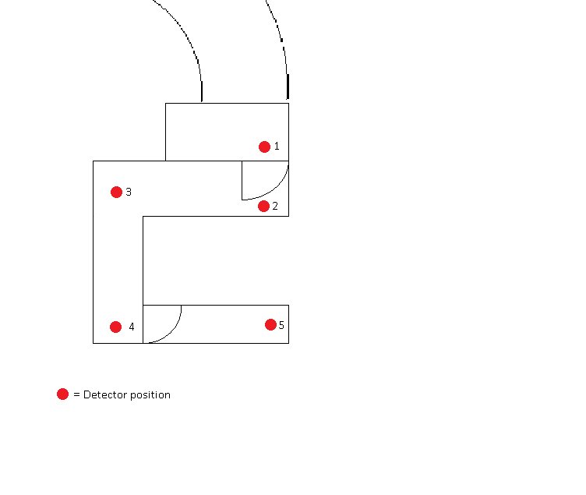
Current/Future Work
Measurements were also taken just at different positions in the ‘labrynth’ (a concrete-surrounded corridor, designed to prevent radiation reaching the outside areas)
A comparison is planned between the measurements and CERN’s simulated results

Slide 13
Current/Future Work
A third set of measurments were taken at the HiRadMat facility at CERN
During these measurements the detector position was varied, and the beam fluence altered
Several Plot of detector response vs beam fluence was obtained
An example plot follows

Slide 14
Current/Future Work
As a result of the measurements at the CERN HiRadMat facility, the following plots were obtained

Slide 15
Current/Future Work
Further Experiments to investigate the ability of the LUPIN to detect neutrons in pulsed fields – possibly at CNAO
Simulations to ensure the design of the detector does not influence response
Develop/Improve methods for Gamma rejection (Medical LINAC)
Improvement of the online digital data handling (FPGA)
Cross Sectional schematic of the LUPIN Moderator

Slide 16
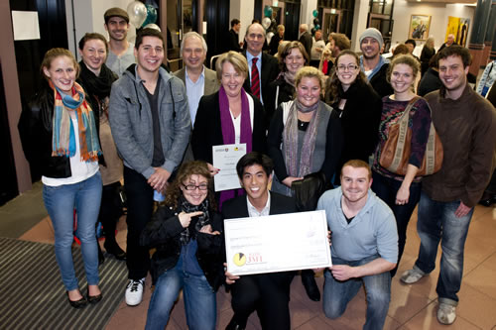
Current/Future Work
Attending MMND conference in Wollongong, Australia
Secondment at UOW with Prof. Anatoly Rozenfeld
http://www.uow.edu.au/content/groups/public/@web/@eng/documents/mm/uow127664.jpg

Slide 17
References
[1] Hiemstra, D. M. "LET Spectra of proton energy levels from 50 to 500 MeV and their effectiveness for single event eects characterisation of microelectronics". IEEE Transactions 50(6), 2245 - 2250, 2003.
[2] U.S. Department of Commerce, National Instiute of Standards and Technology, http://www.nist.gov/index.html, 4 August, 2010.
[3] Wittke, J. H. "Types of Signals", Northern Arizona University, http://www4.nau.edu/microanalysis/Microprobe-SEM/Signals.html, 2008.
[4] Aso, T. Kimura, A. Tanaka, S. Yoshida, H. Kanematsu, N. Sasaki, T. Akagi, T. "Verication of the Dose Distributions With Geant4 Simulation for Proton Therapy", IEEE TRANSACTIONS ON NUCLEAR SCIENCE, Vol. 52, No. 4, August 2005.
[5] Review of particle physics, Eur. J. Phys., Vol. 3, 1998.
[6] Kobayashi, A. S. Sternberg, A. L. Massengill, L. W. Schrimpf, R. D. Weller, R. A. "Spatial and Temporal Characteristics of Energy Deposition by Protons and Alpha Particles in Silicon", IEEE Transactions on Nuclear Science, Vol. 51, No. 6, December 2004.
[7] Johnson, L. R. Keeney, B. Ross, G. Sadrozinski, H. F. - W. Seiden, A. Williams, D. C. Zhang, L. Bashkirov, V. Schulte, R. W. Shahnazi, K. "Monte Carlo Studies on Proton Computed Tomography using a Silicon Strip Detector Telescope", Nuclear Science Symposium Conference Record, 2002.
[8] Agostinelli, S. et al. Geant4-a simulation toolkit, Nucl. Instrum. Methods Phys. Res. A, vol. A506, pp. 250303, 2003.
[9] Geant4 Physics Reference Manual, http://geant4.web.cern.ch/geant4/G4UsersDocuments/OvNovember 2004.
[10] Stopping powers and ranges for protons and alpha particles, ICRU, Bethesda, MD, ICRU Report 49, 1992-3.

Slide 18
[8] Agostinelli, S. et al. Geant4-a simulation toolkit, Nucl. Instrum. Methods Phys. Res. A, vol. A506, pp. 250-303, 2003.
[9] Geant4 Physics Reference Manual, http://geant4.web.cern.ch/geant4/G4UsersDocuments/OvNovember 2004.
[12] “Stopping powers and ranges for protons and alpha particles”, ICRU, Bethesda, MD, ICRU Report 49, 1992-3.
[13] Dowdell, S. Clasie, B. Wroe, A. Guatelli, S. Metcalfe, P. Schulte, R. Rosenfeld, A. Tissue “Equivalency of Phantom Materials for Dosimetry of Secondary Neutrons in Proton Therapy”
[14] Wong, J. H. D. Carolan, M. Petasecca, M. Lerch M. L. F. Khanna, S. Perevertaylo, V. L. Metcalfe, P. Rosenfeld, A.“A silicon strip detector dose magnifying glass for IMRT dosimetry”, 6th Jan, 2010
[15] Ferrarini, M. Varoli, V. Favalli, A. Caresana, M. Pedersen, B. °A widedynamicrangeBF3 neutron monitorwithfront-endelectronicsbased on a logarithmicamplifier °, Nucl. Instrum. Methods Phys. Res. A, vol. A613, pp. 272-276, 2010
[16] Caresana, M. Ferrarini, M. Manessi, G. Silari, M. Varoli, V. °LUPIN, A new instrument for Pulsed Neutron fields°, 2012
[17] Caresana, M. Ferrarini, M. Manessi, G. P. Silari, M. Varoli, V. °A neutron detector for pulsed mixed fields: preliminary measurements°, 2012
[18] Caresana, M. Denker, A. Esposito, A. Ferrarini, M. Golnik, N. Hohmann, E. Leuschner, A. Luszik-Bhadra, M. Manessi, G. Mayer, S. Ott, K. Rohrich, J. Silari, M. Trompier, F. Wielunski, M. °Intercomparison of radiation protection instrumentation in a pulsed neutron field°, 2012

