Slide 1



Eleni Sagia
ARDENT - ESR 14
PhD student at Politecnico di Milano
Supervisor: Prof. Stefano Agosteo
E.Sagia
Vienna - 20 November 2012

Slide 2
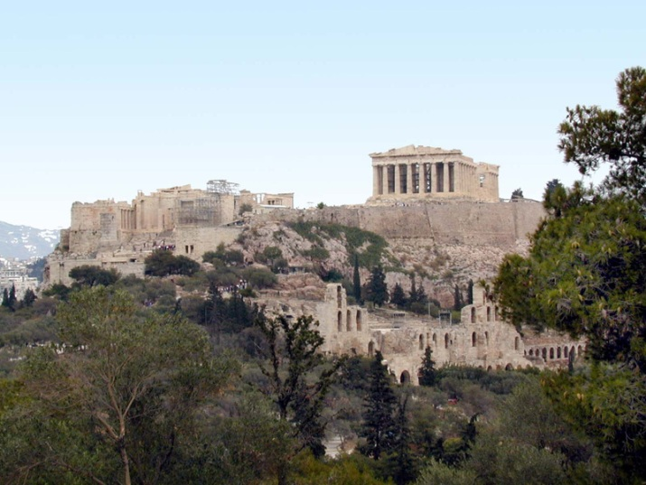
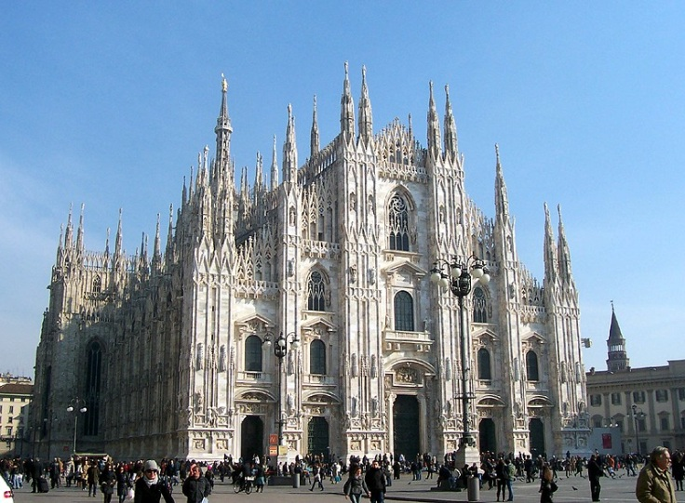
Personal Information
Hometown: Athens, Greece
Current City: Milan, Italy
E.Sagia
Vienna - 20 November 2012

Slide 3



Education
Diploma in
Applied Mathematical and Physical Sciences (2010)
MSc in
Medical Physics and Radiation physics (2012)
Research activity in the Radiation Protection Group
(MSc Thesis)
E.Sagia
Vienna - 20 November 2012

Slide 4
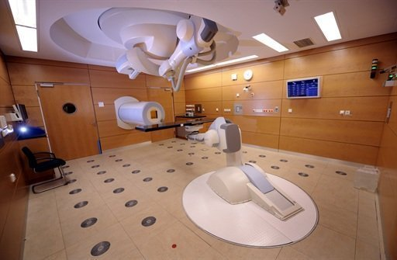
Previous work
Monte Carlo simulations of ion beams on iron and tissue target for determining shielding parameters for accelerators used for hadron therapy
Supervisor: Dr. Marco Silari
E.Sagia
Vienna - 20 November 2012

Slide 5
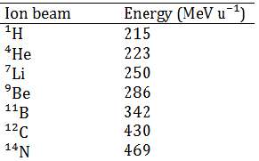
FLUKA Simulations
Monoenergetic pencil ion beam impinging on thick target
Range: 29cm in ICRU tissue
Target geometry
Fe 60mm thickness right cylinder
ICRU TE 350mm thickness right cylinder
E.Sagia
Vienna - 20 November 2012

Slide 6
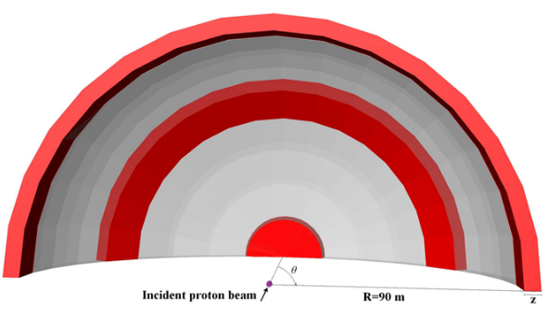

FLUKA Simulations
Shielding geometry
Concrete sphere
ρ=2.31 g${\text{cm}}^{−3}$
Shielding parameters
Source term (Sv m² per primary)
Attenuation length (g ${cm}^{−2}$)
E.Sagia
Vienna - 20 November 2012

Slide 7
Future work (I)
Solid State Microdosimetry
“The fluctuations of energy deposited in individual cells and sub cellular structures and the microscopic tracks of charged particles are the subject of microdosimetry”
ICRU103
E.Sagia
Vienna - 20 November 2012

Slide 8
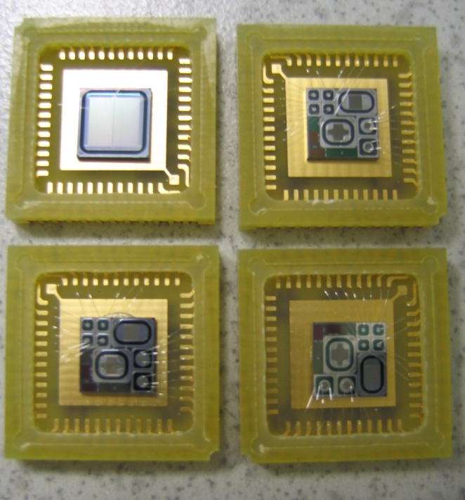
Future work (II)
Objectives
Development of silicon microdosimeters for assessing the quality of hadron therapy fields
Monte Carlo simulations in order to study the detector response to radiation field facilities
Experimental measurements at several treatment facilities (CNAO, CATANA)
Comparison with other detectors in the framework of the ARDENT project
E.Sagia
Vienna - 20 November 2012

Slide 9
Segmented silicon telescope
Matrix of cylindrical ∆E elements (about 2 µm in thickness) and a single residual-energy E stage (500 µm in thickness)
the nominal diameter of the ∆E elements is about 9 μm and the width of the pitch separating the elements is about 41 µm
  more than 7000 pixels are connected in parallel to give an effective sensitive area of about 0.5 mm²
  the ∆E stage acts as a microdosimeter while the E stage provides the LET-dependent correction for tissue-equivalency
E.Sagia
Vienna - 20 November 2012
Notes:
Minimum detectable energy 20keV due to electronic noise

Slide 10

Future research activity plans
Secondment with Prof. Rozenfeld
Wollongong, Australia
MMND & IPCT 2012
Wollongong, Australia
PSI Winter School for Protons 2013
Experimental measurements at INFN-LNL for characterization of the detector
Secondment with P. Colautti & involvement in the MITRA project
INFN-LNL, Italy
Secondment with Prof. Waker
University of Ontario Institute of Technology, Canada
E.Sagia
Vienna - 20 November 2012

Slide 11

The end!
Thank you for your attention!
E.Sagia
Vienna - 20 November 2012

