Slide 1
Understanding beam-beam interactions with Guinea-Pig simulations
Raiymbekov Y. A.

Slide 2
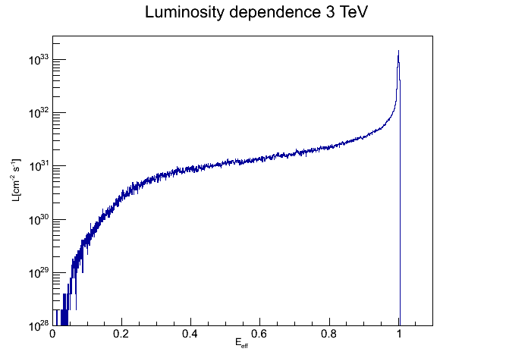
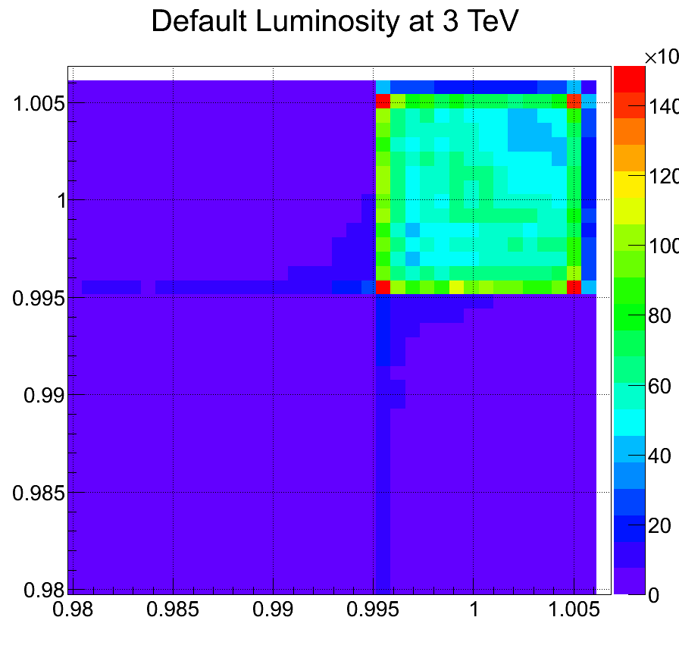
MOTIVATION
- cross section formula, - energy in c.m.
L - luminosity, N – number of events
Luminosity spectrum
GOAL:
Make good observation of Luminosity dependence on machine parameters for CLIC at 3 TeV using Guinea-Pig simulations

Slide 3
Beam-beam interaction at high energy:
Interaction region beam size:
Luminosity
EM field of oncoming beam
Beamstrahlung photons per electron

Slide 4
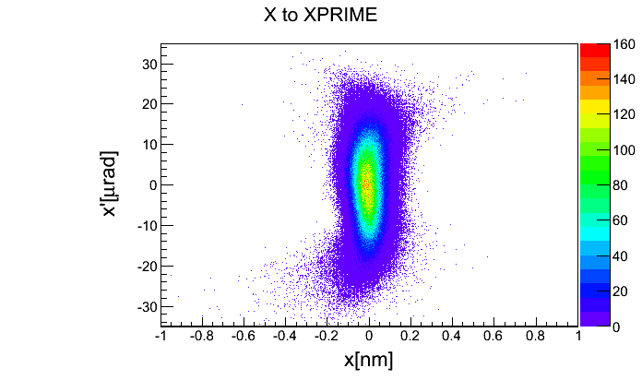
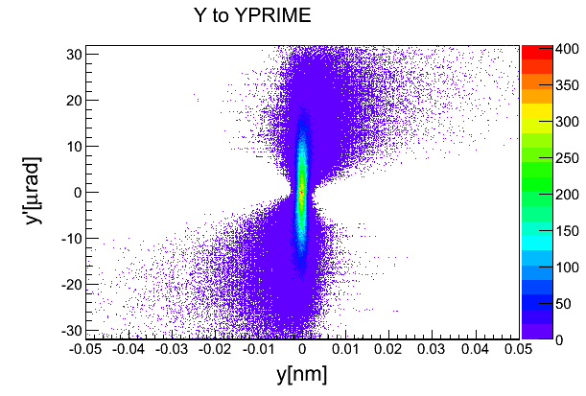
Beam size, beta function and emittance
Beam size
Beta function is reflection of focusing magnets all
along the linacs.
The transverse emittance - the volume in the phase
space of position x and normalized momentum x’.
b
a

Slide 5
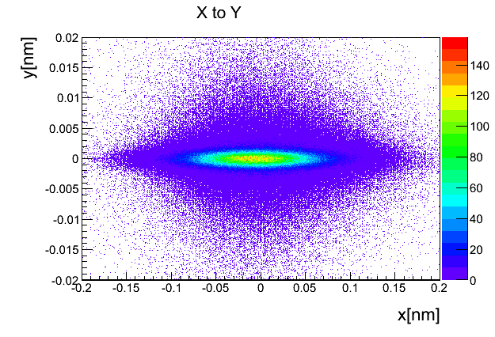
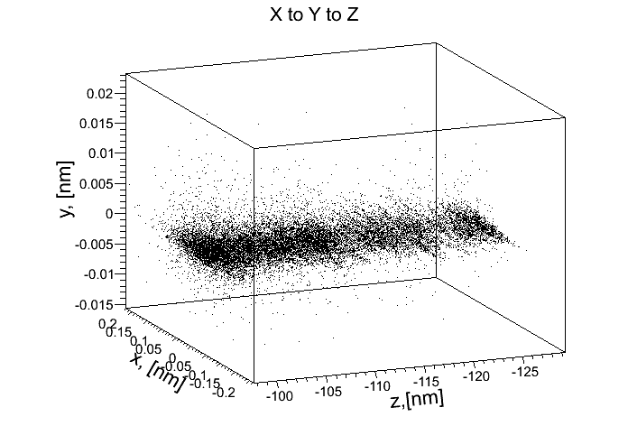
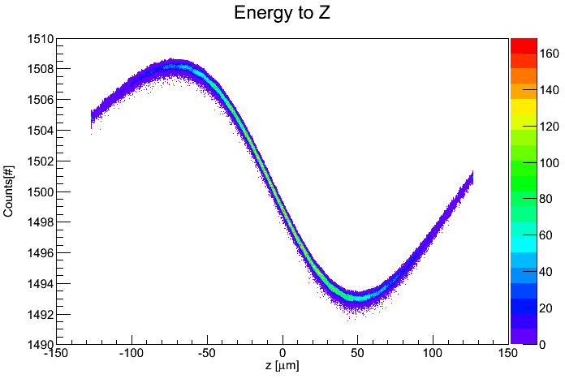
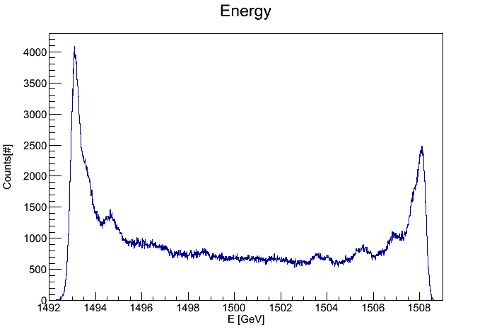
Beam parameters of CLIC
Total luminosity(1/cm² s): 5.9 *10³⁴
Bunch charge(10⁹ e⁻/e⁺): 3.72
Bunch lengh(μm): 44
Hor./vert. IP beam size(nm): 40/1
Beta function(mm): 6.9/ 0.068
Hor./vert. emittance
(10⁻⁵/10⁻⁸ mrad) : 6.6 /2
Beamstrahlung photons per electron: 2.2
z,[μm]
Beam goes

Slide 6
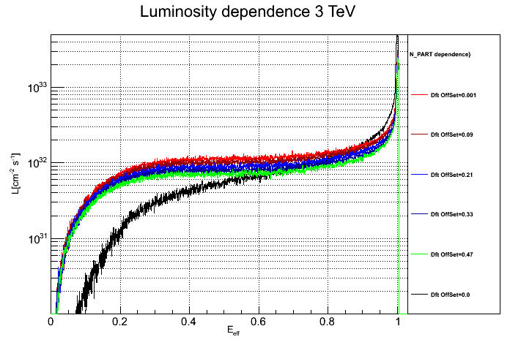
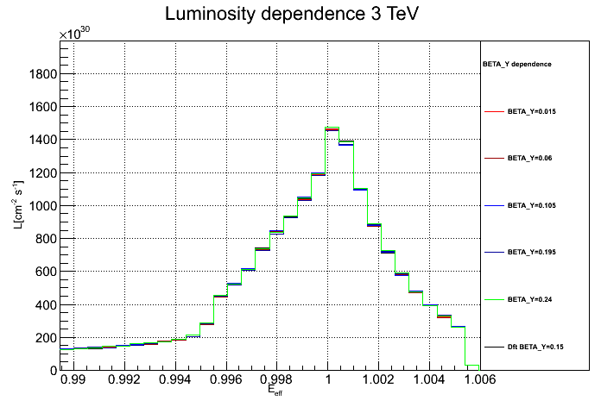
Guinea-Pig simulations bases
Accelerator
Simulation
Beam generator
ENERGY
N_PART
BETA_X
BETA_Y
EMIT_X
EMIT_Y
E_spread
Offset, N_PART
electrons
positrons
Guinea-Pig
Luminosity spectrum
Guinea-Pig

Slide 7
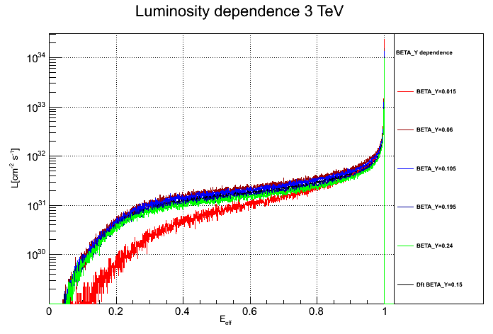
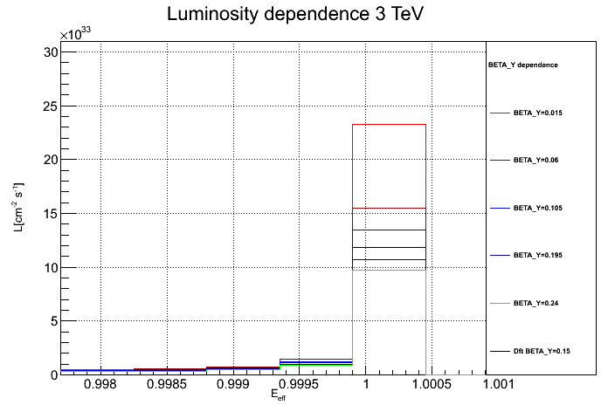
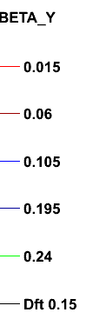
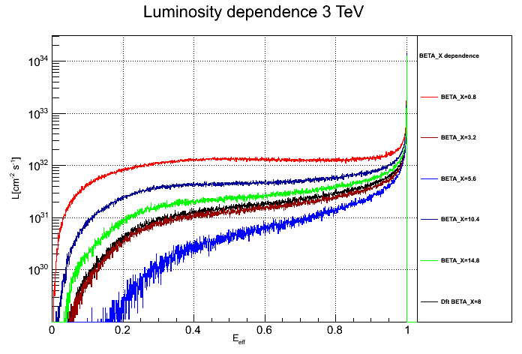
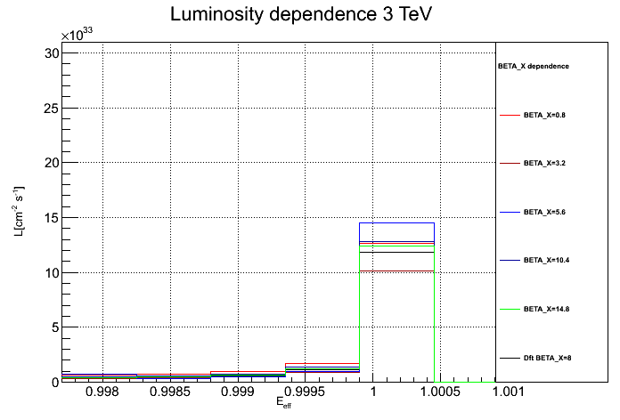
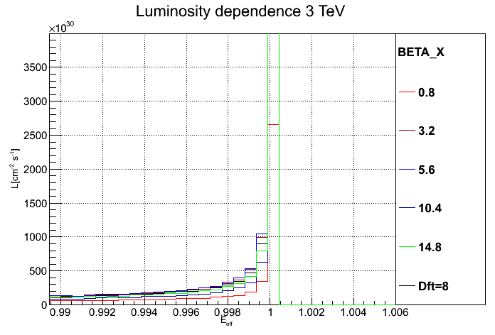
Changing BETA_Y
Changing BETA_X

Slide 8
2D luminosity spectrum
#1
E_{beams}=1.5 TeV
“HEAD_e” with E_{1e} ~ 1.51 TeV > E_{beam-e}
“HEAD_p” with E_{1p} ~ 1.51 TeV > E_{beam-p}
#1
H_{beam-e}-H_{beam-p}
- The majority of front particles is not affected by strong field of oncoming bunches and doesn’t lose energy.
- The interaction region of particles is in top-right position.

Slide 9
2D luminosity spectrum
#2
E_{beams}=1.5 TeV
“TAIL_e” with E_{1e} ~ 1.49 TeV < E_{beam-e}
“TAIL_p” with E_{1p} ~ 1.49 TeV < E_{beam-p}
T_{beam-e}-T_{beam-p}
- The interactions of particles with lowest energy.
- The events with this interaction is in the bottom-left region.
29.08.2012
9

Slide 10
2D luminosity spectrum
#3
E_{beams}=1.5 TeV
“TAIL_e” with E_{1e} ~ 1.49 TeV < E_{beam-p}
“HEAD_p” with E_{1p} ~ 1.51 TeV > E_{beam-p}
#3
H_{beam-p}-T_{beam-e}
-The head of the beam H_{beam-p} interacts with the tail T_{beam-e} of other beam.
- Similar for the H_{beam-e}-T_{beam-p} interaction. Last corner of the peak of the 2D luminosity spectrum.

Slide 11
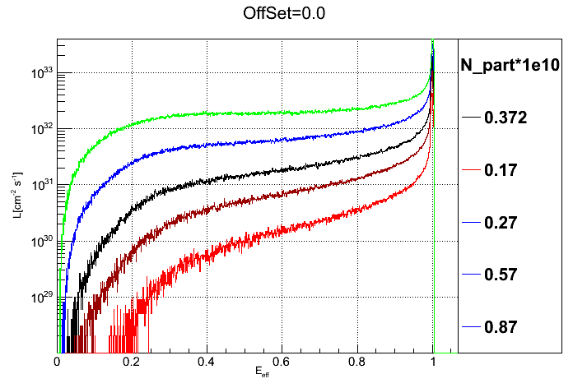
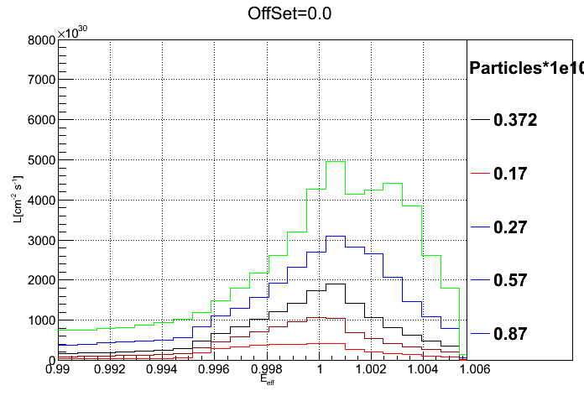
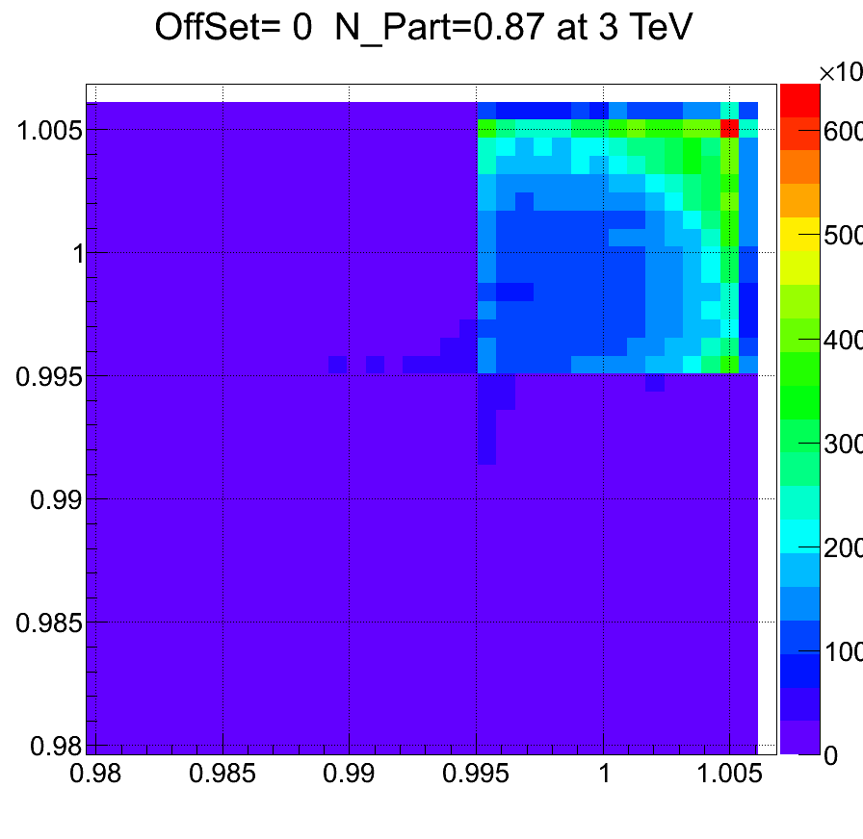
Changing the number of particles from external file and with generated energy spread
The 2D luminosity with high number of particles doesn’t have T_{beam-e}-T_{beam-p}
interaction, because of beamstrahlung.

Slide 12
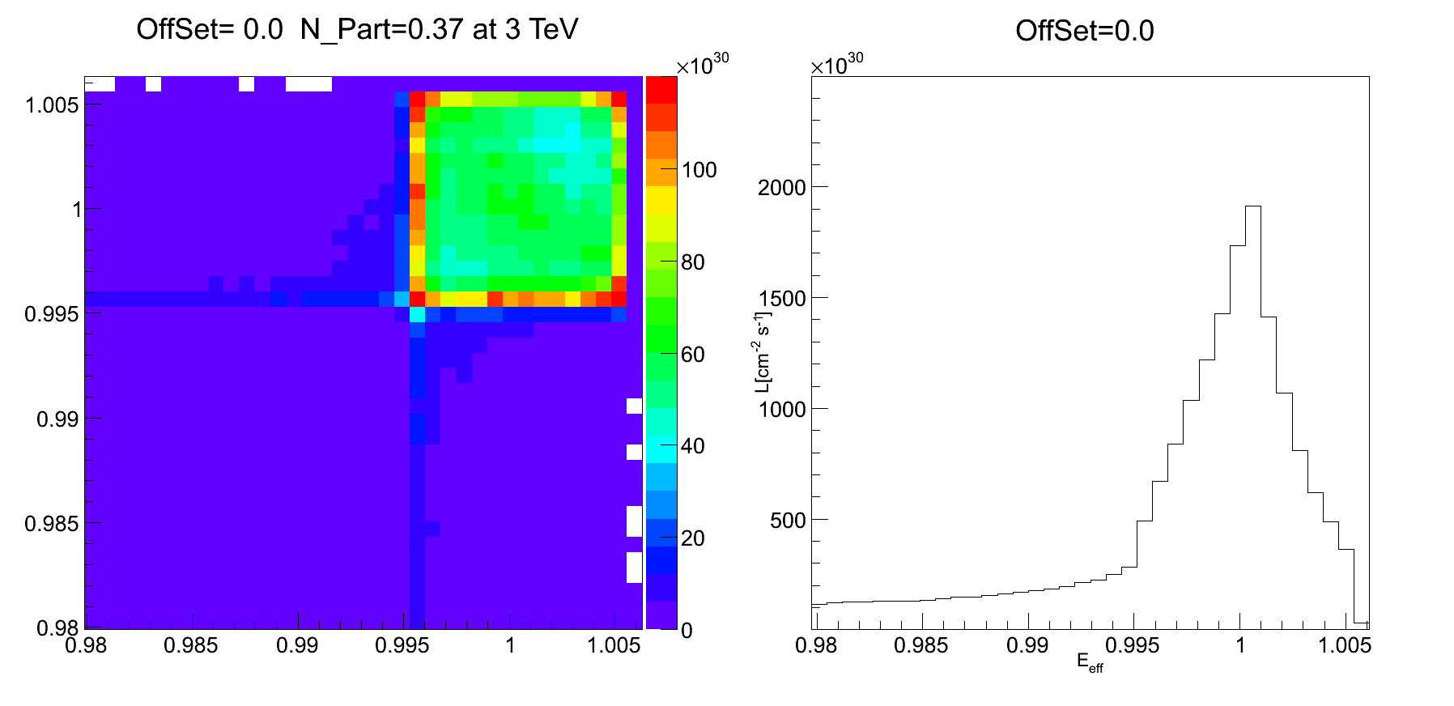
Changing the offset
The Luminosity decreases with a increasing the offset because of beamstrahlung and disruption.

Slide 13
Summary
Understood beam-beam interaction with Guinea-Pig.
Studied dependency of the luminosity on some parameters of generated beam and from external sources:
  Number of particles, energy, energy spread, beta function, emittance, offset, etc.
Beam parameters impact shape of luminosity spectrum.

Slide 14
Thank you !!!

