Slide 1
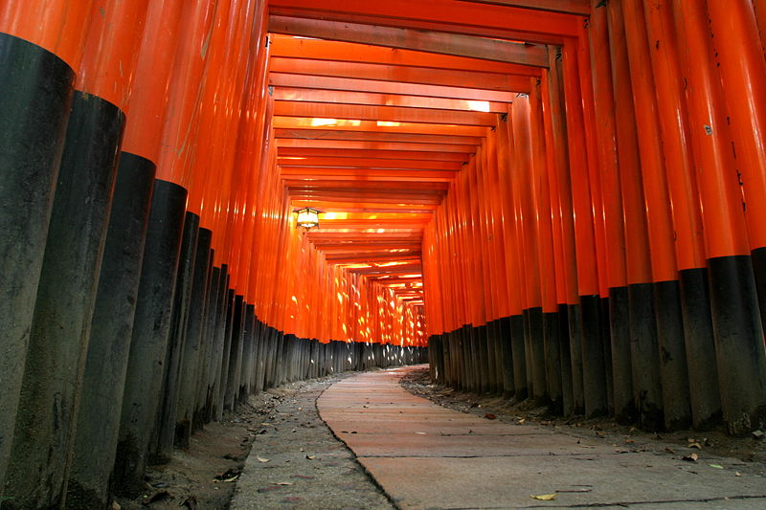
Brief (!!) Outlook as we enter the
2nd Age of Obama
QMUL
November 7, 2012
Dave Wark
Imperial College London/RAL

Slide 2
Non-controversial statements?
Neutrino oscillations are still the only BSM particle physics seen which we can experimentally explore.
The “large” values seen for θ₁₃ compel us to push ahead and fully characterize 3ν oscillations.
LHC upgrades will use up most of the money available for HEP in Europe over the next decade.
A Japanese ILC could use up the rest.
If we want new experiments, we have to make our case, and be prepared to compete.
Compelling experiments will not be cheap…

Slide 3
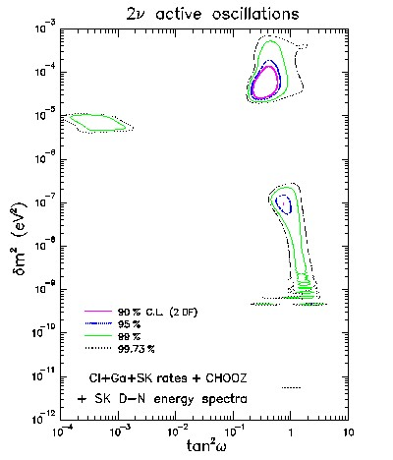
A word of caution about Global Fits…
Global Solar ν fit
prior
to SNO/KamLAND

Slide 4
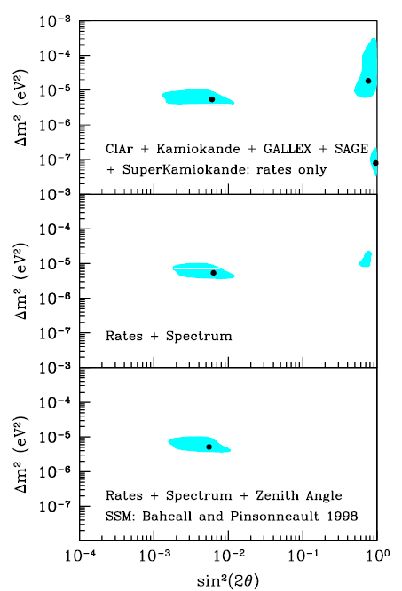
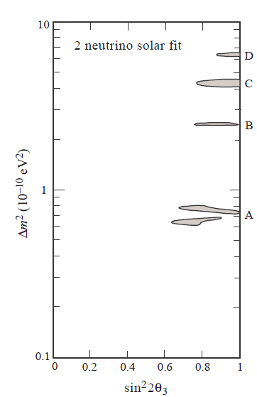
These are 99% c.l. contours!
Global Fits do not replace compelling experiments, particularly in ν physics!

Slide 5
Non-controversial statements?
The UK should make the most of its investments in T2K and MINOS by continuing support for the effective exploitation of T2K and MINOS+.
Longer term, we will want a Neutrino Factory to measure δ to an accuracy comparable to what is known for the CKM matrix.
We should therefore make sure that MICE is successfully completed, which will require continued support and investment.

Slide 6
The UK and T2HK?
T2HK would significantly extend our sensitivity to CP violation in neutrino oscillations.
It would be daft (as well as impolitic) for the UK to throw away its investment in T2K by not participating in T2HK if it proceeds.
As a minimum the UK should continue to operate its contributions to the ND280 and contribute to software/analysis – this is something that we could/should be doing now!
The UK could also consider contributing calibration devices/expertise and/or other detector contributions.
The UK has lots of accelerator institutes – could these contribute to improving the JPARC MR?
If a 2km detector is built, we should consider a major involvement.

Slide 7
The NF and nuStorm?
There is continuing confusion concerning indications (which are partially inconsistent) from quite a number of different experiments of oscillations which are inconsistent with the standard 3ν oscillations.
Several proposals exist to do additional tests in conventional neutrino beams, however it is unclear whether these will actually resolve the situation.
nuStorm uses a different, inherently cleaner neutrino beam, and claims 10σ sensitivity to such non-standard oscillations, which would make a compelling test.
nuStorm would also be a very valuable step towards a Neutrino Factory, and measure cross-sections we need to know.
The UK should seriously consider playing an active role in the experiment (whether at CERN or Fermilab).
A discussion meeting is being organized at Imperial on Nov. 15th, contact Ken Long for details.

Slide 8
LBNO/LBNE/GLADE?
The physics capabilities of LBNO are superior as currently configured (and if the beam from Protvino is added, become overwhelming), but politics may say something different.
In my view, the UK should set as minimum requirements for participation in LBNE that the experiment should:
  Put the far detector deep underground.
  Make it big enough to reach its sensitivity in reasonable time (defined as MTTR).
  Build a world-class near detector.
  Restructure the collaboration for effective international participation.

Slide 9
LBNO/LBNE/GLADE?
GLADE or other experiments in the NuMI beam are an interesting option, but need to show they would offer significant sensitivity advances over T2K/NOvA.
It is highly likely that one of these experiments will feature a large LAr tracking calorimeter.
A high-pressure gaseous Ar TPC could be designed as the near detector for either LBNE or LBNO.
The short-term programme is could be similar in all cases, which is to get more strongly involved in LAr development, particularly the proposed test detectors at CERN.
That takes us into the next ½-day meeting!
There are many great opportunities in this field that are in the cost range of our usual particle physics projects.
JOIN IN!

