Slide 1
WLCG Status
Ian Bird; WLCG Project Leader
LHCC Referees Meeting
25th September 2012

Slide 2
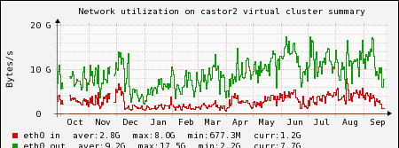
Castor data written 2010-12
2012 Data written:
Total ~19 PB in 2012
Close to 4 PB/month now
Data rates in Castor increased
3-4 GB/s input
~15 GB/s output

Slide 3
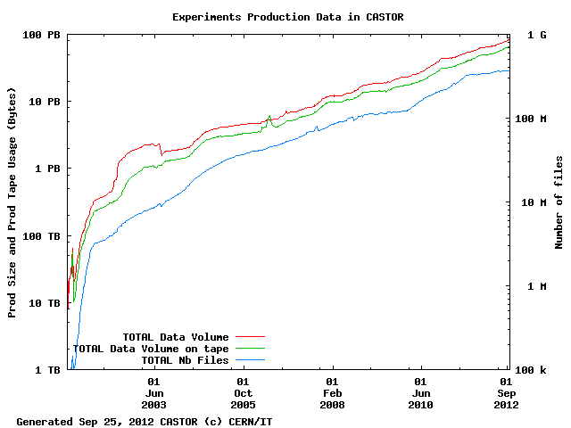

Slide 4
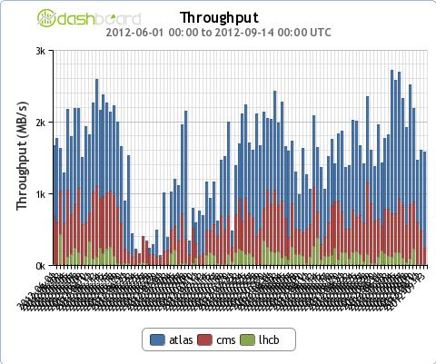
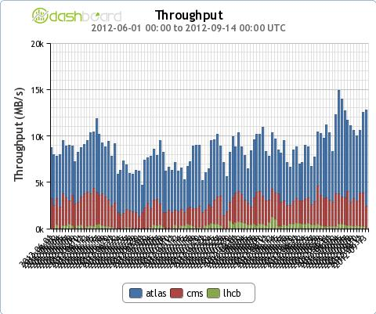
Data in 2012
CERN export: 2 GB/s
June – Sep 2012
Global transfers > 10 GB/s

Slide 5
Operations
Operations over the summer quite smooth
No particular problems
Ongoing LSF issue at CERN:
  Slowdown of response – heavy user load
  Related to scale & complexity of CERN set up
  Some mitigations being implemented
  Review long-term strategy

Slide 6
Tier 0 upgrades
CERN CC – extension
  Scheduled for completion Nov 2012 – still on track
  Required for 2013 equipment installation
Wigner centre
  Site visit last week – progress on schedule
  Expect to be able to test first installations in 2013
  Networking CERN-Wigner (2x100 Gb): procurement ongoing
  Latency testing for 2 months
    Fraction of lxbatch with 35 ms delay – no observed effects

Slide 7
Evolution of resources
2012: pledges
2013-15: latest requests

