Slide 1
LHCb resources updates for 2012-2015
Marco Cattaneo
CERN – LHCb
On behalf of the LHCb Computing Group

Slide 2
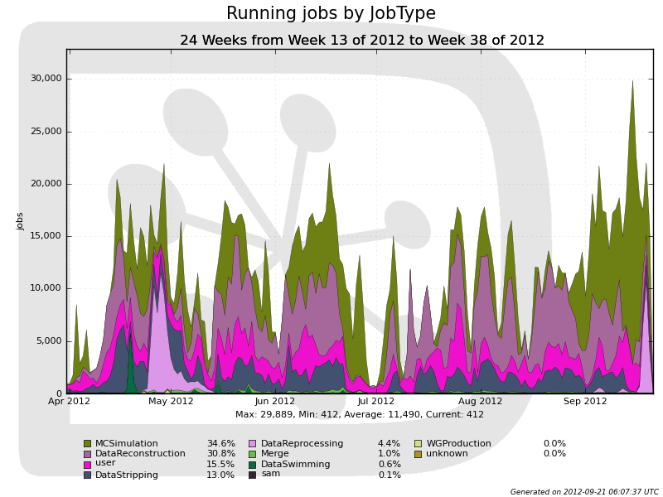
LHCb computing production activities in 2012
Prompt processing (reconstruction and stripping) of new data
“Swimming” of 2011 stripped data
MC production
  Large samples for analysis of 2011 data
  Preliminary samples for 2012 data
Reprocessing of complete 2012 dataset
  Started 17th September
Resources OK until now:
  CPU usage 50% of pledge
    As expected for first half
    of year
      now ramping to >100% with
      reprocessing
  2012 disk pledge ~sufficient
  also for reprocessed data
    Active data management
  Major shortage of tape, already using full pledge at Tier1s!
    Pledge based on 2012 request, assuming shorter run
    Major problem for the future (rest of 2012, but also 2013)

Slide 3
Changes since 2012 request
New reconstructed data format:
  Previously, Reco output (SDST) did not contain copy of RAW
    Both RAW and SDST files had to be staged, synchronously, when restripping
    Very demanding on tape systems, since in general on different tapes
    Does not allow to achieve maximum throughput
  Now write FULL.DST, containing RAW+SDST
    Effectively an extra copy of RAW on Tape
Data taking changes
  Extension of pp run by 2 months
  LHCb operation at higher instantaneous luminosity
    4x10³² cm⁻²s⁻¹ (3.7 in 2011)
  Higher HLT output rate
    (2011: 3kHz, 2012 forecast: 4.5kHz, 2012 actual: 5kHz)
  Participation in pA (heavy ion) run in early 2013

Slide 4
Effect of changes on computing resources
RAW data: 1.7 PB
  43% increase with respect to previous estimates (1.2 PB).
    Two copies on tape
Reconstructed data (FULL.DST):
  3.1 PB, 120 % increase with respect the previous estimate (SDST, 1.4 PB)
    One copy on tape
Derived datasets (DST, MDST for physics analysis)
  43% increase
    disk resident, plus tape archive
Heavy Ion RAW data: 100 TB
Higher CPU peak power for reprocessing
  Originally foreseen after data-taking, now in parallel to be ready for Winter 2013 conferences
    Clashes with prompt processing (data quality, fast analyses)
    Cannot use resources of HLT farm

Slide 5
Mitigation to fit into 2012 pledges
CPU:
  Reduce prompt processing to 50% of new data
    Only at CERN, 20% sub-contracted to Tier2s
    Only for data quality etc., no physics analyses using these data
  Reprocessing extended by two months
    Only at Tier1s, 20% sub-contracted to Tier2s
    Only ~60% of 2012 data available for Winter 2013 conferences
Tape:
  Removed NOW all output of 2012 prompt reconstruction
    Needed for restripping
      No new analyses until reprocessing completed
  Reduce all archives (data preservation) to one copy
Disk:
  Aggressive reduction of 2012 prompt DST/MDST copies
    In parallel with appearance of reprocessed data
  New distribution policy taking into account unused pledge
    In practice, replicas of reprocessed data will go mostly to CERN, RAL, CNAF, GRIDKA

Slide 6
Storage: forecast for March 2013
Disk OK but big imbalance between sites (backup slide)
Serious shortfall in tape, no solution yet
  Already cleaned up all 2012 prompt SDST to fit in existing tape
  No room at Tier1s for second copy of new RAW, and for ONLY copy of FULL.DST

Slide 7
2013-2014
Activities during 2013-2014
  Several restrippings, ~every 6 months
    ~ neutral in disk usage since older strippings get replaced
    moderate increase in tape (archive copy)
  Full reprocessing of 2011-2012 data, during 2014
    Ultimate reprocessing of this dataset
    Duration stretched to fit within existing CPU resources
    ~neutral on tape (FULL.DST replaces previous version)
  Continuing MonteCarlo production at constant rate
    Higher rate than previous estimates to match increased real data sample
      But no increase in Tier2 CPU request, use HLT farm instead
    Linear increase in disk and tape
Requests for 2013-2014 (details in backup slide)
  CPU: 20% increase at Tier1 in 2013, otherwise flat
  Disk: 20% increase per year at Tier1, 25% per year at CERN
  Tape: 100% increase in 2013 at Tier1, 10% in 2014
    Tape increase actually needed ASAP, April 2013 is too late.

Slide 8
Resources after LS1
Date of startup for physics, and number of physics days in 2015
    LHCb nominal luminosity reached rather quickly (lumi levelling). Assume:
      Any data taking before April 2015 has insignificant impact on 2014 resources
      5*10⁶ seconds in 2015, at nominal data rates (i.e. ‘normal’ year)
Changes in data-taking rate (not precisely predictable yet)
    Average multiplicity of pp collisions
      Higher than at 8 TeV
    Effect of pileup on RAW size
      With 25ns bunch spacing, lower multiple interaction rate but greater spillover from out of time events
    Operating luminosity at LHCb IP
      Considering up to 50% higher than in 2012, may lead to higher HLT rate
    HLT bandwidth allocation to different physics channels
      To be studied during LS1, may lead to significant changes in rate
Assume all above lead to doubling of data rate (MB/s) from HLT
    Currently limited by DAQ to 700 MB/s
    Doubles also all derived (reconstruction, stripping) data formats
    CPU time scaled with data volume
2015 equivalent to 2011+2012 combined.
  Resources needs are ~doubled compared to 2014 (see backup slide)

Slide 9
BACKUP

Slide 10
Resources imbalance
Evolution of disk pledges at Tier1s
Changes balance of resources among sites
  Preferentially clean old data from sites below share
  Available space used as weight for placing replicas of new data
E.g. 2012+2011 reprocessed data distribution will be:
Consequence: analysis of 2011 and 2012 reprocessed data will not use all Tier1s according to their CPU share

Slide 11
2013-2014 requests (LHCb-PUB-2012-014)
N.B. 2012 column is what is needed to complete processing of 2012 data, after all possible mitigations

Slide 12
First estimate of resources in 2015
(LHCb-PUB-2012-015)

