Slide 1
ALICE experiment at the LHC
  Dieter Roehrich
  UiB, Norway
What is matter?
The Large Hadron Collider at CERN
The ALICE experiment at the LHC

Slide 2
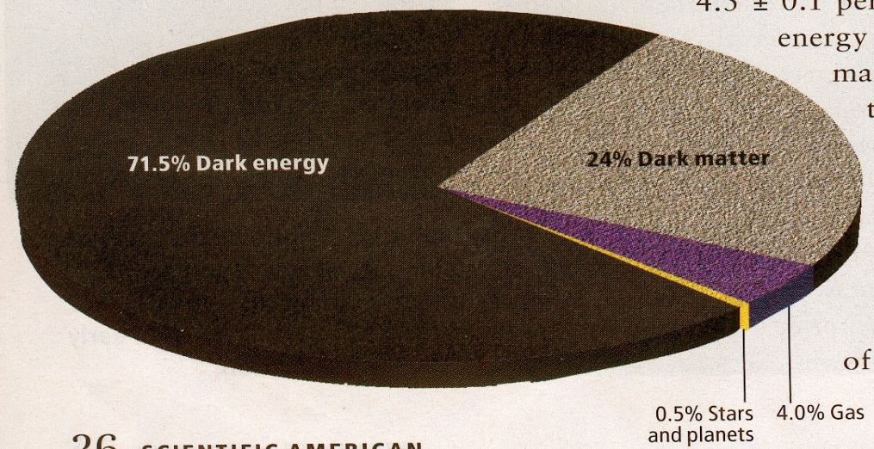
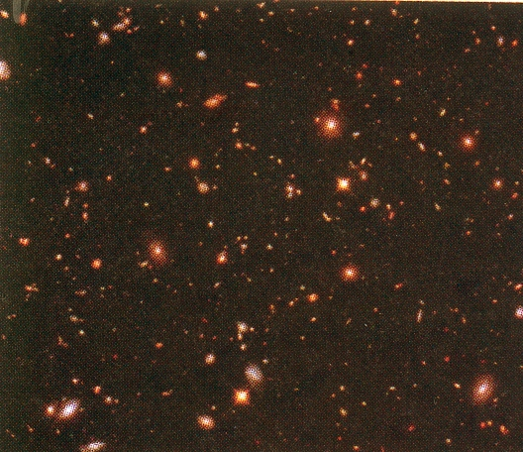
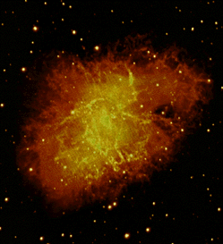
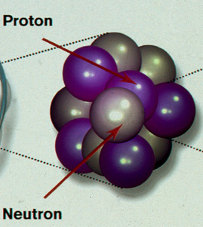
What is matter?
Constituents of the universe
visible universe
M.S. Turner, Sci. Am., Sep. 2009
”QCD-matter”
made up of quarks and gluons - macroscopic manifestion of the strong interaction
nuclear matter @ nuclei
q
q
q
q
q
q
q
q
q
neutron/
quark matter
@ neutron stars?
q
q
q
q
q
q
q
q
q
q
q
q
q
quark-gluon
matter
@ LHC
q
q
q
q
q
q
q
q
q
q
q
q
q
q
q
q
q
q
QCD = Quantum ChromoDynamics

Slide 3
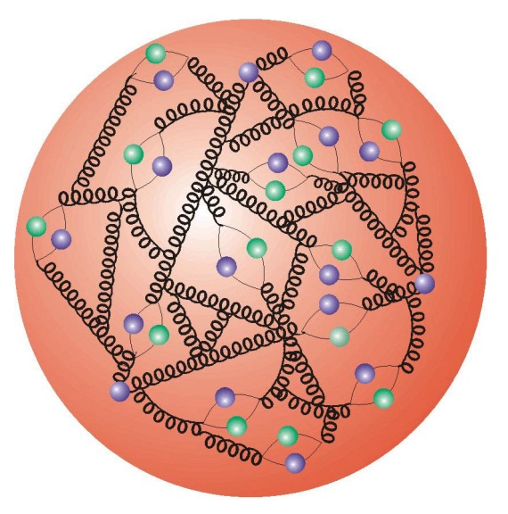
What is a proton?
Looking into a proton:
x: momentum fraction of the proton carried by the parton
u
u
d
low resolution
A proton is not, in fact, simply made up of three quarks (uud).
There are actually 3 “valence” quarks (uud) + a “sea” of gluons and short-lived quark-antiquark pairs.
high resolution

Slide 4

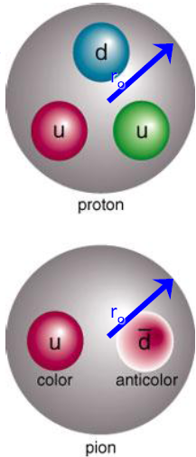
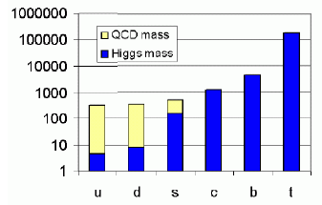
Questions
Confinement
  Quarks and gluons are confined bags of radius r₀
  All hadrons (baryons and mesons) have the same radius
    Characteristic length scale: r₀ = 1 fm
    Characteristic energy scale: hc/ r₀= 200 MeV
Generation of mass
  m_{up} ≈ m_{down} ≈ few MeV/c²
  Nucleon mass ≈ 940 MeV/c²
  Dynamic generation of mass!

Slide 5
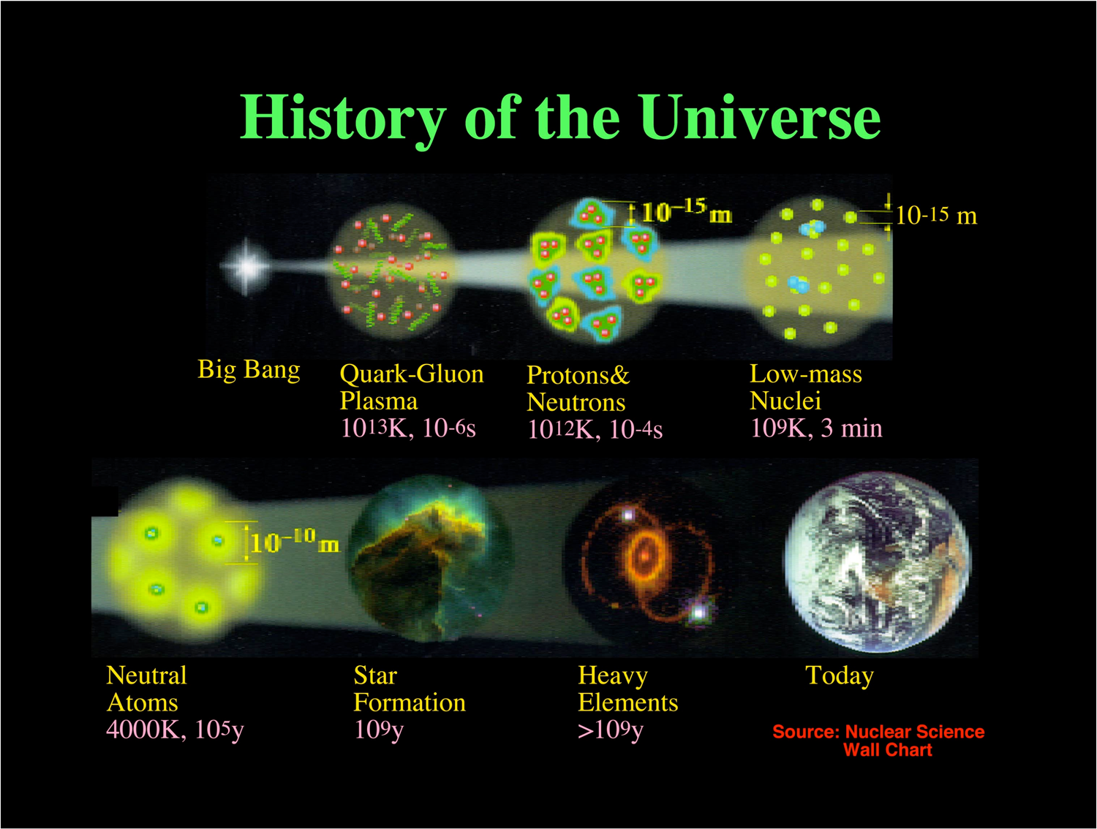
More questions
History of the universe
  first 10 μsec:
  energy density
  ≈ 1 GeV/fm³
  temperature
  ≈ 160 MeV
  hot soup of quarks,
  leptons and force
  carriers,…
  properties of new
  states of matter at
  high temperatures
  and densities

Slide 6
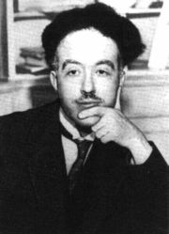

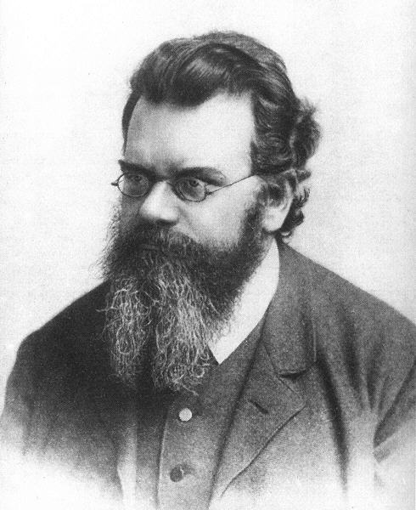
Why do we need particle accelerators?
To accelerate particles to high energies!
The higher energies allow us
to look deeper into matter
(E α 1/size), (“powerful microscopes”)
de Broglie
ii) to discover new, heavier particles
(E = mc²)
Einstein
to probe matter at extreme conditions;
to probe conditions of the early universe
(E = kT)
Boltzmann
Notes:
6

Slide 7
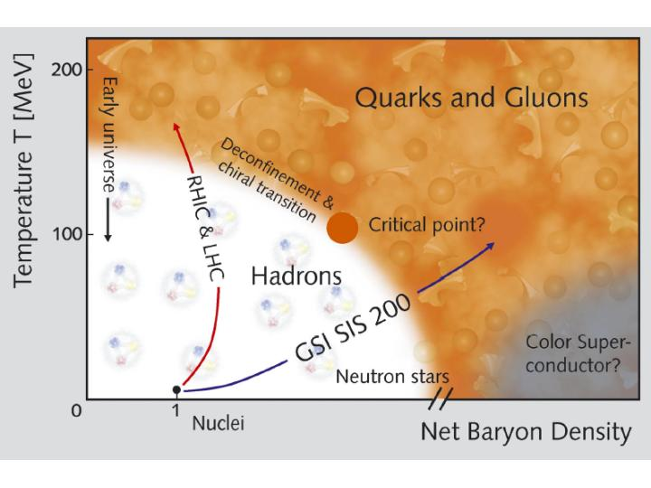

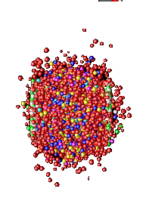

The QCD phase diagram
Goal: exploring phases and structures of the QCD phase diagram
Tool: (Ultra-)relativistic heavy ion collisions
hot & dense

Slide 8
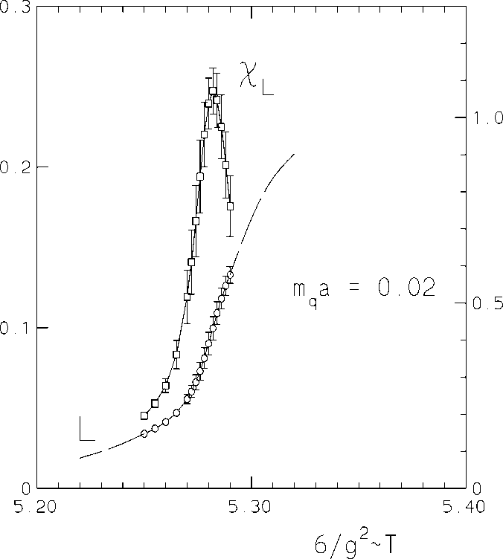
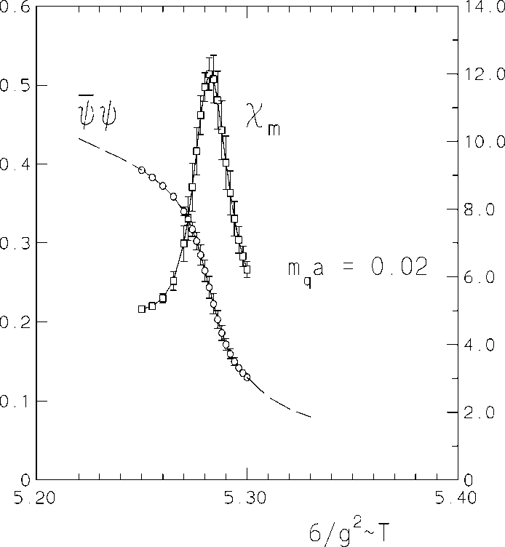
The phase transition – lattice calculations
L∼exp(F/T)
F: free energy, T: temperature
color mobility
deconfinement
color confinement
ψψ: effective quark mass scale
massive ”constituent” quarks
chiral symmetry restoration
massless ”current” quarks
F. Karsch, Lect. Notes Phys. 583, 209 (2002)

Slide 9
Rephrasing it ...
Habe nun, ach! Philosophie, Juristerei und Medizin, Und leider auch Theologie
Durchaus studiert, mit heißem Bemühn.
Da steh ich nun, ich armer Tor!
Und bin so klug als wie zuvor;
[...]
Drum hab ich mich der Magie ergeben,
[...]
Daß ich erkenne, was die Welt
Im Innersten zusammenhält, ...
I've studied now Philosophy
And Jurisprudence, Medicine,--
And even, alas! Theology,--
From end to end, with labor keen;
And here, poor fool! with all my lore
I stand, no wiser than before:
[...]
Wherefore, from Magic I seek assistance,
[...]
That I may detect the inmost force
Which binds the world, and guides its course;
…
Goethe, Faust I, Vers 382 f.

Slide 10
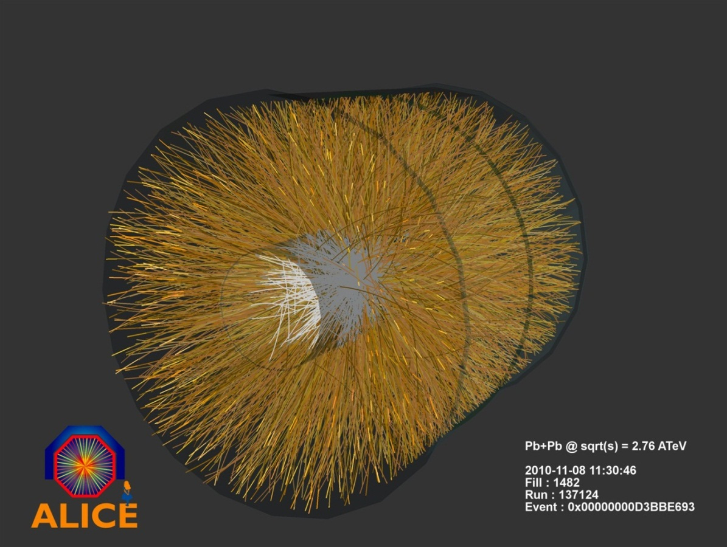
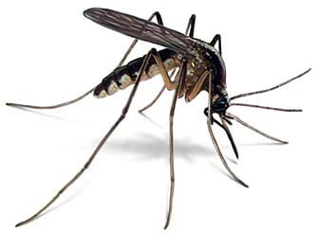
Heavy Ion Collisions at the LHC
On Sunday November 7th, 2010, the ALICE experiment recorded the very first Pb-Pb collision
fireball – a billion times hotter than the sun
Collision of two lead nuclei at 5.5 TeV per nucleon pair = 1100 TeV
macroscopic energy
1100 TeV = 0.2 mJ
≈ collision of two mosquitos
BUT
energy is squeezed into a
microscopic volume

Slide 11


First results from the LHC
Can we talk about matter?
  Does the matter show collective behaviour (hydrodynamic flow)?
  -> yes
Is the matter deconfined?
  Does the matter consist of quarks and gluons?
  Is the matter opaque to partons (quarks and gluons) traversing it?
  -> yes

Slide 12

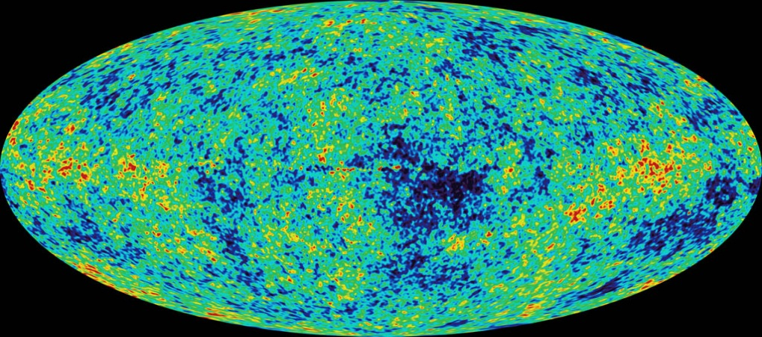
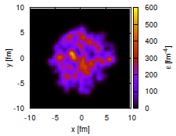
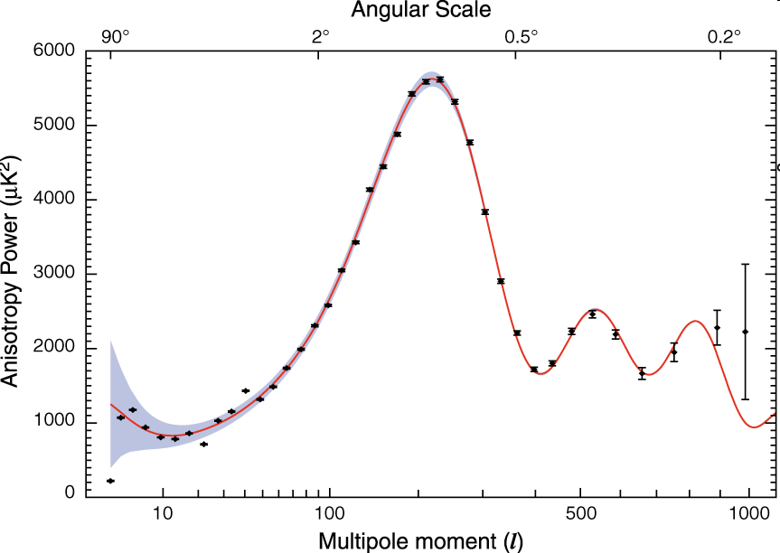
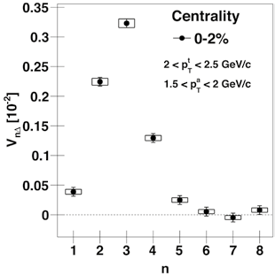
Little Bangs vs Big Bang
Many small events
Strong initial
fluctuations
Asymmetric event shape
One large event
very homogenous
Evolution of the fluctuating initial condition reveals matter properties

Slide 13
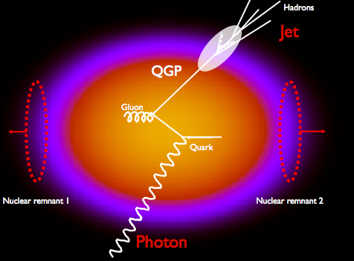
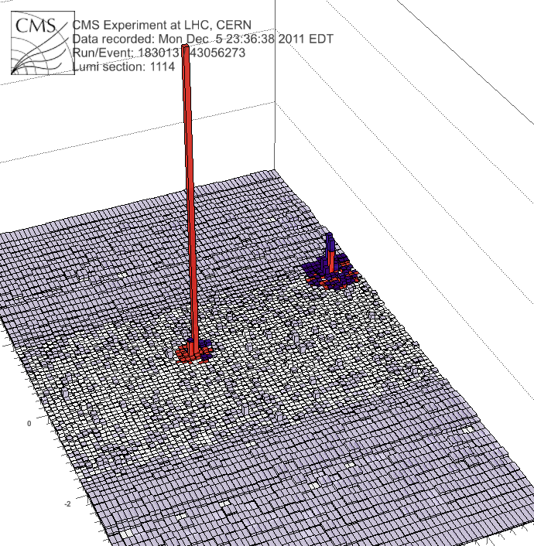
Measuring the energy loss of a parton traversing the QGP
Photon
(191GeV)
Jet
(98 GeV)
fast quarks and gluons loose energy in the medium
-> Quark-Gluon Plasma

Slide 14

Large Hadron Collider @ CERN

Slide 15
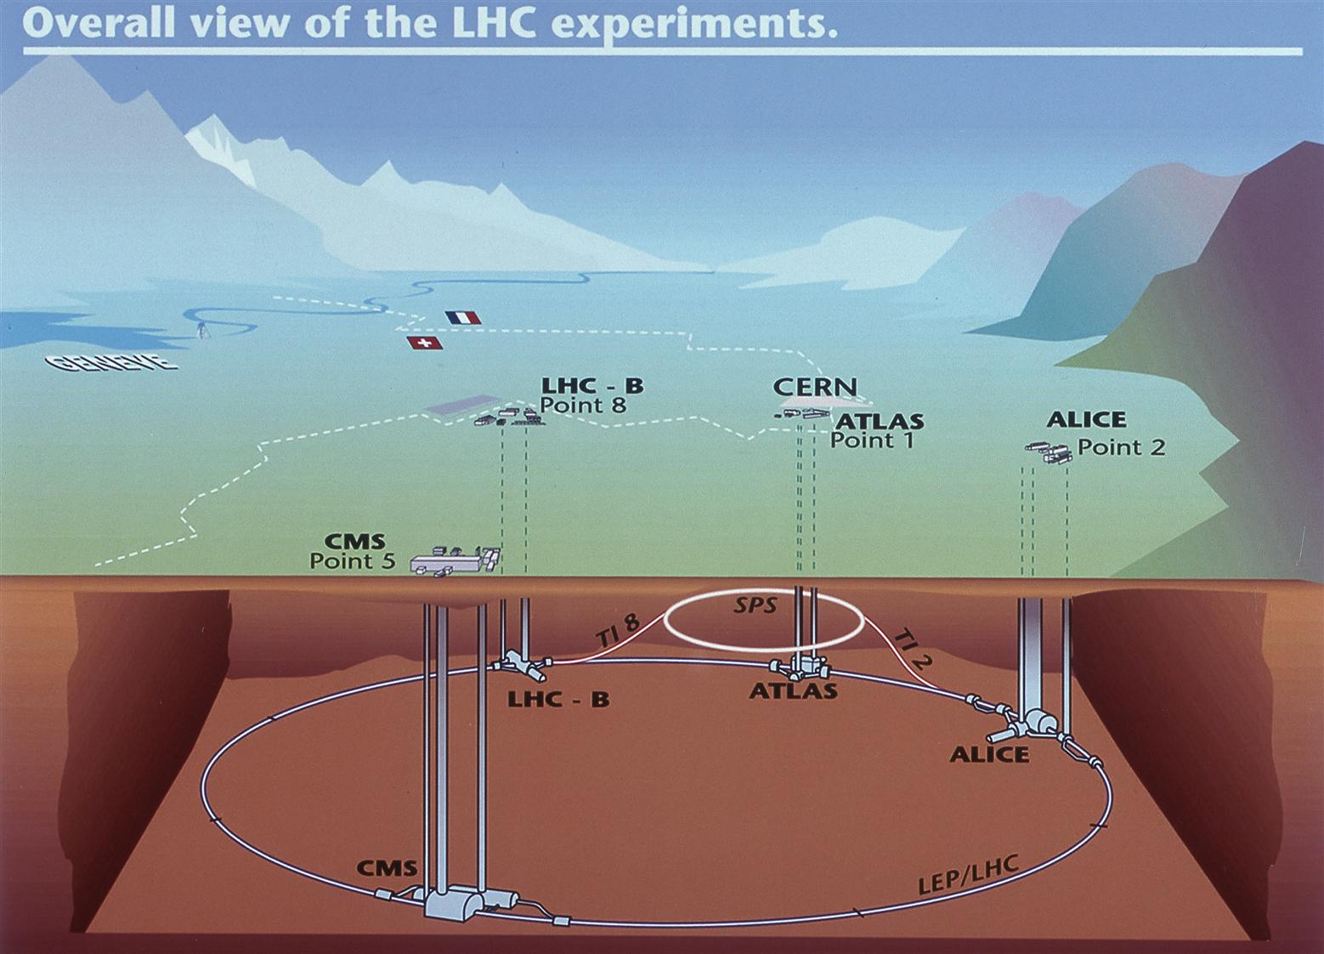
LHC–project: accelerator + experiments
LHC circumference: 27 km
about 100 m underground
Protons and
heavy ions
circulate at
99.999999%
of the speed
of light
Four large
caverns for
experiments

Slide 16
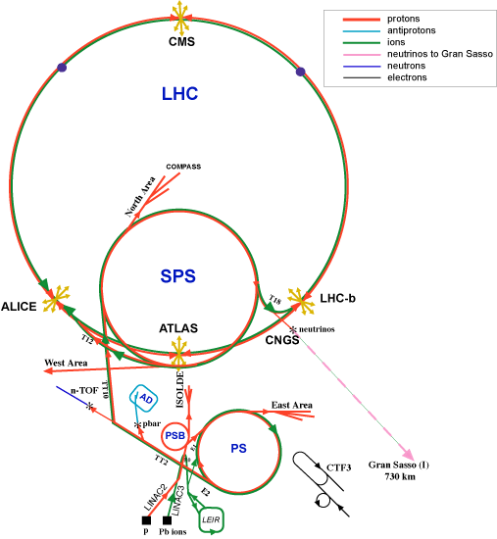
LHC – accelerator complex
The counter rotating proton and heavy ion beams are brought into collision at four experimental collision points around the LHC:
At CMS
LHCb
ATLAS
ALICE

Slide 17
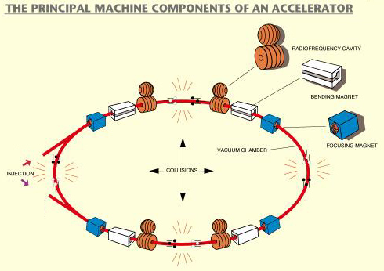
LHC – machine components
R
p (GeV/c)
---------------------
0.3 q B (Tesla)
R (m) =

Slide 18
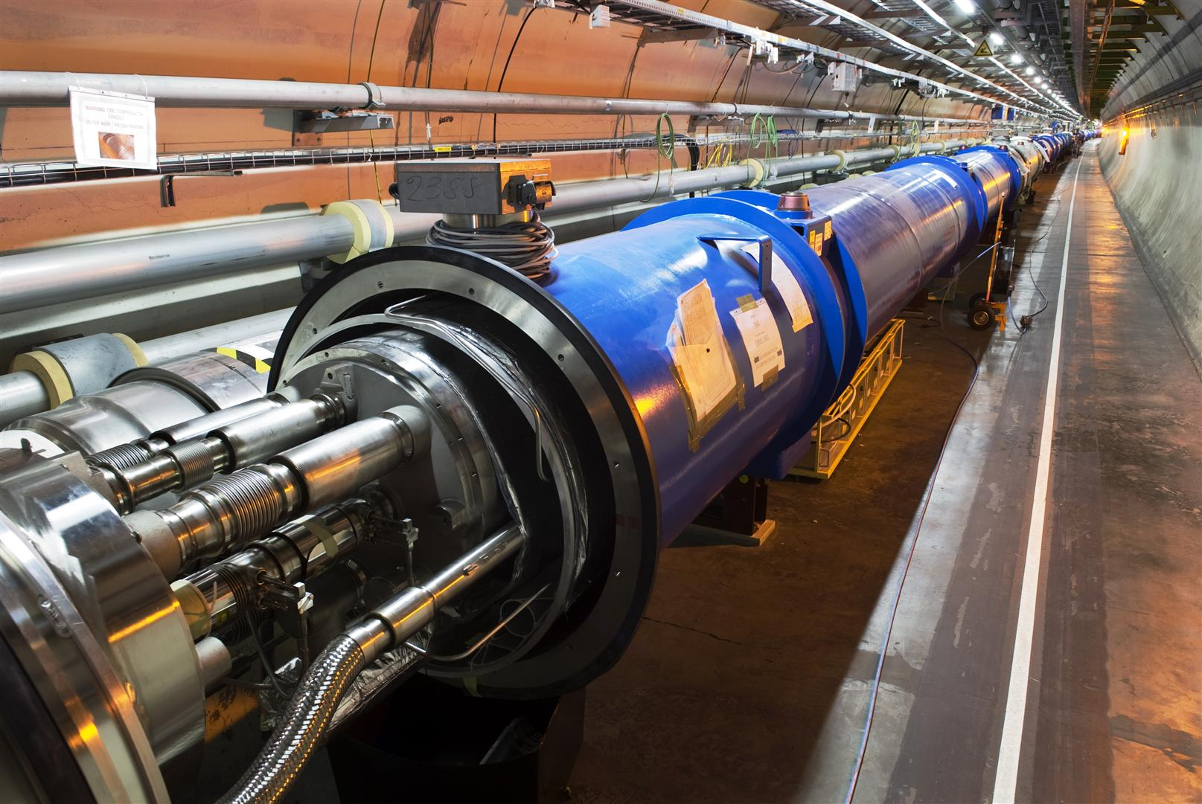
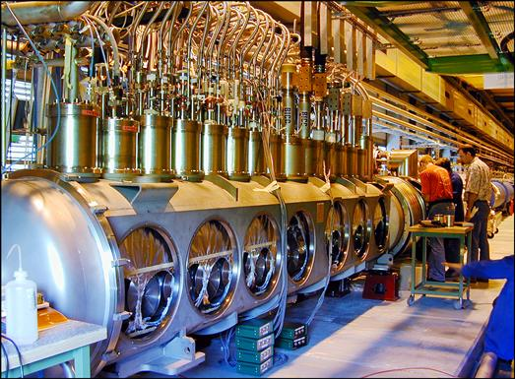
LHC - components
1232 superconducting
dipole magnets bend
the beams
Radiofrequency cavities
accelerate the ion
bunches

Slide 19
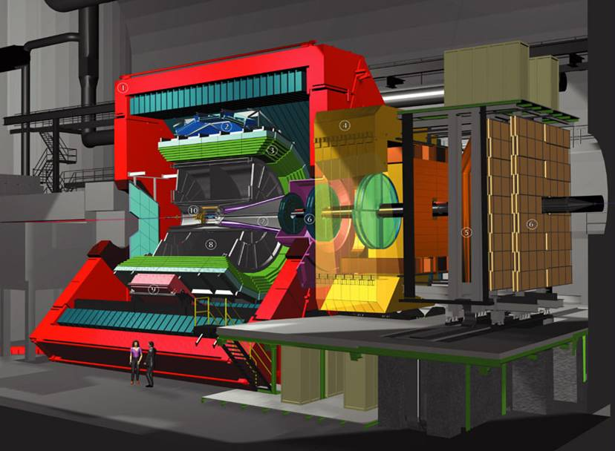
ALICE Set-up
Size: 16 x 26 meters
Weight: 10,000 tons
TOF
TRD
HMPID
ITS
PMD
Muon Arm
PHOS
TPC

Slide 20
Detectors
Detection concepts

Slide 21
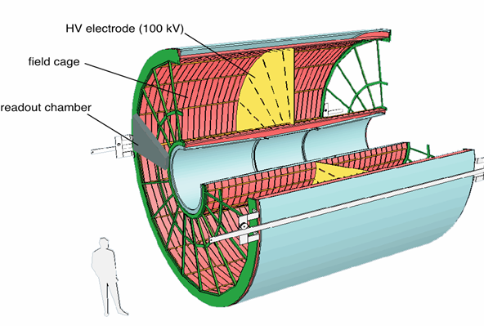
Detectors
Tracking detectors: silicon and/or gas detectors
Multiple thin layers of, for example, silicon sensors or gas volumes
Time Projection Chamber TPC

Slide 22
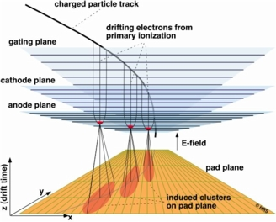
ALICE TPC
Large volume gas detector
Drift volume and MPWC at the
end caps
3-dim. “continuous” tracking device for charged particles
  x,y of pad
  z derived from drift time
Designed to record up to 20000 tracks
Event rate: about 1 kHz
Typical event size for a central Pb+Pb collision:
about 75 MByte
22

Slide 23
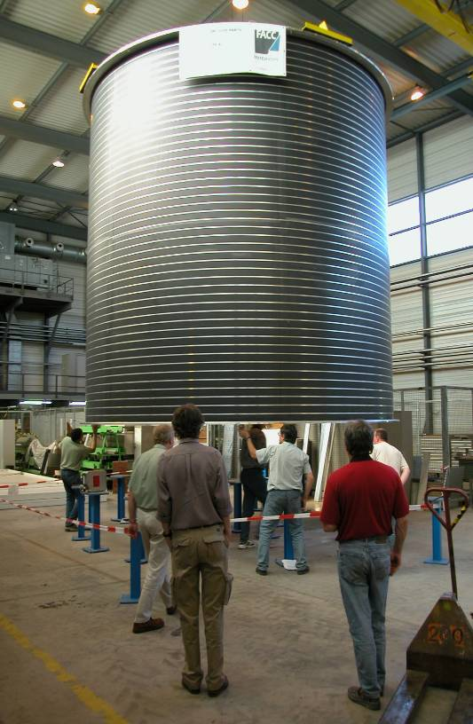
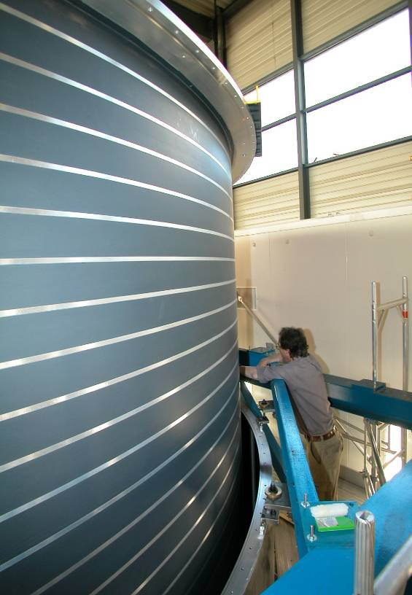
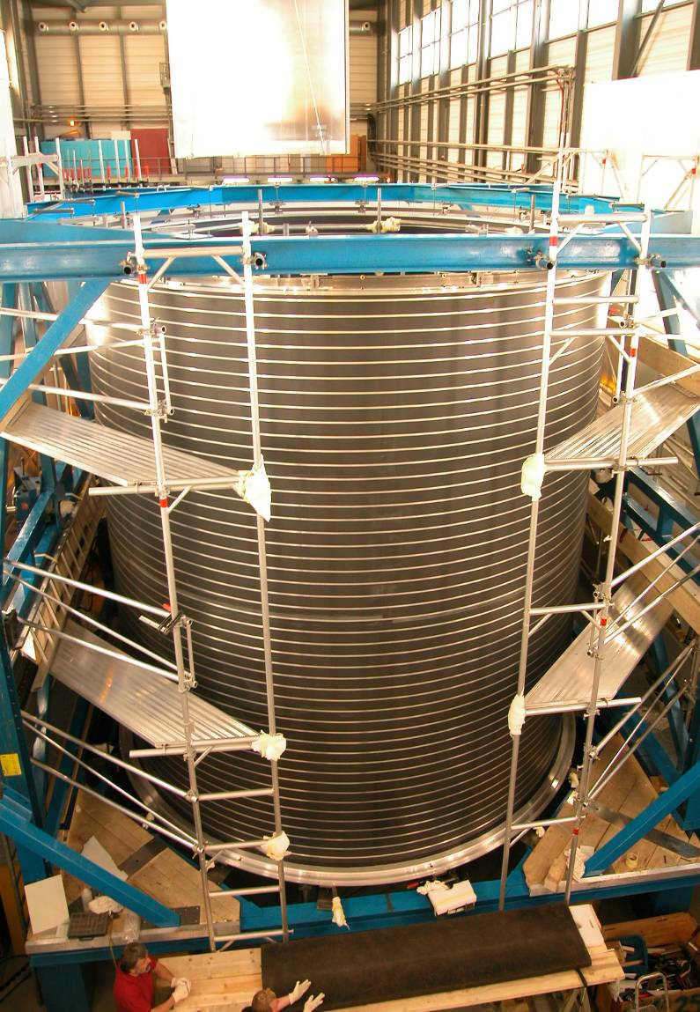
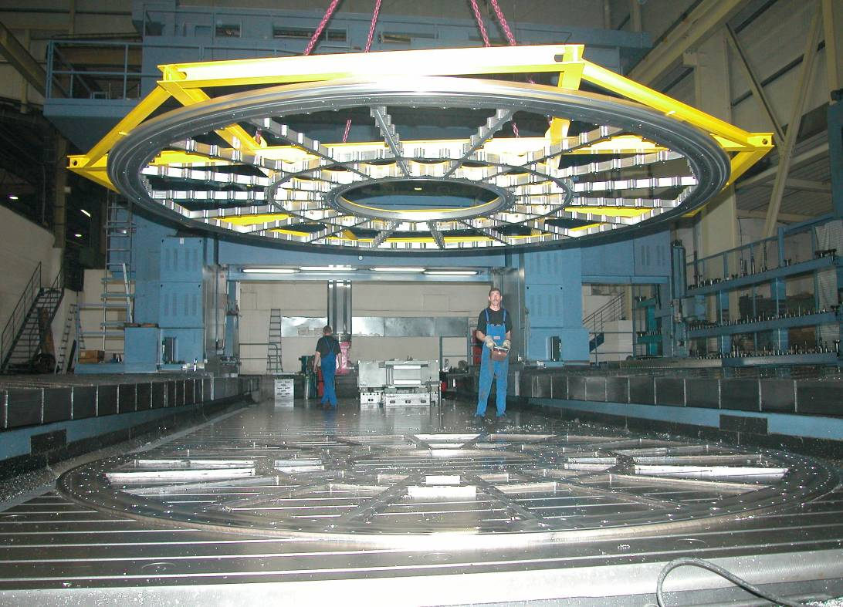
ALICE TPC:
5 years of construction

Slide 24
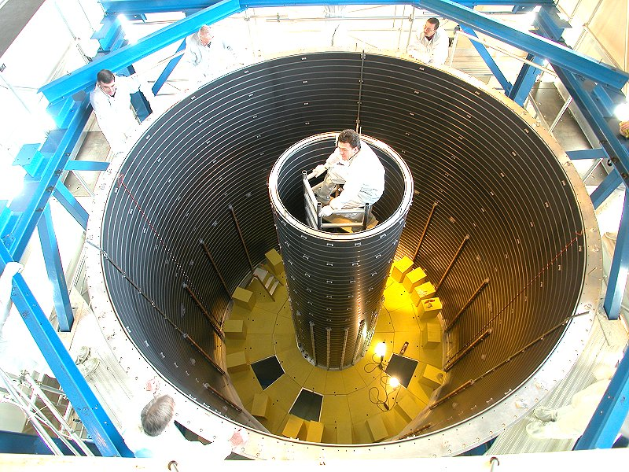
TPC Field Cage

Slide 25
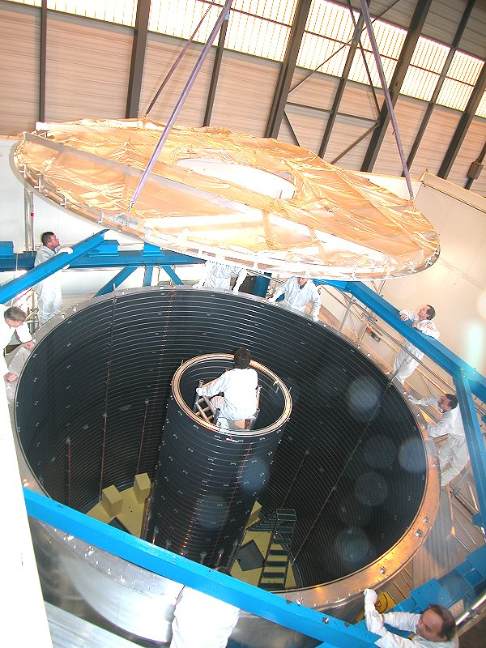
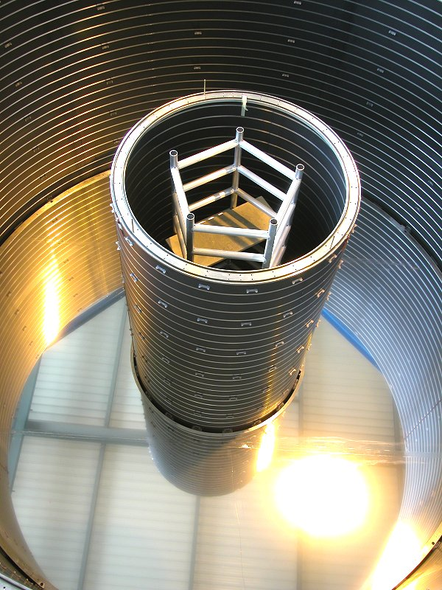
Inserting central membrane
100 μm alumised Mylar

Slide 26
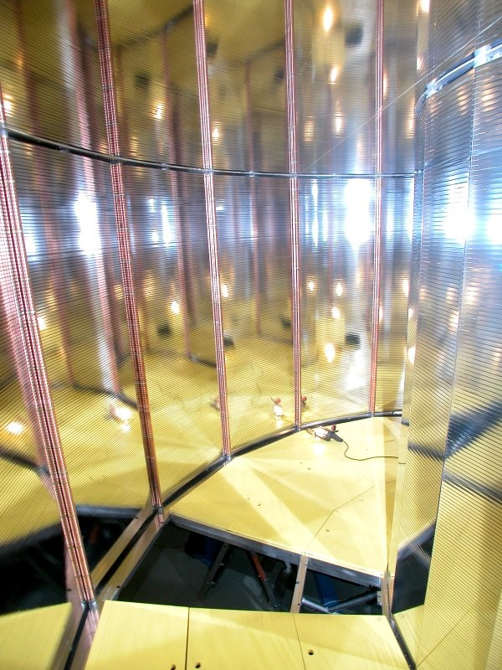
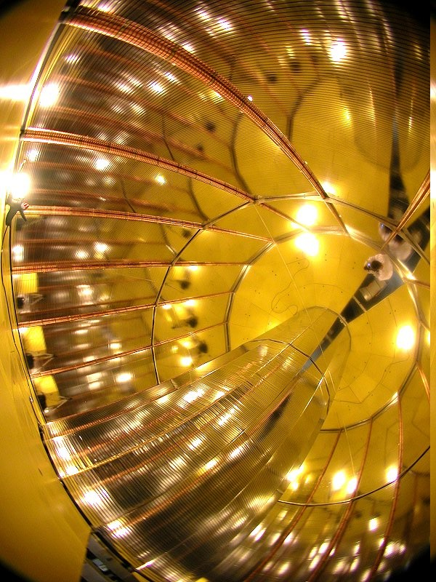
Field defining potential network
Field cage
  Low mass field cage: X/X₀ = 3% at eta = 0
  Suspended Al-Mylar strips, Al-Mylar central electrode
  Mechanical precision 0.2 mm

Slide 27
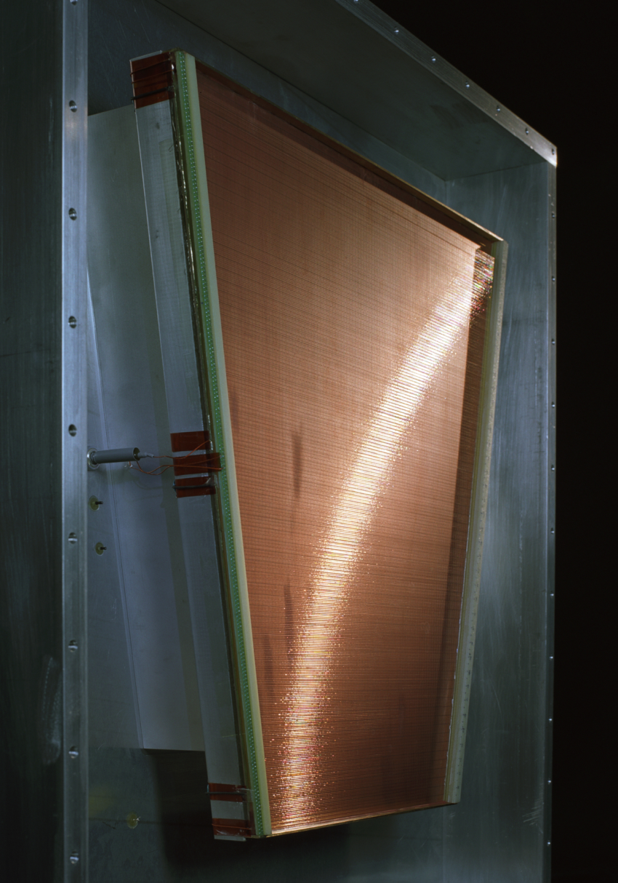
Readout Chambers
Inner Readout Chambers (IROC)
  Padsize 4 x 7.5 mm²
  Anode-cathode distance 2 mm
Outer Readout Chambers (OROC)
  Padsizes 6 x 10 and 6 x 15 mm²
  Anode-cathode distance 3 mm
Gas gain up to ≈ 2 x 10⁴
Gating wire grid
  High suppression of ion feedback (≈ 10⁻⁵)

Slide 28
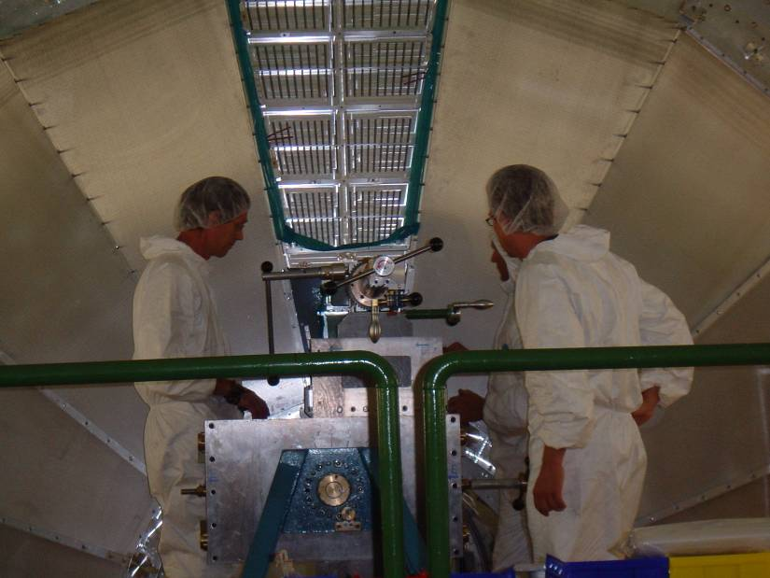
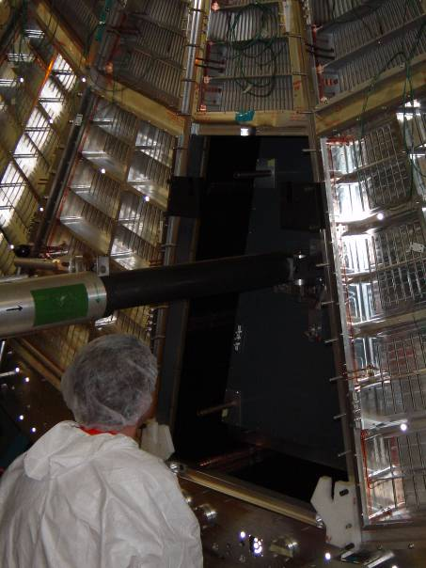
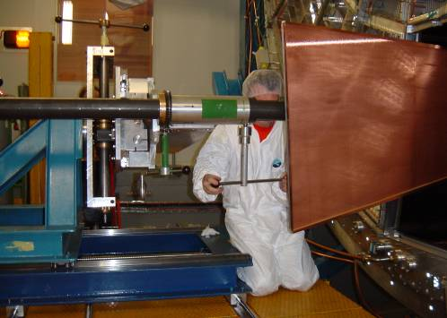
TPC Chambers
First IROC
Last OROC

Slide 29
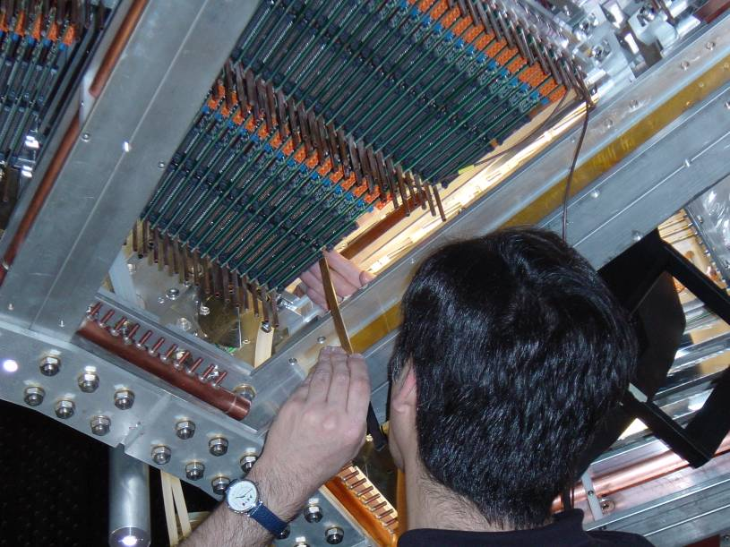
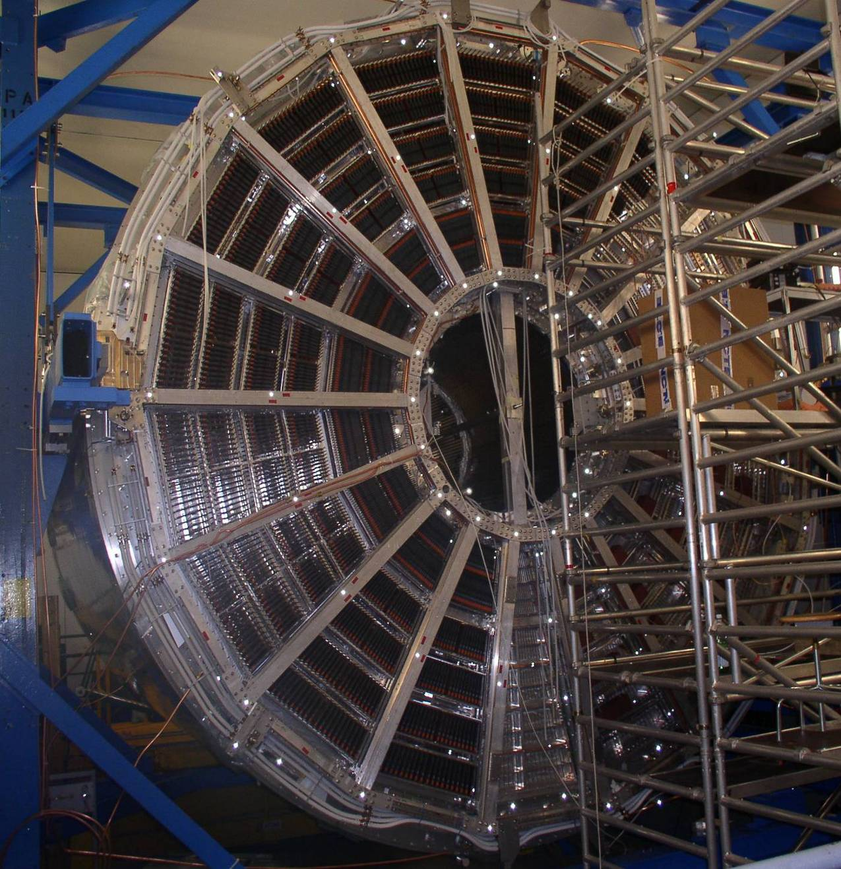
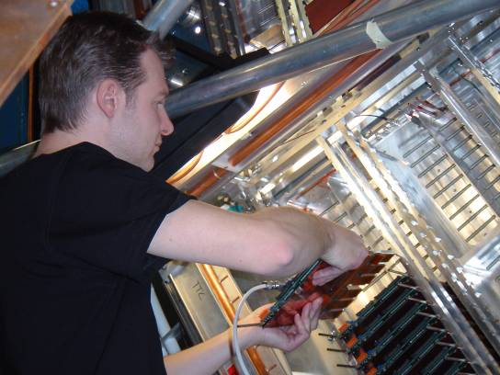
Front-end electronics installation

Slide 30
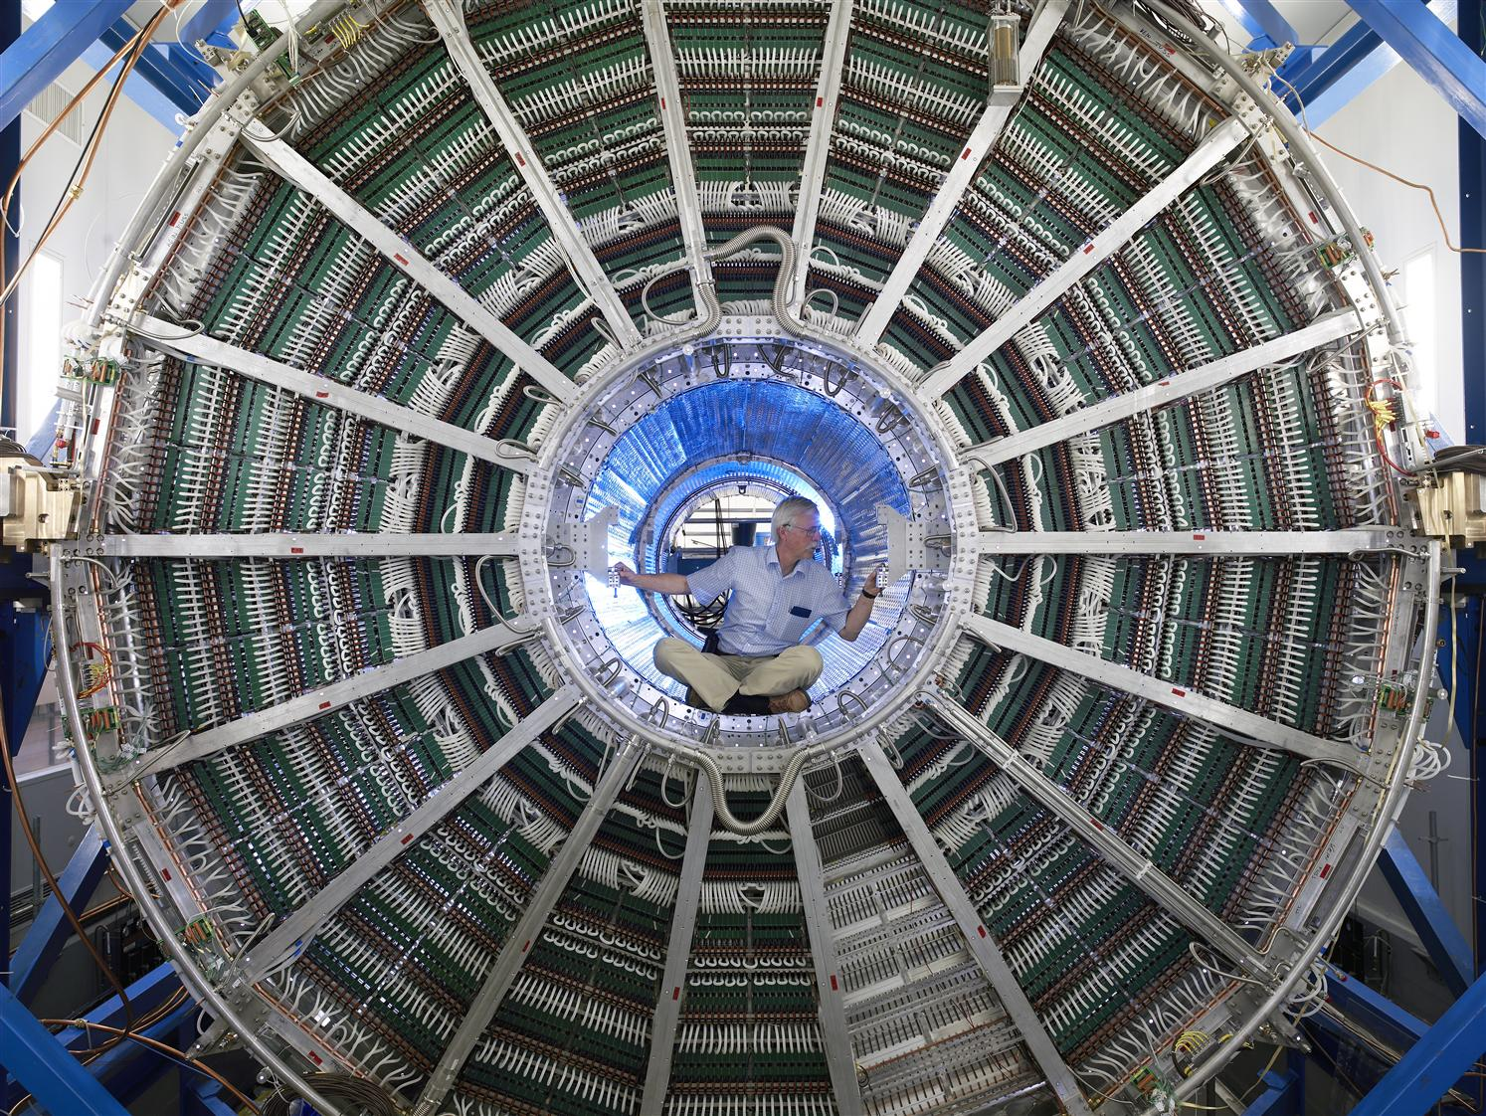

Slide 31
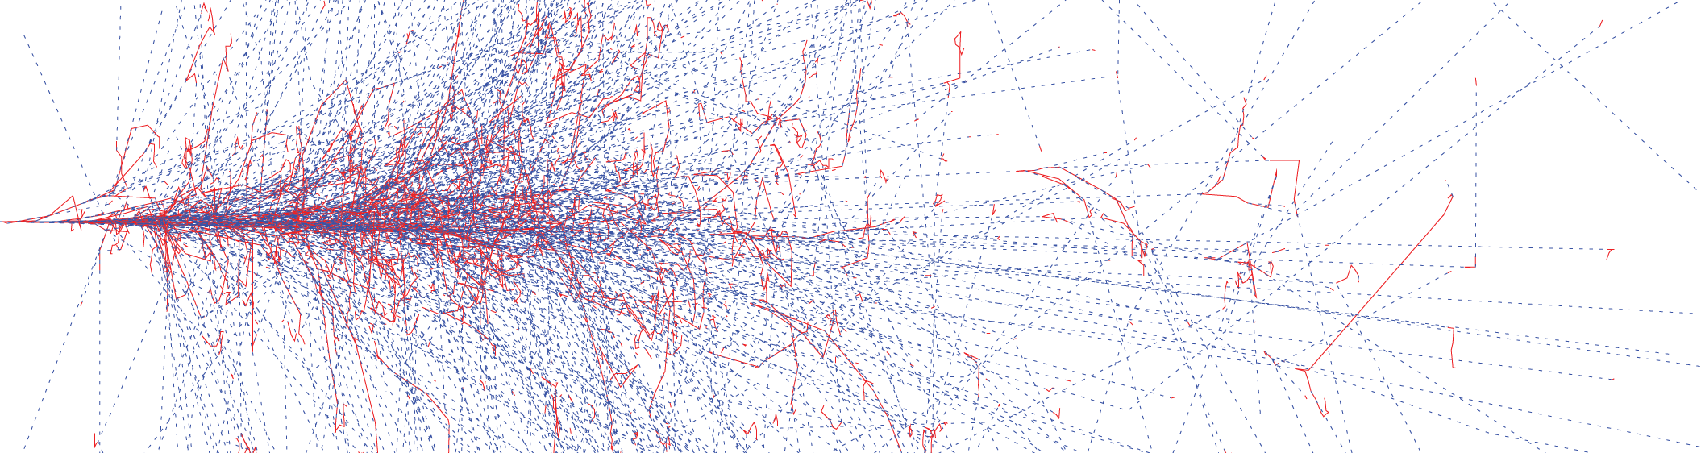
Detectors
Calorimeter
Total number of particles is proportional to energy of incoming particle

Slide 32
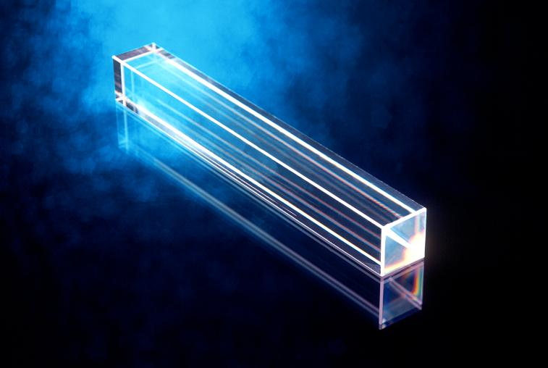
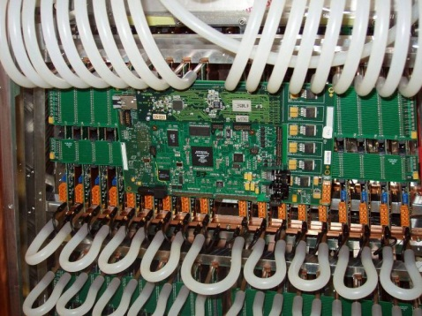





PHOton Spectrometer – readout and trigger
PbO₄W- crystal calorimeter for photons, neutral mesons, 1 to > 100 GeV
Array of crystals + APD + preamp + trigger logic + readout
DAQ
L0 trigger
tasks
  shower finder
  energy sum
implementation
  FPGA
  VHDL firmware
L0/L1 trigger
32

Slide 33

Installation 1st PHOS module

Slide 34

Installation 1st PHOS module

Slide 35
Conclusion
The LHC project at CERN is in operation
Has produced and will produce a plethora of data during the next decades
Will answer many questions, e.g.
  What are the properties of the Quark-Gluon Plasma, i.e. viscosity of that perfect fluid?
  What are the implications for the Early Universe and neutron stars?
  …
Will definitely raise many more new questions...
”Daß ich erkenne, was die Welt
Im Innersten zusammenhält, ...”

Slide 36
The end

Slide 37

Matter – the building blocks
ordinary matter
mass

Slide 38

More questions
soup of quarks, leptons, force carriers
History of the universe
  first 10 μsec: energy density 1 GeV/fm³, temperature 160 MeV
  hot soup of quarks, leptons and force carriers, ...
Are there new states of matter at ultrahigh temperatures and densities?

Slide 39


An attempt at an answer?
QCD’s essential feature:
asymptotic freedom
Running of QCD coupling constant suggests possibility of building a new state of “QCD matter” with “free” quarks and gluons at sufficiently high temperature or sufficiently high baryon density:
Quark-Gluon Plasma

Slide 40



Astrophysics – Neutron Star

Slide 41

Trigger system
Minimal requirements
  Detect collisions
  Initialise readout of detectors
  Initialise data transfer to data acquisition (DAQ)
  Protection against pile-up
High level requirements
  Select interesting events
  Needs real-time processing of raw data and extraction of physics observables
trigger detector
trigger system
Detectors
Readout electronics
Why?
interaction rate (e.g. 8 kHz for Pb+Pb) >
detector readout rate (e.g. 1 kHz for TPC) >
DAQ archiving rate (50 - 100 Hz)
raw data
high-level
trigger
DAQ
trigger
processed data

Slide 42
Trigger hierachy
collision
detect collision by fast detectors
select events according to
centrality
single high momentun particle
pair of particles
jets
reject events due to
past/future protection
filter interesting events based
on complicated event topologies
L0
L1
L2
HLT
1.2 µs
6.5 µs
90 µs
ms
Time
bunch crossings
– 40 MHz

Slide 43


Trigger implementation
fixed latency – hard real-time
pipelined – soft real-time
(micro-)electronics
FPGAs DSPs
PC farms – 2000 cores
L0
L1
L2
HLT
1.2 µs
6.5 µs
90 µs
ms
Time
bunch crossings
– 40 MHz

Slide 44


and a lot of computers...
THE GRID
That is 15,000,000 GB
(15 PB) per year
20 km stack of average CDs per year.

