Slide 1



MARCO
UNICOS based control system
CERN 10.09.2012
Lukasz Zwalinski – PH/DT
Maciej Ostrega – PH/DT

Slide 2
Presentation overview
I/O requirements & system architecture & hardware
Control rack assembly
Software principals
Software development
User interface
Access control
Supervision layout
SCADA interface
Supervision tools
Touch screen
Online pressure enthalpy diagram
MARCO 10th September 2012 L.Zwalinski, M.Ostrega

Slide 3

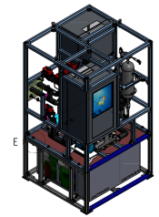
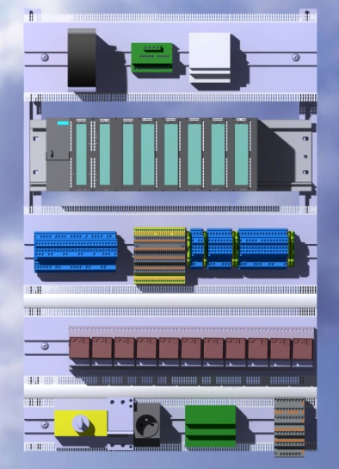
I/O number & system architecture & hardware
Control system architecture
I/O requirements
I/O Type | Number
DI | 32
DO | 32
AI | 34
AO | 8
Selected hardware conforming CERN standard
Component | Type | Piece
S7-300 CPU 315-2 PN/DP | 6ES7315-2EH14-0AB0 | 1
S7, MICRO MEMORY CARD | 6ES7953-8LL20-0AA0 | 1
S7-300, 8AI, RES. 9/12/14 | 6ES7331-7KF02-0AB0 | 5
S7-300, 8AO, U/I, 11/12 BITS | 6ES7332-5HF00-0AB0 | 1
S7-300, 8AI ,2/3/4 Wire Resist Res9/12/14 | 6ES7331-7PF01-0AB0 | 1
S7-300, 32DI, 24 V DC, 1 X 40 PIN | 6ES7321-1BL00-0AA0 | 1
S7-300, 32DO, 24V DC, 0.5A | 6ES7322-1BL00-0AA0 | 1
SIMATIC 8" TOUCH TFT MULTI PANEL | 6AV6643-0CB01-1AX1 | 1
MARCO 10th September 2012 L.Zwalinski, M.Ostrega

Slide 4
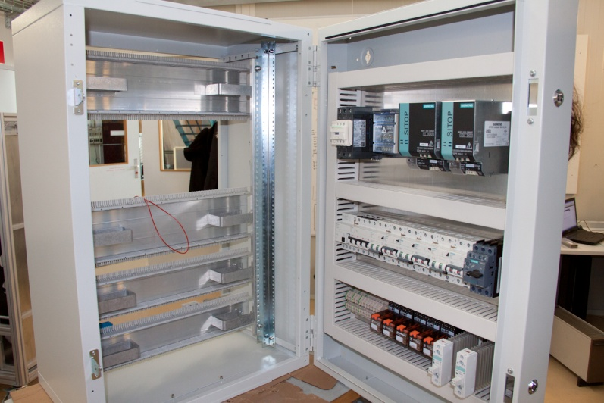
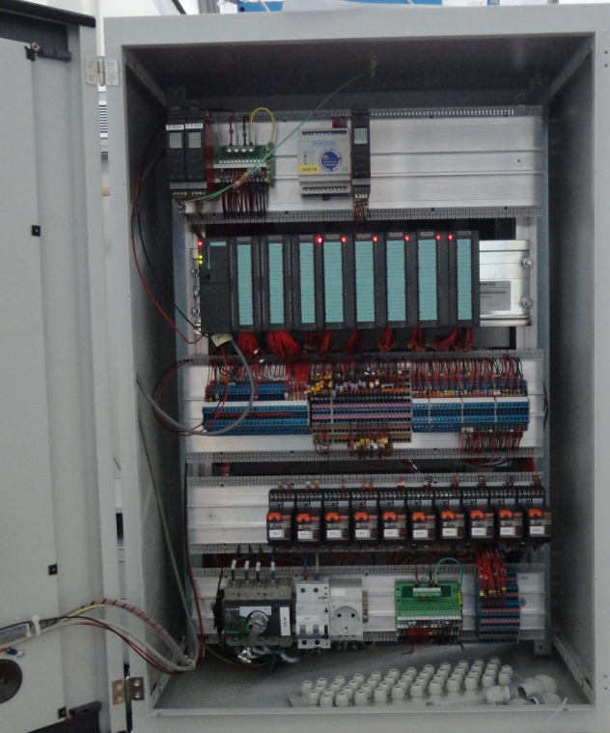
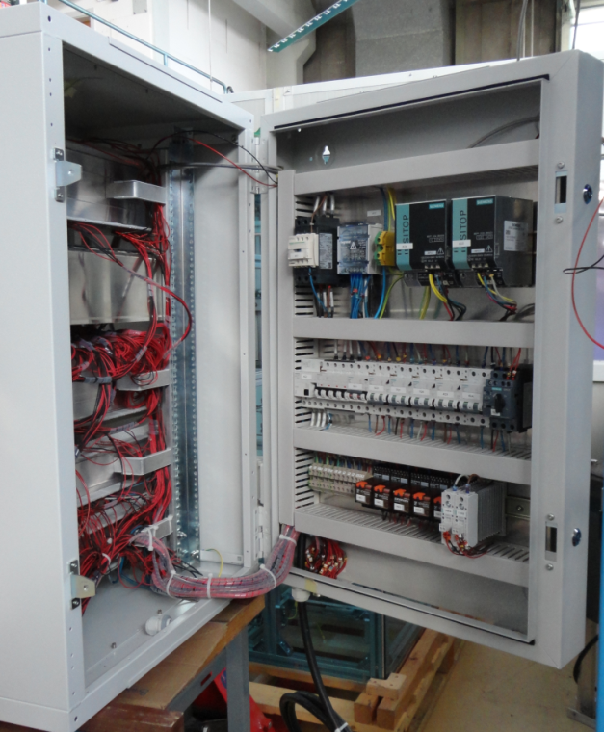
Rack assembly – completed thanks to MPI
Control rack waiting to be placed into MARCO frame.
MARCO 10th September 2012 L.Zwalinski, M.Ostrega

Slide 5
UNICOS CPC 6 - framework
UNICOS‐CPC 6 framework
UNified Industrial COntrol System
Continuous Process Control
UNICOS framework supports 3 control system layers:
supervision (SCADA: WinCC-OA)
control (PLC: Siemens S7 and Schneider)
field layer
The package of programming tools includes:
baseline library (with modular PID algorithm)
code generator
skeleton templates and example of objects list
Object definitions provided by UNICOS are split into:
I/O Objects (Digital Input, Digital Output, Analog Input)
Field Objects (OnOff, Analog, AnaDig, Controller, etc.)
Process Control Objects (PCO)
Offers homogenous user interface
More information can be fond at CERN EN/ICE web pages:
http://j2eeps.cern.ch/wikis/display/EN/UNICOS-CPC+Documentation
https://edms.cern.ch/file/1228441/1.3.1/UCPC6_Operator_Training.pdf
MARCO 10th September 2012 L.Zwalinski, M.Ostrega

Slide 6
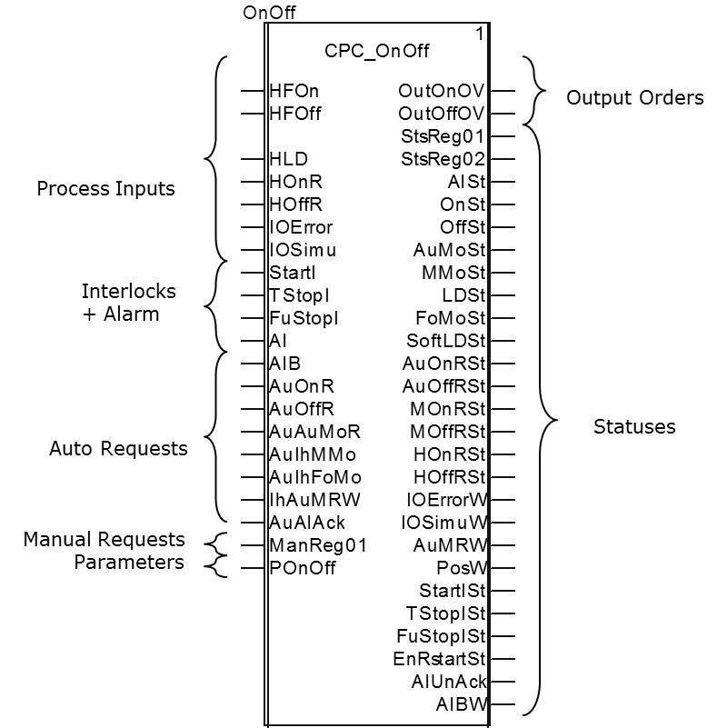
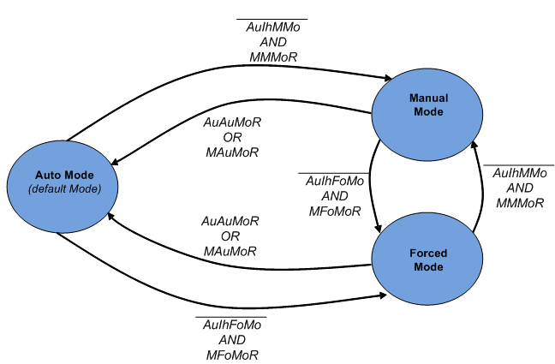
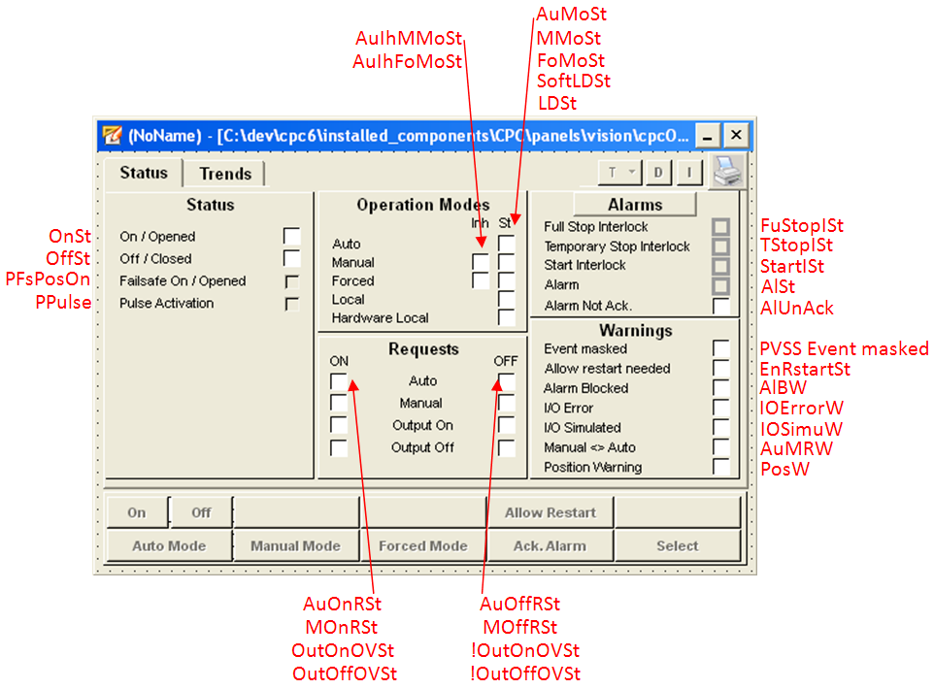
On/Off object example
MARCO 10th September 2012 L.Zwalinski, M.Ostrega

Slide 7
On/Off object example
SCADA inputs:
Name | Type | Meaning
StsReg01 | SHORTINT16 | Status register 1
StsReg02 | SHORTINT16 | Status register 2
SCADA Outputs:
Name | Type | Meaning
ManReg01 | SHORTINT16 | Manual register 1
Name | Type | Meaning | Description | BitPosition
ManReg01 | SHORTINT16 | Manual Register 1 | Manual Register 1 | -
MAuMoR | BIT1 | Manual Auto Mode Request | Manual Auto Mode Request: The operator requests the Auto Mode. | 0
MMMoR | BIT1 | Manual Manual Mode Request | Manual Manual Mode Request: The operator requests the Manual Mode | 1
MFoMoR | BIT1 | Manual Forced Mode Request | Manual Forced Mode Request: The operator requests the Forced Mode. | 2
MSoftLDR | BIT1 | Manual Software Local Mode | The operator requests the Software Local Mode | 3
MOnR | BIT1 | Manual On Request | Manual On Request: The operator requests the On/Open position | 4
MOffR | BIT1 | Manual Off Request | Manual Off Request: The operator requests the Off/Close position | 5
MEnRstartR | BIT1 | Manual Enable Restart Request | Manual Enable Restart Request: The Operator requests a Manual Restart after Full Stop | 9
MAlAckR | BIT1 | Manual Alarm Acknowledgement Request | Manual Alarm Acknowledgement Request: The operator requests Interlocks or Alarms acknowledgement | 15
MARCO 10th September 2012 L.Zwalinski, M.Ostrega

Slide 8
On/Off object example
SCADA inputs:
Name | Type | Meaning
StsReg01 | SHORTINT16 | Status register 1
StsReg02 | SHORTINT16 | Status register 2
StsReg01 | SHORTINT16 | Status Register 1 | Status Register 1 | -
OnSt | BIT1 | On Status | On/Open Status | 0
OffSt | BIT1 | Off Status | Off/Closed Status | 1
AuMoSt | BIT1 | Auto Mode Status | Current status of the Auto Mode | 2
MMoSt | BIT1 | Manual Mode Status | Current status of the Manual Mode | 3
FoMoSt | BIT1 | Forced Mode Status | Current status of the Forced Mode. | 4
LDSt | BIT1 | Local Drive Status | Current status of the Local Mode. The object is driven locally. | 5
IOErrorW | BIT1 | Input/Output Error Warning | Current status of the IOError | 6
IOSimuW | BIT1 | Input/Output Simulated Warning | Current status of the IOSimu | 7
AuMRW | BIT1 | Auto Manual Request Warning Status. | Auto and manual requests discrepancy when Manual/Forced mode active. | 8
PosW | BIT1 | Position Warning | There is discrepancy between the order status and the position status according to Time Delay and Dead-band. | 9
StartISt | BIT1 | Start Interlock Status | Current status of the Start Interlock | 10
TStopISt | BIT1 | Temporary Stop Interlock Status | Current status of the Temporary Stop Interlock | 11
AlUnAck | BIT1 | Alarm UnAcknowledged | Alarm UnAcknowledged: The alarm or at least one of the alarms associated to the object is not acknowledged | 12
AuIhFoMoSt | BIT1 | Auto Inhibit Forced Mode Status | Auto Inhibit Forced Mode status: Current status of the Auto Inhibit forced mode. | 13
AlSt | BIT1 | Alarm Status | Alarm Status | 14
AuIhMMoSt | BIT1 | Auto Inhibit Manual Mode Status | Auto Inhibit Manual Mode Status | 15
StsReg02 | SHORTINT16 | Status Register 2 | Status Register 2 | -
OutOnOVSt | BIT1 | Output On Order Value Status | Output On Order Value Status | 0
AuOnRSt | BIT1 | Auto On Request Status | Auto On/Open Request Status | 1
MOnRSt | BIT1 | Manual On Request Status | Manual On/Open Request Status | 2
AuOffRSt | BIT1 | Auto Off Request Status | Auto Off/Close request status | 3
MOffRSt | BIT1 | Manual Off Request Status | Manual Off/Close request status | 4
HOnRSt | BIT1 | Hardware On Request Status | Hardware On/Open request | 5
HOffRSt | BIT1 | Hardware Off Request Status | Hardware Off/Close request status | 6
FuStopISt | BIT1 | Full Stop Interlock Status | Full Stop Interlock Status | 10
EnRstartSt | BIT1 | Enable Restart Status | Manual Restart after full stop status | 11
SoftLDSt | BIT1 | Software Local Mode Status | Current status of the Software Local Mode. | 12
 |  |  | When true, the alarm or any of the device dependant alarm objects have
AlBW | BIT1 | Alarm Blocked Warning | been blocked by the operator | 13
OutOffOVSt | BIT1 | Output Off Order Value Status | Output Off Order Value Status | 14
MARCO 10th September 2012 L.Zwalinski, M.Ostrega

Slide 9
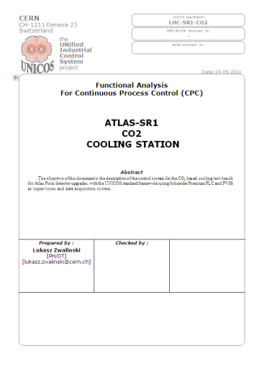
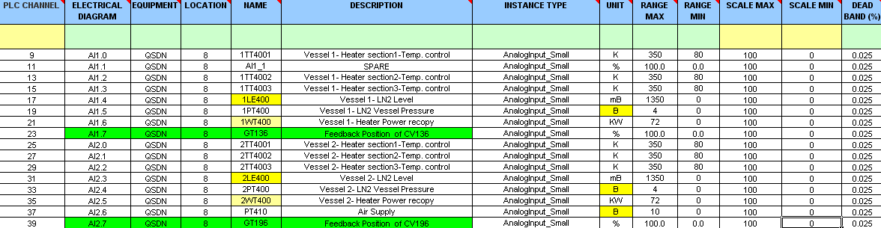
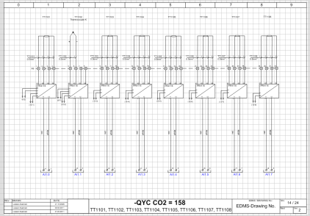
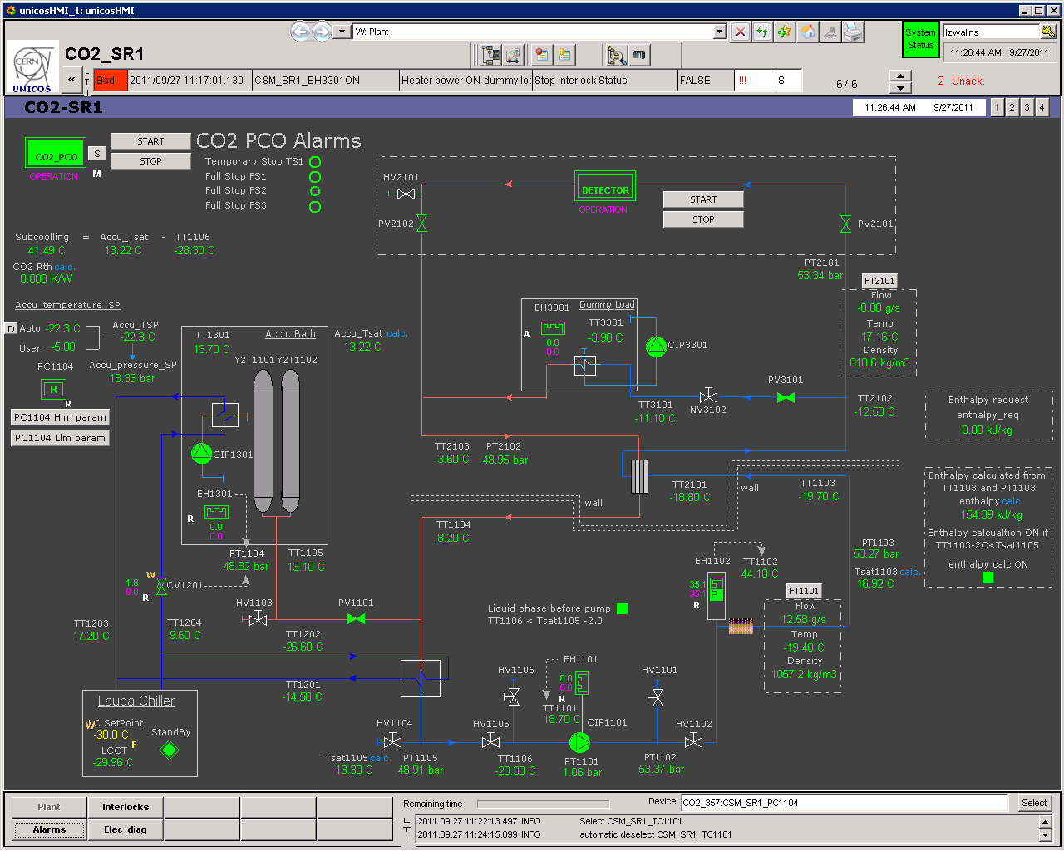
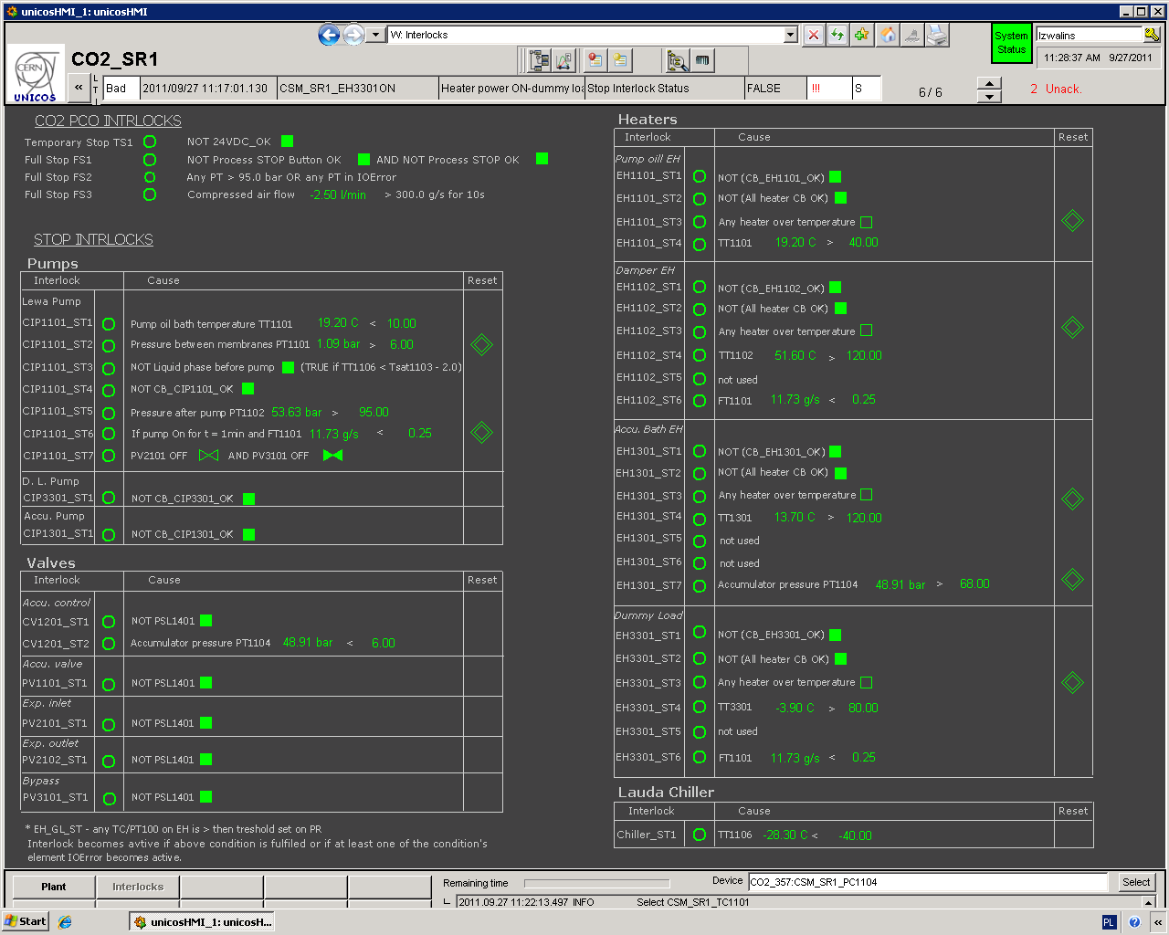
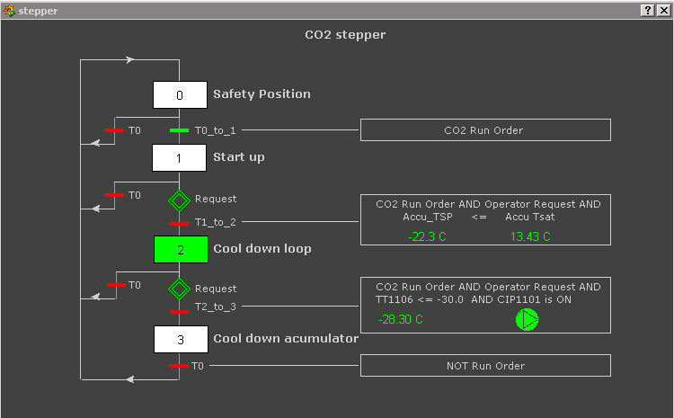

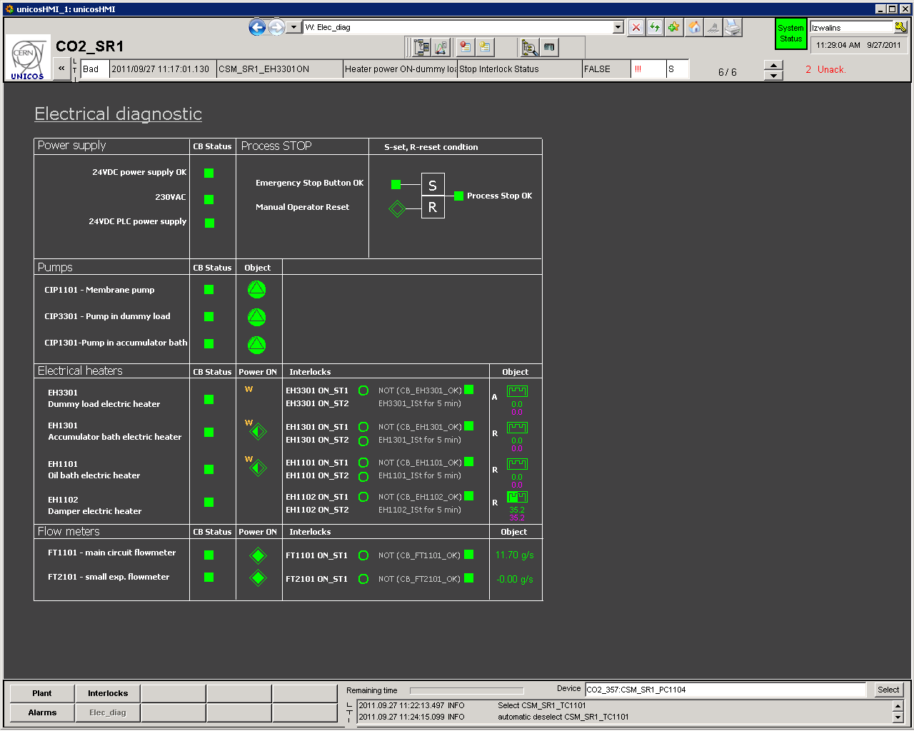





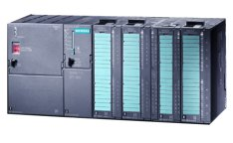
UNICOS project development
Specification XML
Local SCADA Server
Instance Generator
Siemens PLC
Logic Generator
2 software production iterations completed.
MARCO 10th September 2012 L.Zwalinski, M.Ostrega

Slide 10
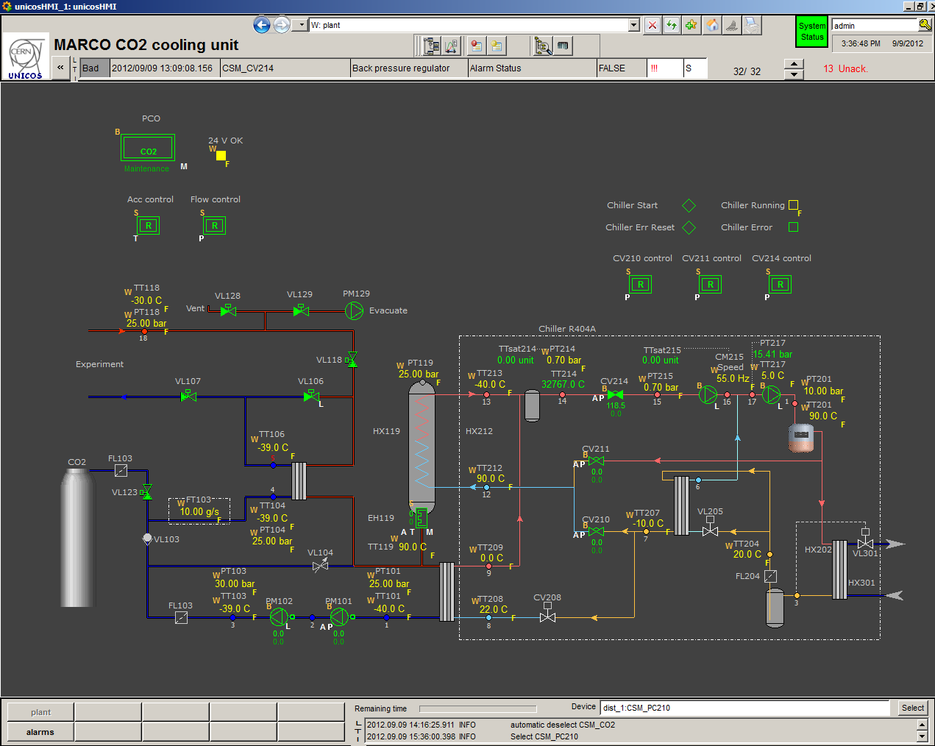
Supervision layout
Header
  fixed area (toolbar)
Process area
  Synoptic
Footer
  Contextual area
  Historic
MARCO 10th September 2012 L.Zwalinski, M.Ostrega

Slide 11
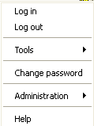
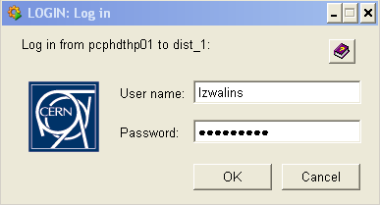
WinCC-OA access
Right click on the Current user name or click on the key
Click Login as
Enter an authorized NICE user / password
Main Access Groups:
Monitor
Operator
Expert
Admin
Only NICE authorized users (defined previously)
are allowed to be log in the WinCC-OA.
MARCO 10th September 2012 L.Zwalinski, M.Ostrega

Slide 12
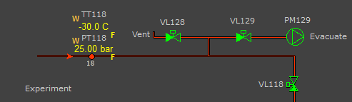
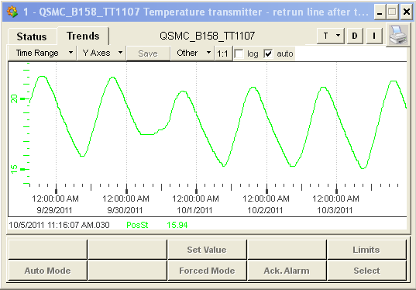
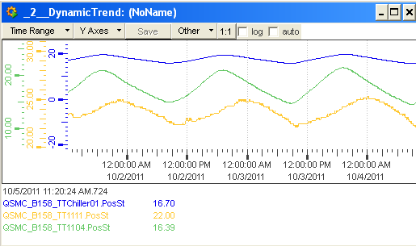

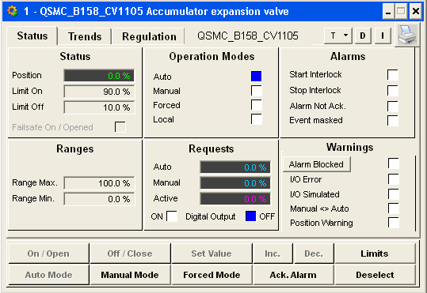
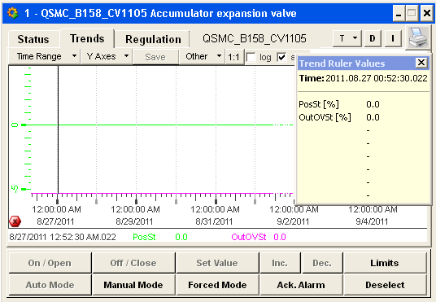
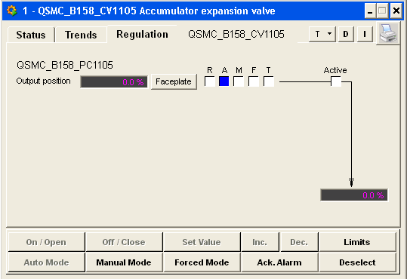
Supervision layout: Process Area
Static info
Text
Drawings
Animated Widgets
Sensors
Actuators
Controller
Process unit
Alarms
Sensor
Actuator
Widget interactions
MARCO 10th September 2012 L.Zwalinski, M.Ostrega

Slide 13
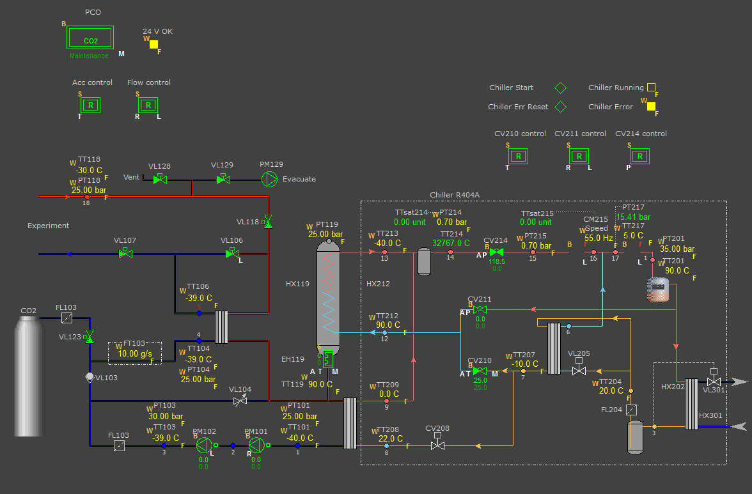
PLC actions representation on WinCC-OA panels
MARCO plant
MARCO 10th September 2012 L.Zwalinski, M.Ostrega

Slide 14
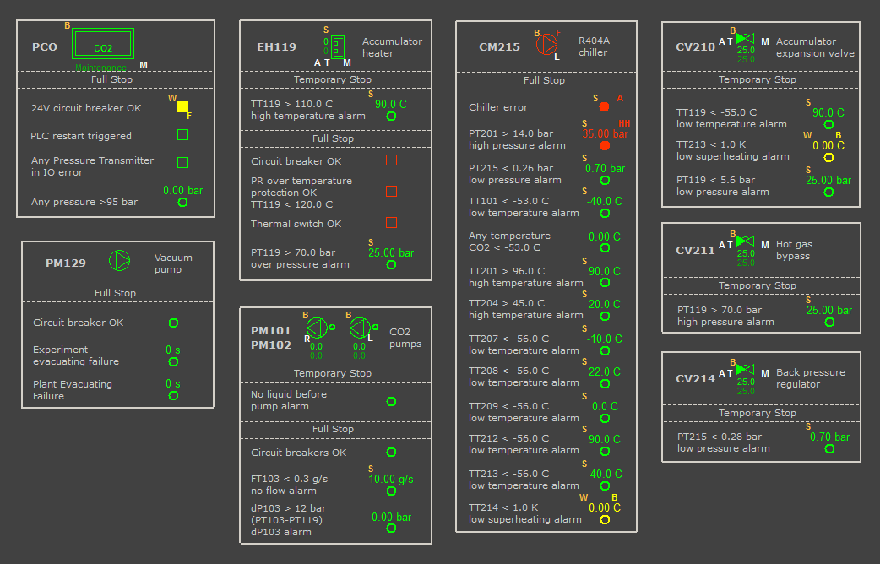
PLC actions representation on WinCC-OA panels
MARCO alarm panel
MARCO 10th September 2012 L.Zwalinski, M.Ostrega

Slide 15
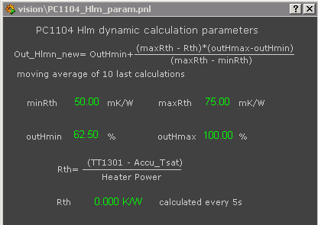
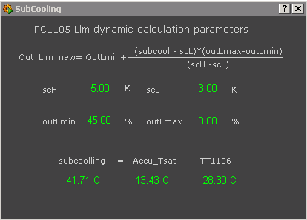
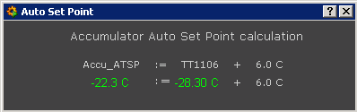
PLC actions representation on WinCC-OA panels
Electrical diagnostic
Stepper
Accumulator limiters
Accumulator Auto SP calculation
MARCO 10th September 2012 L.Zwalinski, M.Ostrega

Slide 16
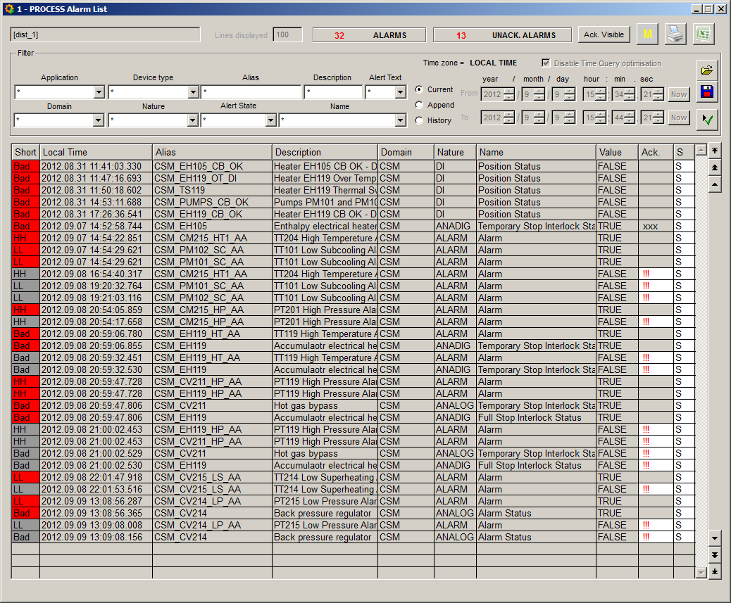
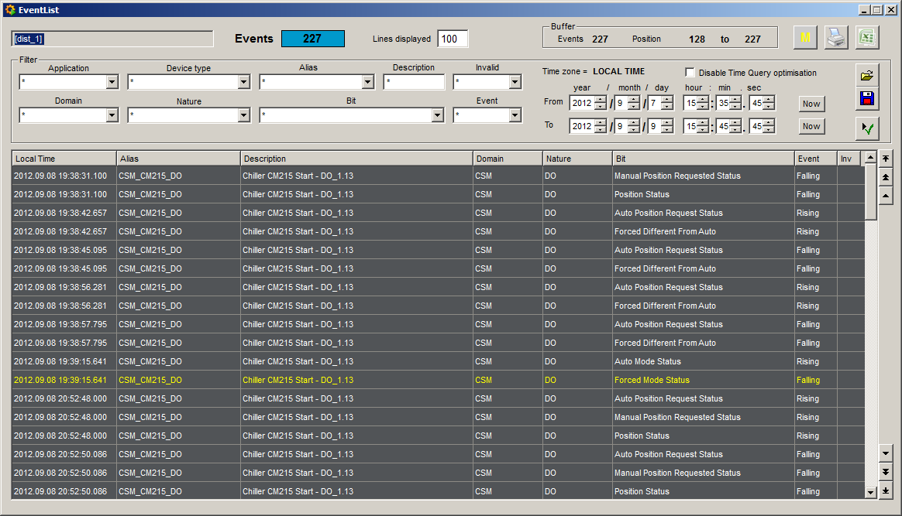
Supervision tools
Alarm list
Event list
MARCO 10th September 2012 L.Zwalinski, M.Ostrega

Slide 17
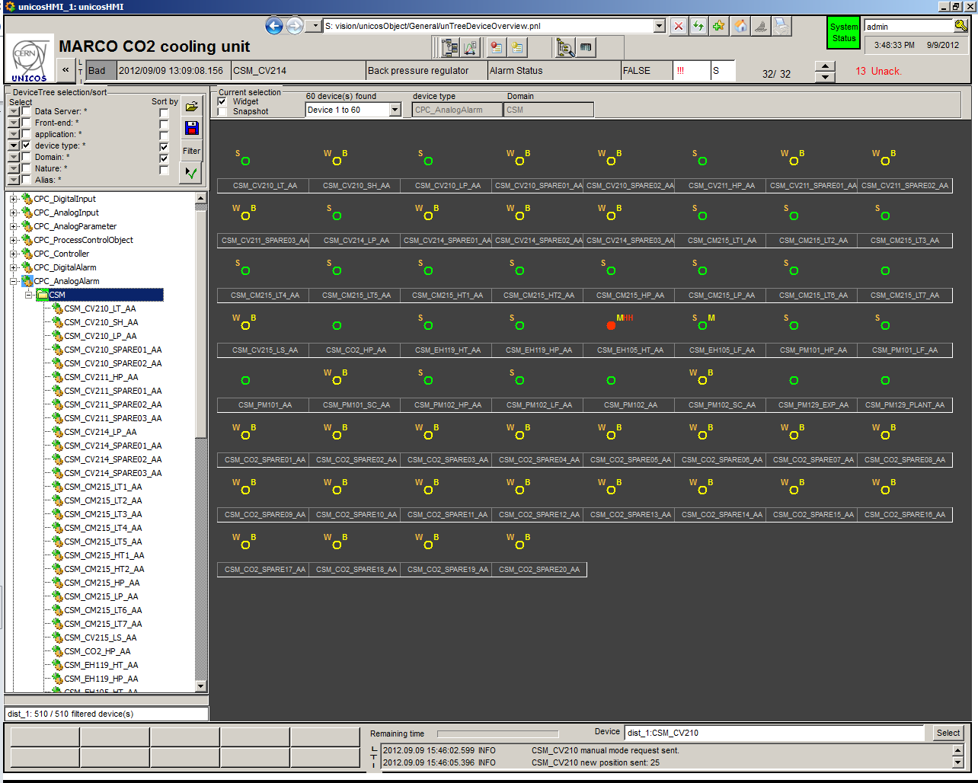
Supervision tools
Device Tree overview
MARCO 10th September 2012 L.Zwalinski, M.Ostrega

Slide 18
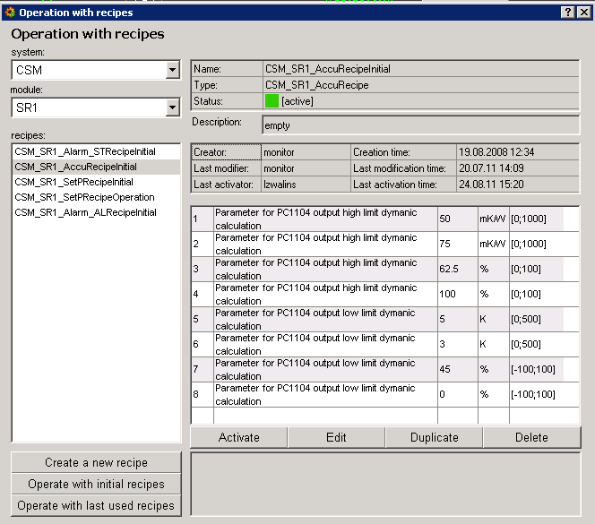
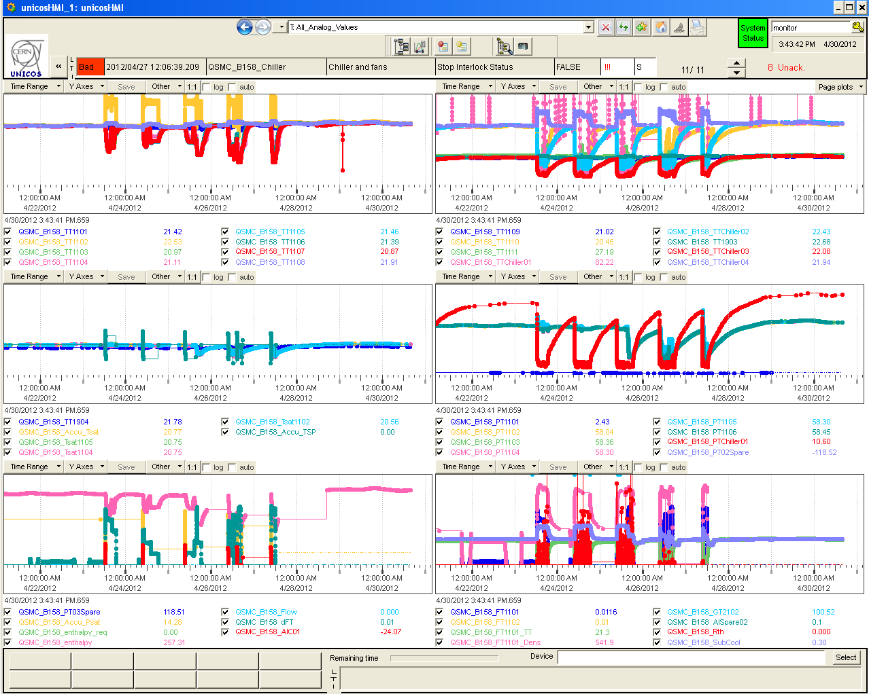
Recipes and user defined trends
Recipe component
User defined trends
Recipe: Massive parameterization (optional)
Alarm thresholds
Set Points
PID parameters
Trends:
Trend tree
Individual trends via object face plate
Dynamic trends
MARCO 10th September 2012 L.Zwalinski, M.Ostrega

Slide 19
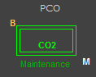
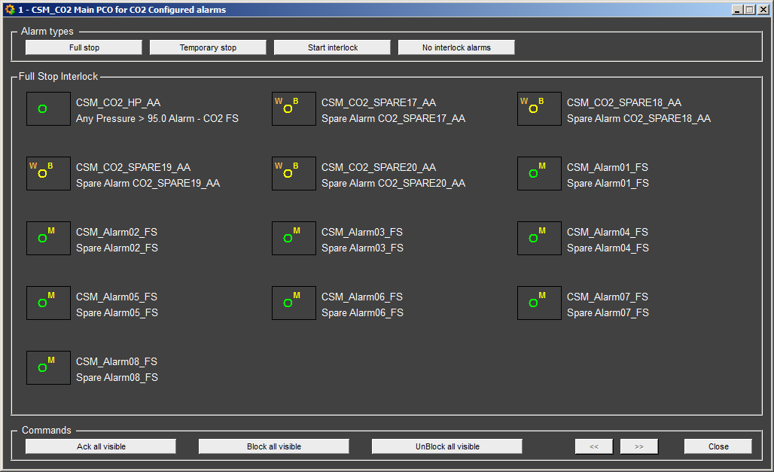
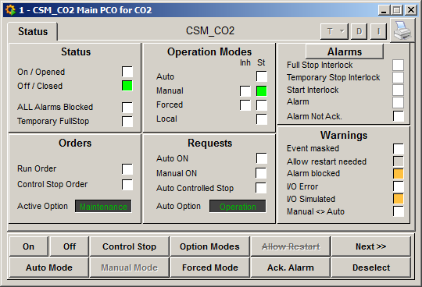
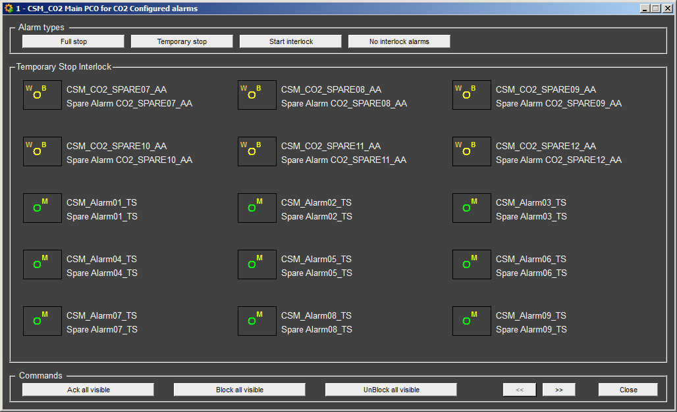
PCO Alarms with SMS or email notification
Digital and Analog Alarms
Types:
Full Stop interlock (FS): Stop the unit/actuator (all dependent units/actuators are set to their fail-safe position) and wait manual acknowledgement before restarting.
Temporary Stop Interlock (TS): Stop the unit/actuator (all dependent units/actuators are set to their fail-safe position) and restart automatically when the interlock disappears.
Start Interlock (SI): Prevent the unit from starting (all dependent units/actuators stay in their fail-safe position).
MARCO 10th September 2012 L.Zwalinski, M.Ostrega

Slide 20
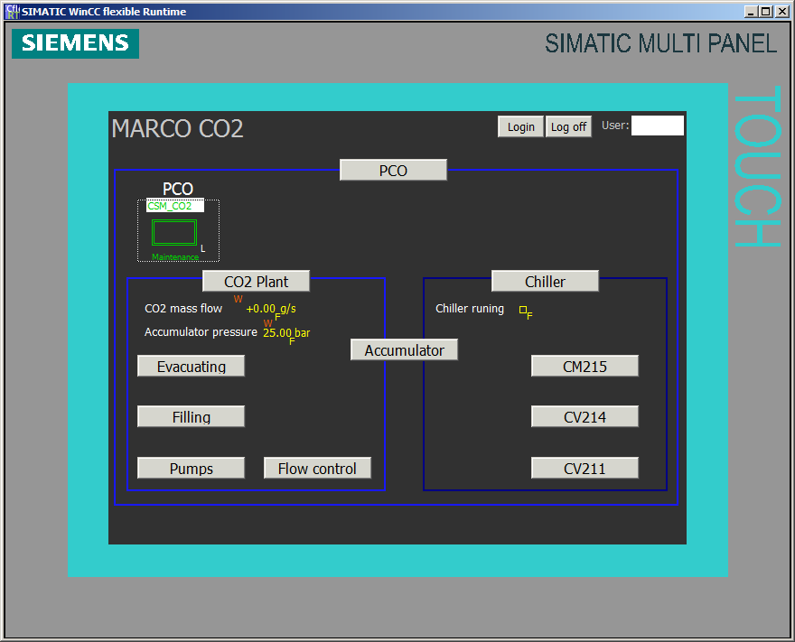
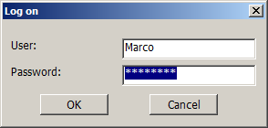
MARCO touch panel in UNICOS
SIMATIC MP 277 8" TOUCH MULTI PANEL
ACCESS CONTROL PANEL
NAVIGATION BUTTON
MARCO 10th September 2012 L.Zwalinski, M.Ostrega

Slide 21
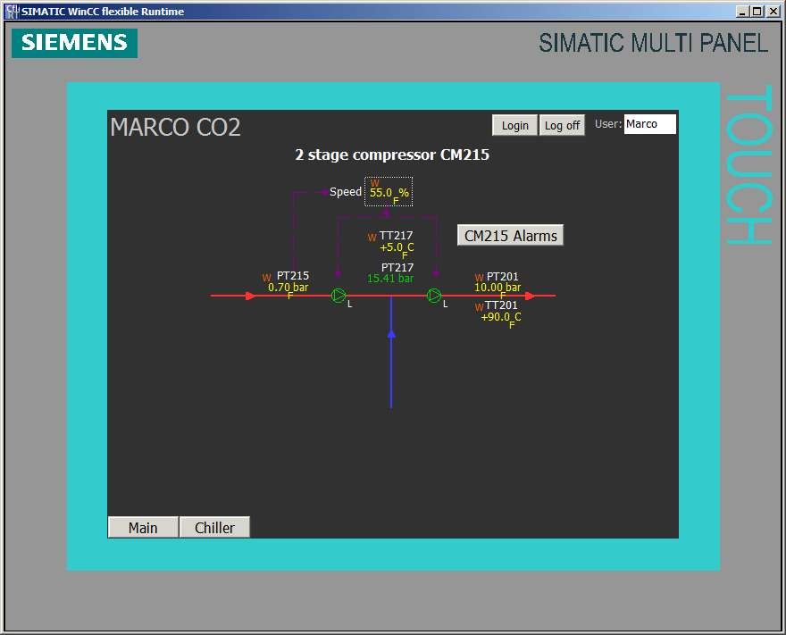
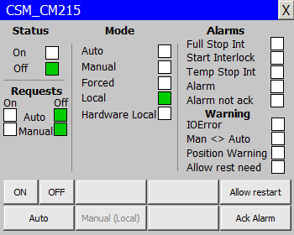
MARCO touch panel in UNICOS
ON/OFF FACEPLATE
ON/OFF WIDGET
MARCO 10th September 2012 L.Zwalinski, M.Ostrega

Slide 22
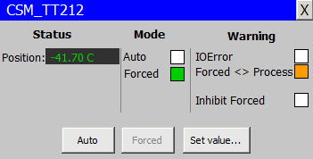
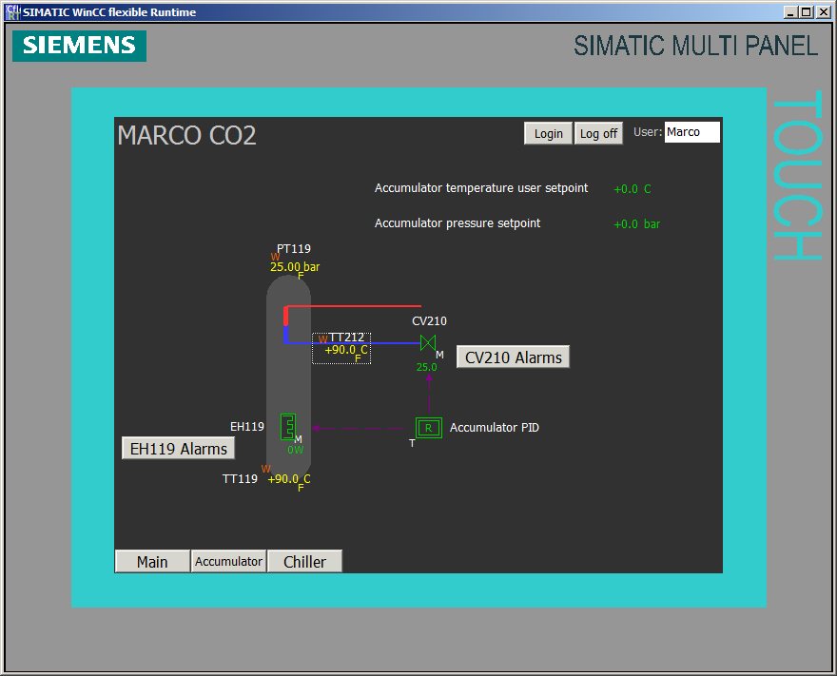
MARCO touch panel in UNICOS
ANALOG INPUT
FACEPLATE
ANALOG INPUT
WIDGET
MARCO 10th September 2012 L.Zwalinski, M.Ostrega

Slide 23
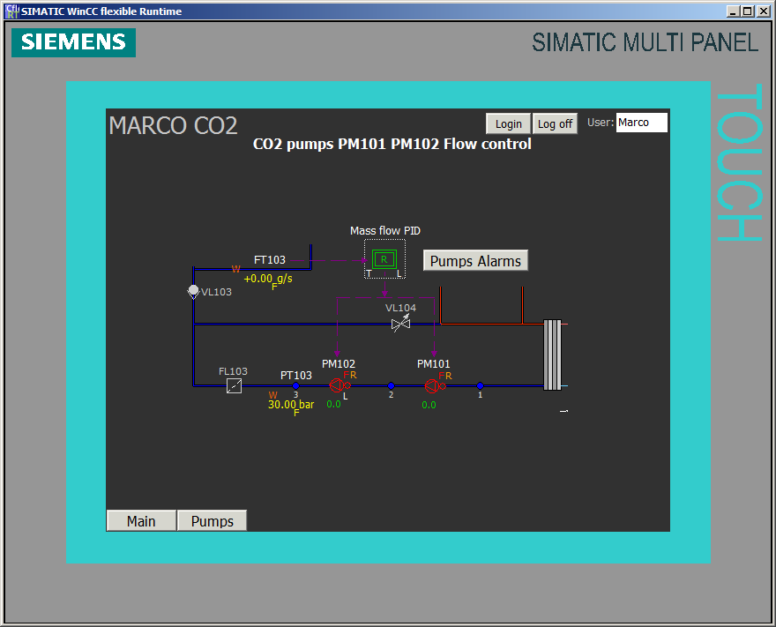
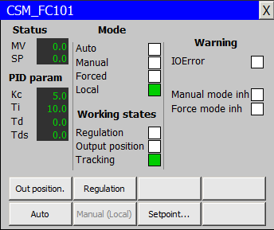
MARCO touch panel in UNICOS
PID CONTROLLER
WIDGET
PID CONTROLLER
FACEPLATE
MARCO 10th September 2012 L.Zwalinski, M.Ostrega

Slide 24
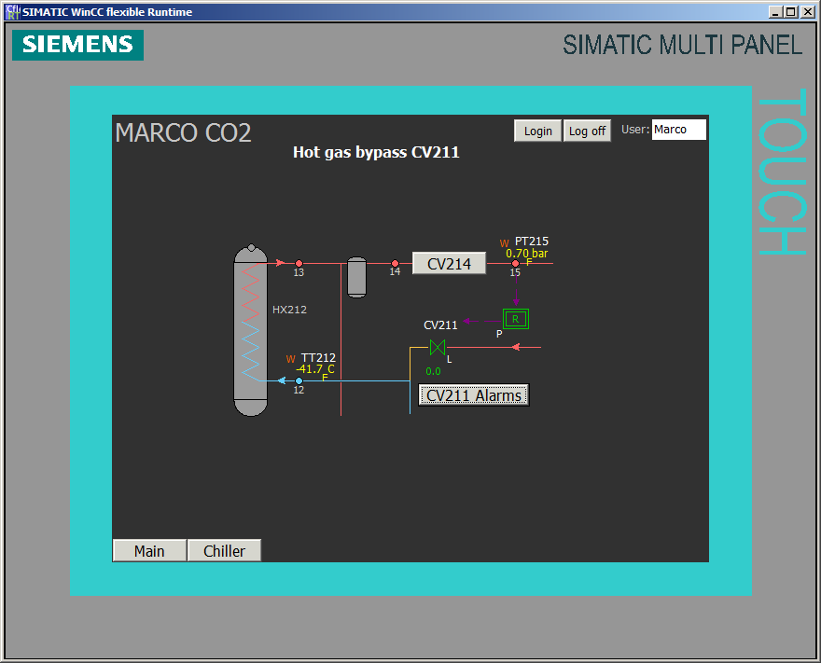
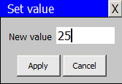
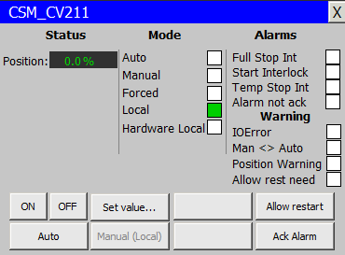
MARCO touch panel in UNICOS
ANALOG
WIDGET
ANALOG
FACEPLATE
MARCO 10th September 2012 L.Zwalinski, M.Ostrega

Slide 25


MARCO touch panel in UNICOS
ANADO
FACEPLATE
ANADO
WIDGET
FULL STOP
INTERLOCK
MARCO 10th September 2012 L.Zwalinski, M.Ostrega

Slide 26


MARCO touch panel in UNICOS
ANALOG ALARM
FACEPLATE
ALARM ACKNOWLEDGE BUTTON
MARCO 10th September 2012 L.Zwalinski, M.Ostrega

Slide 27

MARCO touch panel in UNICOS
DIGITAL ALARM
FACEPLATE
ALARM
BLOCKED
MARCO 10th September 2012 L.Zwalinski, M.Ostrega

Slide 28

MARCO touch panel in UNICOS
PCO FACEPLATE
PCO ALARMS
PCO
WIDGET
MARCO 10th September 2012 L.Zwalinski, M.Ostrega

Slide 29

MARCO touch panel in UNICOS
MARCO 10th September 2012 L.Zwalinski, M.Ostrega

Slide 30
Online p-H diagram
* Still to be implemented in MARCO WinCC-OA applications
MARCO 10th September 2012 L.Zwalinski, M.Ostrega

Slide 31
Thank You for Your attention.
UNICOS framework - more details can be found:
http://j2eeps.cern.ch/wikis/display/EN/UNICOS-CPC+Documentation
MARCO 10th September 2012 L.Zwalinski, M.Ostrega

