Slide 1
DS Dipole MBHSP01 Design, Fabrication, & Lessons Learned
Fred Nobrega
11 T Collaboration Review
September 26, 2012

Slide 2
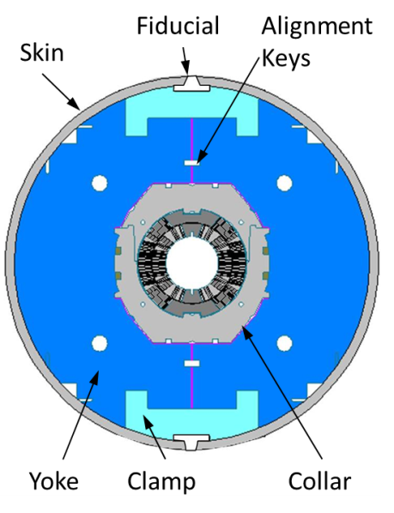
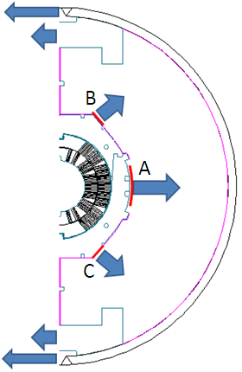
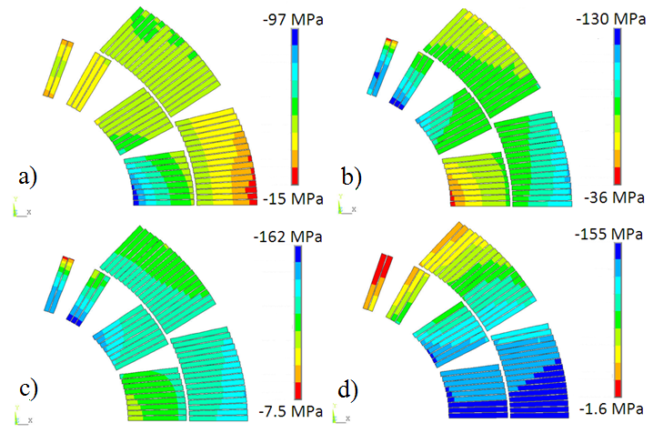
Cold Mass Stress Analysis
Stress analysis for:
  a) collaring
  b) assembly
  c) cool-down
  d) maximum design field
The mechanical design maintains coil compression up to 12 T.
Collar structure is aligned & supported by the yoke and shell.
Maximum stress during assembly ~130 MPa
The mechanical structure is optimized to keep the coil stress below 165 MPa.
EDMS no: 1107424
Parameter and performance specification for the 11 T Dipole demonstrator model magnet
a)
b)
c)
d)

Slide 3
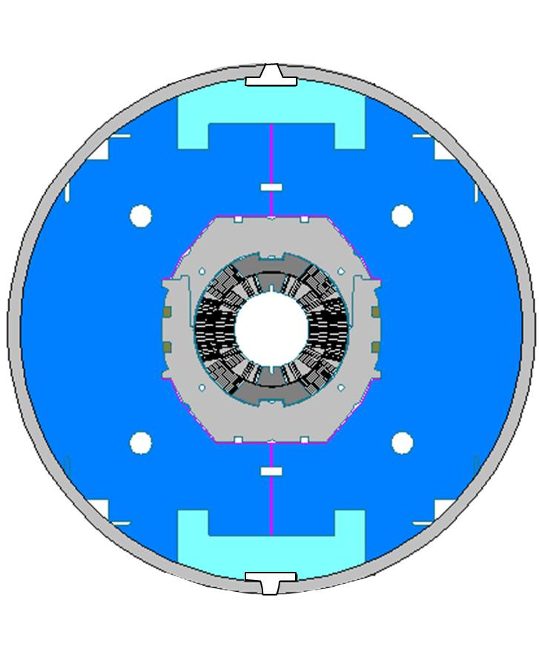
Demonstrator Dipole
As Built Cold Mass Parameters
Parameter | Specification | As Built
Yoke ID, mm | 160..200 | 174.5
Yoke OD, mm | 400
Yoke length, mm | 1700 | 1980
Number of alignment keys | 2
Alignment keys material | bronze
Clamps material | Al | 7075-T6
End fillers material | 316L
Total end filler length, mm | 330 | 355
Skin material | 304L
Skin thickness, mm | 12 | 12.7
Cold mass length, mm | 1970 | 2154
End plate material | 316LN | 304L
End plate thickness, mm | 50
Fiducial
Alignment Keys
Skin
Yoke
Clamp
Collar

Slide 4
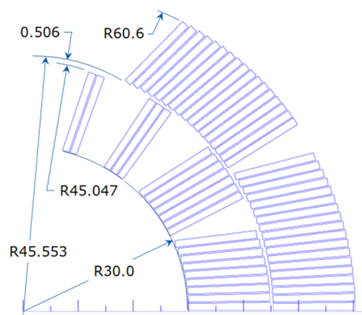
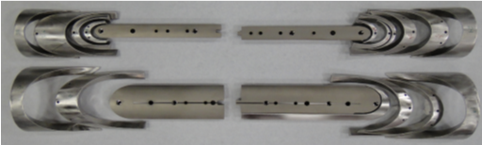
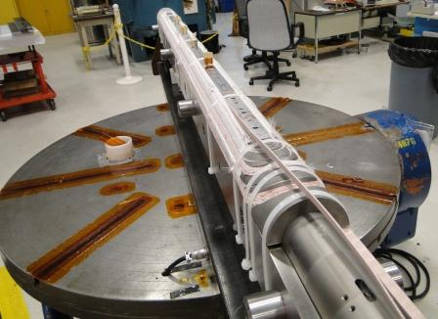
Coil Parameters
The coil has:
  56 total turns, 22 inner, 34 outer
  3 wedges in Layer 1
  1 wedge in Layer 2
  Splice-less layer jump transitions between the inner and outer coils.
  Cable insulation double butt lap by 75 μm thick E-glass
Alignment notch in L2 pole pieces
Nb₃Sn cable expansion due to the phase transformation ~ 3% in thickness & ~1% in width

Slide 5
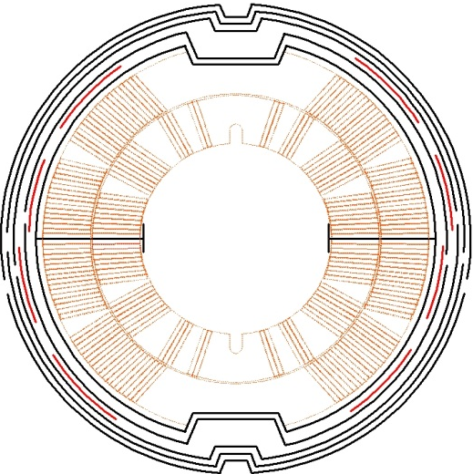
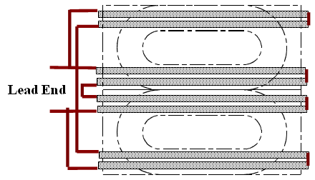
Ground Insulation &
Quench Heaters
MBHSP01 used a 60 mΩ external dump resistor.
Stainless steel quench heaters 25 μm thick were placed in 2 different locations within each coil’s ground insulation as part of a quench heater study.
One set of SS heaters had one layer of 127 μm Kapton next to the coil. Another set had two layers of 127 μm Kapton.
1x 127 μm
Kapton
between coil and heater
2x 127 μm Kapton between coil and heater
25 μm
SS Heater
25 μm
SS Heater
1x 127 μm
Kapton
between coil and heater
2x 127 μm Kapton between coil and heater
Parameter | Value
Number of layers | 5
Insulation material | Kapton
Layer thickness, mm | 0.127
Number of heaters/coil | 8
Heater material | 316
Heater width, mm | 27.8
Heater thickness, mm | 0.025

Slide 6
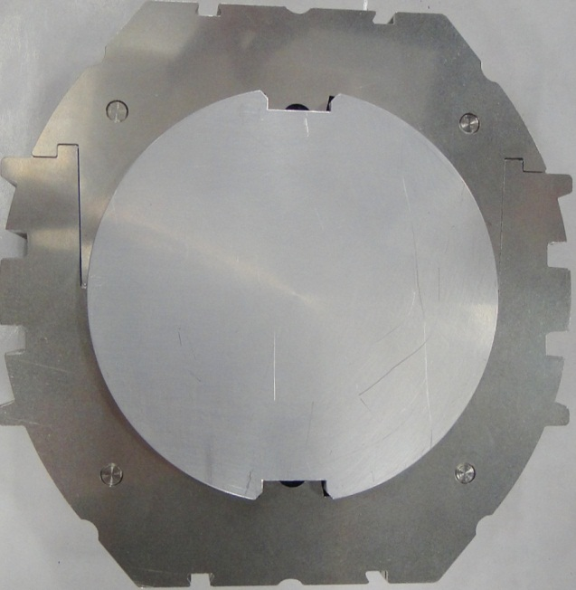
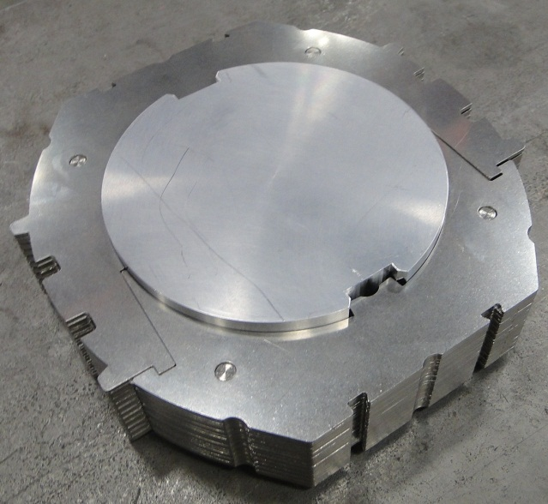
Collar Design
Parameter | Specification | As Built
Protection shoe thickness, mm | 0.5
Protection shoe material | 304
Collar material | 316LN | Nirosta high-Manganese SS
Collar width, mm | 20..40 | 15.2
Lamination thickness, mm | 1.5 | 1.8
Collar pack length, mm | 50
Number of keys | 4
Key height, mm | 6 | 8
Key thickness avg, mm | 5 | 5.4
Key material | Bronze/SS | Phosphor Bronze

Slide 7
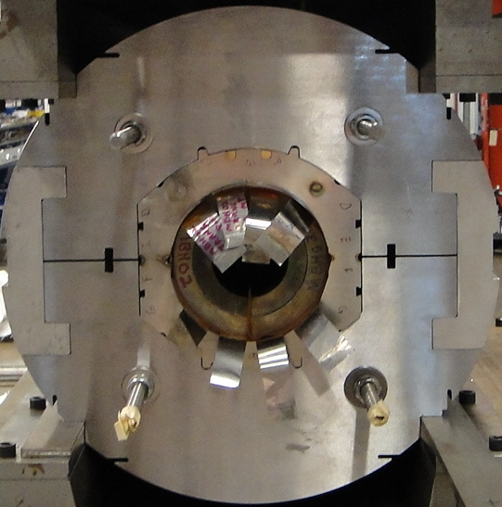
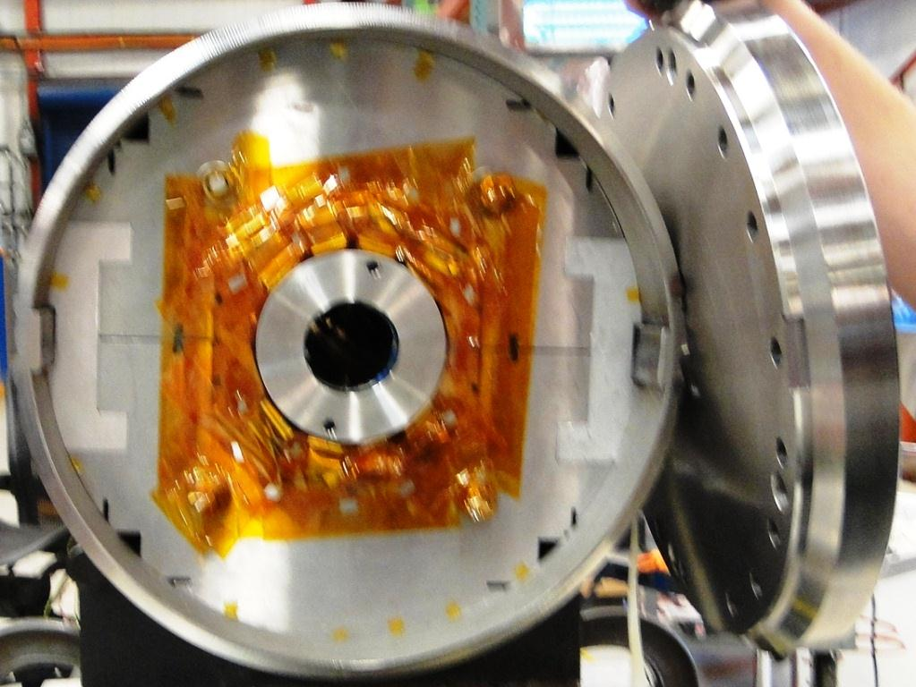
Yoke, Shell, and
End Plate Design
Parameter | Spec | As Built
Yoke thickness, mm | - | 25
Yoke material | - | SAE 1045
Clamp material | Al | Al 7075-T6
Skin material | 304L
Skin thickness, mm | 12 | 12.7
End plate material | 316LN | 304L
End plate thickness, mm | 50

Slide 8
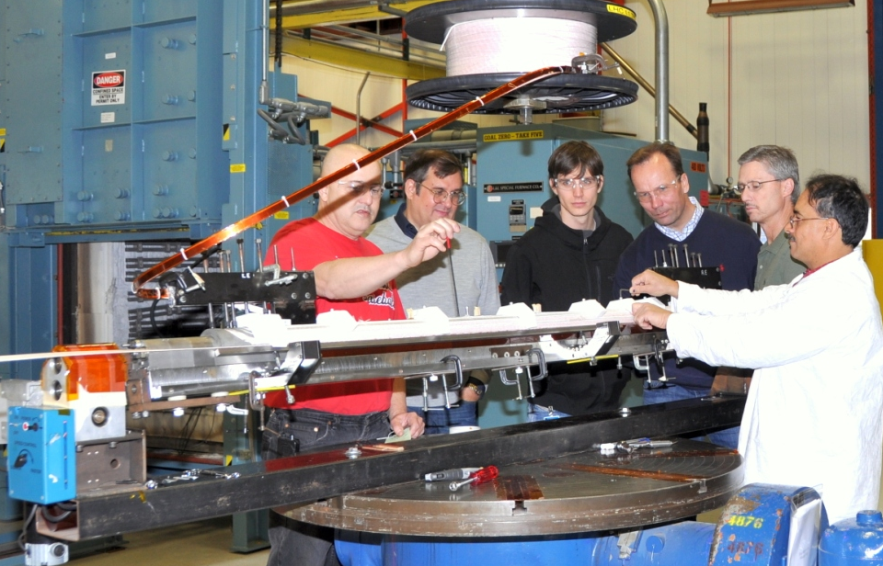
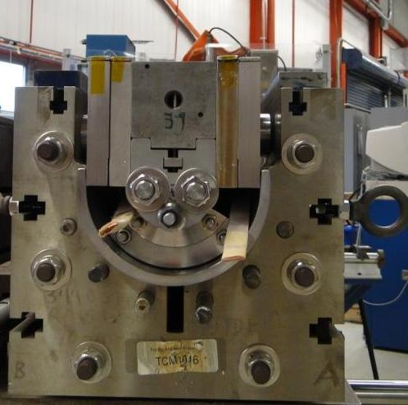
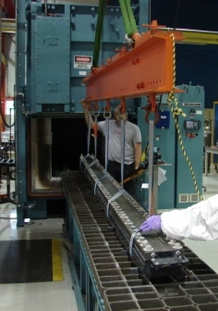
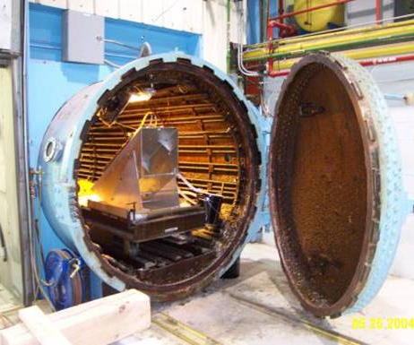
Coil Technology
Cure cycle is 150° C for 30 min. at ~27MPa.
Coil is compressed with 1 mm curing shim. Shim size is approximate sum of cable expansion during reaction and used to pre-compress insulation with binder.
Coil winding tensions is ~156 N.
Pole gap is maintained during winding and curing. Stored coil winding tension is near zero prior to reaction.
CTD-1202X ceramic binder used during winding of end turns to support cable to help prevent popped strands and cable collapse. Binder applied to entire coil prior to curing.
Reaction cycle is in an argon atmosphere and at 210° C for 72 hours, 400° C for 48 hours and 640° C for 48 hours. The heat treatment lasts about 9 days including ramp up and cool down.
Impregnation is with CTD101K and is done in the IB2 vacuum oven at 30-50 μm Hg with epoxy temperature of 60° C.
Curing is done in a different oven at 125° C for 21 hours.

Slide 9
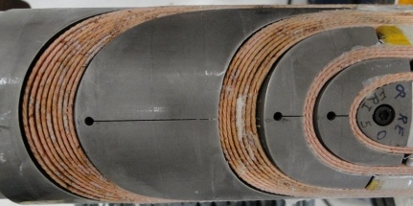
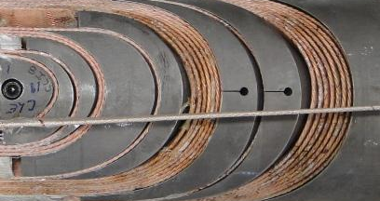
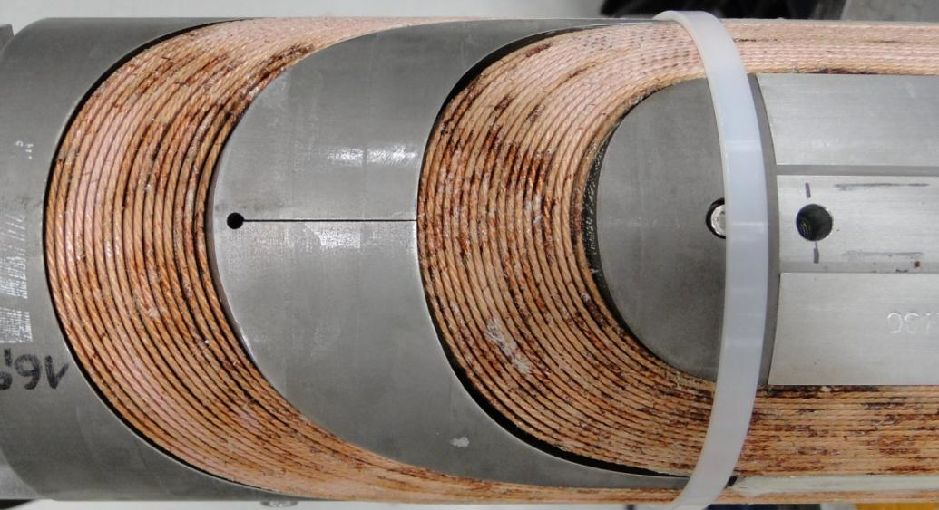
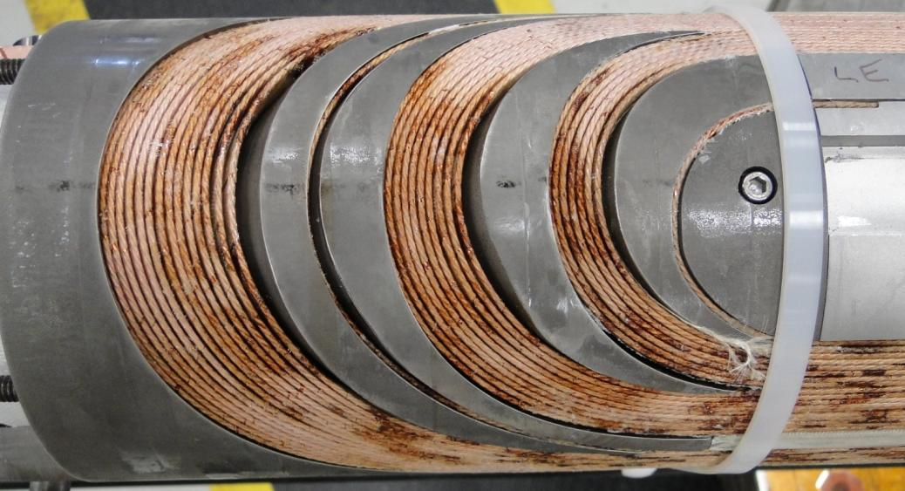
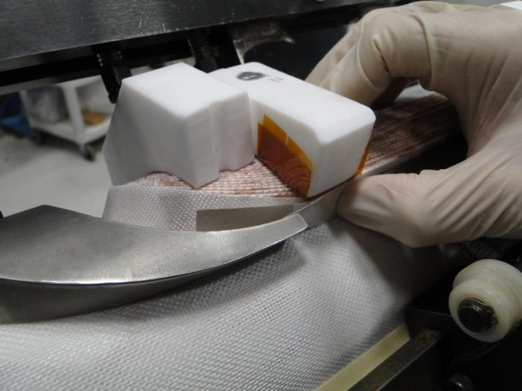
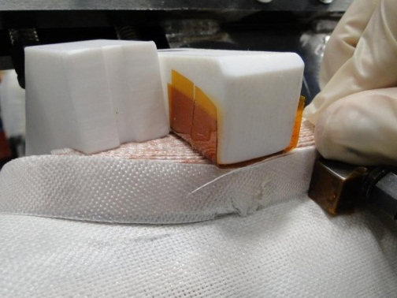
PC00, Cu Coil Winding
End parts designed & provided by CERN
  Laser sintered (SLS)
  2 designs being evaluated, upright, minimum strain
End parts large and stiff
  Hand modification to most parts prior to use
RE, Cu coil
LE, Cu coil
RE, Cu coil
LE, Cu coil

Slide 10
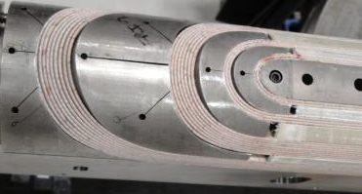
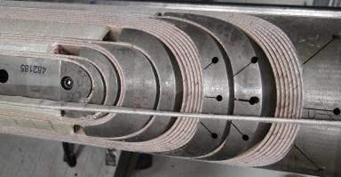
Practice Coil, PC01
PC01 was used for the mechanical model
  Cable insulation was 2 layers butt lap E-glass
  Added more slits to end parts for flexibility.
Cold mass MBHSP01 used coils MBH02 & 03 with a single layer nominal half lap E-glass cable insulation.

Slide 11
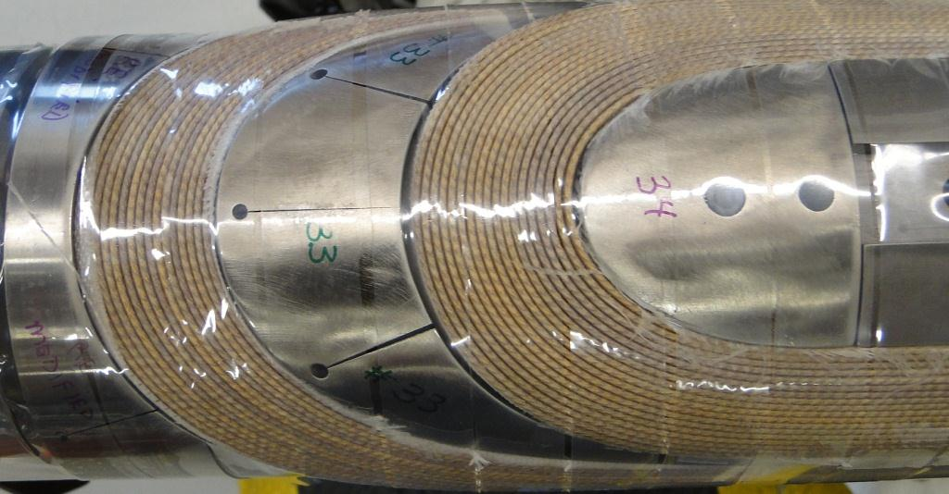
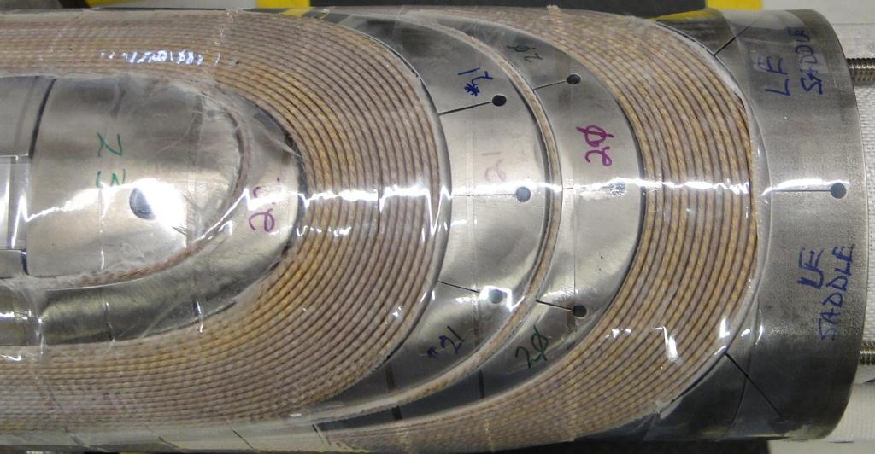
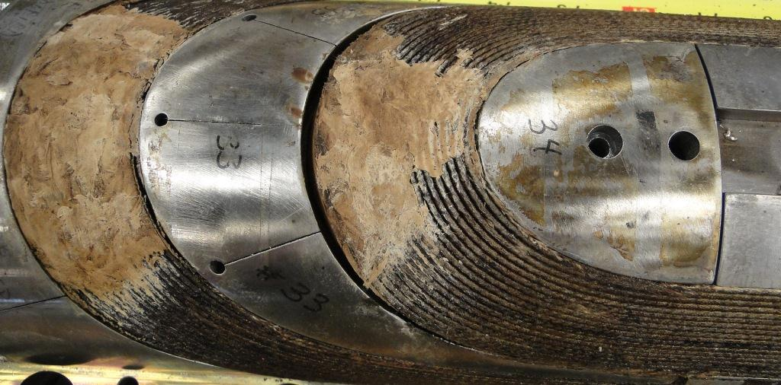
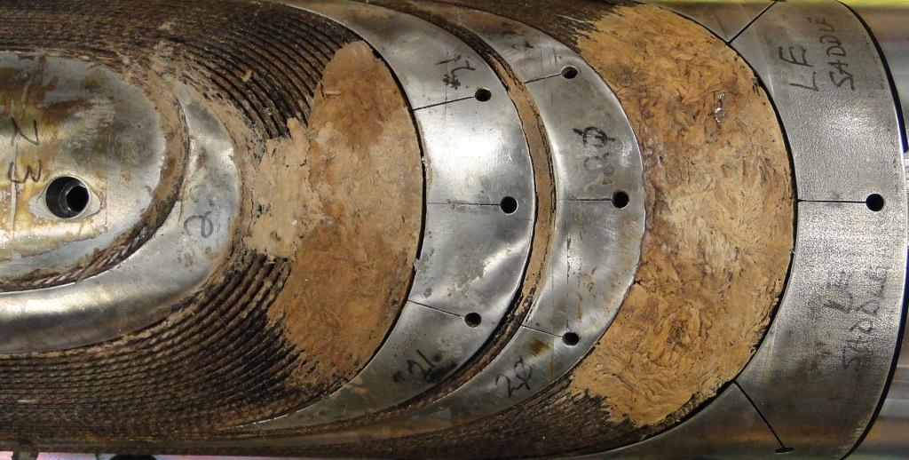
Coil Fabrication, MBH02
L2 Before Curing
MBH02 RE
L2 After Reaction
MBH02 LE

Slide 12
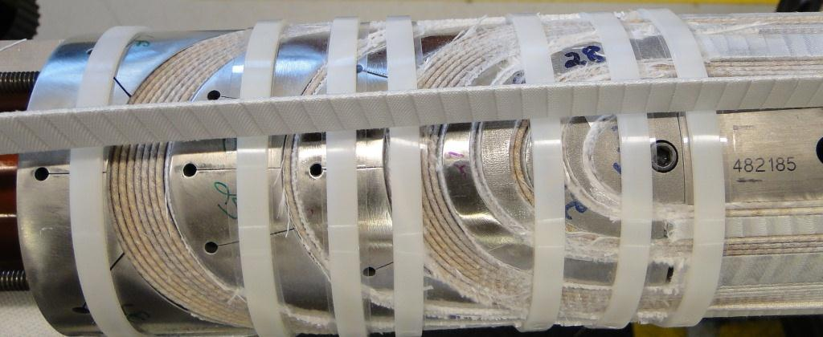
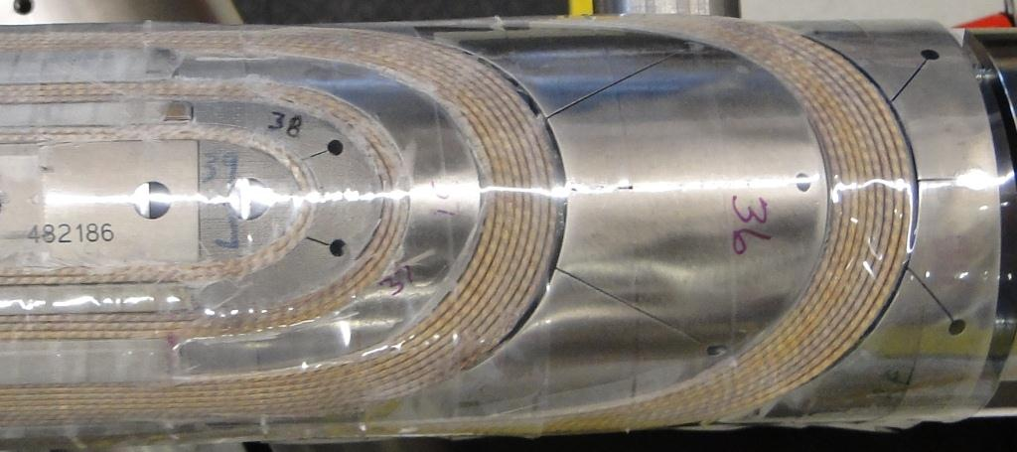
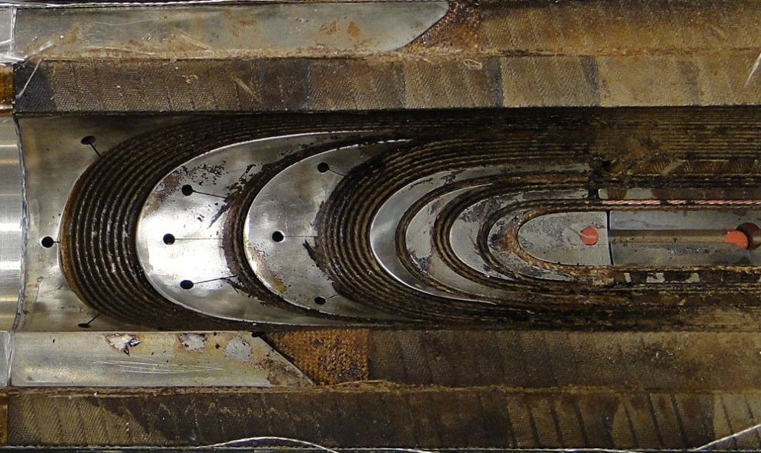
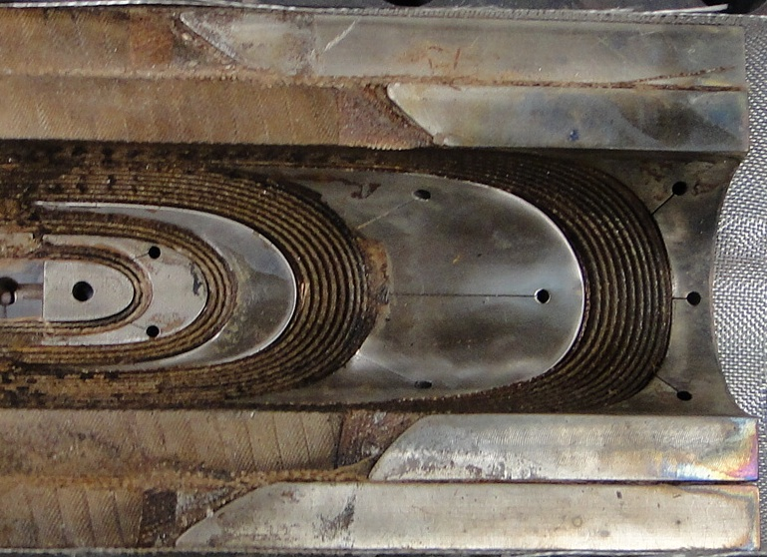
Coil Fabrication, MBH02
L1 outer surface before curing
MBH02 LE
MBH02 RE
L1 inner coil after reaction

Slide 13
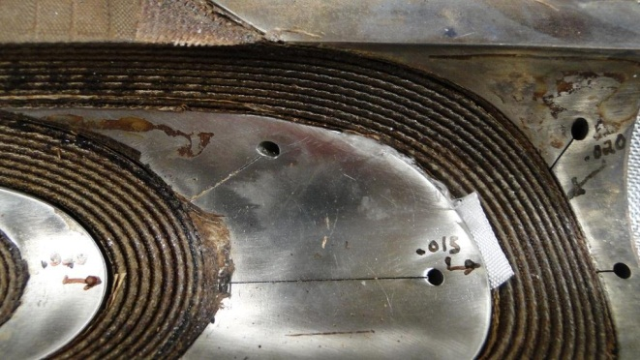
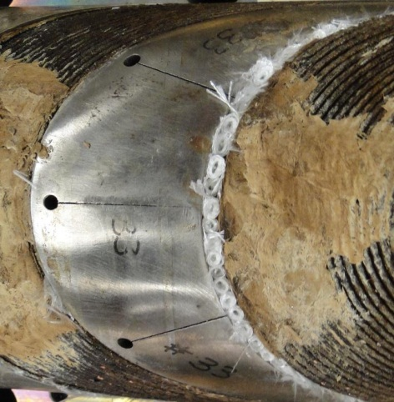
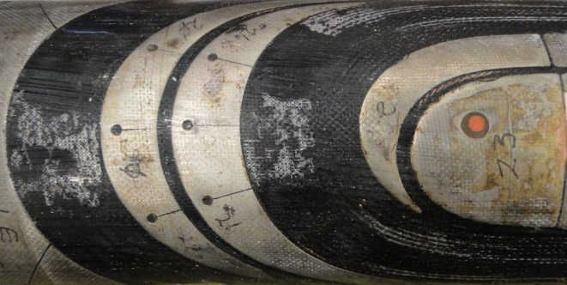
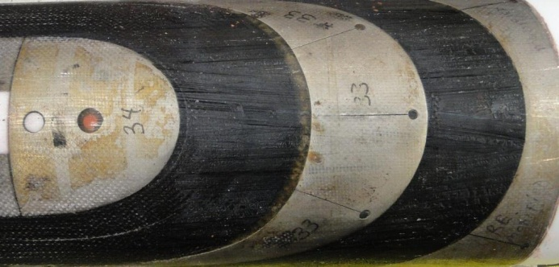
Coil Fabrication, MBH02
Gaps between cable and end parts filled with S2-glass.

Slide 14
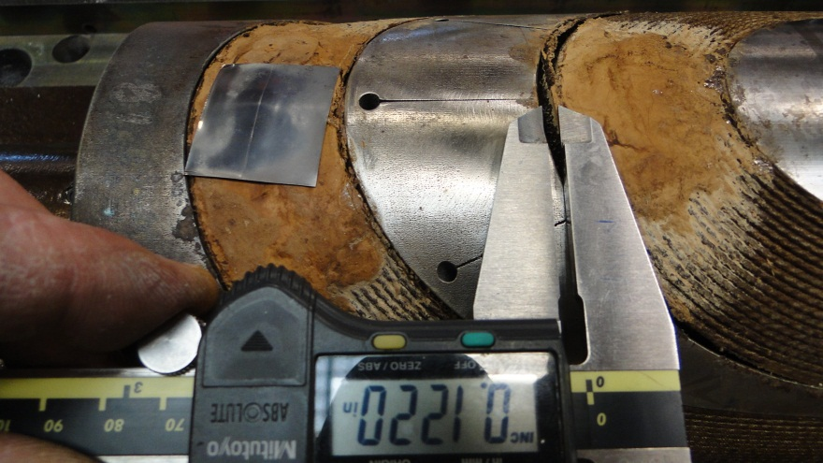
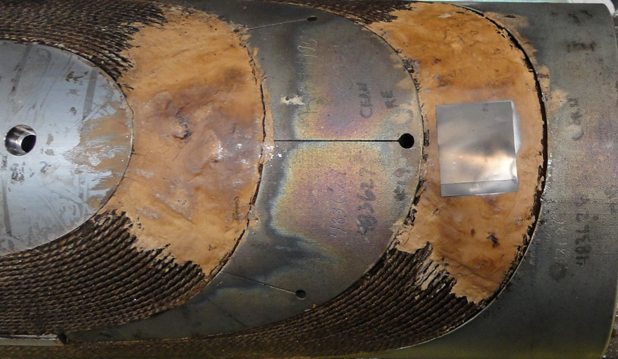
Coil Fabrication
MBH04 (2m) with 3mm gap, used end stopper during reaction, spacer not modified
MBH05 (1m) Spacer legs shortened, saddles modified (1 mm removed from inner saddle parting plane, 1.5 mm from outer saddle), no reaction end stopper.
MBH04
MBH05

Slide 15
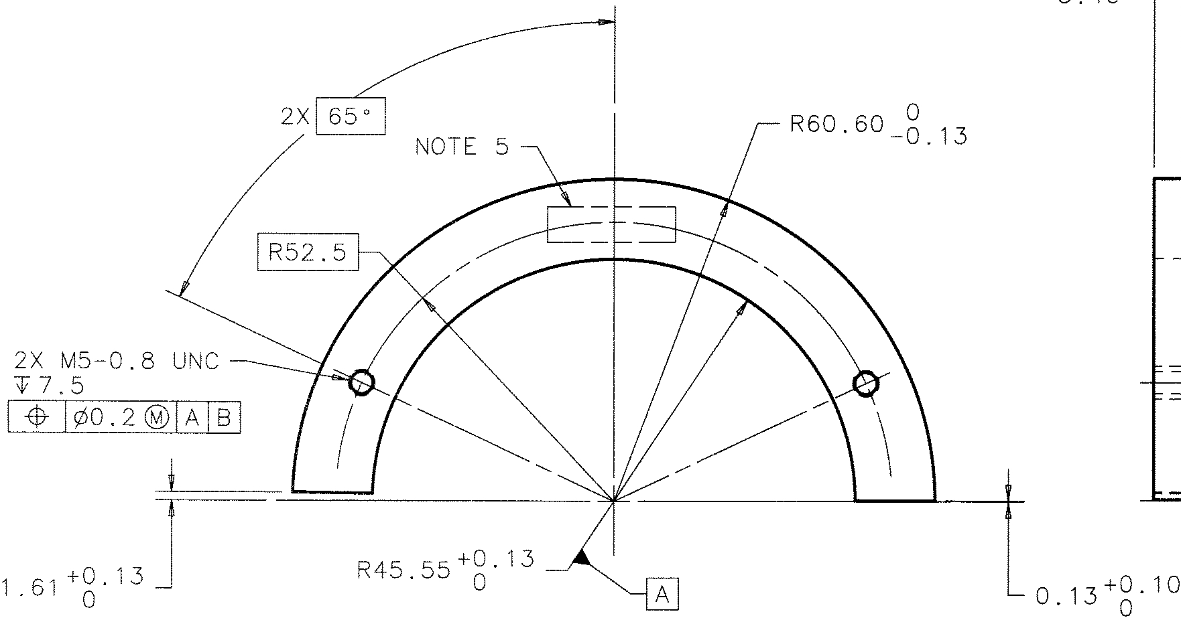
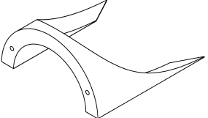
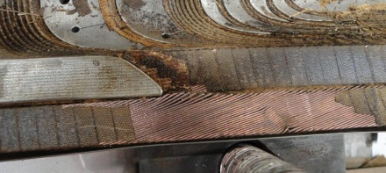
MBH04 Damage
L2 LE saddle out of tolerance
  Outside diameter large by 37 μm
  Mid-plane gap for cable lead small by 60 μm
Insulation between cable lead and saddle too thick by at least 127 μm
Retrospective view of coils 2 and 3 in MBHSP01

Slide 16
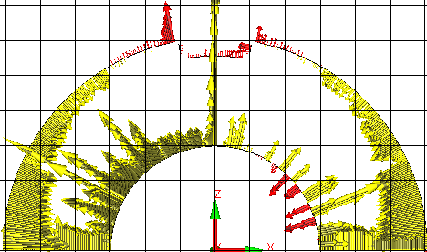
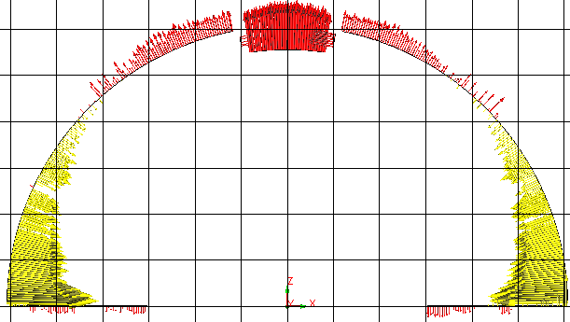
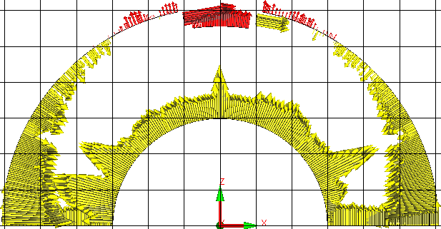
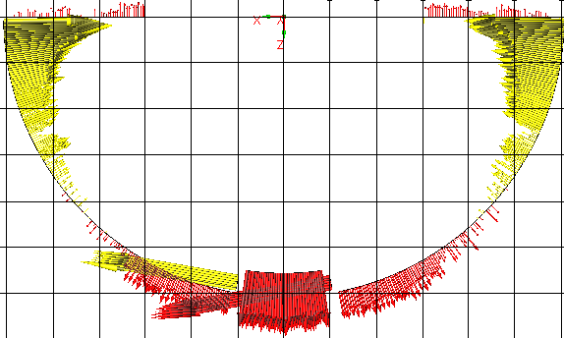
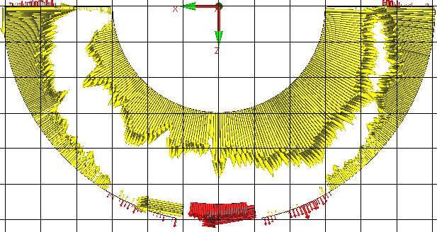
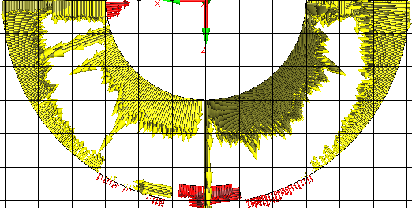
Coil Size Data
(1 box = 101.6 μm)
MBH03
435 mm from RE
MBH01 (PC)
455 mm from RE
MBH02
445 mm from RE
MBH02
1165 mm from RE
MBH03
1165 mm from RE
MBH01 (PC)
1165 mm from RE

Slide 17
Coil Fabrication
Lessons Learned
QC
  End part inspection
Add ceramic binder each end turn for added cable stability.
Remove material from mid-plane of saddles for coil curing. Shim saddles at mid-plane as required for reaction and impregnation process.
Leg length of selected end parts modified
Match cable final turn angle with end part
  Balance between cable hard way bend and torsion

Slide 18
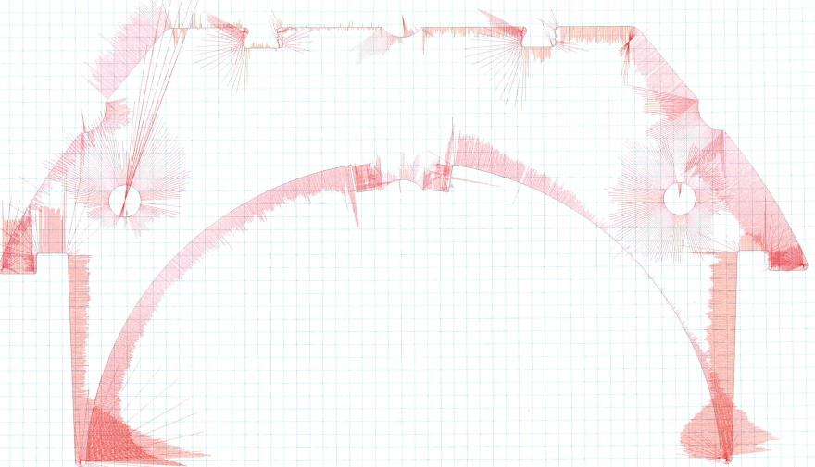
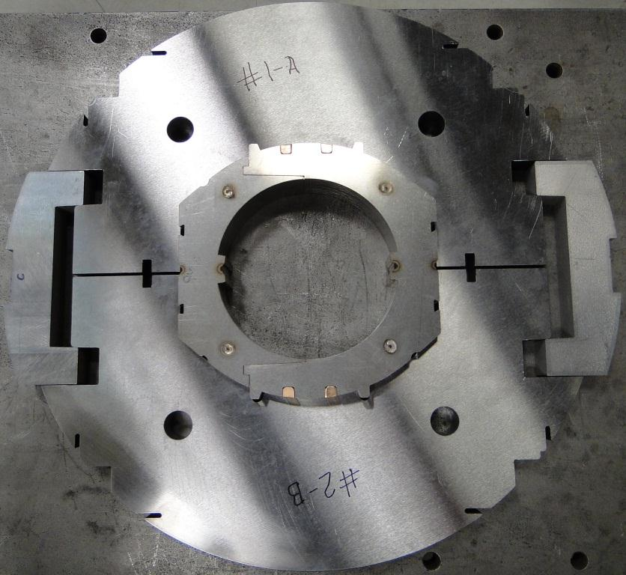

Collar Fabrication
Collars fabricated via laser cutter
Material provided by CERN
  Issues with surface cracks in coil material and with making sheets for the laser cutter.
Average part tolerance from vendor +/- 26 μm with standard deviation of 16.6 μm.
  Several iterations with vendor needed to improve part tolerance to the reported levels.
Collar packs:
  Use 127 μm shim between laminations.
  Are welded longitudinally along the pole and on the O.D. above the pole.
  Have 2 pins each welded at the ends.
1 Box = 25.4 μm

Slide 19




MBHSP01 Coil Shim Plan
MBHSP01 Shim Plan
223.3 μm mid-plane shim
(not tapered at the ends)

Slide 20


Mechanical Model #3
Radial shim 101.6 μm
Mid-plane shim 152.4 μm
Average SG readings
  -40 MPa mid-plane
  -4 MPa Pole
Pressure sensitive film
  High pressure used on mid-plane, max = 130 MPa
  Medium pressure used on coil surface, max = 49 MPa
Mid-plane
POLE
POLE

Slide 21


Mechanical Model #4
Half of collar packs rotated 180° (collar witness mark)
Radial shim 127 μm (added 25.4 μm)
Mid-plane shim 152.4 μm
Average SG readings
  -61 MPa mid-plane
  -5 MPa Pole
POLE
POLE

Slide 22

Collar Deflection &
Coil Stress After Collaring
After Collaring
Collar Deflection | MM#6 |  | Magnet |  | FEA
Horizontal radius change (μm) | 43 |  | 52 |  | 20
Vertical radius change (μm) | 52 |  | 72 |  | 86
Coil Stress Average (MPa) | LE | RE | LE | RE | -
Mid-plane coil A | -59 | -83 | -42 | -54 | -93
Mid-plane coil B | -55 | -67 | -67 | -59
Pole coil A | -1 | -12 | -13 | -9 | -33
Pole coil B | -3 | -13 | -10 | -47
Coil SG locations, pole & mid-plane

Slide 23

End Mechanical Model
Coil sections were positioned such that the upper and lower saddles were in the same position as they would be in the magnet. The cable splice leads were not studied in the MM.
Results from MM#7 Body are from coil ends which include a portion of the straight section. E_{coil} = 20 GPa
Collar Deflection | MM#6 | MM#7 | MM#7 | Magnet |  | FEA
 | Body | Body | Ends | Body | Ends | Body
Horizontal radius change (μm) | 43 | 62 | 24 | 52 | 2 | 12
Vertical radius change (μm) | 52 | 71 | 33 | 73 | 1 | 74

Slide 24
Collared Coil
Stress Summary
Same collar keys used for all mechanical models.
Many mechanical models built with same coils. Coil modulus assumed at 20 GPa.
Pressure sensitive film used to identify high stress areas and uniform loading.
MM#5 had a double layer of pressure sensitive film by mistake.
Average Collar Deflection Radius Change (μm)
 | MM#3 | MM#4 | MM#5 | MM#6 | Magnet | FEA
Horizontal (R) | - | 7 | 67 | 43 | 52 | 12
Vertical (R) | - | 58 | 79 | 52 | 73 | 74
Collared Average Coil Stress (MPa) at SG Location
 | MM#3 | MM#4 | MM#5 | MM#6 | Magnet | FEA
Mid-plane | -40 | -61 | -74 | -66 | -56 | -77
Pole coil | -4 | -5 | -3 | -7 | -20 | -13

Slide 25






Coil Assembly & MM
Coil assembly process developed with mechanical model
Upper and lower collar packs are shifted to interlock all collar packs together
Iron on Kapton used for ground insulation
Silicone O-rings used to hold collars together prior to the keying operation.

Slide 26
Collared Coil
Lessons Learned
Fuji film between saddles indicated low pressure in keyed collar assembly – use tapered mid-plane shim as precaution
Fabrication technique cost and schedule tradeoffs
  Laser cutting
  Wire cutting
  Stamping
Choose 2 of the 3
  Fast
  Cheap
  Accurate

Slide 27


MM Clamped Yoke
2 iterations used to determine the collar to yoke shim.
Clamped Yoke Average Coil Stress (MPa)
 | MM#6-1 | MM#6-2 | Magnet | FEA
Mid-plane | -60 | -39 | -38 | -64
Pole coil | -15 | -21 | -56 | -59
Coil SG locations, pole & mid-plane

Slide 28




Magnet Shell Welding
Nominal gap between alignment key and shell 0.7mm. Actual gap ~3 mm → large weld shrinkage
  Higher coil stress
  Local yielding of end yoke laminations
New weld carriage system not completely debugged prior to use. → weld process not well controlled
Approximately half of coil stress increase came from the fusion weld passes.
End yoke lamination with apparent local yielding
Gaps
Gap

Slide 29
Shell Welding Stress
High shell welding stress due to bending
Step increase in shell stress after fill pass 2 was a result of poor visibility due to camera support issues

Slide 30

Coil Stress
During Shell Welding
Shell Welding Average Coil Stress (MPa)
 | Before Weld | Final Weld | FEA
Mid-plane | -38 | -42 | -39
Pole coil | -56 | -62 | -110
After Skin Welding
Coil SG locations, pole & mid-plane

Slide 31

Final Assembly
50 mm thick end plate
4 bullets with strain gauges preloaded to 4.4 kN each.
Assuming 25% of Lorentz load, end plate deflection calculated to be 159 μm with 81 MPa max stress in the weld area.

Slide 32


Instrumentation
Coil strain gauges (14) on coil pole, mid-plane, and key
Voltage taps (44)
End bullet load strain gauges (8)
Shell strain gauges (16) at 30° and 60° from shell weld

Slide 33
Clamped Yoke & Final Assy
Lessons Learned
Bolted skin for R&D magnets has advantages over welded skin assemblies
  Shim iterations
  Fast turn around of assembly
  Cost
No coil over compression in the straight section from shell welding but can’t exclude coil end damage because of end yoke yielding. Using tapered mid-plane shim can help mitigate unexpected over compression from welding.

Slide 34
Discrepancy Reports
DR’s are written when there is any non conformance with respect to the traveler.
  Written description
  Cause of non conformance
  Disposition
  Corrective action to prevent recurrence
Coil Fabrication Discrepancy Reports
 | Coil Winding | Reaction & Epoxy Impregnation
MBH02 | 7 | 2
MBH03 | 2 | 1
MBH04 | 2 | 1
MBH05 | 0 | 0*
MBH06 | 1
MBH07 | 0 | 0*
* Coil is or will be in fabrication

Slide 35
Lessons Learned
Implemented
  Double butt lap of 75 μm E-glass changed to single half lap cable wrap due to difficulty controlling placement second layer of the wrap to cover gap of 1st layer.
  End part quality control
  End part design revisions, cable lay angle, part length, saddle mid-plane
  Collar manufactures to hold print tolerances
To be implemented
  Less end part modifications by technicians prior to use.
  Shell welding tooling refinement and process improvement before next magnet weldment.
Observation
  Coil degradation appears to be an aggregate effect beginning with and perhaps dominated by the end saddle design.
    Over compression of cable during reaction
    Over compression from shell welding in ends → yoke lamination yield
  Next steps
    Autopsy of MPHSP01 →coil inspection
    Redesign of saddles
    Bolt on shell
    Demonstrate shell welding well understood prior to use
    Tapered mid-plane shim
    Test MBH02 in Jan 2013 with these steps incorporated.

Slide 36
MBHSP01 Schedule
 | Actual days | Planned days
coil 02 wind | 42 | 22
coil 02 react | 28 | 29
coil 02 impreg | 64 | 19
coil 03 wind | 39 | 22
coil 03 react | 71 | 29
coil 03 impreg | 19 | 19
coil assy | 6 | 14
collar assy | 9 | 28
yoke assy | 5 | 6
shell welding | 14 | 14
final assy | 18 | 18
days including w/e weeks months | 315 45.0 10.5 | 220 31.4 7.3
Coil 02 impregnation: Hole miss match 50 mm vs 2 inches wrt impregnation & reaction tooling delayed coil transfer from one set of tooling to the other
Impregnation base plate out of tolerance, part rejected & fabricated again at the same time needed for impregnation
Coil longer than design modify impregnation base plate.
Input from PC01 CMM → changed impregnation radial materials for coil 02
Impregnation curing oven out of service
Coil 03 reaction delay → furnace CPU defective
Collar delay
Yoke delay

Slide 37
Review questions/answers
Phase 1
  Was any problem encountered during construction or final testing understood? Are such problems addressed properly in view of the next steps?
  Was the instrumentation sufficient to evaluate fabrication procedure, validate mechanical and magnetic models and demonstrate that the magnet met specifications?
Yes
Yes
→
→

Slide 38
Backup

Slide 39

Key Strain Gauges
Strain gauges near edge of part have higher strain.
RE L1 Key
MBH03
LE L1 Key
MBH03

Slide 40
MBHSP01 Schedule
 | Start | Finish | Actual days | Planned days
coil 02 wind | 9/16/2011 | 10/28/2011 | 42 | 22
coil 02 react | 11/7/2011 | 12/5/2011 | 28 | 29
coil 02 impreg | 12/6/2011 | 2/8/2012 | 64 | 19
coil 03 wind | 10/29/2011 | 12/7/2011 | 39 | 22
coil 03 react | 12/8/2011 | 2/17/2012 | 71 | 29
coil 03 impreg | 2/18/2012 | 3/8/2012 | 19 | 19
coil assy | 3/20/2012 | 3/26/2012 | 6 | 14
collar assy | 3/27/2012 | 4/5/2012 | 9 | 28
yoke assy | 4/13/2012 | 4/18/2012 | 5 | 6
shell welding | 4/19/2012 | 5/3/2012 | 14 | 14
final assy | 5/4/2012 | 5/22/2012 | 18 | 18
days including w/e weeks months |  |  | 315 45.0 10.5 | 220 31.4 7.3

Slide 41


