Slide 1
11 T Dipole Project Goals and Deliverables
M. Karppinen on behalf of CERN-FNAL collaboration
“Demonstrate the feasibility of Nb3Sn technology for the DS collimation upgrade with an accelerator quality 5.5-m-long twin-aperture 11 T prototype dipole by 2015”

Slide 2
Contributions & Acknowledgements
FNAL:
N, Andreev, G. Apollinari, E. Bartzi, R. Bossert, G. Chlachidze,
F. Nobrega, I. Novitski, G. Wilson, A. Zlobin,...
CERN:
B. Auchmann, A. Ballarino, A. Bonasia, S. Bermudez,
N. Bourcey, A. Cherif, S. Clement, A. Gerardin, M. Guinchard, L. Bottura, C. Kokkinos, B. Favrat, L. Favre, C. Fernandes, P. Fessia, R. Gauthier, B. Holzer, G. Kirby, F. Lackner, G. Maury, J. Mazet, N. Mena, R. Moron-Ballester, J-M. Mucher,
J. Murtomaki, L. Oberli, J-C. Perez, L. Rossi, T. Sahner,
F. Savary, J.-M. Scigliutto, L. Remandet, S. Russenschuck,
S. Sgobba, E. Todesco, D. Tsirigkas,...

Slide 3
Outline
DS upgrade
11 T Dipole & Collimator cryo-assembly options
Design challenges
Beam dynamics requirements update
Project plan and goals
  FNAL Milestones
  CERN Milestones
Magnetic design and parameters
Mechanical design:
  Design choices and goals
  FNAL and CERN Design concepts
Summary

Slide 4
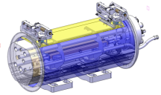
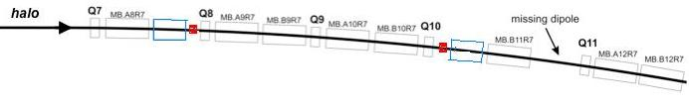
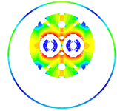
DS Upgrade
Create space for additional (cryo) collimators by replacing 8.33 T MB with 11 T Nb₃Sn dipoles compatible with LHC lattice and main systems.
119 Tm @ 11.85 kA
MB.B8R/L
MB.B11R/L
11 T Nb₃Sn
15,66 m (IC to IC plane)
LS2 2018: IR-1,5, and 2
  3 x 4 MB => 24 x 5.5 m CM + spares
LS3 2022: Point-3,7
  2 x 4 MB => 16 x 5.5 m CM + spares
5.5 m Nb₃Sn
3 m Collim.
5.5 m Nb₃Sn
5.5 m Nb₃Sn
5.5 m Nb₃Sn
3 m Collim
Joint development program between CERN and FNAL underway since Oct-2010.

Slide 5
11 T Dipole & Collimator
Cryo-Assembly options
15,66 m (IC to IC plane)
11,48 m (L_{CM})
10,6 m (L_{mag})
3 m (collimator)
Line X (H.exch.)
beam tubes
Line M
(B.Bar line)
12 m (L_{CM})
5,3 m (L_{mag})
5,3 m (L_{mag})
3 m (collimator)
6,18 m (L_{CM})
6,18 m (L_{CM})
5,3 m (L_{mag})
2,27 m (collimator)
5,3 m (L_{mag})

Slide 6
11 T Nb₃Sn Dipole Design Challenges
Iron saturation effects
  Modified MB Yoke
  Cross-talk between apertures
Transfer function matching with MB
  More turns (56 vs. 40)
  Iron saturation
Coil magnetization effects
  Strand development
  Passive correction
Quench protection
  Heater development
Coil fabrication
  Cable development
  Reproducibility & Handling
  Technology transfer
Mechanical structure
  Forces almost 2 X MB
  First 2-in-1 Nb₃Sn magnet
Thermal
  Resin impregnated coils
Integration
  Optics
  Cold-mass
  Collimator
  Machine systems

Slide 7
Beam Dynamics Requirements
Courtesy of B. Holzer
DA in nsig
DA in nsig
Angle 0..90 deg
Angle 0..90 deg
Scaled MB error table and 11 T PC multipoles
Nb₃Sn dipoles in sector 2 and 7
b3 = 27 units tolerable
b3 = 27 and 11 T dipoles in sector 2/7 and 1,2,5.
we can accept them in any (?) sector.
Quasi local , i.e. sector-wise b3 correction is good enough as long as we stay in the range of b3 < 27 units

Slide 8
Beam Dynamics Requirements
Courtesy of B. Holzer
DA in nsig
Angle 0..90 deg
DA for std. LHC optics vs. ATS with b3 = 27 at injection
ATS is more sensitive to b3 as the beta functions at the location of 11 T dipoles are larger in the ATS.

Slide 9
Beam Dynamics...
Courtesy of B. Holzer
DA at high energy:
  No problem for the standard optics.
  ATS optics still has to be checked, but expected to be fine
Smaller DA appears to be general behavior of the ATS (even without Nb3Sn dipoles)
Message:
We have to improve the b3 at low field by “quite an amount” ... or we have to accept that we need spoolpiece correctors to compensate for it.
DA in nsig
Angle 0..90 deg
DA for different b3 values at ATS-LHC injecton.
There is a tolerance level where the DA is no longer determined by b3.
This tolerance seems tighter than in the standard LHC injection case.

Slide 10
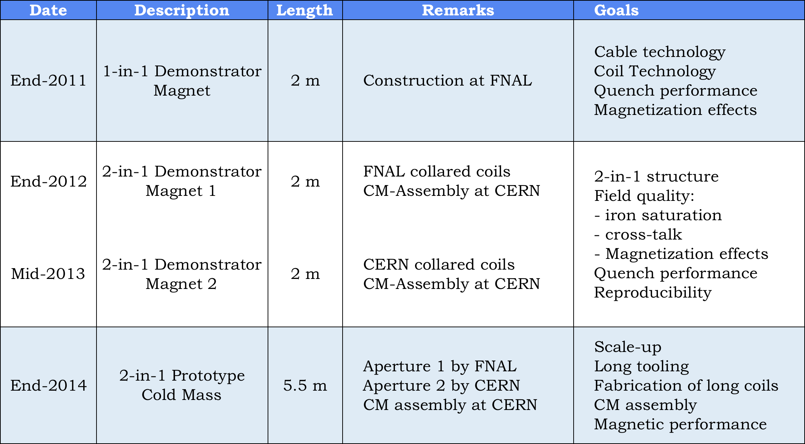
11 T Dipole Model Program
Notes:
Add Original dates
Calendar year

Slide 11
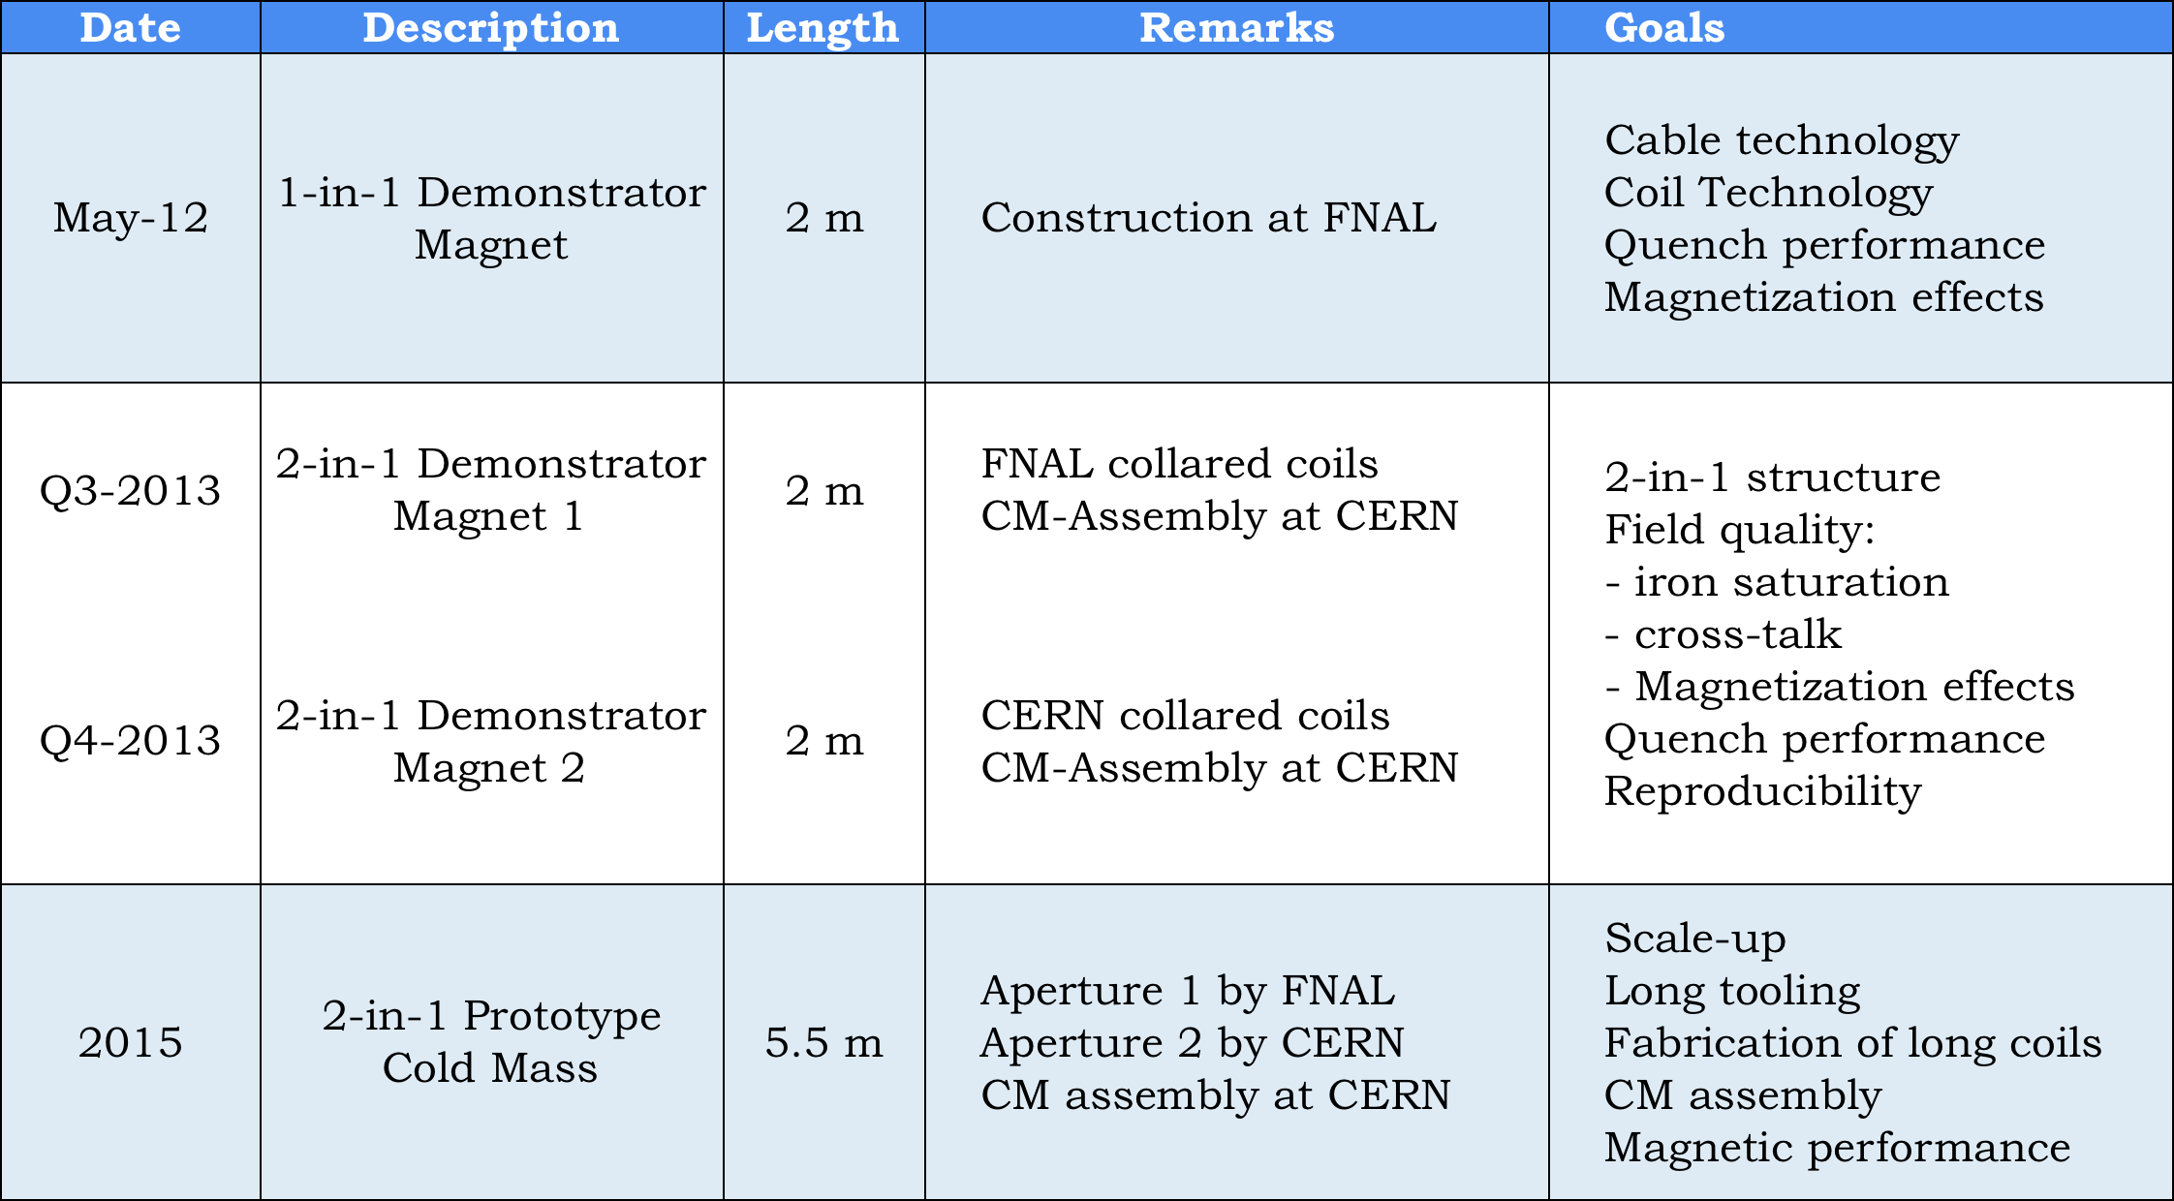
11 T Dipole Model Program
Notes:
Add Original dates
Calendar year

Slide 12
CERN-FNAL Collaboration
FNAL contribution :
  10 years of Nb₃Sn development
  Strand supply and cable development
  Mechanical design and construction of collared coils based on integrated pole concept
  Cold mass assembly of 1-in-1 magnets
  Warm and cold testing including magnetic measurements
CERN contribution:
  Magnetic design
  Strand supply and cable development
  Mechanical design and construction collared coils based on pole loading concept
  End spacer design & supply
  Material supply for collars and iron yokes
  Supply of 2-in-1 yokes and shells
  Cold mass assembly of 1-in-1 and 2-in-1 magnets
  Cold and warm tests

Slide 13
FNAL Milestones
1-in-1 Demonstrator test @FNAL Jun-12
1 m model (cored RRP-151/169)
  Coil fabrication Jun..Oct-12
  Cold mass assembly Nov..Dec-12
  Test @FNAL Dec..Jan-12
  Test @CERN (TBC) Mar-13
2-in-1 Demonstrator (2 m, cored RRP-108/127)
  Coils for aperture-1 Oct..Dec-12
  1-in-1 assembly and test @FNAL Mar..Apr-13
  Coils for aperture-2 Jan..Mar-13
  1-in-1 assembly and test @FNAL Q3-13
  2-in-1 assembly and test @CERN Q4-13
  Eventual coil design update (?) Q4-13..Q1-14
5.5 m prototype magnet (Preliminary)
  Selection of mechanical concept Q1-14
  Tooling commissioning Q4-13..Q1-14
  Practice coil (Cu) Q1-14
  Practice coil (Nb3Sn) Q2-14
  Coils for aperture-1 & mirror tests Q4-14
  Collared coil Q1-15

Slide 14
CERN Milestones
Practice coils (2 m)
  Practice coils #1-#2 (Cu) Jun..Sep-12
  Practice coil #3 (cored ITER Nb₃Sn) Oct..Nov-12
  Practice coil #4 (cored LARP RRP 54/61) Nov..Jan-12
  Mirror test @FNAL (TBC) Feb-12
2-in-1 Demonstrator (2 m)
  Coils for aperture-1 (cored RRP 108/127) Jan..Apr-13
  1-in-1 assembly and test Q2-13
  Coils for aperture-2 (cored PIT) May..Jul-13
  1-in-1 assembly and test Q3-13
  2-in-1 assembly and test Q4-13
  Eventual coil design update (?) Q4-13..Q1-14
5.5 m prototype magnet (Preliminary)
  Selection of mechanical concept Q1-14
  Tooling commissioning Q4-13..Q1-14
  Practice coil (Cu) Q1-14
  Practice coil (Nb₃Sn) Q2-14
  Coils for aperture-1 & mirror tests Q4-14
  Collared coil Q1-15
  2-in-1 cold-mass and cryo-magnet Q3-15
  Cold test Q4-15

Slide 15
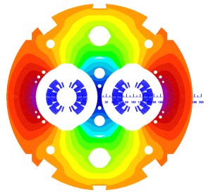
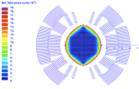
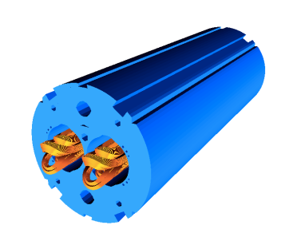
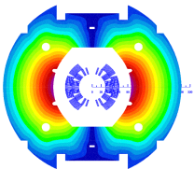
Magnetic design: Coil Optimization
B₀(11.85 kA) = 11.25 T
B₀(11.85 kA) = 10.86 T
11.25 T at 11.85 kA with 20% margin at 1.9 K in
60 mm bore straight CM
Systematic field errors below the 10⁻⁴ level
6-block design, 56 turns (IL 22, OL 34)
14.85-mm-wide 40-strand Rutherford cable, no internal splice
Coil ends optimized for low field harmonics and minimum strain in the cable

Slide 16
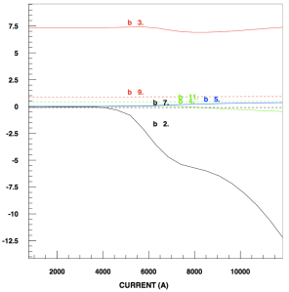
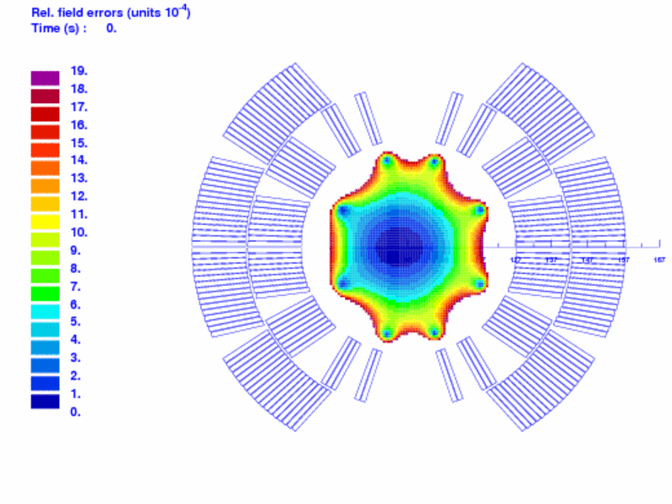
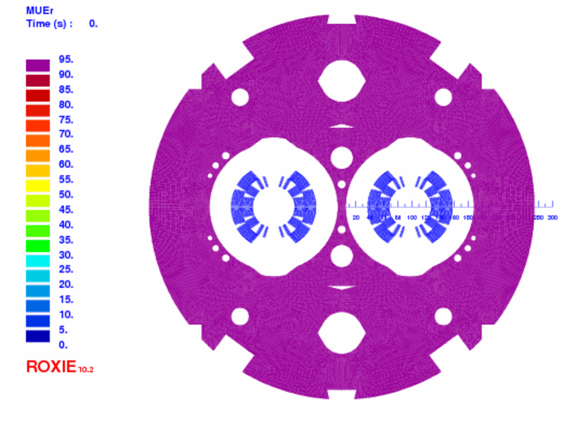
Magnetic Design: Yoke Optimization
Saturation control
  The cut-outs on top of the aperture reduce the b₃ variation by 4.7 units as compared to a circular shape.
  The holes in the yoke reduce the b₃ variation by 2.4 units.
  The two holes in the yoke insert reduce the b₂ variation from 16 to 12 units.
Relative FQ (units)
Relative permeability

Slide 17
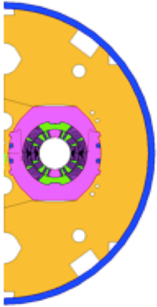
11 T Model Dipole Magnetic Parameters
Notes:
Twin-aperture of two flavours

Slide 18
Mechanical Design Choices & Goals
Separate collared coils
  Most of the coil pre-stress obtained by collaring
  Symmetric loading
  Better control of pre-stress
  Testing of collared coils in 1-in-1 structure
Vertically split yoke
  Assembly process less influenced by friction (vs. horizontal split)
  Closed gap at RT and up to 12 T to provide rigid support for the collared coil
  Better controlled (collared) coil deformation
Welded stainless steel skin
Coil pre-stress
  Within 0..-165 MPa at all times
  Minimal elliptic deformation
  Minimal stress gradient in the coils
  Easy tuning of pre-loading by shimming
  Minimize discontinuous loading and shear stress (end regions)

Slide 19
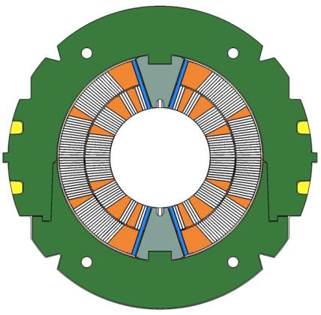
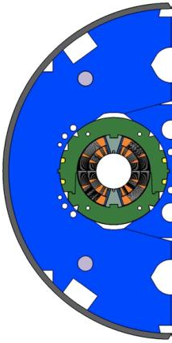
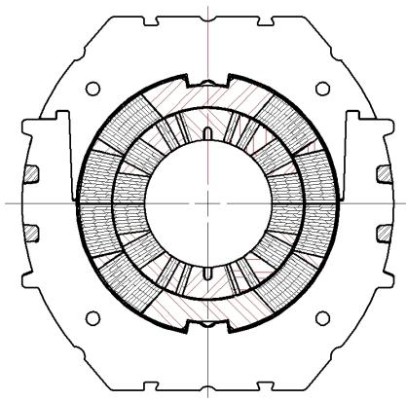
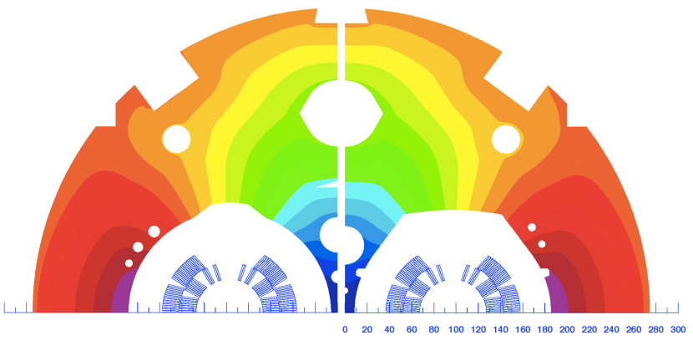
Mechanical Design Concepts
CERN FNAL
Pole loading design
Integrated pole design

Slide 20
Summary
Joint development program between CERN and FNAL underway since Oct-2010, with a goal of building a 5.5-m-long prototype by 2015
1st Phase of the program has been completed
Several lessons have been learned and will be discussed in this review
Transfer of FNAL coil fabrication technology to CERN is well underway
Two mechanical concepts of the 2-in-1 demonstrator magnets will be built
Practice coil winding is in progress at CERN
Work on the 5.5-m-long tooling has commenced
Several R&D topics are being investigated serving also the interest of other HFM programs

