Slide 1


Analysis of magnetic measurements
11-T single-aperture demonstrator built and tested at FNAL
B. Auchmann, M. Karppinen, D. Tsirigkas
for the 11-T collaboration
26.09.2012

Slide 2
Goals
Present the state of our magnetic analysis capabilities for Nb₃Sn magnets.
Present the state of our understanding of the FNAL demonstrator measurements.
Give feedback to the magnetic measurement test plan for future test campaigns.

Slide 3
Outline
Geometric harmonics
Saturation effects
Persistent current effects
Inter-strand coupling currents
z-scans and 3-D modeling

Slide 4
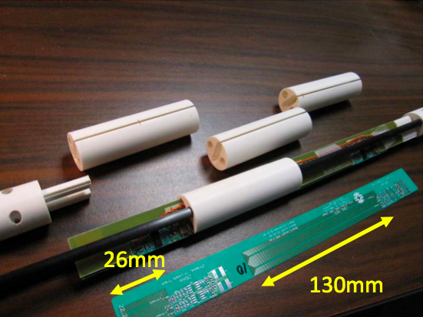
Recall measurement systems and data
Probes
  Printed circuit board 1 inch diameter,
  130 mm and 26 mm length (compare to
  110 mm twist pitch).
  Tangential probe 1 inch diameter,
  250 mm length.
Tests
  ✔ … available, ✗ … not available, ✔ … available but not used.
  Most data available for 4.6 K. Main focus on PCB 130 mm.
 | PCB26 1.9 K | PCB26 4.6 K | PCB130 1.9 K | PCB130 4.6 K | Tang. 4.6 K | Tang. RT
z-scan | ✗ | ✔ | ✗ | ✗ | ✔ | ✔
Eddy current loops 20/40/80 A/s | ✔ | ✔ | ✔ | ✔ | ✔ | ✗
Reset-currents 0/320/760 A | ✔ | ✔ | ✔ | ✔ | ✔ | ✗
Accelerator loop | ✗ | ✗ | ✗ | ✗ | ✔ | ✗
Stair-step loop | ✗ | ✔ | ✗ | ✔ | ✗ | ✗

Slide 5
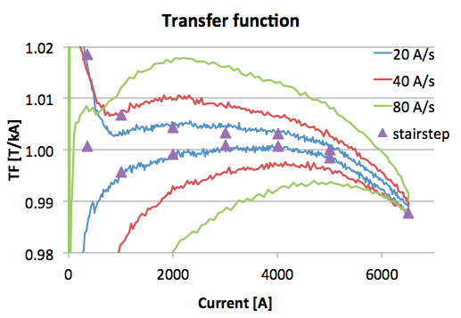
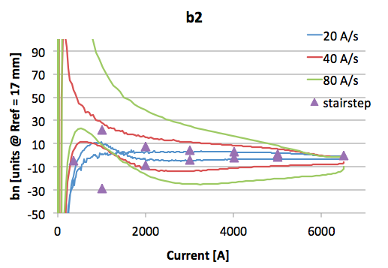
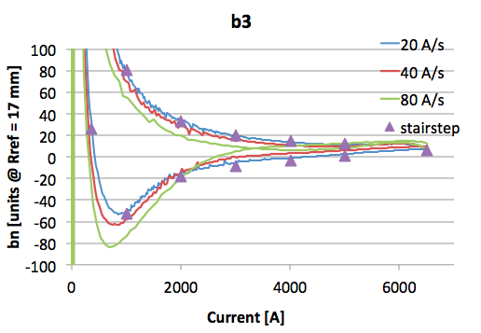
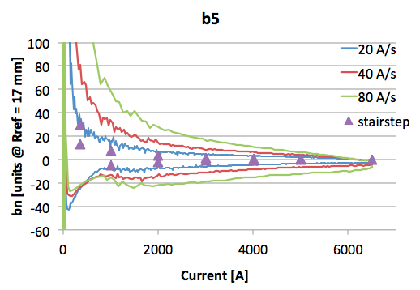
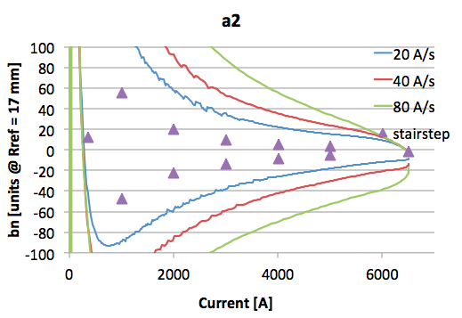
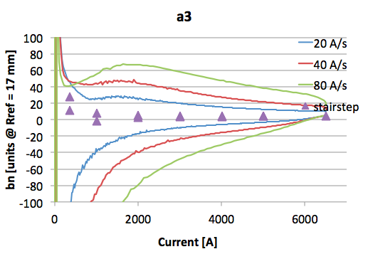
Overview 20, 40, 80 A/s, stairsteps
130 mm PCB probe @ 4.6 K
Notes:
need this at 1.9 K?

Slide 6
Geometric harmonics
Saturation effects
Persistent current effects
Inter-strand coupling currents
z-scans and 3-D modeling

Slide 7
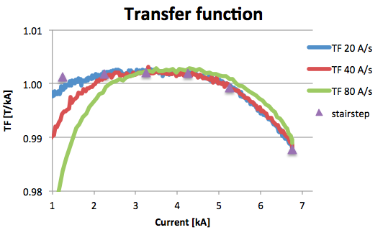
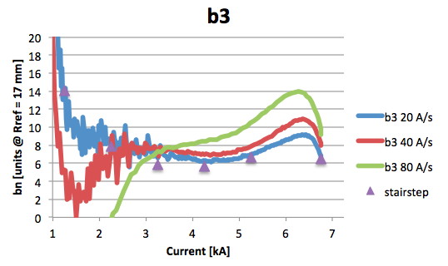
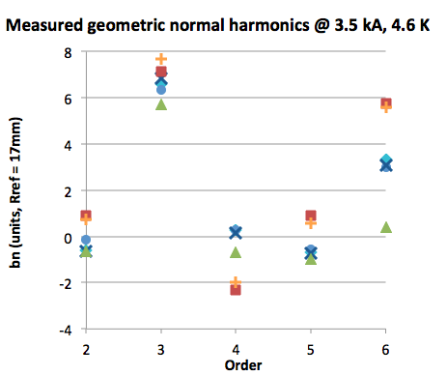
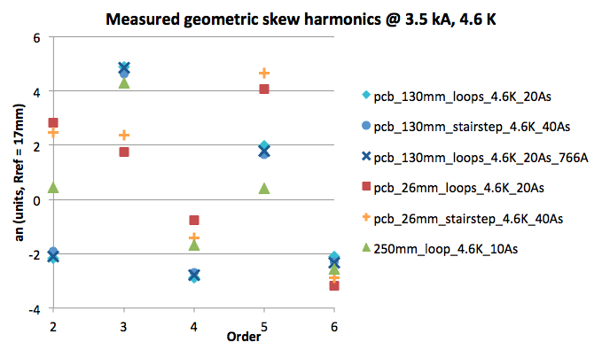
Geometric harmonics
3.5 kA, 20 A/s, selected for
geometric harmonics to avoid
  persistent-current effects,
  eddy-current decay on 6.5 kA
  plateau,
  ramp-rate compensation issues.
Center lines of stairstep- and eddy-current loops

Slide 8
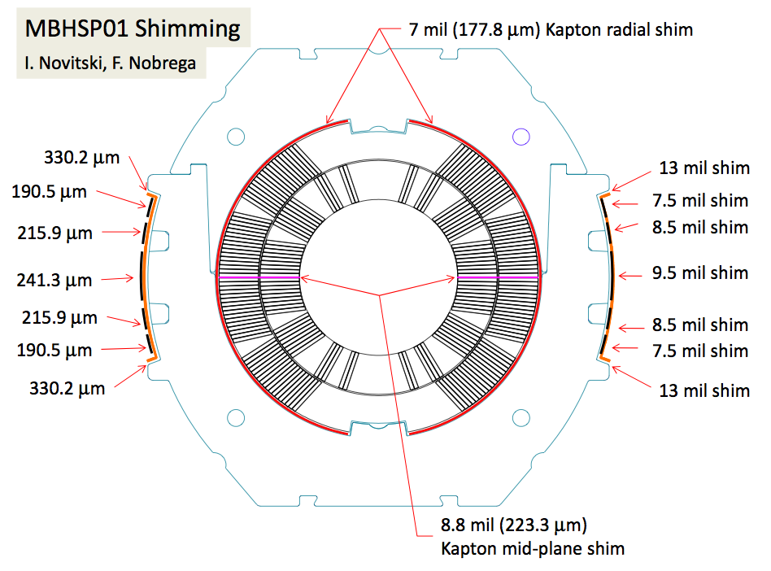
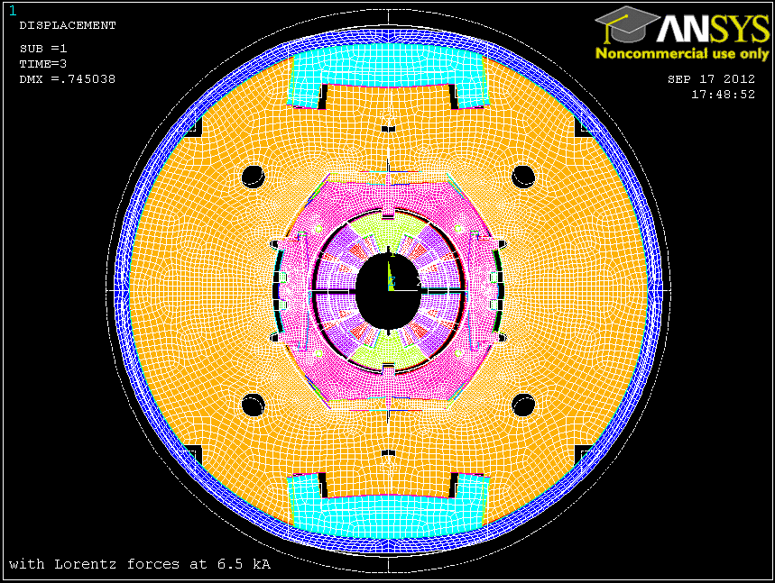
ANSYS/ROXIE interface
ANSYS model includes
  shimming,
  cool-down,
  Lorentz forces.
Full asymmetric model.
Notes:
replace ANSYS printscreen

Slide 9
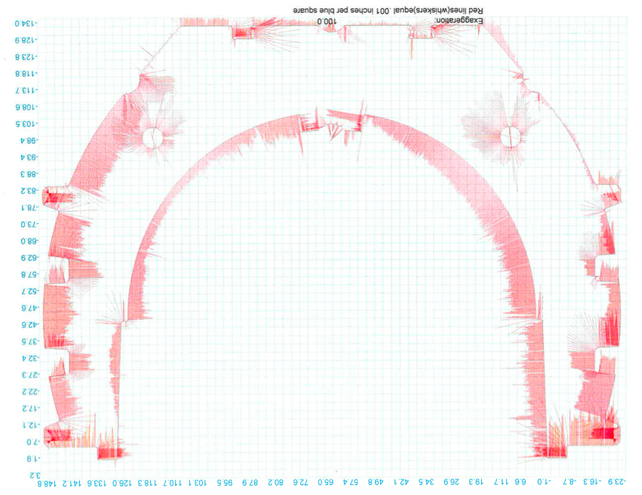
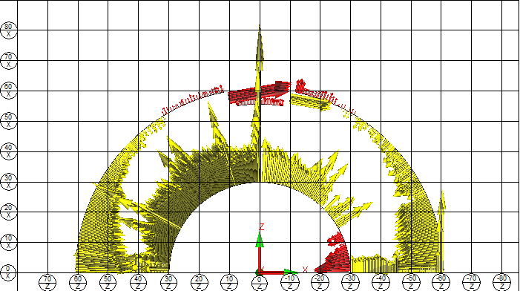
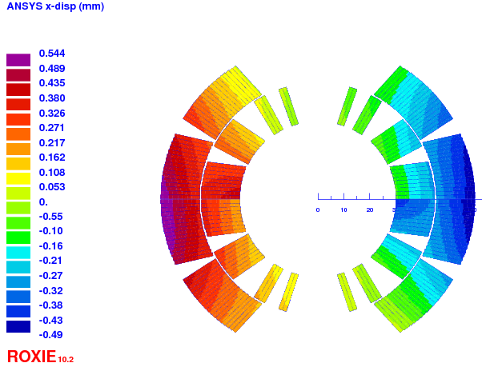
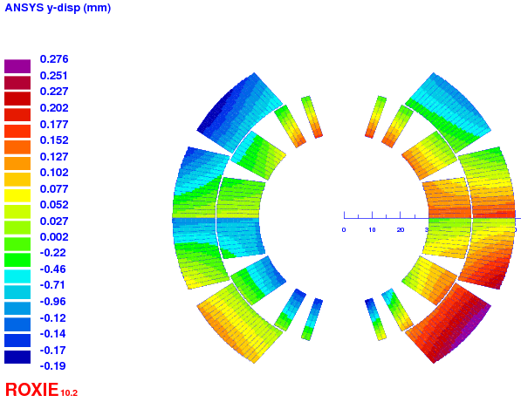
Including inspection data
Collar inspection reports
  contacts (gaps/interferences).
Coil inspection reports
  node-by-node transformation:
horizontal strand
displacement
vertical strand
displacement

Slide 10
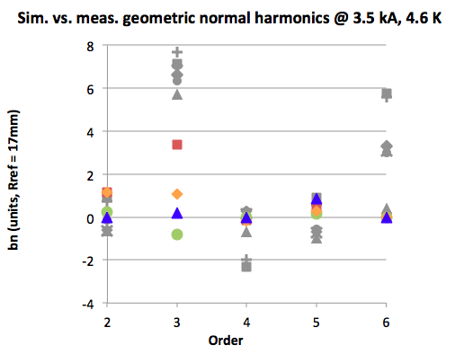
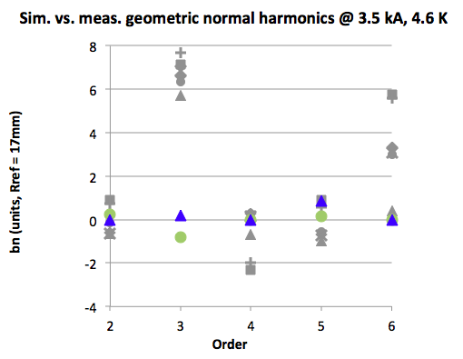
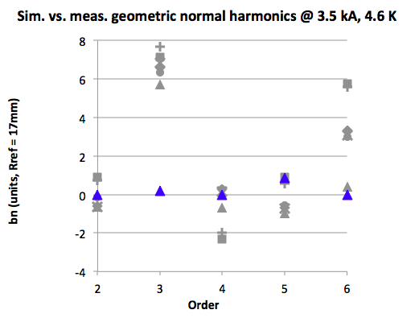
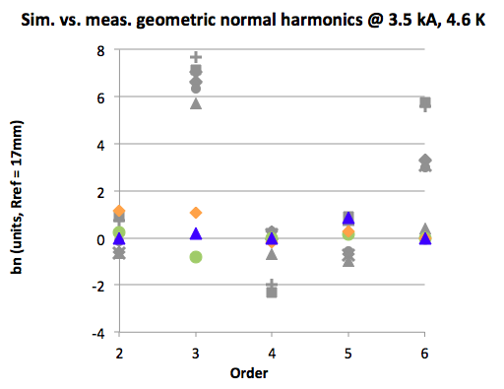
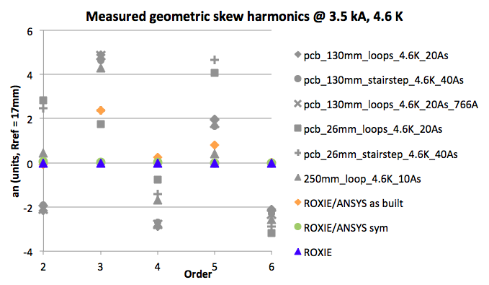
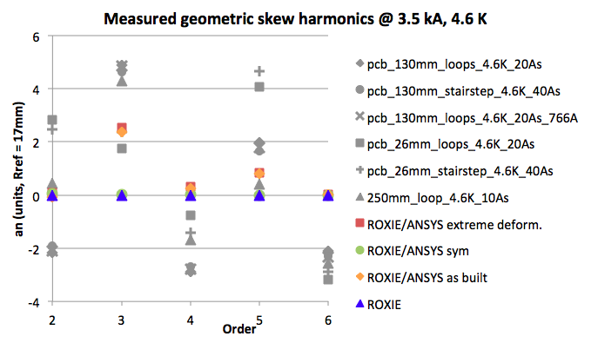
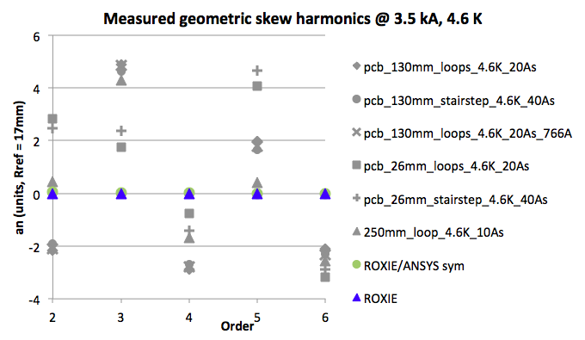
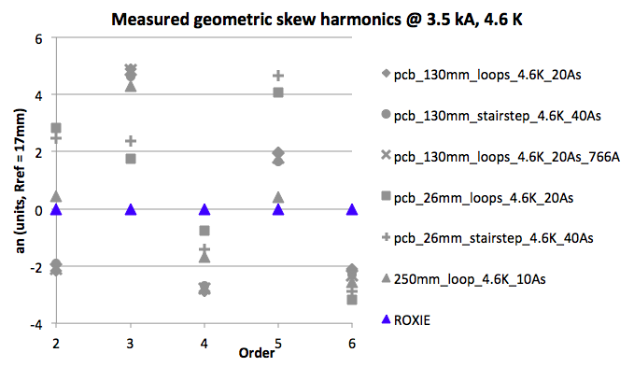
Geometric harmonics vs. predicted
ID/OD alignment of turns may account for
  +/- 1.2 units in b2, b3, a2, a3,
  but only 0.2 units in b6, a6.
ANSYS/ROXIE model improves agreement for b3, a3, a5, and the transfer function.
Simulated skew dipole of 10-20 units not displayed, as it was set to zero by rotation in the measurement data.
Important gap on b3 remains.
Autopsy data may give additional hints
Notes:
error bars, remove tangential probe data, use 1.9 K data!

Slide 11
Geometric harmonics
Saturation effects
Persistent current effects
Inter-strand coupling currents
z-scans and 3-D modeling

Slide 12
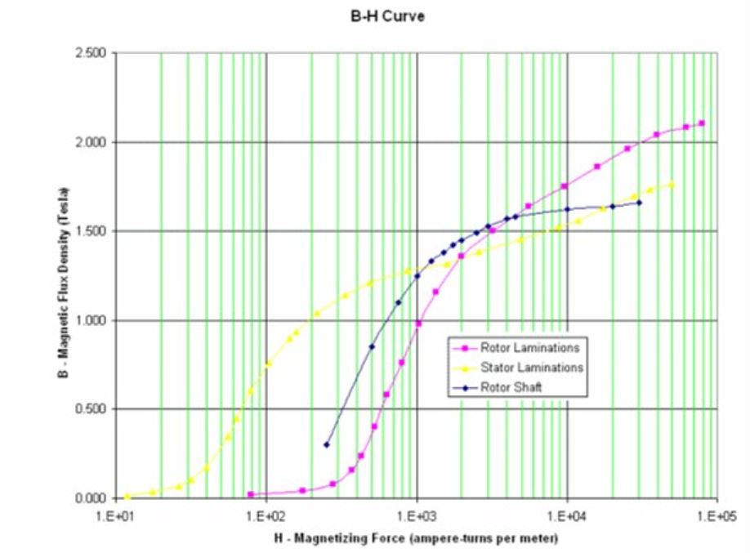
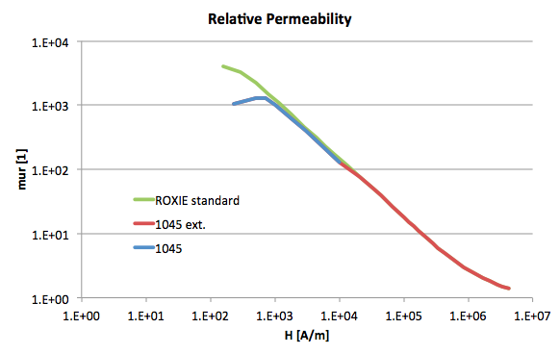
Saturation effects on FQ
BH information: limited data [0.2 T … 1.6 T] at room temperature unstressed.
“Rotor Shaft” 1045 steel data extended by ROXIE standard curve.
Notes:
data available from Emanuela???
call It extrapolated 1045

Slide 13
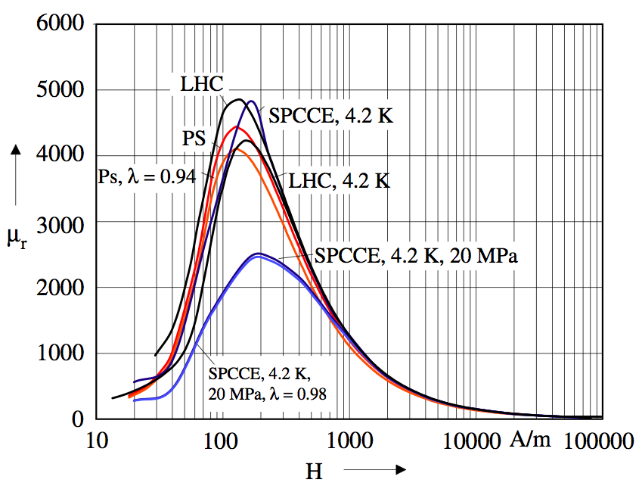
Recall uncertainty in BH data
Uncertainties:
  Compare to plot from S. Russenschuck,
  “Field Computation for Accelerator Magnets”, Wiley-VCH 2010;
  strong stress dependence,
  moderate temperature dependence.
Notes:
maybe this slide can go

Slide 14
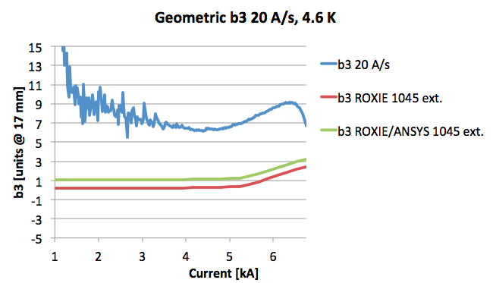
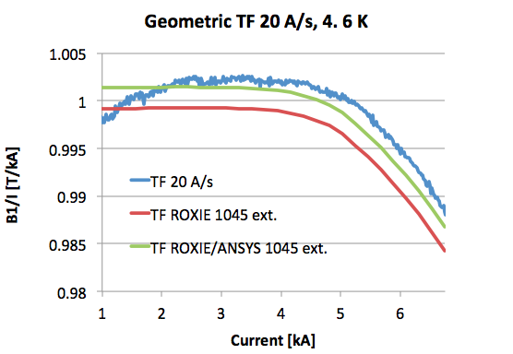
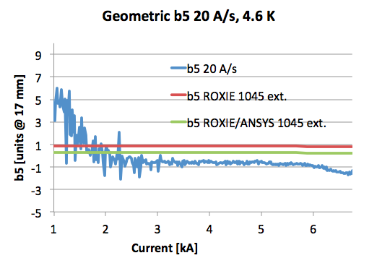
TF, b3, b5 variation
Coil deformation has a
significant impact on TF.
Saturation behavior of
TF, b3, b5 well reproduced.

Slide 15
Geometric harmonics
Saturation effects
Persistent current effects
Inter-strand coupling currents
z-scans and 3-D modeling

Slide 16
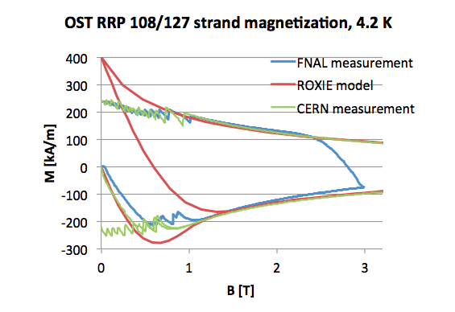
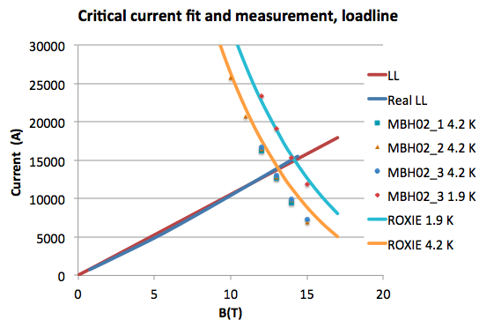
Strand magnetization model
ROXIE magnetization model
  Summers fit,
  Deff = 55 µm,
  Aleksa/Russenschuck/Völlinger scalar model.
Magnetization measurement references
FNAL: E. Barzi et al., “Studies of Nb₃Sn Strands based on the Restacked-Rod Process for High Field Accelerator Magnets”, IEEE Trans. Appl. Sup., Vol. 22(3), June 2012.
CERN: B. Bordini et al., to be presented at ASC 2012, Portland, USA
Strand magnetization model consistent with measurements at CERN and FNAL.
measured data courtesy E. Barzi

Slide 17
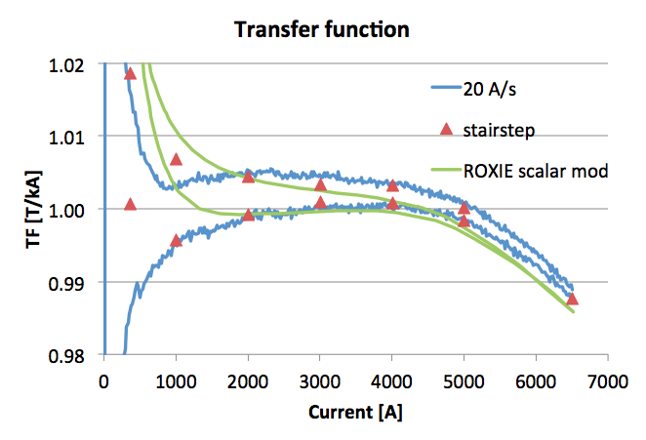
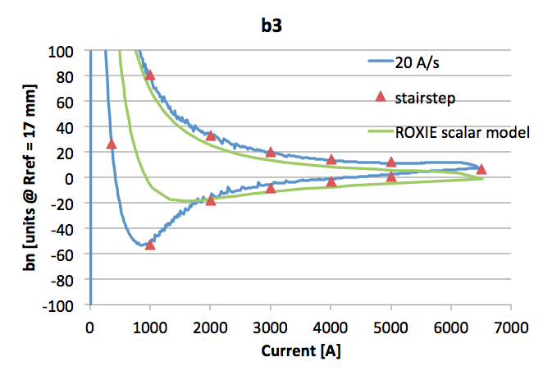
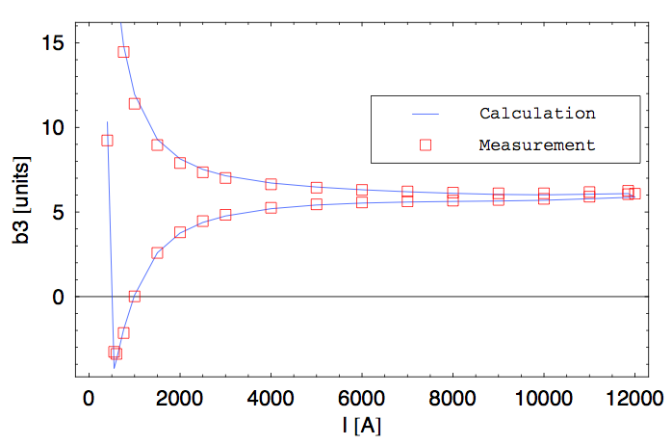
Persistent current effects TF, b3
Scalar persistent current model vs. measurement.
b3 around injection (~760 A)
  The scalar model does not capture
  the low-field coil re-magnetization
  properly.
  Monotonous b3 curve with minimum
  around injection level should be
  amenable to passive shimming.
MB simulation, courtesy N. Schwerg
Notes:
stairstep -→ markers

Slide 18
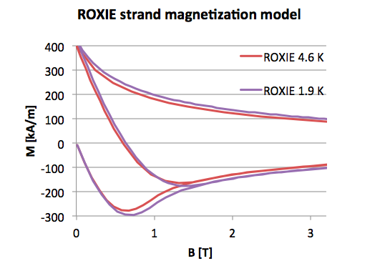
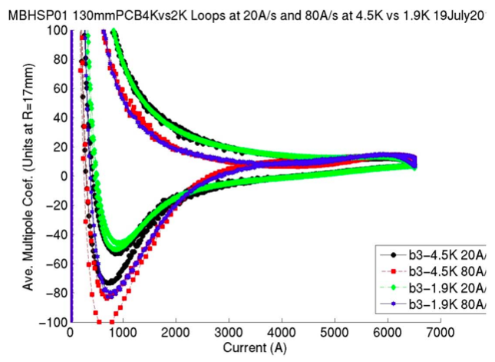
1.9 K vs. 4.6 K
7% change in strand magnetization simulation from 1.9 K to 4.6 K.
Temperature effect in measurements is very small.
Notes:
b3 curves 2x, strand mag, measured

Slide 19
Geometric harmonics
Saturation effects
Persistent current effects
Inter-strand coupling currents
z-scans and 3-D modeling

Slide 20
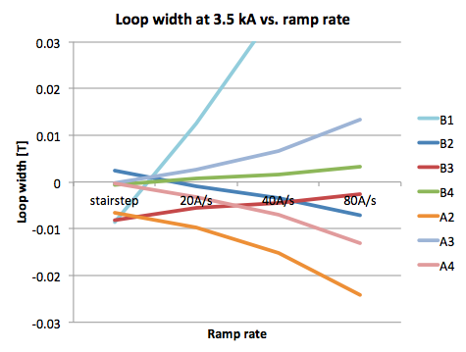
Inter-strand coupling current effect on FQ
Cable eddy-currents generate losses and alter the field
Measured ramp-rate dependence of multipole loop width
Notes:
push bar to right

Slide 21
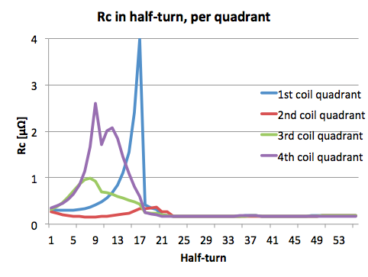
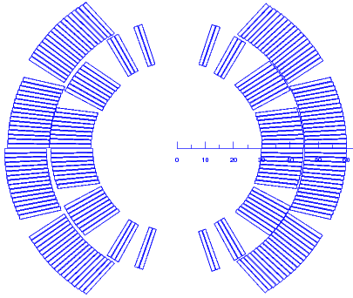
Calculated Rc distribution
Determine Rc distribution that could produce the measured ramp-rate induced field errors.
  R. Wolf, D. Leroy, D. Richter, A. P. Verweij, and L. Walckiers. Determination of interstrand contact resistance from loss and field measurements in LHC dipole prototypes and correlation with measurements on cable samples. IEEE Trans. on App. Supercond., 7(2):797–800, June 1997.
  Calculated Rc is 0.2 – 4 µΩ.
  Larger inner-layer Rc could be due to the inner layer having more room to expand during reaction than the outer layer.
1
2
3
5
6
4
4
6
3
2
1
5
Notes:
outer layer was shimmed harder during reaction though!! IL needs 0.8, got 1, outer layer needs 1.3, got 1

Slide 22
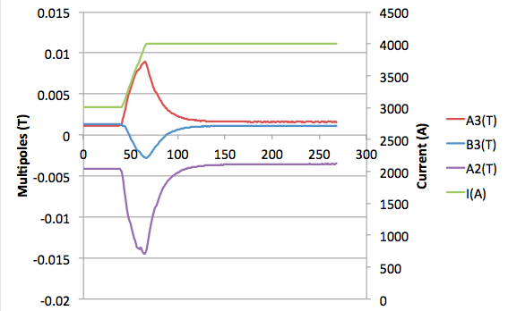
Eddy-current decay
Decay amplitudes are consistent with 40 A/s loop width.
Decay time constants vary from 11 to 15 s consistent with Rc ~ 0.2 µΩ.
Notes:
More analysis to come

Slide 23
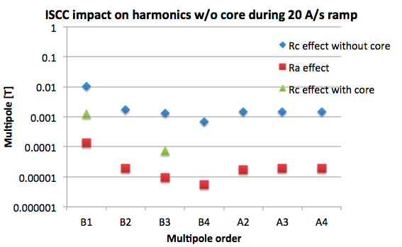
Effect of a core
Compute ramp-rate induced harmonics at 20 A/s for
  Homogeneous Rc of 30 µΩ (expected range: 30 to 100 µΩ),
  Ra = uncored Rc.
Ra effect is 100x smaller than Rc effect.
Core will reduce the ramp-rate induced field errors by
1-2 orders of magnitude.

Slide 24
Geometric harmonics
Saturation effects
Persistent current effects
Inter-strand coupling currents
z-scans and 3-D modeling

Slide 25
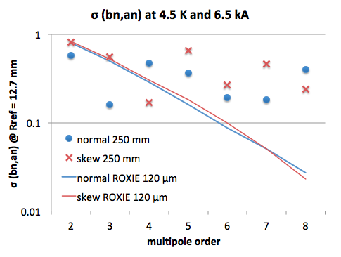
z-scan statistics: coil-block positioning tolerance, and measurement precision
Harmonics measured at 6.5 kA using the 250 mm tangential probe
in 3 axial locations along the straight section.
We match the standard deviation of multipoles to a calculated standard deviation (note: uncertainty on std. dev. is 50% for 3 points) following
F. Borgnolutti, et al., Reproducibility of the coil positioning in Nb3Sn magnet models through magnetic measurements. IEEE TAS 19(3), p.1100, 2009.
Note that 250 mm probe was replaced by PCB due to noise in the higher-order harmonics. Analysis suggests measurement accuracy of 0.5 units.
Focusing on low orders, we find an equivalent random displacement of the blocks of 120 µm. This value agrees with expectations.

Slide 26
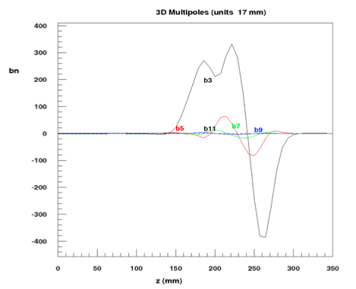
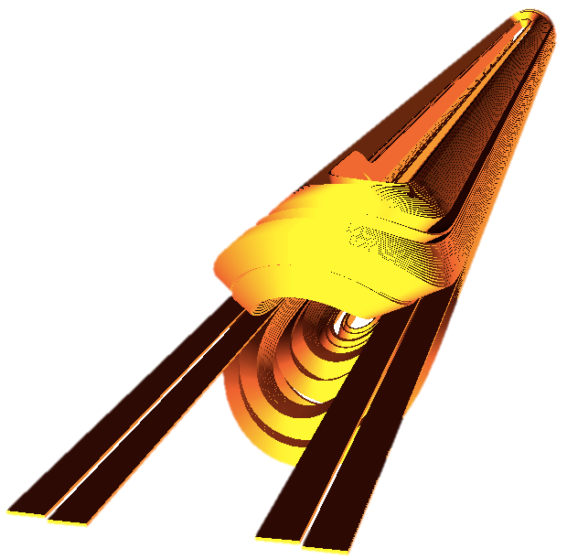
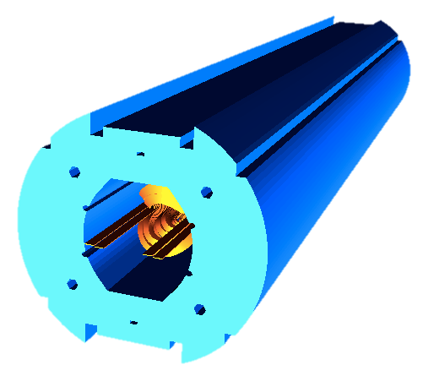
3D field calculation
ROXIE model includes
  current leads, asymmetric lead
  end, layer jump, anisotropic iron
  properties (packing factor).
Model is used to
  optimize integrated harmonics,
  predict peak-field enhancement.
For comparison to measurement
  need a common axial reference
  for measurement and simulation,
  integral measurements,
  short probe, small step-size, z-scan at room temperature.

Slide 27
Feedback for magnetic measurements
Tests to be carried out in future campaigns
  room temperature
    straight-section geometrics
    magnetic length and integrated harmonics
    short probe z-scan
  1.9 K
    accelerator loop (10 A/s, 100 A reset current)
    field quality as function of ramp rate
    stair-steps
    magnetic length and integrated harmonics
    voltage signals during ramp
    loss measurements per cycle as function of ramp rate
    inductance measurements
  Magnetic measurement probes foreseen by MSC-MM for future tests at CERN
    46 mm diameter, 2-m shaft, sectorized (to measure both, straight-section and integrated harmonics), 1-3 Hz rotation frequency.
    shorter mole for warm z-scan required.
    cold z-scan only with anti-cryostat.

Slide 28
Conclusion
Status of the analysis tools for Nb₃Sn magnets
  relevant effects are covered by numerical models to adequate accuracy;
  the numerical model of low-field persistent-current effects requires improvement.
Status of our understanding of the demonstrator measurements
  Geometric
    b3 and skews might be explained by coil shape, shimming, and deformation due to cool-down and Lorentz forces.
  Saturation
    Already reasonably good agreement with simulation.
    BH measurements are being carried out.
  Persistent currents
    Measured sextupole reaches minimum at injection level.
    Passive compensation appears feasible – needs to be designed and tested.
  Inter-strand coupling currents
    Analysis suggests slightly higher Rc than in previous Nb3Sn magnets.
    Core should resolve the issue.
Both labs will pursue consistent test plans and, if possible/necessary, complement each other.

Slide 29
FINE

Slide 30
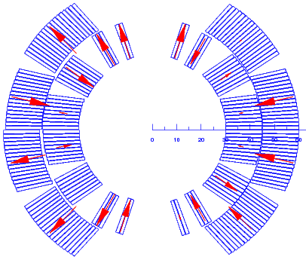
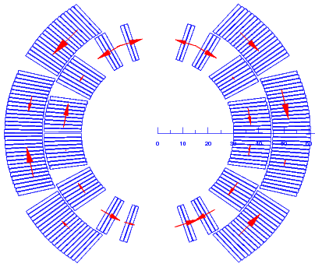
Inverse computation
The geometric harmonics can be reproduced by
  radial movement within +/– 0.5 mm, or
  azimuthal movement within +/– 0.5 deg.
  As such this analysis is of limited use.
ID/OD alignment of turns may account for
  +/- 1.2 units in b2, b3, a2, a3,
  but only 0.2 units in b6.
Notes:
ID-OD alignment plots

Slide 31
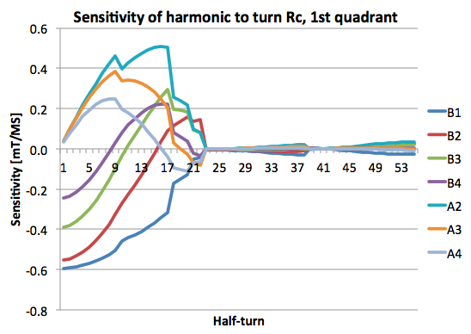
Rc sensitvity calculation
ROXIE computes sensitivity matrices of multipoles w.r.t. Rc in half-turns.
Used to determine an Rc pattern that could produce the measured ramp-rate induced field errors.
  R. Wolf, D. Leroy, D. Richter, A. P. Verweij, and L. Walckiers. Determination of interstrand contact resistance from loss and field measurements in LHC dipole prototypes and correlation with measurements on cable samples. IEEE Transactions on Applied Superconductivity, 7(2):797–800, June 1997.
Inner layer by far more sensitive.
1
2
3
5
6
4
4
6
3
2
1
5

Slide 32




Coil re-magnetization at low currents
Transport current field + PC field = total field (at 760 A).
Vectorial model required.
Iteration scheme required.
BEM-FEM
time loop
ISCC
iteration
PC

Slide 33

Numerical experiments
Scalar model vs. vector model
  we observe a tendency for a more pronounced
  minimum at a lower current.
  right tendency but not conclusive.

Slide 34




Mitigating the persistent-current induced sextupole
Passive compensation: ferromagnetic, passive strands
  Superconducting strands between cold bore and coil.
  Might reduce aperture by as much as 4 mm in diam.
However, the model cannot be used to predict effectiveness.
Design and construction should start now for test in the next magnet.
^{B3 from PC}
^{B5 from PC}
passive strands
ferromagnetic shims
Notes:
check aperture requirements with B. Holzer

Slide 35

Equivalent analysis on HQ by X. Wang (LBNL)

Slide 36



Temperature dependece of harmoncis
There is little temperature dependence in TF and (bn,an)

