Slide 1
CERN 2-in-1 Demonstrator Design, Construction and Test Plan
M. Karppinen on behalf of CERN-FNAL collaboration
“Demonstrate the feasibility of an accelerator quality 2-m-long 2-in-1 dipole providing > 11 T with an adequate margin and being scalable up to 5.5 m”

Slide 2
Contributions & Acknowledgements
FNAL:
N, Andreev, G. Apollinari, E. Bartzi, R. Bossert, G. Chlachidze,
F. Nobrega, I. Novitski, G. Wilson, A. Zlobin,...
CERN:
B. Auchmann, A. Ballarino, A. Bonasia, S. Bermudez,
N. Bourcey, A. Cherif, S. Clement, A. Gerardin, M. Guinchard, L. Bottura, C. Kokkinos, B. Favrat, L. Favre, C. Fernandes, P. Fessia, R. Gauthier, B. Holzer, G. Kirby, F. Lackner, G. Maury, J. Mazet, N. Mena, R. Moron-Ballester, J-M. Mucher,
J. Murtomaki, L. Oberli, J-C. Perez, L. Rossi, T. Sahner,
F. Savary, J.-M. Scigliutto, L. Remandet, S. Russenschuck,
S. Sgobba, E. Todesco, D. Tsirigkas,...

Slide 3
Outline
2-in-1 Demonstrator Parameters
CERN 2-in-1 demonstrator design concept
Magnet assembly process
Structural analysis: straight section
Mechanical model
Structural analysis: end region
Mechanical concepts pros-cons
Magnet design status
Procurement status
QC and documentation
Milestones
Some R&D Topics
Summary
Review questions (Phase 2b) and answers

Slide 4
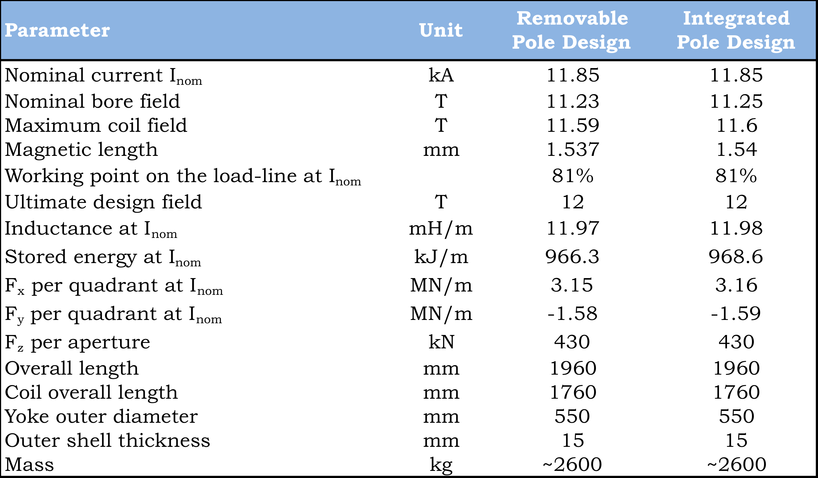
2-in-1 Demonstrator Parameters

Slide 5
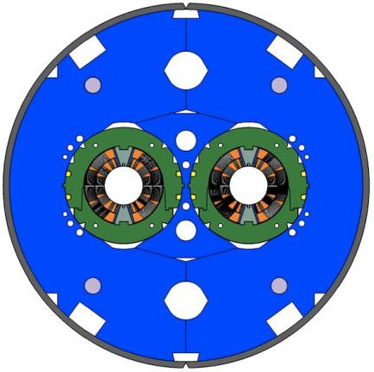
Mechanical Design Features
Separate collared coils
  Most of the coil pre-stress obtained by collaring
  Symmetric loading
  Better control of pre-stress
  Testing of collared coils in 1-in-1 structure
Vertically split yoke
  Assembly process less influenced by friction (vs. horizontal split)
  Closed gap at RT and up to 12 T to provide rigid support for the collared coil
  Better controlled (collared) coil deformation
Welded stainless steel skin

Slide 6
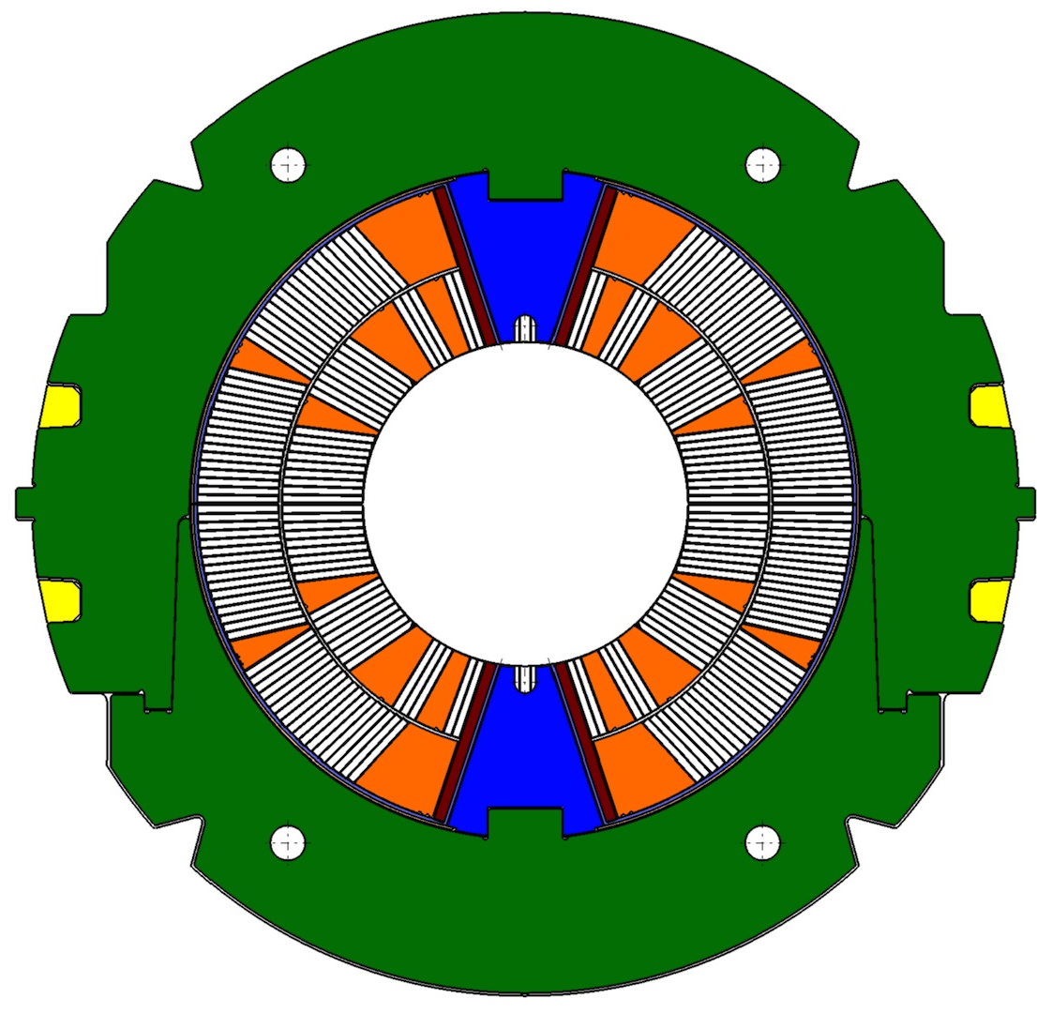
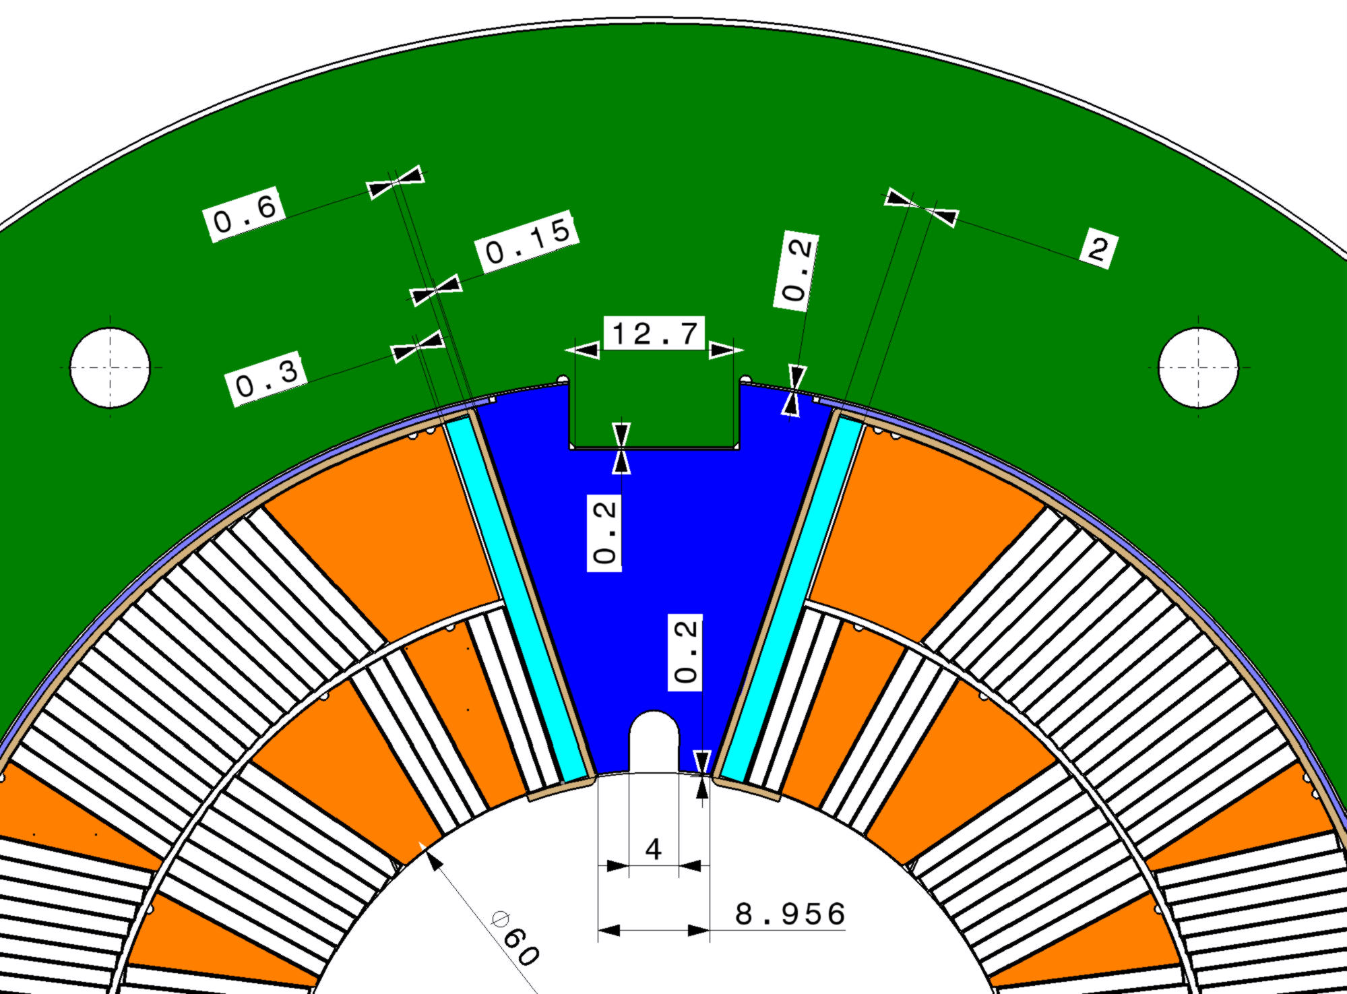
Pole Loading Concept
Shim
Loading plate
Filler
wedge
Pole wedge

Slide 7
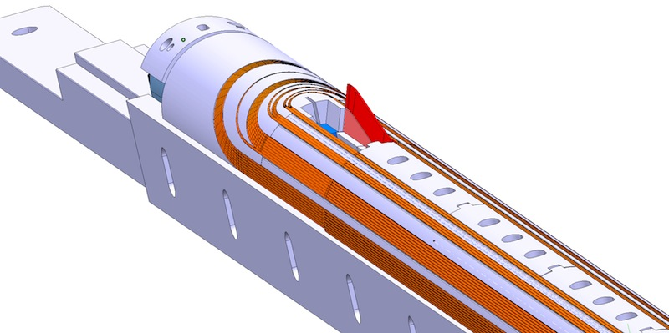
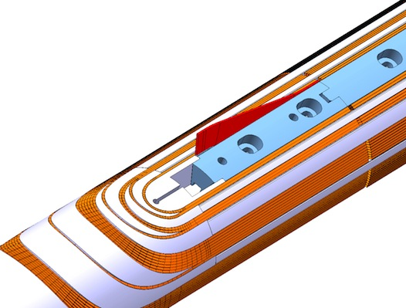
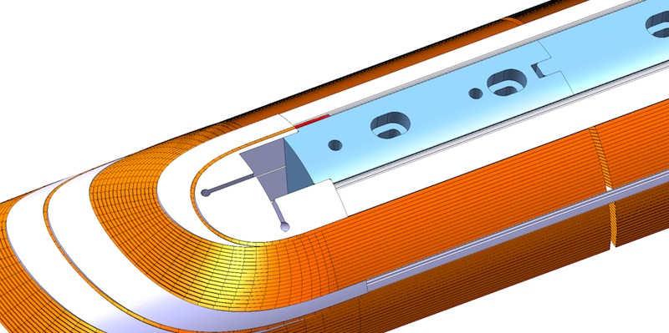
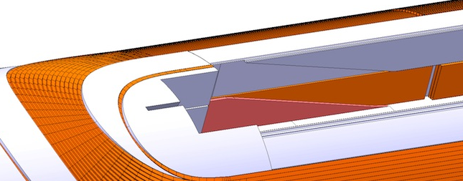
Pole Loading Concept:
Lead End Winding
Inner layer winding pole
Ceramic filler piece
Filler wedge
Outer layer winding pole
Layer-jump region with cable removed

Slide 8
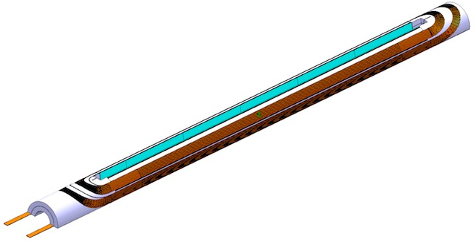
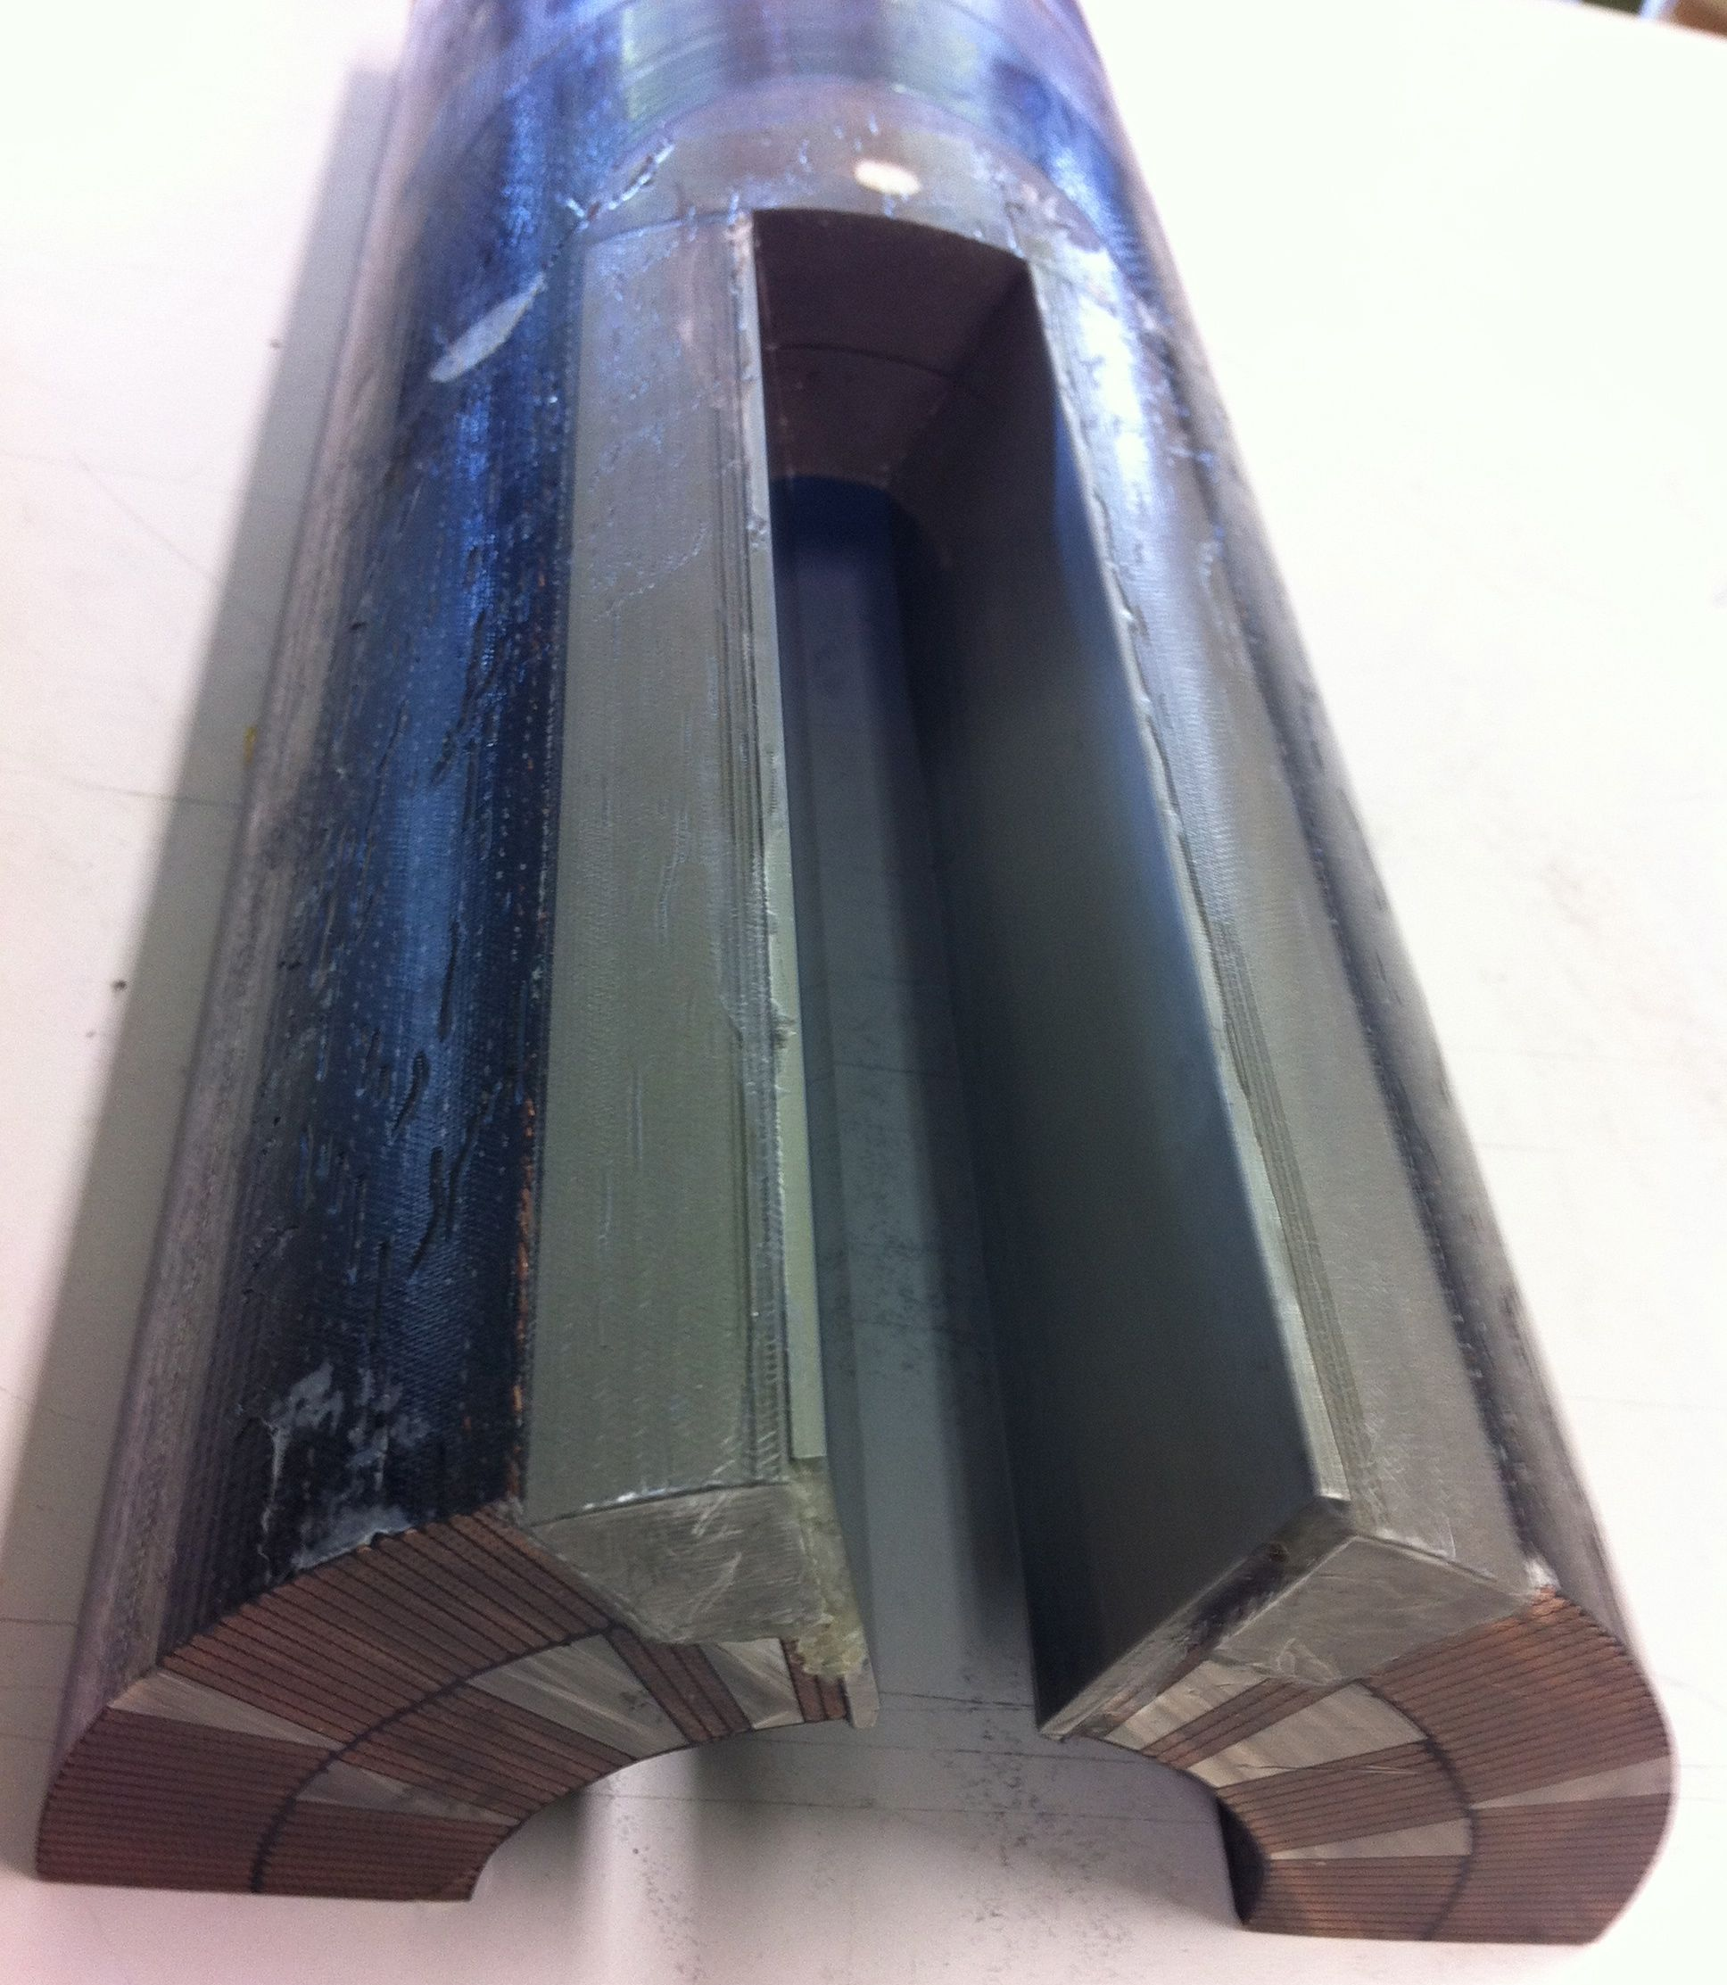
Pole Loading Concept: Coil
Vacuum impregnated coil
Loading plate
(t = 2 mm)
Filler wedge

Slide 9
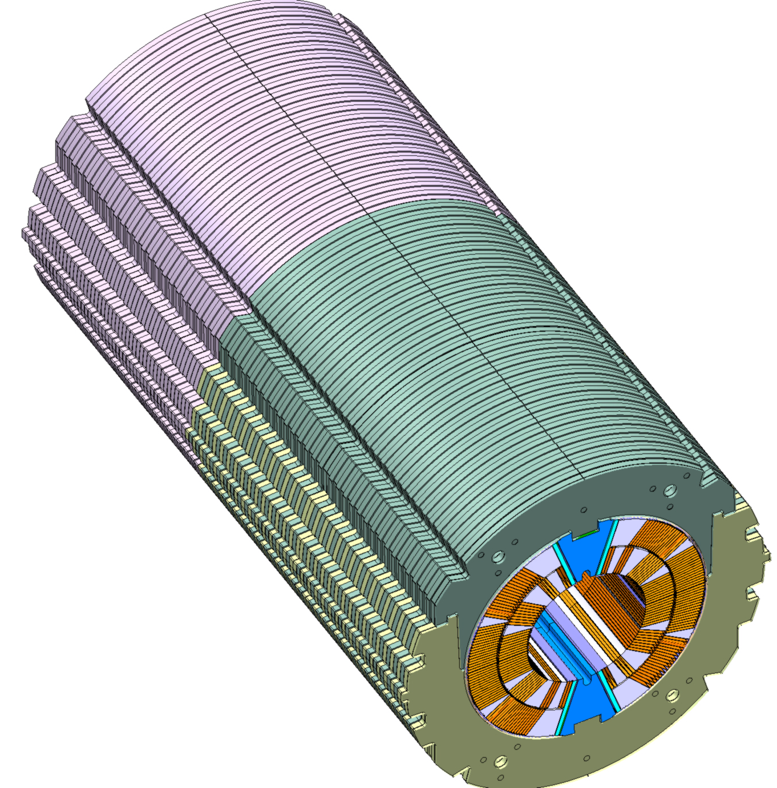
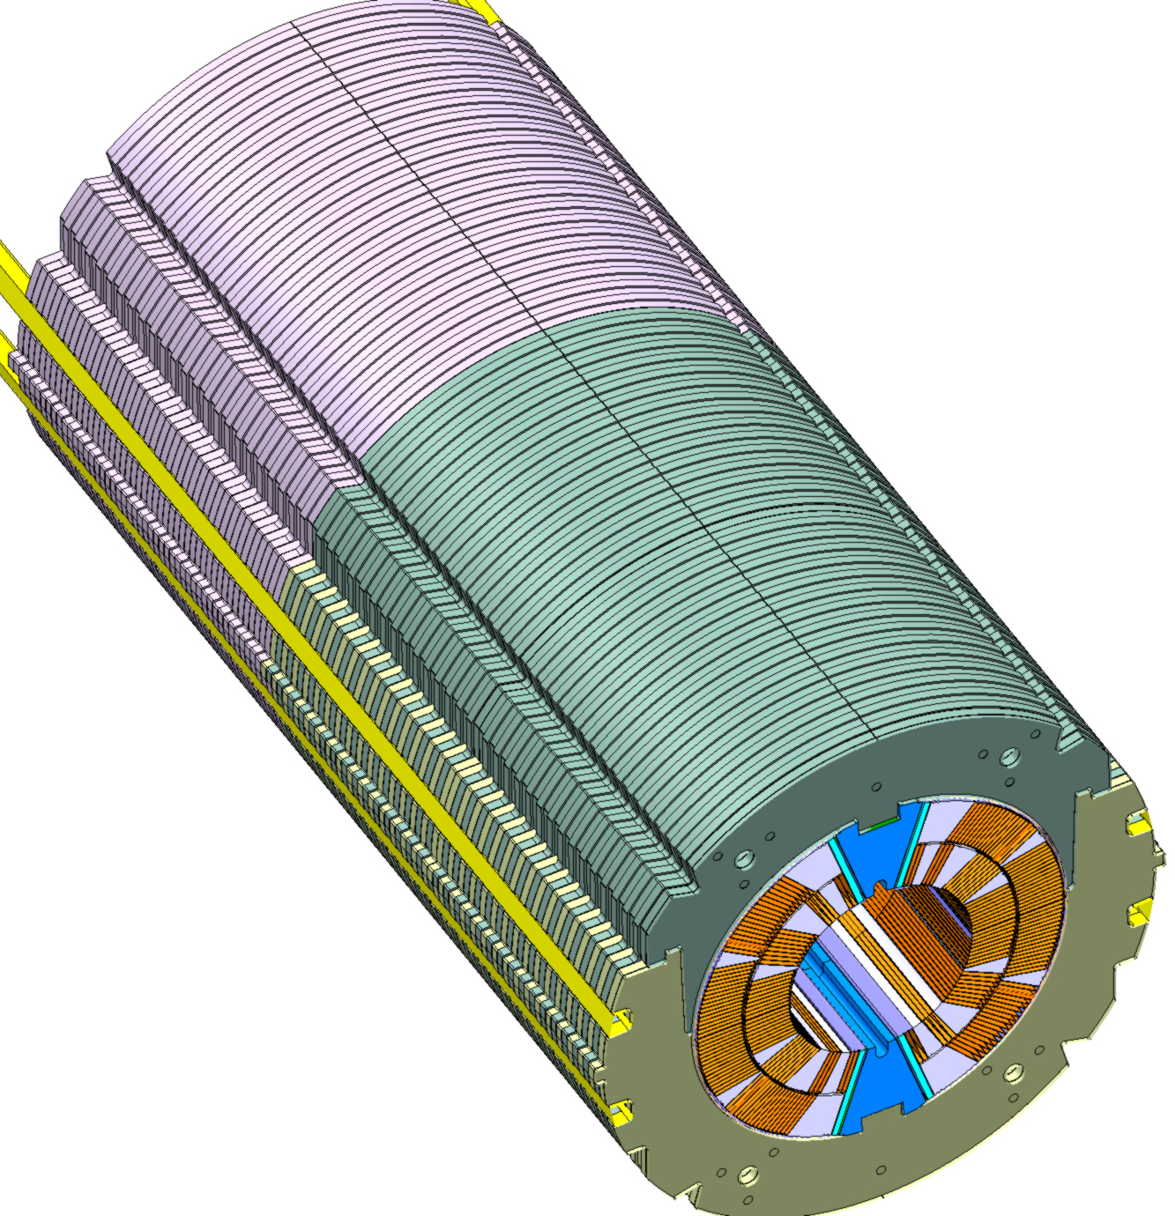
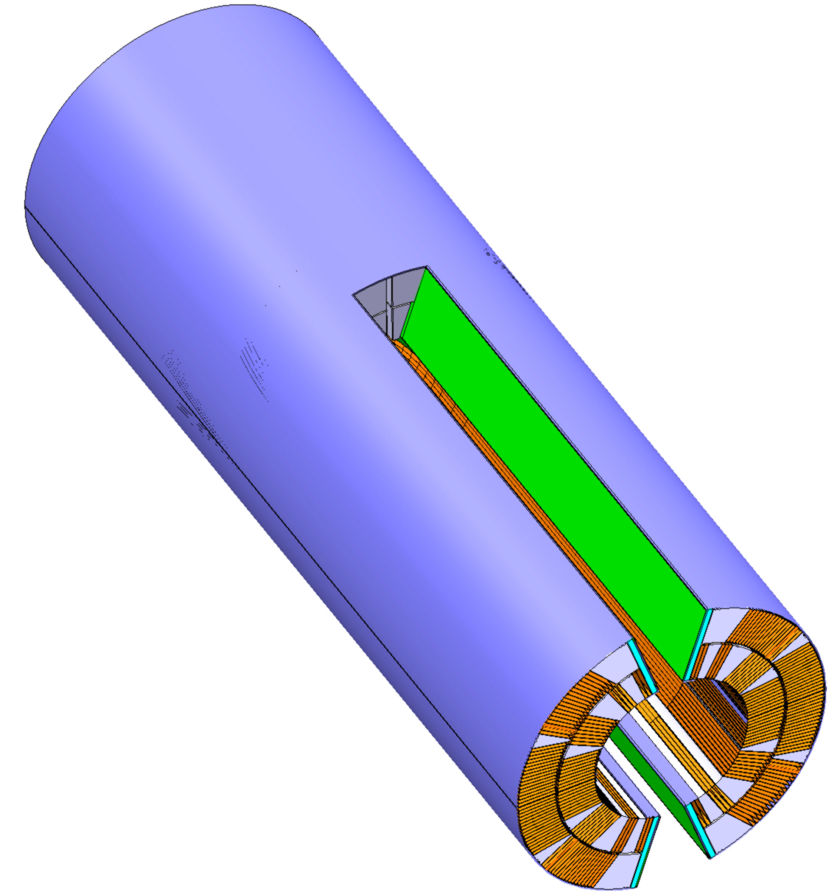
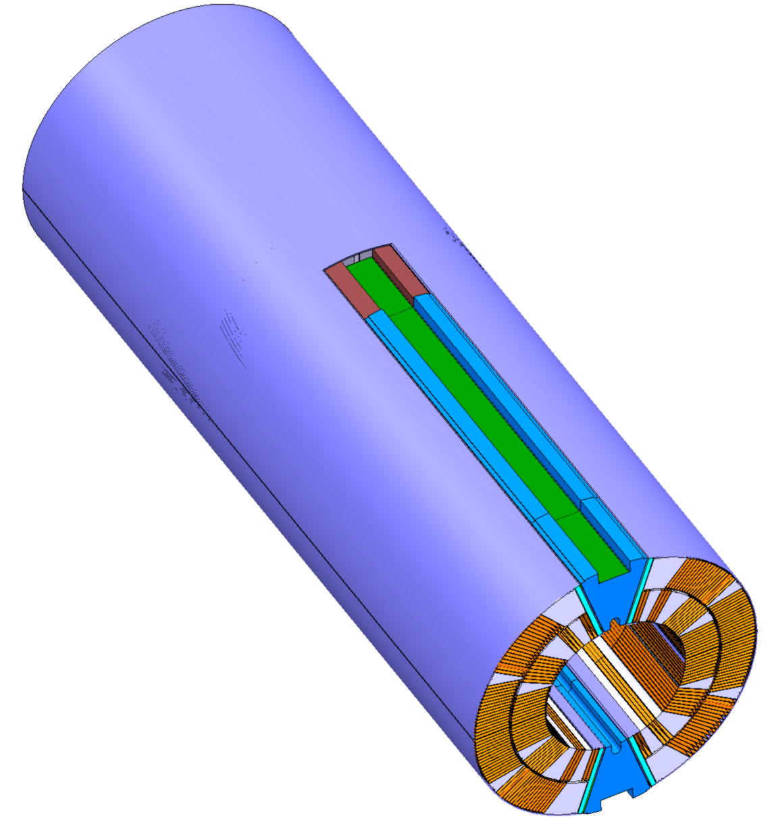
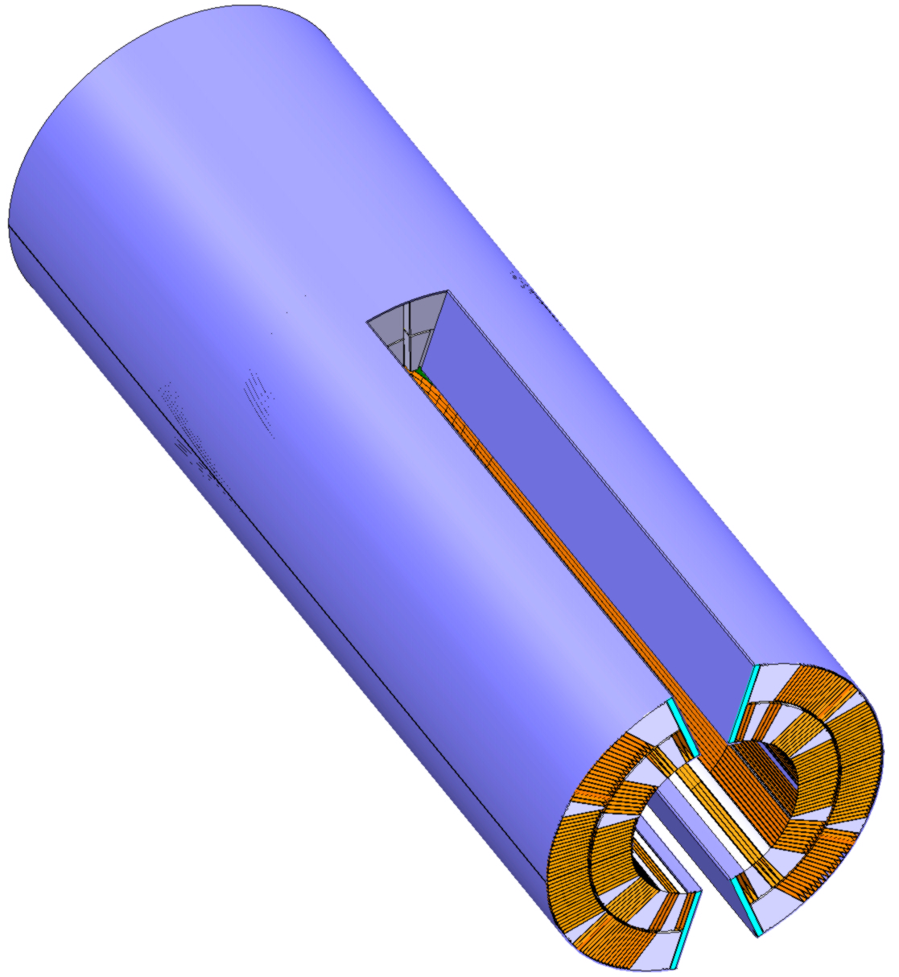
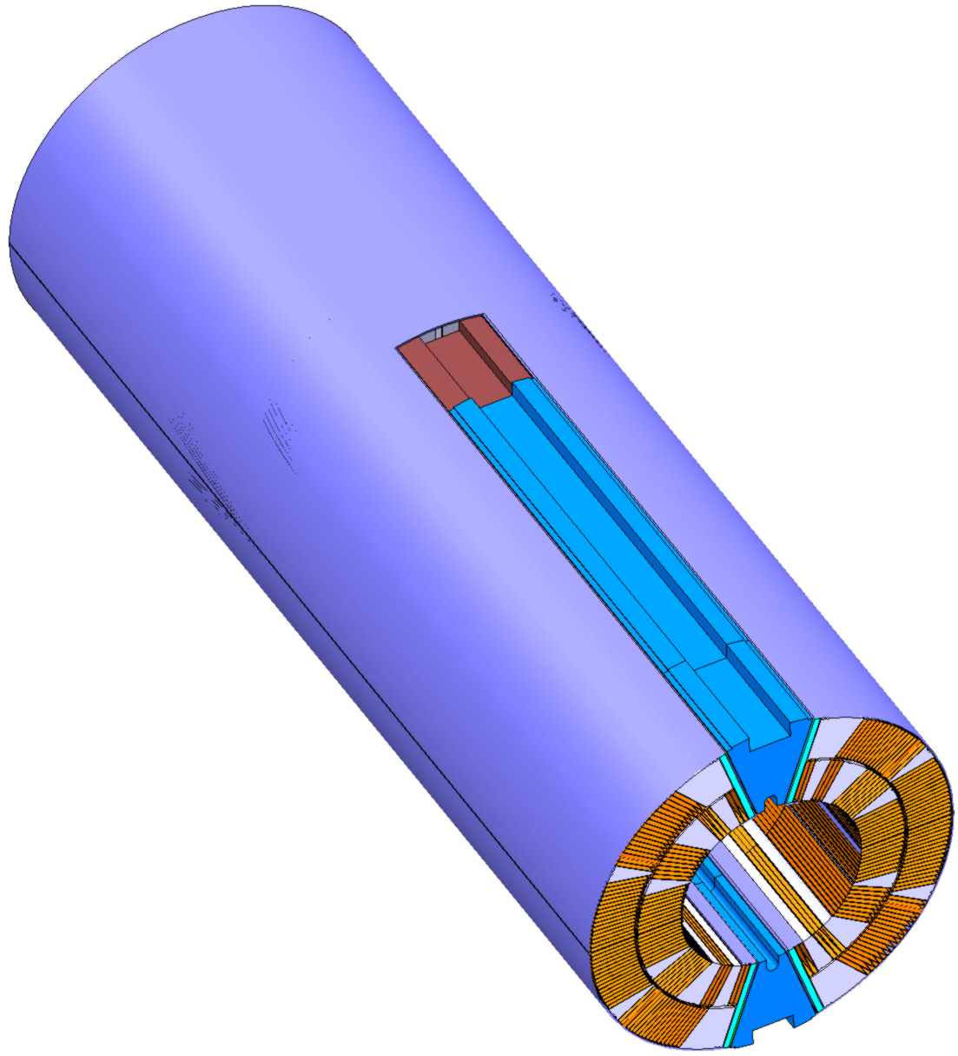
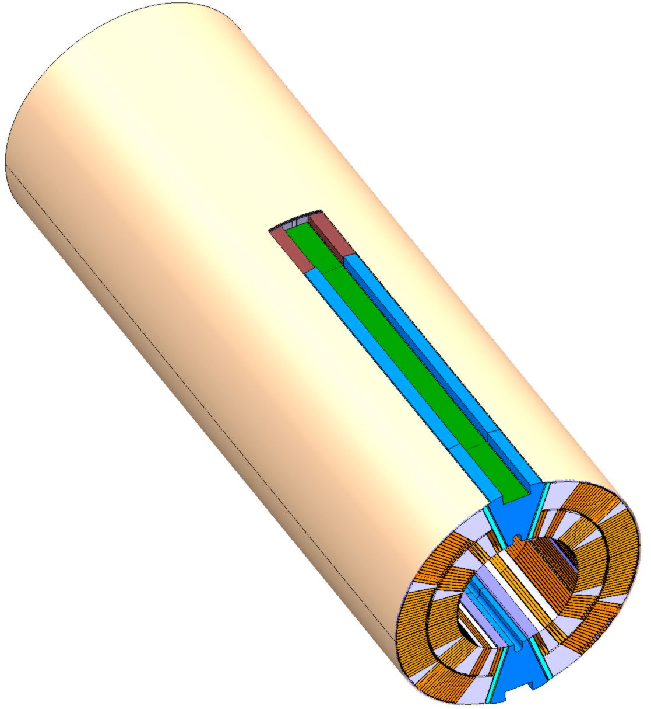
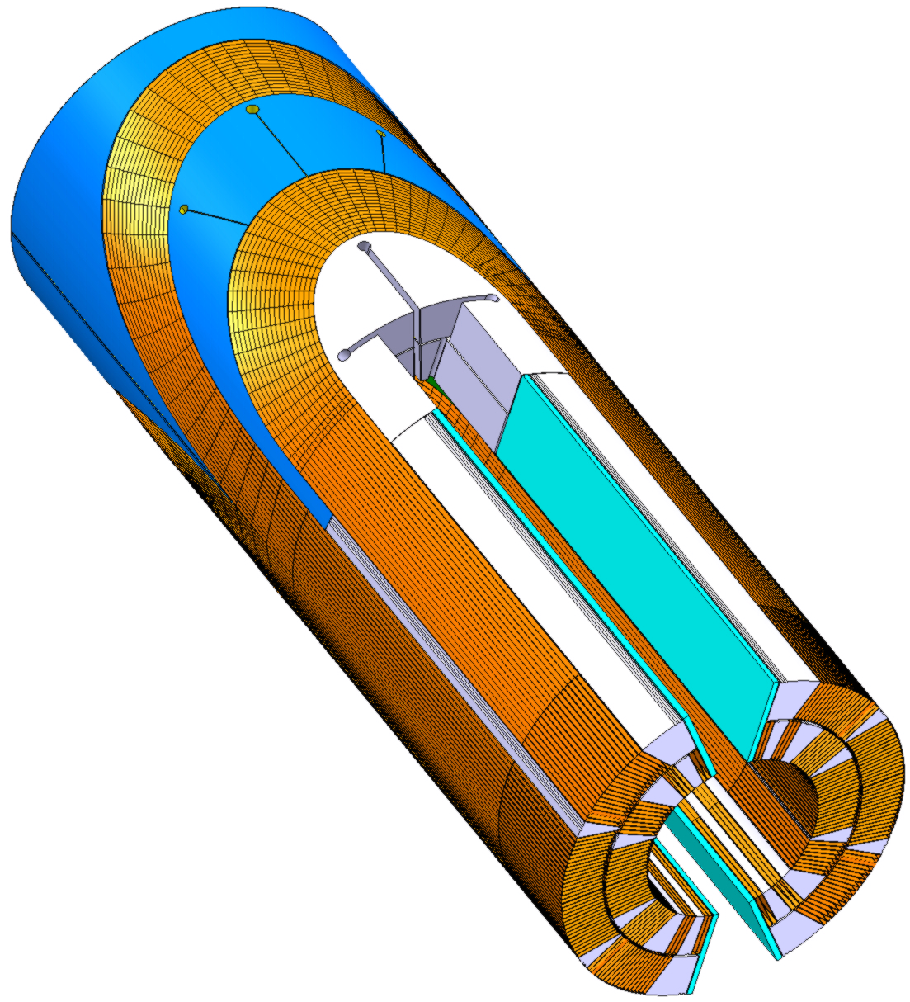
Collared Coil Assembly

Slide 10
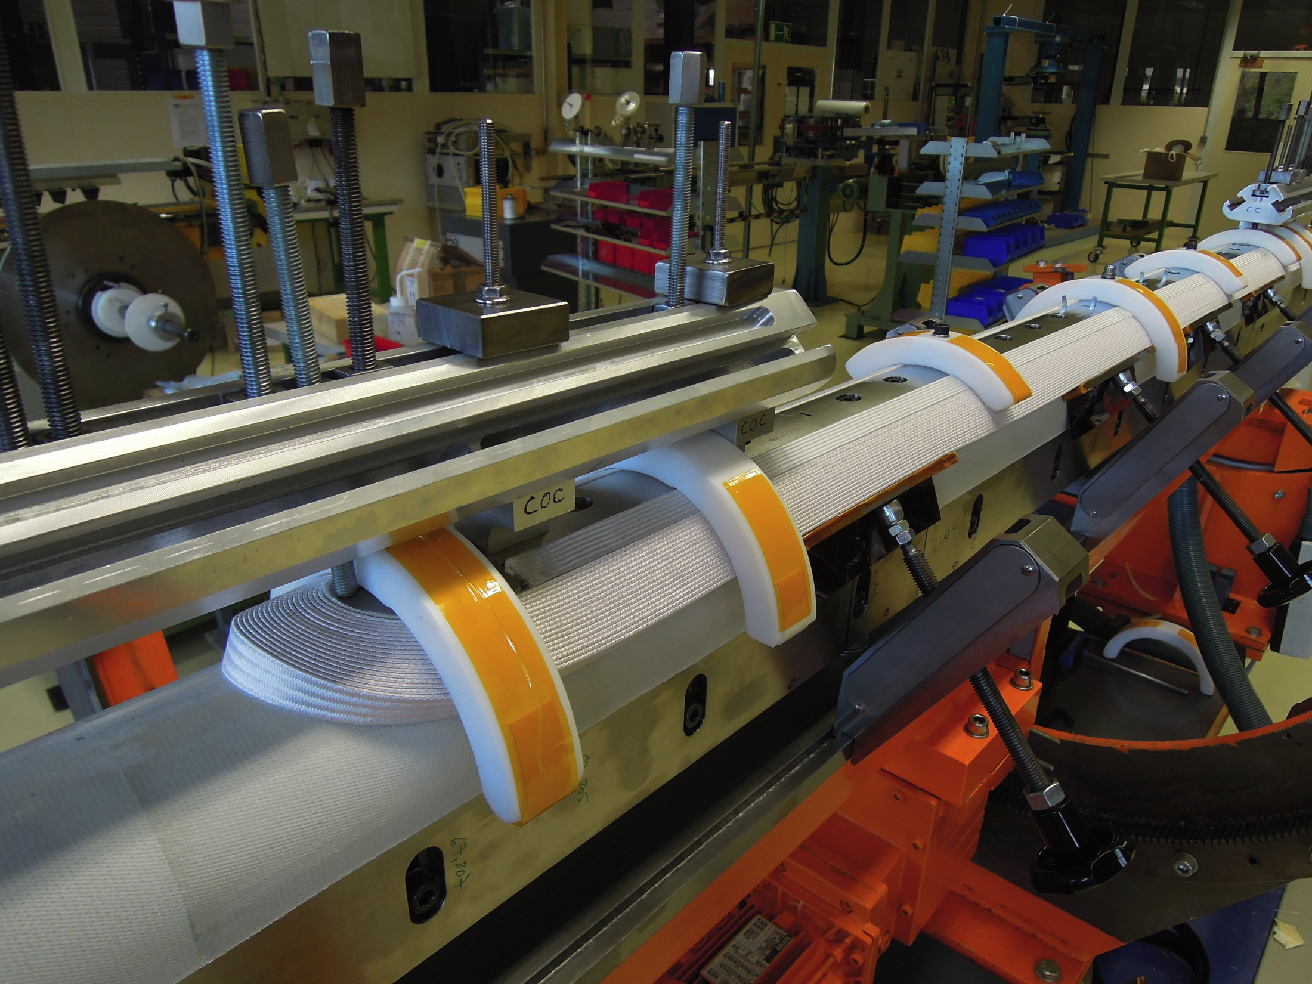
Coil Fabrication

Slide 11
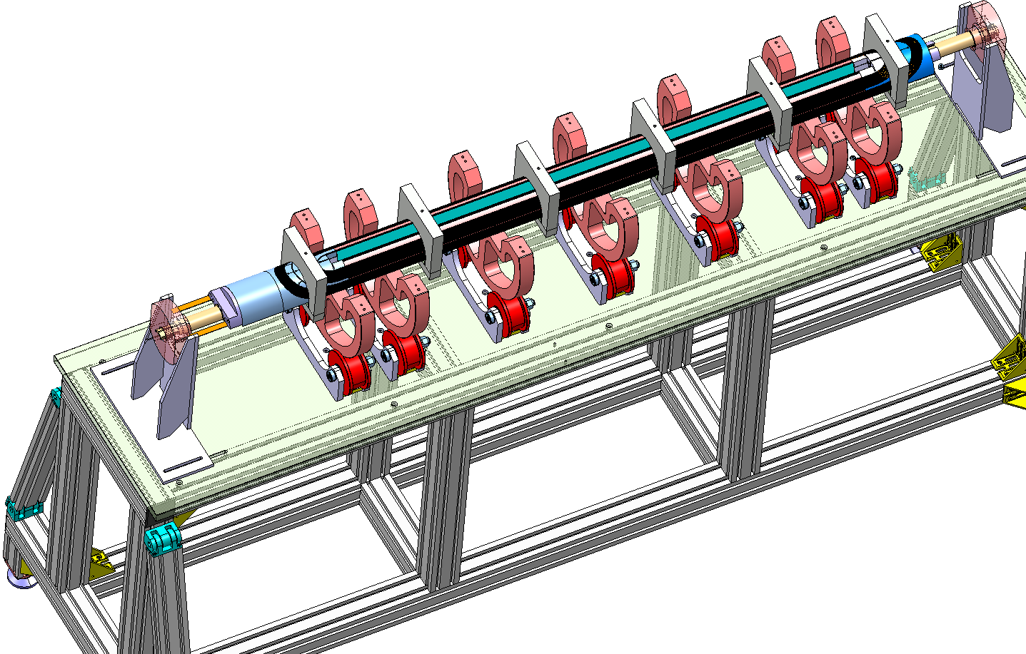
Coil Assembly

Slide 12
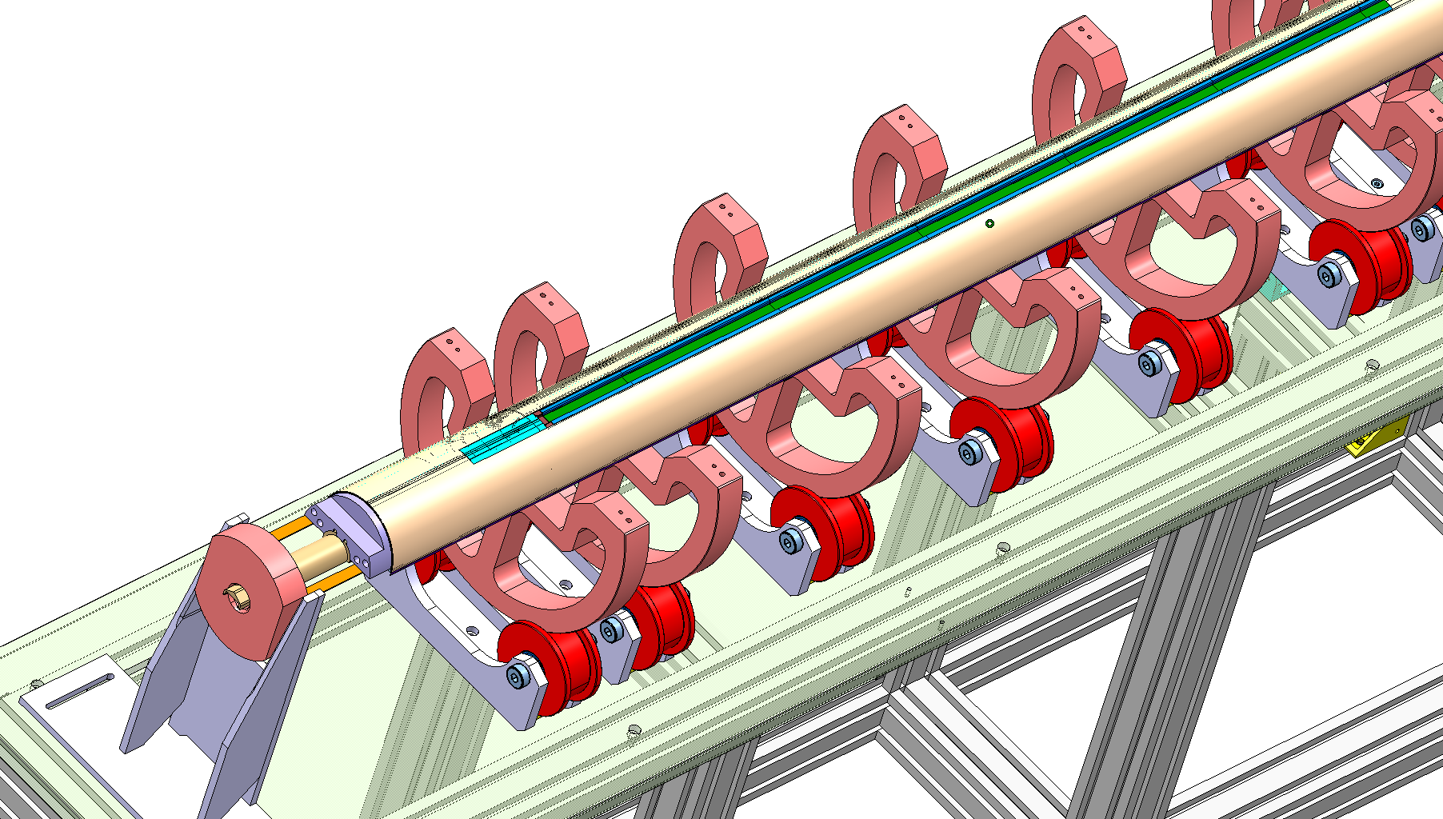
Coil Assembly

Slide 13
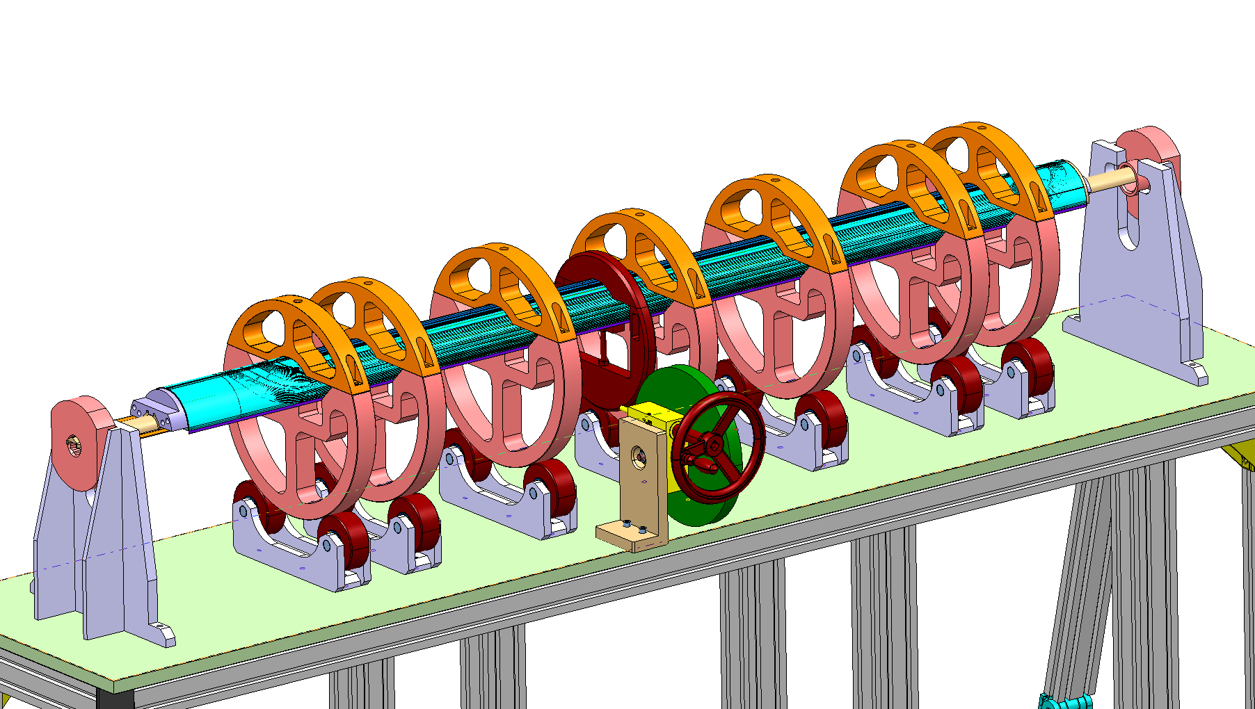
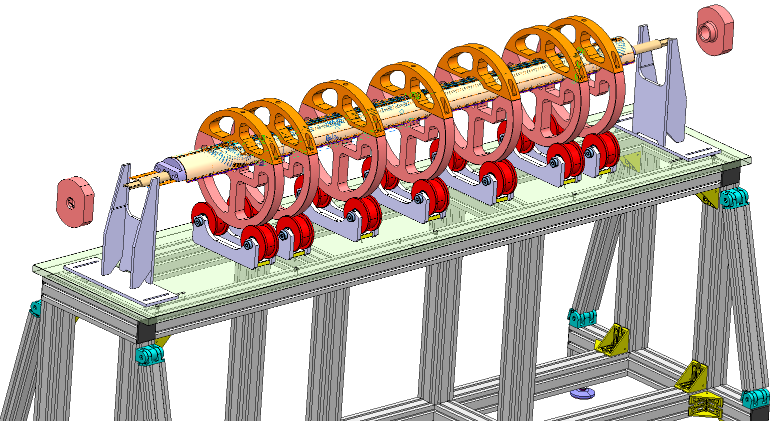
Coil Assembly
Notes:
All on order,

Slide 14
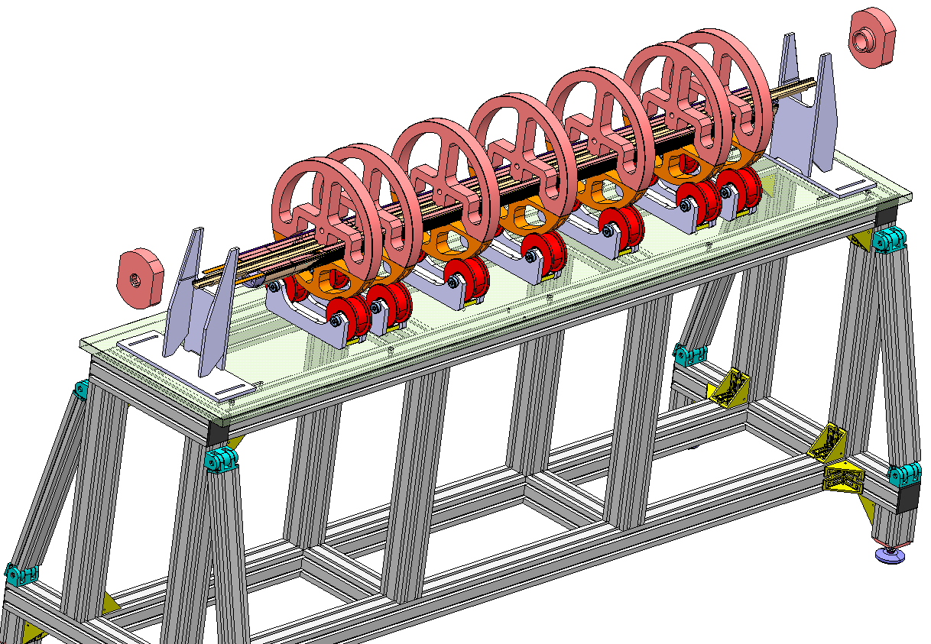
Coil Assembly

Slide 15
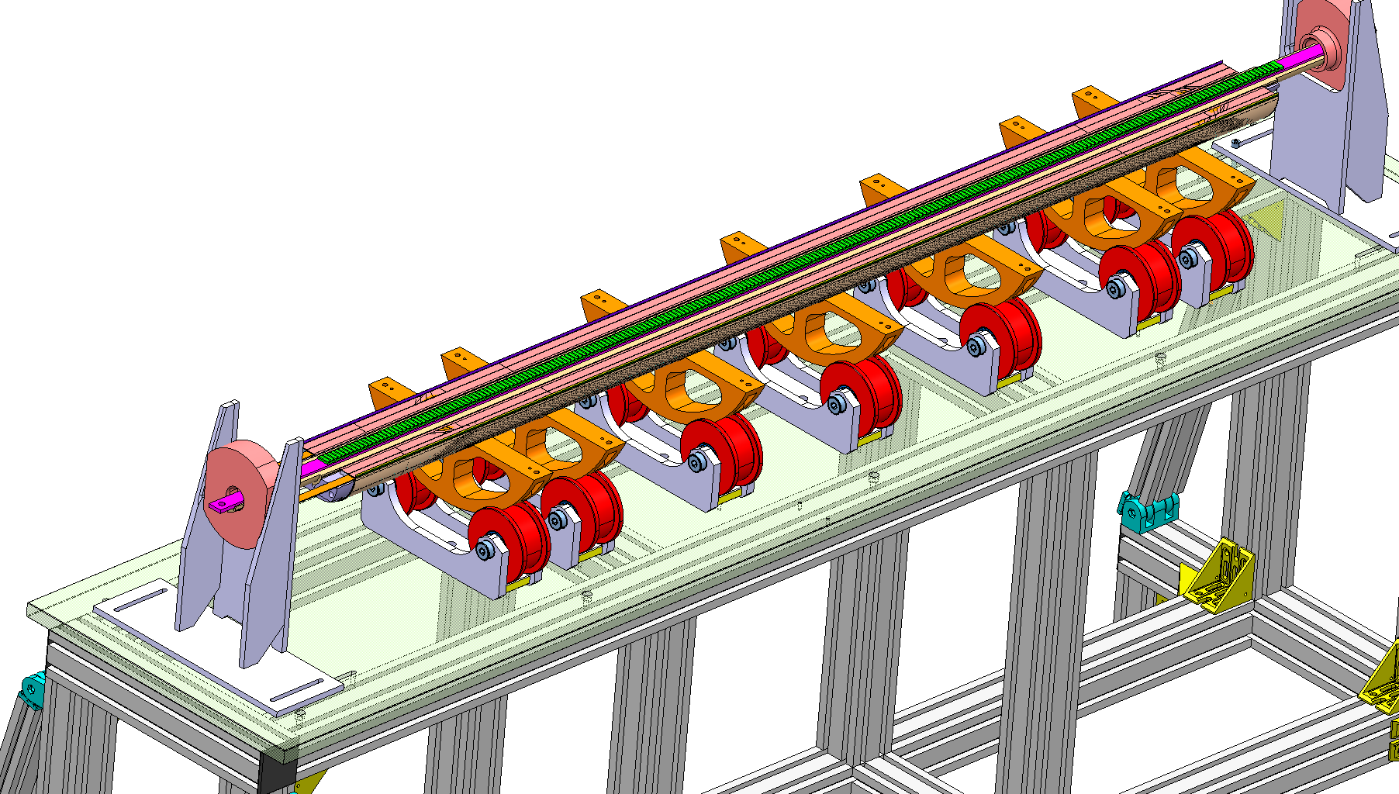
Coil Assembly

Slide 16
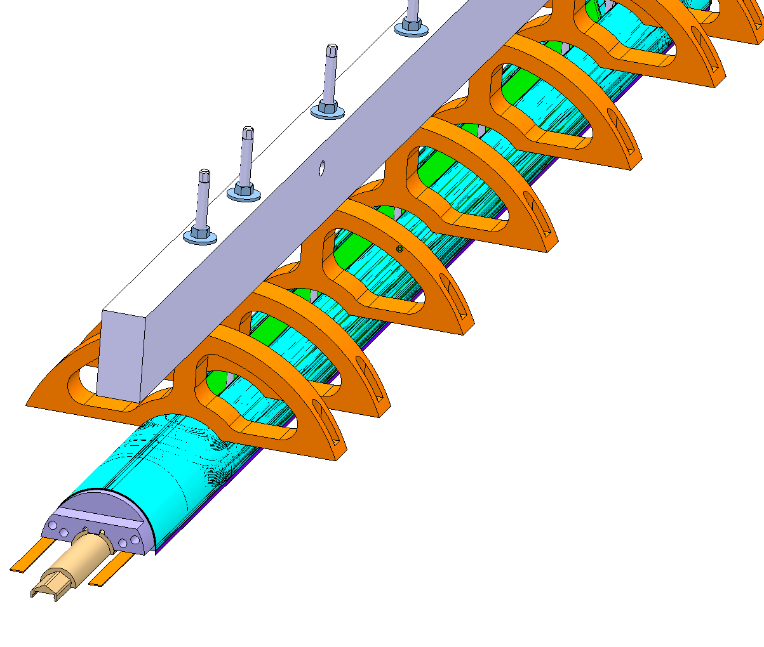
Coil Assembly

Slide 17
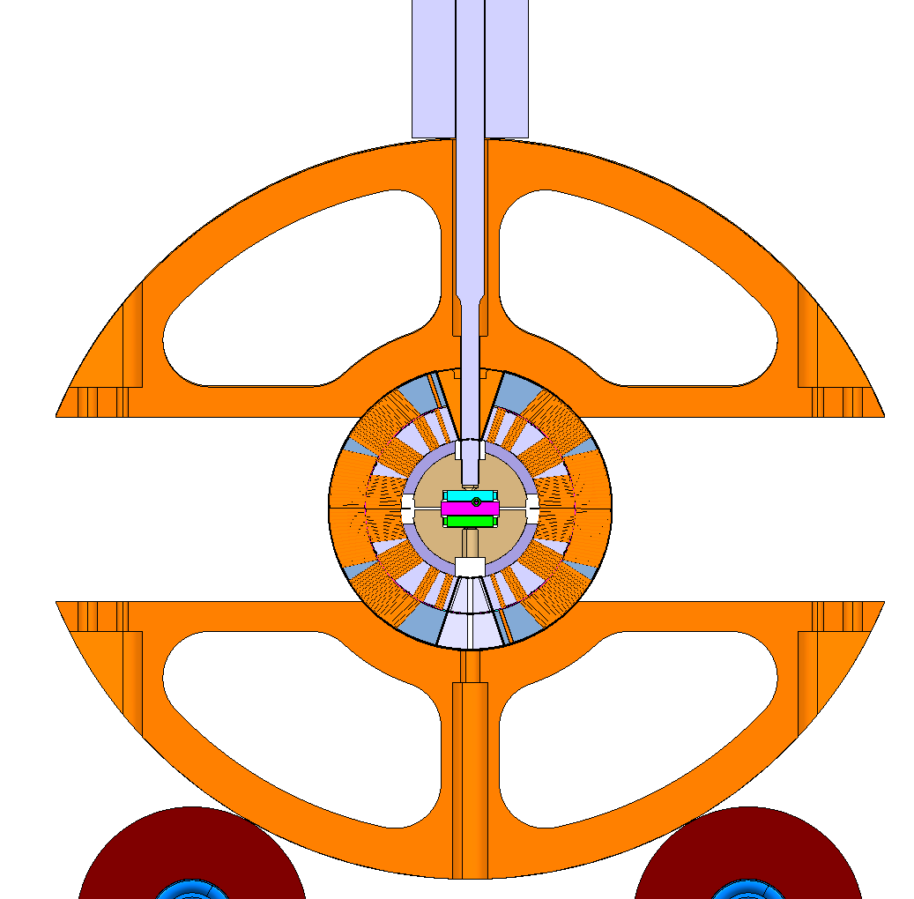
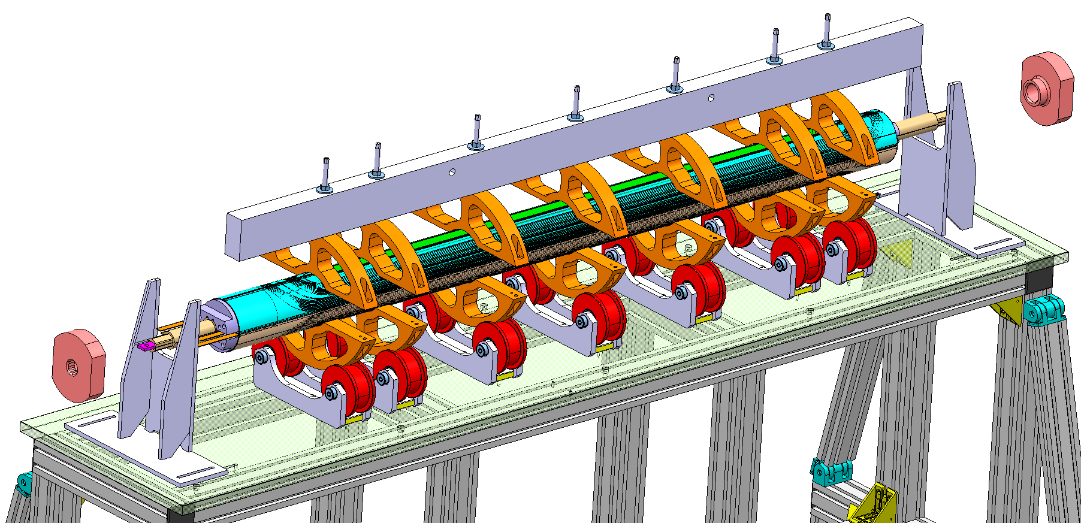
Coil Assembly

Slide 18
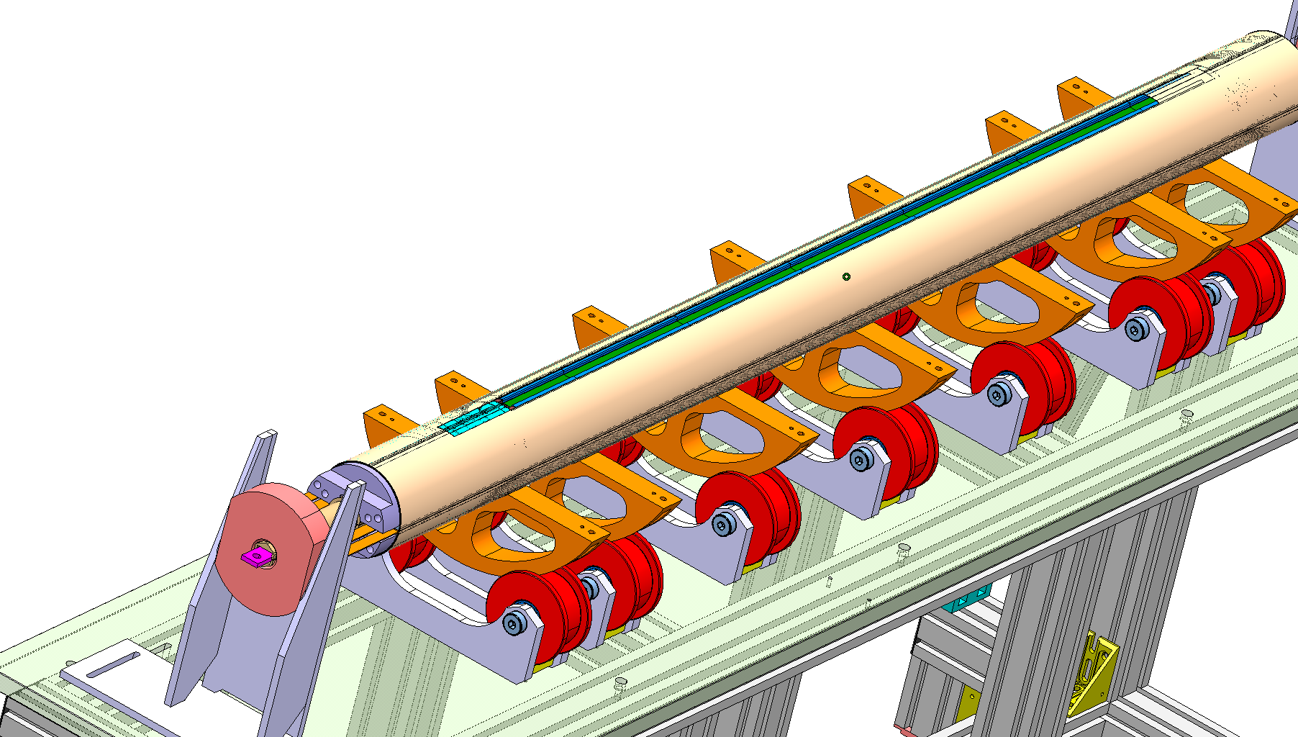
Coil Assembly

Slide 19
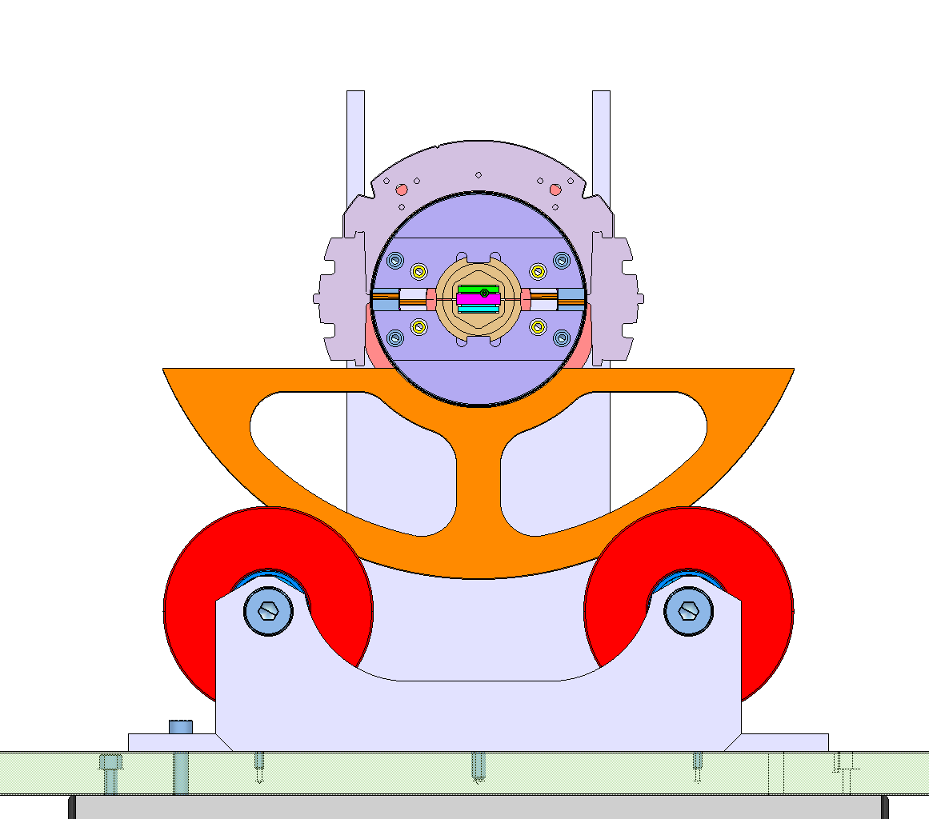
Collaring

Slide 20
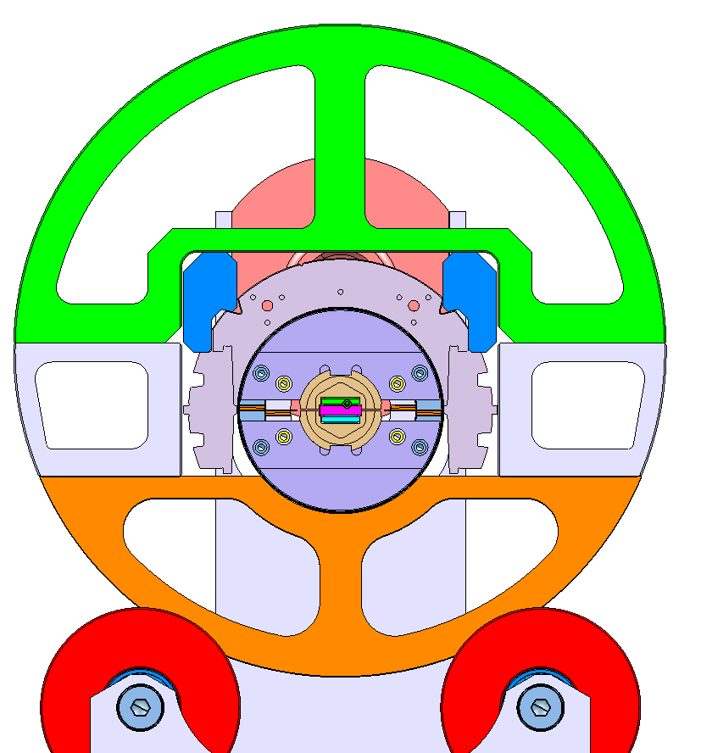
Collaring

Slide 21
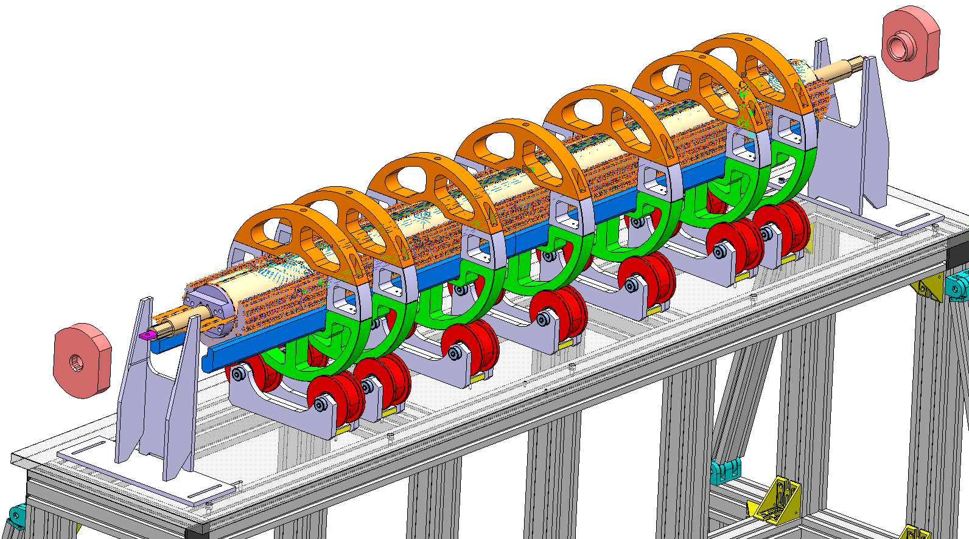
Collaring

Slide 22
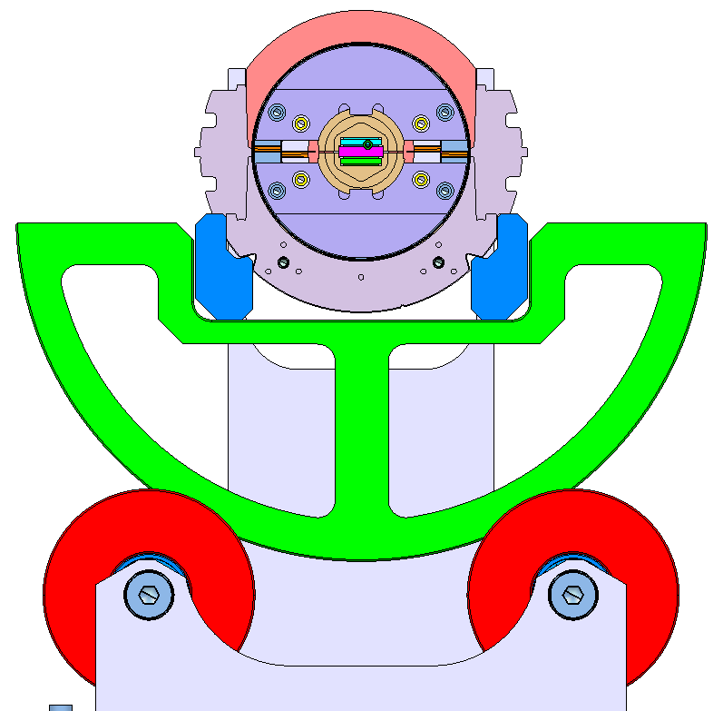
Collaring

Slide 23
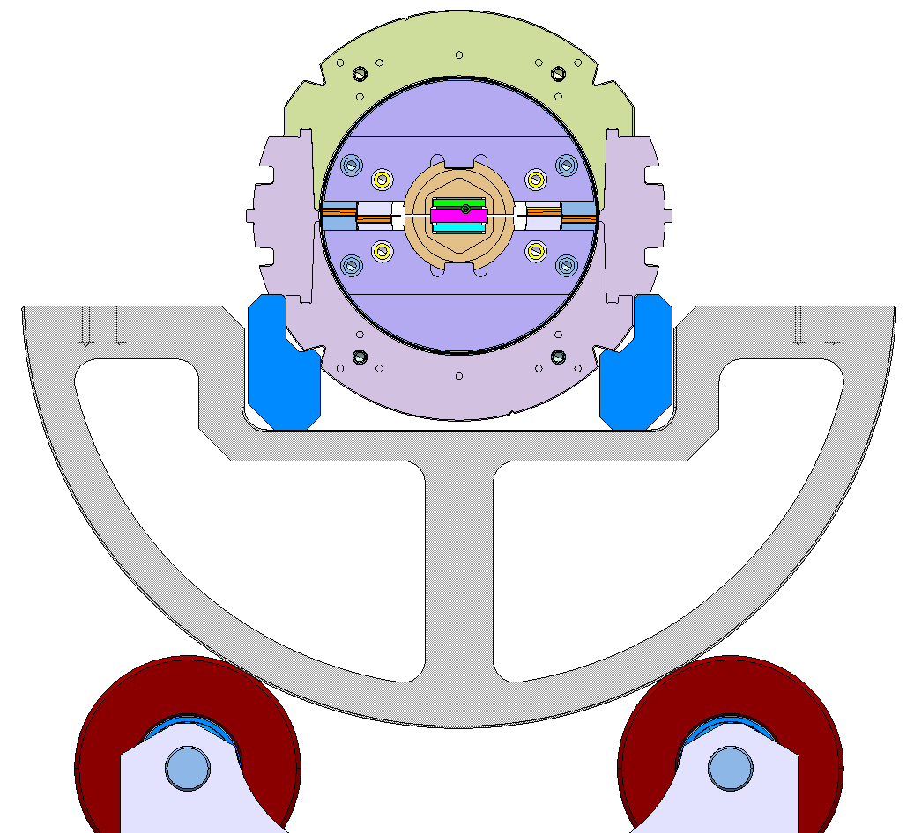
Collaring

Slide 24
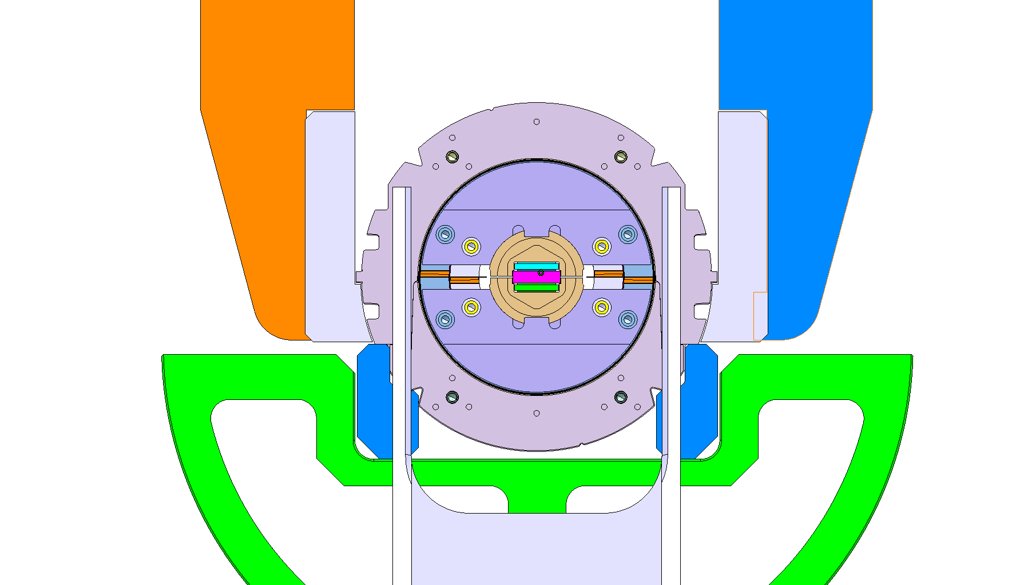
Collaring

Slide 25
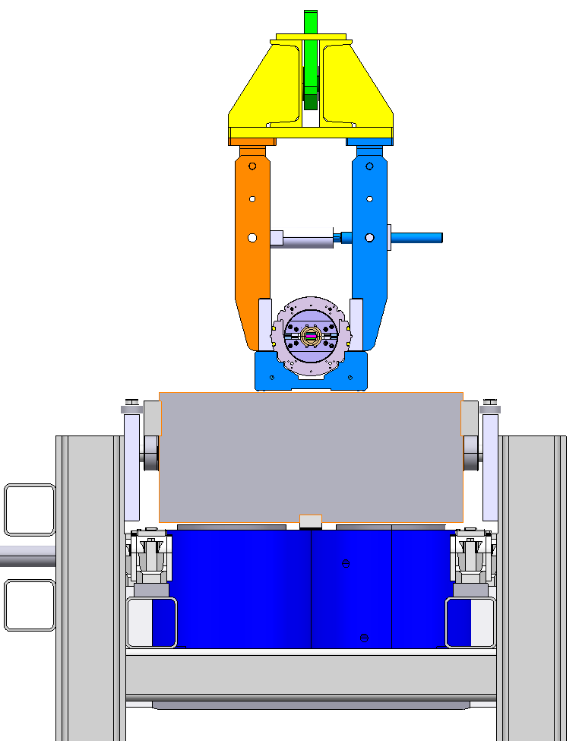
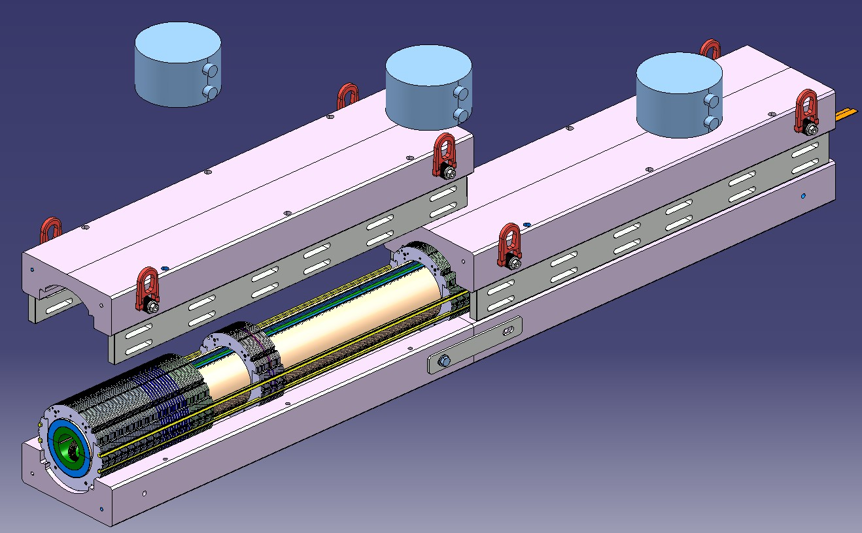
Collaring

Slide 26
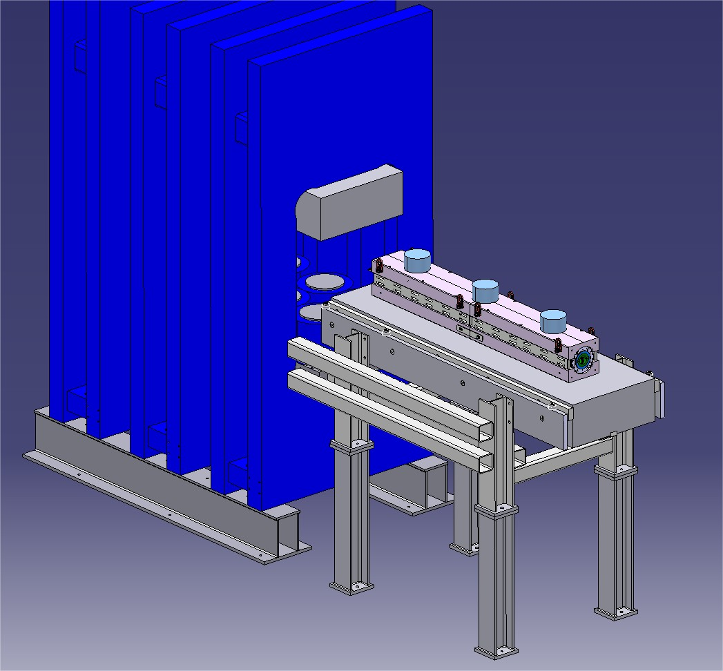
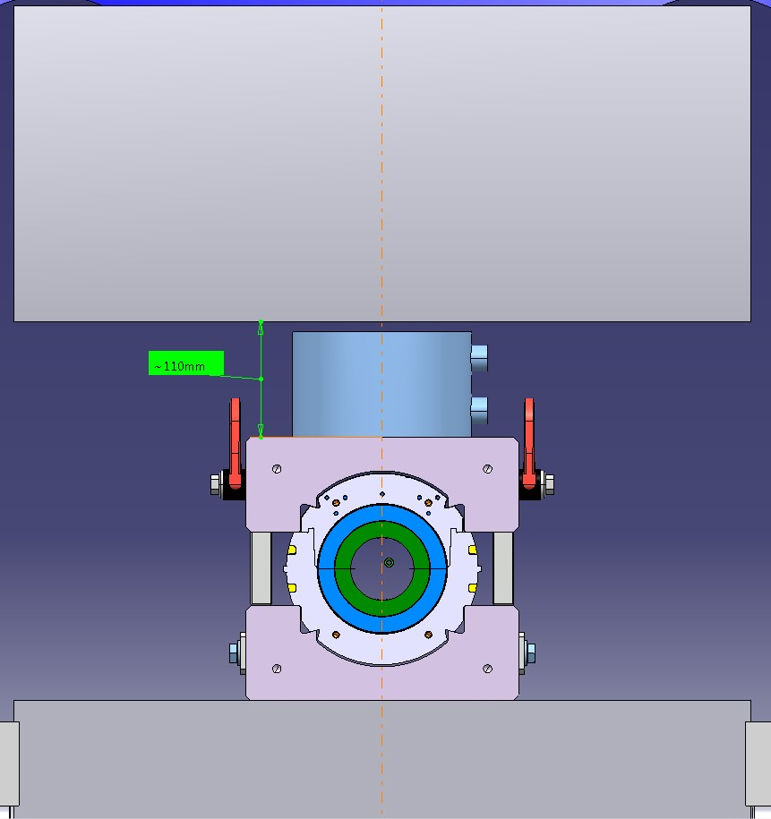
Collaring
Notes:
Recommissioning of the monster press to do.
Load cells being studied.

Slide 27
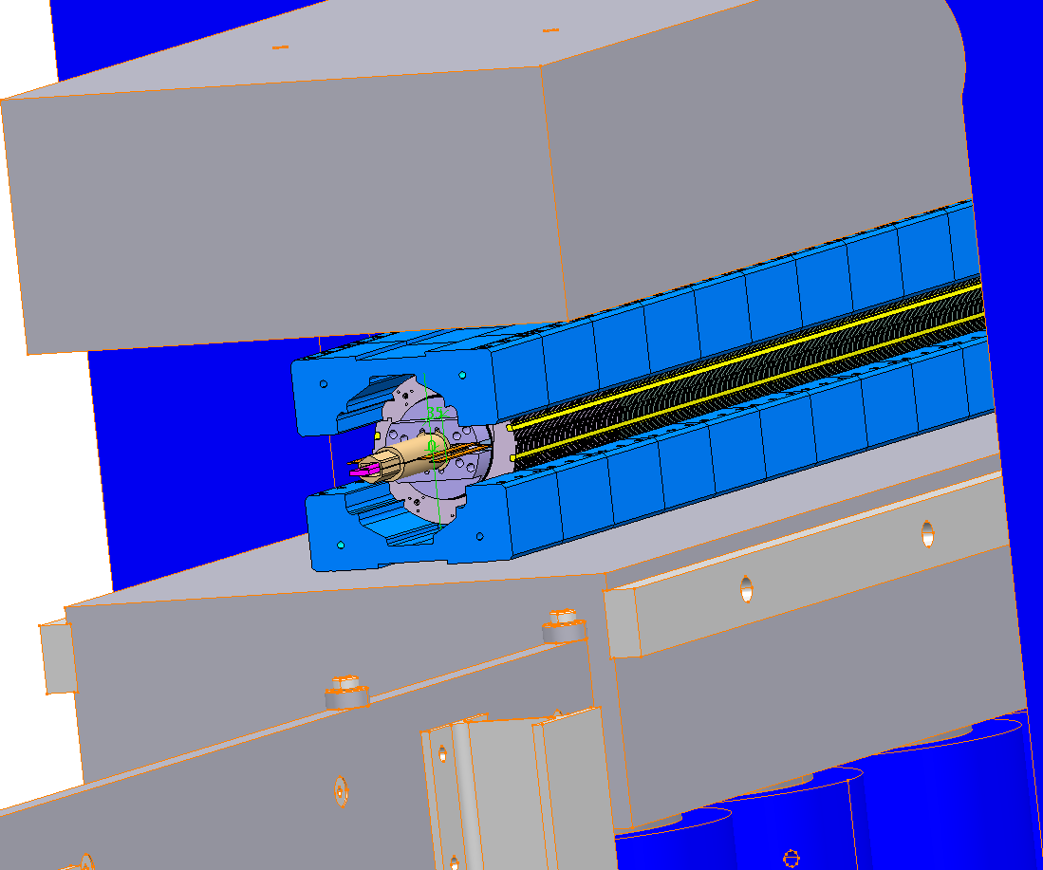
Collaring

Slide 28
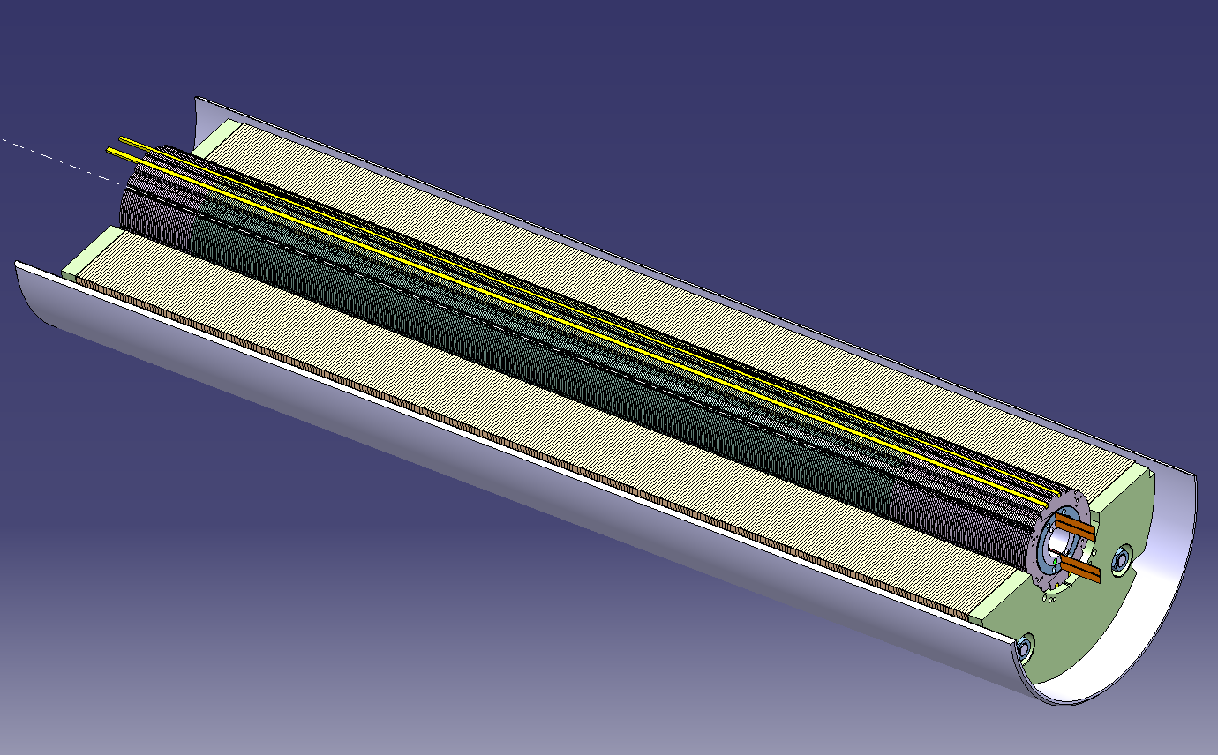
CERN 1-in-1 Cold-mass

Slide 29
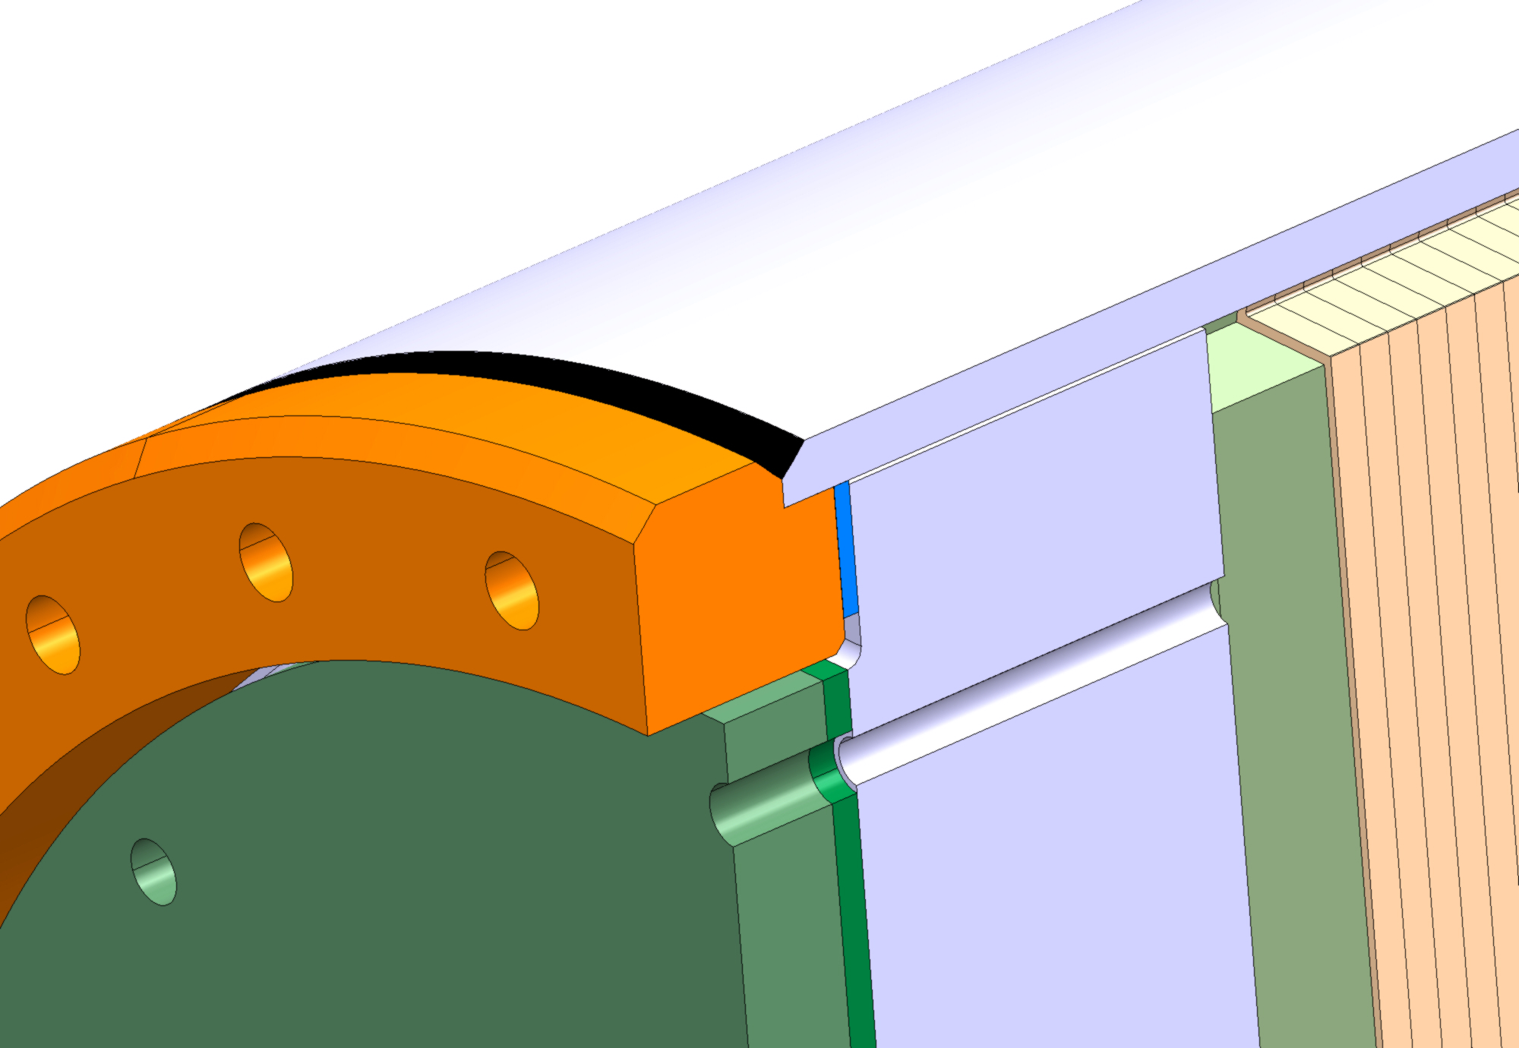
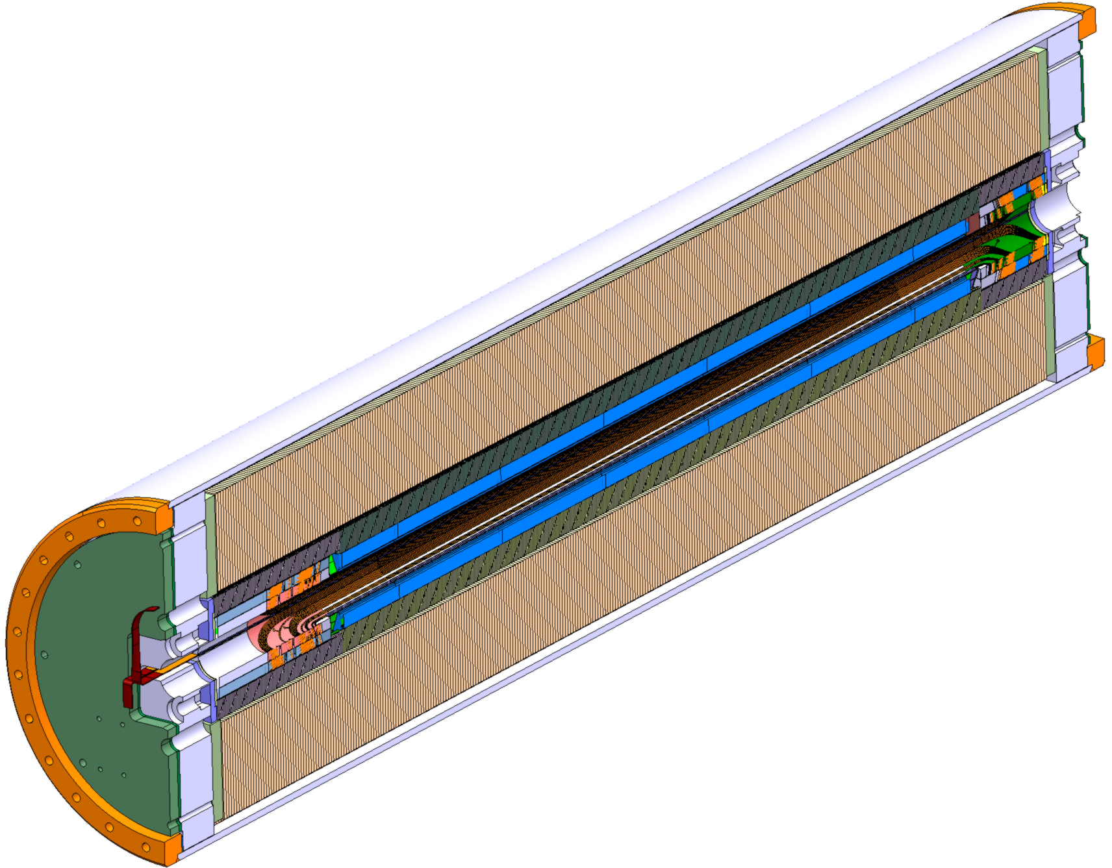
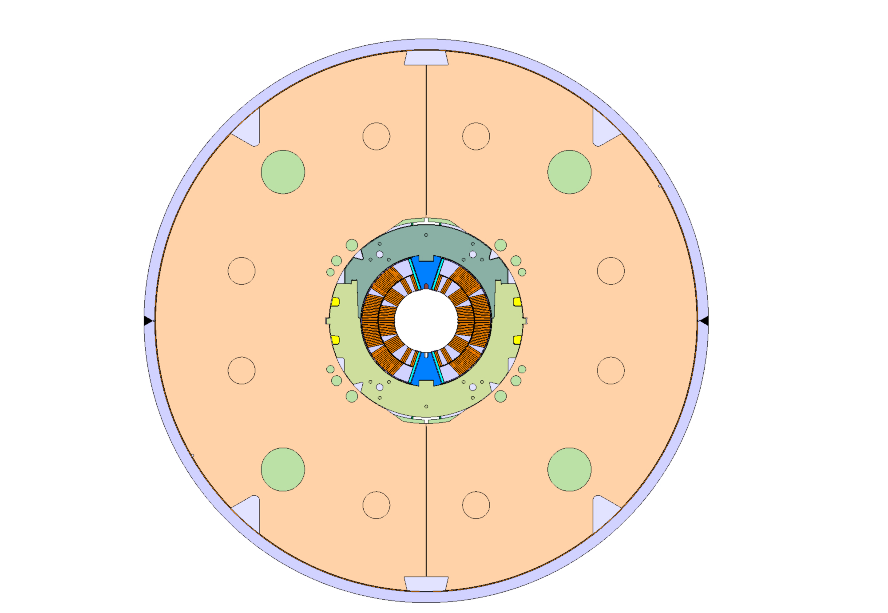
CERN 1-in-1 Cold-mass

Slide 30
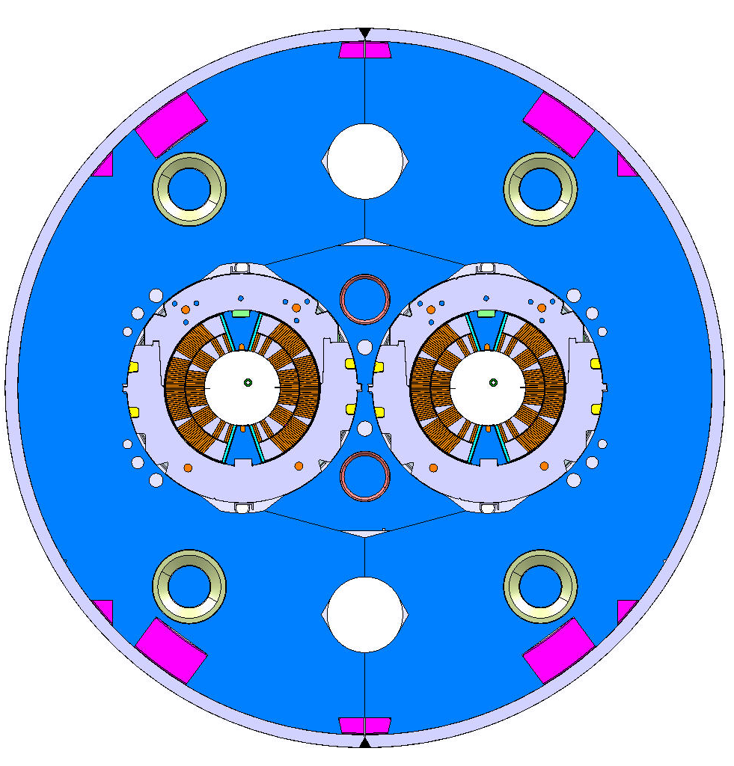
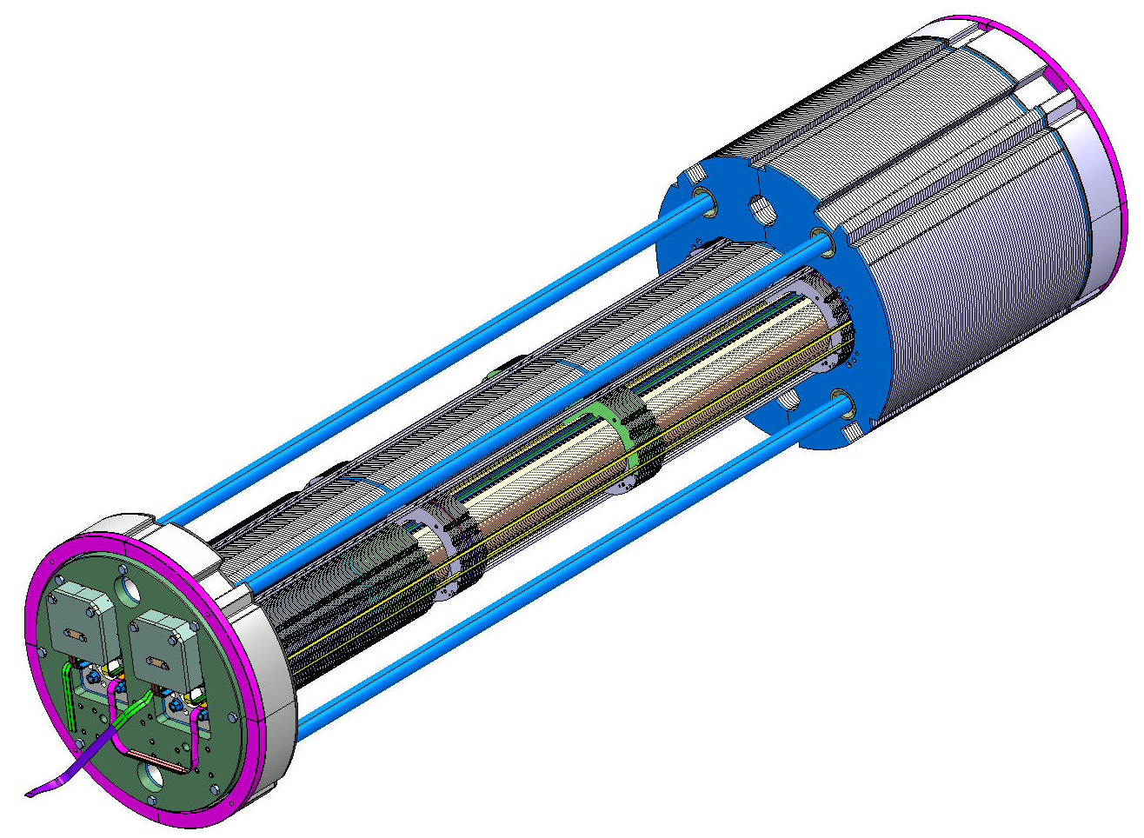
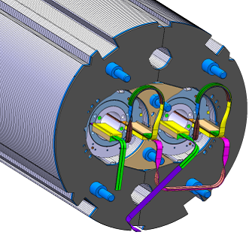
CERN 2-in-1 Cold-mass

Slide 31
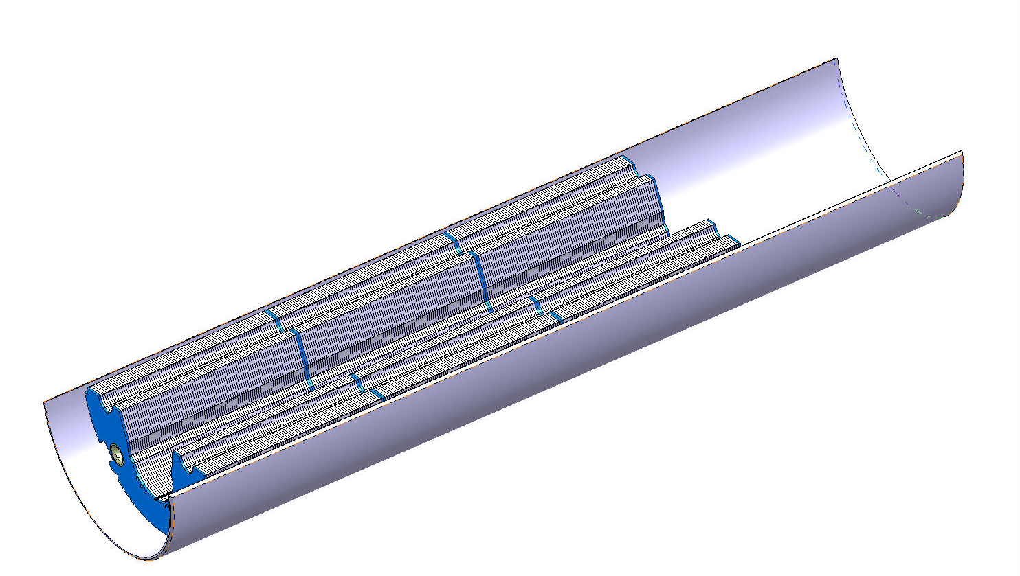
CERN 2-in-1 Cold-mass Assembly

Slide 32
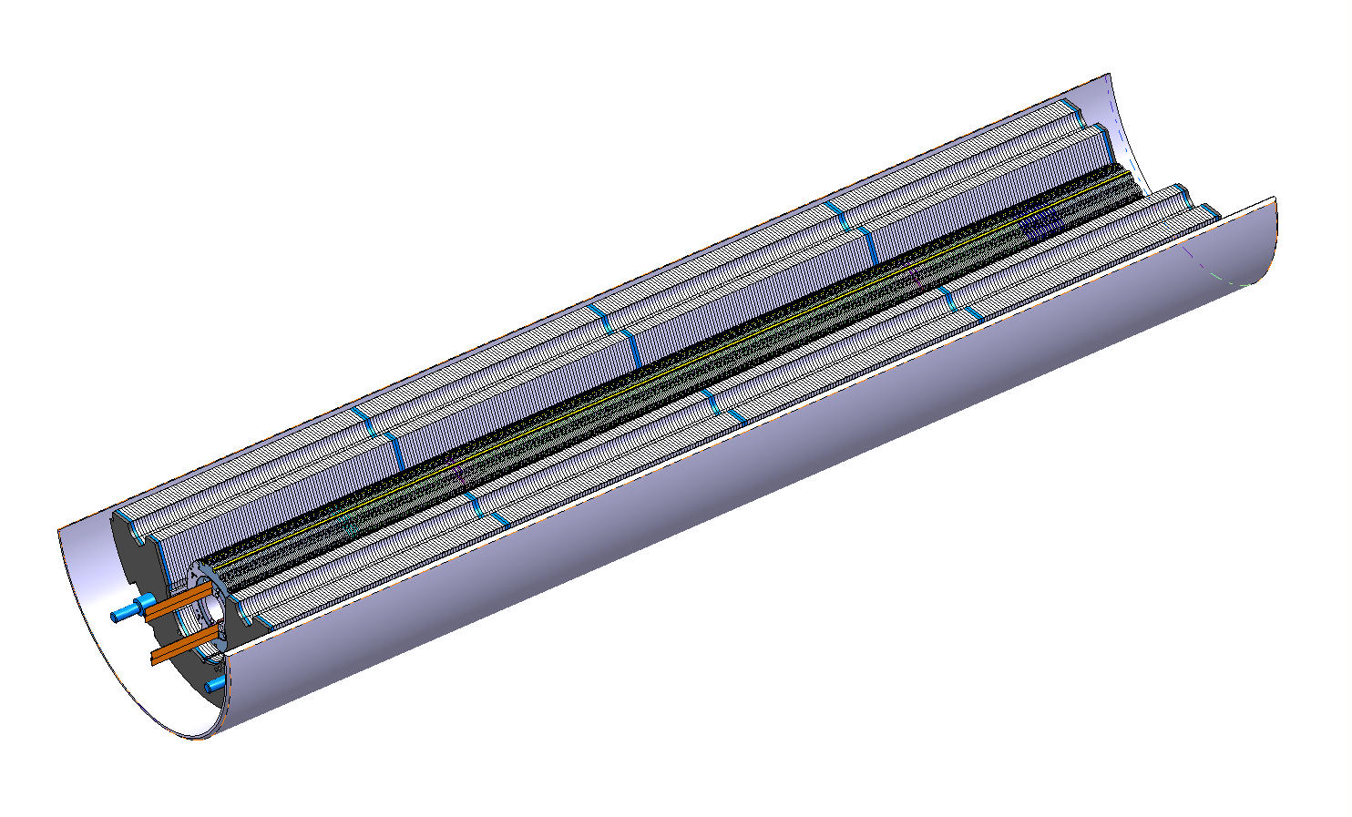
CERN 2-in-1 Cold-mass Assembly

Slide 33
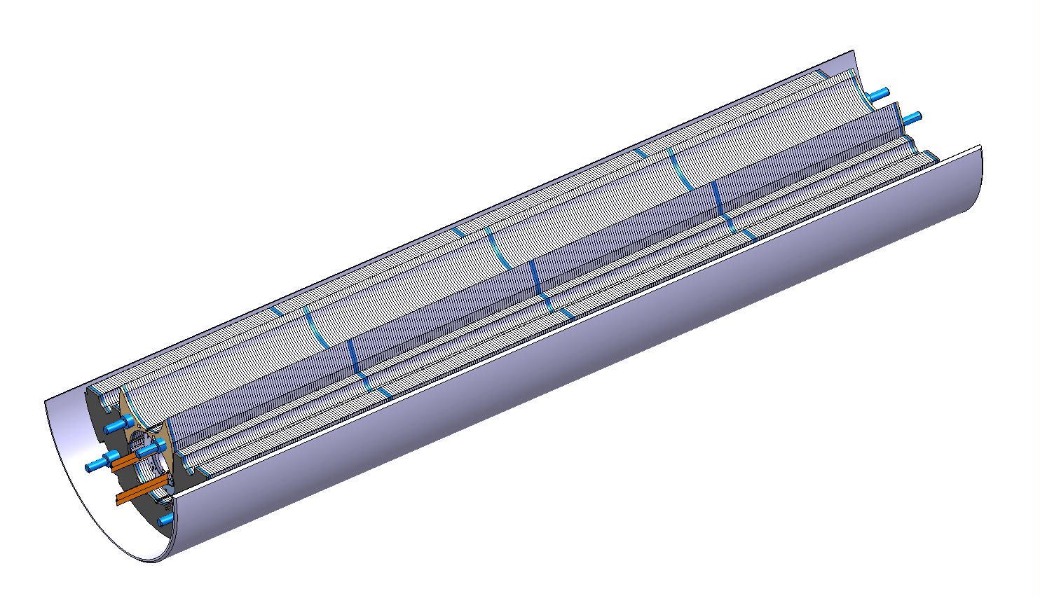
CERN 2-in-1 Cold-mass Assembly

Slide 34

CERN 2-in-1 Cold-mass Assembly

Slide 35

CERN 2-in-1 Cold-mass Assembly

Slide 36

CERN 2-in-1 Cold-mass Assembly

Slide 37

CERN 2-in-1 Cold-mass Assembly

Slide 38

CERN 2-in-1 Cold-mass Assembly

Slide 39


1-in-1 with Pole-Loading
Design features:
  Pole shim
  Collar/yoke shim
  Pole adjustment shim
  Gap closing @ room temperature
  remaining closed to 12 T.
  Stainless-steel shell
(3) is an optional knob.
(2) and (4) must be controlled
in order to close gap at RT.
4.
3.
1.
2.

Slide 40

2-in-1 with Pole-Loading
Design features:
  Pole shim
  Collar/yoke shim
  Pole adjustment shim
  Gap closing @ room temperature
  remaining closed to 12 T.
  Stainless-steel shell
(3) is an optional knob.
(2) and (4) must be controlled
in order to close gap at RT.
5.
4.
3.
1.
2.

Slide 41







Pole Loading Concept: 2-in-1 FEA
Under collaring
press
After collaring
-138 MPa
-140
After CM assembly
at 293 K
At 1.9 K, I = 0 A
0
B₀ = 12 T
-138 MPa

Slide 42


Mechanical model
Validate assembly parameters
Feed-back to FEA

Slide 43



CERN 2-in-1 End Support

Slide 44

Structural Analysis of End Region

Slide 45
Pole loading pros and cons
Direct transfer of collaring force into the coils
Allows using different pole for un-reacted/reacted coils
More “knobs” for tuning the pre-load (poles & mid-plane)
Majority of the pre-stress by collaring
Less sensitive to yoke-collar interface
Smaller spring back after collaring
Closed yoke gap at warm and at cold up to 12 T
Easier to adapt for azim. coil size variations
Top shims allows varying coil stress by 50 Mpa
Less sensitive to friction thanks to the closed gap at RT
Easier to instrument
Transition from transverse to axial loading in the ends
Coil fabrication with temporary pole pieces

Slide 46
Integrated pole pros and cons
Coils more robust to handle
Coils fabrication process easier
“Monoblock” end region
High coil stress during collaring
Majority of the pre-stress by yoke assembly
More complex yoke-collar interface
Larger stress gradients in the coils (bending)
Open yoke gap at warm

Slide 47
Magnet Design Status
1-in-1 (2 m) magnet assembly and fabrication drawings being completed.
2-in-1 (2 m) magnet fabrication design being completed
Tooling design:
  Coil fabrication tooling competed
  Coil assembly tooling completed
  Collaring tooling completed
  Yoke stacking tooling completed
  Cold mass assembly tooling in progress
5.5 m long tooling design in progress

Slide 48
Procurement Status
St. steel end spacers made by SLS
ODS copper alloy based wedges (Discup C3/30 material) expected October
Collar laminations (EDM) for the aperture #1 delivered and in QC. Order for fine-blanking collars for aperture #2 to #5 being raised.
1-in-1 yoke laminations delivered, order for 2-in-1 yoke laminations to raise once FNAL design completed
Order for the outer shells raised
Winding and curing tooling operational
Reaction tooling delivered
Reaction furnace commissioning early October
Vacuum impregnation tooling expected early October
Vacuum impregnation system commissioning early October
All handling and collaring tooling expected by Mid-October

Slide 49
QC & Documentation
FNAL Vector traveller system was implemented at CERN
Procedures and travellers are being written
We currently rely on CERN central metrology services
Dimensional control systems for Nb₃Sn coils are being investigated

Slide 50
CERN Milestones
Practice coils (2 m)
  Practice coils #1-#2 (Cu) Jun..Sep-12
  Practice coil #3 (cored ITER Nb₃Sn) Oct..Nov-12
  Practice coil #4 (cored LARP RRP 54/61) Nov..Jan-12
  Mirror test @FNAL (TBC) Feb-12
2-in-1 Demonstrator (2 m)
  Coils for aperture-1 (cored RRP 108/127) Jan..Apr-13
  1-in-1 assembly and test Q2-13
  Coils for aperture-2 (cored PIT) May..Jul-13
  1-in-1 assembly and test Q3-13
  2-in-1 assembly and test Q4-13
  Eventual coil design update (?) Q4-13..Q1-14
5.5 m prototype magnet (Preliminary)
  Selection of mechanical concept Q1-14
  Tooling commissioning Q4-13..Q1-14
  Practice coil (Cu) Q1-14
  Practice coil (Nb₃Sn) Q2-14
  Coils for aperture-1 & mirror tests Q4-14
  Collared coil Q1-15
  2-in-1 cold-mass and cryo-magnet Q3-15
  Cold test Q4-15

Slide 51
Some R&D Topics
Analysis tools (Quench and persistent currents)
Strand
Cored cable
Cable insulation
End spacers
Wedge material
Inter-layer heater
Internal splice
Notes:
Move to CERN 2in1

Slide 52
Summary
Pole loading concept provides several important engineering features:
  Efficient transfer of the collaring force into the coils.
  Good control and easy adjustment of the assembly parameters
  Minimal bending of the coils
Coil technology transfer from FNAL well in progress
  Very fast tooling design phase
  Very much shortened “trial-and-error” period
  Existing procedures based on US HFM projects experience
  Very open communication and sharing of information in both ways
Coil fabrication is in progress at CERN
All key components and tooling for the 2 m model magnet construction in procurement
Construction and test plan has been established

Slide 53
Answers to Charge
Has technology transfer from FNAL to CERN started in earnest?
  Yes: Coil fabrication technology, traveller system
b. Have the lessons learned in the Phase 1 been used?
  Coil fabrication tooling concept same as at FNAL
  End spacer iterations
  Cable development jointly between CERN and FNAL
c. Have plans been made for development and decision making process of any possible alternative design for coils and/or mechanical structure?
  We first have to build and successfully test both FNAL and CERN 2-in-1 demonstrators. Topic of the 2-in-1 review.
d. Are plans ready for CERN to proceed with coils and cold masses material procurement, construction and testing?
  All tooling and key components in procurement,
  practice coils in progress
  See milestones...

Slide 54
FEA: Material Data
Structure | Material | Thermal contraction (300-2 K) mm/m | E modulus Gpa warm | E modulus Gpa cold
Coil | impregnated Nb₃Sn | 3.3/2.9 (rad./azi.) | 27 | 30
Wedge pole loading | ODS Cu-alloy, Discup | 3.3 | 130 | 130
Wedge inte- grated pole | 316L | 2.9 | 195 | 215
Central post | Ti-6Al-4V | 1.7 | 115 | 125
Collar | YUS 130S | 2.9 | 195 | 215
Keys | Nitronic 40 | 2.64 | 190 | 210
Yoke | Soft iron | 2.05 | 210 | 225
Shell | 304L/316L | 2.9 | 195 | 215

Slide 55



FEA Model Under the Collaring Press
Integrated pole concept Pole-loading concept

Slide 56


Press Displacement, Coil Stress
Integrated pole concept Pole-loading concept
Shim thickness:
  0.1 mm on mid-plane
  0.05 mm radially
Press displacement:
  – 0.025 mm
Peak stress under press:
  148 MPa
  (0.21 mm on pole-wedge)
  0.015 mm pole azimuthal
  0.075 mm still ok
  110 MPa
65 MPa
110 MPa
148 MPa
95 MPa

Slide 57




Collared Coil - Spring Back
Integrated pole concept Pole-loading concept
Collared-coil deformation:
Prestress after collaring
0.03 mm
0.09 mm
default 0.2 mm
0.0 mm
0.4 mm
0.04 mm
0.11 mm
111 MPa
55 MPa
62 MPa
87 MPa

Slide 58









Coil Stress Evolution 1/2
-150 MPa
Yoke assembly
@ room temp.
Cryogenic temp.
12 T

Slide 59
Coil Stress Evolution 2/2
Minimal azimuthal coil stress:
FEA shows that both designs
allow for +/- 0.05 mm
adjustment of the collar size.
 | Integrated pole |  |  |  | Pole loading
 | P1 | P2 | M1 | M2 | P1 | P2 | M1 | M2
Under press | -65 | -80 | -148 | -80 | -110 | -65 | -95 | -82
Spring-back | -55 | -55 | -103 | -55 | -87 | -45 | -45 | -73
Yoke assy. | -102 | -57 | -70 | -70 | -137 | -48 | -60 | -110
Cool down | -129 | -35 | -70 | -70 | -111 | -44 | -55 | -90
12 T | -4 | -14 | -147 | -100 | -10 | -37 | -126 | -139
P2
P1
-150 MPa
M1
M2

Slide 60

Azimutal stress vs. von Mises Stress
Coil stress after yoke assembly at room temperature, pole-loading concept.
Left: von Mises stress, Right: Azimutal stress

Slide 61
Sensitivity to Coil Material Data
Sensitivity to coil material by using uniform coil modulus (including wedges) instead of Nb₃Sn estimate.
Structure | Material | Thermal contraction (300-2 K) mm/m | E modulus Gpa warm | E modulus Gpa cold
Coil approx. | impregnated Nb₃Sn | 3.3/2.9 (rad/azi) | 27 | 30
Coil incl. wedge | impregnated Nb₃Sn, SS | 3.3/2.9 | 44 | 50
27/30 GPa
44/50 GPa
 | Integrated pole |  |  | Pole loading
 | P1 | P2 | M1 | P1 | P2 | M1 | M2
Under press | -65 | -80 | -148 | -110 | -65 | -95 | -82
Spring-back | -55 | -55 | -103 | -87 | -45 | -45 | -73
Yoke assy. | -102 | -57 | -70 | -137 | -48 | -60 | -110
Cool down | -129 | -35 | -70 | -111 | -44 | -55 | -90
12 T | -4 | -14 | -147 | -10 | -37 | -126 | -139
 | Integrated pole |  |  | Pole loading
 | P1 | P2 | M1 | P1 | P2 | M1 | M2
Under press | -65 | -90 | -206 | -122 | -80 | -145 | -95
Spring-back | -60 | -65 | -121 | -99 | -47 | -40 | -85
Yoke assy. | -115 | -70 | -70 | -162 | -70 | -66 | -124
Cool down | -148 | -36 | -70 | -133 | -65 | -60 | -105
12 T | -22 | -2 | -172 | -24 | -6 | -130 | -156

Slide 62


Impact of Over-Compression
Impact of over-compression by additional
0.05 mm collaring press displacement.
Integrated pole concept Pole-loading concept
-145 MPa
-205 MPa
Values for default displacement
 | Integrated pole |  |  | Pole loading
 | P1 | P2 | M1 | P1 | P2 | M1 | M2
Under press | -65 | -80 | -148 | -110 | -65 | -95 | -82

Slide 63



Shape Evolution
Coil deformation
Pole loading, coil inner-contour ellipticity f = b/a
We may review the room-temperature beam separation
of 2 x 97.194 mm.
 | Coil ellipticity |  | Coil center shift
 | Integrated pole | Pole loading | Integrated pole | Pole loading
Yoke assy. | 0.6% vert. | 0.2% vert. | -0.11 mm | 0.02 mm
Cool down | 0.6% vert. | 0.1% hor. | -0.65 mm | -0.39 mm
12 T | 0.1% vert. | 0.6% hor. | -0.57 mm | -0.3 mm
f = 1.002
f = 0.999
f = 0.994
Δx = 0.39
Δx = 0.3
b
a

Slide 64



Shape Evolution
Coil deformation
Integrated pole, coil inner-contour ellipticity f = b/a
We may review the room-temperature beam separation
of 2 x 97.194 mm.
 | Coil ellipticity |  | Coil center shift
 | Integrated pole | Pole loading | Integrated pole | Pole loading
Yoke assy. | 0.6% vert. | 0.2% vert. | -0.11 mm | 0.02 mm
Cool down | 0.6% vert. | 0.1% hor. | -0.65 mm | -0.39 mm
12 T | 0.1% vert. | 0.6% hor. | -0.57 mm | -0.3 mm
f = 1.006
f = 1.006
f = 1.001
b
Δx = 0.11
Δx = 0.65
Δx = 0.57
a

Slide 65










Collar Stress
Yoke assembly RT
Collared Coil
12 T
Cryogenic temp.
Under press

Slide 66






Shell Stress, Yoke Gap
Cryogenic temp.
Room temp.
12 T
shell thickness 10 mm
shell thickness 10 mm
weld shrinkage
0.65 mm
weld shrinkage
0.4 mm

