Slide 1
FNAL Phase 2a Status
Fred Nobrega
11 T Collaboration Review
September 27, 2012

Slide 2
Phase 2a FY2013
FNAL plan:
Fabricate five 2-m long coils and assemble two collared coils
Test each collared coil in a single-aperture configuration at FNAL
Fabricate and test at FNAL 2-in-1 mechanical model to develop twin-aperture demonstrator assembly and pre-stress procedures

Slide 3
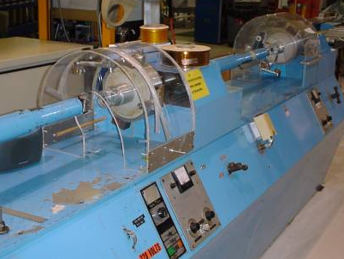
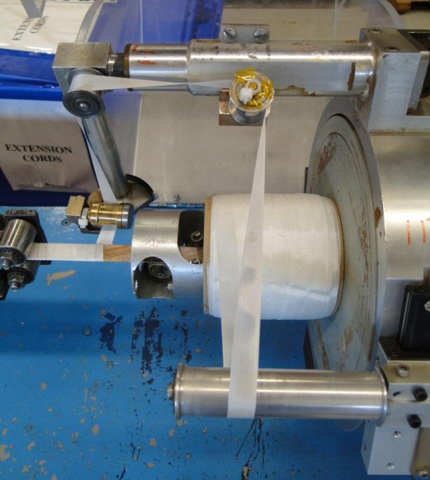
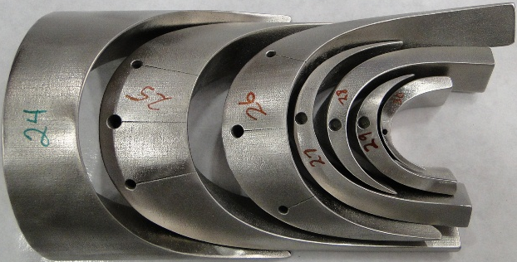
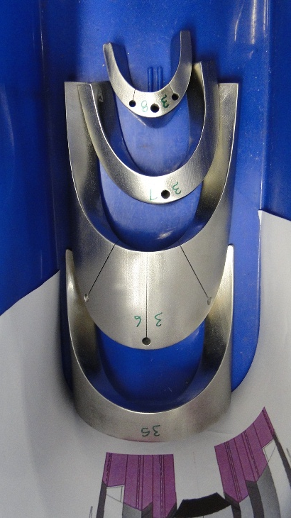
2 m Coils
Cable Insulation
  Half lap 75 μm E-glass
End Part Iteration
  Saddle mid-plane
  Shorter spacer legs

Slide 4
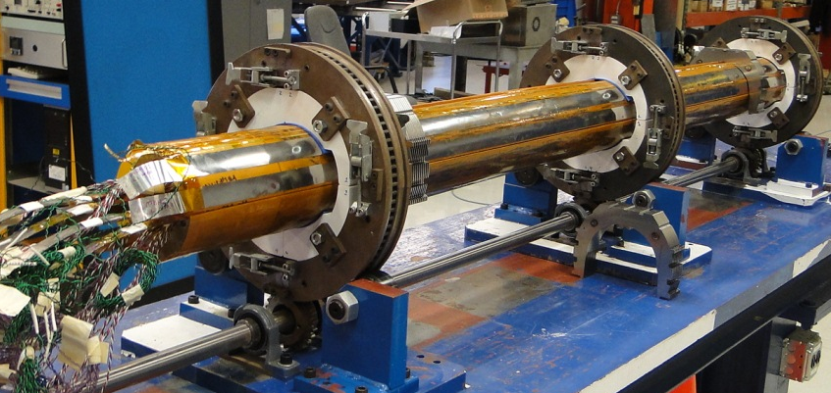
Coil Assembly
Ground Insulation & Quench Heater
  Single layer of 127 μm Kapton between coil and heater

Slide 5
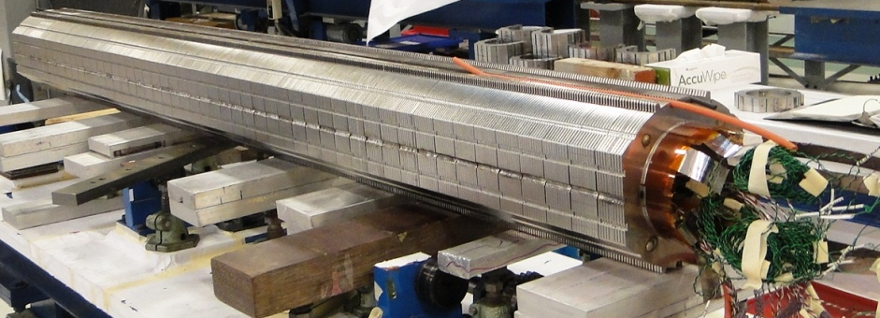
Collared Coil
Collar Design
  Unchanged
  Request for bids for collar fabrication in progress and includes HV Wooding in GB
  Collar delivery by Jan. 2013
  Tapered mid-plane shim at coil ends

Slide 6
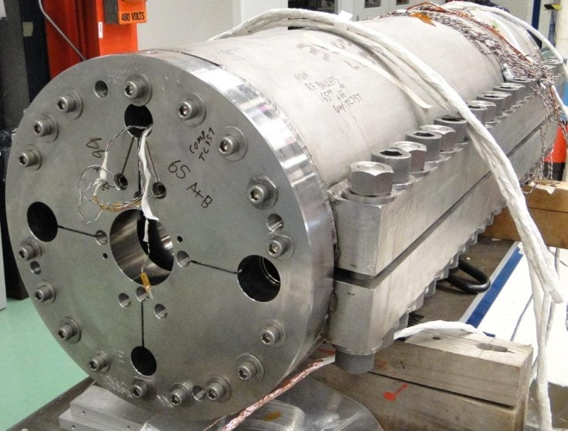
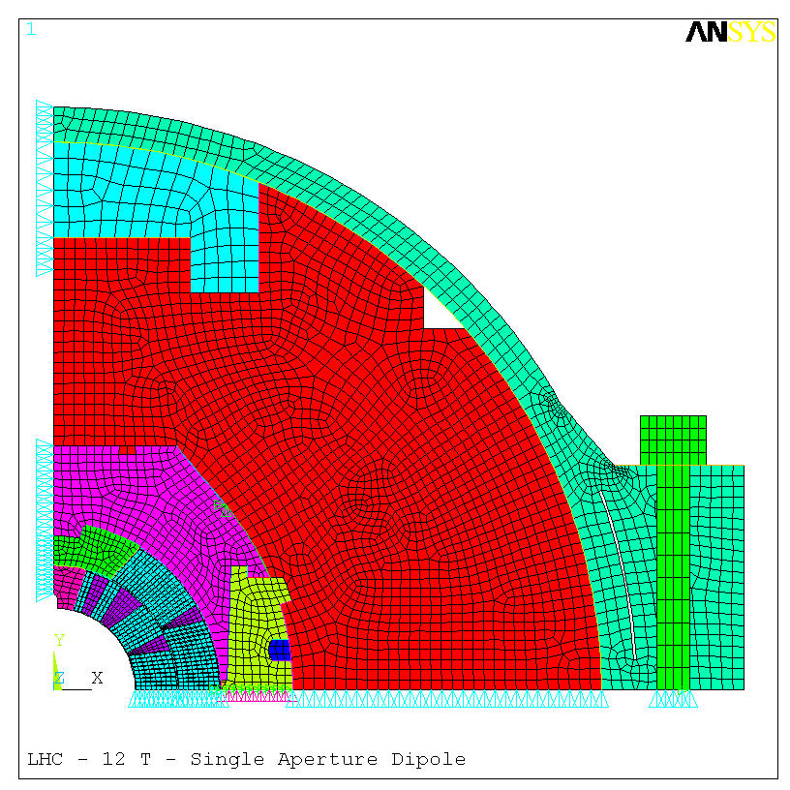
Yoke Design & Final Assy
Yoke Design
  unchanged
Final Assembly
  Bolted shell

Slide 7
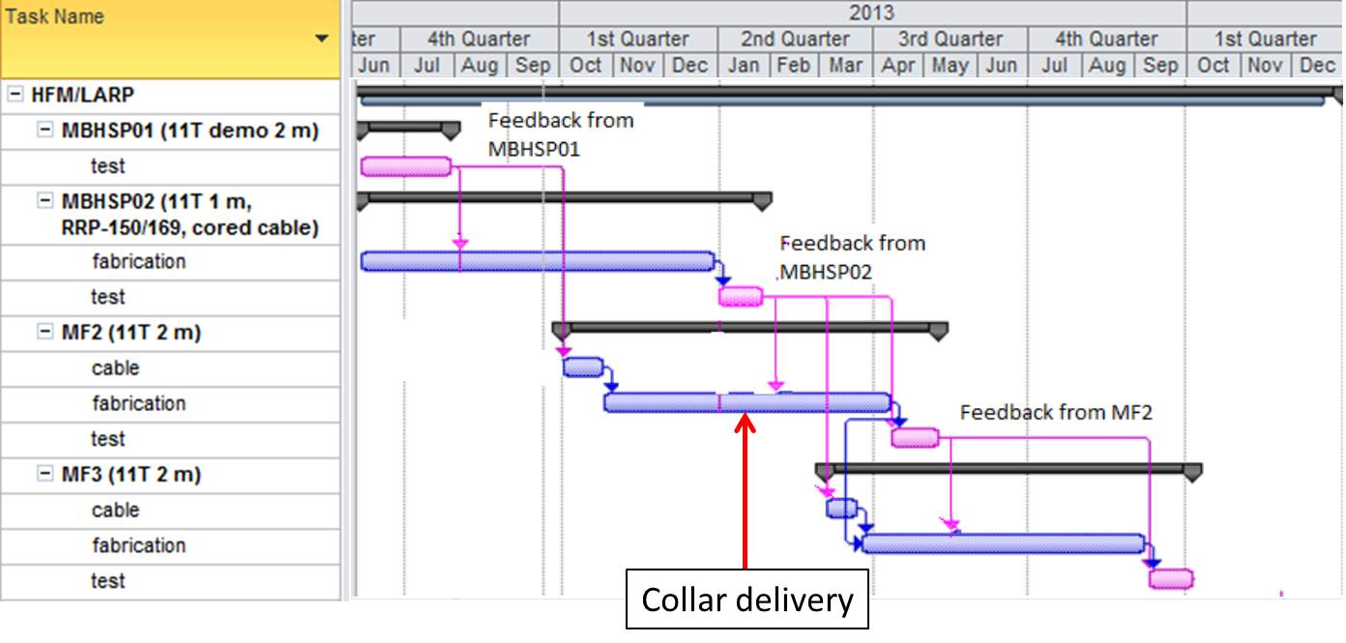
FY2013 Magnet Schedule

