Slide 1


11 T Collaboration Review
26 and 27th September 2012
Cable Insulation, Quench Heater Development,
Coil Fabrication and Mechanical Model
at CERN
D. Smekens

Slide 2
Contributions & Acknowledgements
Many Thanks to our US partners, for sharing their invaluable know-how and helping vastly in the Technology Transfer: A. Zoblin, N. Andreev, R. Bossert, F. Nobrega, M. Wilson, …
For CERN, many thanks to all people involved, in particular:
Coil technology: M. Karppinen, B. Auchmann, L. Favre, C. Fernandes, J. Mazet, G. Maury
Mechanical Model: M. Karppinen, B. Auchmann, G. Kirby, Ch. Kokkinos, J.-C. Perez, Th. Sahner, Ch. Mucher, and all EN/MME members
Polymer Lab TE/MSC: S. Clement, R. Gautier
Characterization of ODS Copper Alloys, Ceramic Wires and Enamels: A. Gerardin, N. J. Mena, S. Sgobba
CATIA Team: Th. Sahner, B. Favrat, L. Favre, Ch. Mucher, J.-M. Scigliutto
Notes:
Remove “and”, first title
Coil Production (add “at CERN”)

Slide 3
Outline
Cable and Insulation
  Cable stability during winding
  Cable insulation: philosophy and insulation scheme
  Cable insulation: preliminary results
  Cable insulation: further developments
Quench Heaters (inter-layer)
  General description
  Trials, preliminary results
  Wire routing through coil end plates
Coil Production
  Coil end design
  Components: end spacers, wedges
  Coil winding: Illustrations & monitoring
  Keystone & misplacement of turns
  Coil production status
Mechanical Model
  Preparation of coil sections
  Preliminary trials
Notes:
Remove “and”, first title
Coil Production (add “at CERN”)

Slide 4
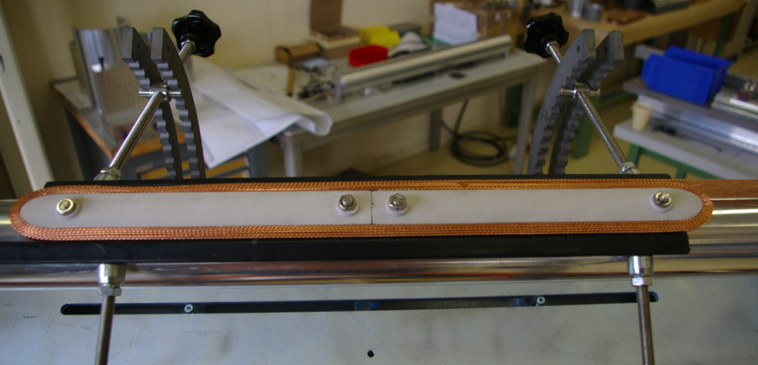
Cable: stability during winding
Copper dummy cable is stable
350 N tensioning force is currently used for winding the inner and outer layer (favorable/unfavorable orientations !)
Tests still to be carried out on real Nb3Sn cable (uncored), and with cable leftovers during coil production (cored)
Wish: standardize the testing method to be able to compare the stability of cables with different parameters (compaction, transposition pitch, keystone angle, ratio hardway and softway bends)

Slide 5
Cable Insulation: Philosophy
The fibre may no longer be a structural reinforcement after reaction but only a mineral filler for the epoxy impregnation
This is true for E-Glass (loosing almost 100% of its mechanical properties)
This is still to be checked for S-Grade fibre glass. S-Glass looses ~75% of its strength after thermal exposure:
  The woven products may exhibit different mechanical properties than single yarns as tested in the litterature
  The thermal desizing (if any) may contribute to further degradation of the mechanical properties
  The ceramic binder may have an impact on the degradation of the fibre mechanical properties (by bonding of the glass filaments)
The absence of structurally strong fibres inside the epoxy matrix may promote fractures inside the insulation
Mitigate by enhancing electrical insulation (mica)
Degraded Mechanical Performance

Slide 6
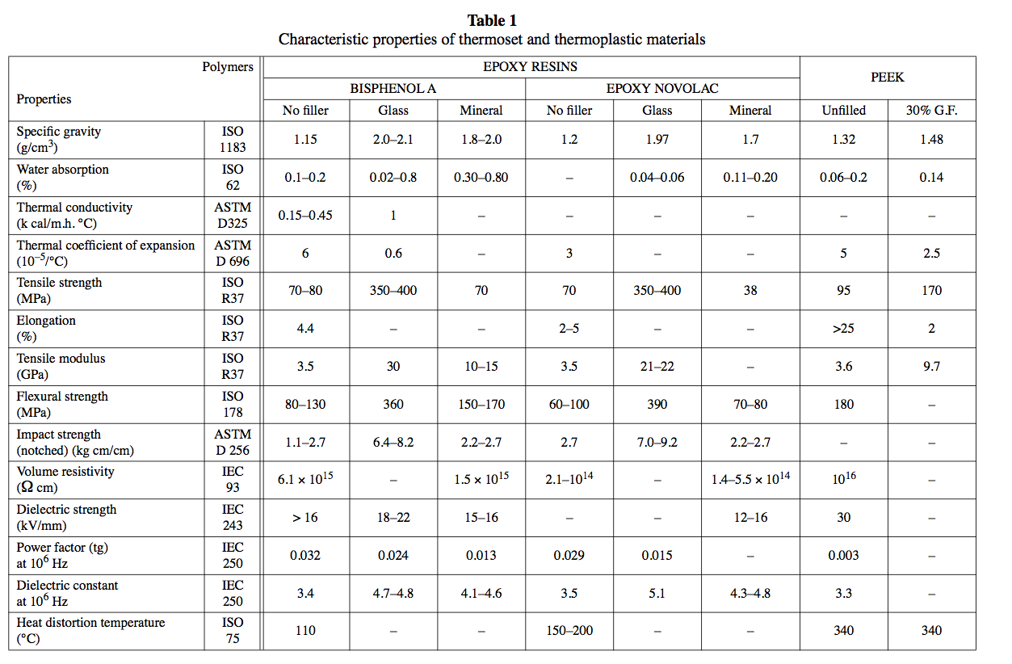
Comparison of mechanical properties between Epoxy with glass fibre reinforcement and Epoxy with mineral filler.

Slide 7
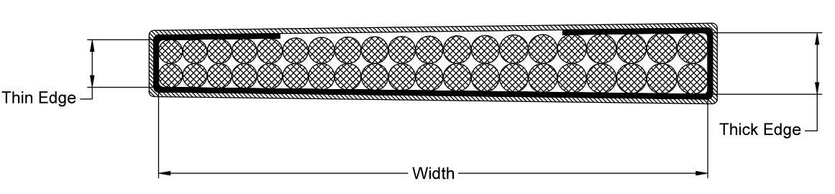
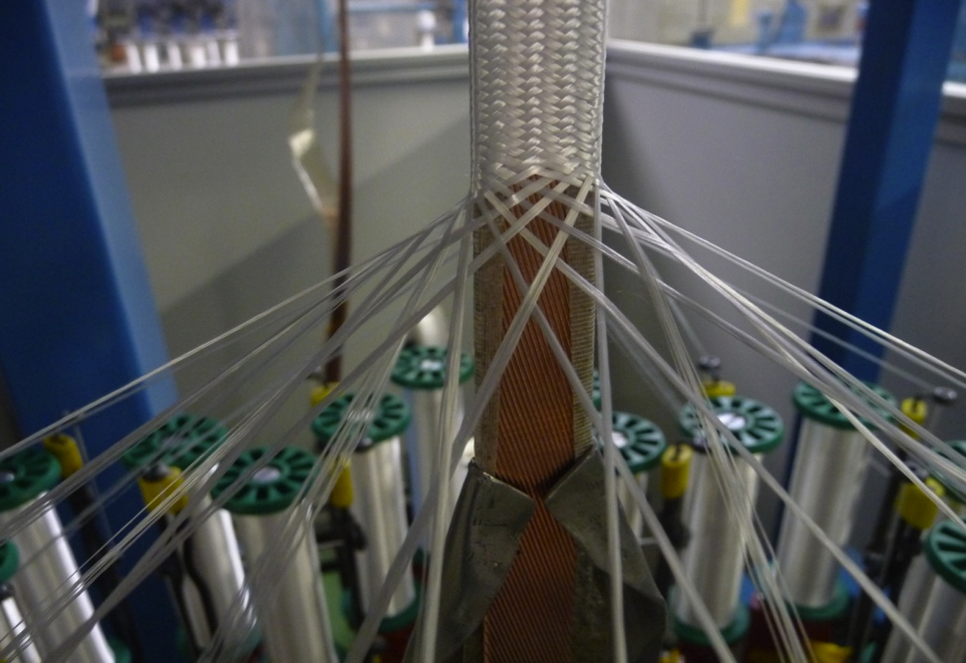
Cable insulation: scheme
Mica insert (COGEBI Firox 80μ : ~25μ phlogopite mica / 65μ E-Glass; + 10% silicone binding agent )
S-Grade glass fibre sleeving braided around the cable (S-2 Glass® from AGY, starch sizing)
C-shape folded Mica tape
S-2 Glass Braided sleeving

Slide 8
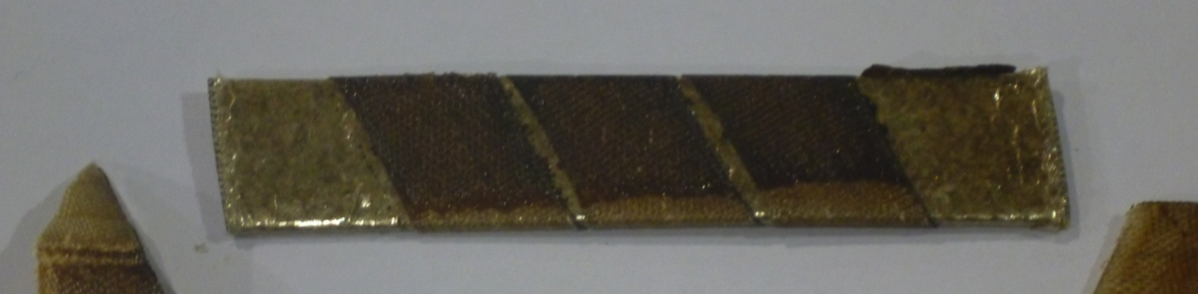
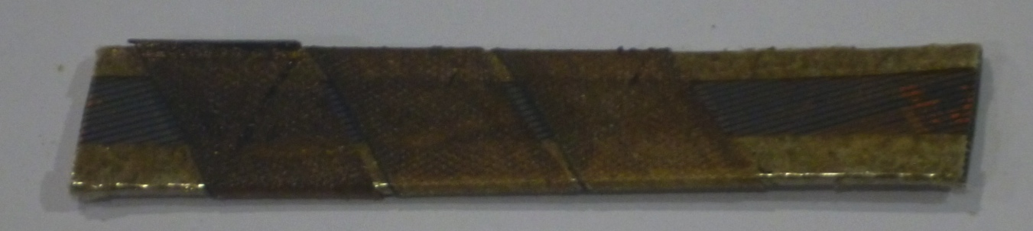
Cable Insulation: preliminary results
Practice Coil #1 : copper dummy cable insulated with 11TEX + Mica;
Practice Coil #2 : 33 TEX ; 100% glass fibre
Coil#2 is less protected during winding (pressure sensitive: create shorts during clamping). More damages to the insulation: the 3x thicker sleeve does not seem to be any stronger than the 11 Tex
Next 2 Coils (Nb3Sn WST Cable) with Glass+ Mica scheme:
  11 TEX (density: 11 grams / kilometer of yarn), S-Grade Glass (AGY 636); 32 spindles braiding
  Mica: C-shape folded protective layer; 80 microns COGEBI Firox
Dummy Copper Cable with mica layer and E-Glass Tape wrapped. Ceramic Matrix impregnated cured and heat treated at 650 celsius under Argon for 6 hours (short cycle).
(J. Mazet)

Slide 9
Cable Insulation: anything further ?
More studies and tests are in progress (outside the 11T Dipole Project, TE/MSC polymer lab)
  Impact of thermal desizing + reaction on S-2 Glass vs reaction cycle only
  Evaluation of thermal stability of 933 AGY chemical sizing + epoxy compatibility (after reaction)
  Evaluation of influence of the ceramic binder (weakening the fibre by bonding the filaments)
  Resizing: palmitic acid resizing station under assembly at CERN (for insulation of other LARP magnet projects, by tape wrapping).
As part of the 11T Dipole Project
  Desizing methods (on yarns before braiding): amylaze, thermal. (study in standby. Aim: to minimize carbon residuals after reaction)
  Looking for alternative fibres (plagioclase and/or pyroxene based fibres. Aim: as mechanically strong as S-Glass, more heat resistant, producers offering to participate in the R&D)

Slide 10
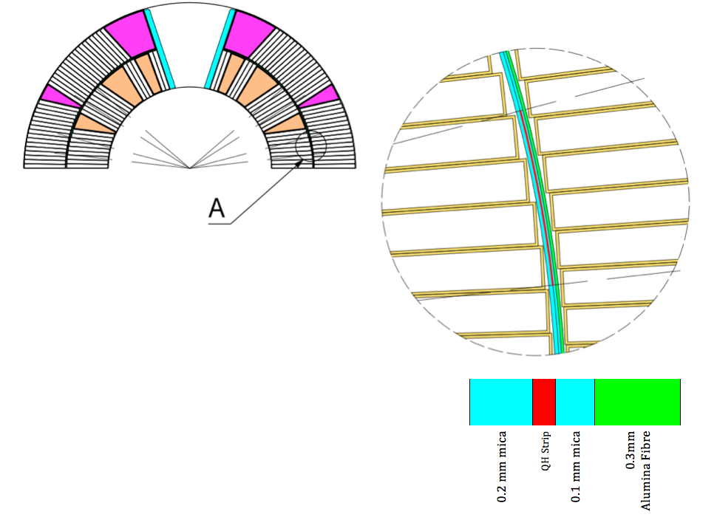
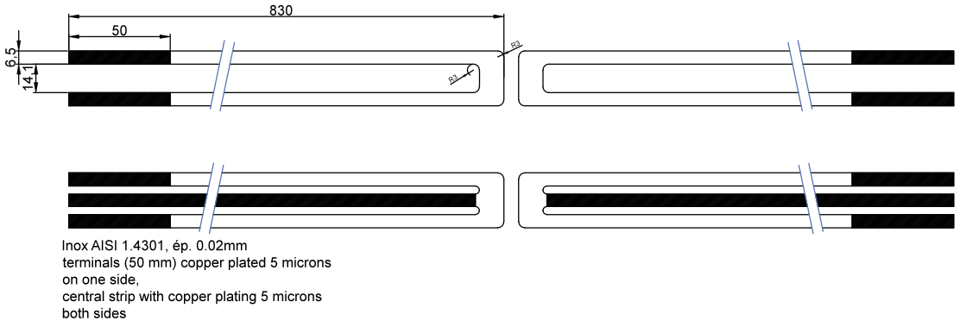
Quench Heater Development
Max. Characteristics (approx.)
R_{QH}=~ 5 Ω ; R// = ~3.1 Ω
U= 200V ; I₀= 66 A
RC = 22 ms (C=7.05 mF)
Temp rise= 250K (adiabatic)
Wo = 130 W/cm²
2 prototypes currently under development: single U shaped heater (on top); 2-zone parallel heater (bottom)

Slide 11
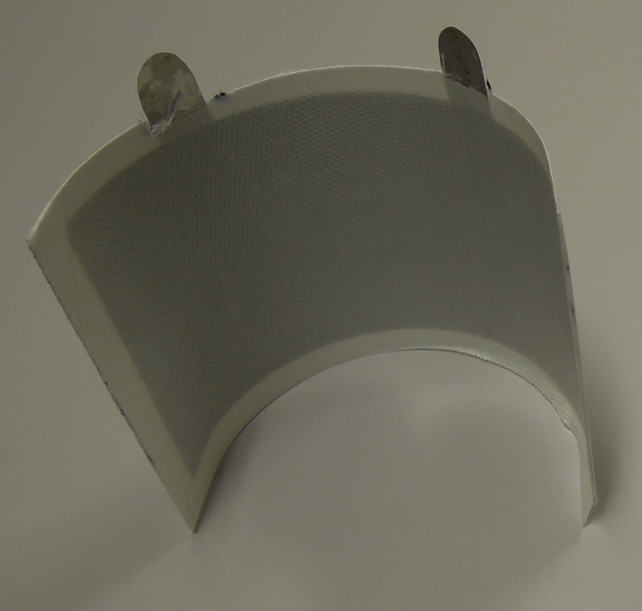
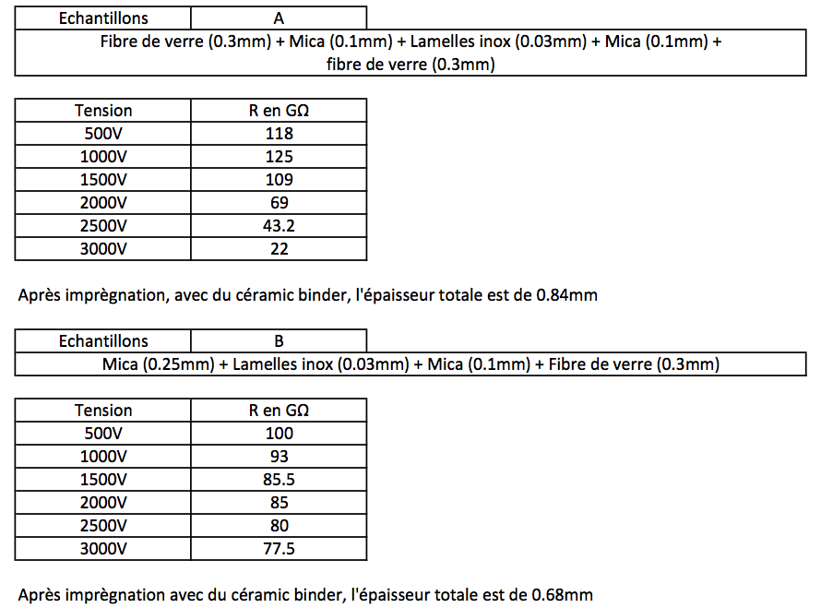
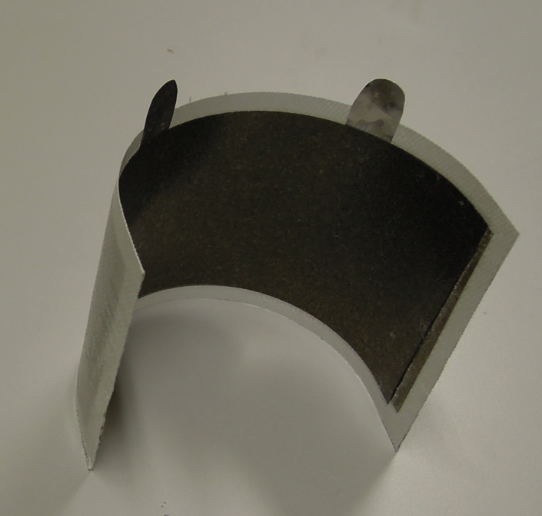
Quench Heater Development
Samples to assess bonding and insulation (G Maury)

Slide 12
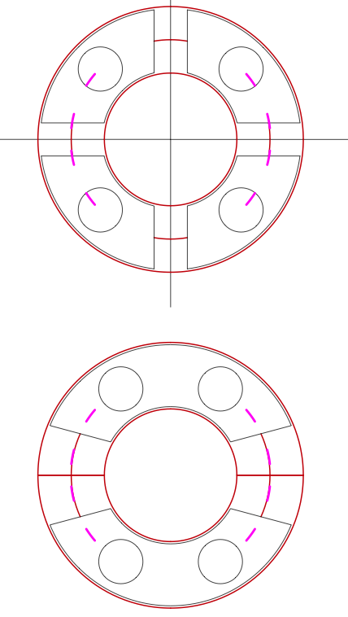
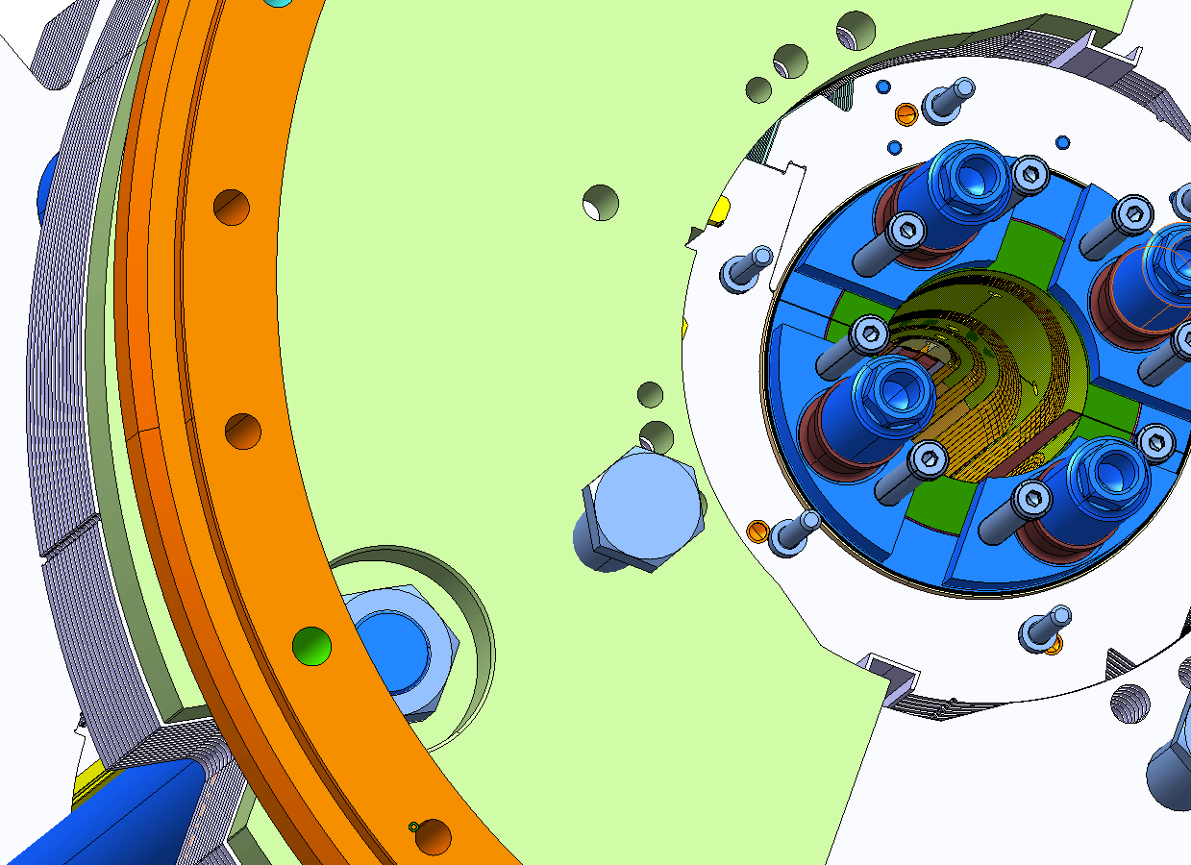
Quench Heaters: Wire Routing
Inter_Layer QH terminals are in interference with the loading area used by the bullet gages of the coil endplates (schematic on top). Re-design of this area might be required (proposed option, schematic on bottom)

Slide 13
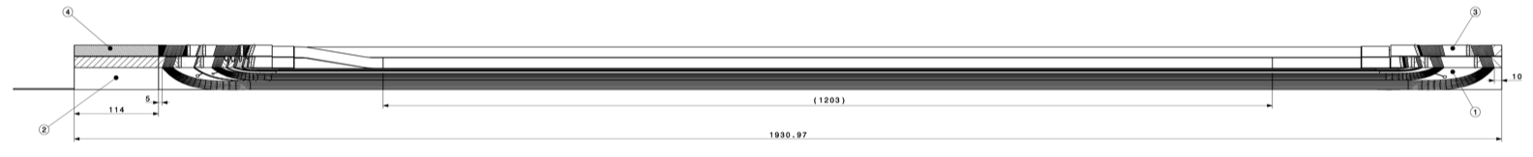
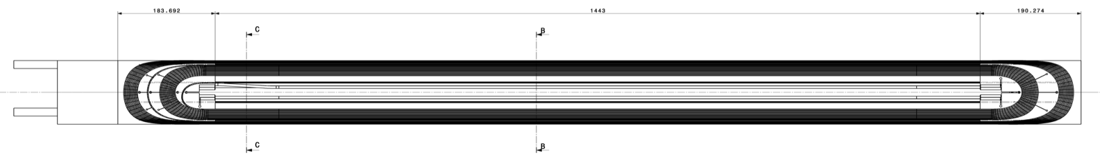
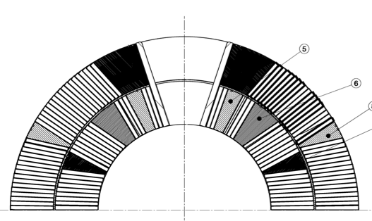
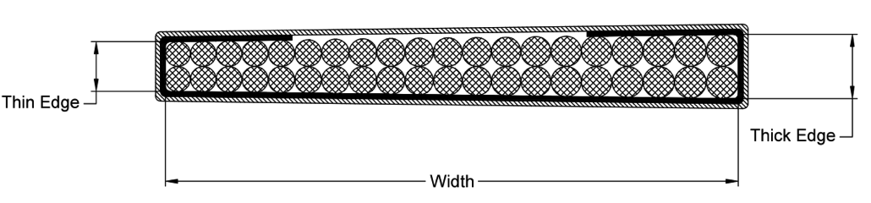
Coil Fabrication at CERN
Notes:
Picture of coil winding, similar cross section, pole loading concept. Main differences for tooling and coils(wedge 5-6, loading plate, keys and layer jump, collars and pole wedges)
X mm long coil, x turns,

Slide 14
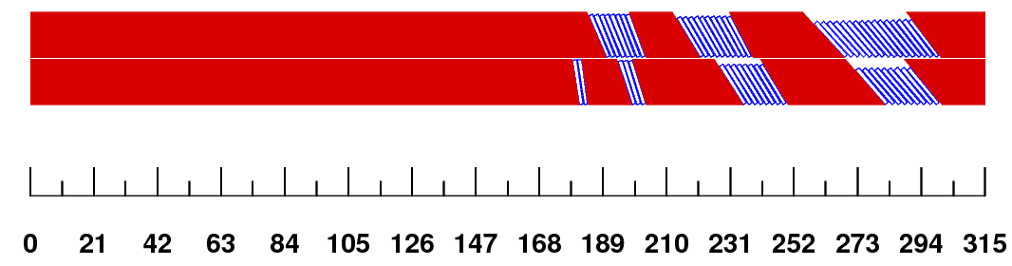
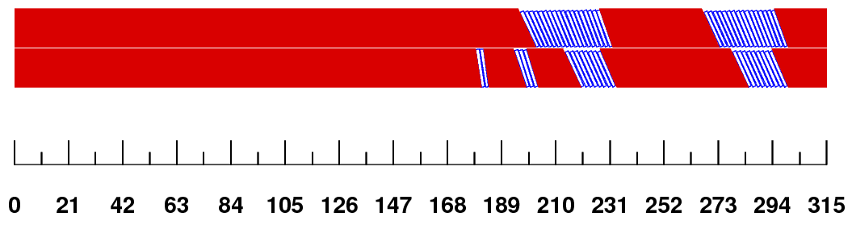
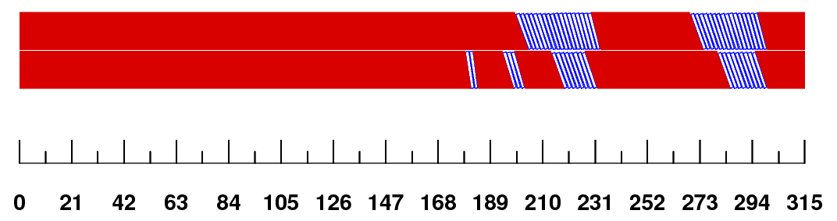
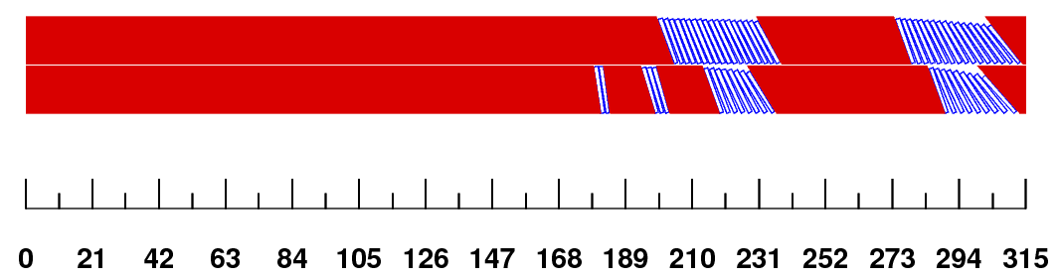
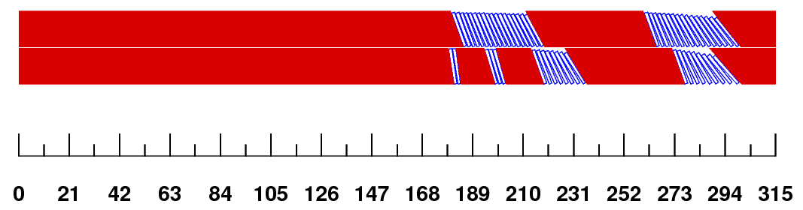
Coil End Design
Initial Design Approach
Min. hardway bend
(practice coils)
More upright cables to minimize the gaps
(practice coils)
Reduced torsion,
incr. hardway
(FNAL MBH coils, CERN practice coil 01)
REX from FNAL MBH coils
“As built” (ver.3)
(CERN Practice coil #2 HCMBHSP003_002)
After reoptimization of block position for field quality (future CERN Coil HCMBHSP003_003)
Layer jump moves to keep overall length
(B. Auchmann)
Notes:
Mention re-opt. of coil ends ←→ Rework of coil assembly to keep overall coil length unchanged
Coil production: 1 practice coil CERN v0 ; 1 practice coil CERNv3 (beta version)
Next coils: Nb3Sn CERNv3 with flex-hinge spacers (possibly enameled)

Slide 15
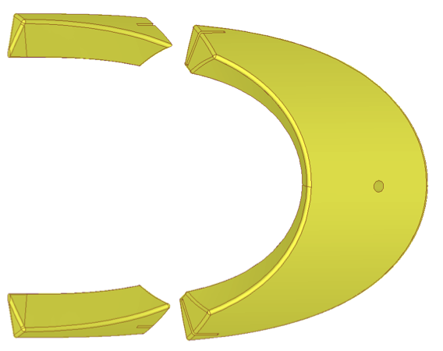
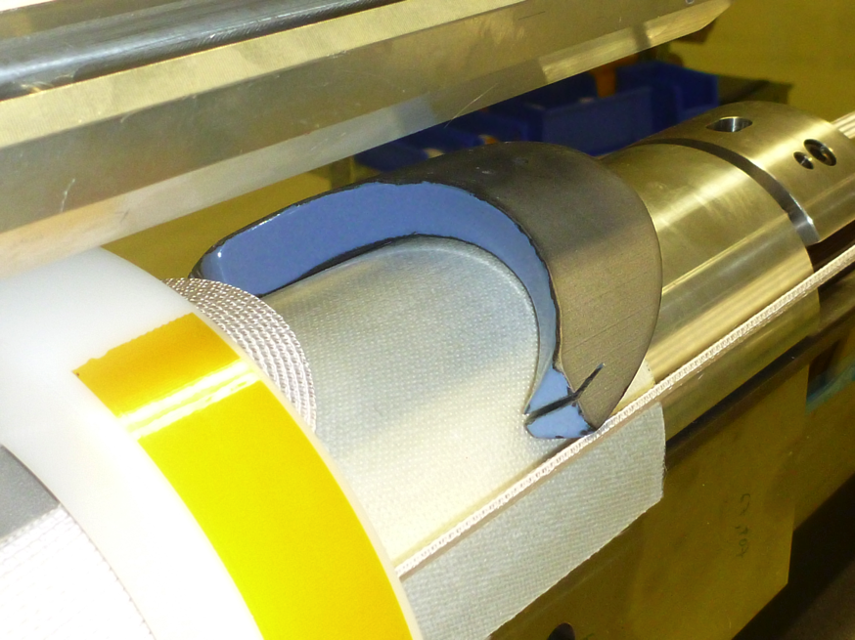
Metallic Coil End Spacers
Technology:
  5-axis machining 10 … 15keuros/set. Several months delays
  Laser sintering 6 keuros/set. 2-3 weeks delays
Issues:
  Very rigid spacers
  Require “heavy”rework (grinding, cutting off extremities to fit the “loose” turns during winding
  Damage electrical insulation
Mitigation: different possibilities currently under investigations. Objective: to prevent shorts and/or heavy grinding of the spacers by the operator to ease the insertion during coil winding.
  Solution 1 (J. Mazet): Flex-hinge (“springy legs”) ; easily achieveable by Laser sintering.
  Solution 2 (J. Mazet): Glass based enamel (traditional French cooking hardware): 10 kV/mm insulation, 850 Celsius OK
Flex-hinge
All rounded edges

Slide 16
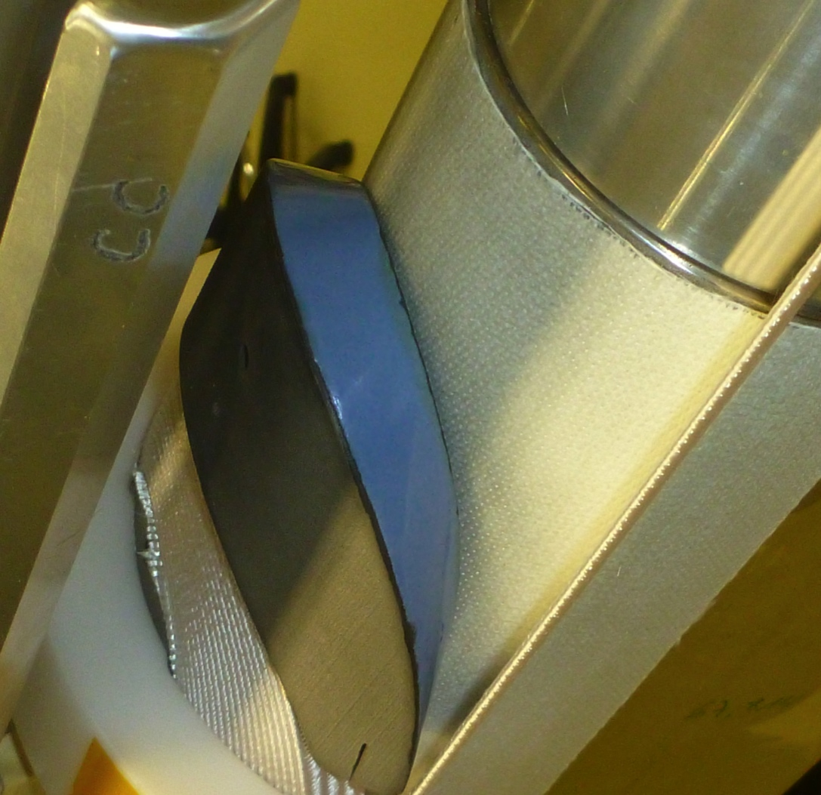
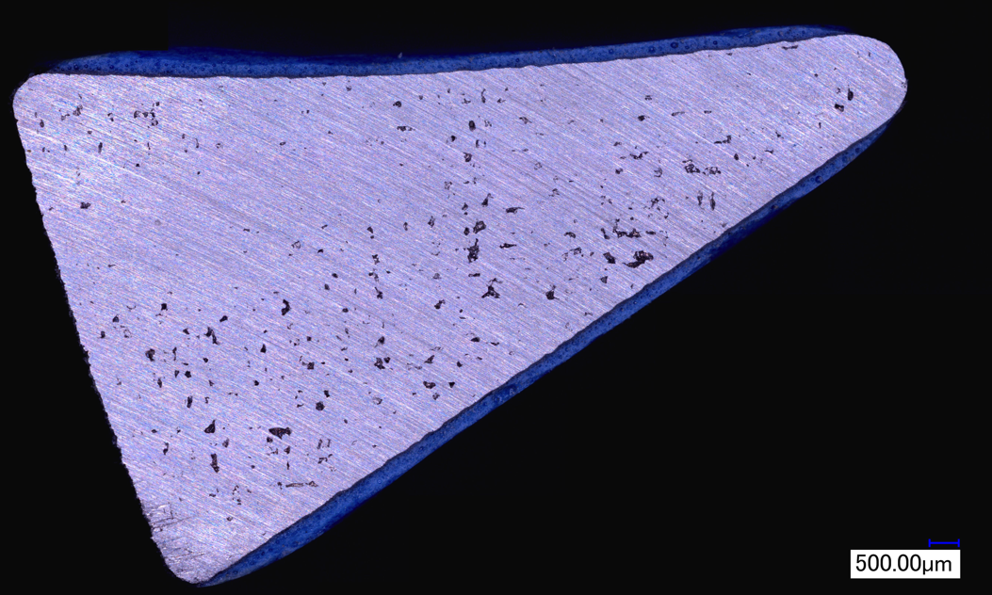
Metallic Coil End Spacers
Traditional French cooking hardware: 10 kV/mm, 0.3 mm thick, -200…+850°C OK
The coating (in blue) is an industrial grade of glass-based enamel, temperature resistant electrical insulator. It is currently used on UHV vacuum flanges as electric insulators between adjacent vacuum sectors.
(J. Mazet)
Notes:
Retirer photo de gauche et remplacer par coupe metallo.

Slide 17
Wedges – ODS Copper (UNS C15715)
Objective: replace 316L SS machined wedges by cold drawn profiles made of ODS copper alloy (Oxide Dispersion Strengthened)
  Copper based alloy, closer to coil material behavior. Thermo contraction at 4.2K: 3.07mm/m
  Better temperature resistance than any other bronze (incl. CuBe and CuZr)
  Cold drawn smooth profiles with rounded corners
  Possibly better heat conduction and enthalpy ? (elec. conductivity: 91 % IACS)
  In development at Luvata (FI) and ECKA (D)since 2011. First pre-series batch due this month.
Yield strength and Hardness (HV) vs. annealing temperature
Characterization carried out by EN/MME, S. Sgobba, N. Jimenez
For more information, refer to EDMS Doc. 1216580

Slide 18
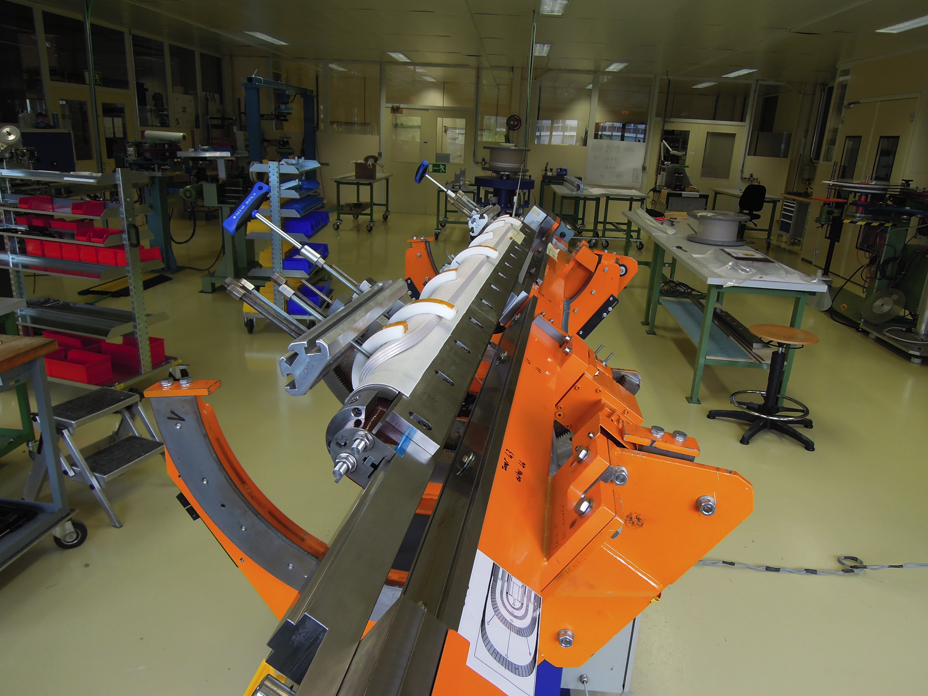

Slide 19
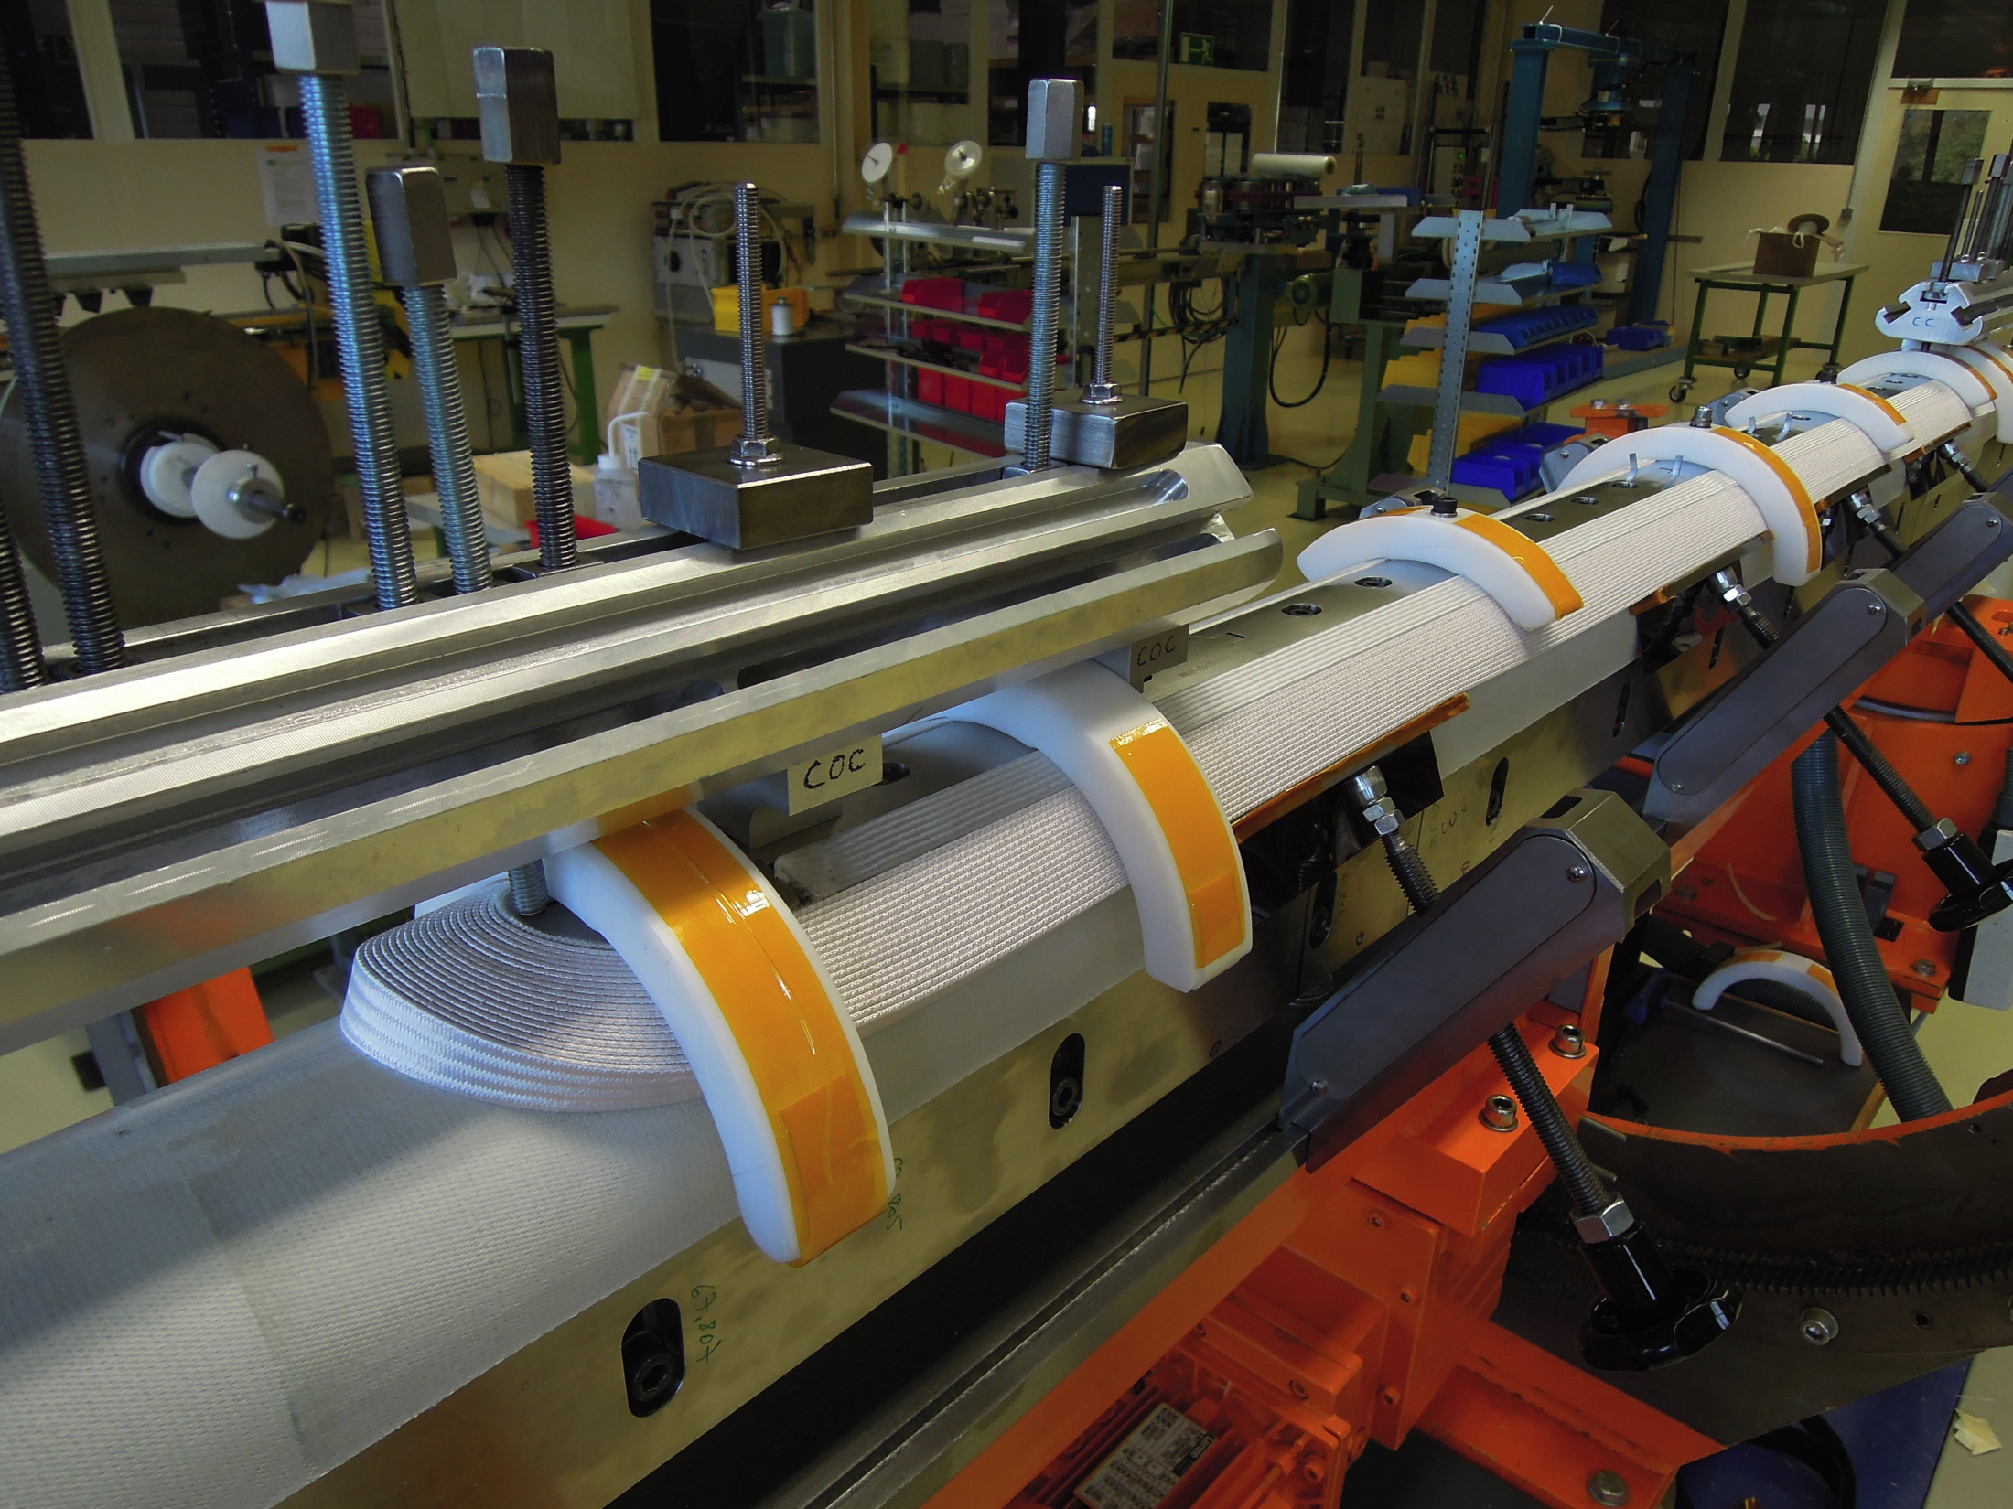

Slide 20
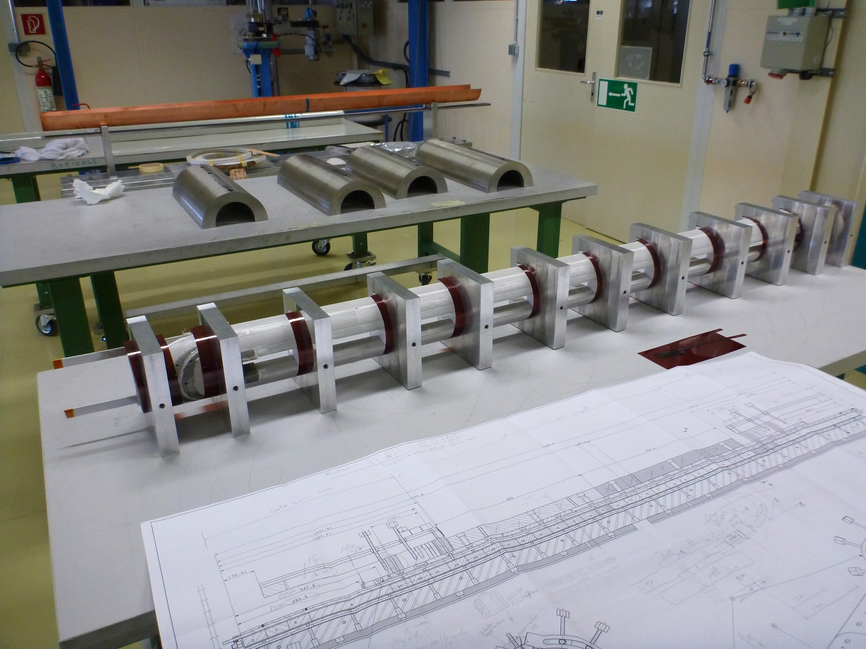

Slide 21
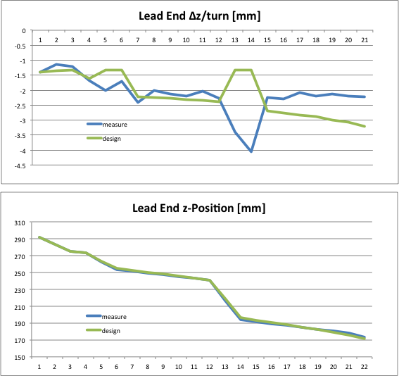
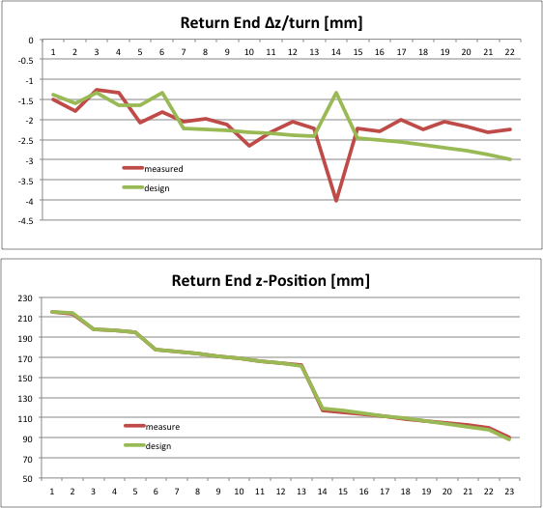
Coil Winding: monitoring length
Practice Coil #2 (HCMBHST003_0002)
Operators record the position of each turn and monitor the “growth”of the coil (green curve: nominal dimension). Operators can compact or loosen slightly the turns in order to reach the nominal length of the coil

Slide 22
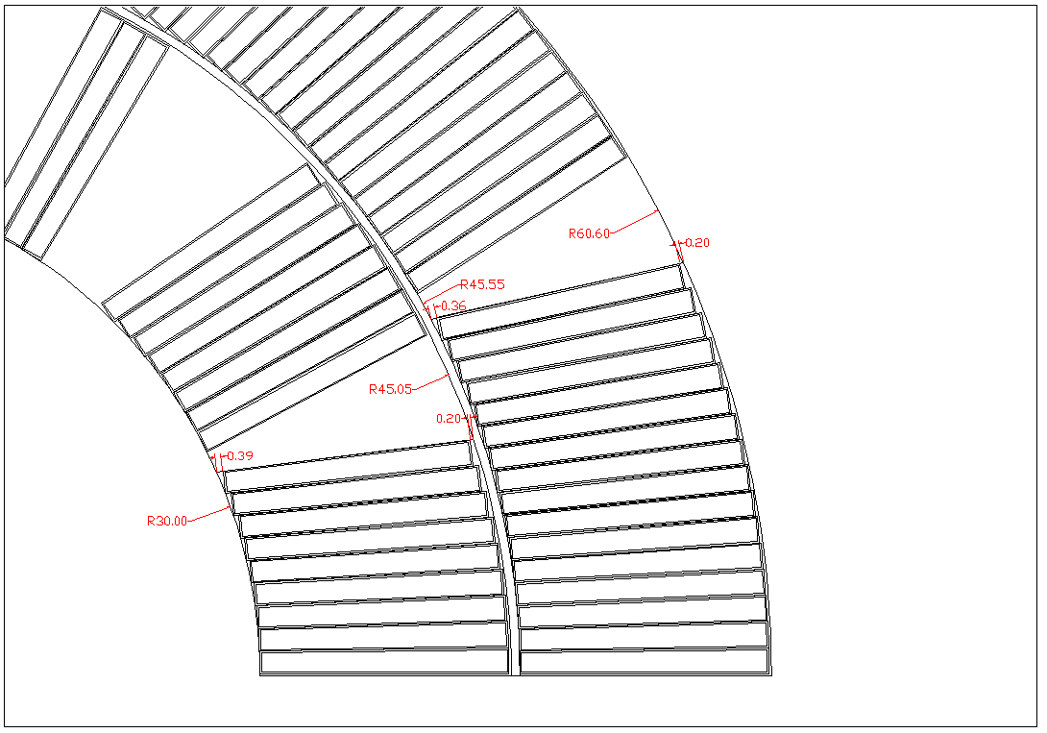
Coil Winding: keystone too flat ?
(unreacted cable)

Slide 23
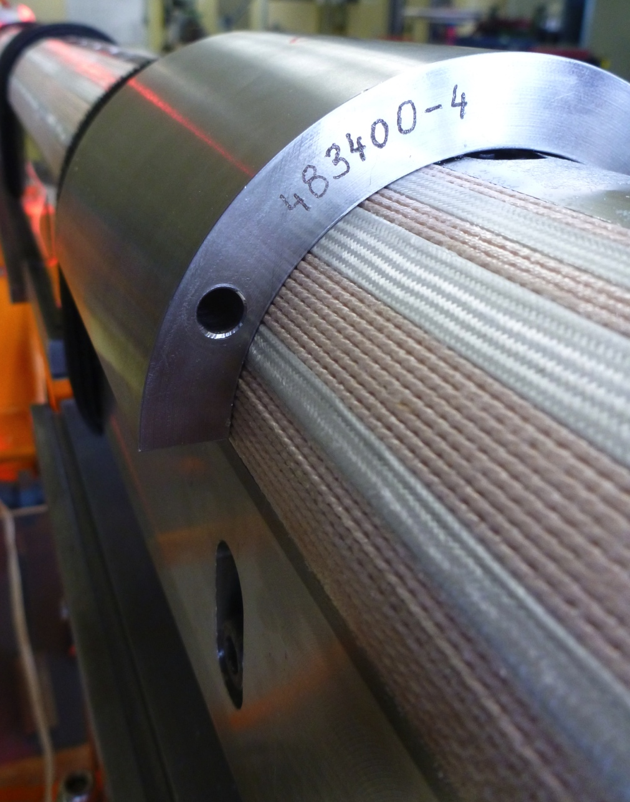
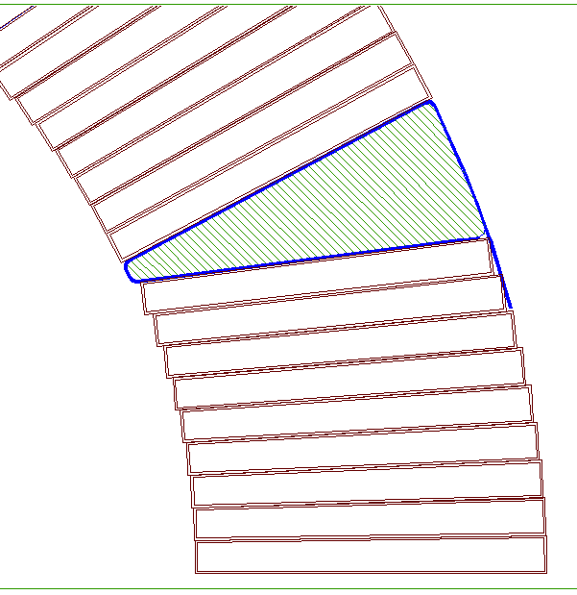
Coil Winding: keystone too flat ?
Turns next to the wedge are free to move during the curing preparation (placement of shells and compression in the press).

Slide 24
Coil Production: Status
Winding: in operation
Curing: in operation
Reaction Tool: in operation
Reaction Furnace: in 1 month time at CERN, running. 3 coils should then be awaiting for reaction (2 practice coils + 1 Nb3Sn with WST cable)
Impregnation Tool: completed at manufacturer. Being checked, acceptance in a couple of weeks.
Impregnation Equipment: November 2012 (?)
Metrology of Coils: Still to be clarified how to carry out dimensional inspection
Schedule: Just in Time. if points 4 to 7 are quickly solved

Slide 25
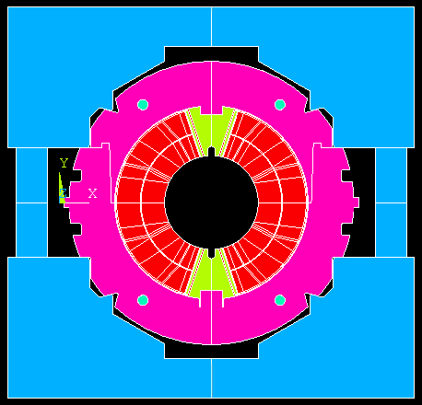
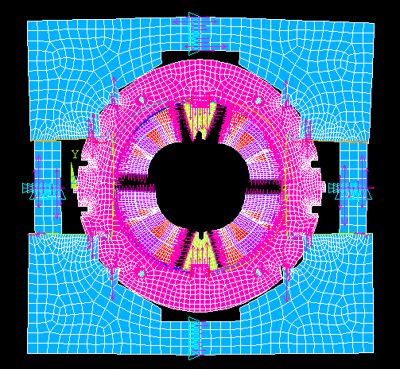
Mechanical Model
Short Mechanical Model
Collaring Simulation (collaring tool + mechanical model)
B. Auchmann

Slide 26
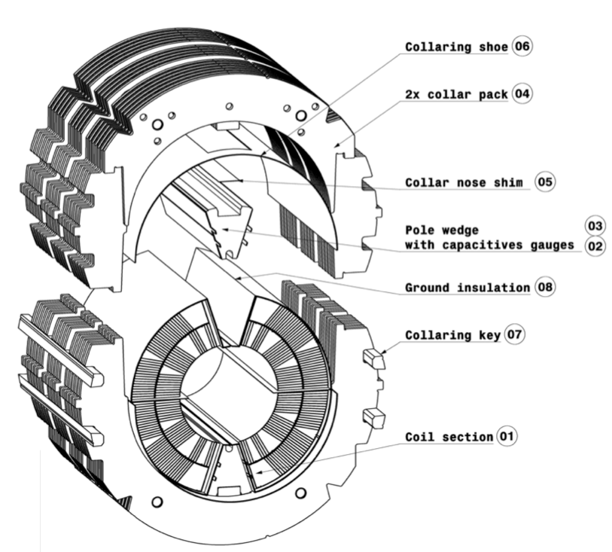
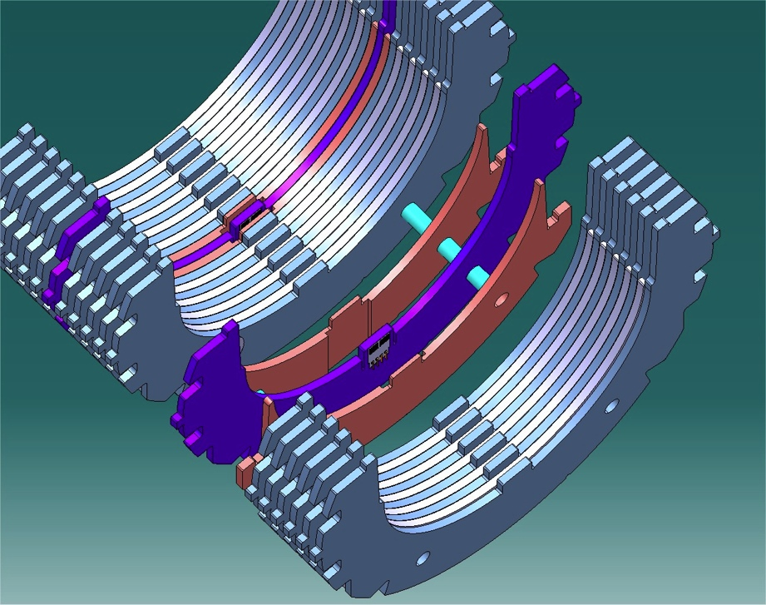
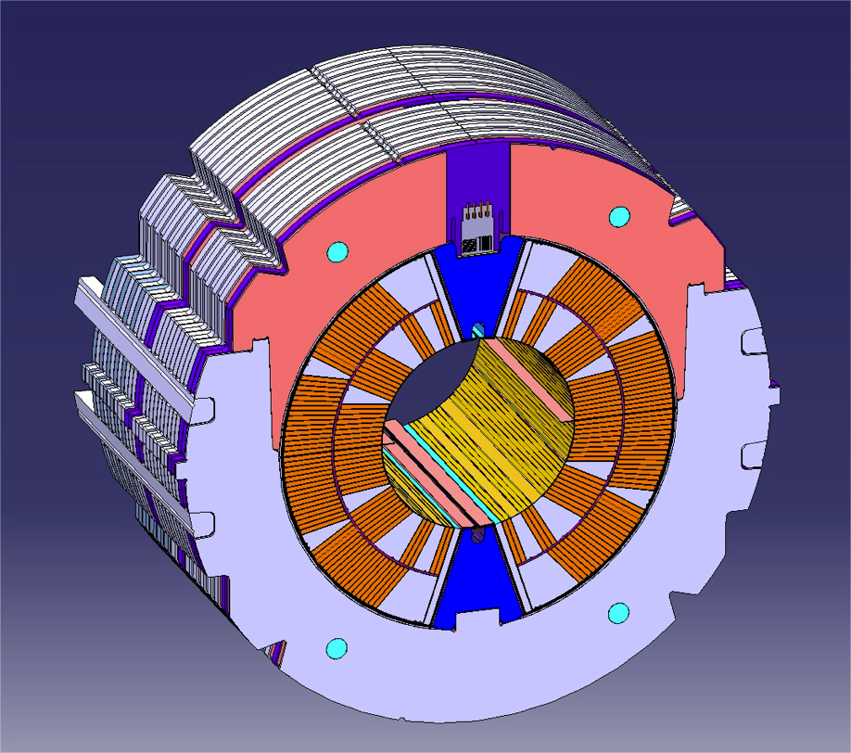
Short Mechanical Model
Pole Loading Concept
L: 120 mm
4 instrumented collars (8 gauges)
8 capacitive gauges to measure the azimuthal compression on the inner and outer layers of the coils

Slide 27
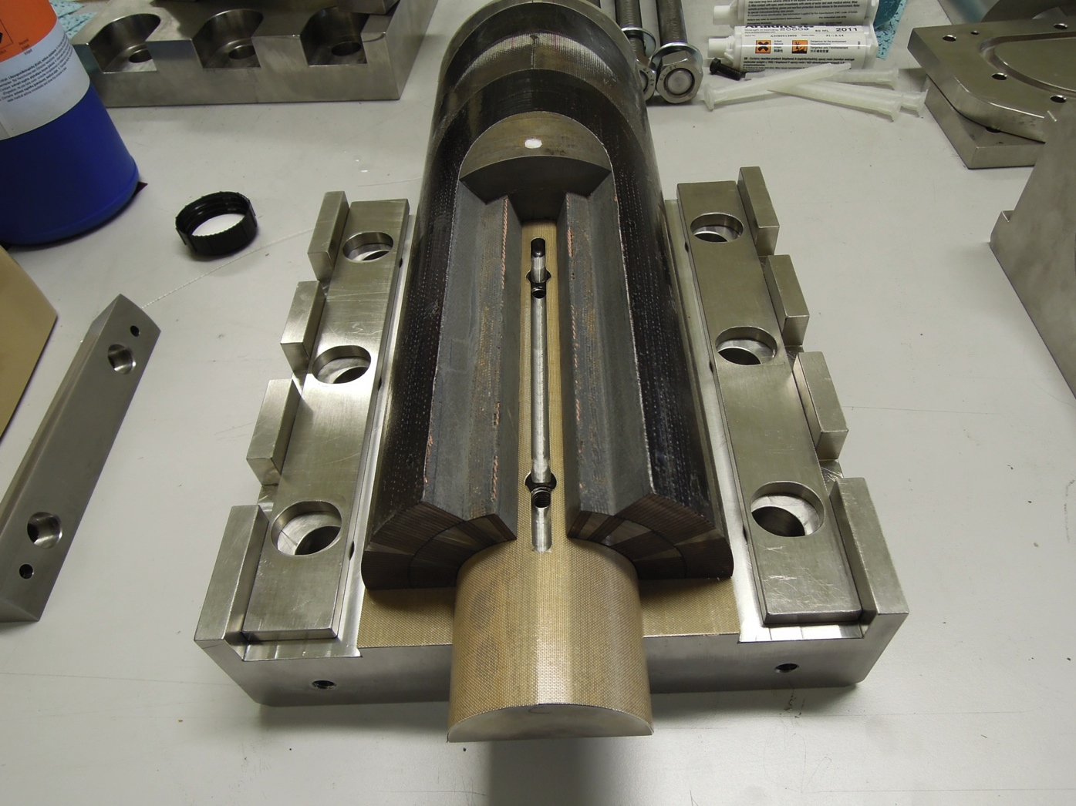
Preparing FNAL PC01 for pole loading
Extremity from practice coil (Nb3Sn) ; Integrated poles removed

Slide 28
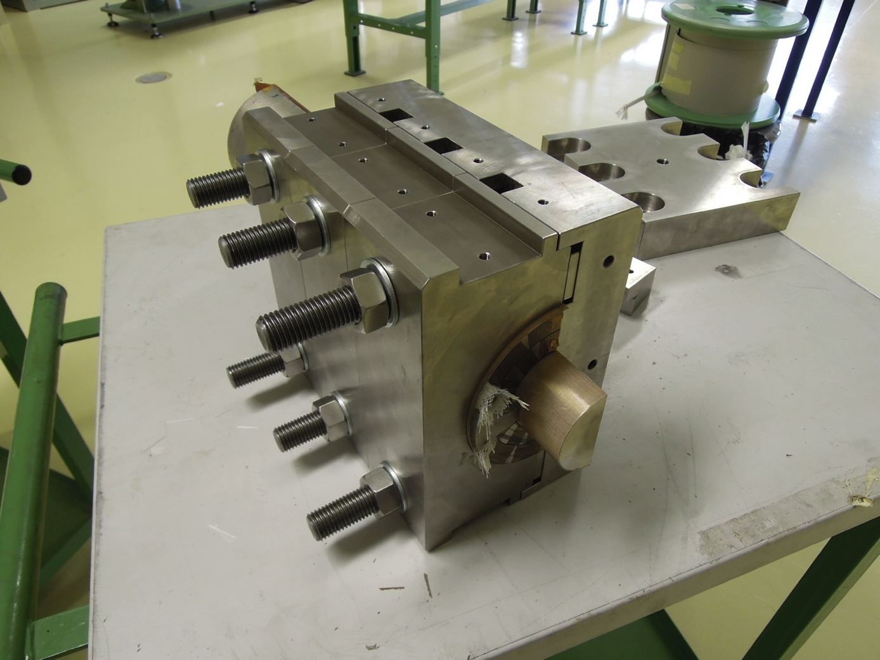
Preparing FNAL PC01 for pole loading
Extremity from practice coil (Nb3Sn) ; filler wedges and loading plate assembled; mold closed.

Slide 29
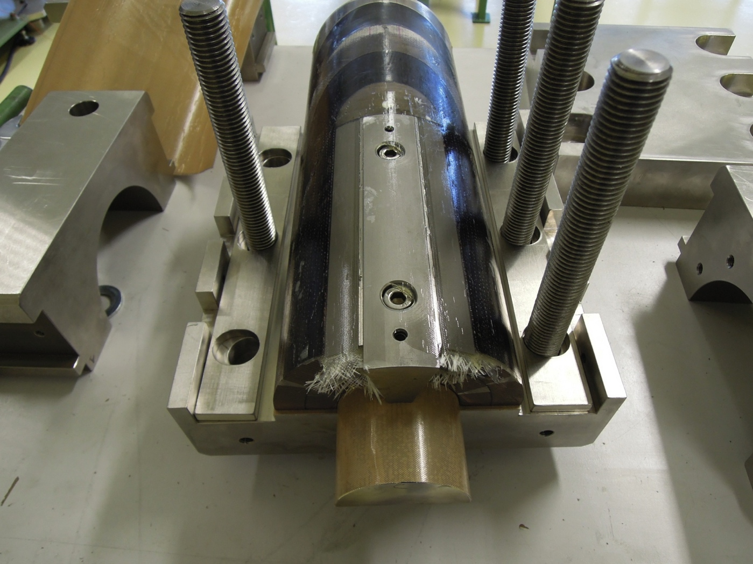
Preparing FNAL PC01 for pole loading
Extremity from practice coil (Nb3Sn) ; After molding

Slide 30
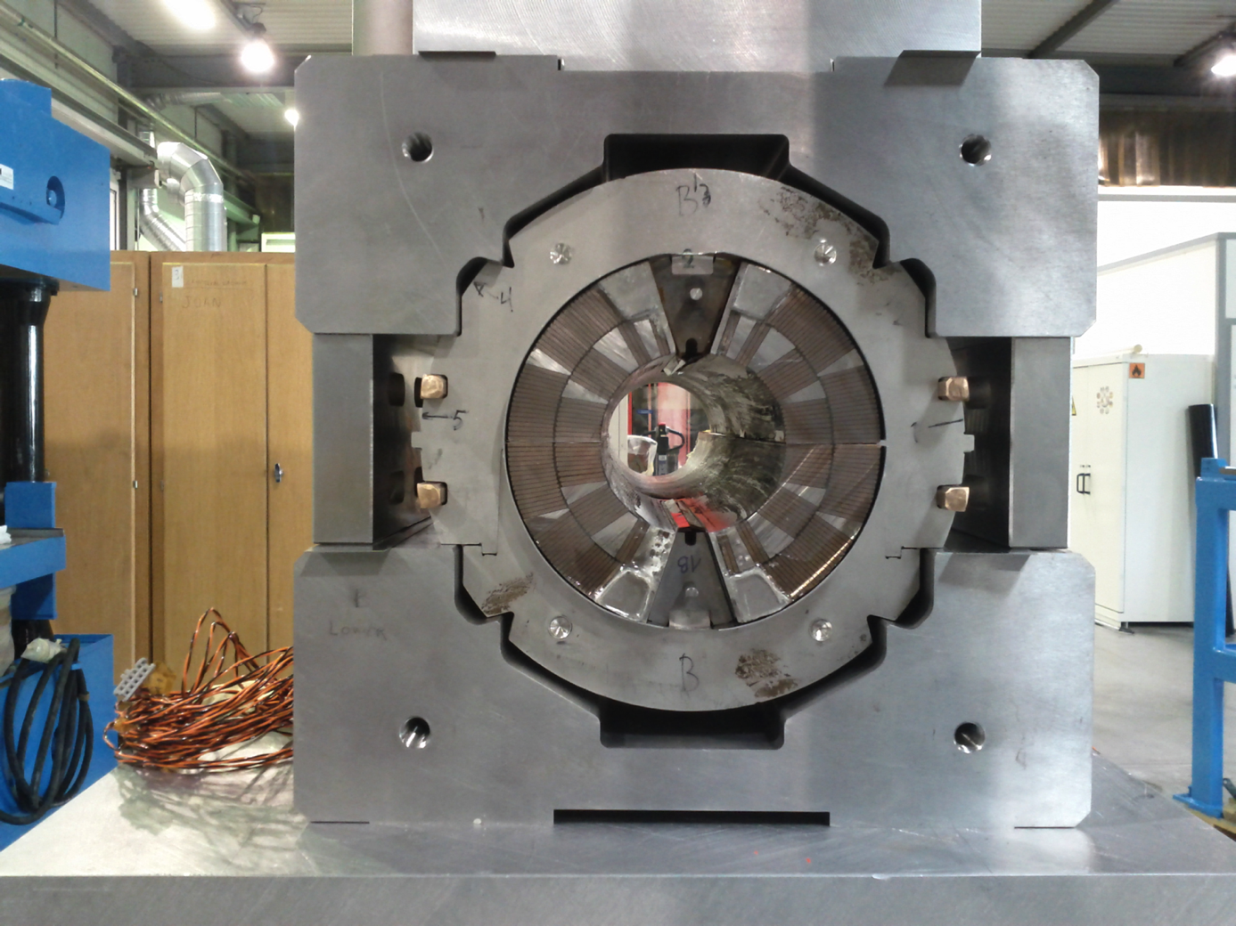
First Trials
First Dry Run Assembly of the short mechanical model

Slide 31
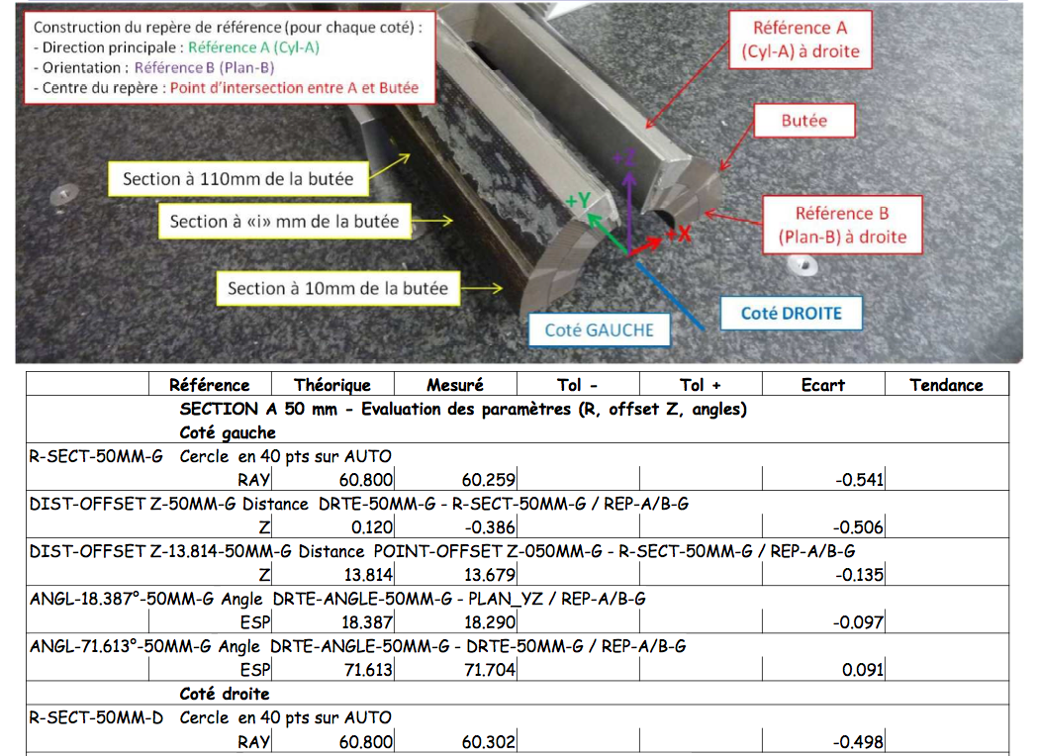

Slide 32
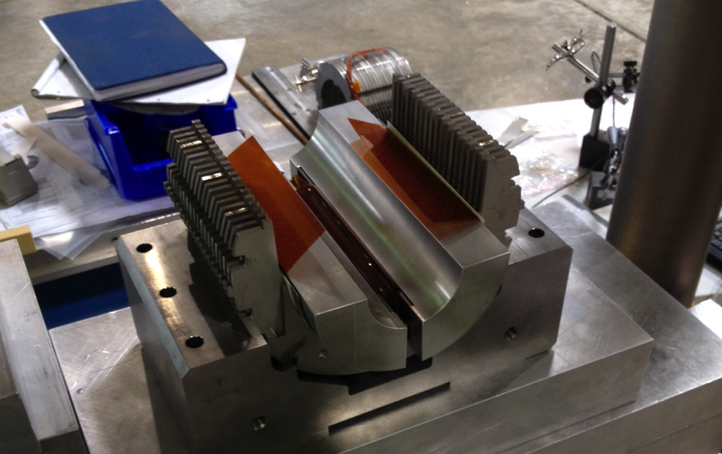
Next Steps
“Calibrate” the collaring by means of a dummy coil, real coils and Fuji paper, to reproduce the same contact areas as with dummy coil, by individual shimming of each coil branch to take into account the assymetry of the coils.
The new shimming scheme should give measurements close to the Ansys model
Check the response of the gauges
Using dummy coils in half mech. model to assess the determine the contact regions as well as the response of the gauges

Slide 33
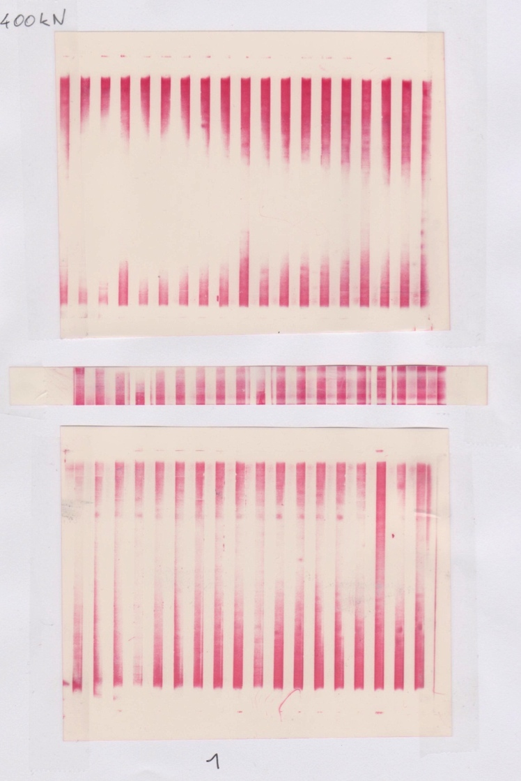
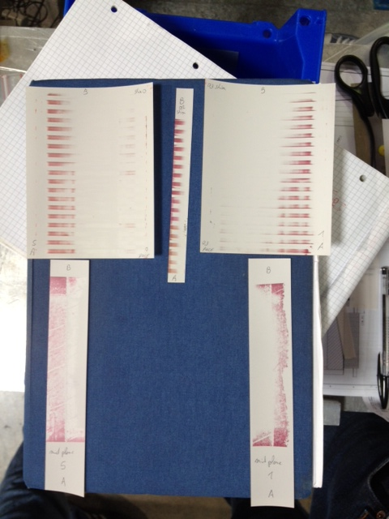
Results with Fuji Paper HS. On left with dummy aluminum coils ; on right with real coil sections

Slide 34
Summary
Coil Production:
  Coil Production has started
  First copper coils give confidence for the next step
  Winding the first Nb3SN coils in October,
  Validation of the reaction tooling and furnace as started (without coil so far)
  Still working on improving the insulation of the different coil parts (cable, wedges, spacers)
Good indication that the pole loading concept works
Collaring trials have allowed to detect minor issues that are being corrected for the 1st aperture:
  the vertical stroke was voluntarily limited by the collar design (currently 0.1 mm over the collaring position). This is too restrictive; collars will be adapted to allow for 0.25 mm
  The collaring shoe design will be modified. At present, if misplaced, the shoe can interfere with the poles.
  Discrepancies between signals from strain gauges and from capacitive gauges. Partially due to the strong assymetry of our coil sections. The present data does not allow to validate the Ansys model.
Just in time to meet CERN milestones of 4 practice coils for January 2013 and 4 coils for aperture 1 & 2 for July 2013

