Slide 1
CERN strand and cable R&D, strand procurement, and cable fabrication for the 11 T dipole
Luc Oberli
Outline:
Strand R&D and strand procurement and inventory.
Main parameters of the cable without a core.
Results obtained during the cable development without a core.
Results of the fabrication of dummy cables with a core.
Future cable development work.

Slide 2
Strand R&D and strand procurement
PIT strands have not been used for cable development but will be used soon.
PIT 114 with Ta doping under fabrication by Bruker and should be delivered in October 2012 (sub-element diameter = 45 μm).
RRP strands have been used for the cable development and for the fabrication of the first cables for the demonstrator.
2 type of strands were used : RRP 54/61 and RRP 108/127
RRP 108/127 with Ta doping is characterized by sub-element diameter of 45 μm and by a Jc(12T, 4.2K) = 2800 A/mm² for the heat treatment 48h/210C + 48h/400C + 50h/665C.
RRP 132/169 with Ti doping under fabrication by OST (d = 42 μm)
RRP 180/217 with Ti doping under development by OST (d = 36 μm)

Slide 3
Inventory of the strand for the demonstrator and the prototype
Quantity | Strand type | Availability | Target use
23 km | RRP 108/127 | In stock | 2 UL for the aperture 1 of the first 2 in 1 demonstrator Q1-13
10 km | RRP 108/127 | To be delivered by Fermi Lab | 1 UL for a spare coil for the first 2 in 1 demonstrator Q1-13
45 km | ~ 30 km of RRP 132/169 | November 2012 | 3 UL for the aperture 1 of the second 2 in 1 demonstrator
 | ~ 15 km of RRP 180/217 | February 2013 | 1 UL for a spare coil
45 km | 20 km of PIT114 | October 2012 | 2 UL for the aperture 2 of the first 2 in 1 demonstrator Q2-13
 | 20 km of PIT114 | November 2012 | 2 UL for the aperture 2 of the second 2 in 1 demonstrator
150 km | ~ 50 km of RRP 132/169 | Expected November 2013 | 2 UL for the CERN 5.5 m prototype
 | ~ 50 km of RRP 132/169 | Expected February 2014 | 2 UL for the CERN 5.5 m prototype
 | ~ 50 km of RRP 132/169 | Expected May 2014 | 2 UL for the CERN 5.5 m prototype
150 km | ~ 50 km of PIT 114 | Expected September 2013 | 2 UL for the CERN 5.5 m prototype
 | ~ 50 km of PIT 114 | Expected December 2013 | 2 UL for the CERN 5.5 m prototype
 | ~ 50 km of PIT 114 | Expected March 2014 | 2 UL for the CERN 5.5 m prototype

Slide 4
Main parameters of the cable without a core
Width | 14.7 mm | 14.7 mm
Number of strands | 40 | 40
Mid-thickness | 1.269 mm | 1.250 mm
Thin edge | 1.168 mm | 1.149 mm
Thick edge | 1.370 mm | 1.351 mm
Keystone angle | 0.79º | 0.79º
t/2d thin edge | 83.4 % | 82.5 %
t/2d thick edge | 97.8 % | 96.5 %
Compaction factor | 86 % | 87.3 %
Transposition pitch | 100 mm | 100 mm

Slide 5
Overview of the cable development work at CERN
3 types of cable without a core were fabricated to optimize the cable parameters for the 11 T dipole.
A 14.7 mmm wide cable with a mid-thickness of 1.269 mm and a keystone angle of 0.71º. (run 57) short piece of ~ 15 m
A 14.7 mm wide cable with a mid-thickness of 1.254 mm and a keystone angle of 0.75º. (run 62) unit length of 230 m
A 14.7 mm wide cable with a mid-thickness of 1.26 mm and a keystone angle of 0.58º. (run 66) short piece of ~ 15 m
3 types of cable with a 12 mm wide 316L core (25 μm thick) were fabricated for the winding of the first practice coils at CERN for the demonstrator
2 unit length of 230 m with hard Cu strand (keystone angle 0.79º)
130 m with hard Cu strand, 1/2 with a core of 11 mm and 1/2 with a core of 12 mm
2 unit length of 235 m with bronze strand produced for ITER by WST (keystone angle 0.74º) (run 73)
1 unit length of 230 m with RRP 54/61 (keystone angle 0.77º) (run 75)

Slide 6
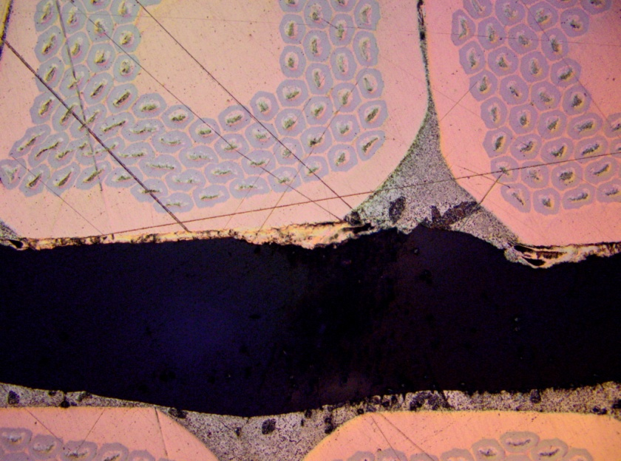
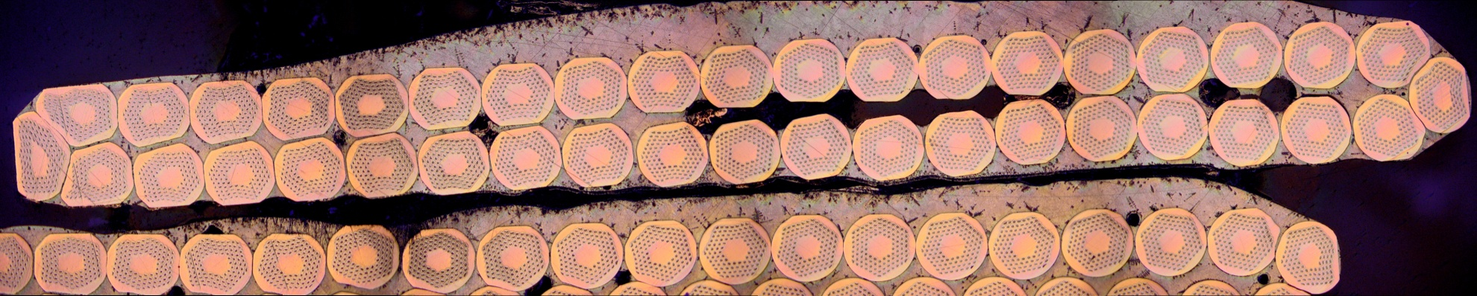
First trial fabrication of the 14.7 mm wide cable (Run 57B)
Cable fabricated without a core
Cable mid-thickness 1.269 mm
Keystone angle 0.71º
Average Ic degradation is - 2.6 %
(result obtained on 6 extracted strands)
- 6 %, - 2 %, - 0.8 %, - 5.6 %, - 1.3 %, + 0.1 %

Slide 7
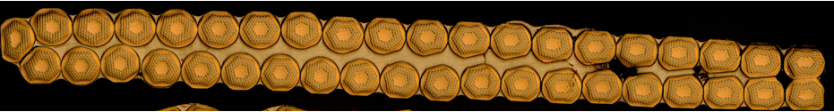
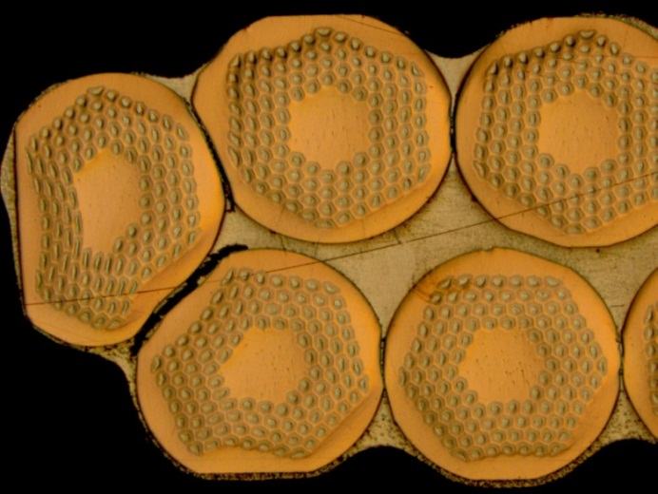
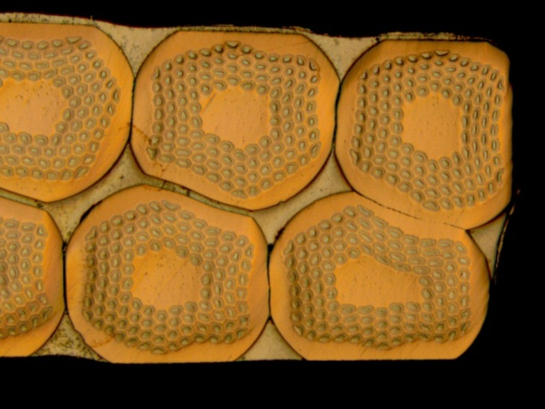
Fabrication of the 1st long cable (Run 62B) for the demonstrator built at Fermilab
Average Ic degradation is - 2.1 %
(result obtained on 4 extracted strands)
for the HT 48h/210C, 48h/400C, 50h/665C
- 6.5 %, - 2.1 %, + 0.5 %, - 0.4 %
Cable fabricated without a core
Cable mid-thickness 1.254 mm
Keystone angle 0.75º

Slide 8
Measurement of the stability current of few extracted strands from the cable 62B
1.
V-I tests : premature quenches are starting already at 8 Tesla for all the extracted strands while for virgin strands the premature quenches are starting at 6 Tesla.
2.
V-H tests were performed at low field on 4 extracted strands from the cable 62B. (heat treatment 48h/210C + 48h/400C + 50h/665C)
Sample 51O00062BF11E : 700 A > Is > 650 A at 4.3 K
750 A > Is > 700 A at 2.04 K
Sample 51O00062BF12E : 700 A > Is > 600 A at 4.3 K
Sample 51O00062BF13E : 750 A > Is > 700 A at 4.3 K
Sample 51O00062BF14E : 750 A > Is at 4.3 K
The stability current is lower than 700 A and greater than 600 A at 4.3 K and greater than 700 A at 2 K.

Slide 9
Ic degradation of 2 cables with a smaller compaction for the thin edge
Ic degradation of the rectangular cable for the RMC, mid-thickness = 1.255 mm (Run 63)
Average Ic degradation is + 1.1 %
(result obtained on 4 extracted strands)
for the HT 48h/210C, 48h/400C, 50h/665C
+ 1.0 %, + 5 %, - 0.6 %, - 1.0
Ic degradation of a cable with a keystone angle of 0.58^{O} fabricated to improve the mechanical stability of the cable mid-thickness = 1.26 mm (Run 66)
Average Ic degradation is + 0.9 %
(result obtained on 6 extracted strands)
for the HT 48h/210C, 48h/400C, 50h/665C
+ 1.2 %, + 1.5 %, + 0.1 %, + 1.6 %, + 0.1 %, + 1.0 %

Slide 10
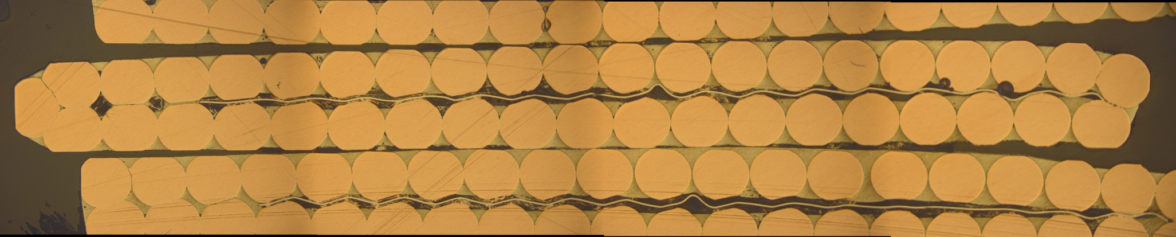
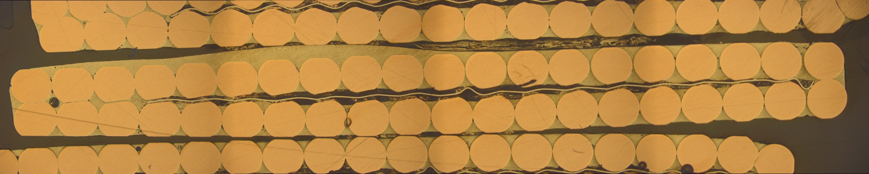
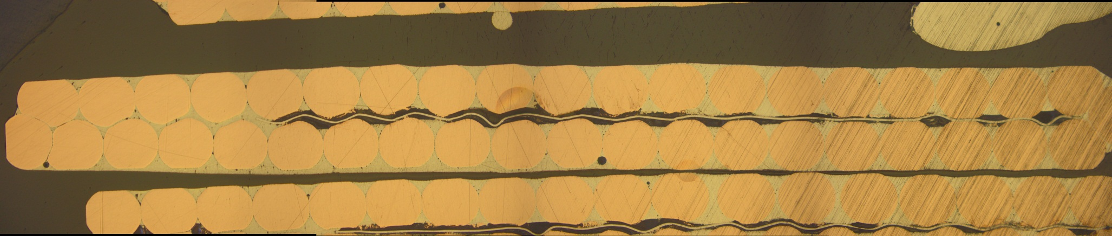
Dummy Cu cable with a 12 mm and 11 mm wide core
12 mm
12 mm
11 mm

Slide 11
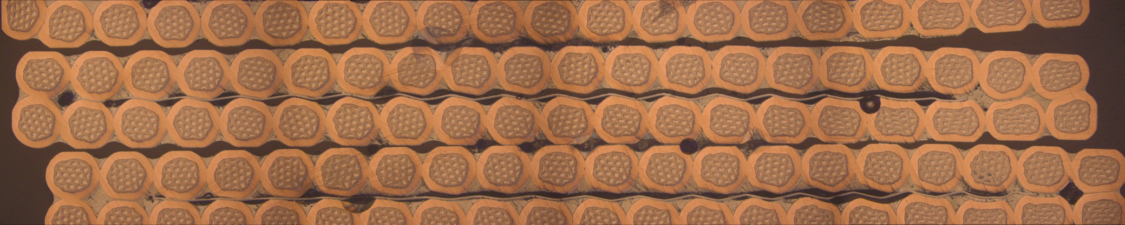
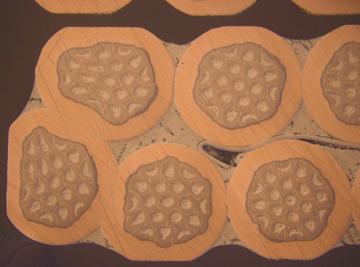
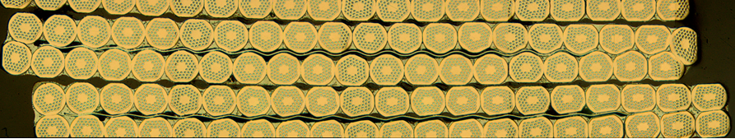
Dummy cable with a 12 mm wide core
Core cable fabricated with bronze strands
Core cable fabricated with RRP 54/61 strands

Slide 12
Summary
The value of the Ic degradation for the cable without a core is low even with a mid-thickness of 1.25 mm.
No problem with magnetic instabilities at low field with the RRP 108/127 strand, Is greater than 700 A at 2 K.
The fabrication of the core cable is well under control.
Cable fabrication with PIT strand shall be performed to confirm the choice of the cable mid-thickness.

Slide 13
 |  | 11 T dipole | LARP’s HQ | 11 T dipole | 11 T dipole | 11 T dipole
Width | 14.7 mm | 15.13 mm | 14.7 mm | 14.7 mm | 14.7 mm
Mid-thickness | 1.269 mm | 1.430 mm | 1.269 mm | 1.250 mm | 1.250 mm
Thin edge | 1.168 mm | 1.331 mm | 1.186 mm | 1.149 mm | 1.167 mm
Thick edge | 1.370 mm | 1.520 mm | 1.352 mm | 1.351 mm | 1.333 mm
Keystone angle | 0.79º | 0.75º | 0.65º | 0.79º | 0.65º
t/2d thin edge | 83.4 % | 83.1 % | 84.7 % | 82.5 % | 83.3 %
t/2d thick edge | 97.8 % | 95.4 % | 96.6 % | 96.5 % | 95.2 %
Compaction factor | 86 % | 85.2 % | 86 % | 87.3 % | 87.3 %
Transposition pitch | 100 mm | 100 mm | 100 mm | 100 mm | 100 mm

