Slide 1
Machine protection aspects of injection and extraction for the CLIC DR
R. Apsimon

Slide 2
Failure modes
Fast failures
Particles hit aperture within few turns
E.g. injection and extraction kicker failures
Passive protection needed (collimators, absorbers)
Slow failures
Failure slow enough to abort/dump beam before it hits aperture
E.g. magnet power supply failure
Use extraction system to remove beam

Slide 3
Injection kicker failure modes
Inductive adder level failure
20 levels: supply ~700V each
Consider up to 3 levels failing simultaneously
Assumed to be caused by failure of FETs on level
~8σ event, so realistic worst-case scenario.
Total inductive adder failure
Likely to be due to a trigger timing error
ALL particles considered dangerous and hit aperture shortly downstream of injection
Injection collimator designed to capture full 6σ beam (+ tolerances)

Slide 4

Collimator considerations [1]
Number of σ that can pass through aperture
$$=\frac{A_{1/2}−δ}{\sqrt{βε}}$$
δ = alignment tolerance = 2mm
A_{1/2} = physical half-aperture
Acceptance calculations at injection emittance
Region | A_{1/2} (mm) | H-plane | V-plane | H-plane | V-plane
LSS | 12 | ≥13.3 | ≥65.3
Arc | 20 | ≥33.7 | ≥126.1
 |  | Injection cell |  | Extraction cell
1st quad | 20 | 17.1 | 246.5 | 17.1 | 246.5
Septum | - | 7.1 | 242.7 | 9.3 | 110.8
Kicker | 12 | 9.9 | 263.0 | 8.7 | 119.9

Slide 5
Collimation considerations [2]
Beam aperture critical in injection/extraction regions
Use absorbers to protect septa (fixed position)
Collimators to protect rest of machine (moveable)
Collimation scheme depends on whether septa are in vacuum or not

Slide 6
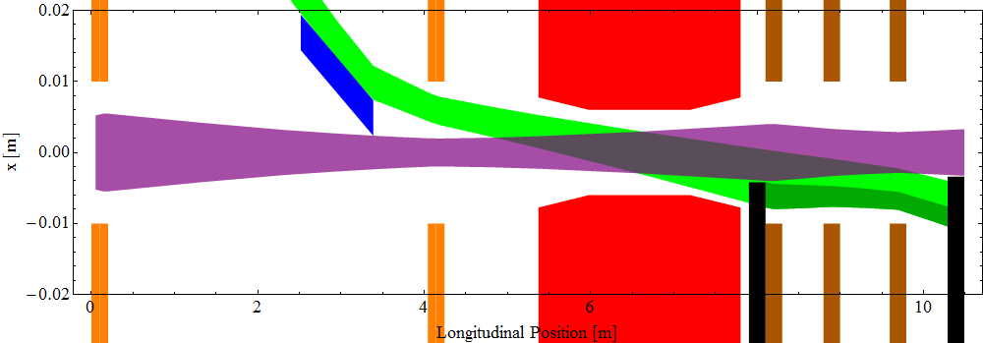
Septa in vacuum: H-plane
Red: kicker Orange: quads in injection cell
Blue: septum edge Brown: quads in matching cell
Purple: stored beam Green: Injected beam (total kicker failure)
Dark green: region of beam removed by first collimator

Slide 7
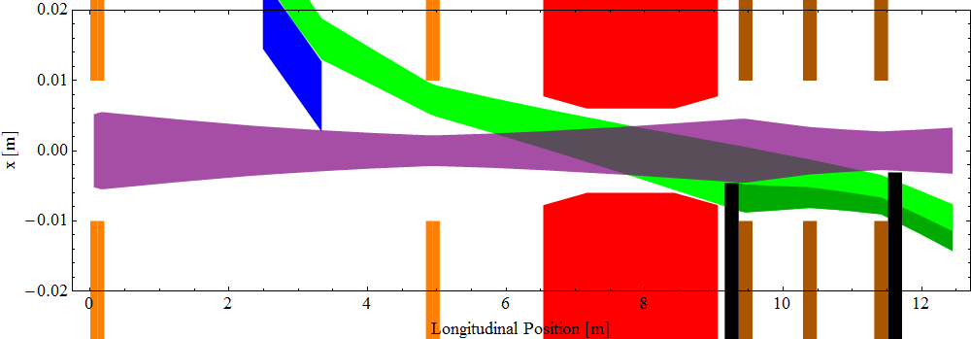
Septa not in vacuum: H-plane
Red: kicker Orange: quads in injection cell
Blue: septum edge Brown: quads in matching cell
Purple: stored beam Green: Injected beam (total kicker failure)
Dark green: region of beam removed by first collimator

Slide 8
Comments on collimator plots
Beam envelope
6σ envelope ± 2mm tolerance
First collimator
Needed to stop particles hitting aperture before reaching second collimator
Second collimator
Designed to completely capture beam for total kicker failure

Slide 9
Injection/extraction parameters
 | Septa in vacuum | Septa not in vacuum
Kicker parameters
Aperture | 12 mm | 12 mm
Voltage | ±12.5 kV | ±12.5kV
Kicker length | 2.43 m | 2.58 m
Thin septum parameters
Gap field | 0.2T | 0.2T
Length | 0.87 m | 0.85 m
Thick septum parameters
Gap field | 1T | 1T
Length | 2.02 m | 1.99 m
Inj/ext cell length | 7.90 m | 9.36 m
Matching cell length | 2.39 m | 3.09 m
Total length | 10.29 m | 12.45 m

Slide 10
Comparison of schemes
Septa in vacuum
Smaller beams; good aperture clearance
>4 m reduction in total length of DR
This is almost entirely drift length
Septa not in vacuum
Efficient collimation

Slide 11
Tracking simulations
Tracking done for failure of 3 inductive adder levels
1000 particles for 100 turns
Uniform random number generators: 6σ ± 2mm phase space
Polar coordinates to create oval beams
340 “dangerous” particles
Exceed 6σ ± 2mm phase space of nominal orbit
Turn number | % absorbed
At injection | 37.4%
1 turn | 52.1%
2 turns | 92.4%
3 turns | 95.9%
4 turns | 97.4%
10 turns | 99.1%
All particles captured by absorbers + collimators; no losses in kickers or elsewhere.
Remaining 0.9% of particles on edge of phase space limit and survive for many turns.

Slide 12
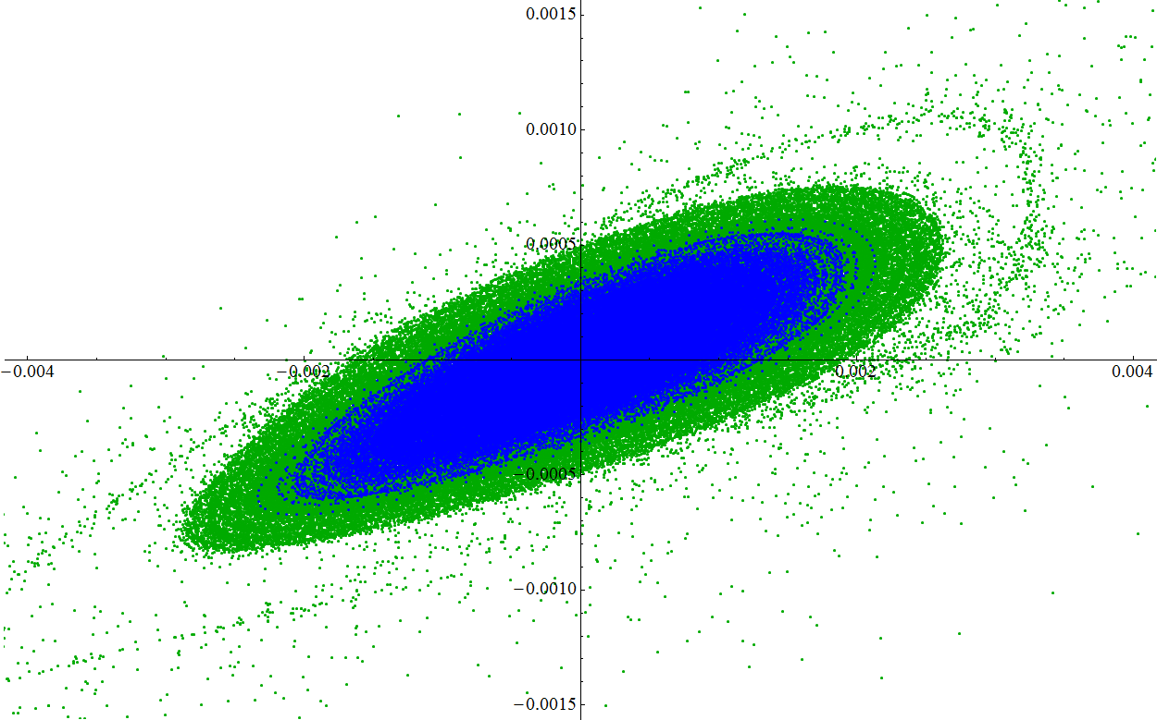
Phase space: no collimation
Phase space plot at second injection collimator

Slide 13
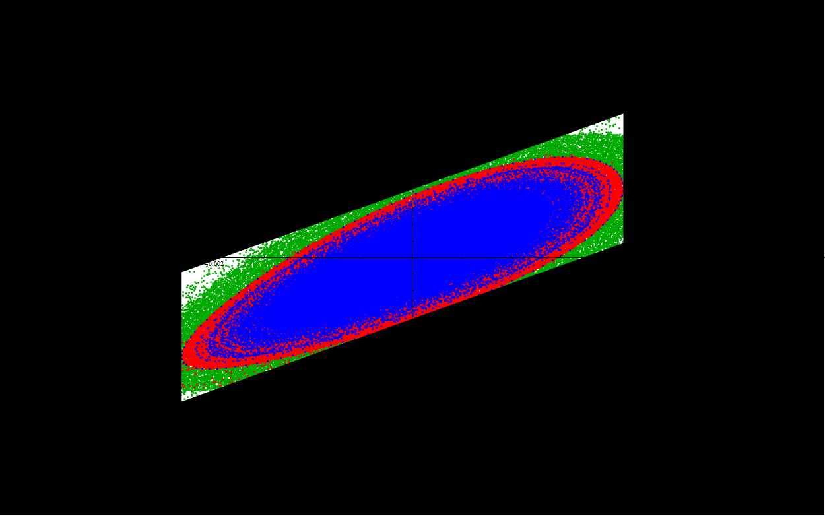
Phase space coverage: 1 turn
Blue: phase space of nominal orbit
Green: Phase space of poorly injected beam (3 levels failed) without collimation
Red: Phase space of poorly injected beam (3 levels failed) with collimation
Black: Phase space confined by collimation

Slide 14
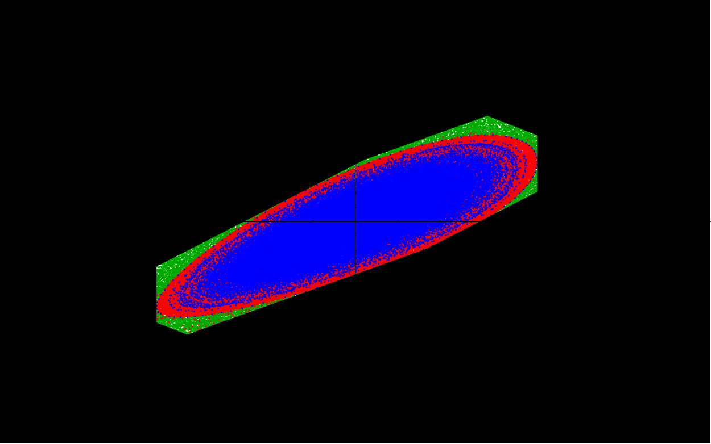
Phase space coverage: 2 turns
Blue: phase space of nominal orbit
Green: Phase space of poorly injected beam (3 levels failed) without collimation
Red: Phase space of poorly injected beam (3 levels failed) with collimation
Black: Phase space confined by collimation

Slide 15
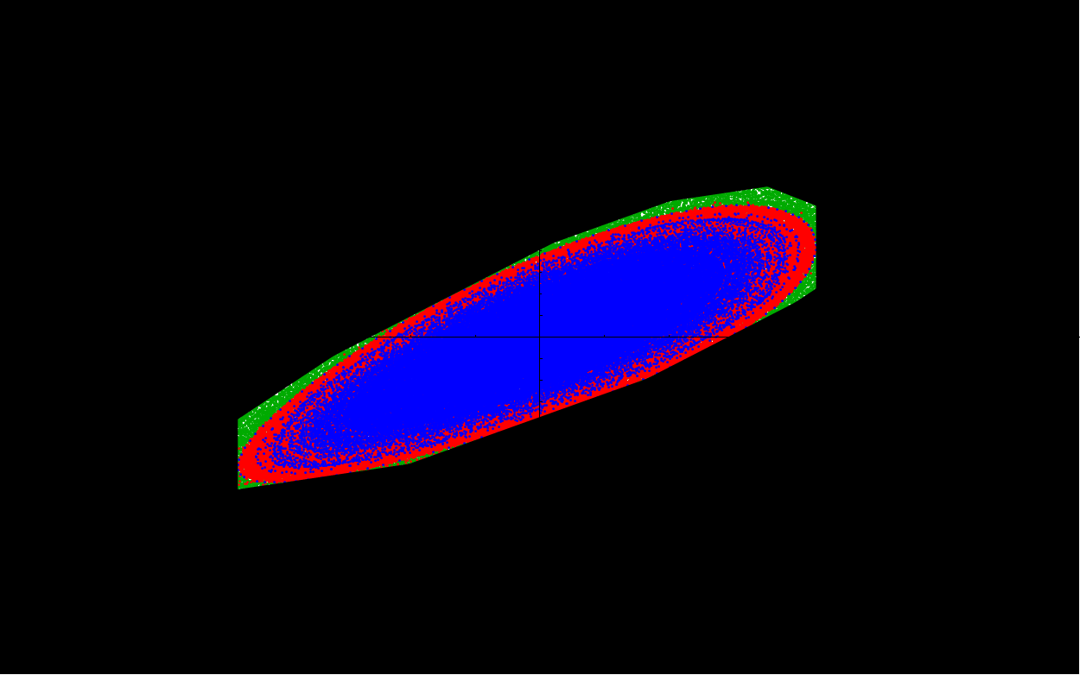
Phase space coverage: 3 turns
Blue: phase space of nominal orbit
Green: Phase space of poorly injected beam (3 levels failed) without collimation
Red: Phase space of poorly injected beam (3 levels failed) with collimation
Black: Phase space confined by collimation

Slide 16
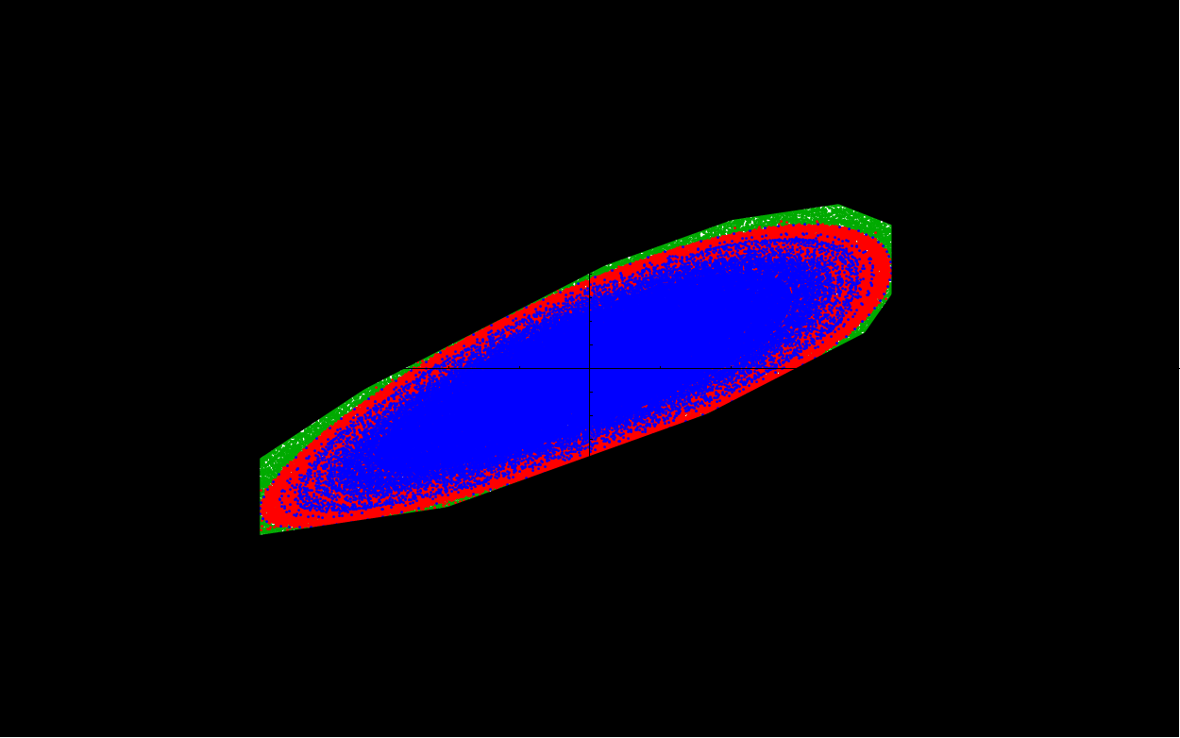
Phase space coverage: 4 turns
Blue: phase space of nominal orbit
Green: Phase space of poorly injected beam (3 levels failed) without collimation
Red: Phase space of poorly injected beam (3 levels failed) with collimation
Black: Phase space confined by collimation

Slide 17
Dump system considerations
Latency
How many turns before beam can be dumped?
Location and space constraints

Slide 18
Breakdown of latency
Signal time of flight to dump kicker
~1μs
Latency of electronics
<1μs
Kicker rise time
~700ns
Time for 1 turn of ring (circumference: 400-450m)
1.3-1.5μs
~2-3 turns of ring required to dump beam

Slide 19
Location + space constraints
Avoid
Regions with synchrotron radiation
High dispersion regions
Near injection or extraction only suitable places.
Dedicated dump cell?
Would add ~10m in each straight section
Unacceptable increase in length
Can extraction cell be used as dump system?

Slide 20
Technical challenges
Kicker must fire in two modes
Extraction mode (±12.5kV)
Dump mode (±17.5kV)
Need to extract beam with injection emittance
Separate dumped beam from extracted

Slide 21
How to achieve 2 kicker modes
Separate inductive adder into 2 banks of levels
“Bank 1” contains 20 levels
“Bank 2” contains 8-10 levels
Extraction trigger discharges Bank 1
Dump trigger discharges Banks 1 and 2

Slide 22
Kicker triggering
Bank 1
Bank 2
Bank 1
Bank 2
Trigger select
Trigger select
“Extract”
“Dump”

Slide 23
Consideration of damping time [1]
Time needed to damp beam:
Injection: 54 μm rad (x), 1.3 μm rad (y)
Extraction: 500 nm rad (x), 5 nm rad (y)
Equilibrium: 470 nm rad (x), 4.8 nm rad (y)

Slide 24
Consideration of damping time [2]
~8.5 damping times to reach design
17ms (injection period 20ms)
How long to charge inductive adder?
Currently unknown, estimate ~90% at injection
Add levels in Bank 2 to compensate missing charge?
Reduce storage time by ~1 damping time?
4% increase in extraction emittance; acceptable?

Slide 25
Kicker failure modes
Extraction mode
Both banks fire: beam dumped → safe
Bank 1 fires: beam extracted → safe
Bank 2 fires: beam absorbed by septum absorber and collimator → safe
Neither bank fires: beam remains in ring
Dump mode
Both banks fire: beam dumped → safe
Bank 1 fires: beam extracted → NOT SAFE
Bank 2 fires: beam absorbed by septum absorber and collimator → safe
Neither bank fires: beam remains in ring

Slide 26
Separate ext and dump beams
Start of extraction line
Kicker gives larger deflection to dumped beam
Use defocussing quad to further separate beams
Septum magnet to separate ext and dump lines
Use same septa design as in extraction system

Slide 27
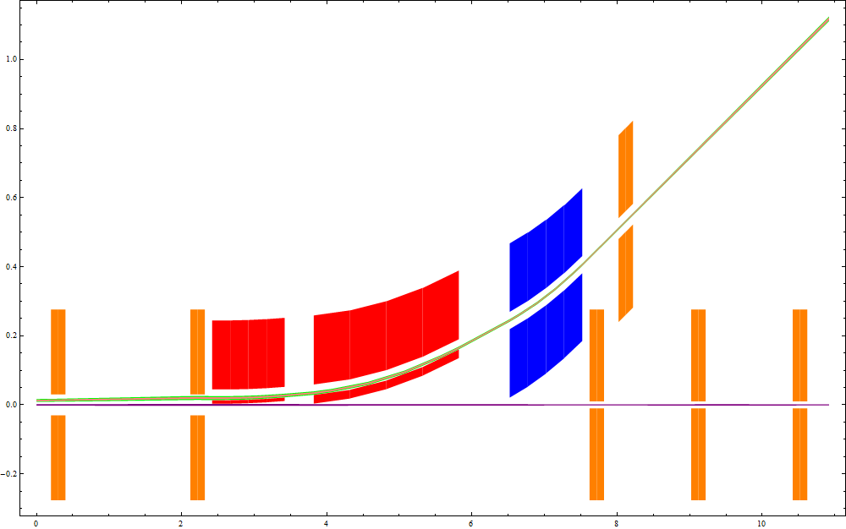
Current design: h-plane

Slide 28
Comments on design
Septa in vacuum?
Easier if extraction septa NOT in vacuum
More lever-arm; less length needed to separate beams
Twiss parameters more controllable
Final quad needed in dump line
Control spot size at dump block

Slide 29
Radiation length
Need minimum 5 rad. lengths for 2.86 GeV e⁻
Use 10 rad. lengths for dump block
Use 5 rad. lengths for absorbers and collimators
Material | Density (kg m⁻³) | Radiation length (m)
Beryllium | 1.84 X 10³ | 0.353
Carbon | 2.25 X 10³ | 0.188
Titanium | 4.50 X 10³ | 0.036
Copper | 8.93 X 10³ | 0.014
Tungsten | 19.3 X 10³ | 0.0035
Higher density means more back scattering, but shorter radiation length

Slide 30
Material choice
In DR, space is limited
short radiation length and low back-scattering
Use titanium: ~20cm for collimators and absorbers
Dump block
Space not limited
Use carbon for dump block
Surround block in higher mass material (e.g. lead) to contain radiation.

