Slide 1
Magnetic Modelling
CM 34
RAL 17th – 19th October 2012
P. J. Smith

Slide 2
Introduction
From discussion at the previous collaboration meeting it was clear that we needed an improved magnetic model of the MICE Hall to help us both understand and resolve the issues that we have.
Since late July I have been putting together a full 3D model of the MICE Hall (with a lot of help from others) which has been designed to represent both the geometry and ferrous masses within the MICE Hall as accurately as possible.
A lot of progress has been made on this model. We are now able to use this model to produce plots that highlight areas of interest.
…however, the model is not yet complete and so any solutions presented must not be ‘over-interpreted’ or taken as gospel. The model needs validating.
It is clearly a high priority to get the model into a state where is produces results that we can both trust and use.

Slide 3
Contents
What we are using to model the MICE Hall & its limitations.
What objects have gone into the model and what remains to go into the model.
Validating the Hall model.
Using the Hall model.
So what do we want to model?
Examples of output from the model.
Time and motion…

Slide 4
The Modeller
To model the MICE hall we are using a magnetic FEA program called OPERA of which many of you will be familiar, the output plots from OPERA have been discussed/shown at previous CMs before.
OPERA is not a CAD program, so whilst it will allow you to input the geometry of the MICE hall to any detail you like, the geometry needs to be subsequently ‘meshed’ for the FEA to do it’s work. The resolution of the mesh is determined by the resolution of the geometry – i.e. higher detail requires a higher mesh size.
Of course the total number of meshing elements go to the cube of the resolution, which significantly impacts upon the time it will take for the program to solve the problem. The MICE hall is big!
Getting the meshing right so that the program produces a good mesh and solves in a tractable time is 90% of the problem with using FEA….compromises have to be made.

Slide 5
What is in the Model?
What’s in the model/What we want to put in the model
Ferrous Components/ Non Ferrous Components
Ferrous Components
Beam Dump
Floor Web
D2
DSA Steel
North Shield Wall
Q4-Q9 (Solid Blocks)
South Shield Wall
Virostek Plates
EMR (Inaccurate)
Quad Bases in Cellar
Linac Wall
SW Distribution Board
Steel Door to MICE Hall
North Mezzanine
Non - Ferrous Components
Hall Floor
Hall Roof
Hall Walls
Solenoids Step IV (S-mode)
Solenoids Step VI (S-mode)
Cellar
Trench

Slide 6
What we wish to add to the model
Screenshot
Ferrous Components
South Mezz Stairs
PPS Cages (may not be possible)
Flooring above the trench
False Floor Behind North Shield Wall (Almost Done!)
Quad Bases and Floor plate
West Wall Stairs
Steel Framework?
Non - Ferrous Components
Outline of MLCR
Outline of ISIS CR
(Basically South End structures)
Solenoids Step IV (F-mode)
Solenoids Step VI (F-mode)

Slide 7
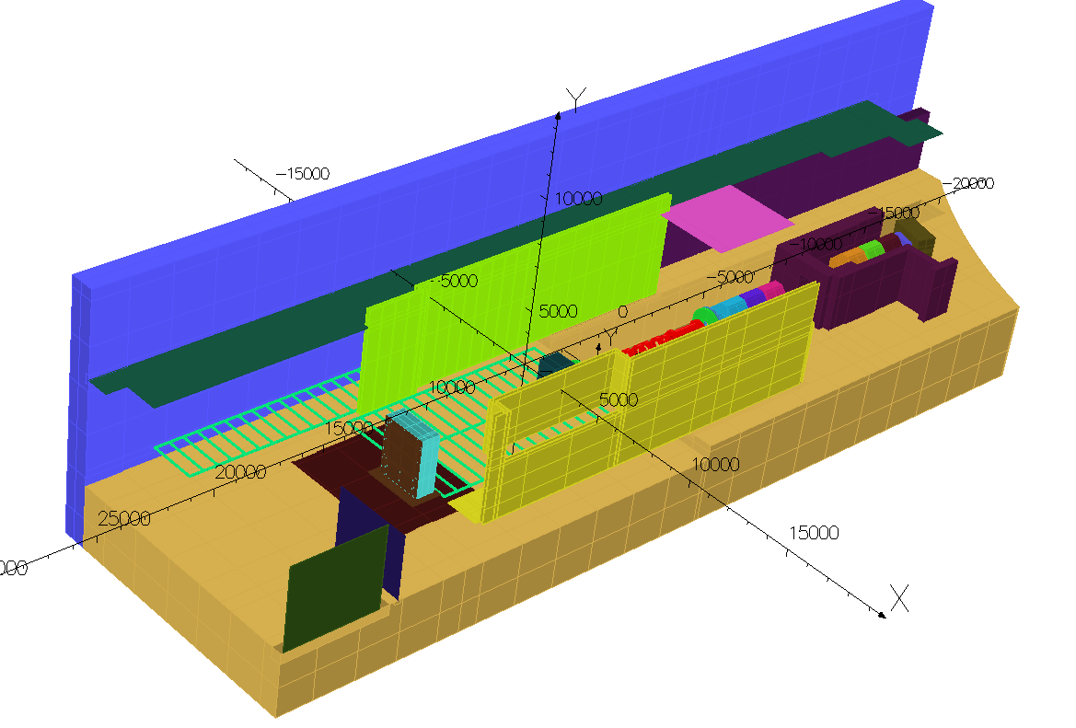
Model of the MICE Hall

Slide 8
Validating the Model
How (when) will we know that the model is giving us results that we can trust?
This is a good question…but I don’t yet have all the answers to this.
I don’t think that this is a black and white issue – I think the model will go through a series of refinements (and sub models) which will allow us to improve on the model over time.
The model is currently under version control, so old models can be revisited and checked as improvements are made. These revisions are stored publicly on ‘Launchpad’.
  https://launchpad.net/micehalloperaproject

Slide 9
Validating the Model
We are taking a proactive approach though to ensuring that the model is as representative as possible.
Geometry is taken from technical drawings of the MICE Hall and is as representative as possible within the meshing limitations discussed earlier
This process is then cross-checked. OPERA outputs a .sat file (CAD) which is then checked against the original drawings for discrepancies.
As long as discrepancies are smaller than meshing resolution then we are ok.
Using other part models that are in existence to check the sanity of the output. Should be in rough agreement.
Considering using data obtained from experimental tests?

Slide 10
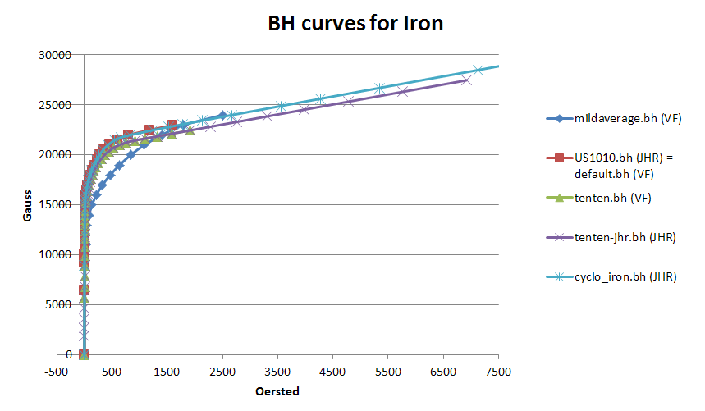
Validating the Model
Materials – This is a little easier. Acquiring BH curves for individual materials within the hall is not really possible (or would be difficult and expensive) and so the appropriate but approximate BH curves need to be used. Generally these approximations will tend to be fairly representative.
  Mild Steel, Good Quality Steel, Reduced Mild Steel
  Air (This is used for all non-ferrous components)
The variation in BH curves is small (although large enough difference between good iron and poor iron that it is worth modelling)

Slide 11
Using the Hall model.
At the moment it is just myself coding for this particular model and Mike Courthold is doing some modelling work using other models.
  There are many, many (probably 100’s) of scenarios that we need to cover and explore…
  Each run of the model with all the components in takes 1-2 days of CPU time…
Clear need to parallelise/speed up the time it takes to obtain a solution.
The resolution of the Hall model is mesh size dependent. Can increase mesh size but it comes at large cost in terms of computational time. There is a desire to independently develop some areas of interest at higher resolution

Slide 12
Using the Hall model.
There are a number of mechanisms and means by which we hope we can tackle this problem.
The model is built from scripts so the production of models can to some extent be automated. – This is useful as we have several licenses at RAL which means that several models can be run in parallel.
The model has been built in such a manner that each ferrous object can be switched in or out of the model. Once it is determined which ferrous objects has an effect in the area of interest, then it is possible to switch off the ones that are of limited use in a model, reducing solve time.
We are exploring using the Hall model to generate the local fields within a given area and then exporting those fields for use in higher resolution models. This in principle means that other higher resolution models can be built independently and then uses the Hall field as their starting point. We have the offer of some additional modelling help from Daresbury to assist here.

Slide 13
What do we want to model?
Pretty much everywhere in the hall needs looking at! Clear focus on Step IV.
We are compiling a list of areas/components of specific interest.
Examples:
  LH2 delivery systems, Q9 power supply, HV rack, Control rack for compressors, Vacuum pumps, Substation, Equipment on the roof, General Field Map Of West Wall, General Field Map of North Wall, Field Maps at Tracker Cryostat locations, Field map at Tracker rack locations, Field Map inside Trench.
If there are particular items that you are concerned about then please feel free to come and talk to me.

Slide 14
Examples of Output from the Model
Given that the model is not complete and adding fairly big chunks of iron can have a large effect on the resulting output I’ve been quite reticent to produce plots of the MICE hall, although understandably that’s what you all want to see…
However my arm has been twisted… however please don’t reproduce these plots for all the reasons discussed in this presentation!
These are quite random but highlight a couple areas of interest.

Slide 15
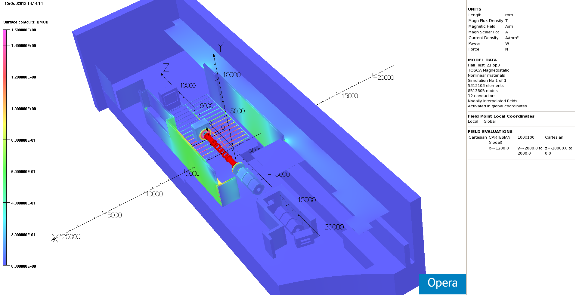
Overview of Hall – 15000 gauss

Slide 16
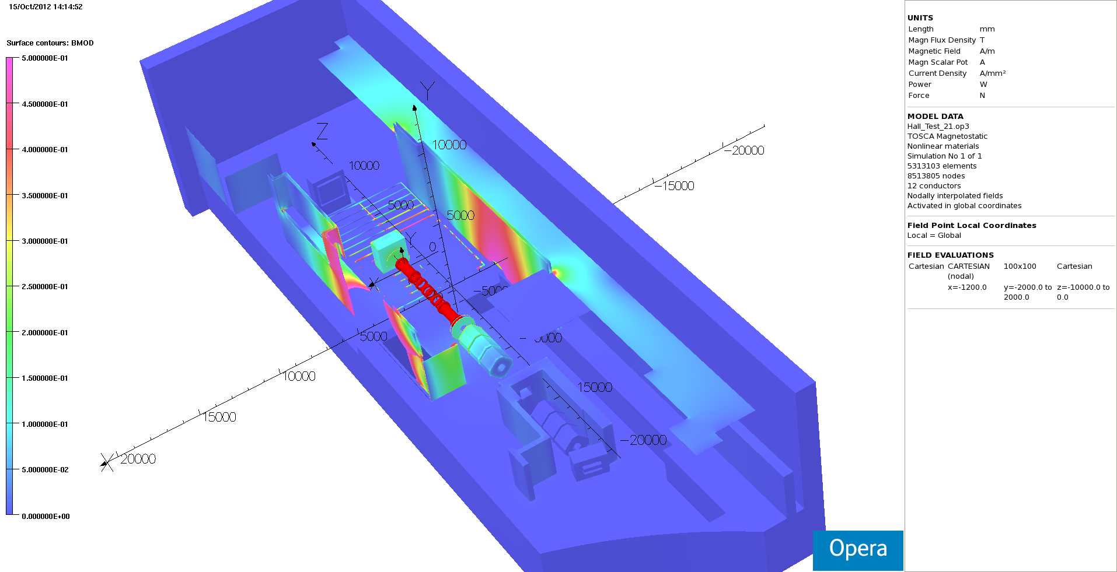
Overview of Hall – 5000 gauss

Slide 17
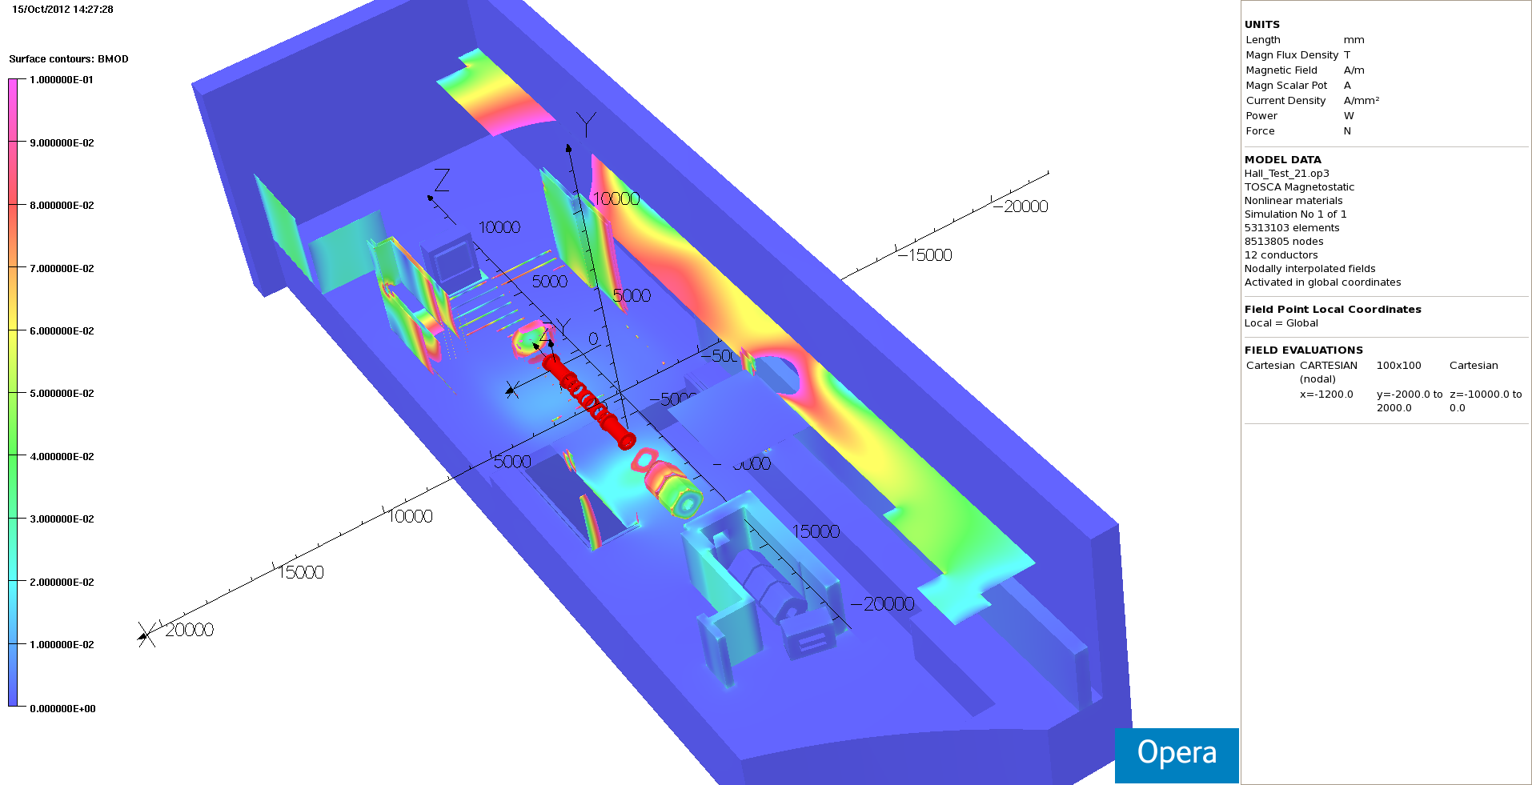
Overview of Hall – 1000 gauss

Slide 18
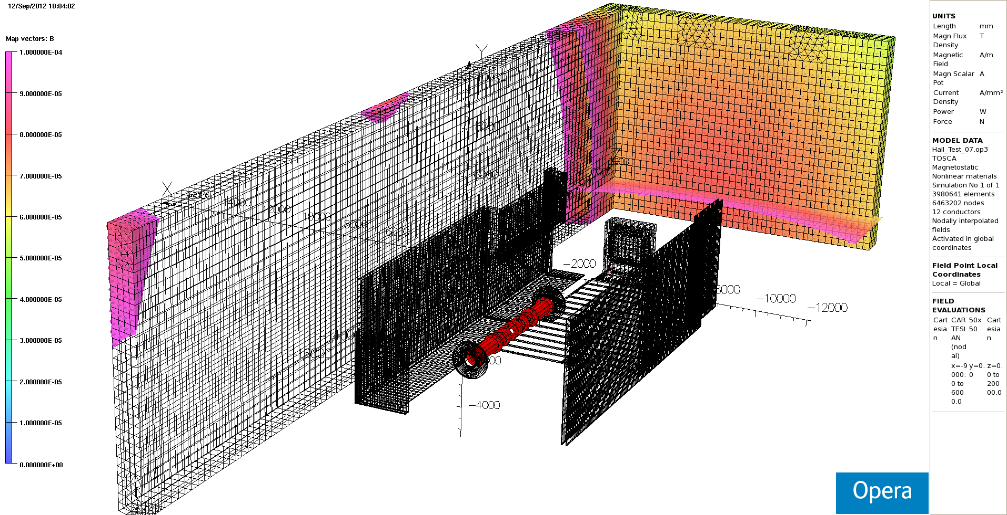
West Wall Example
This is a really OLD model from early September. Much iron missing. Scale is 0 -> 1E-4 Tesla. West Wall looks fine in air.

Slide 19
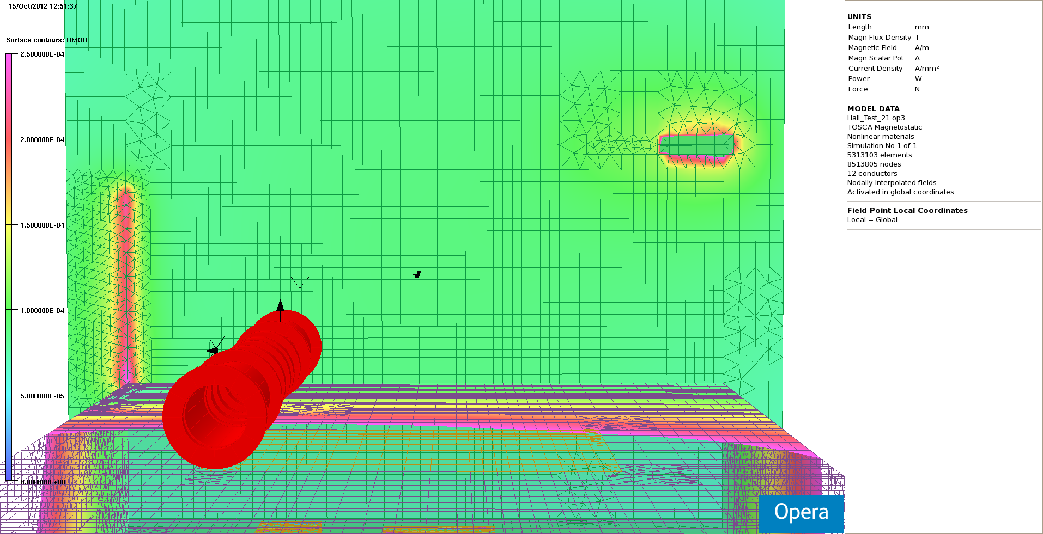
West Wall Example
A more recent model with all iron removed in the plot – Interesting because it gives some preliminary idea of what to expect when iron is placed along the West wall.

Slide 20
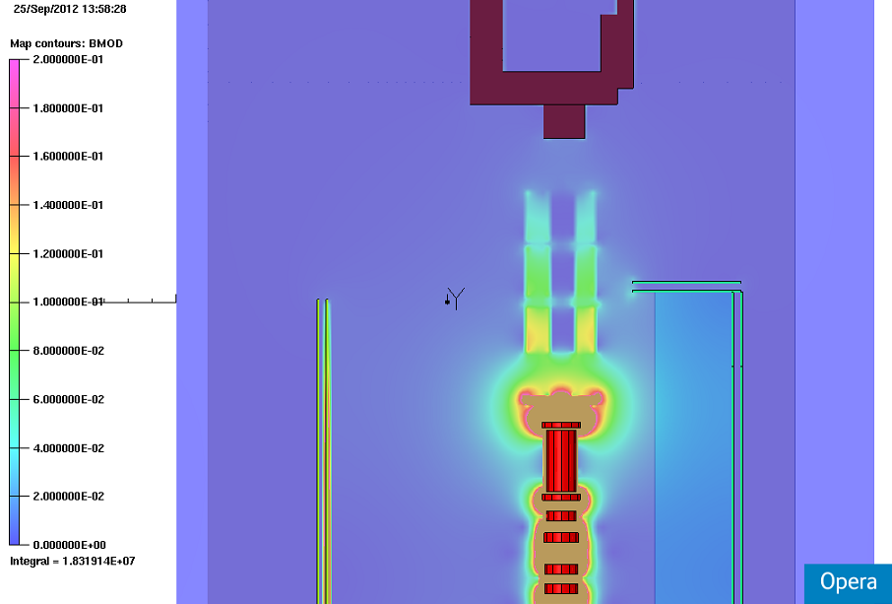
Q9
Quad Bases Missing
TOF cage missing
Quad model is probably too simplistic
Slice through beam axis Step IV sol 240MeV/c
A good example showing the necessity to improve the model before conclusions can be drawn!

Slide 21
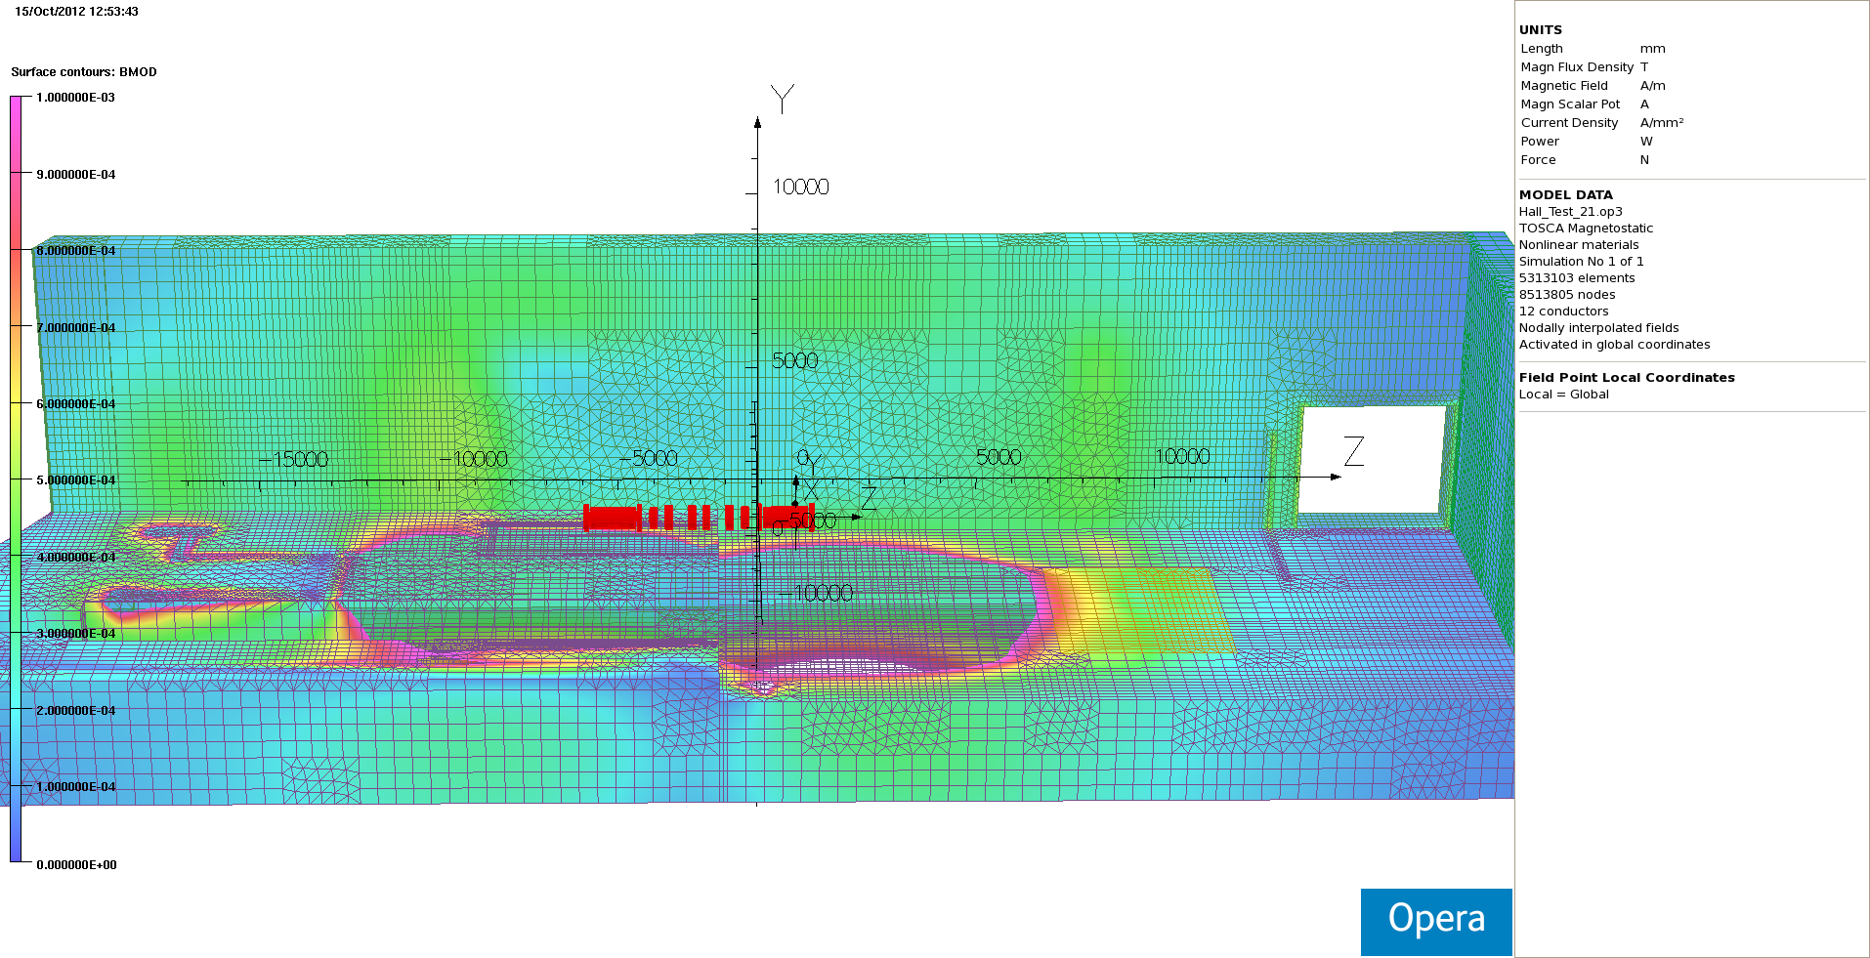
South Wall
The field in air along the south wall from a more recent model – 10 gauss scale. All iron material has been removed from the plot to aid visibility.

Slide 22
Time and Motion…
It is my hope that within the next few weeks a good portion of the structural iron will be in the model and we can then start to look at how we can validate the model.
Mike is also working hard on understanding and automating the exporting fields from the model to be used in sub-models. This will allow others to get involved in the coding.
The magnetic group will then determine what areas/problems we wish to prioritise our efforts on understanding.

Slide 23
Conclusions
Good progress has been made on constructing a more accurate model of the MICE Hall.
There is a lot of work that is ‘in progress’ and the model requires a significant amount of refinement.
We are now looking towards validation of the model and preparing a mechanism by which sub models can be built using the field values output from the hall model as boundary conditions on the sub model.
For those who have access to OPERA the hall model is held in a repository at:
https://launchpad.net/micehalloperaproject

