Slide 1
Step IV & VI: Local Flux Return

Slide 2
Outline
Introduction and Concept
Shielding efficiency
Extension to Step VI
Effect on beam
Forces

Slide 3
Local Flux Return
Explore shielding options
  Initially only for Step IV, but should also work for Step VI (or upgradable)
What has been done so far?
  general concept
  performance Step IV&VI (all cases)
  effect of shielding on field of MICE
  individual components
    walls, Q9, floor, …
However, there are many things which have not been done so far…

Slide 4
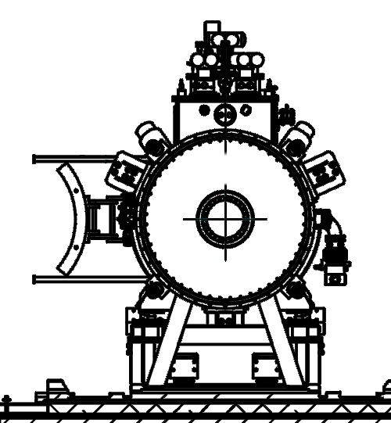
Concept
To get good shielding horizontally: need continuous steel in azimuthal direction
Geometry
  Tube of radius 1.2 m
  wall thickness 10 cm
  azimuthally -50..50°
  weight: 30t
1.5 m
R1.2
2 m
(Note: not to scale)

Slide 5
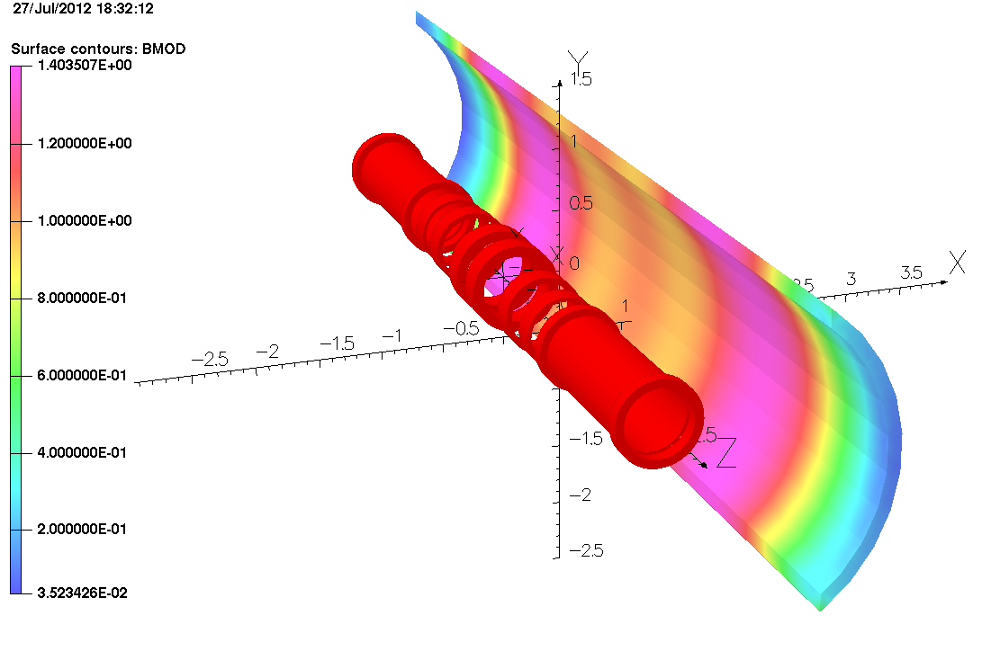
Magnetization In Shield
Wall thickness: 10 cm
r = 1.2 m

Slide 6
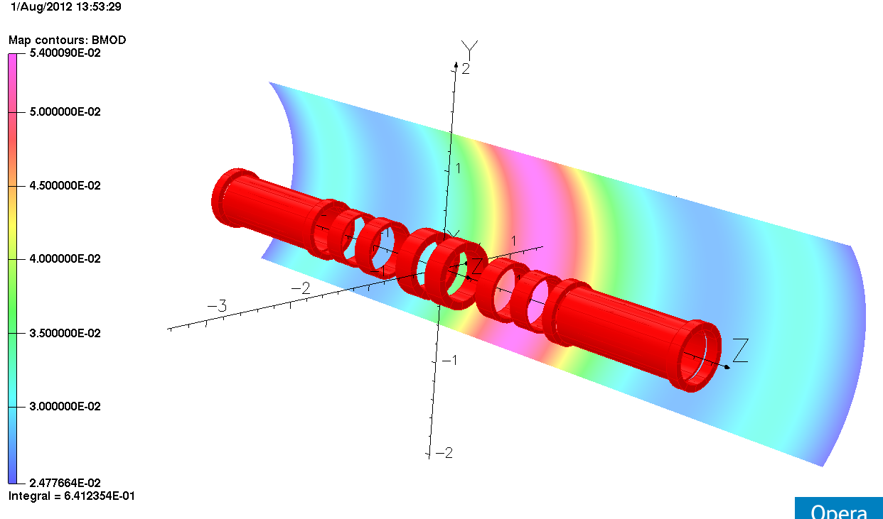
Initial Situation
Peak: 550 Gauss at r=1.5m
Average: ~ 300 Gauss

Slide 7
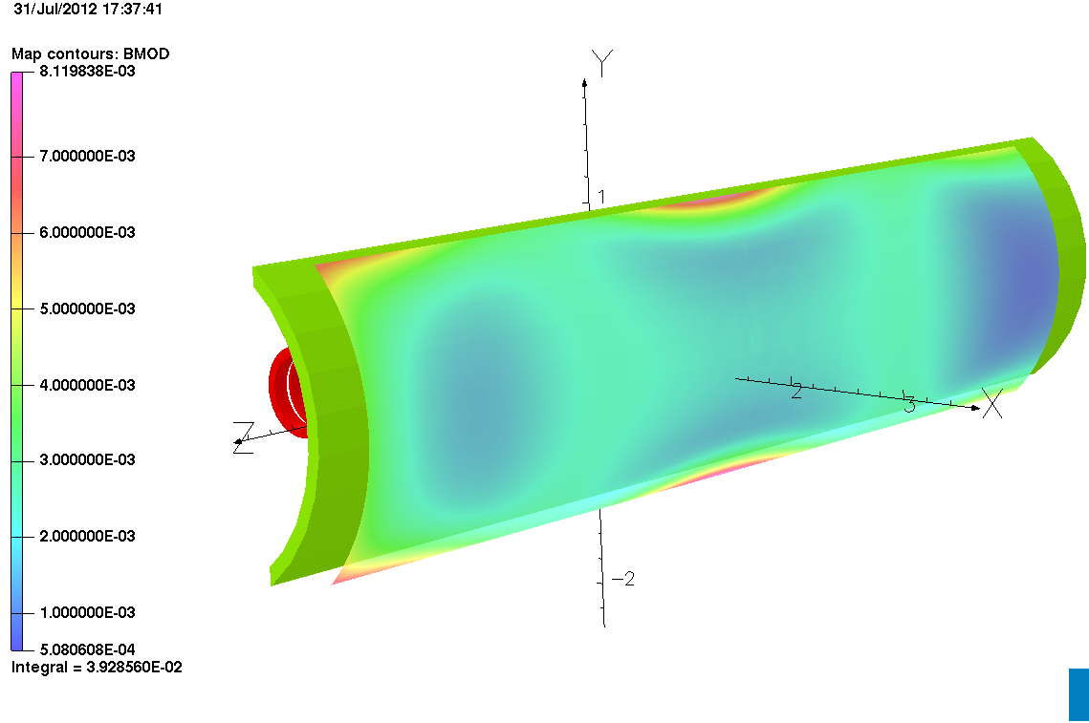
Shielding Efficiency
Step IV, 240 MeV/c, flip
B < 15 Gauss (1.5 mT)
r = 1.5 m

Slide 8
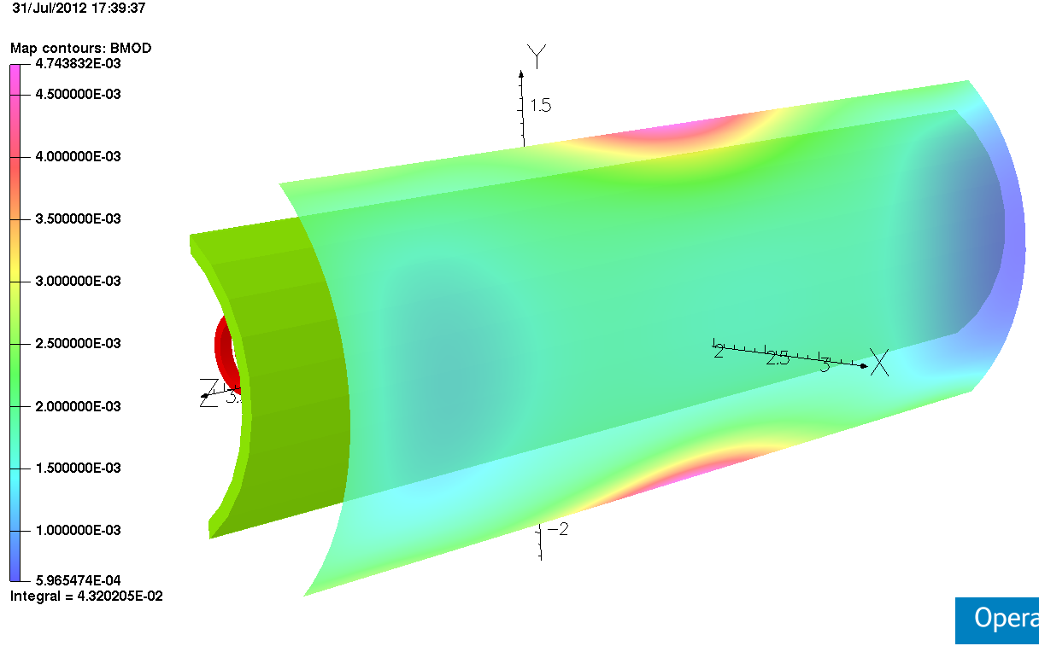
Development of Fringe Field
r = 2 m

Slide 9
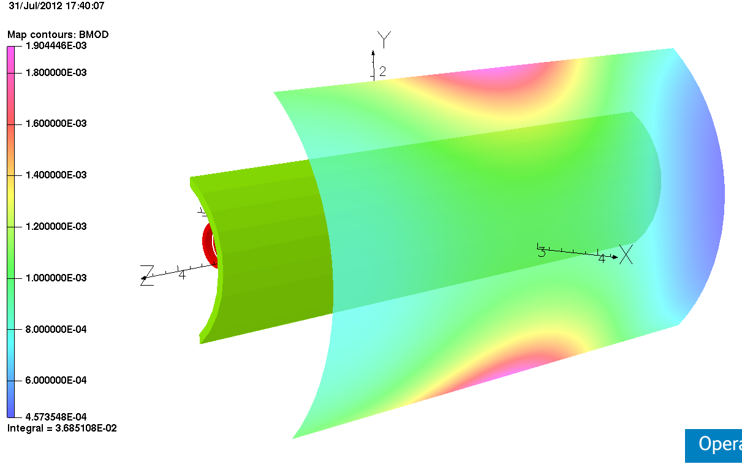
Development of Fringe Field
r = 3 m

Slide 10
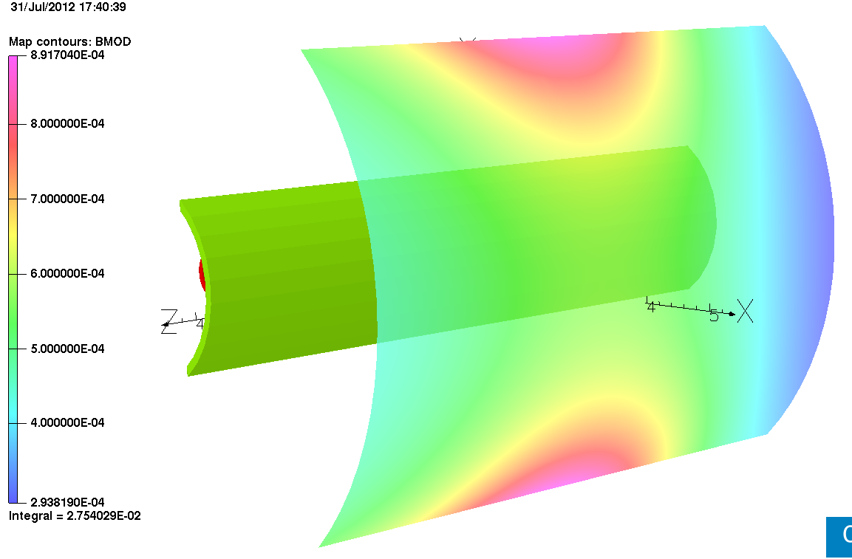
Development of Fringe Field
r = 4 m

Slide 11
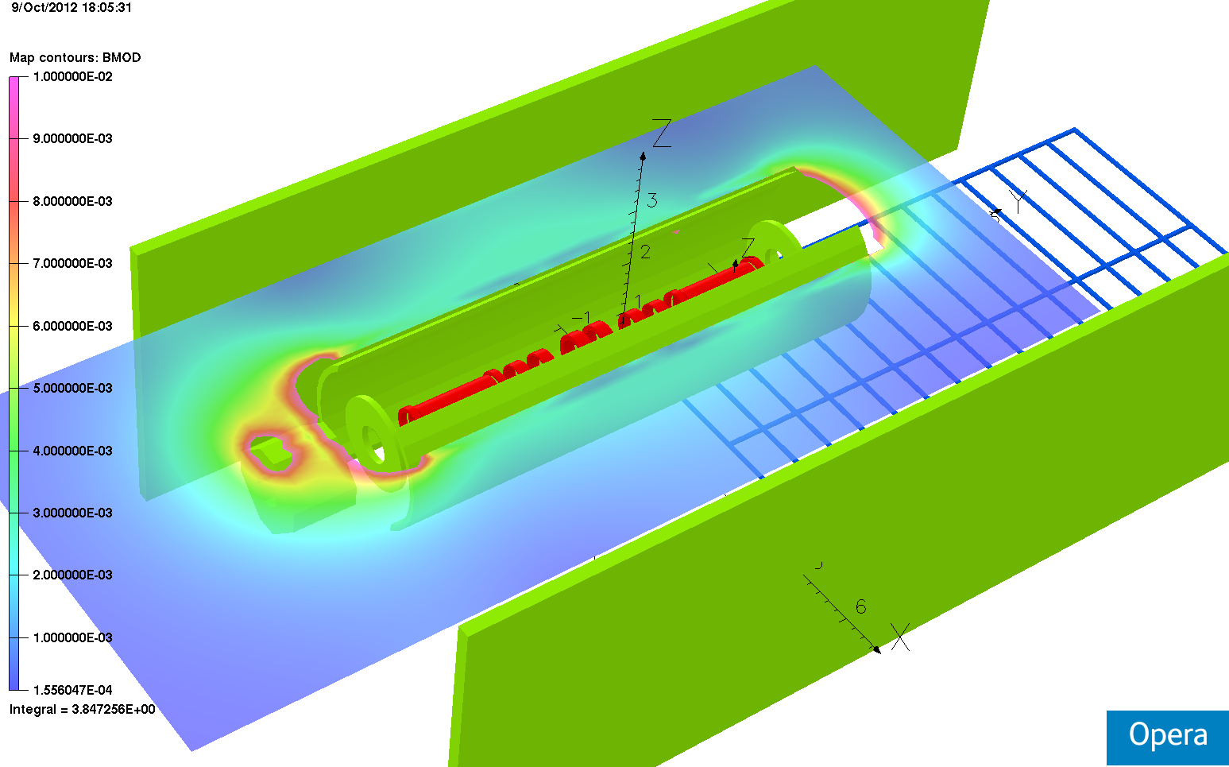
Fringe Field
Vertical Position: 0.75m

Slide 12
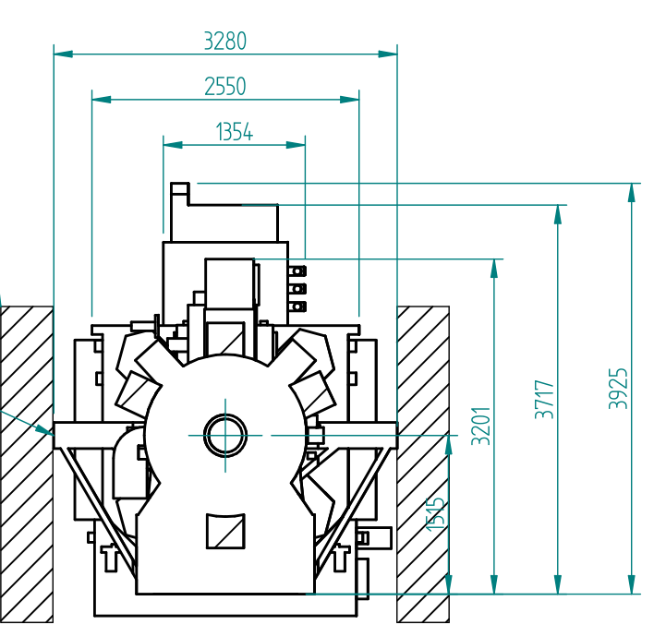
Options for Extension Step VI
MICE Step VI: significantly larger in diameter
  Coupling coils
  RF waveguides
Adaption of scheme possible?
Ideally:
  single scheme for both scenarios
  Or: possibility of modification

Slide 13
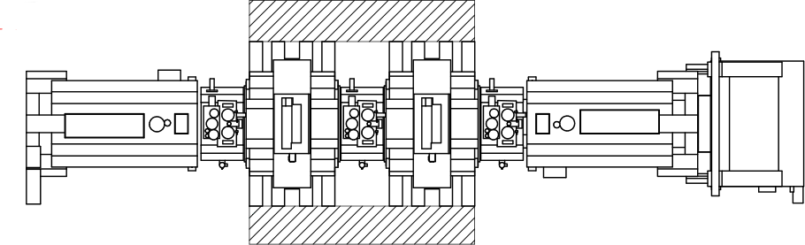
Extension to Step VI
Required: closed iron surface
in long. direction

Slide 14
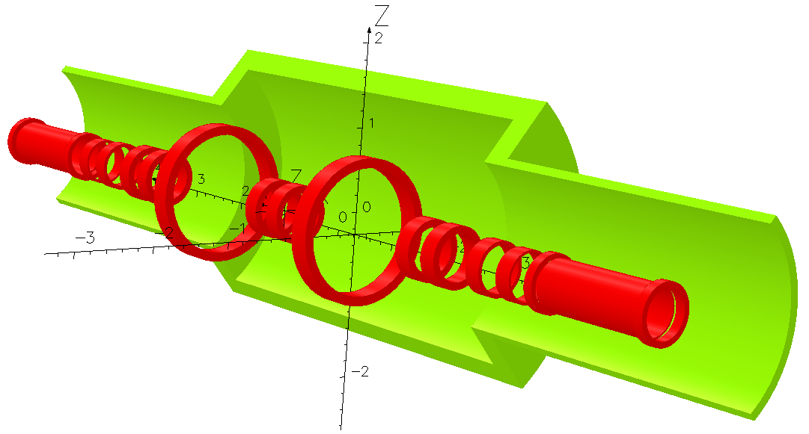
Geometry
5.6 m
4 m
t=0.3m
r=1.8m
t=0.1m
r=1.2m
100°
Weight: 130t
(both halfs)

Slide 15
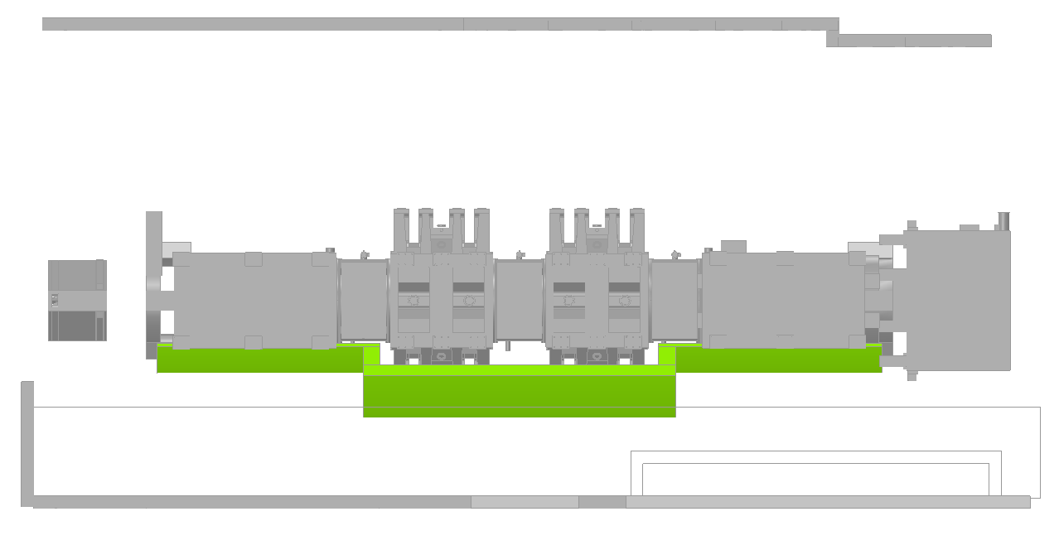
Geometry
Spectrometer
CC
CC
Spectrometer

Slide 16
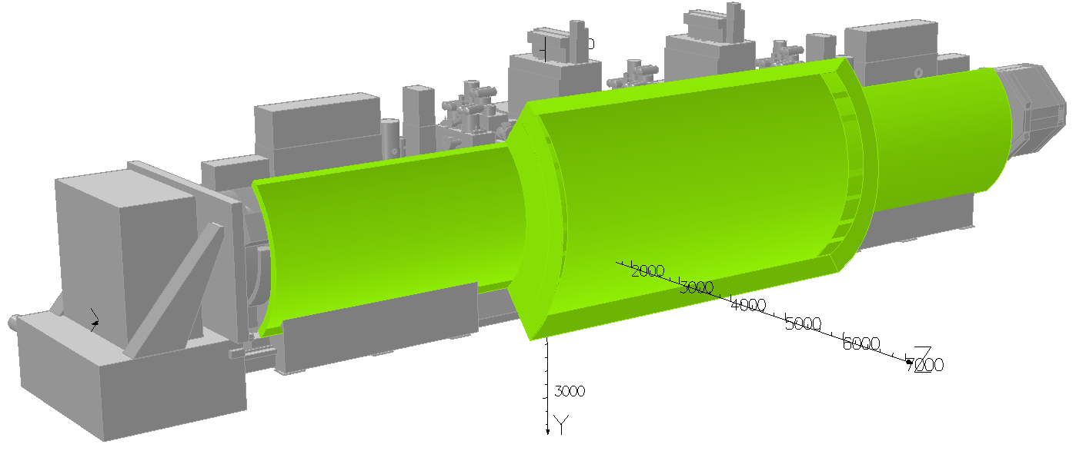
Geometry
Outside faces removed

Slide 17
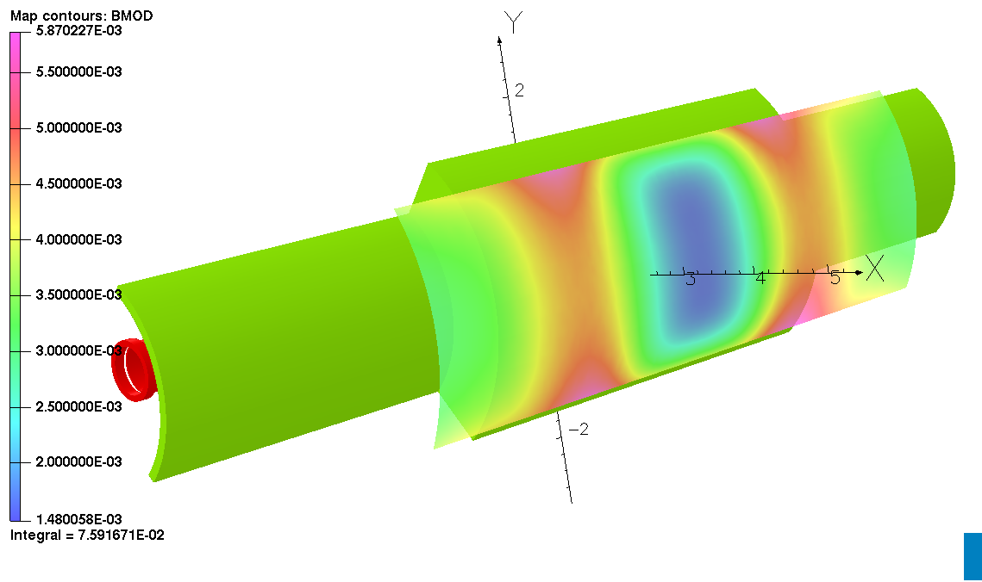
200 MeV Flip Mode
r=2.5m
Peak: 5.8 mT
Average: 3 mT?

Slide 18
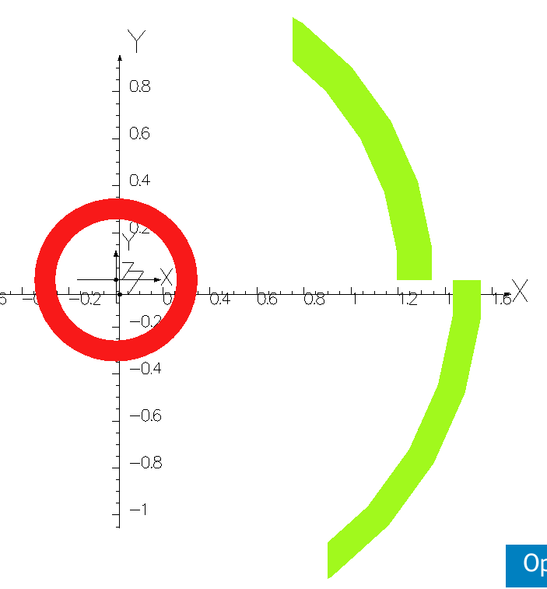
MICE Step VI – Option 2
Gap in radial direction
  still continuous flux return path in longitudinal direction
Shield at different radii
  azimuthal angles must match
  overlap seems not necessary
Allows feed-in/out of tracker wiring?

Slide 19
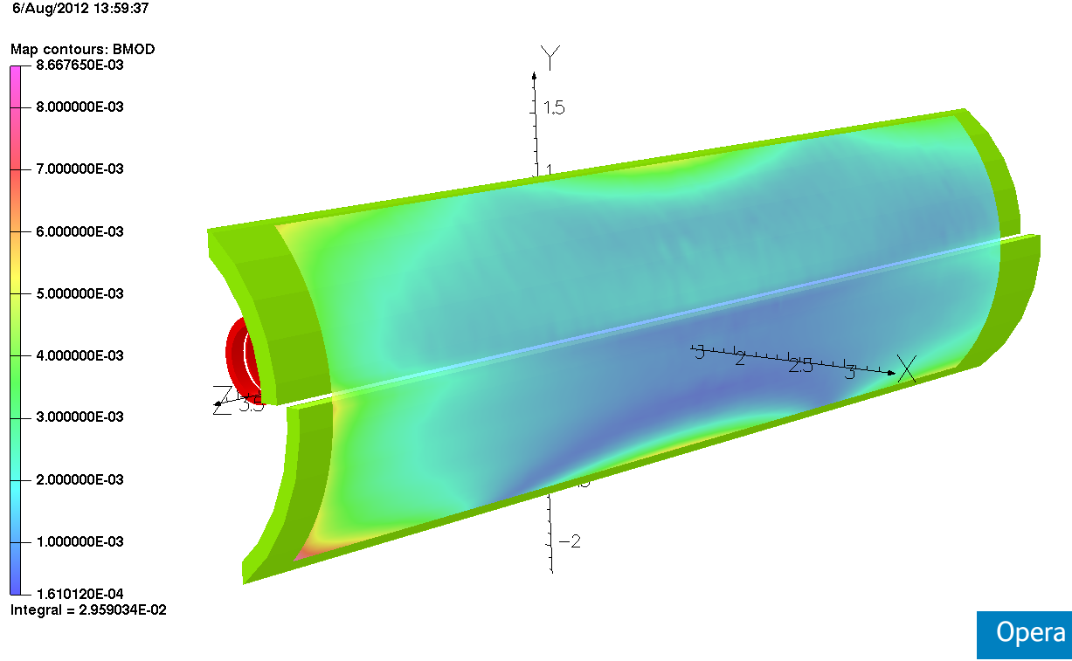
MICE Step VI – Option 2

Slide 20
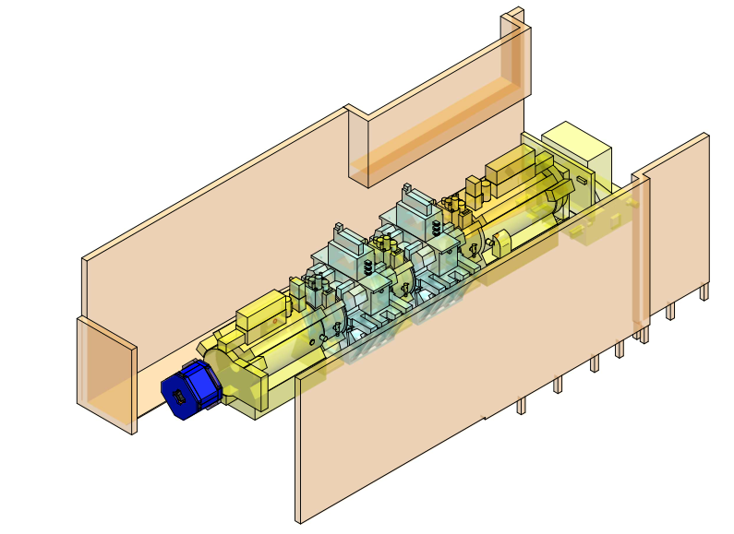
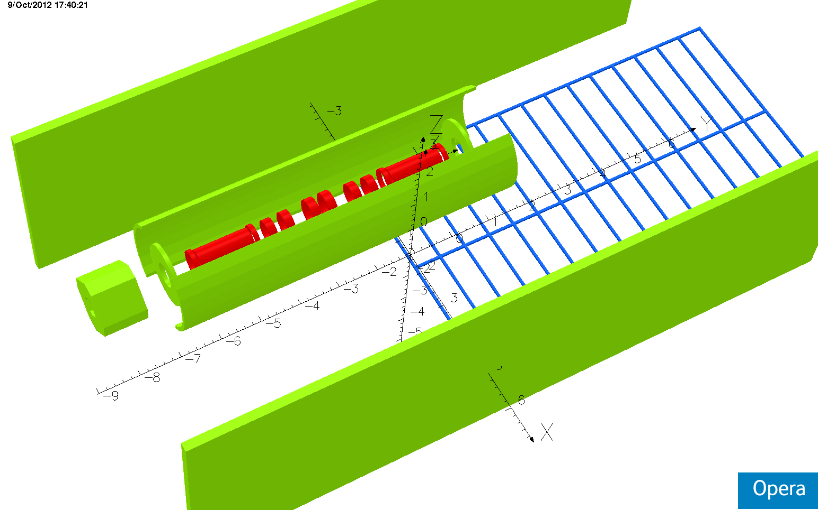
Additional Iron Structures
Additions:
  ‘Virostek’ shields
  TOF cage
  Quad Q9 (simplified)
  Floor
Field reductions due to shield
  Q9: 63 to 36 mT
  Walls: 150 mT to 12 mT
Floor
Shield

Slide 21
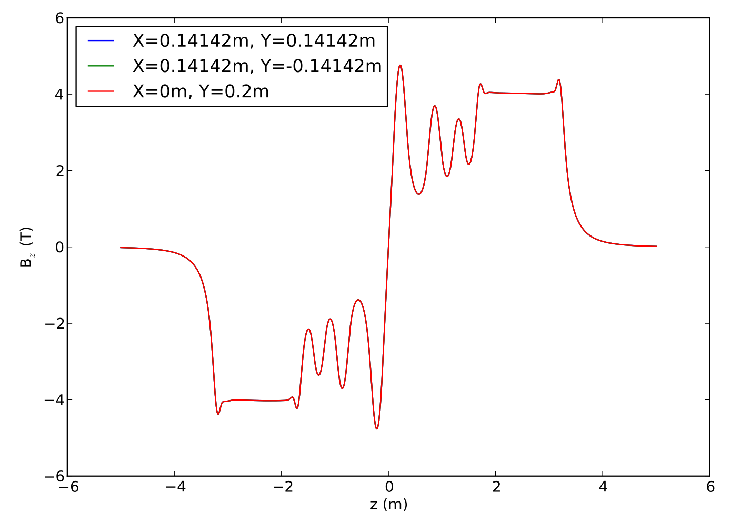
Effect on Field in Channel
3
R0.2
1
2

Slide 22
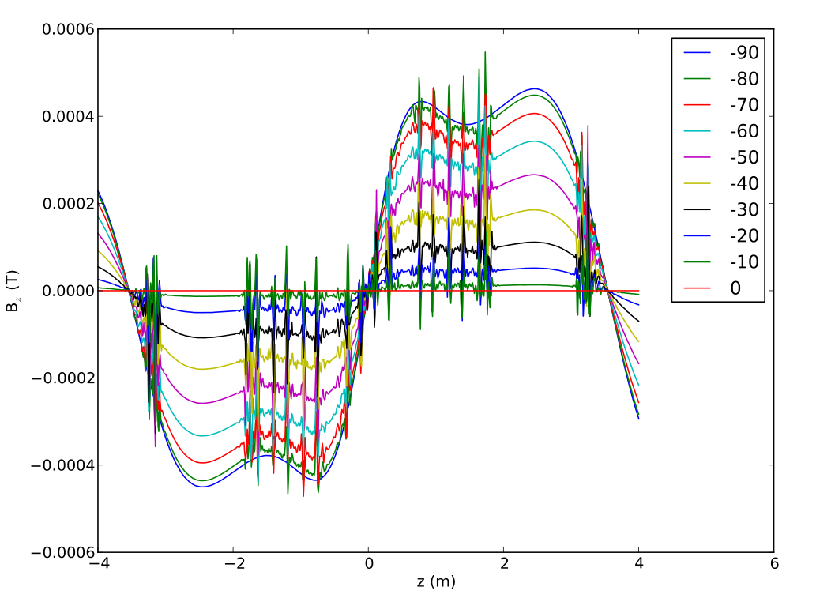
Variation of B_{z}
θ
ΔB with respect to B_{z} at θ=0°

Slide 23
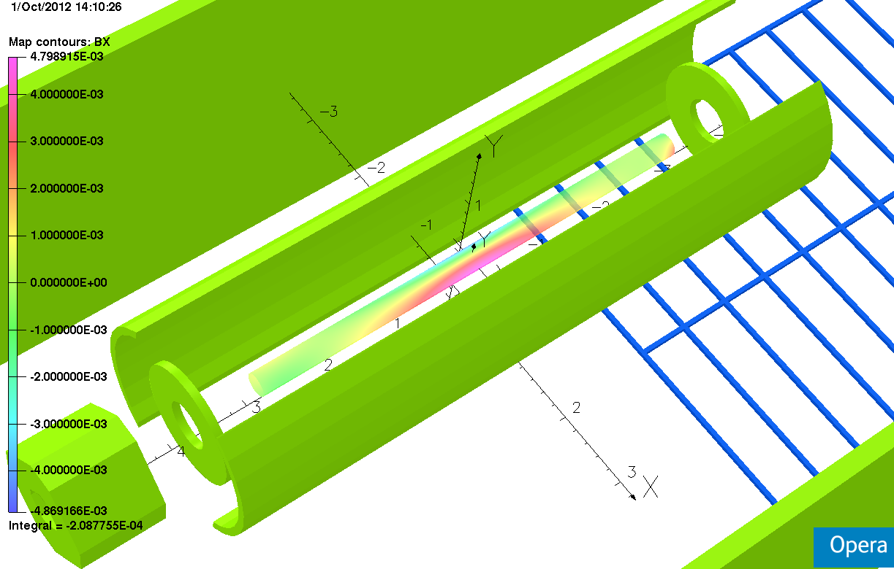
Unwanted Multipole Components
5 mT @ r=150mm
Additional hor. field introduced by shield

Slide 24
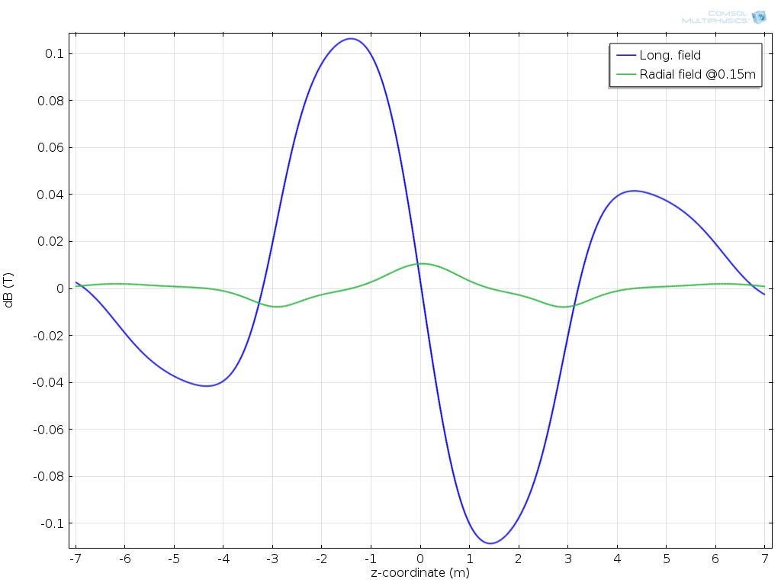
Unwanted Multipole Components
Caused by uncorrected
coil currents
2D Simulation

Slide 25
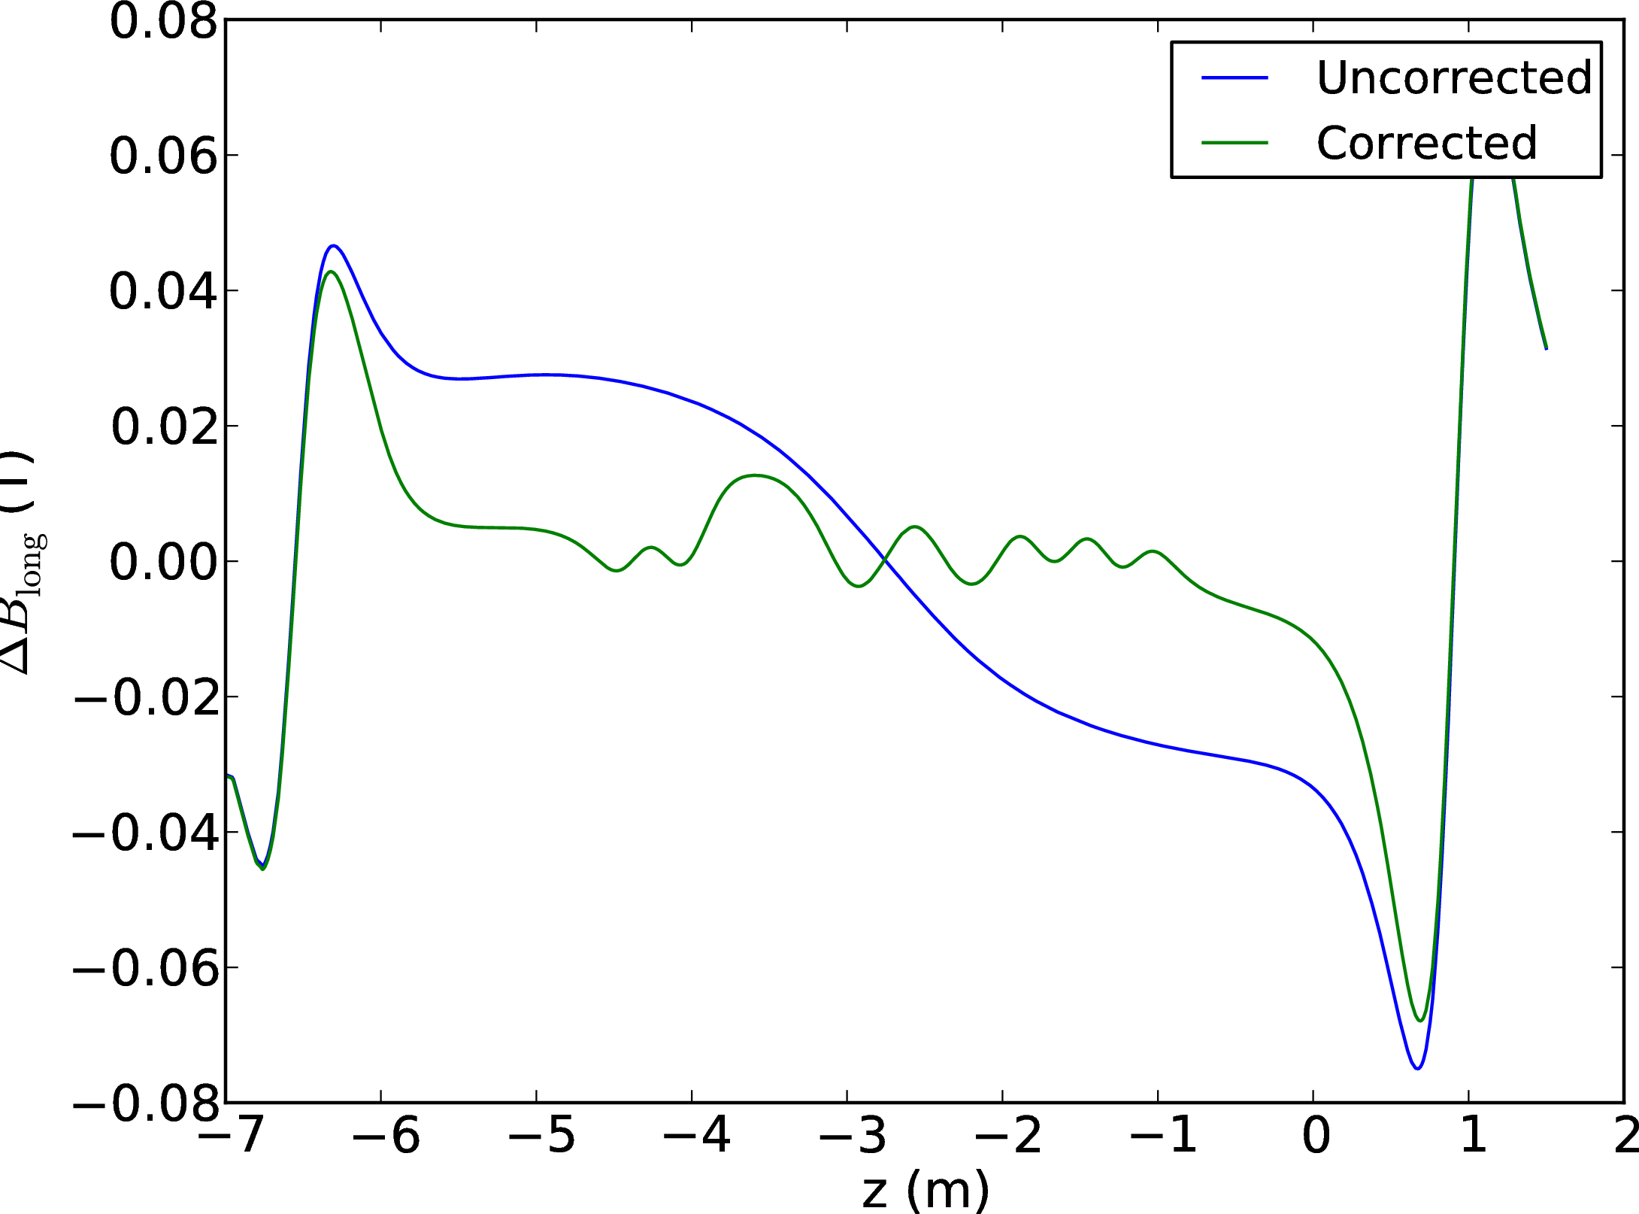
3D Field Correction

Slide 26
Forces
Forces on shield under quench conditions
  Normal operation: no longitudinal force on proposed shield
  Cases studied: Step IV
    1. one tracker solenoid switched off
    2. one focusing coil switched off
Coil forces
Forces evaluated in Opera/VectorFields
  Maxwell stress tensor
  (virtual work gives identical results within simulation accuracy)
  Field evaluation: Mesh = nodal, coil = integral

Slide 27
Forces on Shield
 | Hor. Force [kN] | Long. Force [N]
200 MeV Flip One tracker inactive | -13.6 | 73
200 MeV Sol One tracker inactive | -9.3 | 70
200 MeV One FC inactive | -30 | -8
Reference 200 MeV Flip | -30 | -158
Reference 200 MeV Solenoid | -13 | -143

Slide 28
Coil Forces Step VI
 | No Iron | Iron | Change
FC1 | -3367202 | -3410424 | 1.012836
CC | -203400 | -379805 | 1.867281
FC2 | 3235323 | 3294357 | 1.018247
FC3 | -3281620 | -3339131 | 1.017525
Match 1 | -190322 | -199323 | 1.047294
Match 2 | -49992 | -51374 | 1.027644
End1 | -851298 | -850645 | 0.999233
Spect. Sol | -29037 | -14438 | 0.497228
End2 | 1400771 | 1407749 | 1.004982
Force in Newton

Slide 29
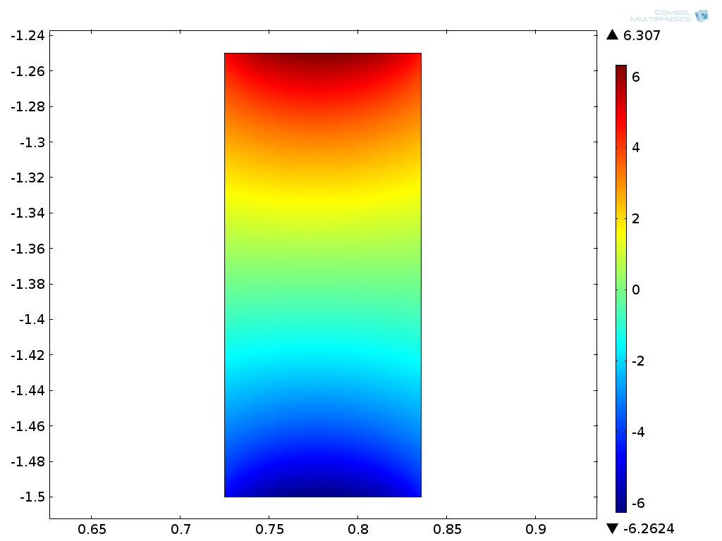

Radial Field CC
Iron
No Iron

Slide 30
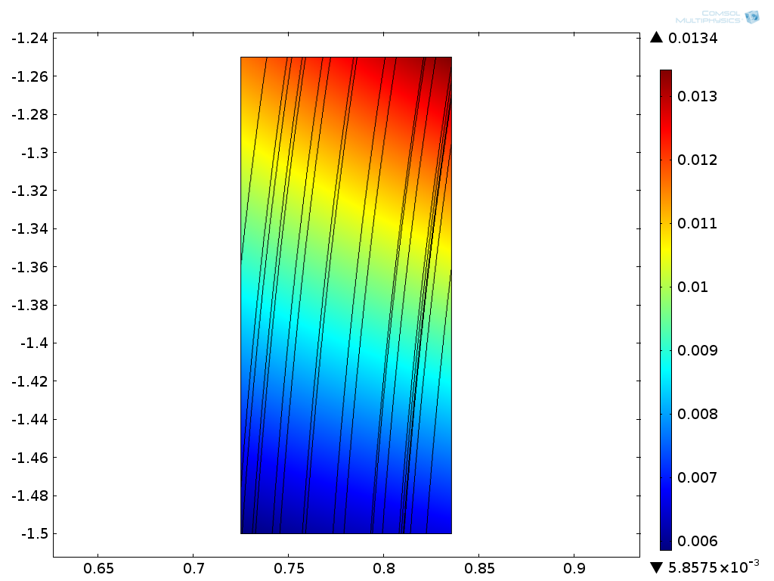
Radial Field CC
z [m]
F = (JxB)*V
Field difference (radial): 10 mT, J=115 A/mm²
V=(2*pi*0.8)*0.25*0.1
F=140 kN
r [m]

Slide 31
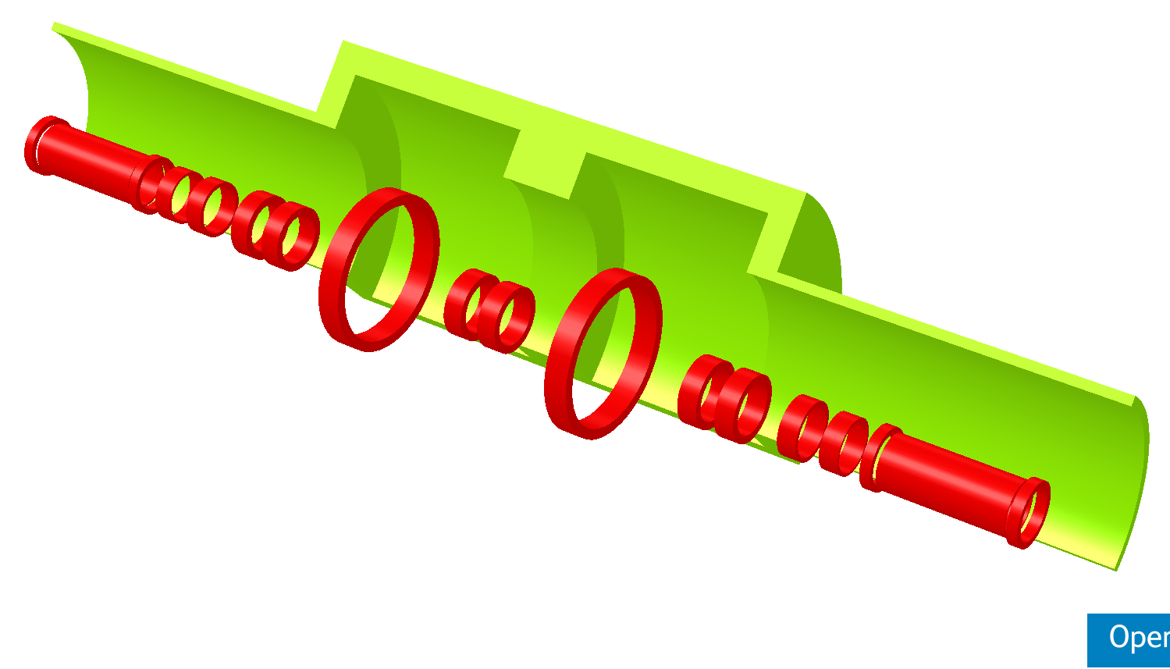
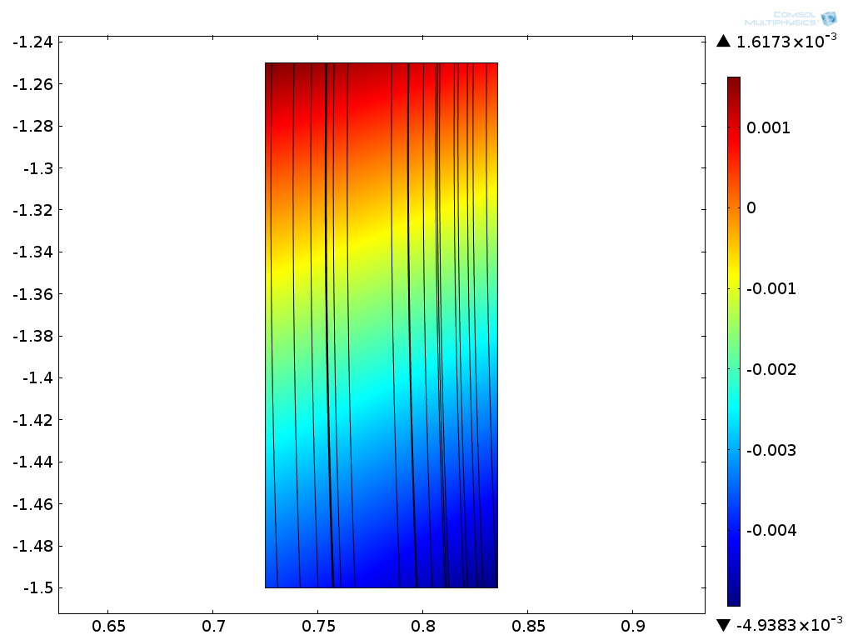
Step VI Force on CC
Add ‘nose’ to shield
Force (Opera 3D):
198 kN (97% of TRD)

Slide 32
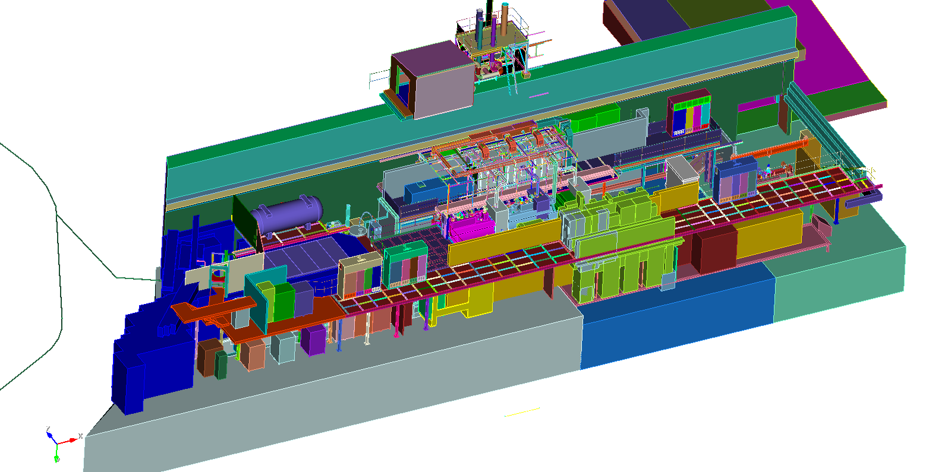
Engineering
Courtesy of Jason Tarrant, STFC
BNL engineering effort to look into practical design and manufacturing
Present estimate: Full design 1st week January
Procurement: 4 months

Slide 33
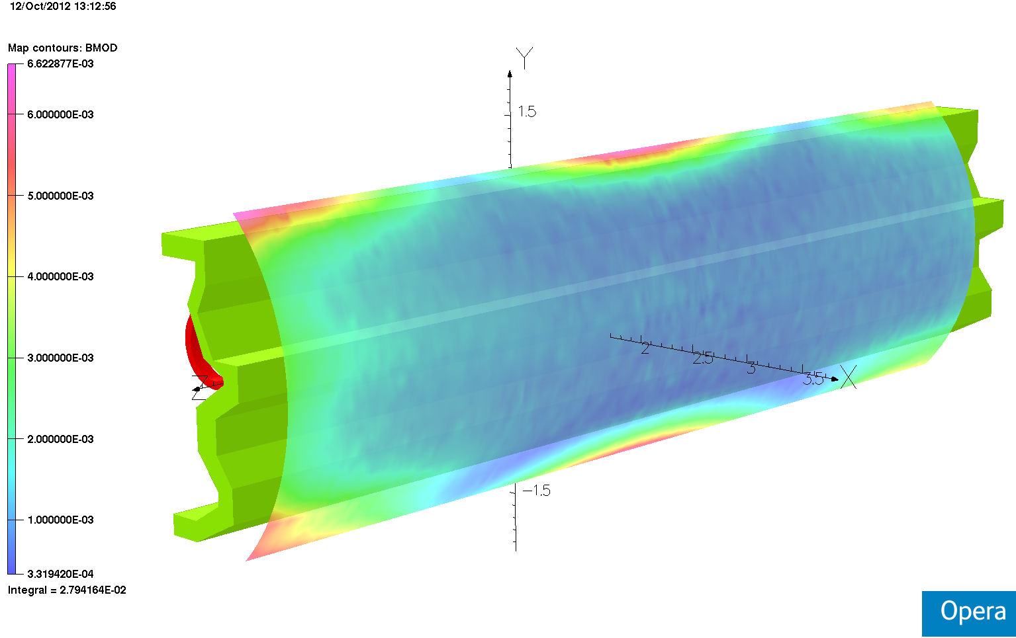
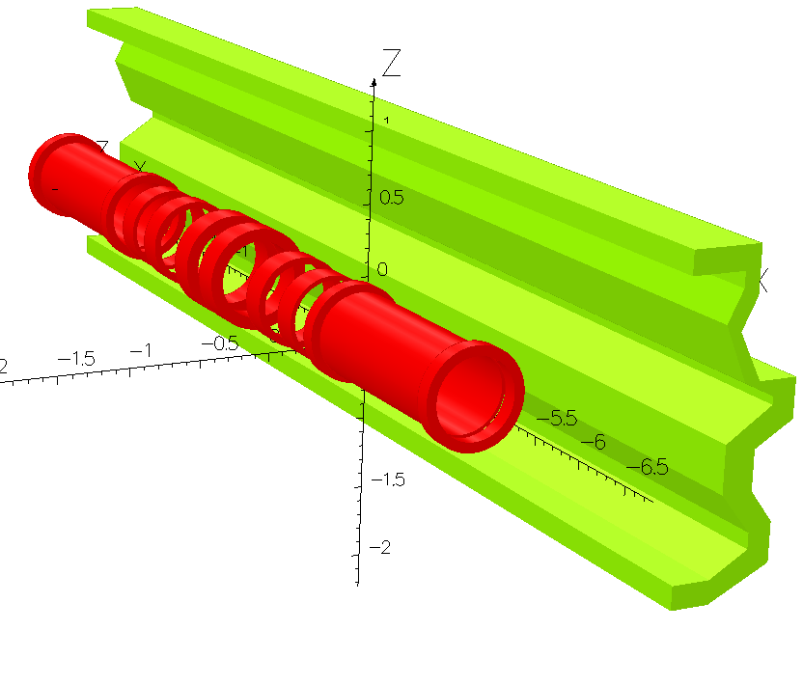
Geometric Freedom

Slide 34
Conclusion
Conceptual design of local flux return
  reduces stray field in hall significantly (factor 30)
  shield: about 30t of iron (130t for Step VI)
  force on shield manageable
Effect on beam
Effect on other iron structures in hall
  Q9, floor, walls
Extension to Step VI possible
  includes solution for natural breaks in shield for wire feed-in/out
Engineering

Slide 35
Additional Slides

Slide 36
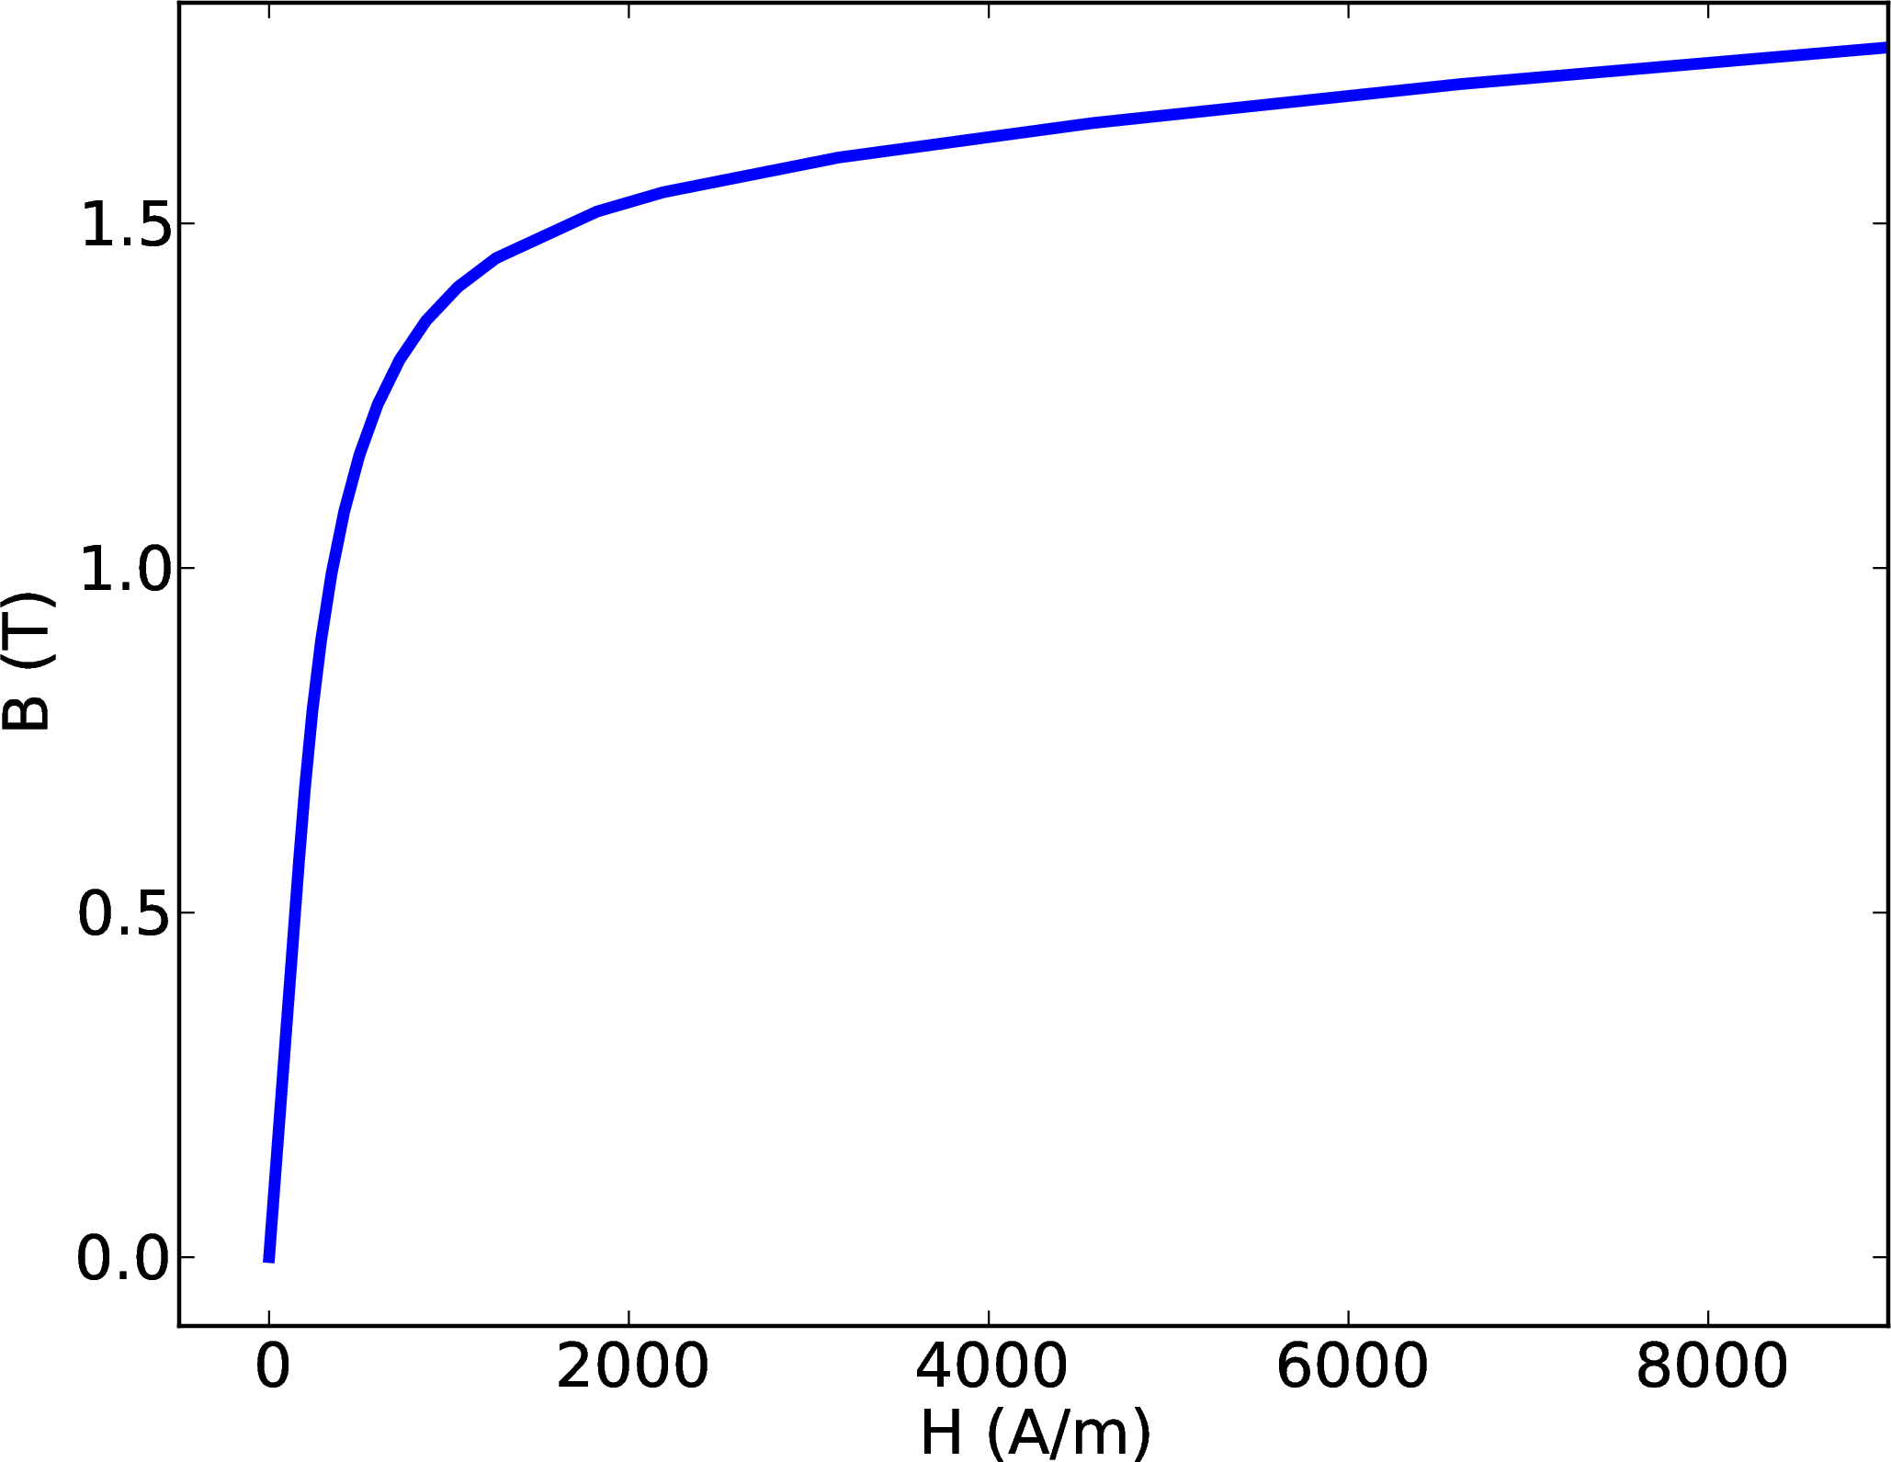
Simulation Details
Finite element simulations
  Opera from VectorFields/Cobham
  Comsol Multiphysics
Iron
  AISI 1010 steel
  BH curve: Opera/VF
(Benchmarking)

Slide 37
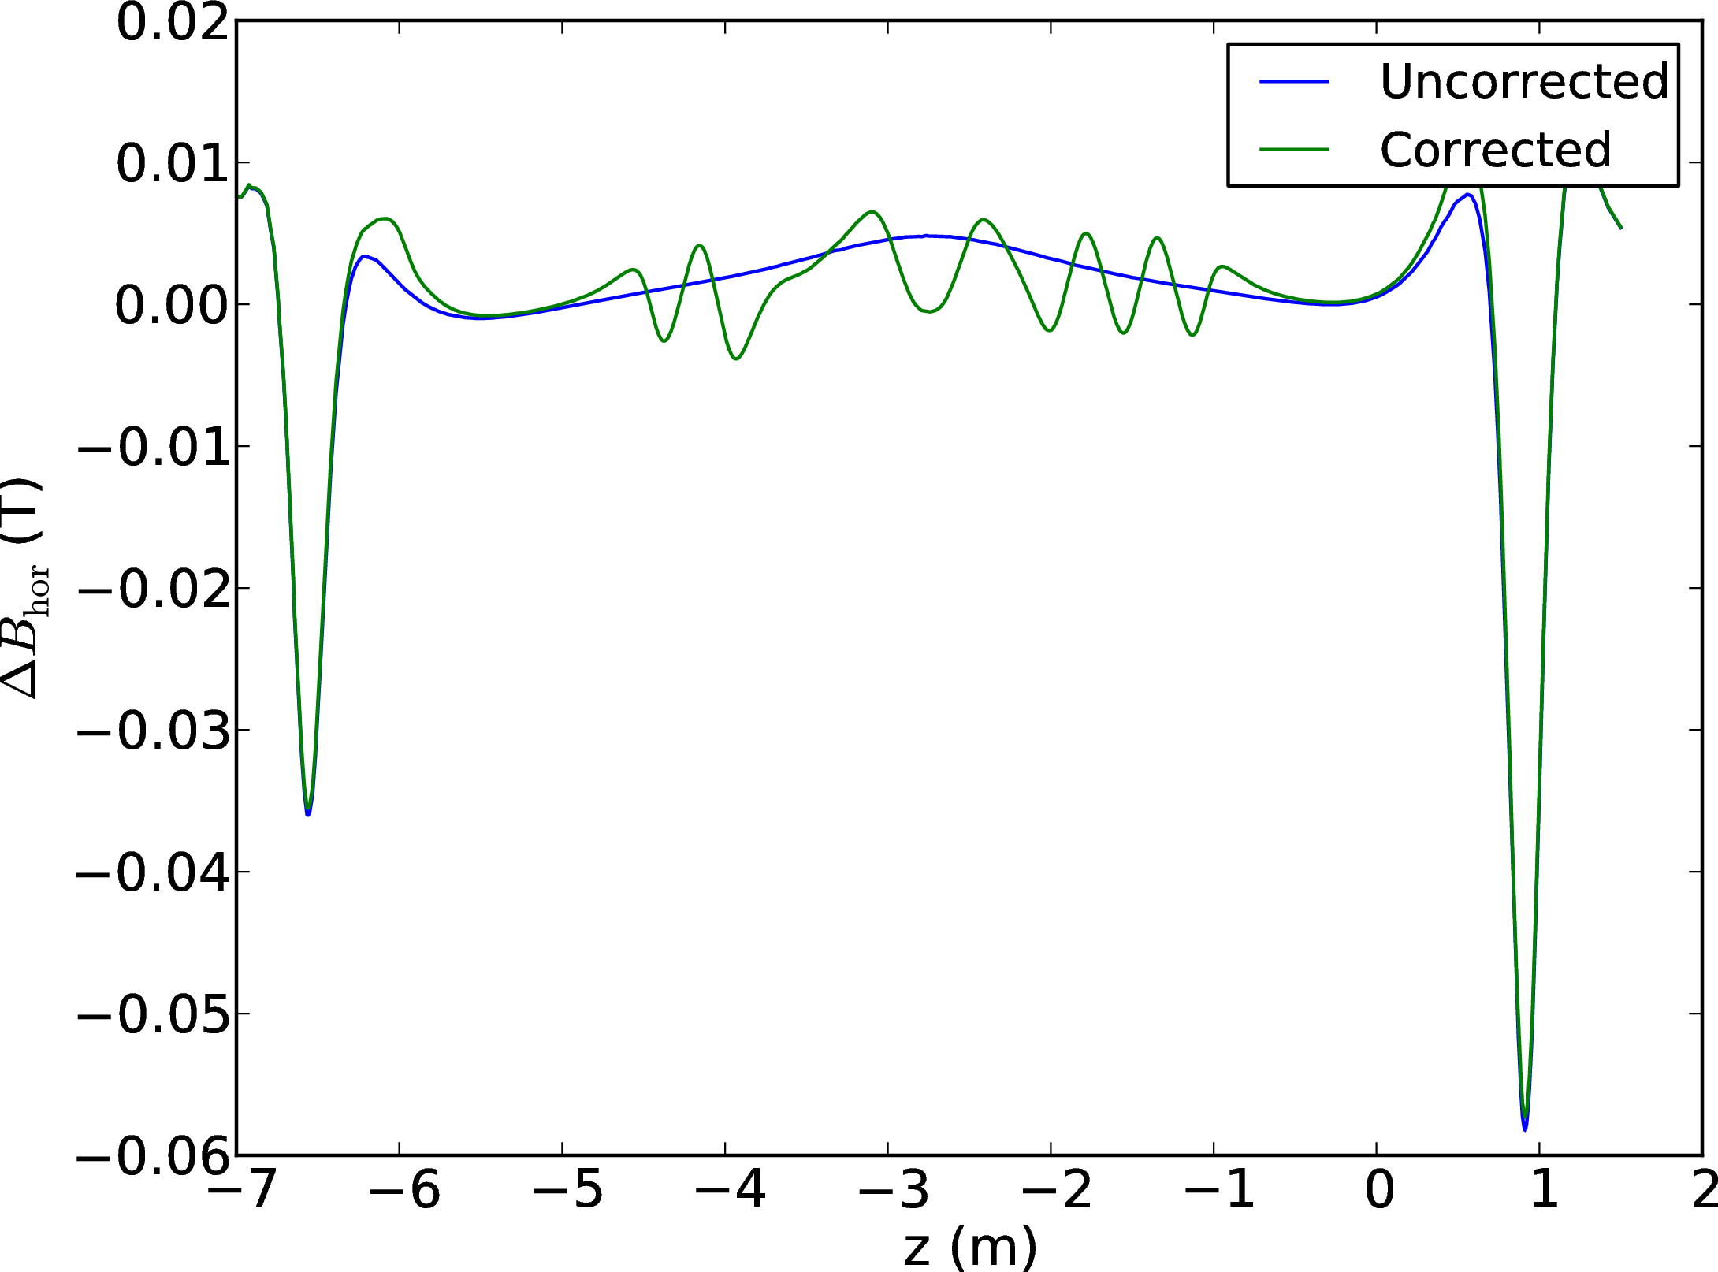
3D Field Correction

Slide 38
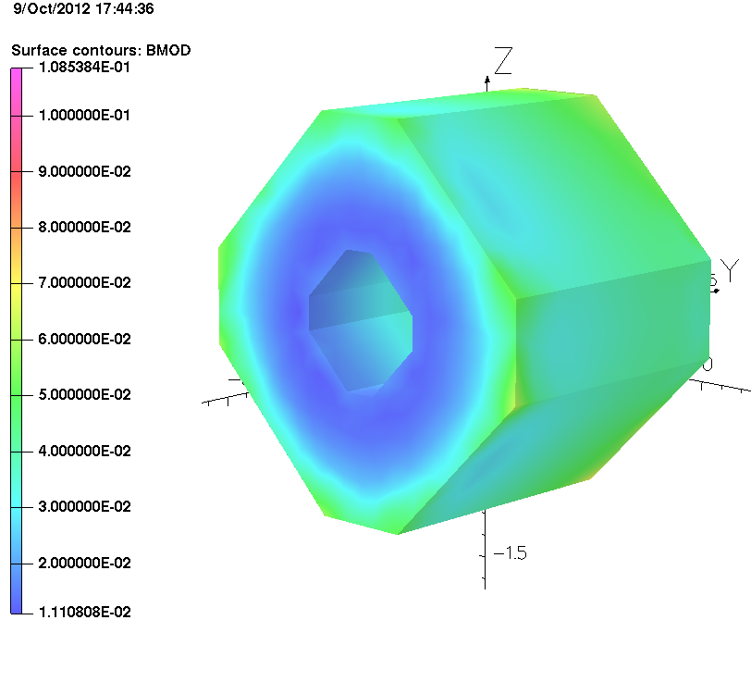
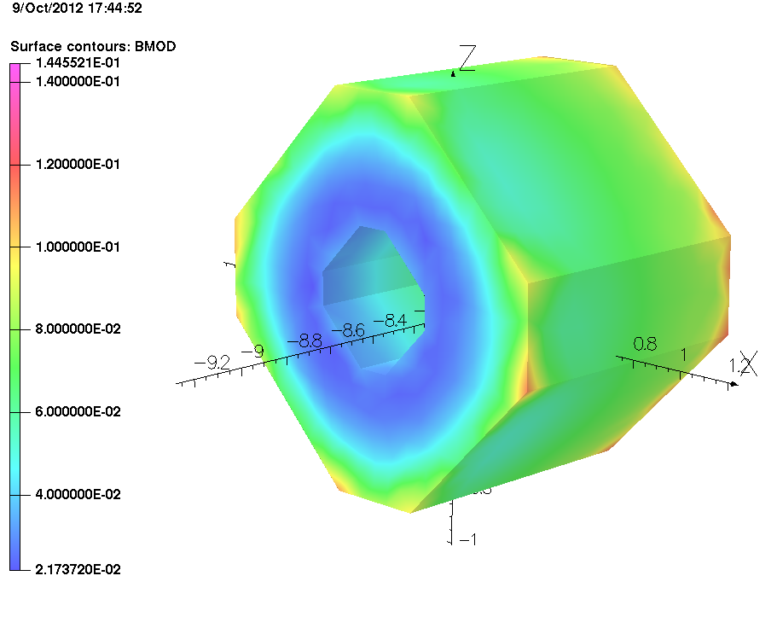
Quad Q9
No Shield: 62mT
Shield: 36 mT (average)

Slide 39
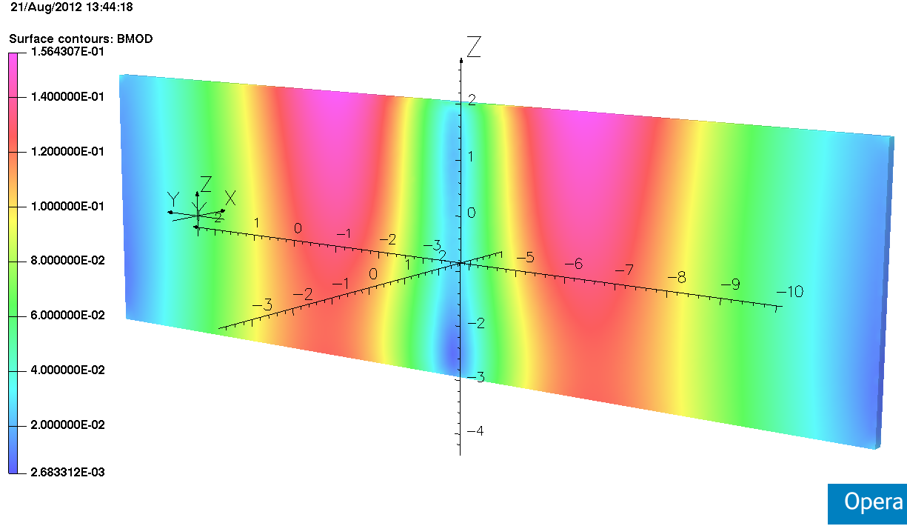
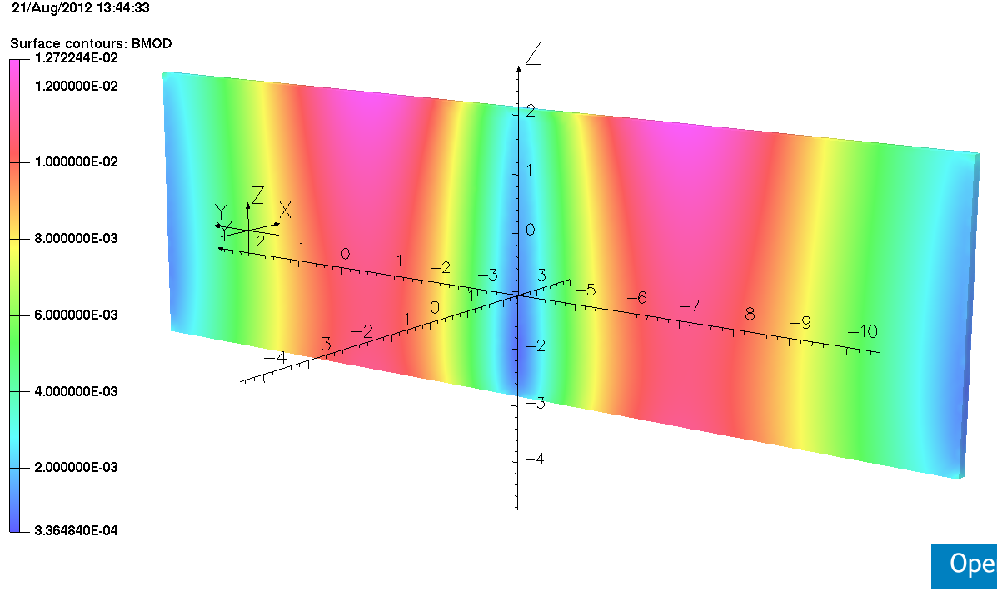
Walls
No Shield: 150 mT (peak)
Shield: 12 mT (peak)
Reduction of factor 10+

