Slide 1
MICE CM34
Engineering and Schedule summary
Engineering summary
Schedule plans
Andy Nichols, STFC, 18/10/12

Slide 2
Engineering Summary
Major topics covered elsewhere in agenda, but covered useful items:
Radiation shutter tests, as requested by TB are complete
  Direct motor drive works fine
  Able to cope with twice anticipated incline of rails
  Magnetic compatibility is OK
  Minor issues with control box placement and cable routing, but easily understood
  Rail material now on order, long lead time
Electrical engineering:
  ‘MICE’ Quench detector production line underway at DL
  Tenders for Decay Solenoid are back
  Delivery anticipated for April 2013 – will affect planned EMR run
  MC stated that DS will not be run with existing PSU

Slide 3
Schedule planning
October/November are busy months for scrutiny!
  October 31st – MPB (MICE Project Board)
  November 5th – UK OsC (Oversight Committee)
  November 12th – FAC (Funding Agency Committee)
We have to:
  Agree among the MICE an achievable schedule for the project
  Prepare a fully resource-loaded project plan for the MPB, to include:
    Construction
    Operation
    Significant milestones
Useful workshop on Tuesday:
  US & UK construction schedules have converged
  We believe they are aligned with available resources
  Thanks to Alan, Ken, Mark, Alan G, and Peter, Richard at FNAL

Slide 4
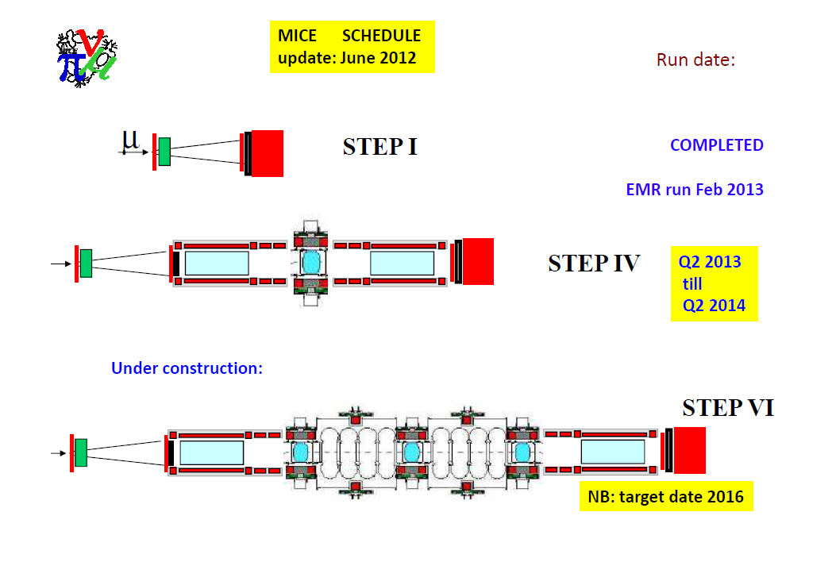
Present schedule slide, lifted from MICE page – as agreed at CM33, Glasgow
Q2 2014
Long shutdown Aug
2014
2018
Possibility of Step V
At 2017
Properly edited version of this will follow…..

Slide 5
Some schedule considerations
Some of the main drivers:
  FC is late, delivery late October, everything is ready for it here
  SS #1 has problems with blocked vents and heater controls, plan being made for completion and delivery (to RAL) of both magnets at once in Q3 2013
  Magnetic shielding plan in R5.2 must be implemented, Default plan and local yoke will be studied in parallel – detailed WPs under construction
  EMR has been delayed, but is not critical path
For Step V & VI, we can now aim at 2017/18 as aspirations, but am sure much more detail is required
  The third FC module will be fitted to that plan
  As can the RF infrastructure work

Slide 6

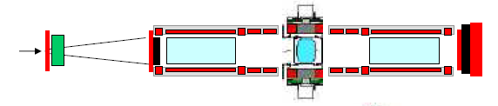
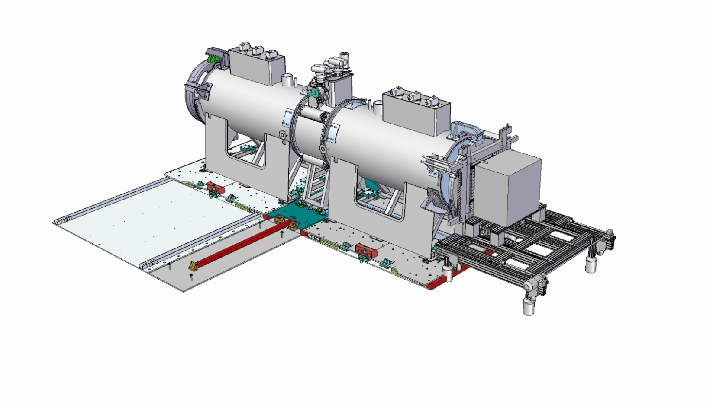
STEP IV
Subsystem | Date
Spectrometer solenoid #1 + #2 | Q3 2013
Fibre tracker #1 + #2 | Ready
Focus coil #1 | Nov ’12
LH₂ system A | TBC
Solid absorber(s) | TBC
Liquid absorber | Ready
Diffuser | Ready
Virostek plate & TOF cage assy | Ready
Substation upgrade | Ready
EMR installation | Feb’13
Radiation shutter | Ready
AFC Moving platform #1 | Ready
SS platforms Installation | Ready
Magnetic shielding plan | TBC
Step IV ready Q2, 2014

