Slide 1
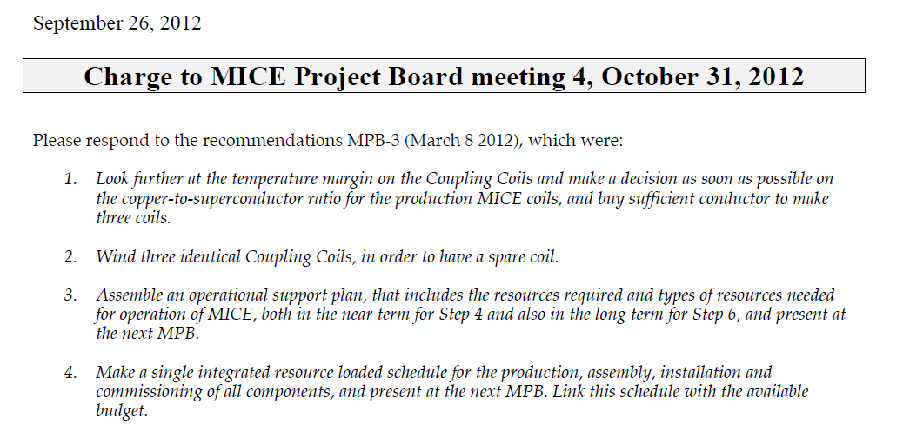
got answer from Steve Gourlay
got answer from Steve Gourlay
got answer from Andy Nichols & Linda Coney
work carried out by Ken Long, Alan Grant,
Mark Palmer et al

Slide 2
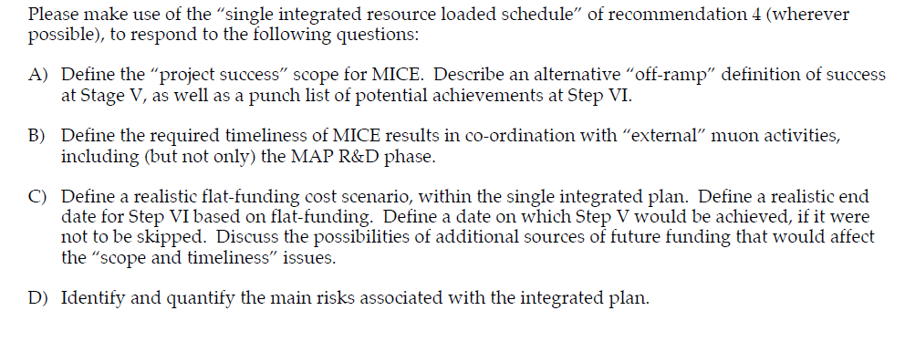
this was defined in the MICE proposal and I dont know that it has changed
Mark Palmer to prepare text. relation with European Strategy (proposal by 2018)
CERN help with coupling coils
I would like to go around the table to get your opinions

Slide 3
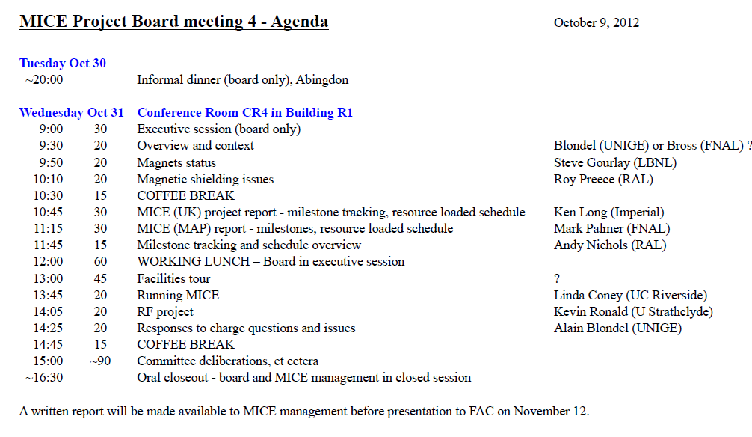
MPB agenda

