Slide 1
Meeting of Task 2.2 on HL-LHC Lattice & Optics
Status of Optics calculations
impact on magnet R & D
on crab cavity R & D
input for tracking calculations (magnet quality & multipole compensation)
for beam-beam simulations
for collimation task
etc etc
mid term goal: establish HL-LHC V1.0 (Nov. 2012)

Slide 2
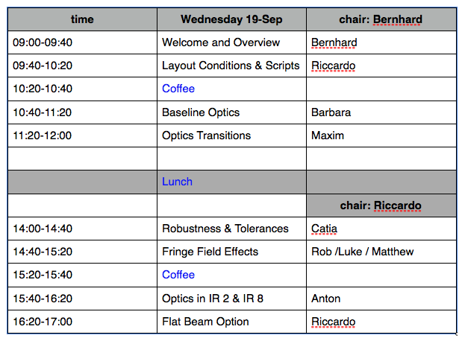
Meeting of Task 2.2 on HL-LHC lattice & optics
Basic Idea: ≈ 30 ... 40 min presentation, 0 ... 10 min discussion

Slide 3
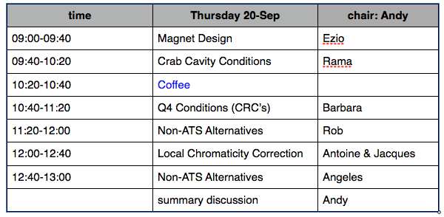
Wednesday evening: 19:30 Pizzeria d’Oro

Slide 4
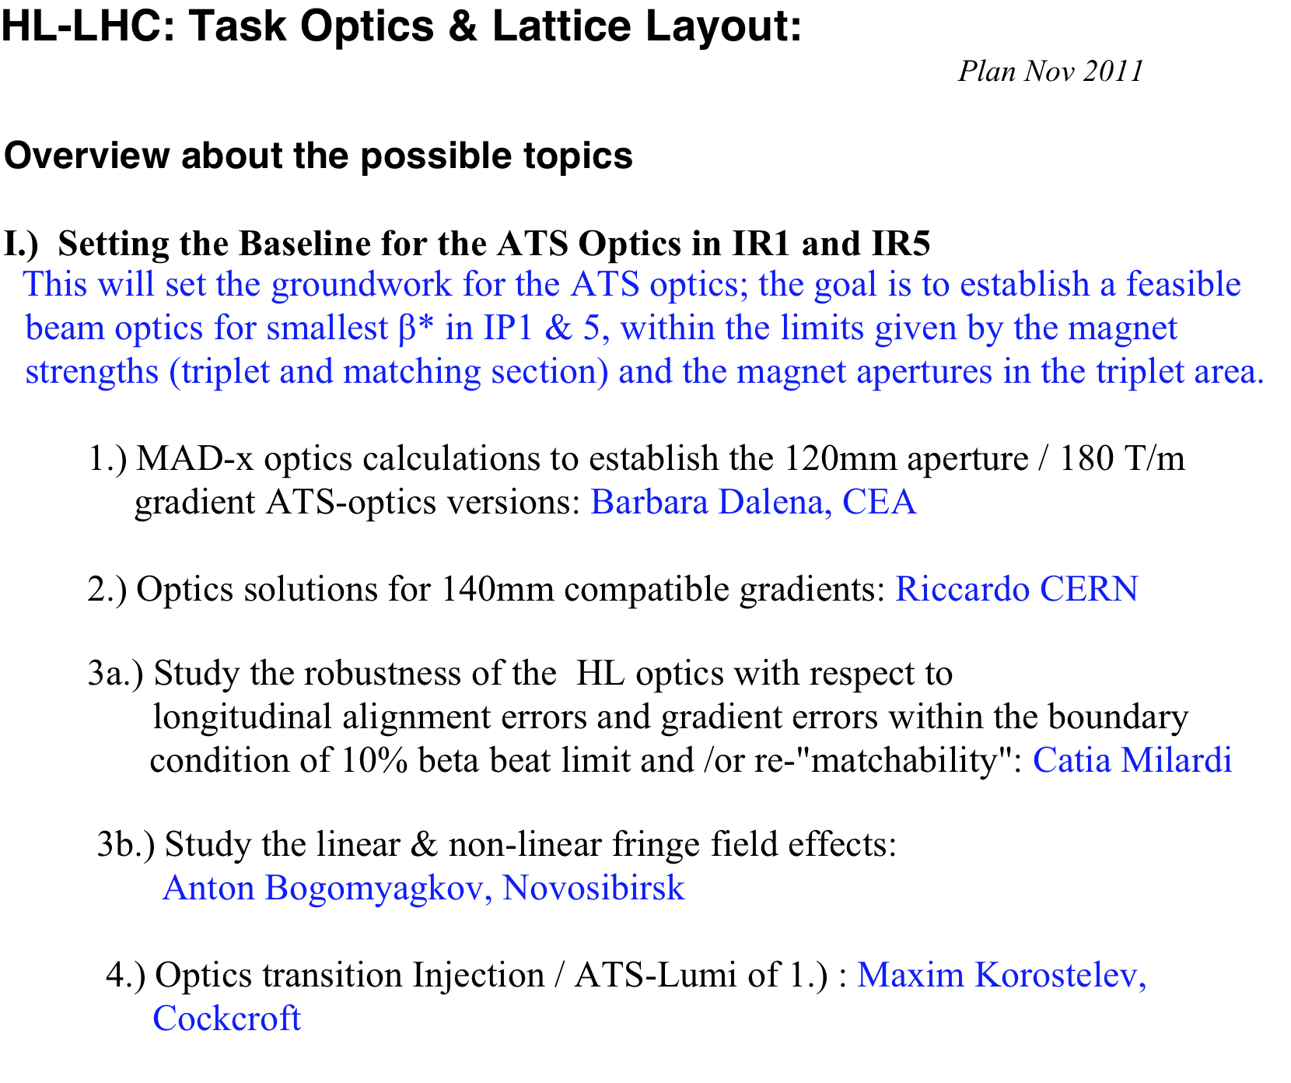

Slide 5
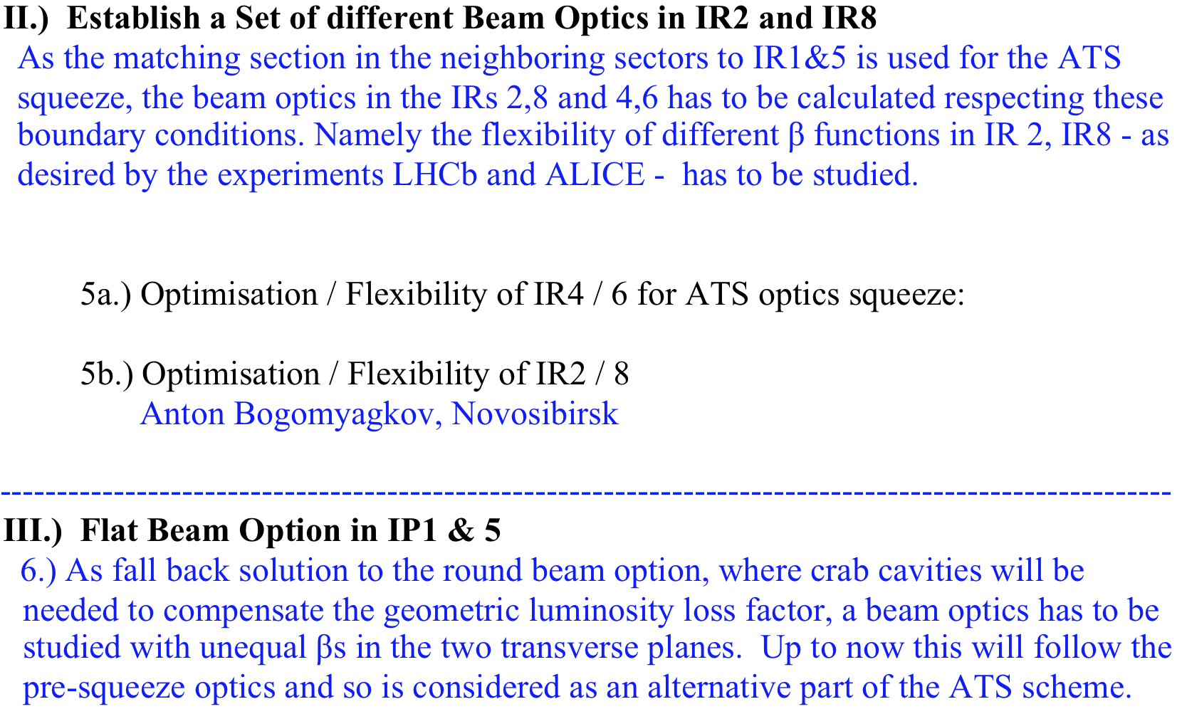
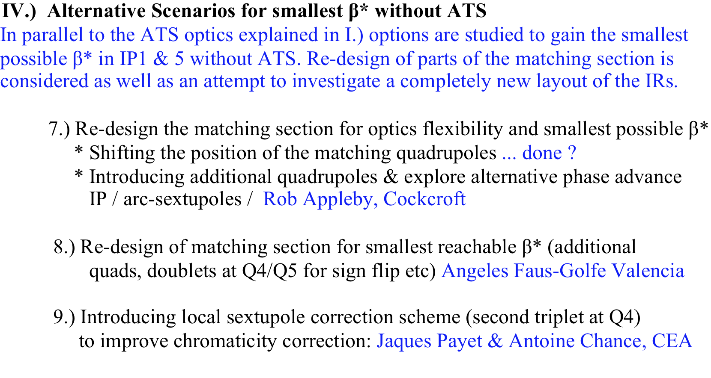

Slide 6
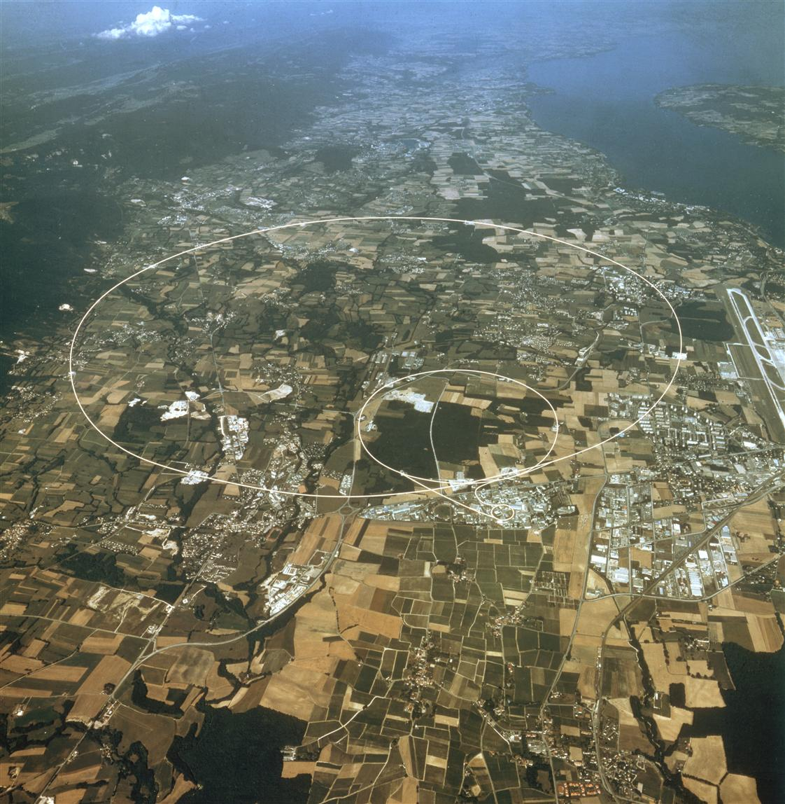
LHC Upgrade Challenges
IP6
IP5
IP4
IP8
IP1
IP2
*

Slide 7
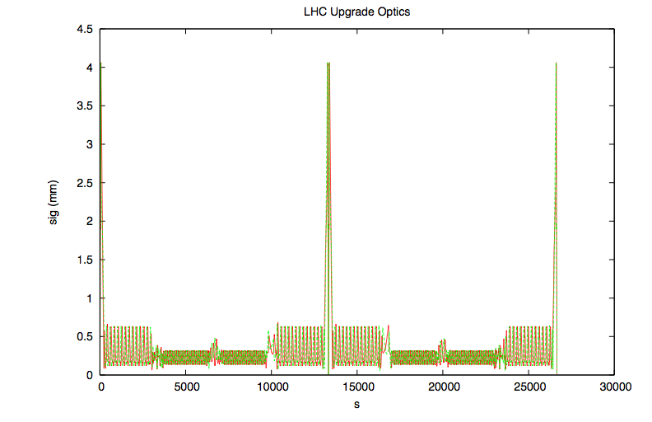
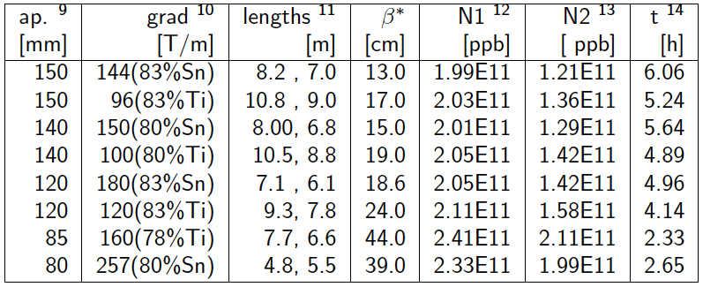
LHC Luminosity Upgrade in ATS
IP8
IP1
IP2
set up four baseline optics
based on assumptions on
aperture & magnet technique
Notes:
7

Slide 8
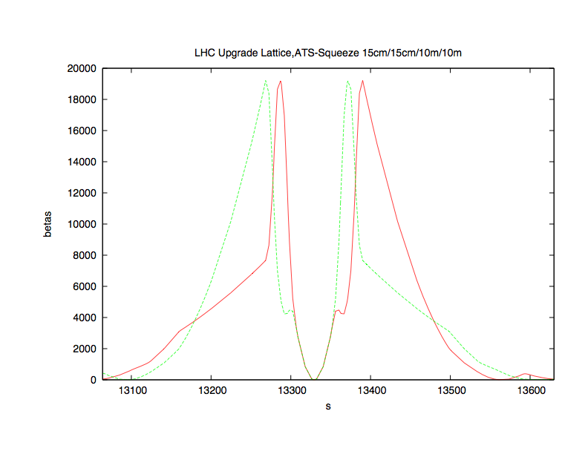
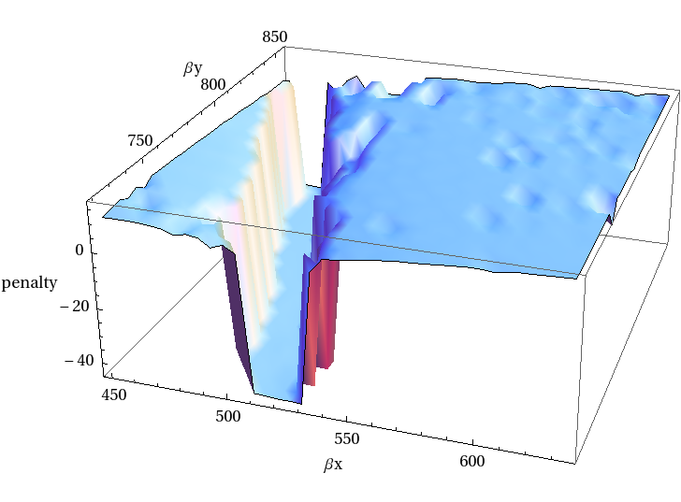
LHC Upgrade Optics in IP1 / IP5
We need to generate the triplet with different boundary conditions according to the triplet gradient we want to reach
For which hardware limitations
do we get an optics solution
AT ALL ??
Don’t forget: any solution must fit to the rest of the machine !!!
174 T/m

Slide 9
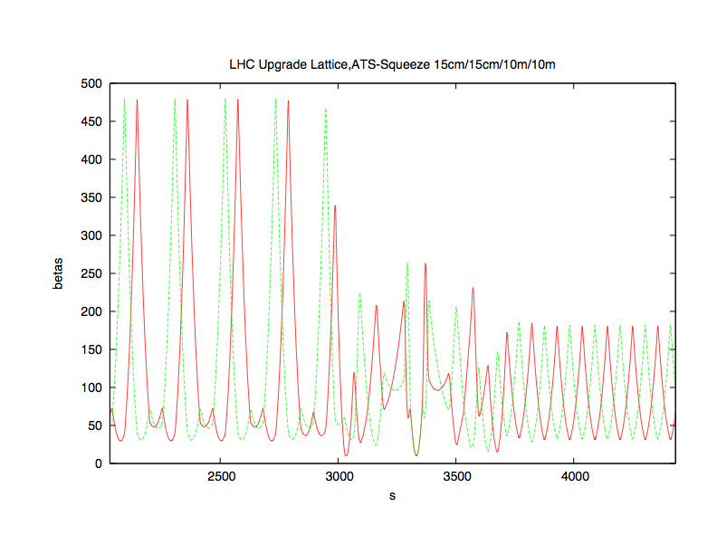
LHC Upgrade Optics in IR2
the “ATS Squeece Optics
(15cm/15cm/10m/10m)
IP1, ATS Optics
IP2
IP3, Standard FoDo Optics
Find an otpics solution that is feasible for the Luminosity upgrade
and guarantees adequate conditions for the ALICS and LHCb experiment at the same time.

Slide 10
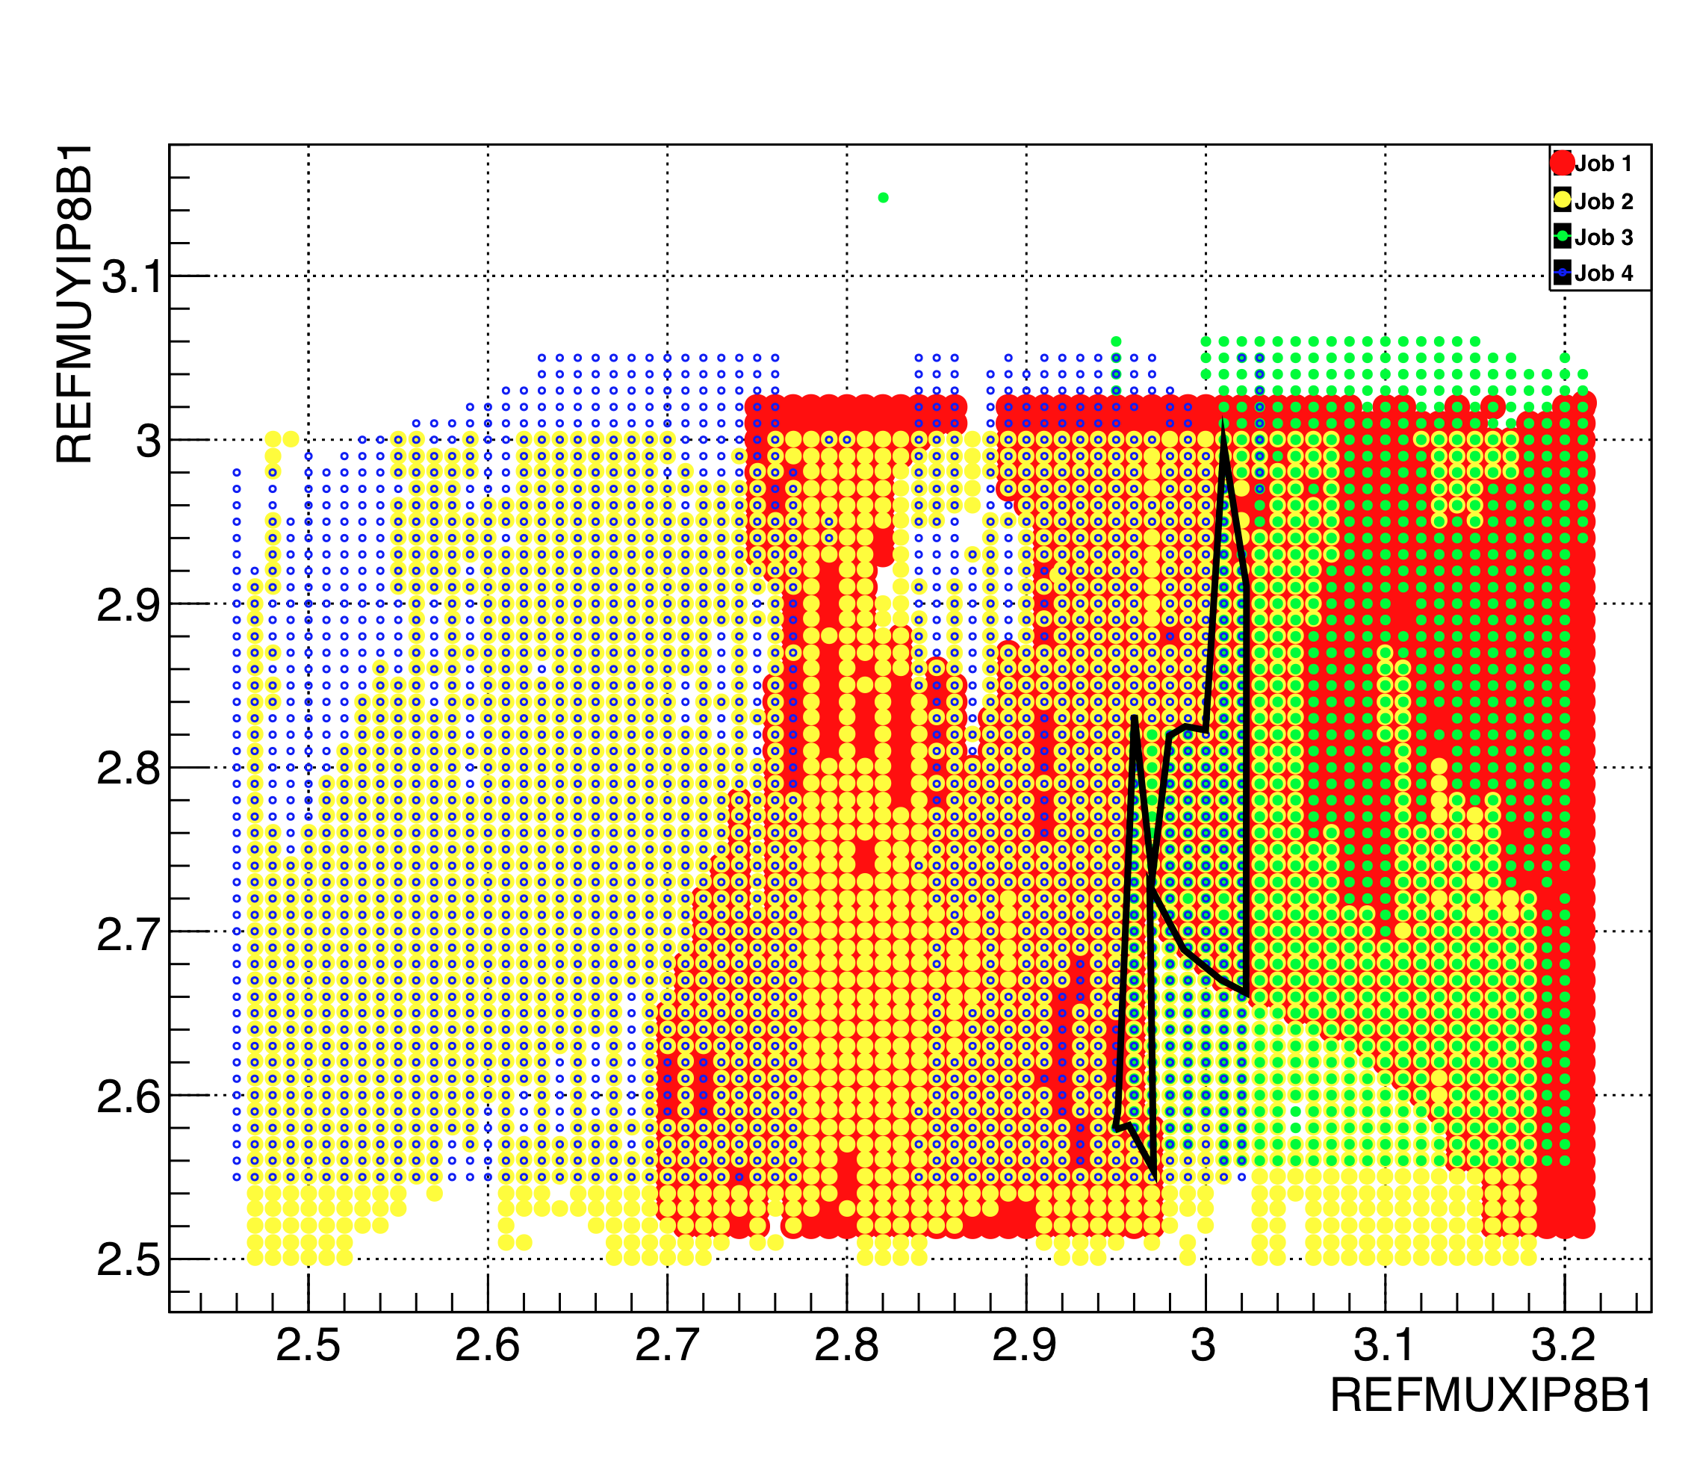
A large variety of beam optics studied & optimised
bog_150_0100_0100_3000_3000.madx β*(IP8) = 3m standard ATS, round
bog_150_0050_0200_3000_3000.madx β*(IP8) = 3m standard ATS, flat_xy
bog_150_0050_0200hv_3000_3000.madx β*(IP8) = 3m standard ATS, flat_yx
bog_150_5500_5500_10000_10000.madx β*(IP8) = 10m ATS_injection
bog_150_0400_0400_0500_0500.madx β*(IP8) = 50cm ATS ions
Each optics has to be „implemented“ into the overall LHC lattice & optics.
Main Issue: Search for ideal phase advance
over IR8.

Slide 11
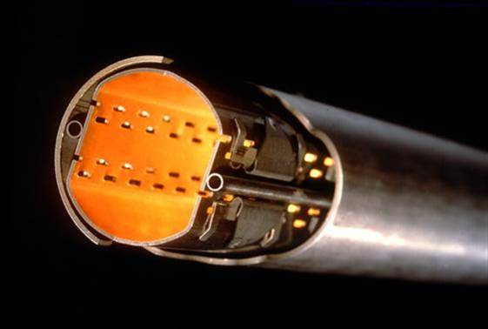
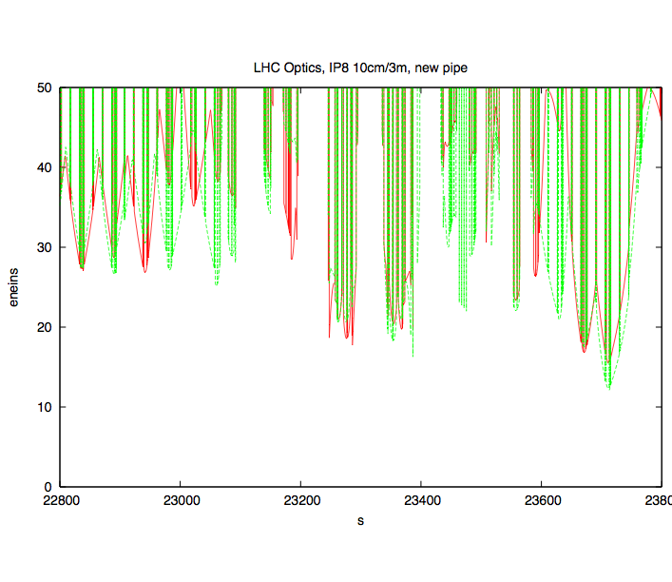
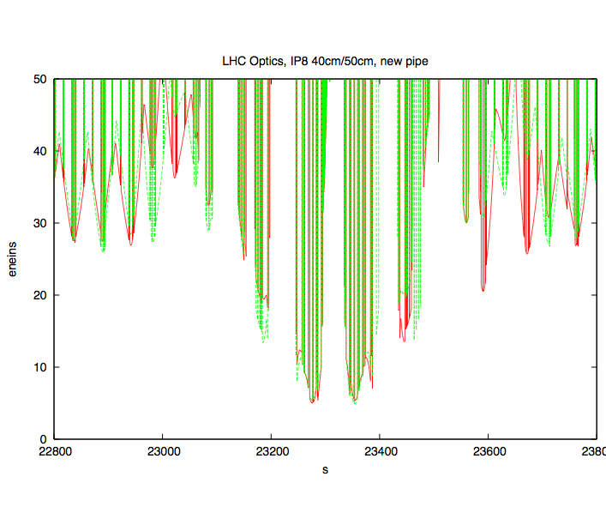
Aperture Calculations
calculate the number of σ that – for a given bam optics –
fits into the vacuum chamber
magnet aperture
new experiment beam pipe
14 σ
IP8
7 σ !!!

Slide 12
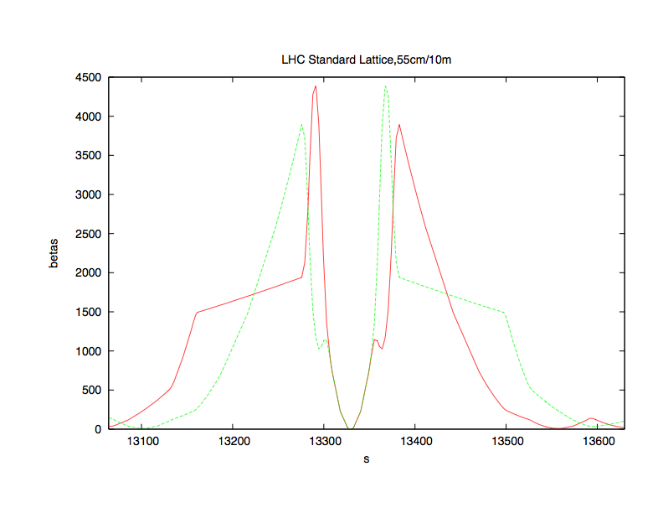
LHC Upgrade Optics Tolerances & Robustnes
β_{max}=4.5km
β_{max}=20km
LHC Standard: β*=55cm
LHC Upgrade: β*=15cm
Impact on magnet strength,
apertures,
sensitivity of the beam (gradient errors & multipoles)
crab cavity voltage etc

Slide 13
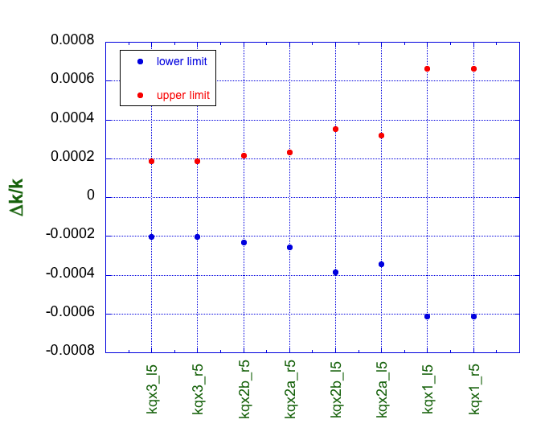
High Luminosity LHC
Study of the tolerances for the quadrupole strengths in the IR5
check the allowed tolerance window in magnet length, power converter stability,
quadrupole gradient ...
Tolerance criteria:

Slide 14
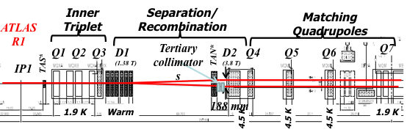
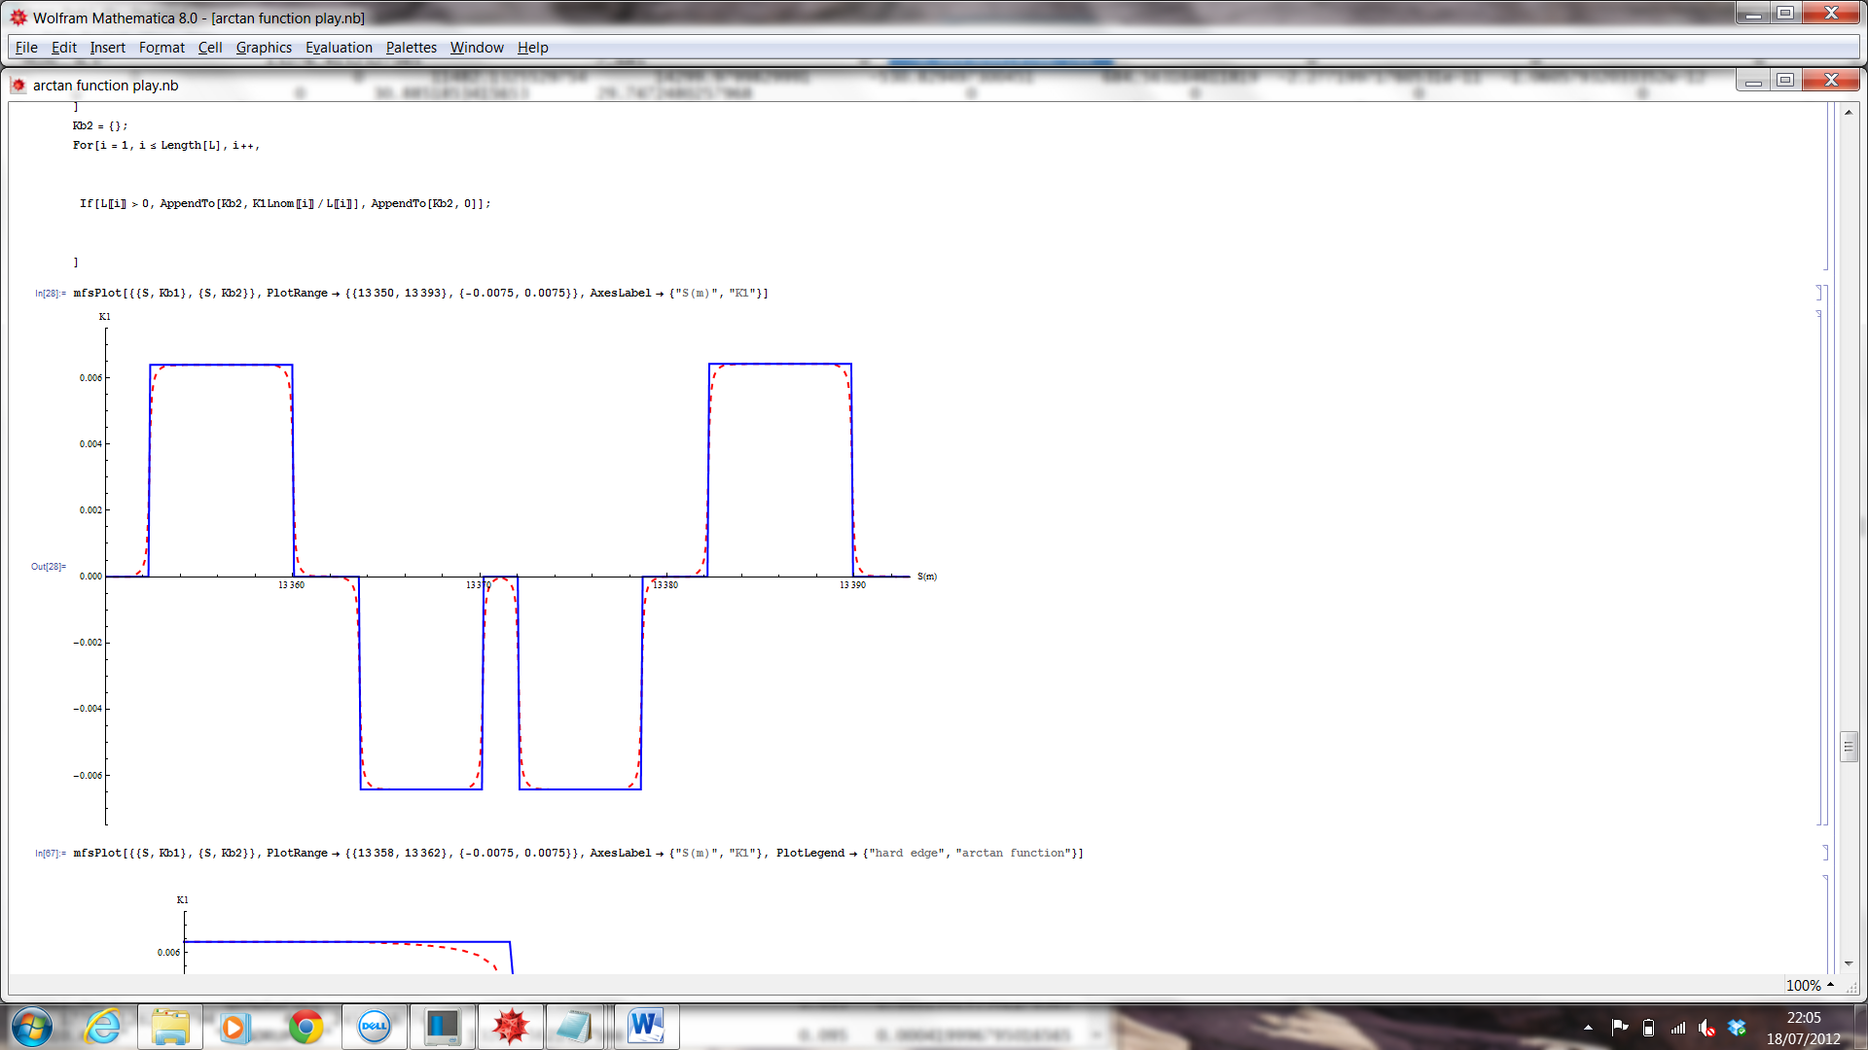
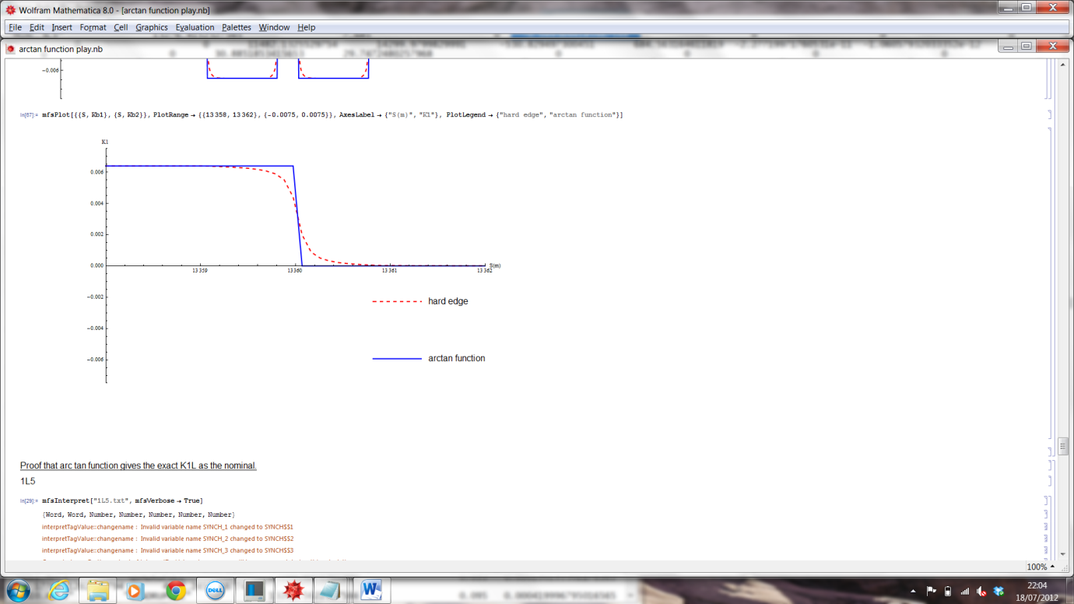
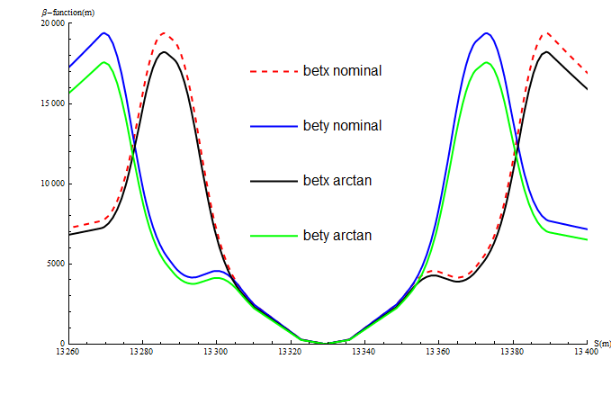
LHC Upgrade Optics Fringe Field Effects
improve the magnet box model, taking into account realistic fringe field effects
clearly we require:
but the effect on the beam is determined also
by the β-function
L

Slide 15

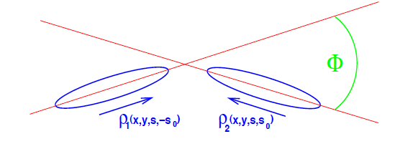
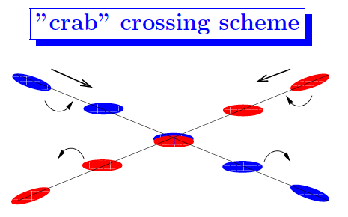

LHC Upgrade Optics x-angle, Crab Cavities, Flat Beam Option
* S
ideal luminosity formula
★★★★★★
loss factor due to crossing with an angle
(pure geometric effect ... but large)
≈ 0.37

Slide 16
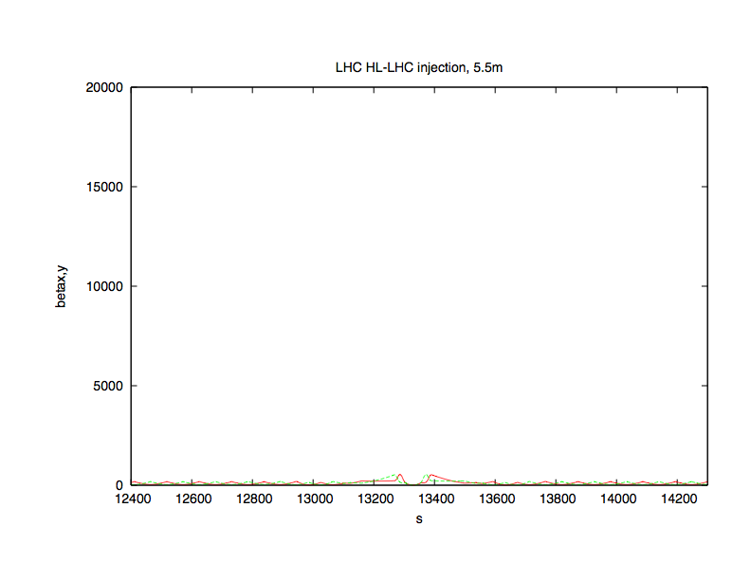
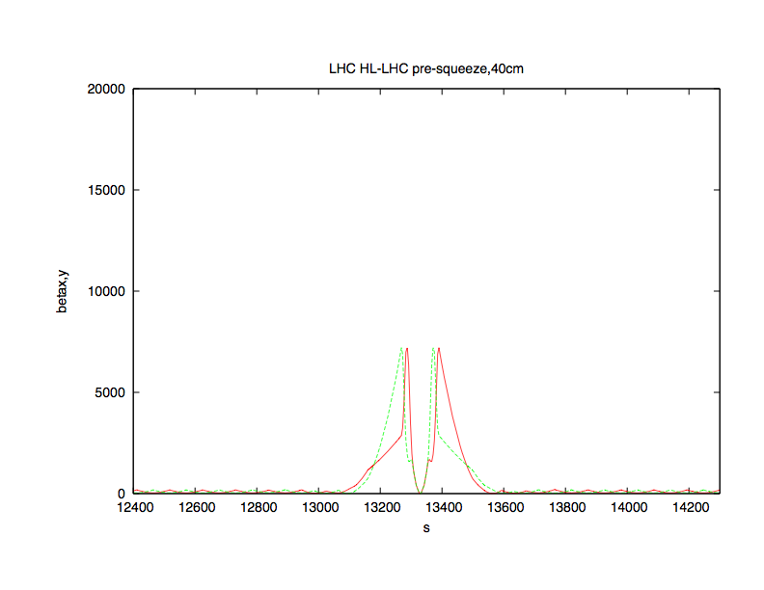
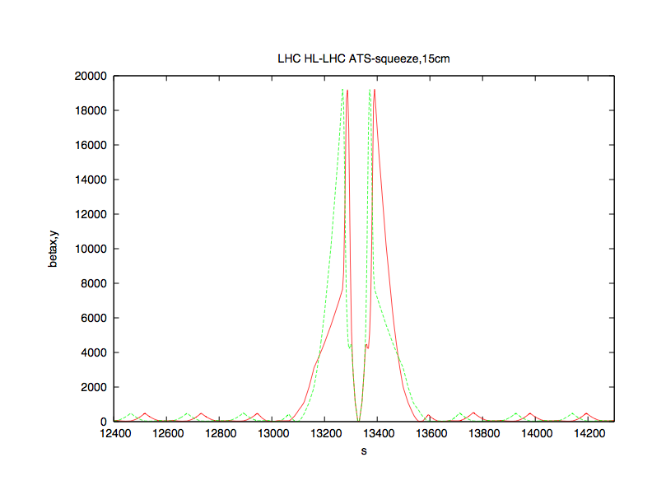
LHC Upgrade Optics Transition
Injection - Presqueeze
find a smoooooth transition without (too many) hysteresis problems
5.5m injection optics
40cmpre-squeeze optics
15cm ATS optics

Slide 17
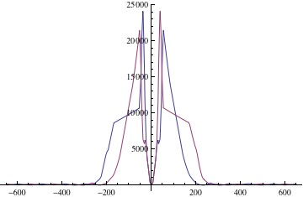
LHC Upgrade: Non-ATS Solutions
Re-Design of the Matching Section for Optics Flexibility and for Plan “B”
re-positioning of the matching quadrupoles, namely Q4...Q6
introducing an additional quadrupole lens between q3 and q7.
get the smallest β* at the IP1 & 5, to establish an ambitious pre-squeeze optics or - even more to obtain β* values that will allow us to get the required luminosity without ATS squeeze.
Re-Design of the Matching Section on Big Scale
Local Sextupole Correction Scheme

Slide 18
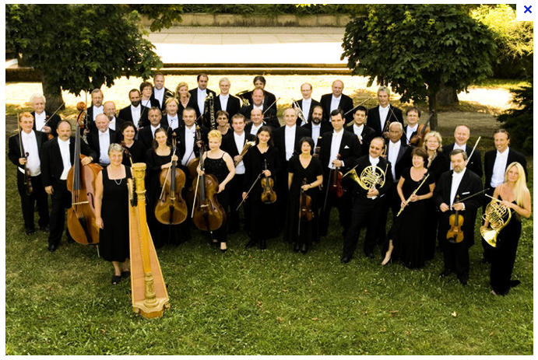
!
Than’x to all of you for the great effort and motivation
 | Optics
Gradient
 | 11m | 5.5m | 40cm | 15 cm | 10cm | flat | 20cm
150T/m | ✔ | ✔ | ✔ | ✔ | ✔ | ✔
100 T/m |  |  | ✔ | ✔
170 T/m |  |  | ✔ | ✔ |  |  | ✔
123 T/m | ✔ |  | ✔ | ✔ | ✔
next steps:
complete the optics table
-> define the triplet parameters
Q4 problem (crab cavities)

