Slide 1
Effect on the Beta-function due to magnetic fringe fields from the inner triplet quadrupoles
Matthew Bryn Thomas
Rob Appleby

Slide 2
Scope
Introduction
Magnet Model set up
Linear fringe field model
  Strength profile
  Beta-beat
  Effect of different set ups
  summary
Arctan fringe field model
  Strength profile
  Beta-beat
Summary

Slide 3
Introduction
The ATS optics assumes a ‘Hard Edge’ model for the quadrupoles. In reality magnetic fringe fields exist that will perturb the solutions from this ‘ideal’.
Over the summer we’ve been looking at the extent of these perturbations on the the beta-function (beta-beat).
By using MAD-X to simulate the beam optics, the magnetic fringe fields of the inner triplet quadrupole magnets around IP5 were modelled.
The upgrade design used for the analysis was the ATS optics with a Beta* of 15cm at the interaction point.
The purpose is to provide information on how much beta-beating will be caused in more realistic magnets and whether this error can be absorbed safely into the machine optics through matching.

Slide 4
Model Set-Up
A macro using seqedit in MAD-X was developed in order to replace the inner triplet magnets with an arrangement of five smaller magnets bordered by “fringe magnets” . An illustration is shown below for a specific magnet arrangement.
The main magnet is split in to 5 smaller elements so that the behaviour of the beam can be explicitly observed inside the magnet as more information is outputted from MAD-X
L
d
5*m*d
Figure 1: Diagram of the reconstructed magnet for a 10 fringe magnet example case

Slide 5
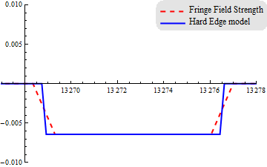
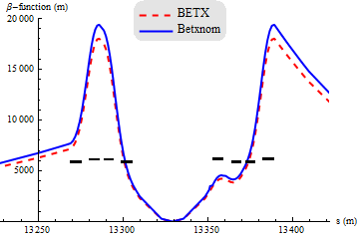
Linear fall off model
The linear fall off model used three fringe magnet cases of 5, 7 and 10 fringe magnets (slices) (called stages). For each stage three different slice lengths were considered (called trials).
The purpose of the linear fall off model was:
To ensure that the MAD-X coding was bug free
To gain an insight into how much beta-beating is created for different field ranges before a more accurate field model is used.
To see any effect on the number of slices for fixed fringe length
k1 [/m^2]
S [m]
N=5 slices, Fringe
field range=57cm
N=5 slices, Fringe field range=20.55cm

Slide 6
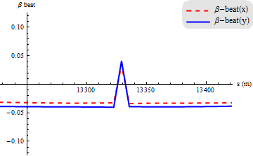
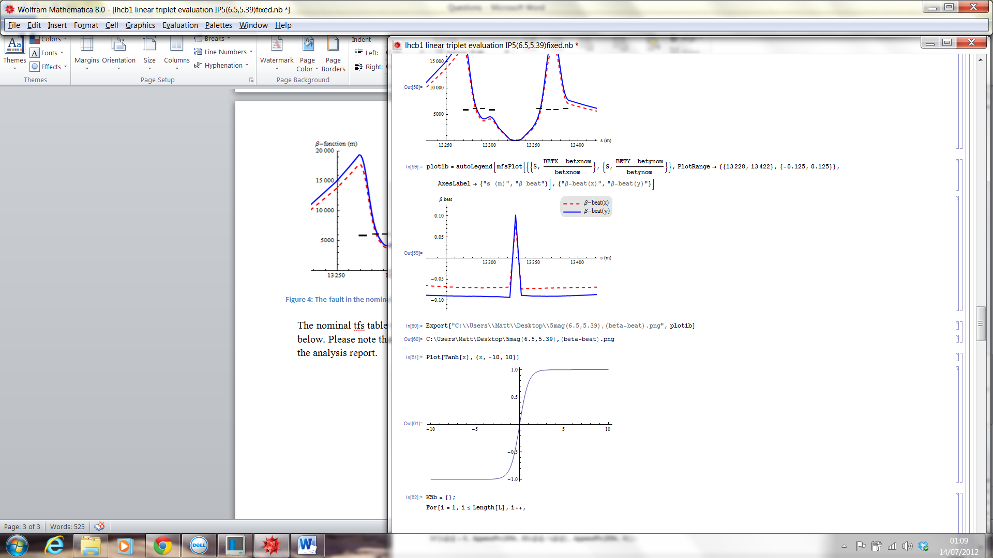
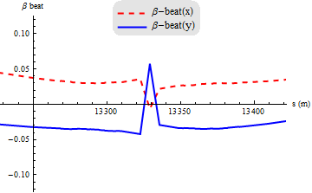
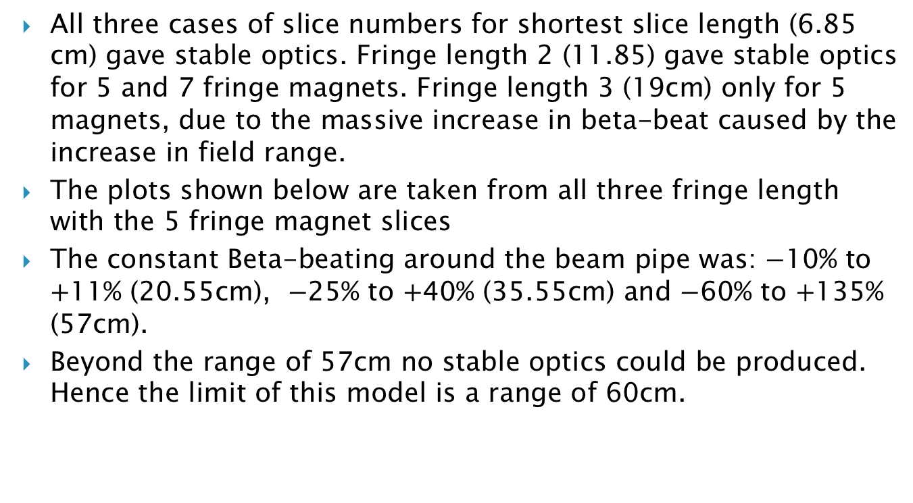
Beta-beat as field range increases
All three cases of slice numbers for shortest slice length (6.85 cm) gave stable optics. Fringe length 2 (11.85) gave stable optics for 5 and 7 fringe magnets. Fringe length 3 (19cm) only for 5 magnets, due to the massive increase in beta-beat caused by the increase in field range.
The plots shown below are taken from all three fringe length with the 5 fringe magnet slices
The constant Beta-beating around the beam pipe was: 10% to 11% (20.55cm), 25% to 40% (35.55cm) and 60% to 135% (57cm).
Beyond the range of 57cm no stable optics could be produced. Hence the limit of this model is a range of 60cm.
left: Range=20.55cm, Centre: Range=35.55cm, Right: Range=57cm

Slide 7
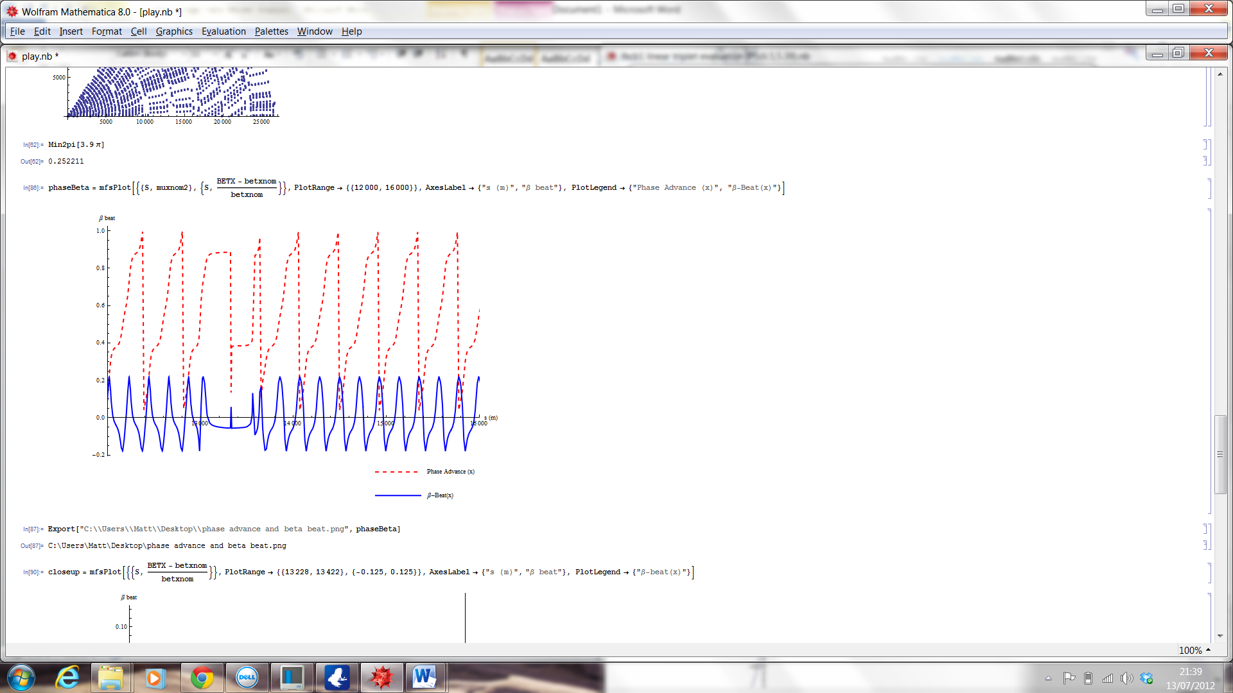
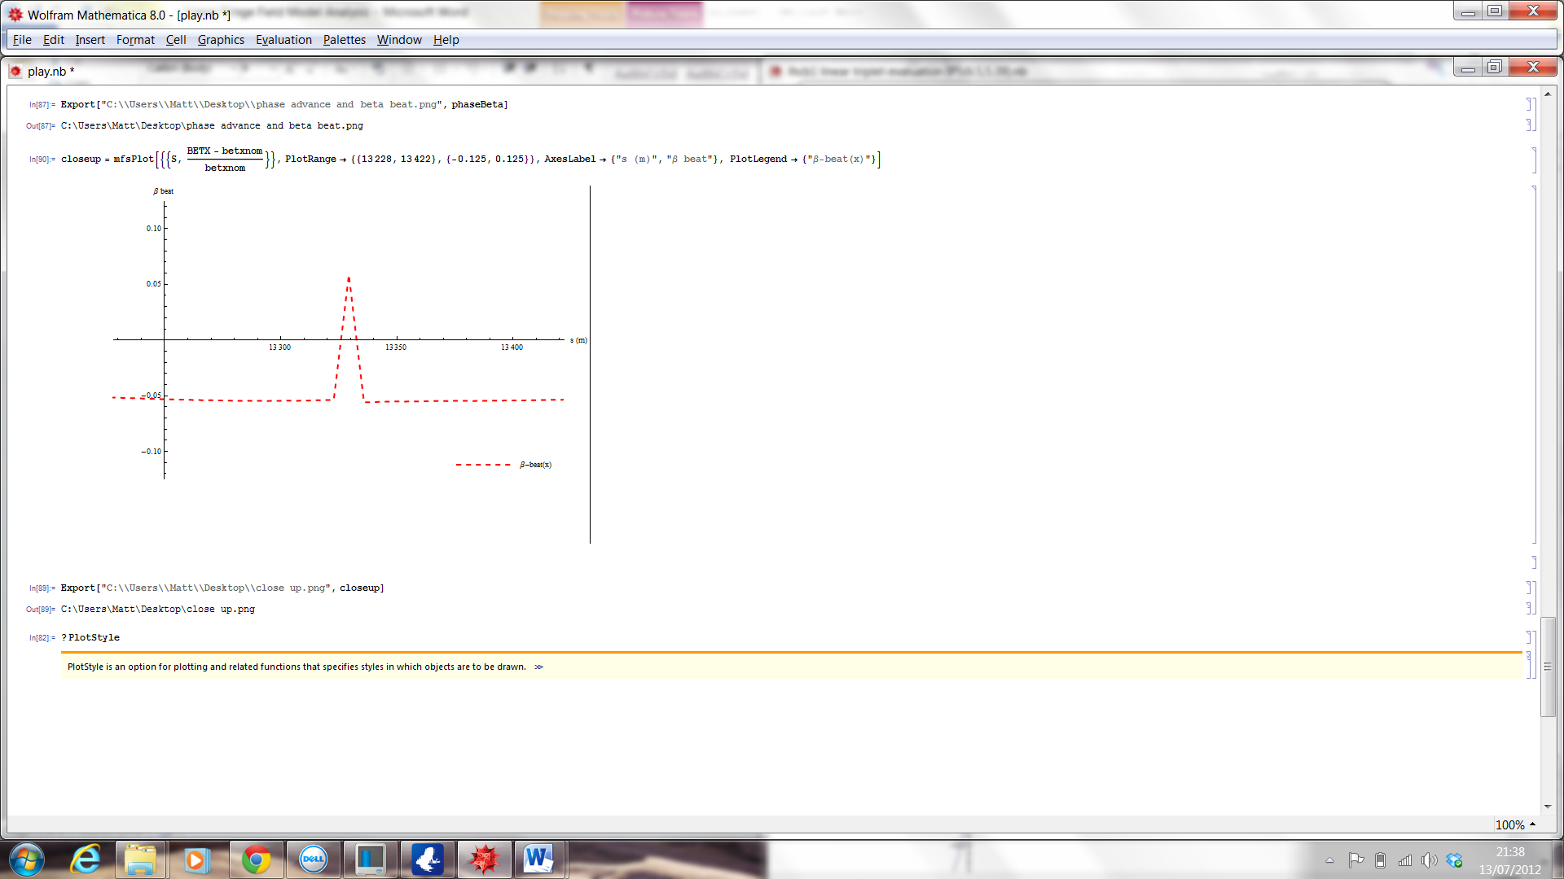
Beta-beat over a range of 4000 metres
This shows how the beta-beat relates to the phase advance for the 7 fringe magnet set-up of magnet length 6.85cm. This plot now has a range of 4 kilometres ( phase advance in units of 2π).
It can be seen that the beta-beat oscillates at twice the frequency of the phase advance as would be expected. Furthermore, the relative percentage beta-beat remains constant throughout the LHC ring.
IP5
Figure 1: The top graph shows the beta-beat and the phase advance in units of 2pi over a 4 km of the LHC ring. The bottom graph is a close up of interaction point 5.

Slide 8
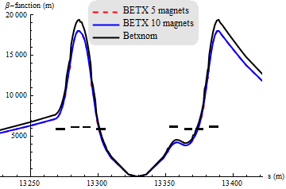
Difference in number of fringe magnets used
The effect on the beta function of using a varying number of fringe field slices was investigated. This was to see if there where any additional effects contributing to the beta-beat from this effect and make sure the beta-beat is stable for different numbers of slices.
The beta function for a fringe model with both 5 and 10 slices is shown below along with the nominal beta-function.
It can be seen that the beta function is unchanged through the use of 10 magnets and 5
magnets. Thus for future
models a fixed number of
fringe magnets can be
selected without effecting
the beta function.
Figure 8: Plot of the beta function for 2 cases where the extension of the fringe field is the same but the number of fringe magnets used is halved

Slide 9
Discussion of results
The Linear Model succeeded in providing information to minimise potential errors.
The method used to attain these results is consistent with expectations and shown to produce a beta-beat that behaves as expected.
provided that the number of fringe magnets are used adequately describes the shape of the field then the number of slices does not play a role in perturbing the beta function
The beta-function is very dependant on a difference in total integrated strength.
Now we recalculate the beta-beat with a more realistic field model.

Slide 10
Arctan Fringe Field Model
Following results from the linear model a constant number of 20 fringe magnets at either end of the magnet (10 inside and 10 outside of the original length) were selected.
The purpose of the linear fall off model was:
To give more realistic predictions of the beta-beat cause by fringe fields in the inner triplet.
To fully parameterize the MAD-X subroutine in terms of the individual lengths, strengths and positions of the magnets along with the range of the field required so as to be used in matching.
We just consider a full range of 0.95cm

Slide 11
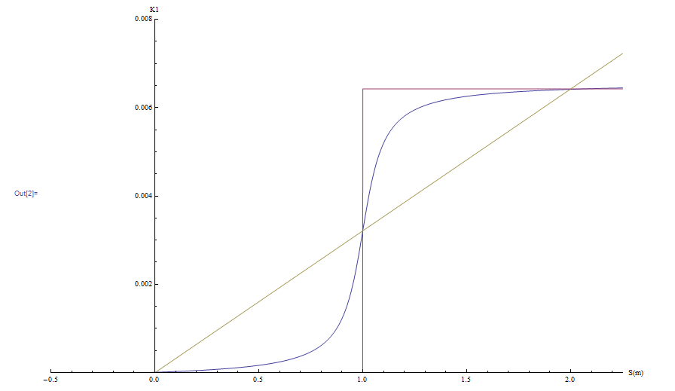
Arctan functional form
A rule of thumb for a magnetic fringe field range is that the aperture size in millimeters is equal to the range of the field in centimeters. For the LHC this corresponds to a range of 110cm.
For this model the ballpark figure of 1m fringe field range was taken however due to the design limits of the triplet only a range of 0.95cm could be modeled before magnets started to overlap
To the right shows an illustration of the hard edge model, the linear model and the new arctan function for a particular K1 strength.

Slide 12
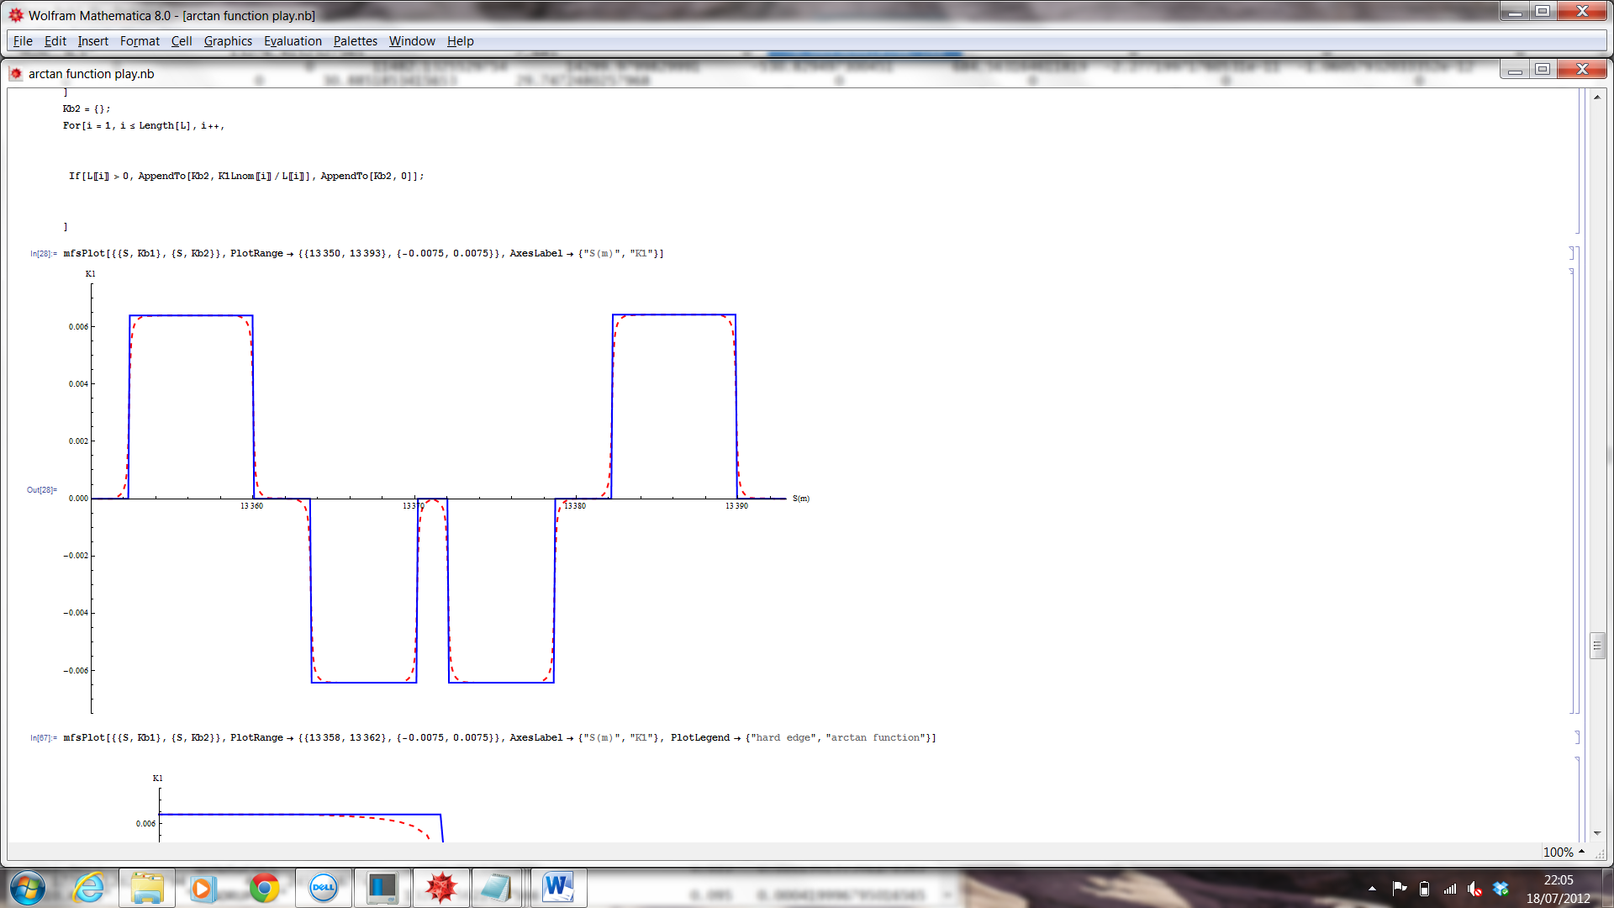
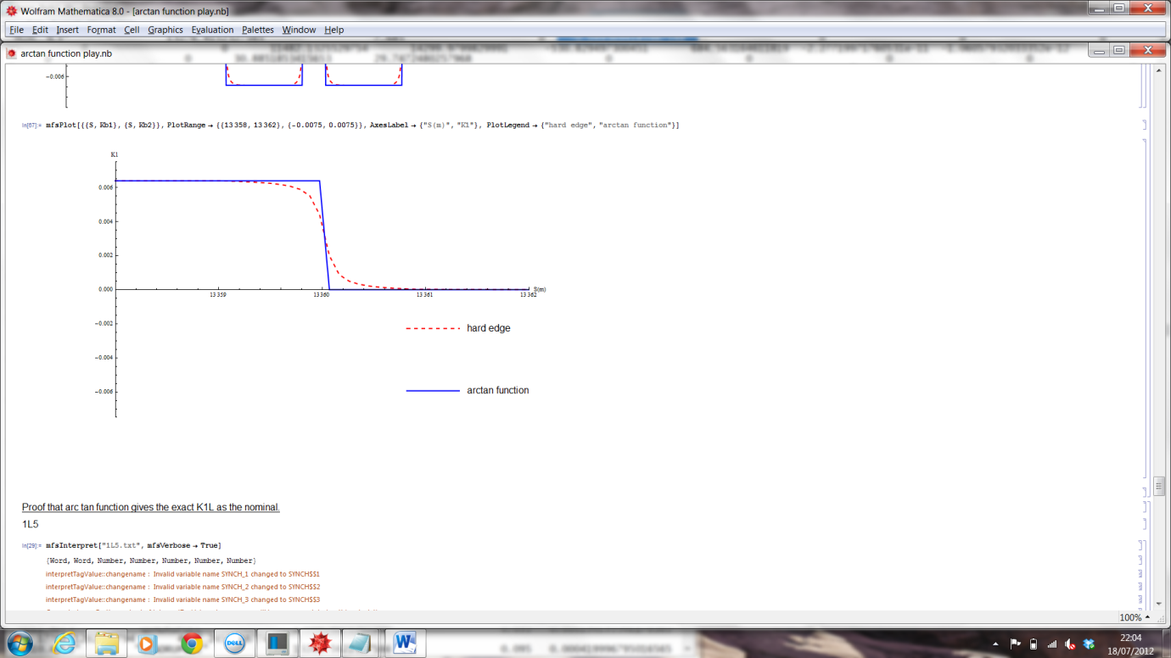
Arctan Strength Profile
Below shows the outputted data from MAD-X plotted in Mathematica of the K1 strength profiles for the hard edge model and that of the arctan model. For reference; this is the right hand triplet and IP5 is to the left.
ArcTan Model
Hard edge

Slide 13
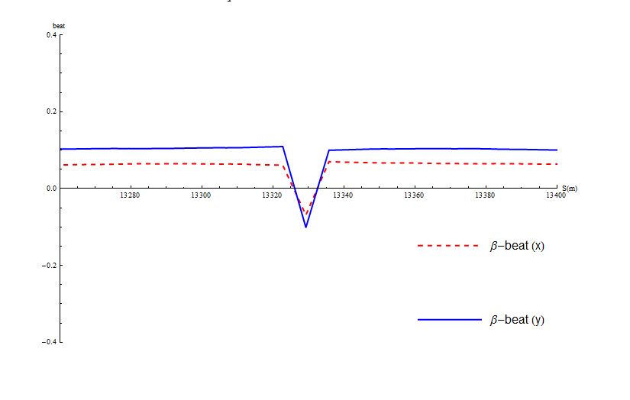
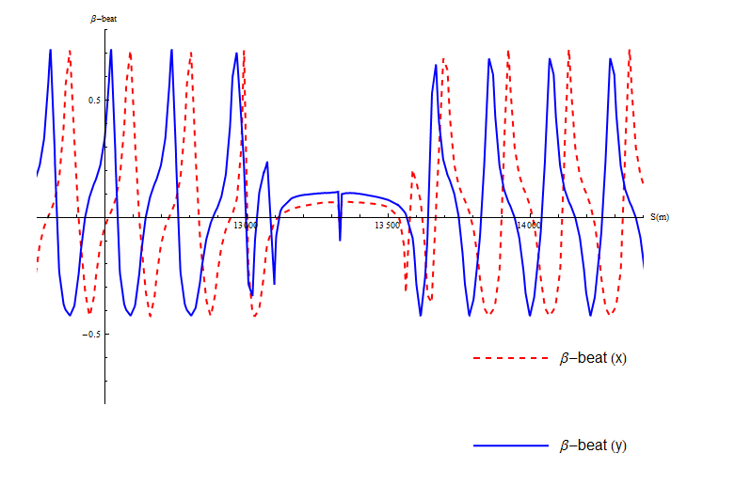
Beta-beat plots of the arctan model
Below shows the beta-beating caused by the arctan fringe field model. Both the 150 metre range of the triplet magnets (left) and a larger range of 2000 metres (right) are shown.
Note that this model produces a beta-beat around the IP of 10% (x-direction) and 5% (y-direction) and a constant value of -40% to +70% around the beam pipe. Whereas in the linear model the maximum range tolerated was approximately 0.6m and the usual beta beating was about 7-10% with a constant value of -60% to +135%.

Slide 14
Conclusions
During the development of the upgrade optics, a hard edge model for quadrupole fields is usually assumed. However for real magnets this is not the case and magnets produce fringe fields that extend out along the beam pipe.
We’ve studied the effect on the beta function for fringe models in the IP5 inner triplet for the 15cm ATS optics.
The linear model was very successful in providing solid understanding and checking. This minimised the errors that could have been caused by faulty and inconsistent set-ups
It was found that the linear model gave a 135% beta beating. This had increased rapidly as the range of the field was extended until the optics became unstable at around 60cm.

Slide 15
Conclusions
The more realistic arctan model gave a beta beating of 10% about the IP with constant value of -40% to +70% around the beam pipe.
It’s nice that a more realistic model gives a lower beta-beat!
The smoothness of the beta-functions and the symmetry about the IP would suggest that as the model is refined to become more realistic with a reduced fringe field magnitude then the optics will remain stable.
One would predict that the beta-beat is also like to reduce in magnitude in correlation with the field model such that the effect could be absorbed into the machine optics through matching.

Slide 16
Future considerations
The MAD-X subroutine used to model the fringe fields are fully parameterized in terms of the individual lengths, strengths and positions of the magnets along with the range of the field required.
Although it would be interesting to alter the gradient of the arctan model to discover the effect on the beta-function, we’ll probably learned all we need to from this model.
For future work we’ll
  See how much the mismatch can be removed by tweeking the strength
  Use a field map of the real quadrupoles to get the most up to date and accurate results of the beta-beat to our actual quadrupoles
  Rematch the linear optics to absorb the beta-beat into the match
I (Matt) hopefully will continue to work on this until Xmas, with Luke and Rob.

