Slide 1



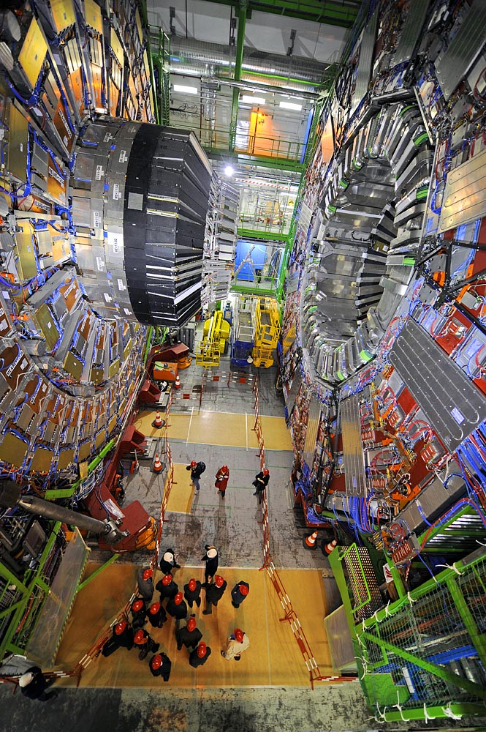
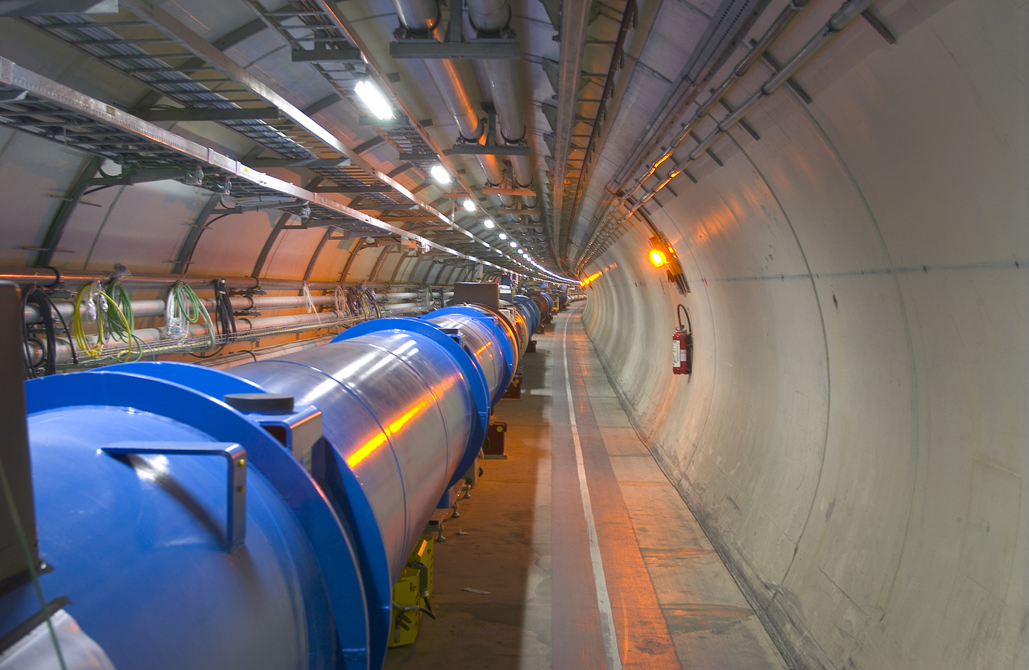

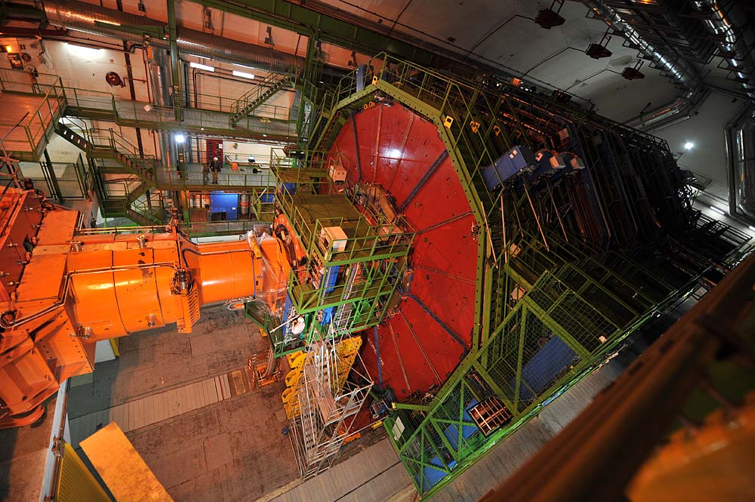
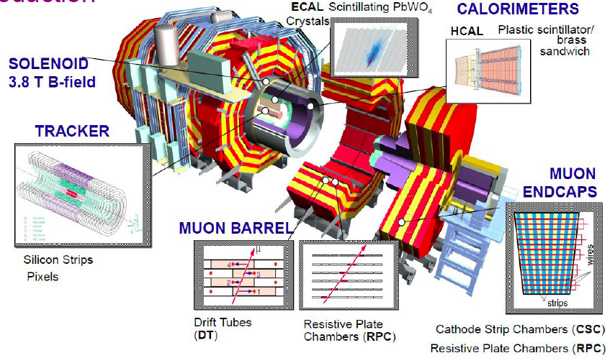
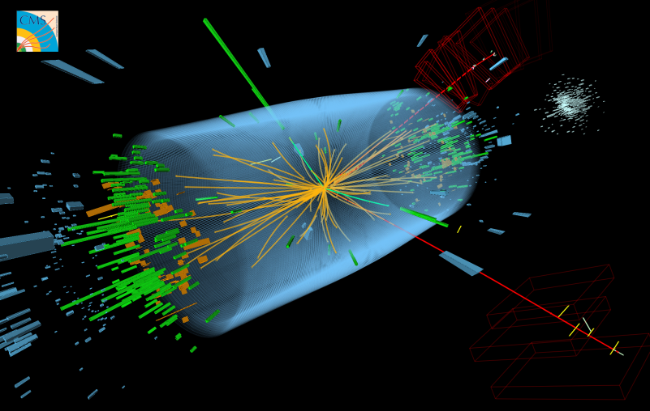
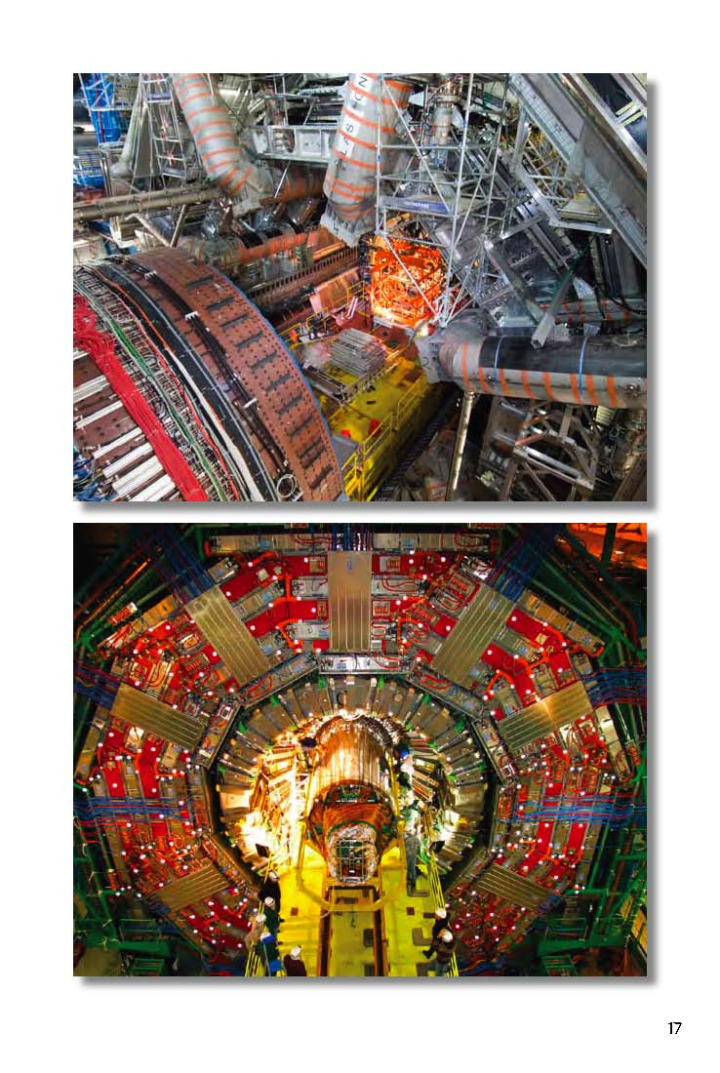
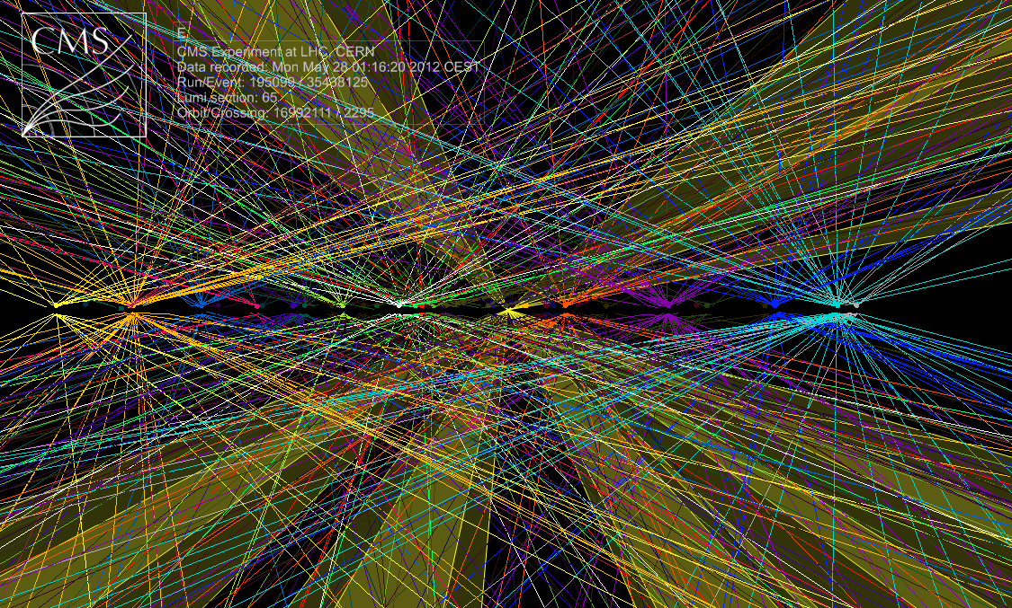
CMS Higgs Search: Discovery, Measurements and Prospects
A 48 Year Search
Observing a New Boson
A Gateway
Opening a New Era
of Physics
~50 Vertices, 14 Jets, 2 TeV
Harvey B Newman
LISHEP 2013
March 22, 2013
Raw ΣE_{T}~2 TeV
14 jets with E_{T}>40
Estimated PU~50

Slide 2

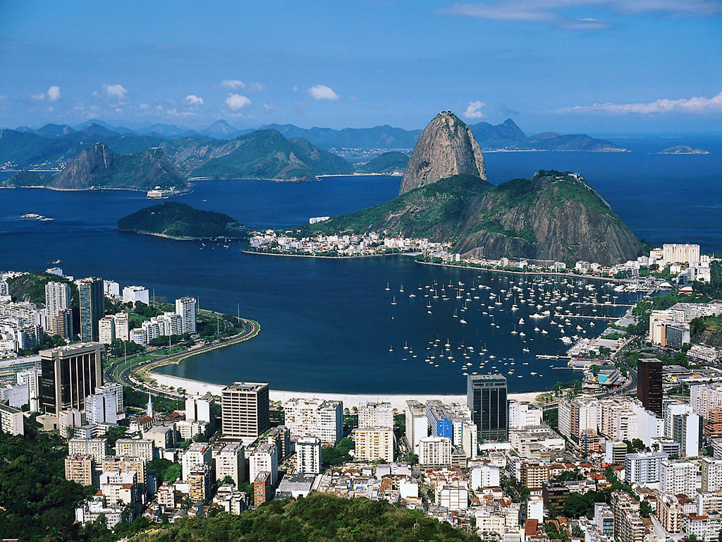
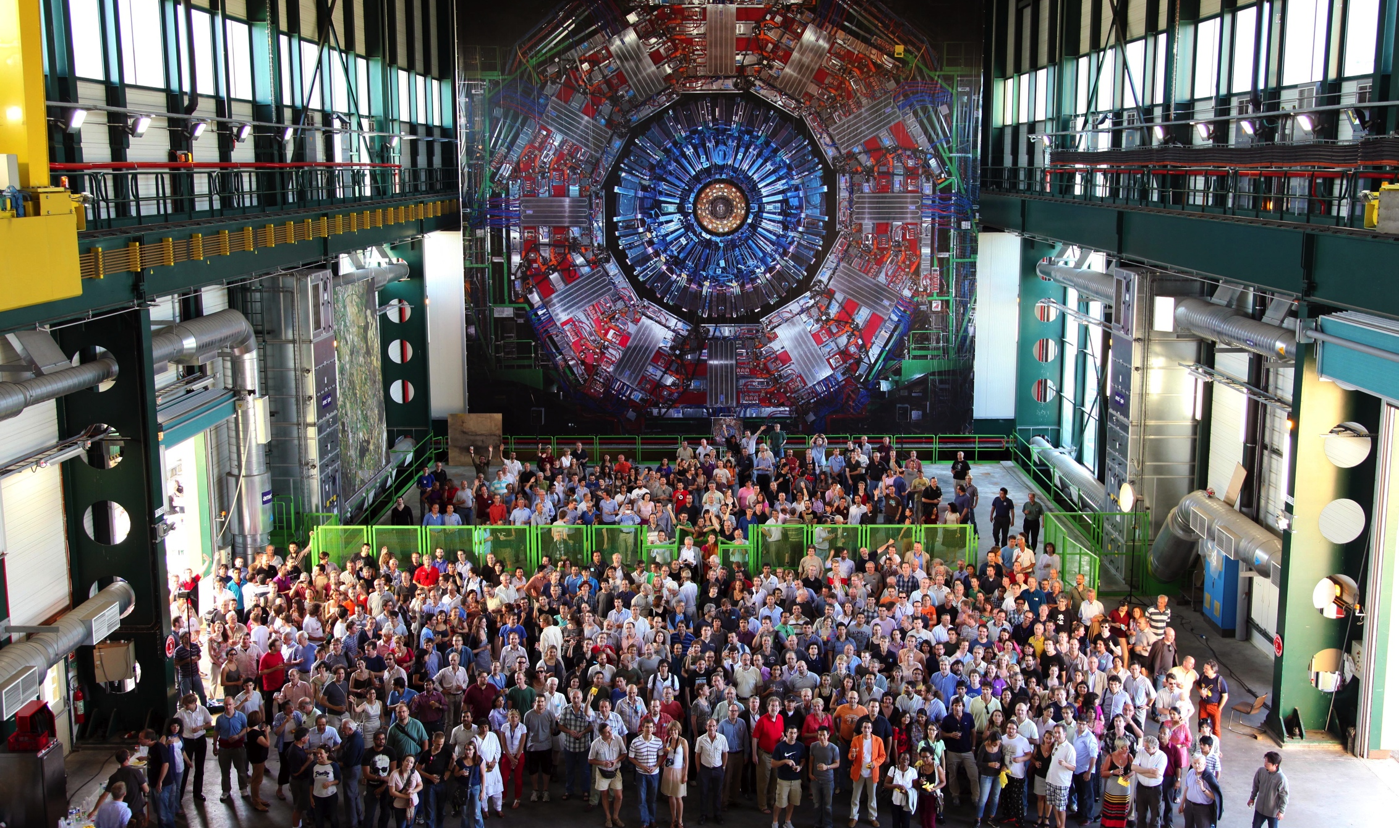
On behalf of the CMS Collaboration

Slide 3
CMS: A New Boson
Exploration in the Post-Discovery Era
2012 Data in CMS
Post Discovery Progress
  Is it the SM Higgs Boson ?
  Is there just one ?
Updates on Signals in Individual Channels
Properties
  The Mass
  Couplings to Fermions
  as well as Vector Bosons
  Spin/Parity
BSM Higgs Searches:
Outlook
CMS Higgs Measurement
Talks at This Session
A New Boson in the
ZZ  4 Lepton Channel
Guenakh Mitselmaker (Florida)
A New Boson in the
γγ Channel
Chris Palmer (UC San Diego)
Measurements in the b-bar
and τ+τ− Channels
Robertval Walsh (DESY)

Slide 4
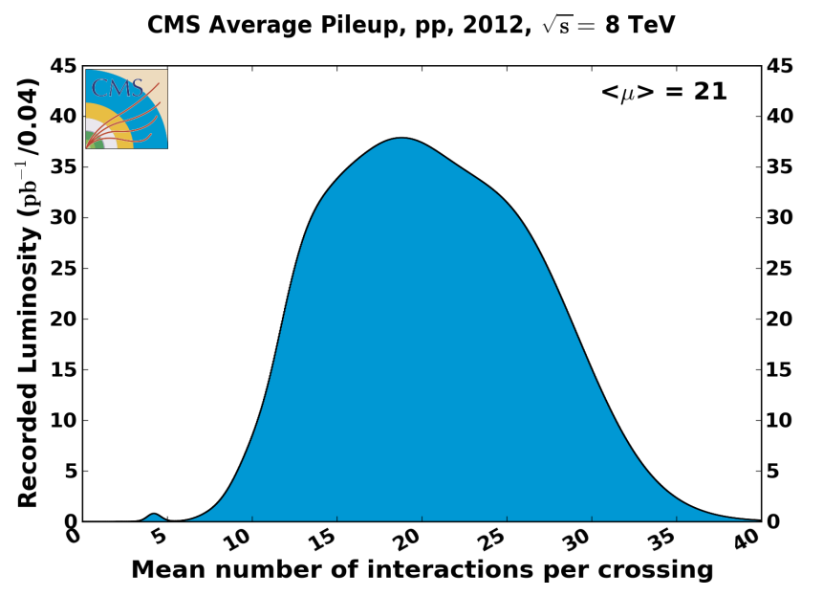
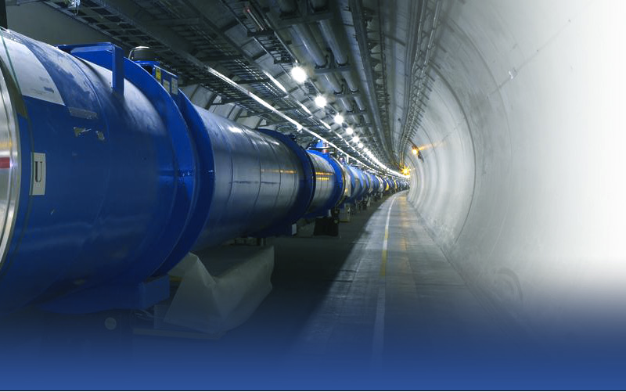
The LHC: Spectacular Performance
To 7.7 X 10³³; The Challenge of Pileup
Average 19,
up to ~50 Interactions/
Crossing in 2012
1.1x10¹¹ → 1.5x10¹¹ ppb X 2
Emittance: ε 3.5→ 1.8 micron X 2
2012: 8 TeV X 50 nsec β* → 0.6m
~50 Vertices, 14 Jets, 2 TeV

Slide 5
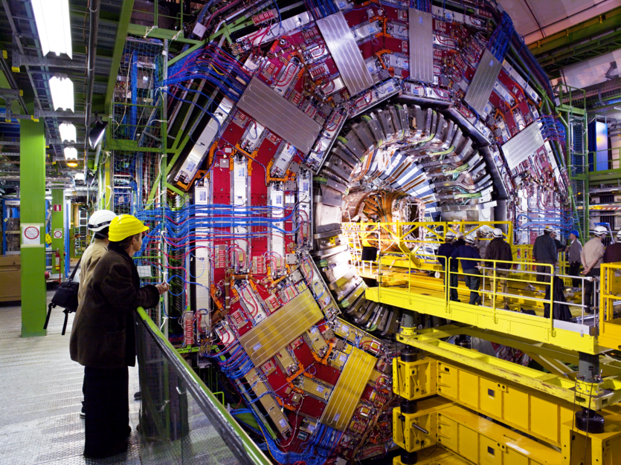
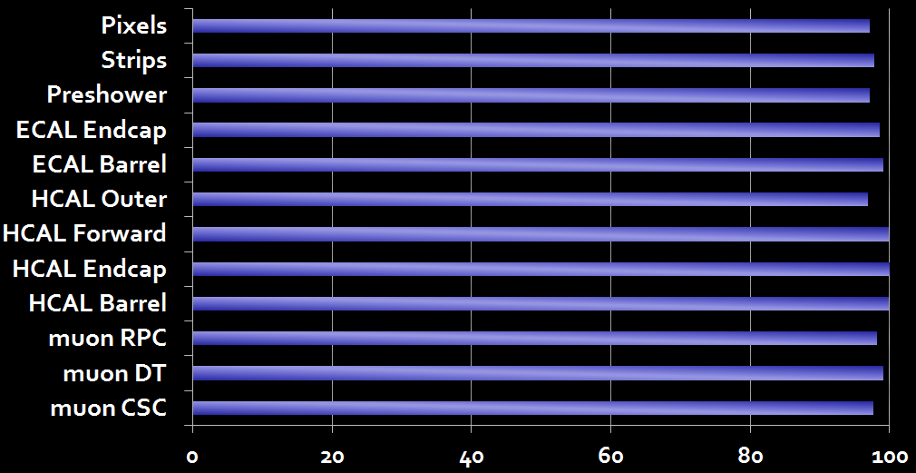
Modular 3.8 Tesla Design with H in Mind
Extending the State of the Art:
2.7 GJ Magnet, 200 m² Tracker, 76k Crystal ECAL Global Muons 7% at 1 TeV, Software HLT
Works beautifully!

Slide 6
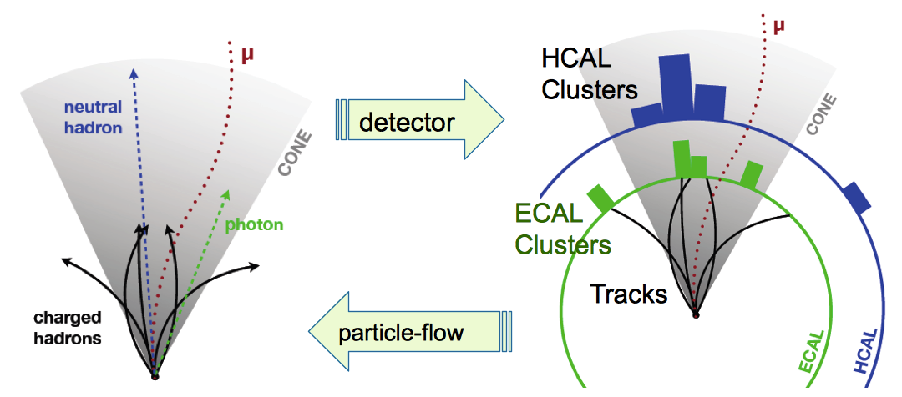
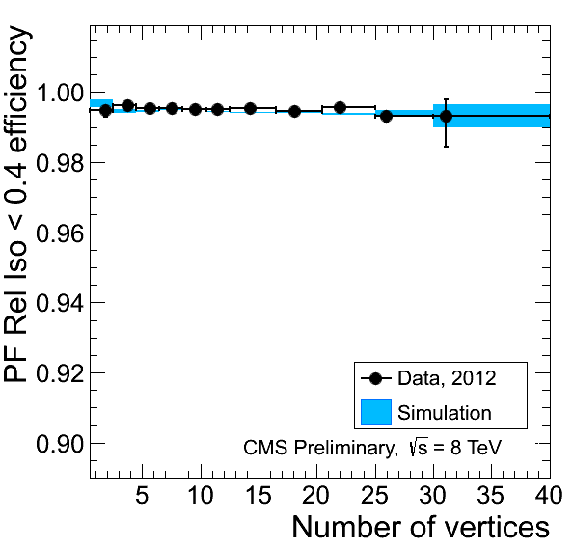
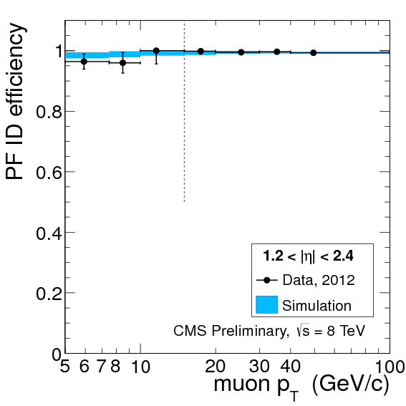
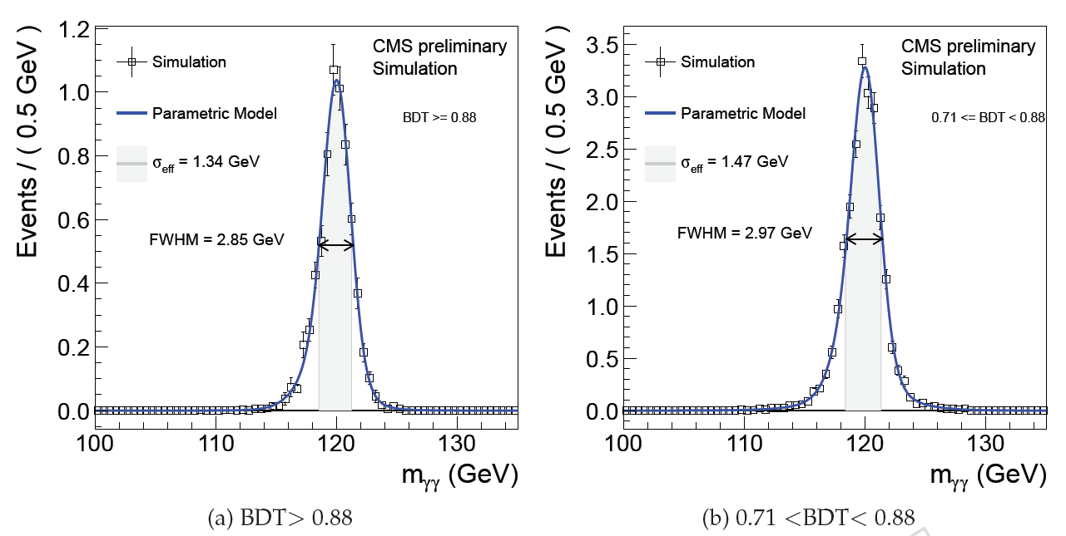
CMS Global Event Reconstruction
Made possible by CMS granularity and high magnetic field
Particle-flow based Muon isolation
Particle-flow based Muon identification
Optimal combination of information from all subdetectors
Returns reconstructed “particles”: e, μ, γ, Charged & Neutral Hadrons
Used as building blocks for jets, τs, Missing E_{T}, lepton isolation
Tags charged particles from pile-up
Minimized Pileup Impact on jet reco.,
lepton & photon ID, isolation
Restored 2011 performance
Photon Resolution in ECAL Barrel
σ_{eff} 1.2%
σ_{eff} 1.1%
Using 8 TeV Prompt Calibration
Notes:
6

Slide 7
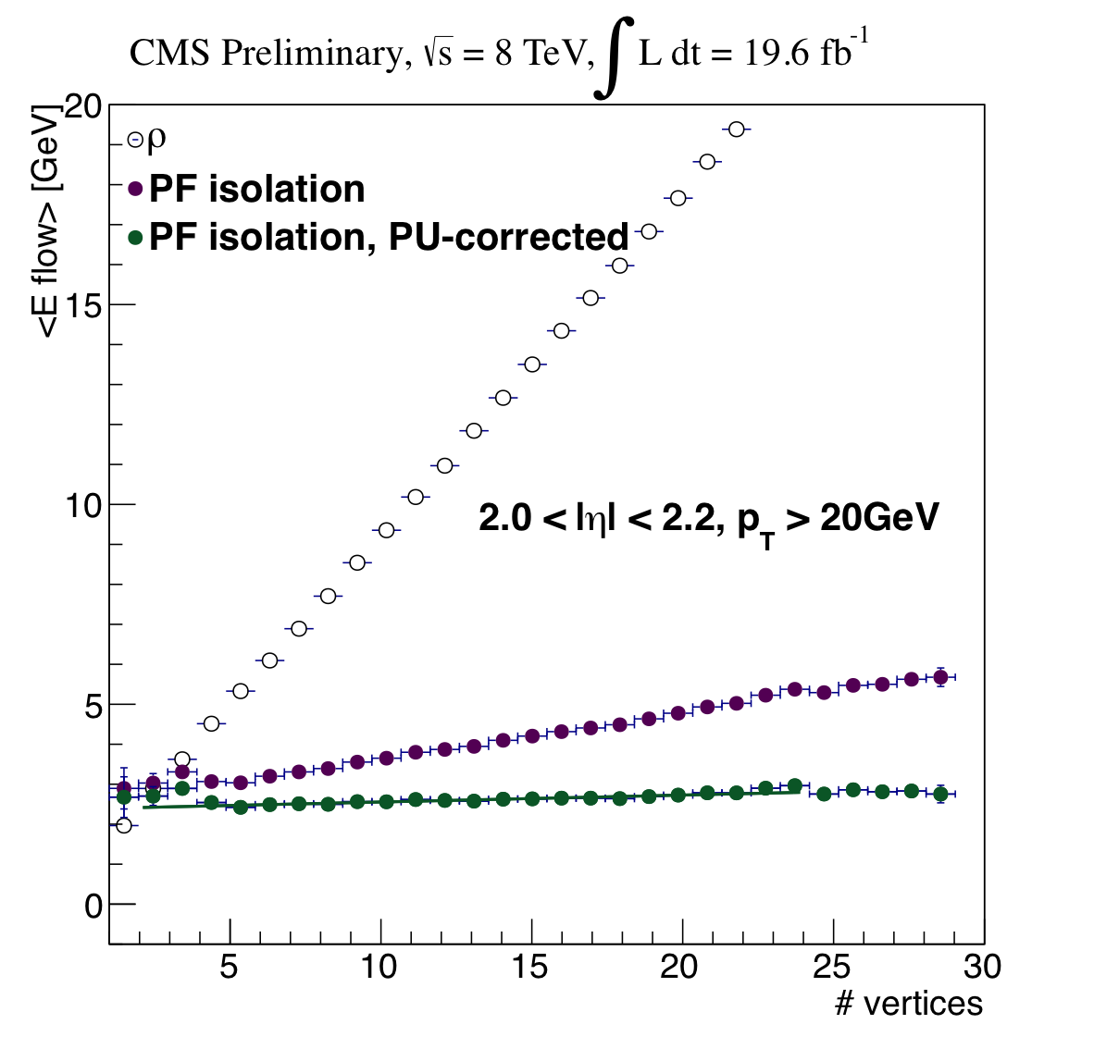
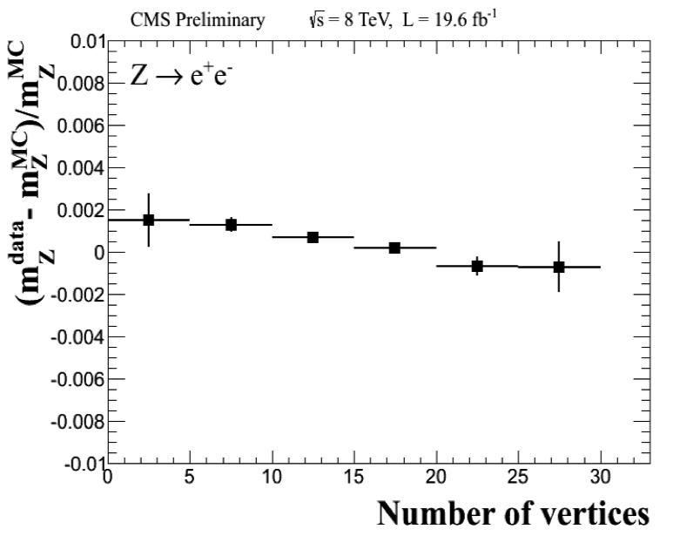
Stability Against Pileup
Electron Isolation and Energy Scale
Electron isolation in data
with Z➞e⁺e⁻ events
Momentum scale in data
with Z➞e⁺e⁻ events
Charged: consistency with vertex
Neutrals: Average energy subtraction
Effect within 0.2% in [0-30] reconstructed vertices in the event

Slide 8
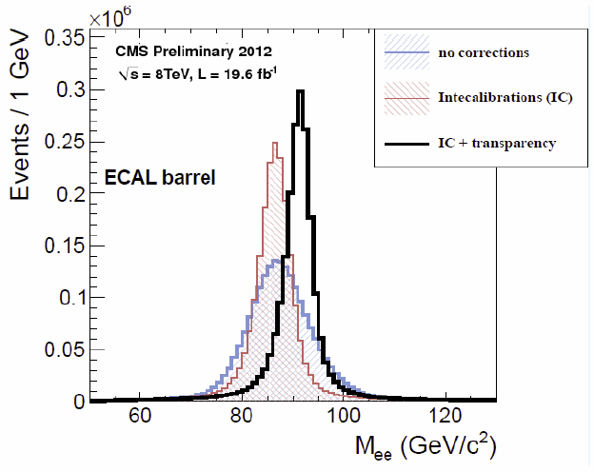
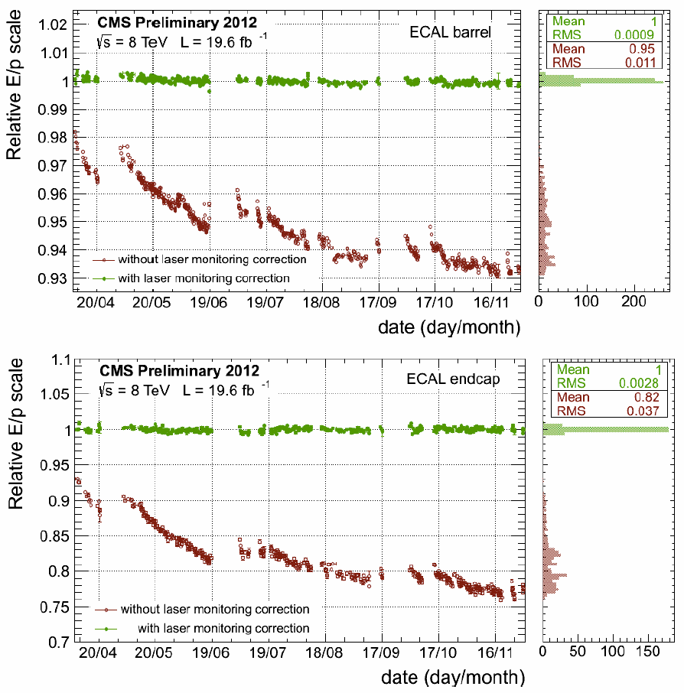
Photon Energy Resolution
Comprehensive Monitoring and Calibration
Laser runs every 40 minutes: crystal by crystal transparency corrections
With π⁰,η Intercalibration + Z  ee + W  eν (E/p) scale corrections
Barrel
RMS=0.09%
E/p History
Z  ee: Effect of
IC + Laser Corrections
Endcaps
RMS=0.37%
Excellent Stability with monitoring & calibration for 2012: 0.09 EB (0.37 EE) %
  Instrumental resolution: from Z → e+e- , W → eν with ECAL energies
  and electron track directions: 1% and Stable in ECAL Barrel

Slide 9
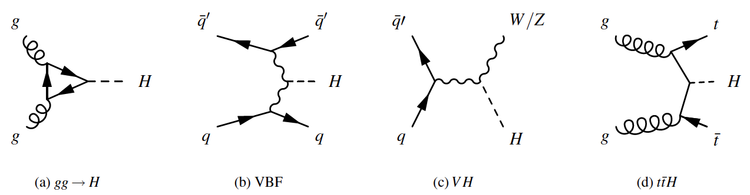
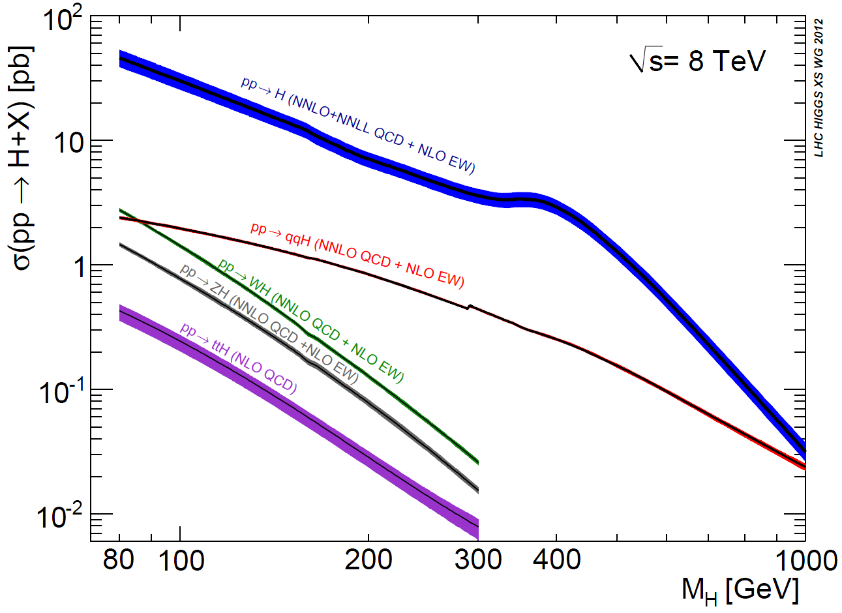
Higgs Production at the LHC
7-8 TeV pp CollIsions (8 TeV +25%)
V
V
gg fusion gg H
VB fusion (VBF)
Assoc Prod: WH, ZH
Assoc. Prod: t-tbar H
NNLO QCD + NLO Elwk
Dominant production
at 125 GeV
gg→ H
Subdominant but
with Larger S/B:
VBF: ~13X Less
WH + ZH: ~18X Less
ttH ~150X Less
gg fusion
qqbar H
t-tbar H
Assoc WH
Assoc ZH

Slide 10
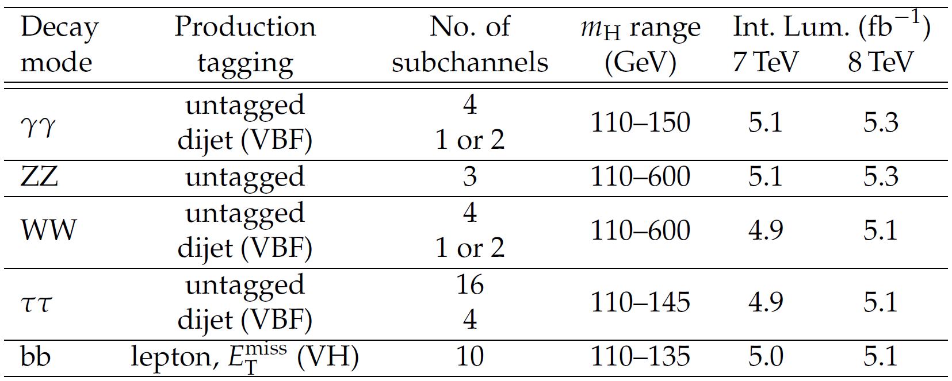
CMS Higgs Search Channels
Updates on a New Boson
CMS-HIG-12-028 (HCP);
13-001 Through 009
m_{H} resolution
1-2%
1-2%
20%
15-20%
10%
High Sensitivity
✴
19.6
Dijet, e, μ, MET
✴
4l and 2l2τ
110-1000
19.6
✴
19.5
19.4
12
Other Modes Updated for HCP (11/12) and Moriond (this month)
New Updates (Low Mass): W/Z + H  WWW  3l 3ν; H  Zγ
New Update (High Mass): H  ZZ 2l2τ (high sensitivity)
High Mass Modes: ZZ  2l 2ν; ZZ  qq′ 2l; WW  qq′ lν
Other Low Mass Modes: WH + ZH  qq′ 2l 2ν

Slide 11
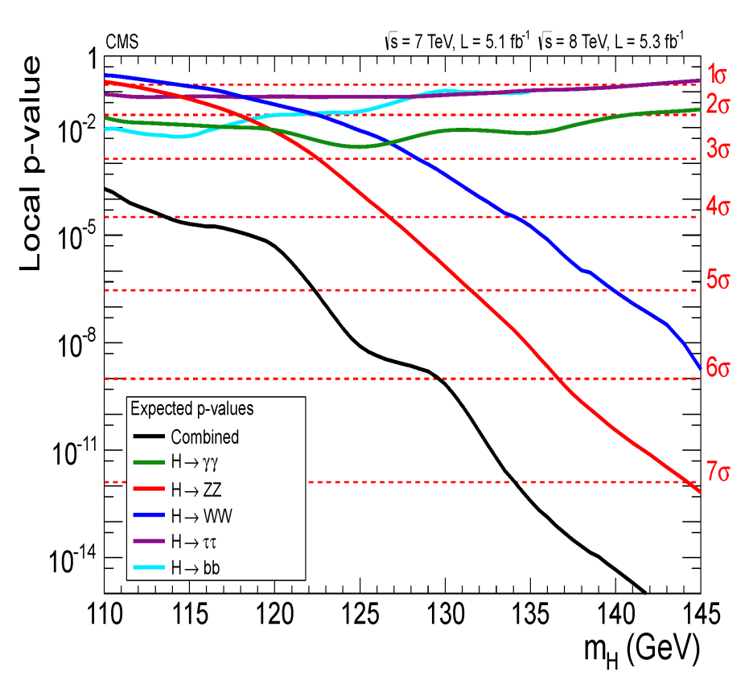
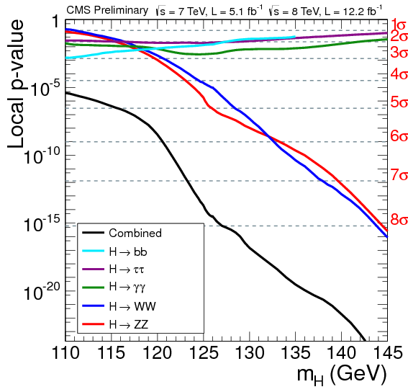
CMS Higgs Search Channels
Expected Sensitivity: p-values
ICHEP: 5 + 5 fb⁻¹ at 7 and 8 TeV
HCP: 5 + 12 fb⁻¹ at 7 and 8 TeV
ττ
ττ
bb
γγ
γγ
bb
WW
WW
ZZ 4l
ZZ 4l
Combined
Combined
ICHEP (July) to HCP (Nov.)
Sensitivity Increase
from 5.8 σ to 7.8 σ by HCP
Driven by ZZ (4l), WW, γγ;
bb, ττ Important
HCP: For Illustration only

Slide 12

H ➔γγ
candidate
Full 2011-12 Dataset:
5.1 fb⁻¹ at 7 TeV + 19.6 fb⁻¹ at 8 TeV
Search for a narrow mass peak with two isolated high E_{T} photons
on a smoothly falling background
High Resolution: ~1% in barrel
M_{γγ}=125.9 GeV
σ_{M}/M=0.9%
Analysis optimized categorizing events by γ ID and vertex efficiency; S/B & mass resolution.
Specific di-jet tag categories targeting VBF
production mode (Higher S/B)
Exclusive categories (e,μ, E_{T}^{Miss}) targeting
WH, ZH Associated Production
CMS PAS HIG-13-001

Slide 13
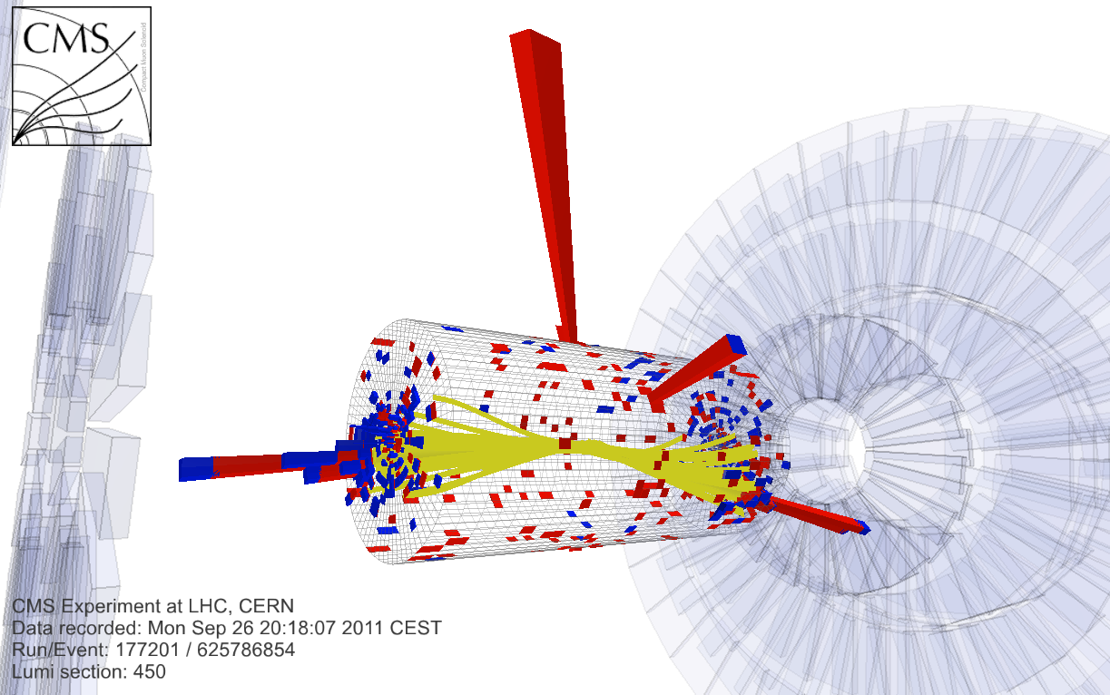
Di-jet Tagging
13
Lower Rate but Higher S/B
Exclusive selection of
di-photon events with
VBF-like topology:
  Two high p_{T} jets with
  large Δη and dijet M_{jj}
~80%-pure VBF events
for large Mjj
Di-jet event with:
diphoton mass 121.9 GeV
dijet mass 1460 GeV
jet p_{T}: 289 and 189 GeV
jet η: -2.022 and 1.860
Analysis improvements in 2012:
Split tagged events in two classes based on M_{jj} + jet p_{T}
  ~15% improvement in sensitivity
Removal of jets from pileup events
  Based on jet shape variables, tracks in jet and vertexing
  Cross-checked with Z+jet
  and γ+jet events

Slide 14
H → γγ Analysis Overview
MVA Analysis: Fit to Diphoton mass m_{γγ} in event categories
      4 event classes based on a Diphoton MVA output , 2 di-jet categories
      (VBF) + 3 Exclusive categories (VH,ttH): Electron, Muon, E_{T}^{Miss}
      Diphoton MVA Score uses: Probability (correct vertex), per-event m_{γγ} resolution estimate, prompt photon ID score, + diphoton kinematics
Cross-checked with a cut based analysis
  Simple and robust: photon ID & mass fit in categories
      2 rapidity x 2 shower shape categories with different
      Signal/Background ratios; + 2 di-jet + 3 Exclusive Categories
Also cross-checked with alternative background model:
    MVA combining diphoton ID and m_{γγ} ; fit data in mass
    sidebands to model background under the peak
MVA analysis 15% more sensitive than cut-based analysis

Slide 15
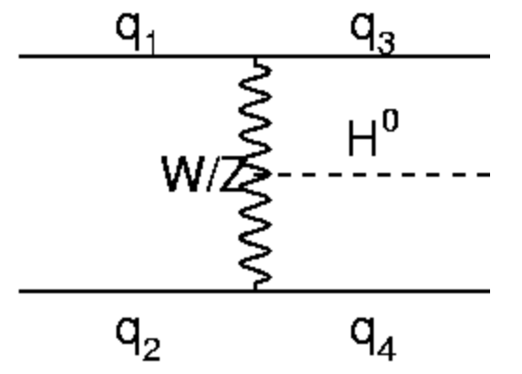
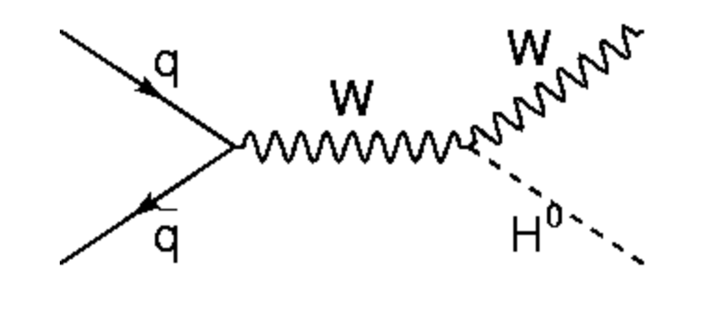

H → γγ Exclusive Categories
In addition to the untagged categories, high S/B
categories are defined using add’l objects in the event
  Di-jet: 2 categories (loose/tight) with increasing
  VBF purity (loose ~50%, tight ~80%). MVA
  analysis uses a dijet BDT-based selection
  (validated using Z+jets events)
  VH: Additional Leptons (electrons and muons with
  p_{T}>20 GeV) or MET (>70 GeV): lepton categories
  have negligible gg contamination, 20% for MET
Significantly improves the sensitivity to
measure the Higgs couplings
Events are uniquely assigned to a category
following the S/B ordering:
VBF
VH

Slide 16
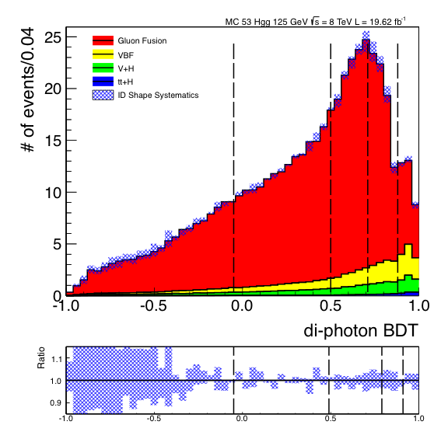
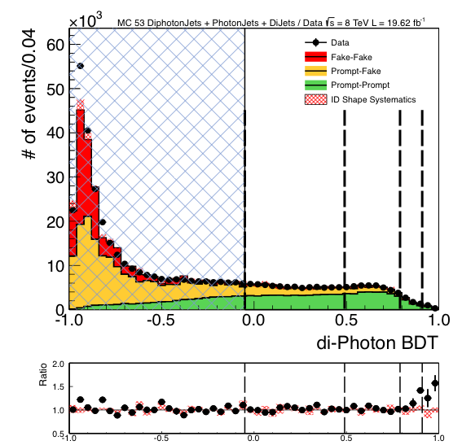
Diphoton MVA
Event Classification
Encode all relevant information on
S vs B (aside from m_{γγ} itself) into a single MVA diphoton discriminant,
with input variables largely independent of m_{γγ}
  Photon ID MVA for each photon: based on isolation, shower shape, energy density per event
  Kinematics and Topology: p_{T} and η of each photon, and cos Δφ between
  the two photons
  Per-event mass resolution
  Correct-vertex probability
Validation of the inputs (photon ID, energy resolution): uses Z→ee, μμγ
Validation of the output with Z→ee
Cat 3
Cat 2
Cat 0
Cat 1
Signal MC
and Data
Background MC & Data
Cat 3
Cat 2
Cat 0
CUT
Cat 1
Notes:
The larger amount of data at low bdt output indicates that there are more fakes in data but they do not affect the analysis.

Slide 17
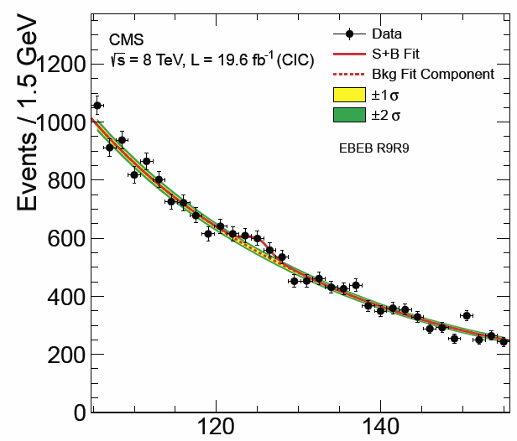
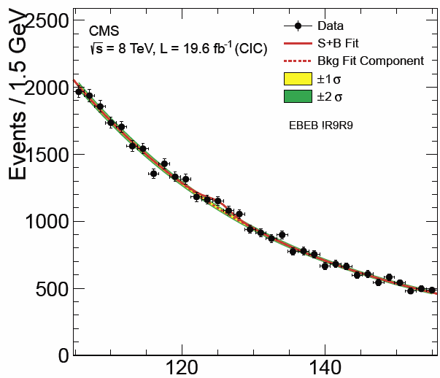
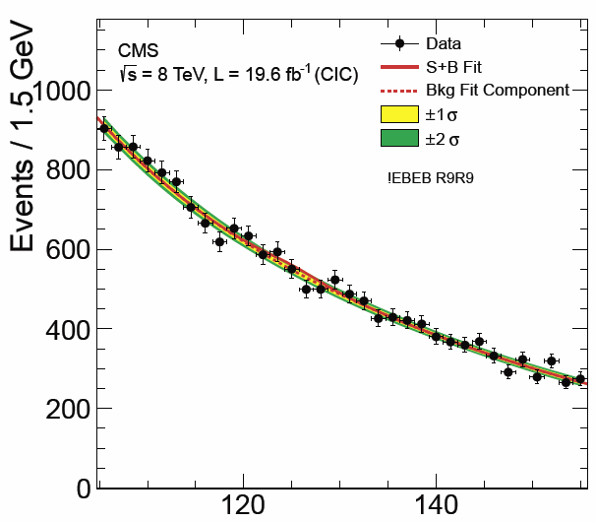
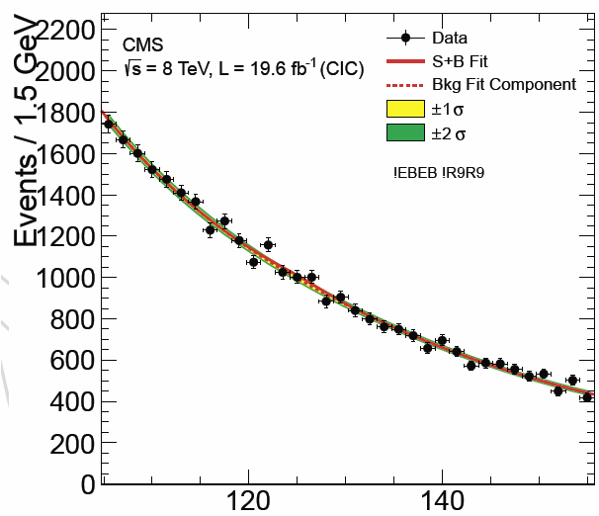
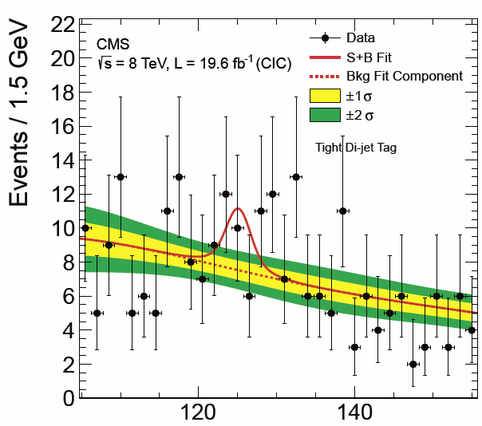
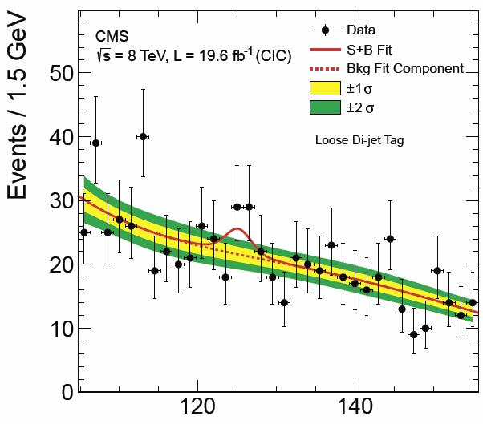
8 TeV Diphoton Mass Distributions
S+B Mass Fits to 4 Inclusive and 2 Dijet Classes
Background model
is from the data:
  Mass distribution in each category fitted with a 2nd to 5th order polynomial
  Order: bias below 20% of stat. fit error
  Causes some loss
  of performance due to the number of fit function parameters
  Also found to agree with MC within errors (~15%)
Untagged 0
Untagged 1
Untagged 2
Untagged 3
Dijet Tight
Dijet Loose
Dijet tight
17

Slide 18
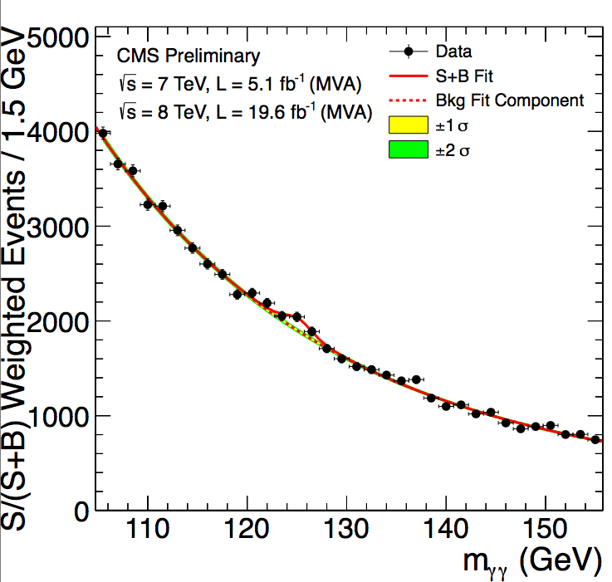
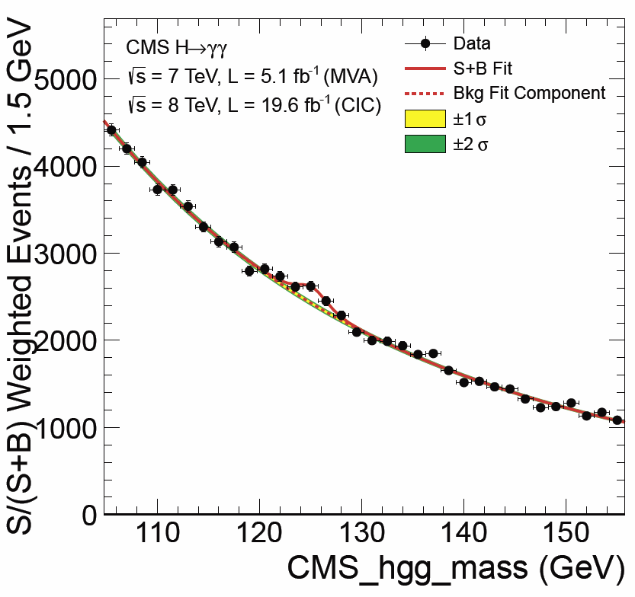
S/(S+B) Weighted Mass Distributions
MVA and Cuts-Based Analysis Side by Side
Sum of mass distributions for each event class, weighted by S/(S+B)
  B is integral of background model over a constant signal fraction interval
Weighting
to Correctly
Show
S/(S+B)
An illustration:
Not used to derive the quantitative Results
MVA Based
Cuts Based
S/(S+B) Weighted
S/(S+B) Weighted
R.J. Barlow, “Event Classification Using Weighting Methods”, J. Comput. Phys. 72 (1987) 202
Notes:
The weighting of events is similar to what is used in the final significance extraction

Slide 19
P-Values for SM Higgs
Full 7 + 8 TeV Dataset Side by Side
MVA Analysis
Cuts Based
Minimum p-value at 125 GeV
with local significance 3.2 σ
  (Expected from SM Higgs: 4.2 σ)
Minimum p-value at 124.5 GeV
with local significance 3.9 σ
  (Expected from SM Higgs: 3.5 σ)
Significance decreased a bit with more data and new
analysis, compared to the published results
19

Slide 20
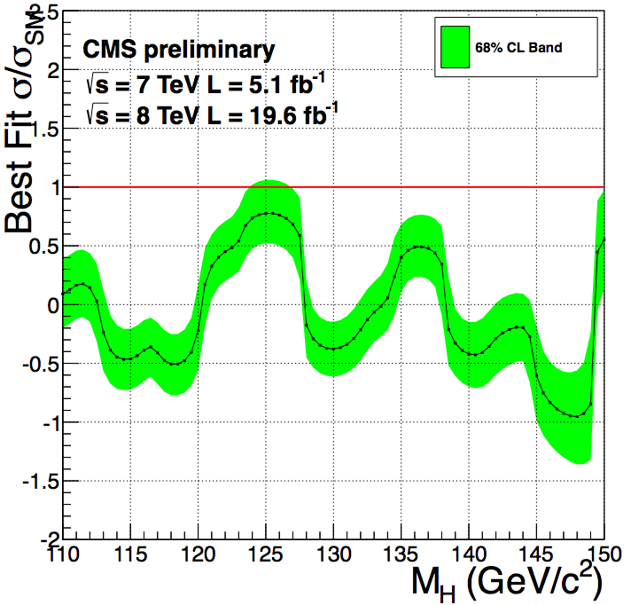
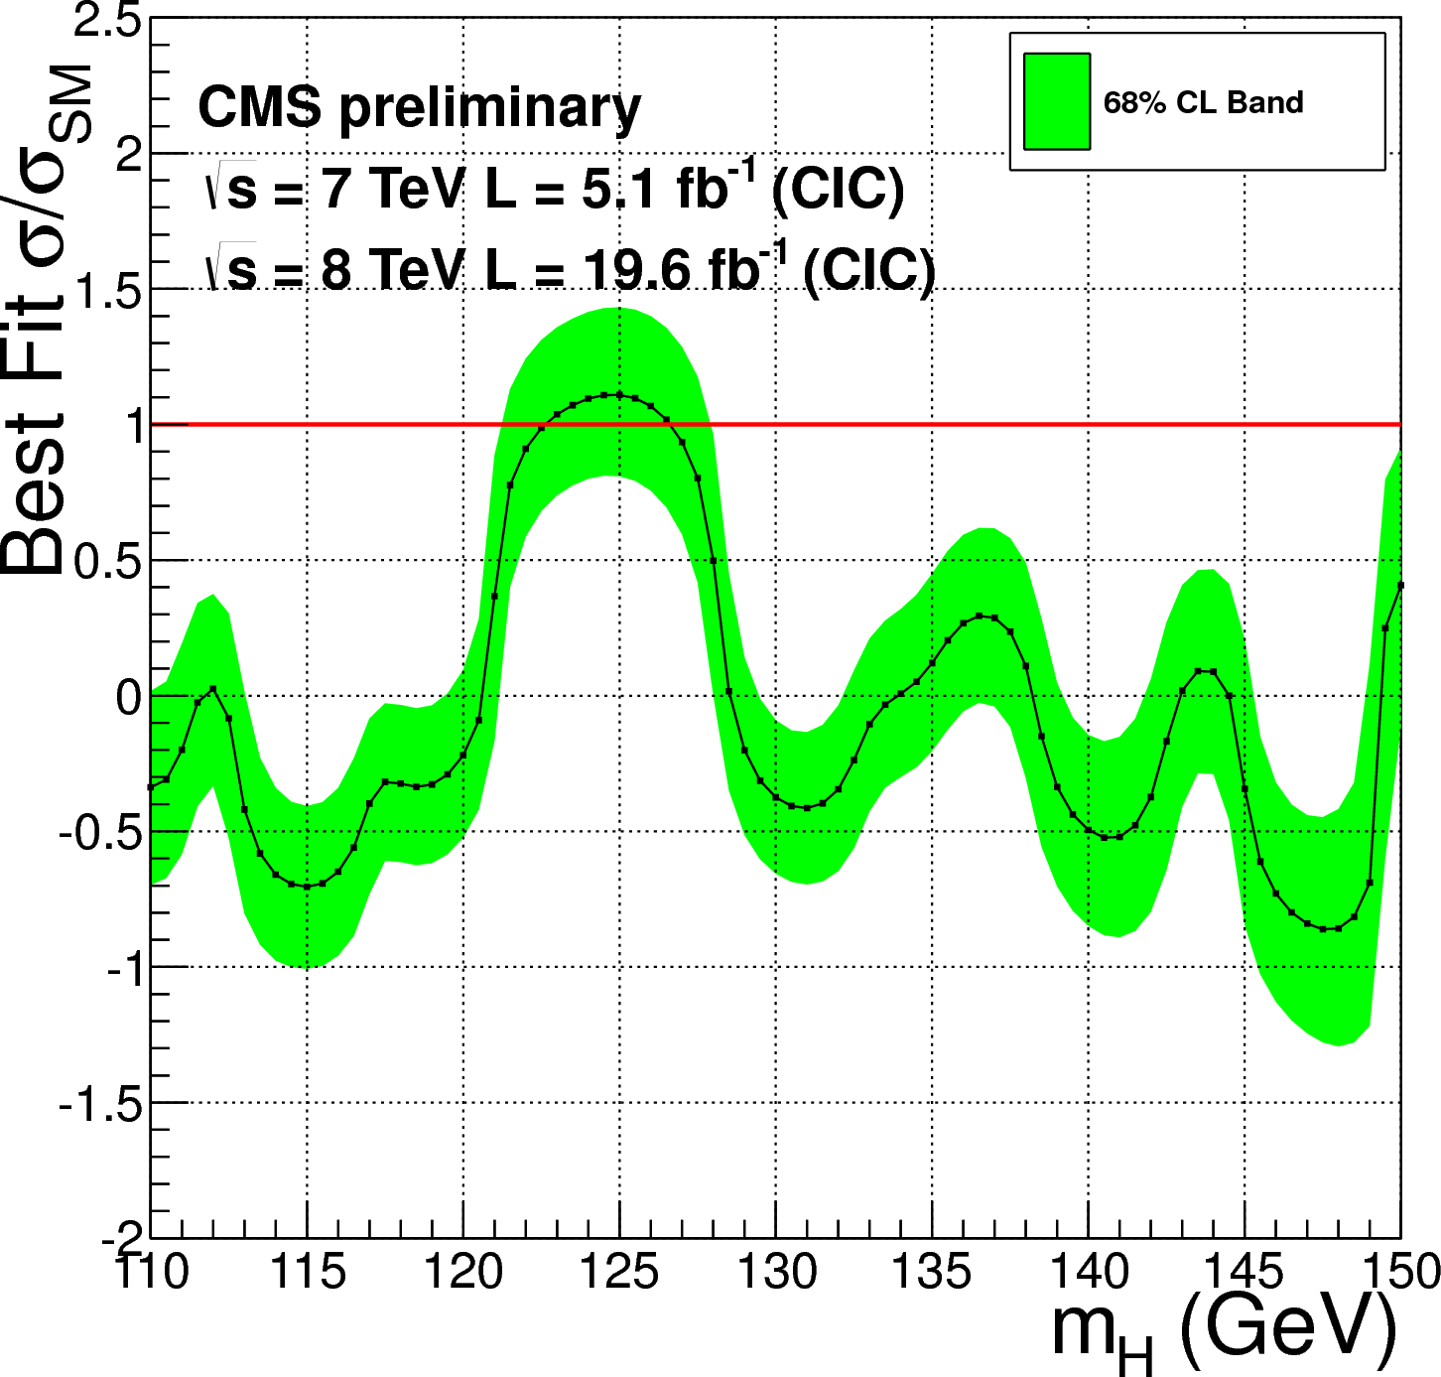
H  γγ Fitted Signal
Strength Vs M_{H}
MVA Based
Cut Based
Fitted Signal Strength
σ/σ_{SM} = 0.78
Fitted Signal Strength
σ/σ_{SM} = 1.11
+0.28- 0.26
+0.32- 0.30
Signal strength decreased a bit with more data and new
analysis, compared to the published results
20

Slide 21
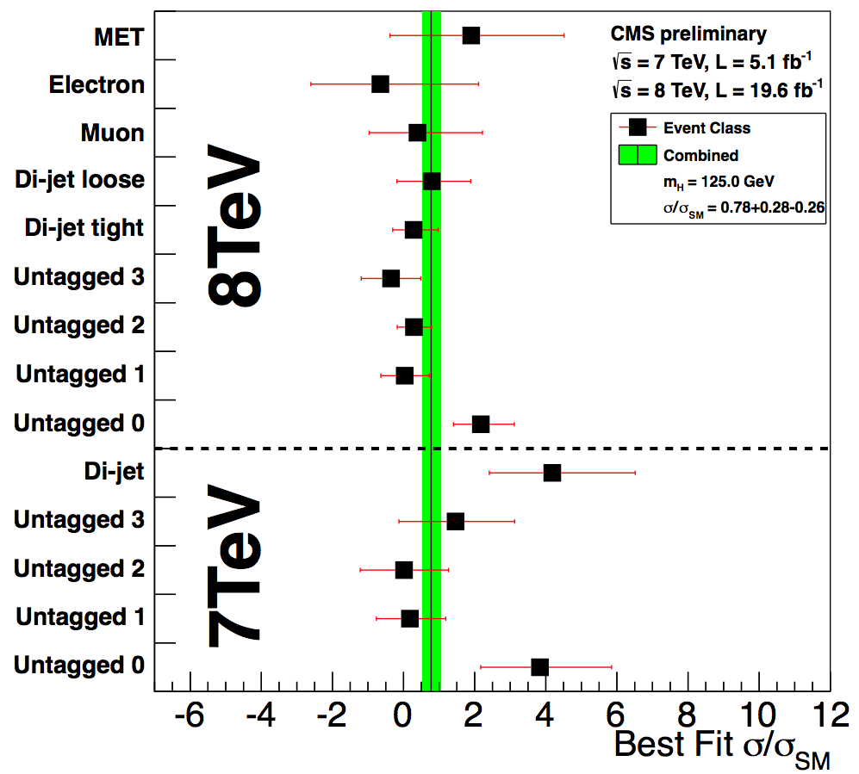
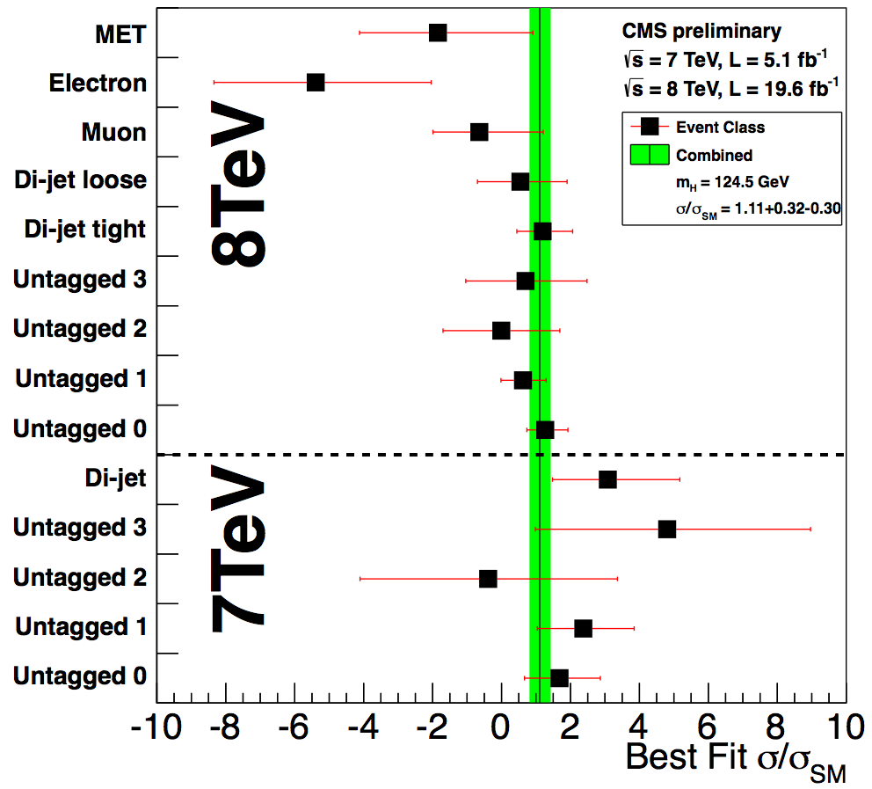
H γγ Best Fit Signal Strength
Compatibility Among the Classes
MVA
Based
Cut
Based
Best fit signal strength σ/σ_{SM} is consistent
among different classes and with the SM, within errors
Note: in spite of the same names, untagged classes in the two analyses are different
21

Slide 22
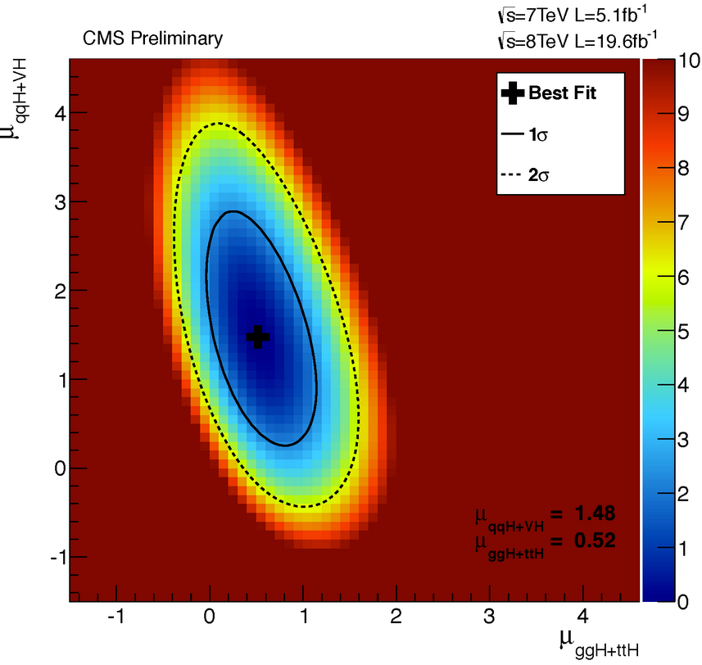
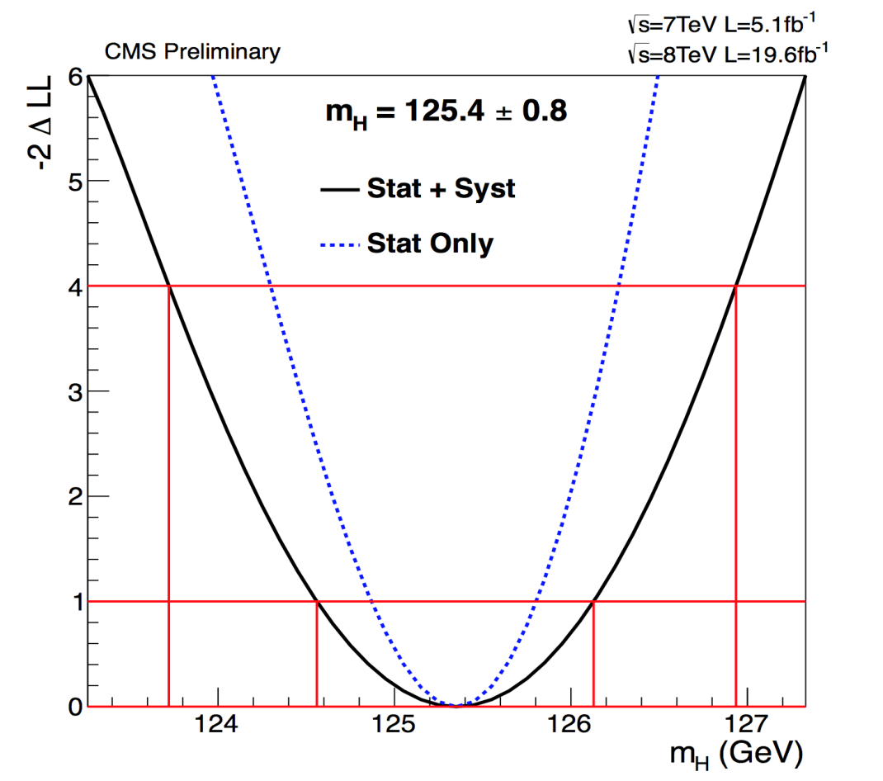
H γγ : Couplings μ_{V} (VBF+VH) vs μ_{F} (ggH+ttH) and Mass Determination
22
μ_{V}
Mass measured profiling μ_{V}, μ_{F}
along with all other nuisances to reduce model dependence
Main Systematic:
Energy Scale extrapolation from
M_{Z} to M_{H} ~125 GeV
(0.47%)
Best Fit
(0.52, 1.48)
+
♦
SM
μ_{F}
μ_{V} and μ_{F} are consistent, within 1 sigma, of SM prediction
Best Fit: Mass = 125.4 GeV ± 0.5 (stat) ± 0.6 (syst.) GeV

Slide 23
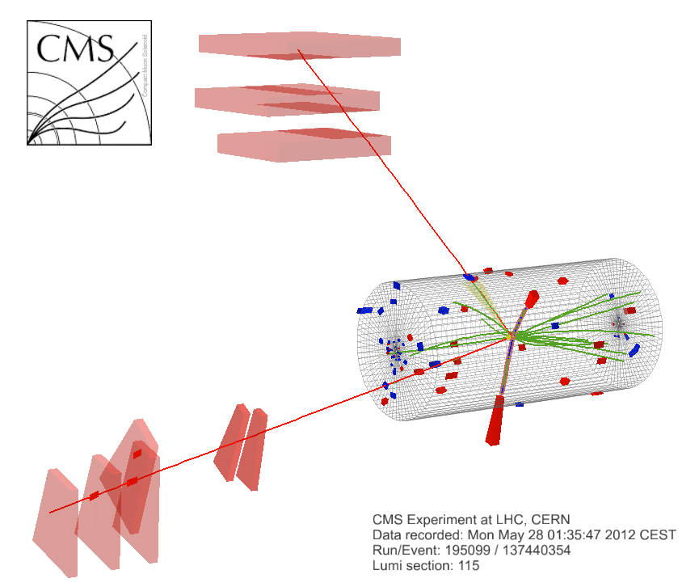
H → ZZ(*) →4𝓵, 2𝓵2τ (𝓵 = e,μ)
The Golden Channels
CMS HIG-13-002
Signal: 4 isolated lepton-pairs (SF, OS) from a common vtx; peak over small continuum BG
Fully reconstructed, Mass resolution ~ 1-2%
Kinematic info. ideal for properties tests
Selection: Same flavor, opposite charge pairs
  Z₁: P_{T}^{min} (e) > 7, P_{T}^{min} (μ) >5, 40 < M_{ll} <120 GeV
  Z₂: 12 < M_{ll}< 120 GeV
  3D IP to vtx < 4σ
  Z p_{T} Thresholds; Special selections for ττ
Reducible Backgrounds:
  t-tbar → 2l 2ν 2b ; Z + bb: Removed by Isolation & Impact parameter requirements
Irreducible background: pp → ZZ Continuum
  Rate obtained from Z yield in data, + theory prediction for ratio of ZZ to Z cross sections
  BG shape corrected to NLO w/ MCFM
μ⁺(Z₁) p_{T} :
43 GeV
e⁻(Z₂)
p_{T} : 10 GeV
8 TeV DATA
4-lepton Mass
126.9 GeV
M_{4μ} = 201 GeV
μ⁻(Z₁) p_{T} :
24 GeV
e⁺(Z₂) p_{T} : 21 GeV
23

Slide 24
H → ZZ(*) → 4 Leptons
Analysis Improvements in 2012-13
Improvements in 2012 (I)
Up to HCP:
New lepton selection,
extending the p_{T} range
Muon reconstruction
Recovery of photons
from final state radiation
Blind low mass “signal” region.
Kinematic Discriminant
Exploit angular information
to discriminate signal from irreducible ZZ background
~20% gain in sensitivity
with respect to 2011 analysis
Pure Scalar 0+ compared,
favored over pure 0-
Improvements in 2012 (II)
Since HCP:
In 2l 2τ events: Constrain ττ mass to the nominal Z mass;
τ isolation requirements retuned
Dijet categories: gg H + 2Jets Also search for VBF
Improved K_{D}: take interference among identical leptons fully into account
Compare pure 0⁺ hypothesis
to more alternative J^{P}
hypotheses

Slide 25
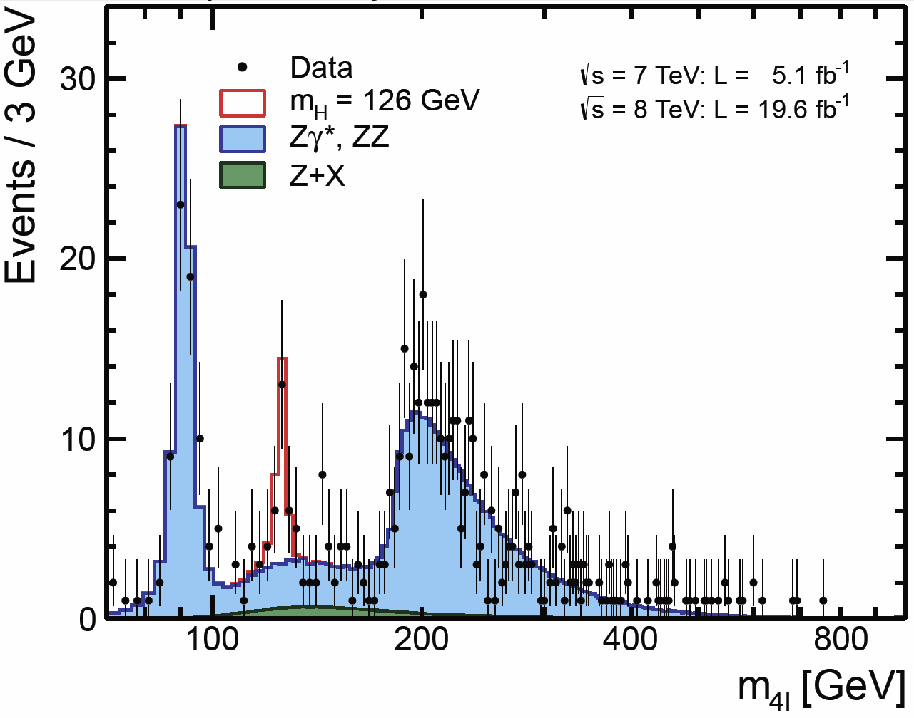
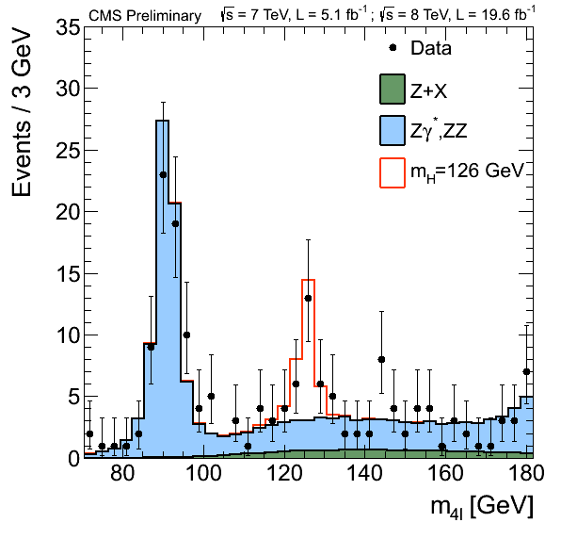
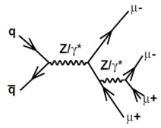
H  ZZ(*)  4e, 4μ, 2e2μ Candidates
Mass Spectrum
Good description of Z 4L Peak, and ZZ continuum
Low Mass Region
σ(ZZ, 8TeV) = 8.4±1.0 (stat.)
± 0.7 (syst.)
± 0.4(lum.) pb
Clear Signal Peak Near 126 GeV
Z 4l Peak Provides Cross Check

Slide 26
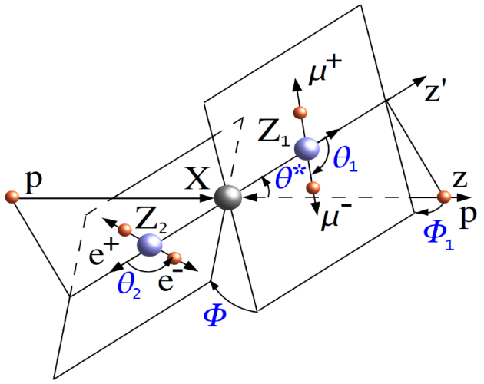




H → ZZ(*) → 4 Leptons
K_{D}: Matrix Element Kinematic Discriminant
To further improve S vs. B separation, construct a discriminant based on the kinematic information (angles and masses)
signal
Signal
template
background
template
background
template
K_{D}
Signal
template
K_{D}
K_{D} =
K_{D} Vs M_{4l}
K_{D} Vs M_{4l}
K_{D} Vs M_{4l}
High mass data w/error bars
Superimposed on background
Low mass data with error bars
Superimposed on background
Low mass data: Signal-like clustering near 126 GeV

Slide 27


H → ZZ → 4l and 2l2τ (New)
M (2l2τ) and Upper Limits Over the Full Range
M(2l2τ): No Excess at High Mass
95% CL on σ/σ_{SM}
2l2τ Sensitive
at High Mass
SM Higgs is excluded at 95% CL in the range 130 – 827 GeV
Expected exclusion 130 – 778 GeV

Slide 28


H → ZZ(*) → 4l Results
P-values (1D, 2D, 3D best fits) and signal strength
P Values (in σ) from 1D, 2D, 3D Fits
Best Fit μ = σ/σ_{SM}
1D, 2D, 3D Fits:
M_{4l}, K_{D} and
P_{T}/M; or V_{D} for the dijet channel
3D Fit Significance
6.7σ at 126 GeV
(expect 7.2σ for SM H)
 >5σ from this
channel alone
2D Fit: 6.6σ
(expect 6.9σ)
1D Fit: 4.7σ
(expect 5.6σ)
2σ
+0.30
- 0.24
Overall μ= 0.91
4σ
5σ
Untagged
μ= 0.85
+0.32
- 0.26
Obs. M4l
Obs. M4l +KD
6σ
Obs. M4l+ KD +
P_{T}/M or V_{D}
Expected
Dijet Tag
μ= 1.22
7σ
+0.84
- 0.57

Slide 29



H → ZZ → 4l
Mass Fit and Coupling Factors μ_{V} and μ_{F}
3D Fit (M_{4l}, K_{D}, δM_{4l}) for mass: M = 125.8 ± 0.5 (stat) ± 0.2 (syst) GeV
Momentum Scale, Resolution: Studied & tuned in dilepton control samples
In Dijet category: P_{T} spectrum, V_{D} : used to disentangle prod. Mechanisms:
Scale factors for Couplings to Vector Bosons μ_{v} (from VBF, ZH, WH)
and to Fermions μ_{F} (from gg via quark loops, ttH)
Still Largely Statistics Dominated
Mass Fit
μ_{V}= 1.0
+2.4
- 2.3
μ_{F}= 0.9
+0.5
- 0.4

Slide 30



H → ZZ → 4l
Spin and Parity Measurements
We know it is a boson, not Spin 1, not 100% 0- [PRL 110 081803 (2013)]
To go further: build two discriminants based on the complete LO ME’s
D_{bkg} to separate Signal from Background, combined with mass info.
D_{JP} to Separate an SM Higgs from alternative J^{P} hypotheses
Test (in ZZ and WW) several well-motivated alternatives using
fully correlated information in the (D_{bkg} ,D_{JP} ) plane: Pure States Only

Slide 31


H → ZZ → 4l
Spin and Parity Test Statistics

Slide 32


H  Zγ  l+l-γ (l = e, μ): New Rare
Decay Channel with Good Resol’n
CMS PAS-HIG-13-006
Combined m(eeγ), m(μμγ) Distribution
95% CL Limit on σ/σ_{SM} vs M_{H}
  Isolated leptons and photons
  Four classes each for eeγ, μμγ divided by S/B: shower shape and η
  Mass resolution (σ_{eff}) = 1.6 – 3.3 GeV

Slide 33


H  WW  2l 2ν (l = e, μ)
High Sensitivity, Low Resolution
CMS HIG-13-003; http://cds.cern.ch/record/1523673
μ P_{T}
32 GeV
Signal characteristics
  2 opposite sign, isolated leptons
  Significant E_{T}^{Miss}  No Mass Peak
  Smaller ΔΦ (l⁺l⁻) and hence M_{ll}
  for low M_{H}: Higgs is a scalar
e P_{T}
34 GeV
ΔΦ
ME_{T}
47 GeV
Analysis Strategies
  Cuts Analysis (M_{H} Dependent) + 2D Shape Analysis
  Separate categories with different S/B to optimize
  (1) by lepton flavor; eμ (DF) events are purest
  (2) by 0, 1, 2 Particle-Flow Jets (VBF), P_{T} > 30 GeV
  No b-jets and no isolated 3rd lepton [suppress WZ]
Lepton P_{T} > 20, 10 GeV
Analysis Improvements
  New Lepton Selection, extending the p_{T} Range
  New electron E Determination, with MV regression
  M (126) Resol’n improved: 2.7 (3.8) to 2.0 (3.0) GeV
Main Backgrounds
W+Jets, Drell Yan, Top, WW
33

Slide 34

H  WW Cut-and-Count: Cut Evolution
Cut-by-cut: at each step, background are normalized to the data
Major Requirements
Lepton P_{T} > 10, 20 GeV, tight ID & Isolation
  Removes QCD, W+jets contamination:
  Leaves Drell-Yan-dominated sample
Missing E_{T} Discrimination; Veto Z →μμ, ee
  Removes Drell-Yan contamination:
  Leaves a WW & top dominated sample
Classification by N_{Jets} (P_{T} > 30 GeV),
soft lepton & b-jet veto [“top tag”]
  Removes Top contamination:
  Leaves a WW dominated sample
Kinematic discriminants:
M_{ll}, M_{T} (WW), ΔΦ_{ll}
  Mitigate pp → WW background
M_{H} – dependent cut optimization:
Leaves a WW+Higgs dominated sample;
an excess is visible

Slide 35



H  WW Cut-and-Count Analysis: DF 0 Jet
Optimized Selections per mass point are applied on
leptons’ p_{T}, M_{ll}, M_{T} (WW), ΔΦ_{ll} to enhance a Higgs signal
Final Cuts: After backgrounds are fitted from the data in control regions
M_{ll}
M_{T} (WW)
ΔΦ_{ll}
Observe excesses over background in the signal regions
MH | signal | WW | WZ+ZZ+Z/𝛾*→ll | Top | W+jets | W𝛾* | All bkg. | Data
125 | 90±19 | 310±29 | 11.4±1.1 | 20.0±4.3 | 48±13 | 40±13 | 429±34 | 505

Slide 36


H  WW 2D Shape Analysis eμ 0-Jet: PDFs
Relaxed Selections are applied on kinematic variables
wrt cut-based. Performed a binned fit to M_{ll}, M_{T} (WW)
Signal, m_{H}=125 GeV. 0-jet eμ
Total background. 0-jet eμ
M_{ll} vs M_{T} (WW)
Clear region in 2D space dominated by the signal
Gain wrt cut-based comes from use of kinematic distributions

Slide 37


H  WW 2D Shape Analysis eμ 0 and 1 Jet: Data
Relaxed Selections are applied on kinematic variables wrt cut-based. Binned fit to M_{ll} vs M_{T} (WW)
8 TeV Data - Expected Background
0-Jet eμ
8 TeV Data - Expected Background 1-Jet eμ
Clear excess observed in signal-enriched region (Low M_{ll}, M_{T} ~100 GeV)

Slide 38


H → WW → 2l 2ν (l = e, μ) Results
Combined σ/σ_{SM} 95% CL Limits
7+8 TeV Limits (95% CL) on σ/σ_{SM}
σ/σ_{SM} with M_{H}=125 GeV) as background
Observed
Observed
Expected(median)
Expected
Injection:
M_{H} = 125 GeV ± 1σ
Observed limit matches expected background + H(125) signal injection
  ✴ Masses of 128-600 GeV are excluded at 95% CL
  + Limits on Additional Higgs-like bosons above 113 GeV
38

Slide 39


H  WW  2l 2ν
Signal Significance
7+8 TeV: Signal Significance vs M_{H}
Signal strength μ=σ/σ_{SM} vs M_{H}
For M_{H} = 125 GeV:
Observed Significance = 4.0 σ
Expected Significance = 5.1 σ
  Mass resolution of this channel
  (~30 GeV) gives a wide
  minimum in the Likelihood
39

Slide 40


H  WW  2l 2ν
Signal Strength
Best Fit Signal Strength μ vs M_{H}
Best Fit Strength By Channel
SF
1 Jet
7 TeV
SF
0 Jet
DF
1 Jet
DF
0 Jet
SF
1 Jet
8TeV
SF
0 Jet
DF
1 Jet
DF
0 Jet
  Best fit Signal Strength
  for M_{H} = 125 GeV:
  μ = σ/σ_{SM} = 0.76 ± 0.21
Best Fit μ = σ/σ_{SM} by channel
Consistent results
among the channels
40

Slide 41

H → WW → 2l 2ν
Testing Spin Hypotheses: 0⁺ vs 2⁺
Discrimination based on Binned Fit to M_{ll} vs M_{T} (WW)
P-Value (in σ) of other hypothesis
Hypothesis Expected Observed
Hypothesis | Expected | Observed
Assuming Signal Strength =1
0⁺ | 1.9 σ | 0.9 σ
2⁺_{m} | 2.4 σ | 1.3 σ
Assuming Prefit Strength on Data
0⁺ | 1.5 σ | 0.5 σ
2⁺_{m} | 1.8 σ | 1.3 σ
Expected separation between 0⁺ & 2⁺_{m} : 2 σ
Data is consistent with both hypotheses [CL(2+) = 14%]

Slide 42


WH  WWW  3l 3ν (l = e, μ)
New Sensitive Channel
CMS PAS-HIG-13-009
  95% CL Limits
  on σ/σ_{SM}
  3.3 Observed
  (3.0 Expected
  for M_{H} = 125 GeV)
  Signature: Three high p_{T} isolated leptons with moderate E_{T}^{Miss}
  Two Approaches: Cut-Based and shape-based using ΔR (l+l-)
    Shape-based has 20% better performance
  Z Veto and anti b-tagging to reject WZ and Top backgrounds
  Smallest m_{ll} < 100 GeV and smallest ΔR (l+l-) < 2

Slide 43




H  ττ
Signatures: eμ μτ_{h} eτ_{h} μμ τ_{h}τ_{h}
CMS PAS-HIG-13-004
Jet₂ E_{T} =46 GeV
  Probes coupling to leptons
  Sensitive to All production modes: gg fusion, VBF, VH
  High σ•BR at low mass
  Signature: Broad excess in m_{ττ}
  Challenging backgrounds:
  DY → ττ,ee,μμ, W+Jets,Top, QCD
Jet₁ E_{T} = 177 GeV
E_{TMiss} = 97 GeV
τ→ π⁺π⁰ν
Mu P_{T} =20 GeV
P_{T}^{vis} = 70 GeV
_{Visible Mass(ττ) = 75 GeV}
_{Mass ( jj ) = 580 GeV}
_{Δη (jj) = 3.5}
Analysis Strategy
Select well-isolated leptons
Topological cuts to suppress background: M_{T} in lτ_{h}, p_{T}(H) in τ_{h}τ_{h,…}
Split events into Categories:
  1 Jet (GGF) or 2 Jets (VBF); and Low vs High P_{T} (τ_{h} or μ)
  Dedicated categories for VH, with relatively hard leptons or MET
  Veto events with tagged b-jets with P_{T} > 20 GeV
  0 Jets: Used to constrain backgd normalize, Tau ID Efficiency, E Scales

Slide 44




H  ττ: μ+τ_{had} , e+τ_{had,} μ+e, μμ, τ_{h}τ_{h}
Many nalysis Improvements
Analysis Optimized:
Improved lepton & (PF) τ_{had} ID: P_{T}^{ch}/P_{T}^{τ} in ΔR Rings about τ
BDT for improved (PF-based) E_{T}^{Miss}
Consistency of E_{T}^{Miss} from ν_{τ}s
New m_{ττ} reconstruction with event-by-event likelihood
15-20% resolution
MVA selection for VBF tag
Real taus
Fake taus
M_{ττ} improved reco τ_{μ}τ_{h}
M_{ττ} improved reco τ_{e}τ_{h}
τ ∀πν
τ ∀a₁ν
τ ∀ρν
1 Prong
3 Prong
1 Prong + Strip

Slide 45

H  ττ: Anatomy of the Analysis
Handling the Dominant Backgrounds
R. Wolf at HCP

Slide 46



H  ττ: Signal Extraction
Combine 1-Jet and 2 Jet (VBF)
  Combine channels and categories
  Each channel in each category weighted by its expected S/B
Combined
2 Jet (VBF)
1 Jet

Slide 47


H  ττ: Statistical Interpretation Limits and Signal Injection
95% CL Limits on σ/σ_{SM} vs M_{H}
compared to background expectations
95% CL Limits on σ/σ_{SM} vs M_{H}
compared to background + M_{H} (125)
M_{H} (125)
Injected
Results are consistent with the expectation for the presence of a SM boson at M_{H} = 125 GeV (within 1σ)
47
Notes:
Left plot shows iterations of analysis from last year’s summer conferences to now. Scaling by sqrt(N) last year’s result would give us roughly 3x SM sensitivity; we are now at 1.28 x SM at 125 GeV

Slide 48

H  ττ
P-Values: Significance
Broad excess is observed
over the low mass M_{H} range
Maximum local significance
is 2.93σ at 120 GeV
  Consistent with the presence
  of a 125 GeV SM scalar boson
Observed significance
is 2.85σ for M_{H} = 125.8 GeV
  Expected: 2.6σ
Strong Indication that the new particle decays to Taus
48
Notes:
Left plot shows iterations of analysis from last year’s summer conferences to now. Scaling by sqrt(N) last year’s result would give us roughly 3x SM sensitivity; we are now at 1.28 x SM at 125 GeV

Slide 49



H → ττ: Signal Strength vs Mass and Compatibility Among Categories
Signal Strength vs M_{H}
Prod. Categories
Decay Categories
μ
M_{H}
Combined Best Fit Strength μ = 1.1 ± 0.4 (M_{H} = 125 GeV)
Results consistent across categories, and with SM
49
Notes:
Left plot shows iterations of analysis from last year’s summer conferences to now. Scaling by sqrt(N) last year’s result would give us roughly 3x SM sensitivity; we are now at 1.28 x SM at 125 GeV

Slide 50


VH → Vbb Associated Production
W,Z + H  l+l- , lν, νν, l =e,μ + bb
CMS PAS-HIG-
12-046 (HCP)
  H bb: Largest σ•BR for M_{H}< 135 GeV
But very large QCD Background
 Use V+H Associated Production: Greater S/B
Signature: Leptons, 2 b-jets and E_{T}^{Miss}
5 Channels Z(ll)+H(bb), Z(νν)+H(bb), W(lν)+H(bb)
  Reducible Background: W, Z + Jets, Top
VH: Boosted Higgs Analysis
Require high momentum (W or Z) and H; and 2 b-tagged jets
  With back-to-back V and H
Use MVA to Reconstruct M_{bb,}
Classify Events: 8-9% Resolution
Main backgrounds are estimated
from data in control regions
Z (μμ) H (bb) Candidate
b-Jet Cand. P_{T} = 153 GeV
Secondary Vtx Tag 92%
2nd b-Jet Cand.
P_{T} = 48 GeV
Muon: P_{T} 161.8 GeV
Secondary Vtx Tag 99.6%
Muon: P_{T} 27.3 GeV

Slide 51


VH  V bb Associated Production
Many 2012 Analysis Improvements
MVA for better b-jet P_{T} 
M_{bb} mass resolution
~10% for M_{H} = 125 GeV
Split events in medium and high boost:
Based on P_{T}(V)
Reconstruct Jet Energy
using BDT regression:
15-20% improvement
Use full shape of final MVA discriminant
Gain in sensitivity ~50% overall, already on 2011
dataset
Extensively validated
in data using
Z(ll) + bb, ttbar,
and single top
events
M_{bb}
1
Large P_{TV}  Larger S/B
4
W(eν)H
BDT Output
2
VH (125)

Slide 52


VH  V bb Signal Extraction
Example: All Channels, High P_{T}(V) Bin
M(bb) Distribution After Selection
M(bb) After Background Subtraction (Except VV)
  Consistent with Diboson Expectation
  plus a small excess in the Signal Region

Slide 53



VH Vbb: Results
Local Significance and signal strength
HCP
95% CL Limits on σ/σ_{SM}
Best Fit σ/σ_{SM}
Channels are compatible
within errors (M_{H} = 125 GeV)
Observed σ/σ_{SM} limit is 2.5 at 125 GeV
  Expected Limit with
  no SM Higgs is 1.2
Observed local significance is 2.2σ
    Expected Limit is 2.1σ with presence
    of SM H at 125 GeV
    Compatible with SM
Combined best fit
signal strength σ/σ_{SM} is μ = 1.3
With H(125) Injected
Z(ll)+H(bb)
Local p-values Vs. M_{H}
Z(νν)+H(bb)
W(lν)+H(bb)
+0.7
- 0.6

Slide 54



Observation of a New Boson Near 125.8 GeV p-values and Significance by Channel
HCP
ττ
Excess at ~125.8 GeV:
Combined Significance 6.9 σ
High sensitivity, high mass
resolution channels: γγ + 4l
  ZZ  4l: 4.4 σ Excess
  γγ 4.0 σ Excess
bb
WW
γγ
ZZ 4l
Expected σ
Observed σ
Combined
H→ZZ | 5.0 | 4.4
H→γγ | 2.8 | 4.0
H→ WW | 4.3 | 3.0
H→ bb | 2.2 | 1.8
H → ττ | 2.1 | 1.8
H → γγ+ZZ+WW + ττ + bb | 7.8 | 6.9
CMS-HIG-12-045
54

Slide 55


Compatibility with SM Higgs boson
Best Fit σ/σ_{SM} grouped
by Decay Mode
σ/σ_{SM} grouped
by prod. and decay mode
HCP
HCP
Compatible
with SM:
χ²/NDF = 8.7/11
Prob. = 0.65
Overall best-fit signal strength: σ/σ_{SM} = 0.88±0.21
Signal strength σ/σ_{SM} in different modes is self-consistent, but some required more data to fully distinguish a SM signal from background
HCP

Slide 56

Compatibility: Among Channels and with SM Higgs boson
New updates on some modes using the full 2011-12 dataset:
ττ, WW, ZZ
H  ττ: μ = 1.1 ± 0.4
H  WW: μ = 0.76 ± 0.21
+0.30- 0.24
H  ZZ: μ = 0.91
New (and older) results are compatible with the SM Higgs boson
+0.28
- 0.26
Also Note Latest H  γγ Result on Full Dataset: μ = 0.78

Slide 57


Characterization of the Boson: the Mass
γγ
Assume one particle, use sub-channels
with good mass resolution:
γγ(untagged), γγ(VBF), ZZ(4l)
Do a likelihood scan for the
Mass & Signal Strength
Results are self-consistent; can be combined
ZZ
Combined
To reduce model dependence, float cross sections in 3 channels;
do 1D fit for a common mass:
m_{X} = 125.8 ±0.4(stat) ±0.4 (syst) GeV
γγ
ZZ
Notes:
This combination is model dependent as we assume that the relative event yields in gamgam, VBF gamgam, and zz4l channels are defined by the SM Higgs boson phenomenology. The total cross section, however, is allowed to float.
The main model independent result is on the next page.

Slide 58



Couplings Compatibility Tests
LHC Higgs Cross-Section WG: A. David et al, arXiv:1209.0040
Assumptions: Single resonance, zero width, SM tensor structure
There are 8 Independent parameters to describe all the currently relevant decays and production mechanisms:
which are given by:
We cannot extract all 8 parameters with the current data.
So instead we do coupling compatibility tests in terms of
scale factors relative to the SM: for the couplings κ, or
ratios of the scale factors λ
Example: For the gg  H → γγ process:
(σ x BR) (gg  H  γγ) = σ_{SM}(gg  H) BR(H  γγ) • κ_{g}² κ_{γ}² /κ_{H}²

Slide 59



Custodial Symmetry
Test the Ratio of Couplings to the W and Z Bosons
  κ_{Z}, λ_{WZ} = κ_{W} / κ_{Z} Profiled
  κ_{F} = 1 as in SM
Full profiling of κ_{Z}, κ_{F}
λ_{WZ} in [0.68 - 1.55] 95%CL
HCP
  λ_{WZ} = κ_{W} / κ_{Z} is compatible with 1 (Custodial Symmetry)
  as in SM. Errors still relatively large

Slide 60




Six Coupling (C6) Model
Assume Custodial Symmetry , BR_{BSM}=0
End up with six scale factors:
Fit each one of these while profiling the others
HCP

Slide 61


κ_{V} and κ_{F}: Map the Vector Boson and Fermion Couplings to Two Scale Factors
  Assume custodial symmetry and fermion universality
κ_{F}
κ_{V}
  Data are consistent with the SM: κ_{V} =1; κ_{F} = 1

Slide 62



Searching for New Physics in the Boson’s Total Width  BR_{BSM}
  New Particles can hide
  in the loop-mediated couplings
  And contribute to
  the total width
  Affects κ_{g}, κ_{γ}, κ_{H}
  Allow the total width to scale as 1/(1 – BR_{BSM})
HCP
HCP
  Result: BR_{BSM} < 0.62 at 95% CL

Slide 63


All the Boson Couplings and Ratios
Many Constrained at 95% CL
HCP
Bottom line: compatible with SM. Some errors still large.
Will improve with analysis on full dataset

Slide 64

CMS Coupling Determination Projections
At LHC (300 fb⁻¹) and HL-LHC (3000 fb⁻¹)
Two scenarios
Experimental+theoretical systematics unchanged
Scale experimental systematics with √L +
reduce theoretical uncertainties by 50%
Pessimistic
Optimistic: + a challenge for theorists
Precision
on the Couplings:
6-15 (3-9)% with 300/fb
5-11 (1-4)% with 3000/fb
LHC
HL LHC
Η ∀μμ decay rate: preliminary studies indicate 5σ significance;
between 25% and 10% precision on H to μμ coupling at HL LHC

Slide 65
BSM Higgs Overview
Extensions to the SM
  Fermiophobic Higgs sector
  4th generation of heavy fermions
Supersymmetric
  MSSM with two Higgs doublets:
    H⁰  bb, ττ
    H±  τν
  NMSSM with additional scalar field a₁  μμ
Triple your fun
  Minimal Type II Seesaw Model: Relate to ν mass* + NP
  Triplet scalar field → Doubly charged Higgs
*Grimus et al http://arxiv.org/pdf/0902.2325v3.pdf

Slide 66


MSSM Higgs
Two Higgs doublets
  Five Higgs particles
      Three neutral Φ = h, H, A
      Two charged (H±)
  Two free parameters
      Search in m_{A} – tan β plane
  Production enhanced: b, t loops
Coupling ∝ tan²β for tan β > ~7
Searches @ CMS
Neutral Φ: ττ (and bb,μμ)
pp  Φ  ττ ; Φ b  bbb, with
semileptonic, hadronic b-decays
Charged H±: look in top decays:
tt → H⁺W⁻bb or H⁺H⁻ bb with H →τν
~
~

Slide 67



MSSM Φ(h, H, A) ττ
Enhanced coupling to b quarks,
add associated production via b-tags
CMS PAS
HIG 12-050
b-tag and no b-tag (ggF) classes
ττ Mass constructed via Max. Likelihood technique using
  τ decay kinematics
  Compatibility of E_{T}^{Miss}
  with neutrino hypothesis
Resulting M_{ττ} resolution is
~15-20% Almost Gaussian
Large tan β Region Excluded
τ_{μ}τ_{h}
τ_{e}τ_{h}
CMS-PAS-HIG-12-050
τ_{e}τ_{μ}
τ_{μ}τ_{μ}
m_{h}^{Max} scenario provides conservative limits
m_{ττ} in the b-tag categories

Slide 68




Charged Higgs in Top Quark Decays
Signatures: τ_{h}+Jets μτ_{h} eτ_{h} eμ
JHEP 07(2012)143
CMS-PAS-HIG-12-052
Strategy:
  Look for t t → (H⁺b) (W⁻b)
  or (H⁺b) (H⁻ b) with H → τν
  Three classes of events:
    All hadronic with jets
    + τ → hadrons
    Lepton+jets with τ→ hadrons
    Dilepton in the eμ channel
BR (t  Hb) large for small or large tan β
M_{H} = 100GeV
Studies assuming BR (H  τν) = 1

Slide 69

Charged Higgs Results
Limits in Each Channel and Combined
Combined Limits on
BR(t H⁺b): 2-3%
For M_{H+} in 80-160 GeV:
Consistent with
SM Backgrounds

Slide 70
Summary and Conclusion
The examination of the new boson in CMS has advanced rapidly; many analyses have been improved; some new ones have begun
We have made more accurate measurements of the boson’s mass
We have set new limits on the production of add’l Higgs-like bosons
We have made new measurements of its decays to bosons in WW
and ZZ, and to fermions, especially in the ττ and bb final states
The boson’s signal strength and couplings, measured in several channels, are compatible with SM expectations
  But the uncertainties in some channels are still relatively large
The boson’s spin and parity is compatible with 0+. Several other alternative pure J^{P} states are disfavored at 98% CL or greater
We have found no sign of BSM physics in the Higgs width, nor in direct searches for MSSM, fermiphobic, or charged Higgs bosons
Much has been learned; but these explorations have just begun;
The greatest opportunities for discovery lie ahead of us

Slide 71
Many More
CMS Physics Results
https://twiki.cern.ch/twiki/bin/view/CMSPublic/PhysicsResults

Slide 72
For Further Information
CMS Higgs Results twikipage
https://twiki.cern.ch/twiki/bin/view/CMSPublic/PhysicsResultsHIG
July 4 Seminar at CERN
https://cms-docdb.cern.ch/cgi-bin/PublicDocDB/ShowDocument?docid=6125
CMS talks on Higgs searches at ICHEP 2012
https://indico.cern.ch/conferenceProgram.py?confId=181298
LHC Implications for TeV Scale Physics
https://indico.cern.ch/conferenceDisplay.py?confId=173388
CMS Observation of a New Boson at 125 GeV Paper http://cdsweb.cern.ch/record/1470975
SUSY 2012 Conference Talks
http://www.phy.pku.edu.cn/~susy2012/
HCP (Kyoto) Conference Talks
http://www.icepp.s.u-tokyo.ac.jp/hcp2012/
Moriond Conference Talks
http://moriond.in2p3.fr/

Slide 73
In the Discovery Era The Outlook

Slide 74


Slide 75






Observation of a New Boson Near 125 GeV
“The Discovery of the Century”
BR
Tevatron Evidence
μ vs M
"Combined results of searches for the SM Higgs boson in pp collisions at s=7TeV" (http://www.sciencedirect.com/science/article/pii/S0370269312002055)
"Combined search for the SM Higgs boson with the ATLAS detector at the LHC" (http://www.sciencedirect.com/science/article/pii/S0370269312001852).
75

Slide 76





Precision Electroweak, Including the “SM Higgs”: It Fits
Gfitter Post July 4 2012
Precision W Mass
Precision Top Mass
173.36 ± 0.38 ± 0.91 GeV
M_{H} =
125-126 GeV
It Fits

Slide 77

Higgs Mass and Vacuum Stability
A 125.5 GeV Higgs mass means you are just on the wrong side
of the Vacuum Stability bound
We seem to be in a very particular metastable region
OR –New physics exists at an intermediate mass scale ~10¹¹ GeV
We need to know both the Higgs mass and the top mass precisely, to know if the vacuum is stable [New role of ILC or CHF?]
M_{top} versus M_{H} to NNLO

Slide 78

SM-Like MSSM Higgs and Beyond
A 125.5 GeV Higgs needs tan β > ~5, and large mixing X_{t}
Also favors large M_{S} especially for less than maximal mixing
But M_{S} cannot be Too large, else theory is unstable at high scales
M_{H} = 125.5 GeV and indications that BR(γγ) might be > BR(γγ) SM have led to many speculations, and an industry of model-space profile likelihood studies, both within and beyond the MSSM

Slide 79


Higgs and Supersymmetry
See Carena and Nath talks at SUSY2012
MSSM has two Higgs Doublets, leading to:
H, h (CP Even, Higgs-Like), A (CP Odd) and H±
H_{u} doublet couples only to up-quarks; H_{d} only
to down-quarks; so SUSY is flavor diagonal if SUSY is unbroken
Quartic Higgs couplings determined by SUSY gauge couplings
  The lightest Higgs (h) mass is strongly correlated with the
  Z Mass, and is naturally light
  Other Higges can be as heavy as the SUSY breaking scale M_{S}
Important quantum corrections to the lightest Higgs mass due to incomplete cancellation of top and stop contributions in the loops
A 125.5 GeV Higgs favors large LR Stop Mixing X_{t} and/or large M_{S}

Slide 80

Beyond the MSSM Higgs
M. Carena at SUSY 2012

Slide 81

CMS Phase 2 Upgrade at HL-LHC
Higgs Couplings with 3000 fb⁻¹
Extrapolation to higher luminosity by two orders of magnitude
is subject to large uncertainties: these are early projections
  Scenarios 1 and 2 are likely to provide upper and lower bounds
Experience at LEP and the Tevatron indicates that scaling by 1/√L might not be unrealistic; in spite of a more challenging environment
The Higgs couplings could possibly be measured with high precision: 1-4% in Scenario 2
H  μμ decay could be measured
with 5σ significance
  And the H to μ coupling
  could be determined to ~10%
Multiple Higgs production
can be observed (σ = 33 fb), and
  The self-coupling coefficient
  λ in the Higgs potential
  could be measured

Slide 82





The Outlook
SM or not: the 125-6 GeV “Higgs” boson has taken us to the threshold of an era
of new physics, with a host of questions
Natural, Split or High Scale SUSY ?:
  A nearby 3rd generation at ~0.5 TeV ?
  Another nearby scale at ~5-50 TeV ?
OR: new singlets, doublets, triplets; new scalars, vectors, composites, extra dim. ?…
Vacuum (meta)stability 
Another new scale at ~10¹⁰⁻¹² GeV ?
Neutrino masses (via seesaws or RH ν):
A “similar” intermediate scale ?
The Discovery has Expanded our Vision
Exciting years ahead of results and
(new) ideas: about EWSB and beyond
High Scale SUSY
Split SUSY
Giudice Strumia
Unstable
10¹⁰
Metastable
10¹²
Stable
M_{h} in GeV
λ at High Scales
Degrassi et al. NNLO

Slide 83
Backup Slides Follow

Slide 84




LHC: Remarkable Performance
Peak luminosity: 7.7 X 10³³
500 MHz Inelastic Collisions
ATLAS and CMS
August 19
CMS Collected: 6 fb⁻¹ by ICHEP. 23 fb⁻¹ by December 6
Beyond the New Boson Discovery: New Physics Landscape in 2015 ?

Slide 85


Electron Scale and Resolution
Electron scale linearity wrt MC with Z, J/Ψ, ϒ(1S)➞e⁺e⁻
Electron relative resolution
in data with Z➞e⁺e⁻
G1=golden electrons
G2=non golden electrons
Better than 1% in barrel
Better than 2% in endcaps
Best category: 1.2% resolution
Worst one: 4% resolution

Slide 86

Final State Radiation Recovery
Applied on each Z for photons near the leptons
Expected Performance for M_{H}=126 GeV
μ,e
μ,e
γ
ΔR(l, γ)_{min}<0.5
& E_{T}> 4 GeV
ΔR(l, γ)_{min}<0.07
& E_{T}> 2 GeV
Particle Flow ID
|η|<2.4
Isolation
Z
Associates photon with Z if:
  M(ll+γ)< 100 GeV
  |M(ll+γ)-Μ_{Z}|<|M(ll)-M_{Z}|
Removes associated photons from lepton isolation calculation
86
Notes:
-FSR recovery affects 6% of the events
-80% of those events correspond to real FSR photons
-20% of those events are fakes
-The purity of 80% is enough as it can be seen from the shape
of the recovered plot. The upper tail is small and the peak
is symmetric which implies that the impurity does not affect
performance
-Maybe it can be stated in later slides that two of the events
in the interesting region have identified FSR

Slide 87

Pile-up Jet Tagging
Rejection of jets from PU, also outside the tracker coverage, relies on jet shape variables.
Important in VBF searches.
Validation on data: jet counting in
Z → μμ events vs vertex multiplicity.
Stable to <1% for jet p_{T} > 20 GeV
Typical jet
Pileup jet
Result: jet thresholds and characteristics (well represented
by MC) are Independent of Pileup

Slide 88





Precise π⁰,η  γγ Calibration
Stream: 1st Time at a Hadron Collider
Data after L1 Trigger
Online Farm
~1 - 10 kHz
π⁰ Calibration
~50 kHz
π⁰ Mass History in EB Stable to 0.3%
η⁰ Mass History in EB Stable to 0.4%
Level 1 trigger rate:
several π⁰’s/event
Advantage: high π⁰ rate
(use L1 not HLT triggers)
  Use with laser crystal transparency monitor
“Design” calibration → 0.5%:
for optimized H→γγ detection
June 2011 on: 5-10 kHz rate 
Bi-weekly calibration in
central barrel to ~0.5%
2012 EB Crystal Calibration
vs. |η|: Precision 0.4 – 0.9%
2012 EE Crystal Calibration
vs. |η|: Precision 2%

Slide 89


Clusters: Energy Resolution
ECAL Relative Energy resolution with Z➞e⁺e⁻
Effect of Energy Corrections
on Z➞e⁺e⁻ mass
Inclusive electrons
In the best categories, σ_{Ε}~1.5%
Significant improvements by including cluster corrections

Slide 90


Electron/Photon Reconstruction
Electrons
ECAL Barrel (EB)
Cluster reconstruction in ECAL
  Common for both electrons & photons (Electrons also reconstructed as photons)
  Designed to collect bremsstrahlung and conversions in extended phi region
Photon identification specific to H➔γγ
Dedicated track reconstruction for electrons
  Gaussian Sum Filter allows for tracks with large bremsstrahlung
Energy scale and resolution
  Extensive control with Z and J/ψ➔ee and Z for both electrons and photons

Slide 91


CMS Higgs Search Channels
Expected Sensitivity in μ = σ/σ_{SM}
HCP: 110 – 145 GeV at 7 and 8 TeV
HCP: 110-1000 GeV at 7 and 8 TeV
For Illustration only
WW
ττ
ττ
ZZ 4l
bb
γγ
γγ
bb
ZZ 4l
WW
Combined
Combined
HCP: For Illustration only

Slide 92


Higgs Boson Decays
Main Decay Modes:
bb,, WW(*), ττ, ZZ(*), γγ; High M_{H}: WW(*), ZZ(*)
High Mass Resolution Channels H  γγ and H ZZ(*)  4l
H  WW high Yield
Focus on high sensitivity channels

Slide 93

H → γγ Analysis Key Points
  Diphoton Mass Resolution: M² = 2E_{γ1}E_{γ2} (1-cos θ)
    Energy Resol’n: ECAL Calibration & Energy Corrections
    Photon Directions: Primary vertex determination
    Photon Identification: Separate prompt photons from
    reducible background from misidentified neutral mesons
    in QCD γ+Jet and multi-jet events
    Event categorization: (diphoton ID, inclusive/exclusive channels)
      Probe different production processes (gg, VBF, VH) and exploit the different S/B and/or different resolution to maximize the sensitivity: Inclusive + Exclusive Dijet, e, μ, E_{T}^{Miss} Categories Background Modeling from the Data:
      Provides good description: background is ~70% QCD Di-Photon

Slide 94
H → γγ Analysis Improvements in 2012-13
Improved the energy calibration on the
first 5.3 fb⁻¹ of 2012 data (after publication)
Added more exclusive channels in 2012 analysis
Added MVA classification in dijet selection
for the MVA analysis

Slide 95


MVA Diphoton Analysis:
Signal Model Mass Resolution (8 TeV)
Untagged Category 0: σ_{eff} = 1.1%
All Categories: σ_{eff} = 1.7%
Notes:
Signal x5 – only us MC bg for analysis optimization.
Also used to measure the ratios of efficiencies between data and MC

Slide 96
H → γγ Cuts-based Analysis Overview
  First separate events into classes with different σ_{m}/m
  and S/B to increase the analysis performance
    Do photon ID & mass fit in each class,
    then combine in final fit
    Inclusive: 2 pseudorapidity x 2 shower shape categories
    with different Signal/Background ratios
    2 Di-jet categories targeting VBF: Higher S/B
    Exclusive categories targeting VH associated production:
    Electron Tag, Muon Tag, E_{T}^{Miss} Tag
      With tighter E_{T} and conversion veto cuts on the photons,
      and add’l kinematic cuts to suppress the backgrounds
    Systematics: ID and Selection for γ, e, μ (data/MC scale factors), Energy scale and resol’n (e/γ), R9 Selection, etc.

Slide 97
Compatibility among the two analyses
We estimate the correlation between the two analyses using the resampling jackknife technique:
M. Quenouille (1949), J. W. Tukey (1958)
The correlation coefficient between the two measurements is found to be r=0.76
Signal strength compatibility only in 2012AB (published) :
  New MVA vs published MVA: 1.6σ
  Cut-based vs old cut-based (published cross-check): 0.5σ
A large number of tests have been performed.
No source of systematic error was found.
Differences appear to be of a statistical nature.
 | Signal strength compatibility (including correlation)
MVA vs CiC in full dataset | 1.5 σ
MVA vs CiC only in 2012 dataset | 1.8 σ

Slide 98


Photon Energy Scale and Resolution
ECAL cluster energies corrected using a MC trained MVA regression
  Improves resol’n and restores flat response of energy scale vs. pileup
      Inputs: Raw cluster energies & positions, lateral and longitudinal shower shape variables, local shower positions w.r.t. crystal geometry, pileup estimators
Regression also used to provide a per photon energy resolution estimate
After “best” individual crystal calibration and transparency corrections: measure Energy
Scale & Resolution with Z→e⁺e⁻
  Also Z→μμγ for photon scale
Both EB |η|<1
High R9
E_{5x5}
E_{SC}
E_{SC corr}
Effect of regression
on the
Zee peak
Notes:
LH plot shows that we get the smearing correct
RH plot shows the improvement coming from the regression

Slide 99

Energy Scale vs Time (in Z ee)
Stability at 0.3% level before application of analysis level corrections with prompt reconstructed data

Slide 100

MVA Photon ID
Validation with Z→ee
(inverted electron veto)
Photon pre-selection:
  E_{Tγ1}/m_{γγ} > 1/3, E_{Tγ2}/m_{γγ} > 1/4
  Photon ID a bit tighter than trigger selection and MC EM enrichment filters
  Efficiency measured using tag and probe with Z→ee
  Electron veto: Efficiency measured using tag and probe with Z→μμγ
MVA based photon ID discriminates photons from fakes:
  Inputs: isolation, shower shape, per-event energy density, pseudorapidity
Barrel
Endcaps

Slide 101


MVA γγ Vertex Choice
Mass reconstruction: Depends
on correct position of the primary vertex
Interaction vertex is identified using tracks from recoiling jets
and the underlying event plus conversions
  correct in 83% (79%) of cases for pileup in 2011 (2012)
Vertex identification with a BDT
  Input variables: Σp_{t}², Σp_{t} projected onto the γγ transverse direction,
  p_{t} asymmetry and conversions
Correct vtx finding probability also estimated using a BDT
Efficiency to ID correct
vertex within 10 mm
Data/MC efficiency for Zμμ
after removing the μ tracks

Slide 102

Pileup Robustness:
Cut-based ID Efficiency
Cut-based Photon ID efficiency per event decreases
with increasing pileup; well described by MC

Slide 103

Di-jet Tagging: Selection
Analysis improvements in 2012:
Split di-jet tagged events in two categories based on M_{jj} and jet p_{T}
  ~15% improvement in sensitivity for dijet category
  Better sensitivity to separate different Higgs production modes
Removal of jets from pileup events
  Based on the jet shape variables, tracks in jet and vertexing
  Cross-checked using Z+jet and γ+jet events
Dijet selection cuts
103

Slide 104

H→ γγ MVA: Systematic Uncertainties
Per Photon, Per Event, Per Category

Slide 105
H → γγ Cut-based analysis
Cut-based analysis uses a cut-based photon identification
and a different definition of event classes
  Photon identification data/MC efficiency scale factors computed from Z→ee and Z→μμγ.
4 categories are defined according to the photon characteristics
  Barrel-endcap & converted/unconverted from shower shape
  Different mass resolution and S/B among the 4 categories
Cat 0 | Both photons in barrel | Both photons R₉ > 0.94
Cat 1 | Both photons in barrel | At least one photon with R₉ < 0.94
Cat 2 | At least one photon in endcaps | Both photons R₉ > 0.94
Cat 3 | At least one photon in endcaps | At least one photon with R₉ < 0.94

Slide 106
Photon ID: Cut Based
Validation with Z→ee
(inverted electron veto)
Four Categories: Barrel or Endcap;
Shower Shape R₉ < 0.94, R₉ > 0.94
Photon pre-selection:
  E_{Tγ1}/m_{γγ} > 1/3, E_{Tγ2}/m_{γγ} >1/4
  H/E, shower shape, Isolation
  Photon ID a bit tighter than trigger selection
  and MC EM enrichment filters
  Efficiency measured using tag and probe with Z→ee
  Electron veto: Efficiency measured using tag
  and probe with Z→μμγ (no electron veto)
ID Selection in Each Category:
  Shower shape, H/E, global event isolation,
  corrected by per-event energy density

Slide 107

H→ γγ Cuts Based Expected Event Yields, Resolution and Backgrounds in Each Category
107

Slide 108

H→ γγ Cuts Based: Systematic Uncertainties
Per Photon, Per Event, Per Category
108

Slide 109


H  γγ Results: 95% CL Limits
MVA mass-fit
Cut-based
Exclude almost the full mass range at 95% CL
Except the region around 125 GeV

Slide 110


Jacknife Resampling
Jackknife resampling can be used to estimate the
variance of statistical estimators in a non parametric way.
  Achieved evaluating
  the estimator on subsets
  of the statistical sample.
Given analyses A and B,
used to estimate the variance of μ_{A}-μ_{B} by applying the jackknife resampling method to the events selected by
either analysis.

Slide 111
Overlap of Selected Events
MVA
8%
18%
MVA
50%
81%
CiC
CiC
32%
11%
Data
(Background MC agrees)
Signal MC

Slide 112

H  ZZ(*) Event Yields 110 – 160 GeV
Observed Vs. Expected Signal + Background Rates
Z+X Background from data in control regions
ZZ background from Simulation

Slide 113

H  ZZ(*) Event Yields 100 – 1000 GeV
Observed Vs. Expected Signal + Background Rates
Z+X Background from data in control regions
ZZ background from Simulation

Slide 114

H  ZZ  2l₁ 2l₂ (l = e, μ)
Improved Electron Resolution in 2012
New electron Energy Determination using regression
  M_{H} (126) Resolution Improved
    σ_{CB} from 2.7 to 2.0 GeV; σ_{eff} from 3.8 to 3.0 GeV (4e events)
    σ_{CB} from 1.8 to 1.7 GeV; σ_{eff} from 2.8 to 2.4 GeV (2e2μ events)
114

Slide 115

H → ZZ → 4l and 2l2τ
Over the Full Range: P-Values
SM Higgs is excluded at 95% CL in the range 130 – 827 GeV
expected exclusion 130 – 778 GeV

Slide 116





H → ZZ(*) → 4l: Signal/Background Separation
Variables in 1D, 2D, 3D Fits: M_{4l}, K_{D} and (P_{T}/M or V_{D})
M_{4l} with K_{D} > 0.5
Kinematic Disc. K_{D}
P_{T}/M_{4l}
DiJet Discriminant V_{D}
Events in the Peak Region: 121.5 < M_{4l} < 130.5 GeV
V_{D}: A Fisher Discriminant for
the Dijet-tagged Category using
m_{jj} and Δη_{jj} as inputs.
Events are mainly gg  H + 2 jets; also targets VBF

Slide 117

H → ZZ → 4l
M_{Z1} Versus M_{Z2}

Slide 118

H  ττ
Signatures: eμ μτ_{h} eτ_{h} μμ τ_{h}τ_{h}
CMS PAS-HIG-13-004
Jets P_{T} > 30 GeV
V. Dutta at Moriond

Slide 119

M(ττ)
Improved Reconstruction

Slide 120

H → bb-bar Reconstruction
Regression Input Variables
15% Improvement in Resolution
10-20% Increase in Analysis Sensitivity

Slide 121









Combining CMS
SM Higgs Searches
Decay | Prod. Topology | Luminosity
H→bb | VH + ttH | 5+12 fb⁻¹ at 7+8 TeV
H→ ττ | Inclusive + VBF + VH | 5+12 fb⁻¹ at 7+8 TeV
H → γγ | Inclusive + VBF | 5+12 fb⁻¹ at 7+8 TeV
H → WW | 1 jet + VBF + VH | 5+12 fb⁻¹ at 7+8 TeV
H → ZZ | Inclusive [+ dijet tag at Moriond] | 5+12 fb⁻¹ at 7+8 TeV
CMS HIG-12-045
✴ Main Channels: ZZ, γγ, WW, bb, ττ
✓

Slide 122


H → ZZ → WW/ZZ, 2l2q, 2l2ν
Searches for Additional Bosons

Slide 123


H  ZZ  2l2ν
E_{T}^{Miss}
95% CL Limit on σ/σ_{SM} vs M_{H}
  Final State: Dilepton from a Z, Large E_{T}^{Miss}
  Split in Categories: e, μ; 0,1,2 Jets
  Use M_{T} as the Final Variable

Slide 124


H  ZZ  2l2q
M_{ZZ}
95% CL Limit on σ/σ_{SM} vs M_{H}
  Final State: Dilepton from a Z, DiJet from another Z
  Split in Categories: e, μ; 0,1,2 b-Jets
  Use M(2l2q) as the Final Variable

Slide 125


WH  qq′WW  qq′2l2ν
M (Jet-Jet)
95% CL Limit on σ/σ_{SM} vs M_{H}
  Final State: Two leptons, Two Jets and E_{T}^{Miss}
  Use Methods from the main H  WW  2l2ν analysis

Slide 126


H  WW  qq′lν
CMS-PAS-HIG-12-046
M(qq′lν)
95% CL Limit on σ/σ_{SM} vs M_{H}
  Final State: One high pT isolated lepton, two or more Jets,
  and large E_{T}^{Miss}
  Use M(qq′lν) as the final variable
  No significant excess observed
  Analysis in progress: looking at higher masses

Slide 127

Statistics: Computing Limits for the Higgs Search
CERN-CMS Note-2011-005: Procedure for the LHC Higgs Boson Search Combination in Summer 2011

Slide 128

Statistics: Computing Significance for the Higgs Search

Slide 129


Searching for New Physics in the Relative Couplings to u and Quarks and to Leptons
  In the MSSM the relative couplings to u and d quarks are modified
  The relative couplings to leptons and quarks also
  can be modified in more general two Higgs doublet models
λ_{du}
λ_{lq}
HCP
  Result: the up/down and lepton/quark Coupling Ratios
  λ_{du} and λ_{lq} are both consistent with 1  Consistent with the SM

Slide 130



Charged Higgs in Top Quark Decays
Event Selections
JHEP 07(2012)143 CMS-PAS-HIG-12-052

Slide 131




Fermiophobic Higgs: γγ, WW, ZZ
BSM Model with two Higgs doublets
and no coupling to fermions
  Gluon fusion and ttH production
  forbidden; no change in VBF and VH
  Big enhancement (10x) to γγ branching
  Yields for FP Higgs at 125 GeV comparable to SM: γγ, ZZ, WW; also Zγ
Jets (VBF) and Leptons (VH)
produced at LO:
  WW and γγ have
  both VBF and VH
  Boosted Higgs
  For ZZ: repurpose
  SM Analysis
  2012: 8 TeV γγ Update
Previous 95%CL limits: Tevatron 119 GeV [arXiv:1109:0576v1], ATLAS 121 GeV[arXiv:1205.0701v1]
CMS 110-194 GeV [arXiv1207.1130v1]

Slide 132


Fermiophobic Higgs
By Tag and Overall Combined Result
Dijet Tag: Most sensitive channel
95% CL M_{H} Limit 131 GeV in 2012
Lepton Tag: Best S/B channel
95% CL M_{H} Limit 121 GeV in 2012
MET Tag: High S/B;
complements lepton tag
Untagged: 70% of selected sample
Exploit harder VBF, VH diphoton P_{T} spectrum by using
Constructed 2D model using m_{γγ}, π_{Τ}^{γγ} for signal and background
2012: 8 TeV Update in the γγ mode
T
95% CL: Exclude
110 GeV < M_{H} < 147 GeV
(nearly the whole range)
99% CL: Exclude
110 GeV < M_{H} < 134 GeV
arXiv:1207.1130 ; CMS-HIG-12-009 ; CERN-PH-EP-2012-174

Slide 133






NMSSM: Light Pseudoscalar a₁ → μ⁺μ⁻
Add a Scalar Singlet to the MSSM Higgs Family
Cross Section x BF Upper Limits
Mass Range 1
5.5 – 8.8 GeV
pseudoscalar
Limits of 2-6 pb
Mass range 2:
11.5 – 14.0 GeV
[First time]
Mass range 1:
5.5 – 8.8 GeV
Mass Range 2
11.5 – 14 GeV
Excellent μμ mass resoln
Limits of 1.5-2.5pb
|η| < 1.1:
σ ∼ 67 MeV
arXiv:1206.6326 ; CMS-HIG-12-004 ; CERN-PH-EP-2012-176

Slide 134






Doubly Charged
Higgs Φ⁺⁺
Minimal Type II See-Saw Models
  An additional scalar field that is a triplet under SU(2)_{L} ; motivated by ν masses
  New Higgs-like particles: Φ⁺⁺, Φ⁺, Φ⁰
  If observed would open a new window
  on neutrino physics at the LHC
CMS search for Φ⁺⁺ and Φ⁺
  Produced in pairs, or in association
  with singly charged Higgs (first time)
  Unique experimental signatures
  Search in 7 TeV data using same-sign lepton combinations of all flavors
7 TeV CMS Results: 0.036, 1, 4.9/fb
ℓℓℓ, ℓℓτ_{h}
ℓℓℓℓ, ℓℓℓτ_{h},ℓℓτ_{h}τ_{h}
Φ⁺⁺ and Φ⁺ masses assumed degenerate
arXiv:1207.2666 ; CMS-HIG-12-005 ; CERN-PH-EP-2012-169

Slide 135




CMS Upgrade Program

Slide 136


CMS Phase 1: Projected Precision of Higgs Signal Strength Measurements with 300 fb⁻¹ at 14 TeV
Detector and trigger performance assumed to be
the same as the current detector
Assume the same systematics as in
the 2012 analysis (Scenario 1)
Result: Precision expected per channel is typically 10-15% with 300 fb⁻¹

Slide 137

CMS Phase 1 Upgrade
Impact on H ZZ 4l Analysis
Analysis as developed for 7-8 TeV, Average Pileup = 50

Slide 138


CMS Phase 1: Projected Precision on Higgs Couplings with 300 fb⁻¹ at 14 TeV
Two Scenarios
Scenario 1: same systematics as in 2012
Scenario 2: theory systematics halved,
other systematics scaled by 1/ √L
Result: With 300 fb⁻¹ the uncertainties on the Higgs Couplings
are expected to be in the range σ(κ_{V}) = 3-6% to σ(κ_{b}) = 7-15%
Scenario 1
Dotted lines: no theory uncertainties

