Slide 1

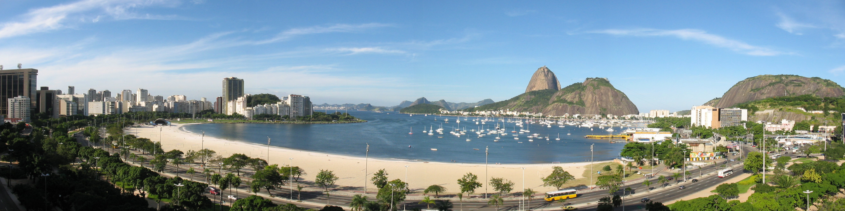
The LHC future:
the CMS perspective
T.Camporesi, CERN
LISHEP 2013

Slide 2
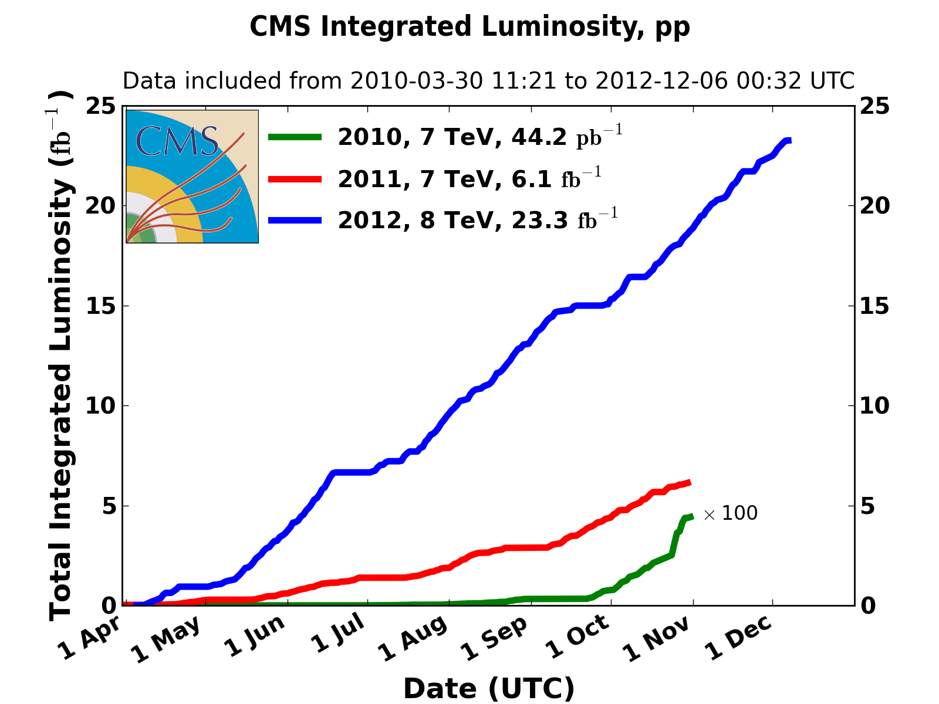
LHC prediction trustfulness
2010: 0.04 fb⁻¹
  7 TeV
  Commissioning
2011: 6.1 fb⁻¹ (exp 5)
  7 TeV
  … exploring the limits
2012: 23.3 fb⁻¹ (exp 20)
  8 TeV
  … production
…. We better take seriously the LHC predictions….

Slide 3
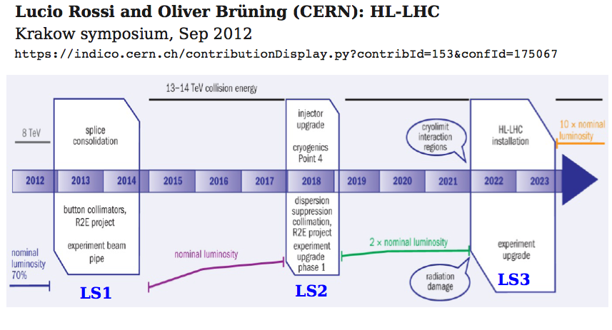
LHC plans

Slide 4
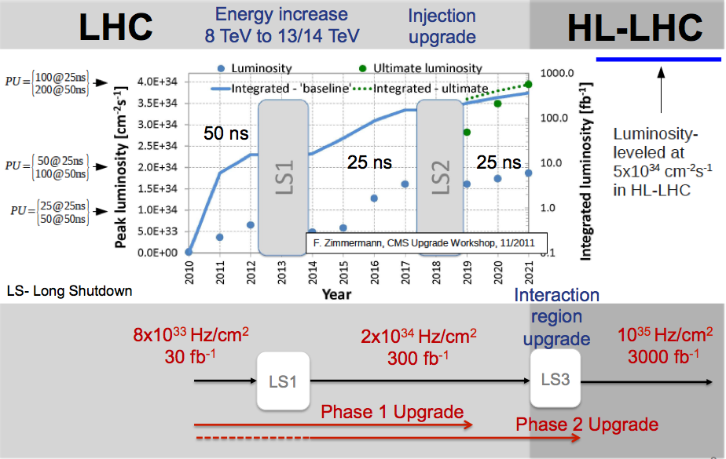
Map into CMS space

Slide 5
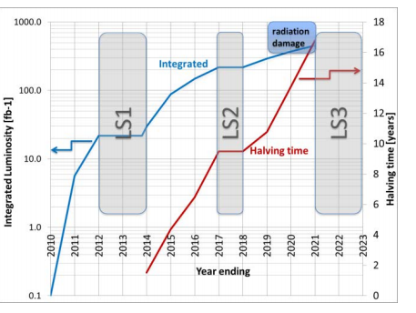
A comment about statistics
Stat. halving time Assuming flat lumi accumulation
Flat lumi accumulation is probably not the right assumption: trigger selection can influence stats for specific searches/measurements

Slide 6
The accelerator complex
What we know
What to expect

Slide 7
Performance from injectors 2012
Design report with 25 ns:
1.15 x 10¹¹ ppb
Normalized emittance 3.75 microns
Bunch spacing [ns] | Protons per bunch [ppb] | Norm. emittance H&V [microns] Exit SPS
50 | 1.7 x 10¹¹ | 1.8
25 | 1.2 x 10¹¹ | 2.7

Slide 8
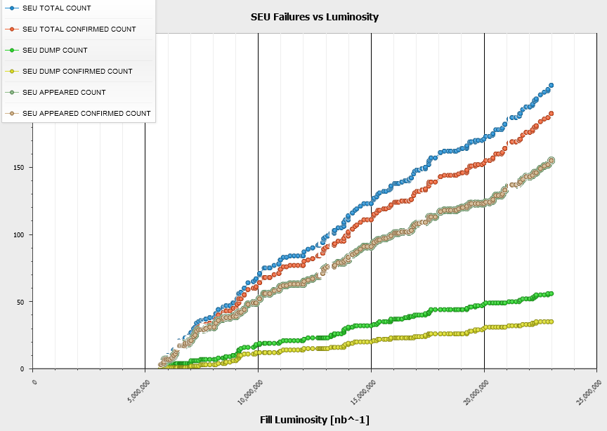
Radiation effects (SEU ++)
2012 SEE Failure Analysis
2011
Several shielding
campaigns prior
the 2011 Run +
Relocations ‘on the fly’
+ Equipment Upgrades
~12 dumps per fb⁻¹
2011/12 xMasBreak
‘Early’ Relocation
+ Additional Shielding
+ Equipment Upgrades
2012
~3 dumps per fb⁻¹
R2E-Project aiming for …
< 0.5 dump per fb⁻¹
>LS1 (nominal -> ultimate)
Equipment relocations @ 4 LHC Points
(>100 Racks, >60 weeks of work)
Additional shielding
Critical system upgrades (QPS, FGC)

Slide 9
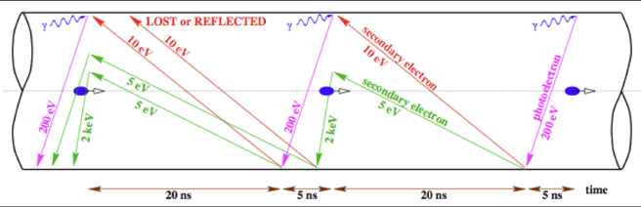
25 ns & electron cloud
Typical e– densities: n_{e}=10¹⁰–10¹² m^{–3} (~a few nC/m)
Typical e– energies: <~ 200 eV (with significant fluctuations)

Slide 10
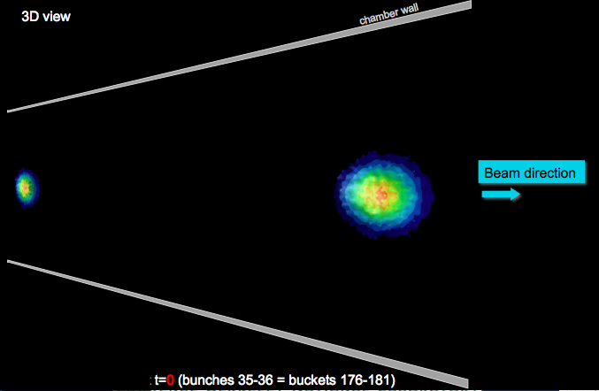
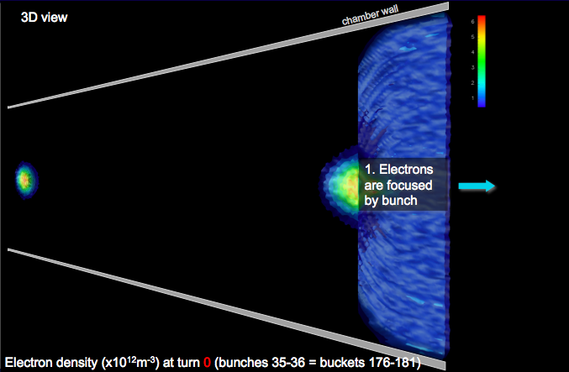
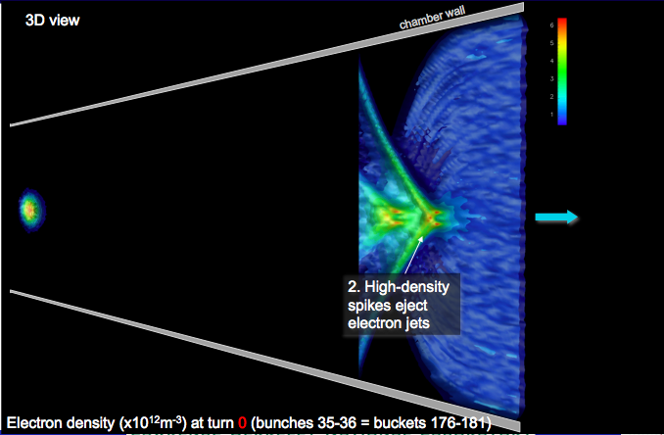
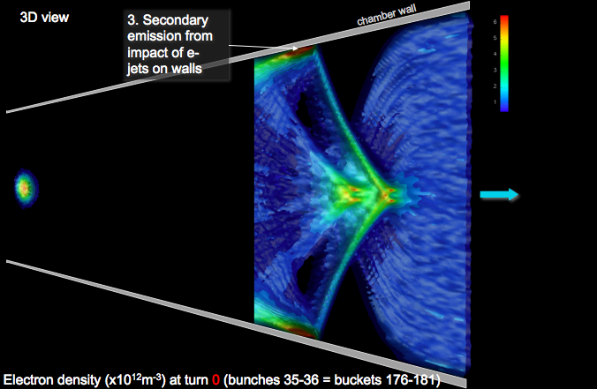
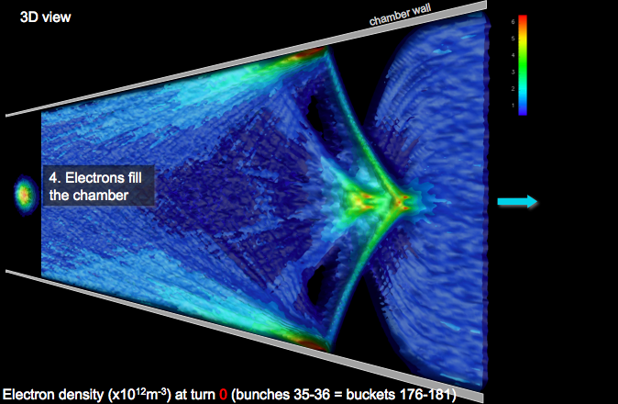
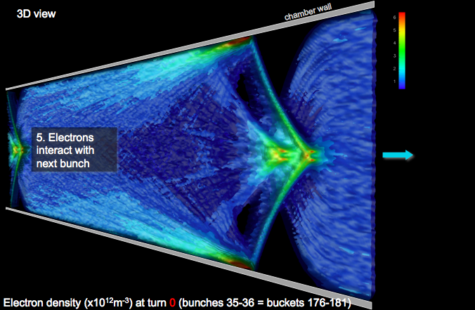
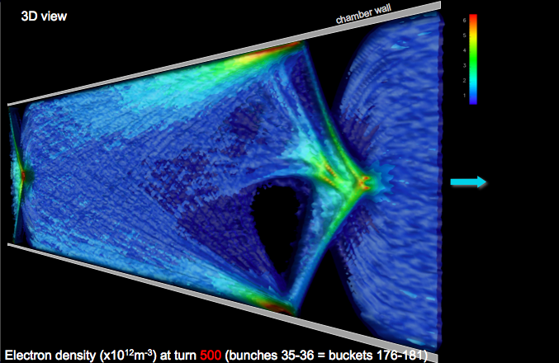
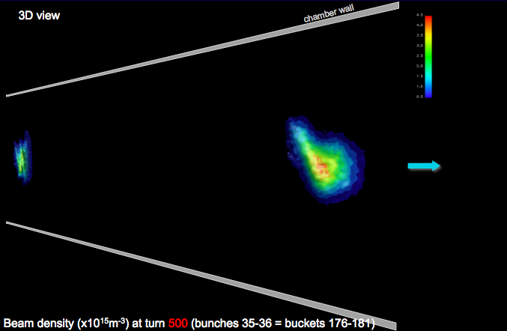

Warp and Posinst have been further integrated, enabling fully self-consistent simulation of e-cloud effects: build-up & beam dynamics
Turn 1
CERN SPS
at injection (26 GeV)
Turn 500
Miguel Furman ECLOUD12
10

Slide 11
Electron cloud: consequences
Possible consequences:
  single-bunch instability
  multi-bunch instability
  emittance growth
  gas desorption from chamber walls
  excessive energy deposition on the chamber walls (important for the LHC in the cold sectors)
  particle losses, interference with diagnostics,…
In summary: the EC is a consequence of the interplay between the beam and the vacuum chamber “rich physics”
  many possible ingredients: bunch intensity, bunch shape, beam loss rate, fill pattern, photoelectric yield, photon reflectivity, SEY, vacuum pressure, vacuum chamber size and geometry, …
Electron bombardment of a surface has been proven to reduce drastically the secondary electron yield of a material.
This technique, known as scrubbing, provides a mean to suppress electron cloud build-up and its undesired effects
Defense: design (saw-tooth pattern on the beam screen inside the cold arcs, NEG coatings, solenoids, etc.)

Slide 12

The 2012 25 ns scrubbing
  3.5 days of scrubbing with 25ns beams at 450GeV (6 - 9 Dec. 2012):
  Regularly filling the ring with up to 2748b. per beam (up to 2.7x10¹⁴ p)
  Scrubbing effects in the arcs:
  Quite rapid conditioning observed in the first stages
  The SEY evolution significantly slows down during the last scrubbing fills (more than expected by estimates from lab. measurements and simulations)
  Reconstructed comparing heat load meas. and PyECLOUD sims.

Slide 13
25 ns & electron cloud
There is a change of mode of operation with 25 ns. Electron cloud free environment after scrubbing at 450 GeV seem not be reachable in acceptable time.
Personal convinction: Need to ramp and scrub
Operation with high heat load and electron cloud density (with blow-up) seems to be unavoidable with a corresponding slow intensity ramp-up.
2015: SEY etc. will be reset - initial conditioning will be required
  FROM LHC OPS: Will need to start with 50 ns and only later to move to 25 ns to recover vacuum, cryogenics, UFOs conditions we were used in 2012.

Slide 14
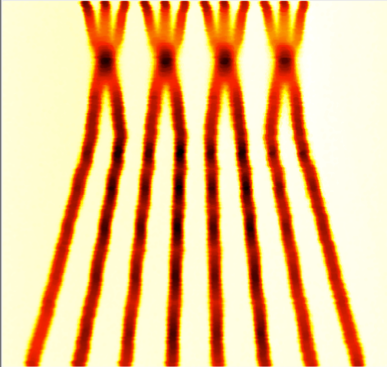
Beam from injectors LS1 to LS2
 |  | Bunch intensity [10¹¹ p/b] | Emittance,[mm.mrad] | Into collisions
25 ns ~nominal | 2760 | 1.15 | 2.8 | 3.75
25 ns BCMS | 2520 | 1.15 | 1.4 | 1.9
50 ns | 1380 | 1.65 | 1.7 | 2.3
50 ns BCMS | 1260 | 1.6 | 1.2 | 1.6
BCMS = Batch Compression and (bunch) Merging and (bunch) Splittings
Batch compression & triple splitting in PS
Rende Steerenberg, Gianluigi Arduini, Theodoros Argyropoulos, Hannes Bartosik, Thomas Bohl, Karel Cornelis, Heiko Damerau, Alan Findlay, Roland Garoby, Brennan Goddard, Simone Gilardoni, Steve Hancock, Klaus Hanke, Wolfgang Höfle, Giovanni Iadarola, Elias Metral, Bettina Mikulec, Yannis Papaphilippou, Giovanni Rumolo, Elena Shaposhnikova,…

Slide 15
50 versus 25 ns
 | 50 ns | 25 ns
GOOD | Lower total beam current Higher bunch intensity Lower emittance | Lower pile-up
BAD | High pile-up Need to level Pile-up stays high High bunch intensity – instabilities… | More long range collisions: larger crossing angle; higher beta* Higher emittance Electron cloud: need for scrubbing; emittance blow-up; Higher UFO rate Higher injected bunch train intensity Higher total beam current
Expect to move to 25 ns because of pile up…

Slide 16
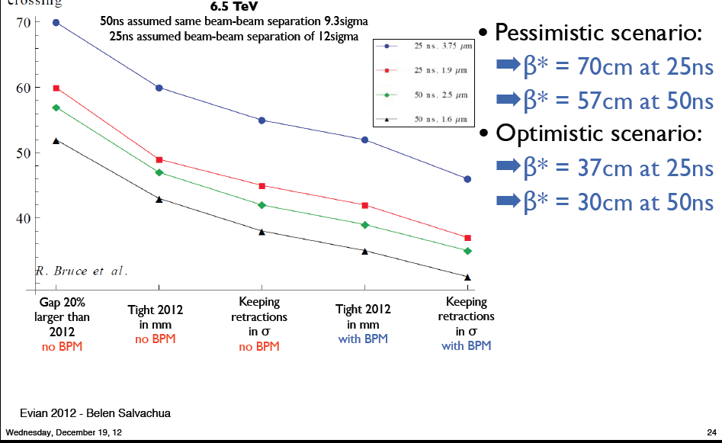
β* reach at 6.5 TeV

Slide 17
Potential performance
 | Number of bunches | Ib LHC FT[1e11] | beta*X beta*sep Xangle | Emit LHC [um] | Peak Lumi [cm-²s⁻¹] | ~Pile-up | Int. Lumi per year [fb⁻¹]
25 ns | 2760 | 1.15 | 55/43/189 | 3.75 | 9.2e33 | 21 | ~24
25 ns low emit | 2320 | 1.15 | 45/43/149 | 1.9 | 1.5e34 | 42 | ~40
50 ns | 1380 | 1.65 | 42/43/136 | 2.5 | 1.6e34 level to 0.9e34 | 74 level to 40 | ~45*
50 ns low emit | 1260 | 1.6 | 38/43/115 | 1.6 | 2.2e34 level to 0.9e34 | 109 level to 40 | ~45*
6.5 TeV
1.1 ns bunch length
150 days proton physics, HF = 0.2
85 mb visible cross-section
* different operational model – caveat - unproven
All numbers approximate

Slide 18
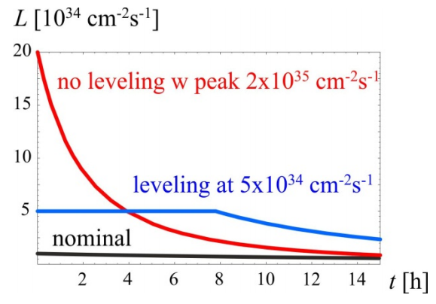
HL -LHC
This is a new regime: Phase 1 detectors were designed to handle between 1 and 2 10³⁴ Hz/cm²

Slide 19
The CMS view point
The short term challenges
The upgrade program:
Phase 1
Phase 2 ( HL LHC)

Slide 20
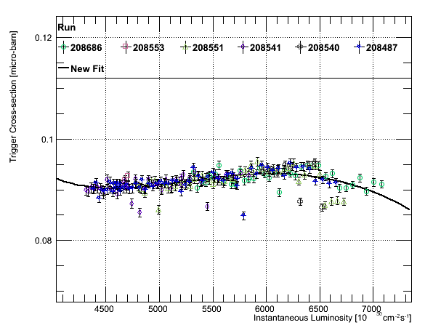
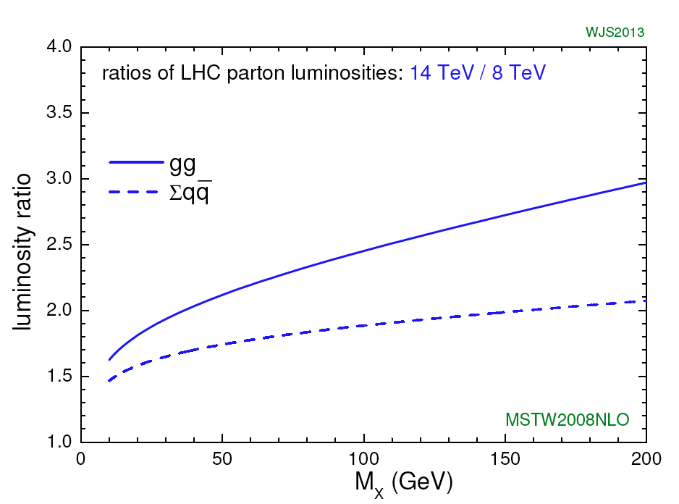
HLT : challenges for 2015
2012: 8 TeV HLT σ ∼0.09 μb
  PU=25, small dependence on PU
8 TeV→ 14TeV ⇒ rates double
  Average output rate of ~ 1.2kHz at 10³⁴cm⁻²s⁻¹ if menu untouched.
To keep the present acceptance:
  Improve HLT object reconstruction
    Allowing tighter cuts
  Reconsider strategies
    More cross triggers
  Will need more CPU
    e.g. to extend PF usage
    Particularly if PU <> grows above 25
σ_{HLT}≈ 0.09μb
20

Slide 21
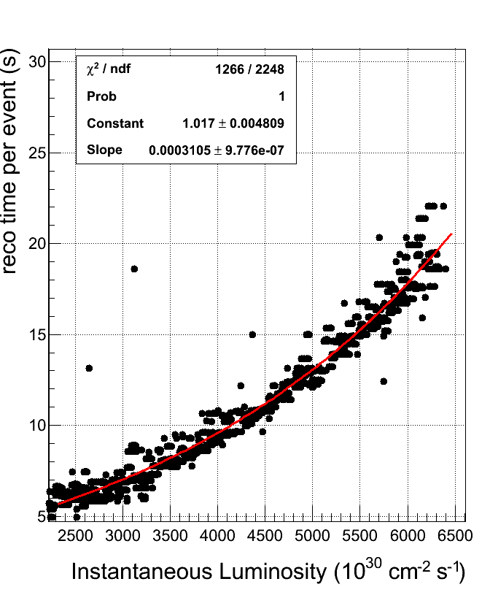
The Tier-0 Today
Off the chart:
Start of record fill
35
Many improvements
  But reco time is still non-linear with instantaneous luminosity
Preparing for both extremes of 25 and 50 ns bunch spacing
  Goal is to keep the physics performance the same as run1.
    Our physics projections are made with that assumption.
7500
21

Slide 22
50 ns spacing is too hard…
175
Points measured from current
release as run on high PU MC
150
Projecting ahead
  Would need a factor of 10 reduction in cpu time per event to maintain our current perfromance at highest projected luminosities
  Realistically?
    Could conceivably foresee factor of 2 reduction in cpu time per event
      We already gained factor of 3 in early 2012
125
50 ns and ultimate lumi need major upgrade of computing resources and SW improvements/sacrifices
100
90
80
70
60
50
40
Previous slide
Peak lumi X 10³³ Hz/cm²
7500
10000
18000
22

Slide 23
CMS upgrade program

Slide 24
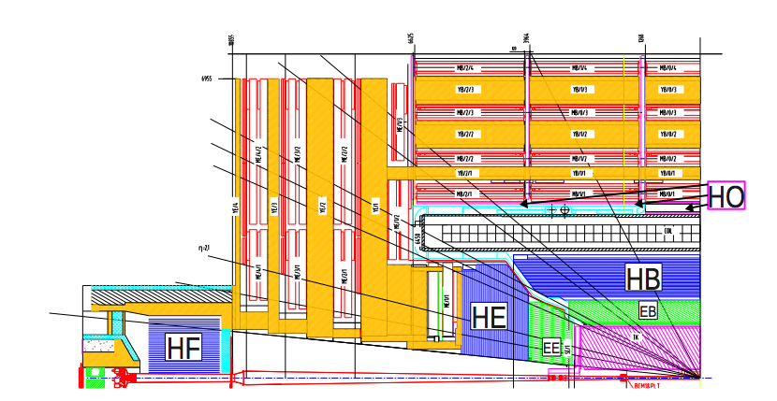
Detector upgraded in LS1
DT sector collectors
ME4 endcap muons
HF PMT
ME1 FE electronics
Cold trackrer operation
New beampipe

Slide 25
Short term (LS1)
Completion of staged projects:
  Completion of muon coverage
  Implement Cold tracker operation
Fix problems detected in first LHC run
  HF, Cerenkov light from PMT windows: replace PMTs with new thinner window and multianode PMTs
  Replace HPD for HO with Si-PM (unforeseen instability of HPDs at fields lower than 3 T)
  Consolidation of DT front-end fiber readout (sector collector)off-cavern: allows intervention and easy reconfiguration for trigger upgrade +new front-end theta trigger board ( FPGA based)
Prepare for future upgrades :
  New smaller diameter beam-pipe ( necessary if wanting to install new pixel in extended end of year shutdown)
  Optical splitting of calorimeter trigger lines+ new optical output for muon trigger ( to allow parallel commissioning of trigger upgrade –μTCA based- during LHC operation in 2014-2015)
  Install new HF backend electronics (μTCA to replace VME) : first step of full HCAL upgrade
See Gilvan
See Gilvan
See Gilvan

Slide 26
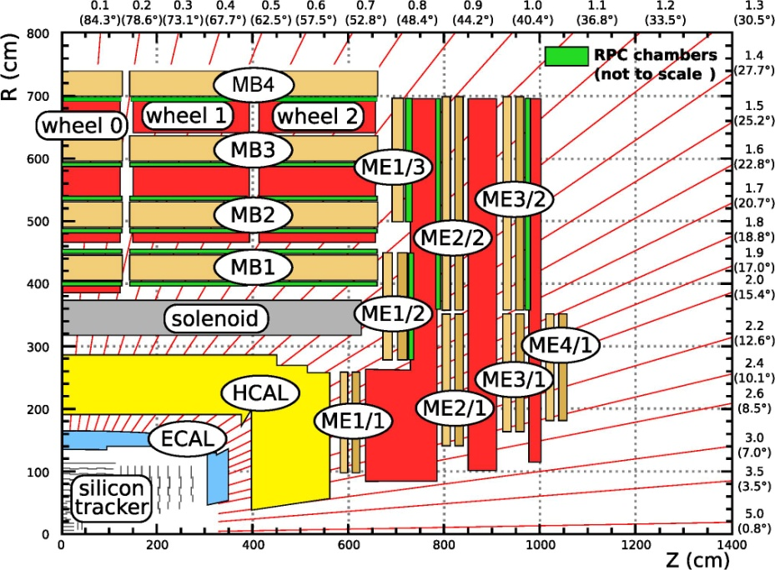
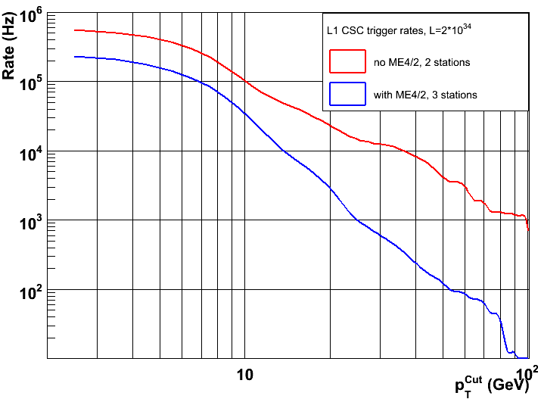
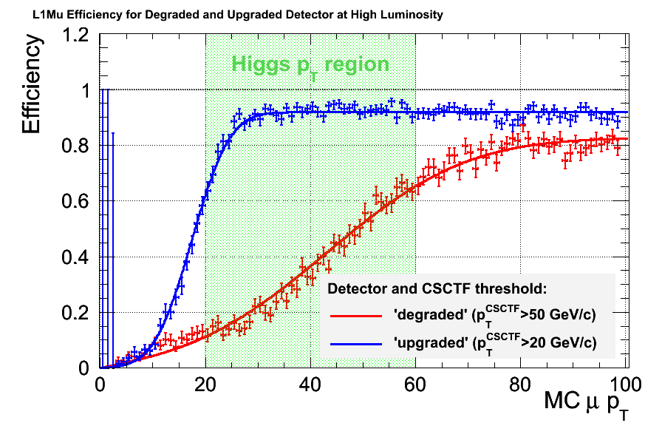
LS1 Muon Upgrades
Trigger performance: significantly lower threshold for same rate
CSC and RPC: ME4/2 (1.25<|η|<1.8)
More hits, lower rates
CSC: ME1/1 (2.1<|η|<2.4) new digital boards and trigger cards : higher strip granularity
Electronics reliability
DT: new trigger readout board and relocation of sector collector from UXC55 to USC55 (new optical links)
Target Rate 5 kHz

Slide 27
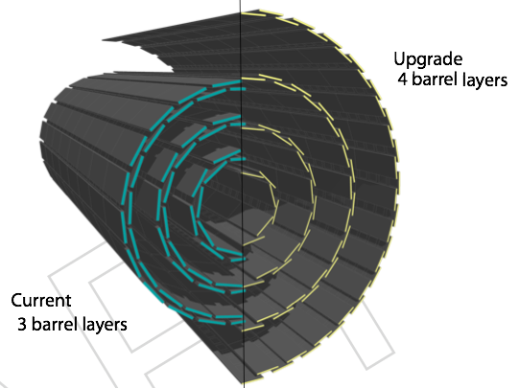
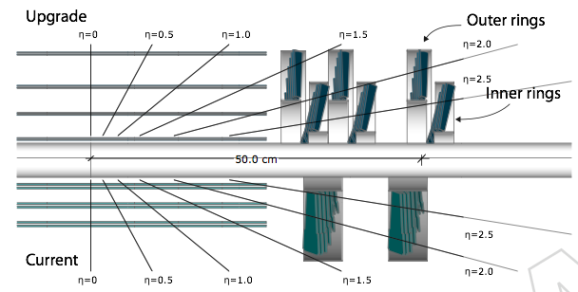
Medium term (LS1 to LS2): pixel
Features of New Design
Robust design: 4 barrel layers and 3 endcap disks at each end
Smaller inner radius (new beampipe), large outer
New readout chip with expanded buffers,
embedded digitization and high speed data link
Reduced mass with 2-phase CO₂ cooling, electronics moved to high eta, DC-DC converters
Ready to install by end of 2016

Slide 28
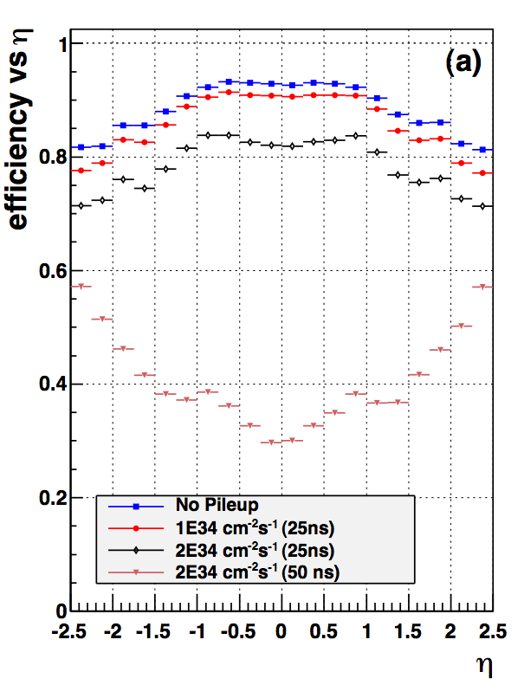
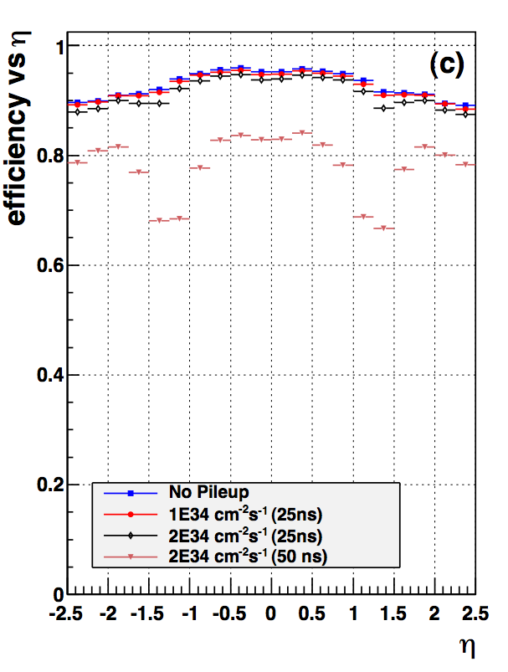
Upgraded Pixel tracking
Current Pixel front end designed to handle 10³⁴...
Beyond the FE buffer structure does not keep up
Tracking efficiency for tt ̄ sample with ROC data losses. → pions etc. (hadronic interactions)
current detector
upgrade detector
0 PU
better 0 PU
25 PU
50 PU
100 PU
Fake Rate= 6% (η=0, 100PU)
Fake Rate= 2% (η=0, 100PU)
6

Slide 29
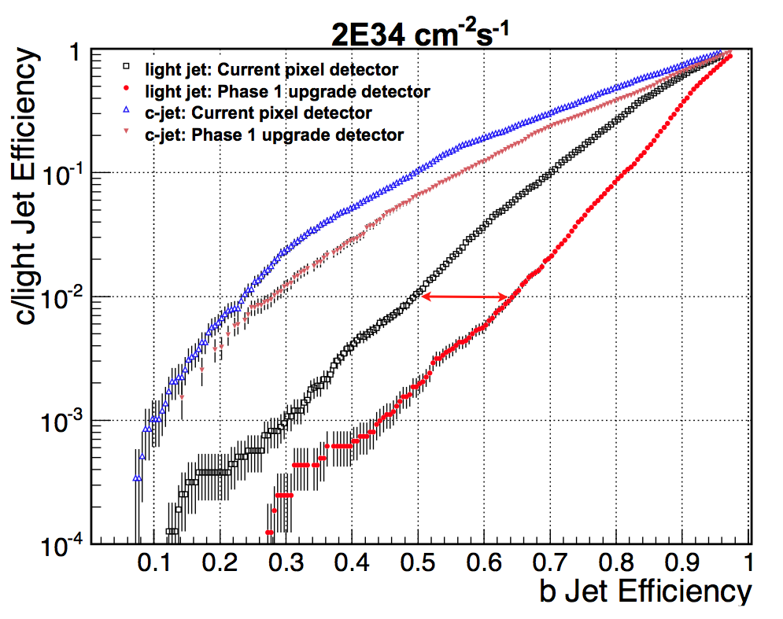
Upgrade: Pixel b-tagging
b-jet efficiency
~ 1.3x better
@ 10⁻² udg-rej.
current
upgrade
Primary vertex resolution improved by gain factor ~1.5 - 2

Slide 30
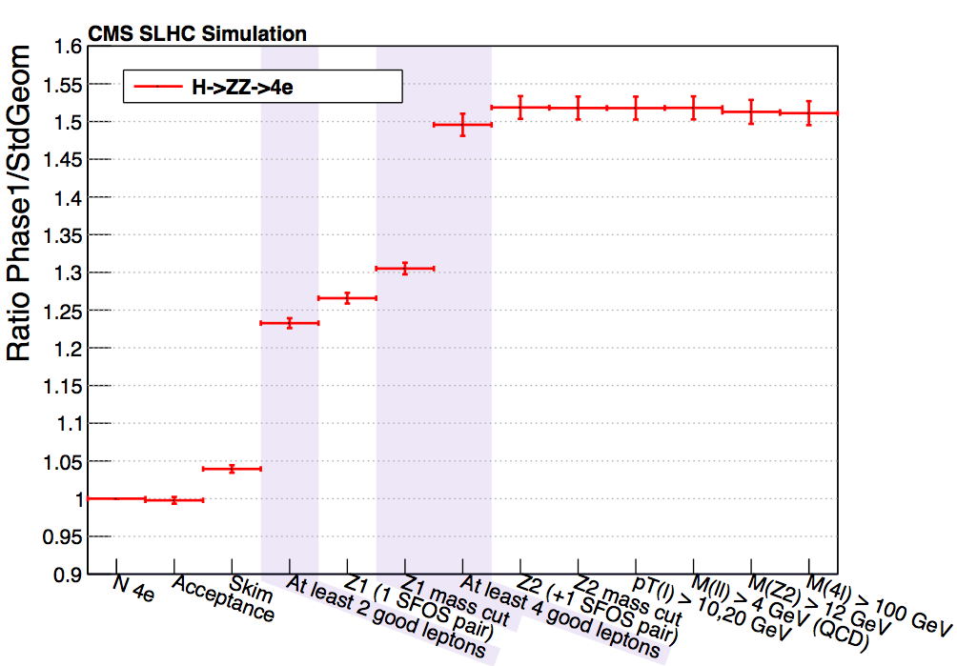
Pixel upgrade: use case H→4ℓ
Event selection: (as 2012 analysis)
events with ≥ 4 isolated leptons
2 leptons with p_{T}>17 GeV and 8GeV
same 2 leptons with N_{pixhit} >2
e-reconst. PF and η<2.5, p_{T}>7GeV
μ-reconst. PF and η<2.4, p_{T}>5GeV
leptons from primary vertex SIP_{3D}< 4
40 GeV < M_{Z1} < 120 GeV
12 GeV < M_{Z2} < 120 GeV
p_{T}(l) >10,20 GeV & M_{4l} >100 GeV
Significant gain in signal reconstruction efficiency:
H→ 4μ +41%
H→ 2μ2e +48%
H→ 4e +51%
Conclusion:
Upgrade detector provides physics reach as current detector with 40-50% more efficiency.

Slide 31
Pixel upgrade:ZH → ℓ⁺ℓ⁻+2 b-jets
Event selection:
events with ≥ 2 leptons + ≥ 2 jets
p_{T}>20 GeV for leptons & jets
H with highest p_{T} combination
Z with hightest p_{T} combination
75 GeV < M_{Z} < 105 GeV
p_{T} >100 GeV for both H & Z
H & Z back to back: Δφ < 2.9
CSV tag on both b-jets
light jet rejection 0.1% (HE) & 1% (LE)
Z → μ⁺μ⁻
Both lepton channels (μμ, ee) show gain of 65% in signal efficiency for upgraded system.
HLT Trigger with 3 out of 4 hits from upgraded pixel for muons may benefit significantly.
Upgrade pixel system will lead to considerable increased sensitivity in this channel.
9

Slide 32
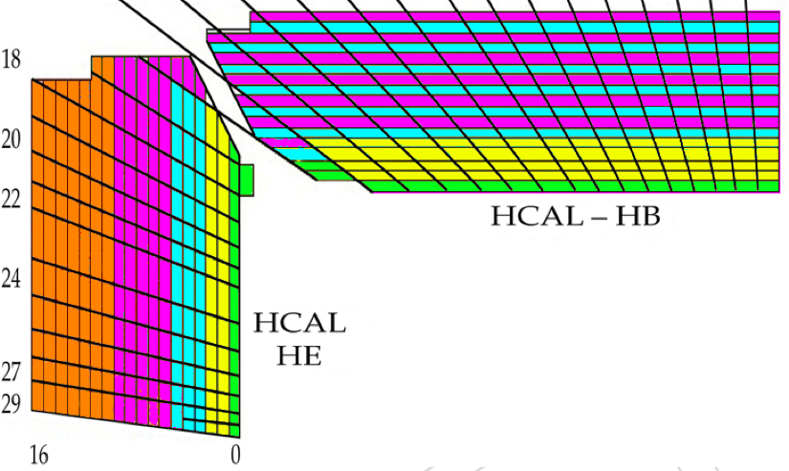
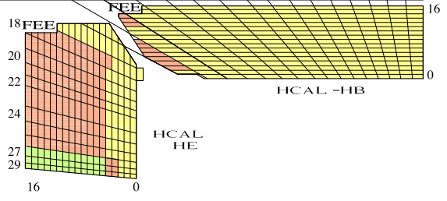
LS1 to LS2: HCAl
See detailed presentation this afternoon: here only a summary
HB/HE: replace HPD with SIPMs
Improved S/N and depth segmentation
Improved calibration, bkg & PU suppression,
EM isolation (analysis and trigger)
Install front-end electronics in LS2
Paramount to maintain efficient Particle flow
approach in high pileup environment

Slide 33
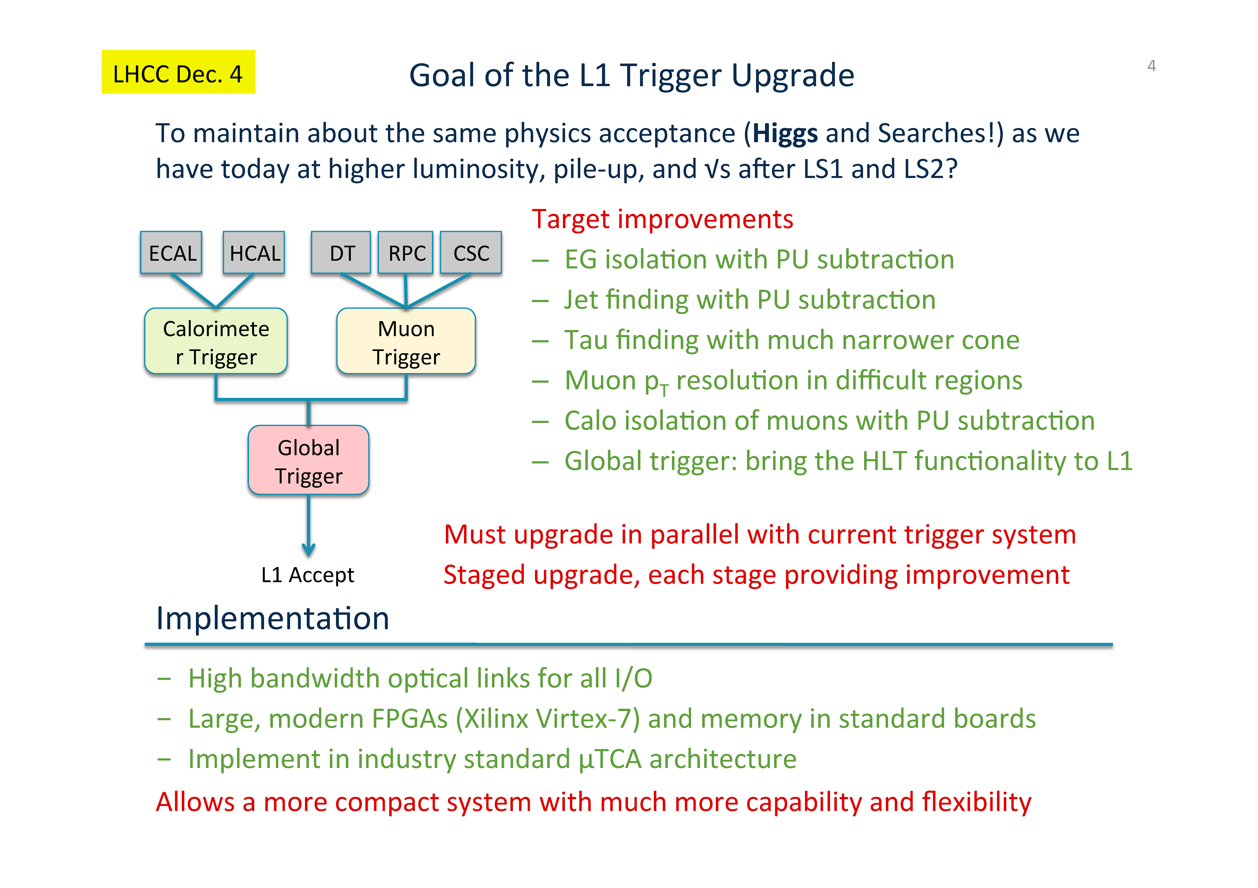
L1 Trigger Upgrade

Slide 34

Longer term: LS3,HL-LHC
Si –trackers to be replaced: tracker in L1 trigger
Endcap calorimeters very likely to need replacement/upgrades (assessing longevity)
Muon chambers: the detectors themselves should still be ok. Issue will be trigger ( and possibly readout)
Physics needs & performance: being assessed

Slide 35
HL-LHC /LS3
Need stepping up R&D and design effort in the next 2 years: if we want to be ready for installation in 2022 we need to have clear ideas ( read TR-level) of what to build by end 2014.
0th order: need a detector with the same performance as today: hence require replacement of components rad damaged
But running at lumi of 5 10³⁴ (pileup ≳ 100) will require substantially improved detector

Slide 36
Challenges of HL HLC
5 10³⁴ Hz/cm² luminosities challenges for CMS
  Trigger: studying of having Tracker in L1 trigger to provide parameters of tracks with P_{t} >2 GeV ( including estimate of vertex!) to correlate with other trigger info at first level
  Exploring what would be needed to have 1 MHz L1 trigger ( and longer L1 trigger decision latency)
  Particle flow : will need high calorimetric granularity
  In forward region will need to have ways to estimate vertex origin of physics objects ( thinking about VBF like tagging) : looking into what VERY forward tracking and fast timing devices could do.

Slide 37
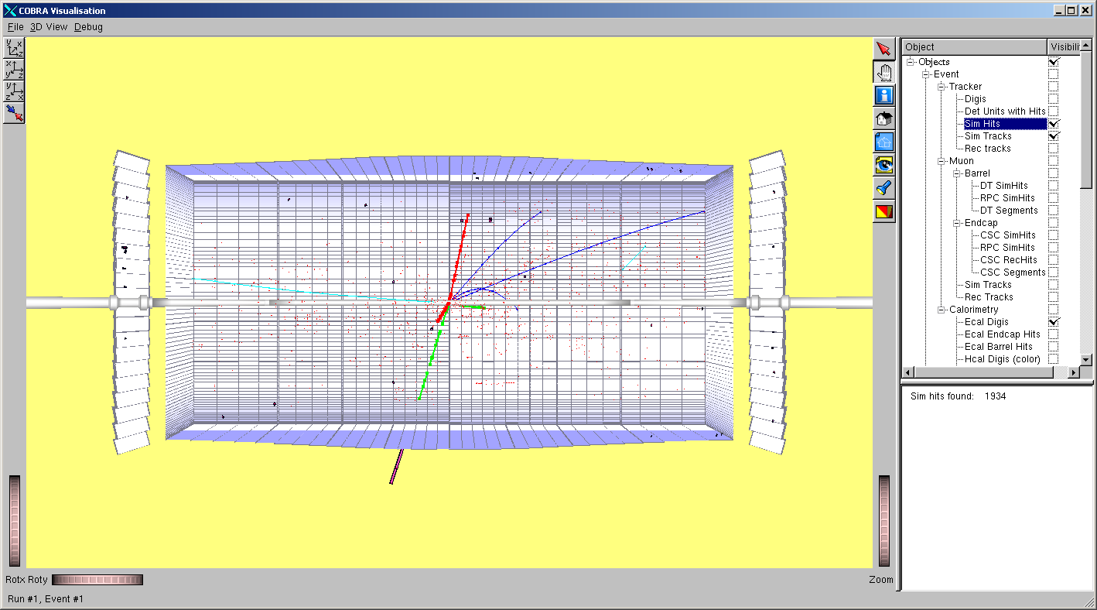
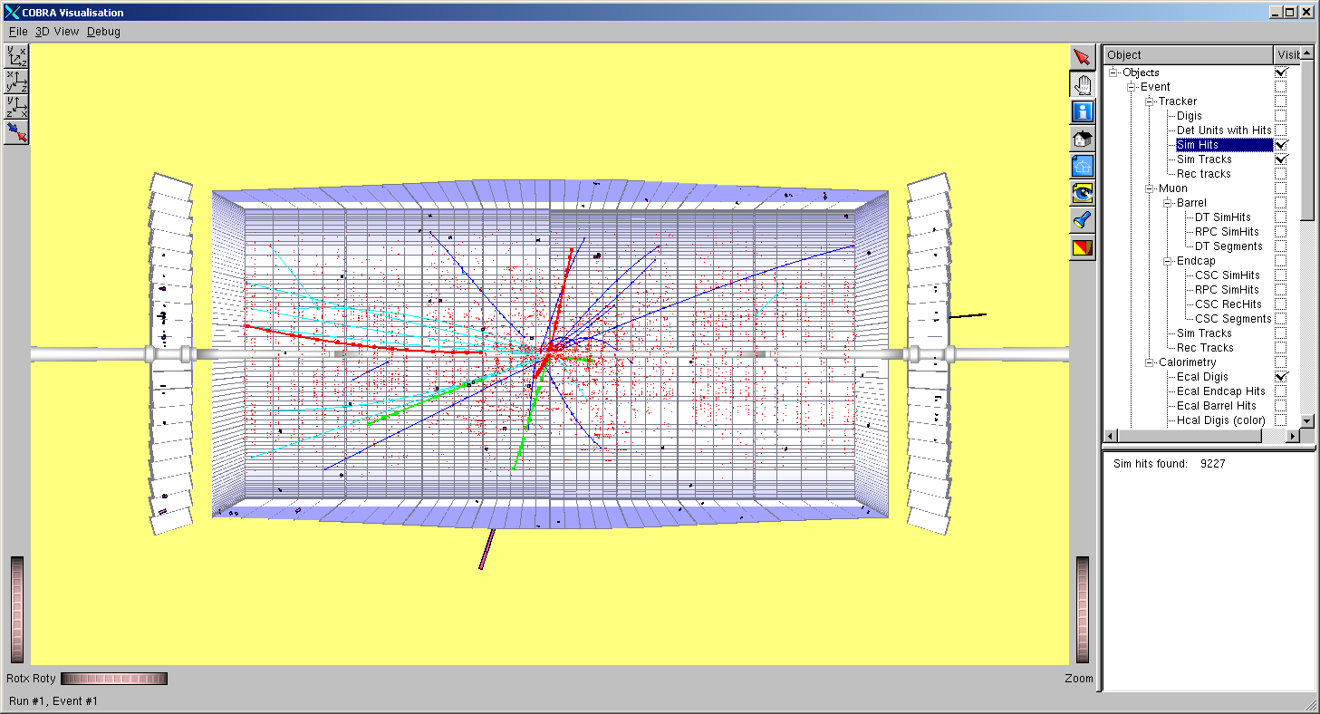
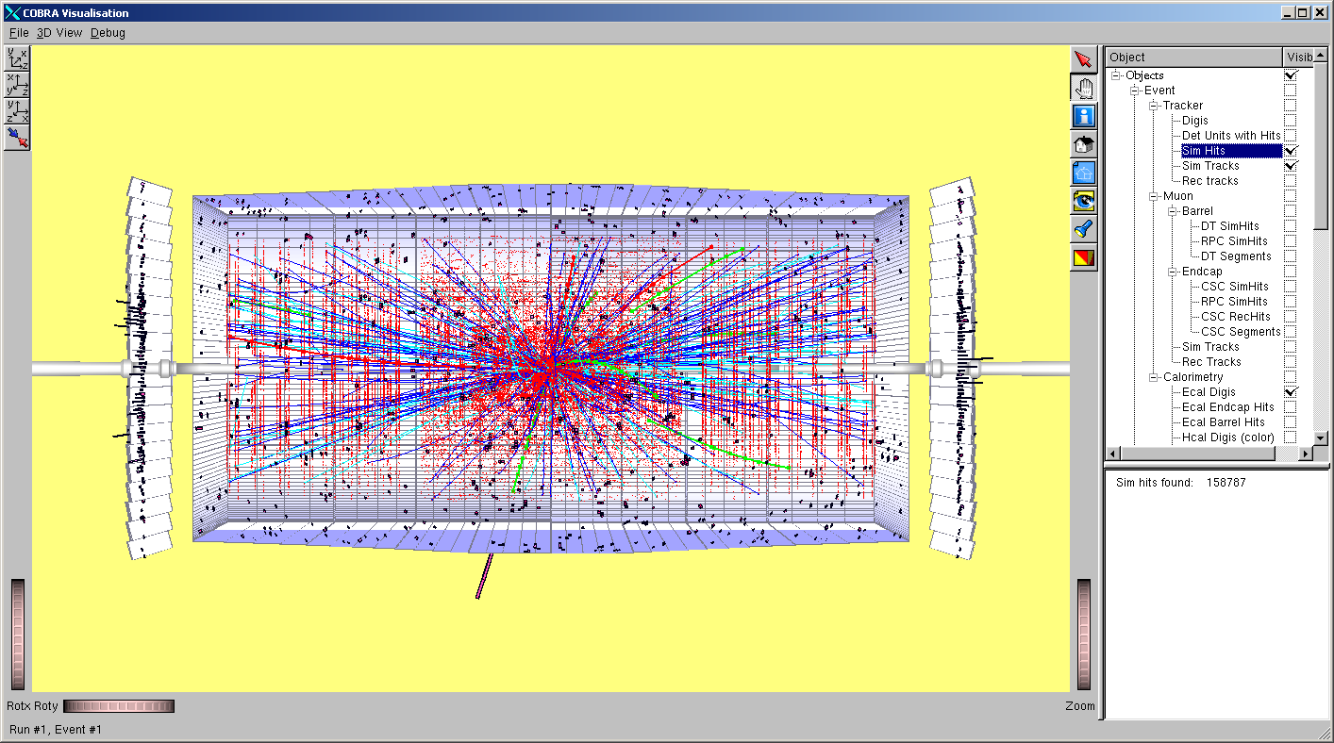
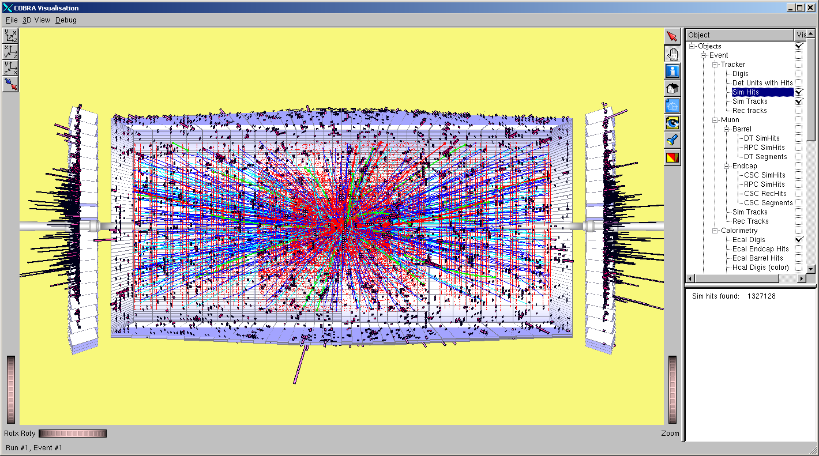
10³² cm⁻² s⁻¹
10³³
10³⁴
10³⁵

Slide 38
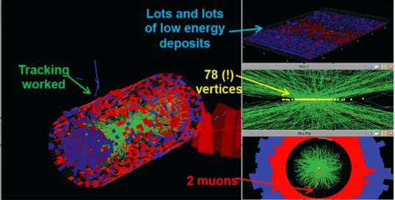
Preview ( special fill ): what we learned
Reconstruction algorithms are such that one can assume that with
a working detector (this implies major upgrades for LS3!)
adequate granularity
one can cope with extreme conditions…
Heavy ion running an additional proof.
We know that today trigger systems will be inadequate.

Slide 39
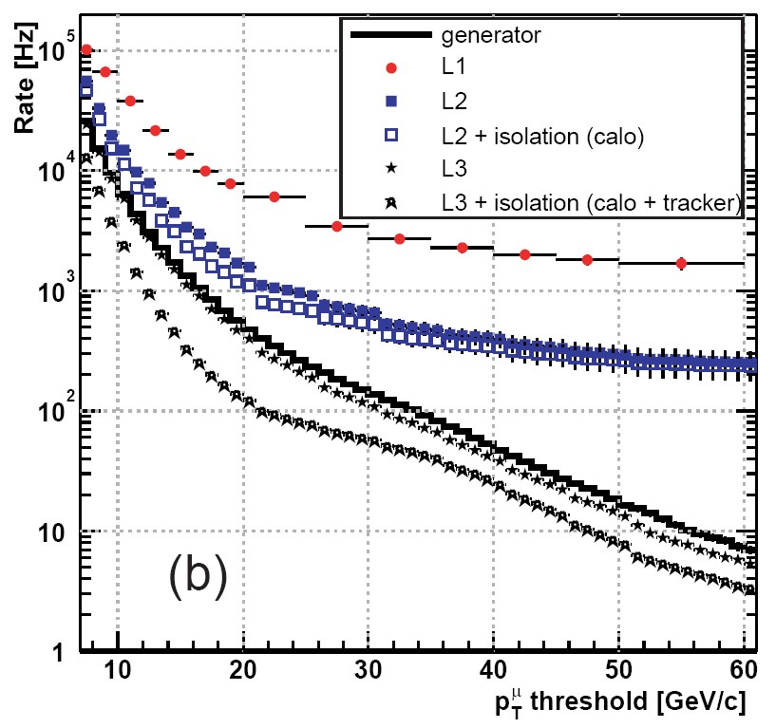
LS3: Tracker trigger
Tracker stubs to be correlated with Muon stubs: allows to reduce by factor muon trigger rate at the ‘useful’ P_{t} thresholds
Simulation confirmed by special fill at high lumi
Present trigger rates flattens out at P_{t} ≳ 30 GeV

Slide 40
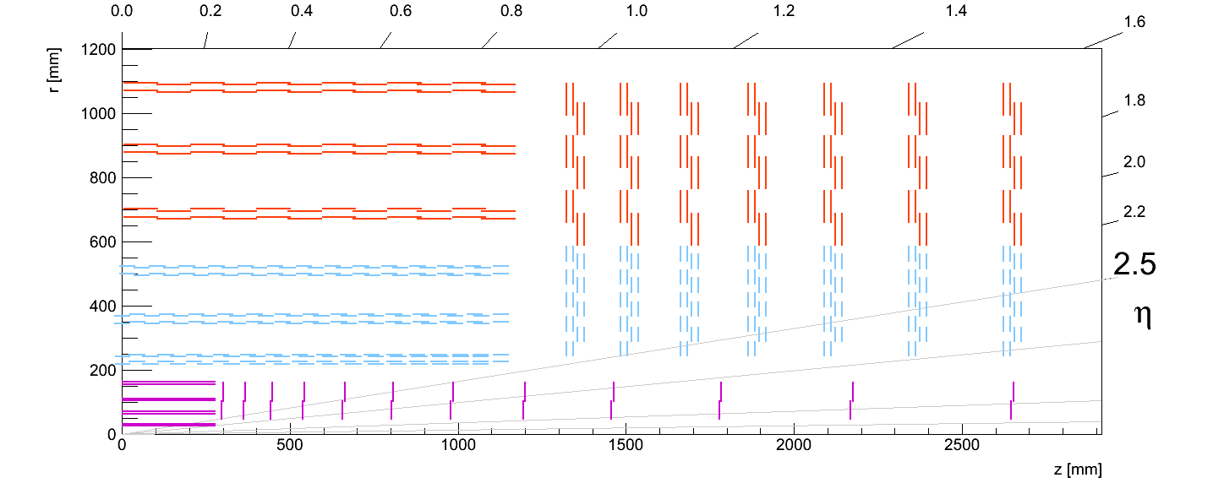
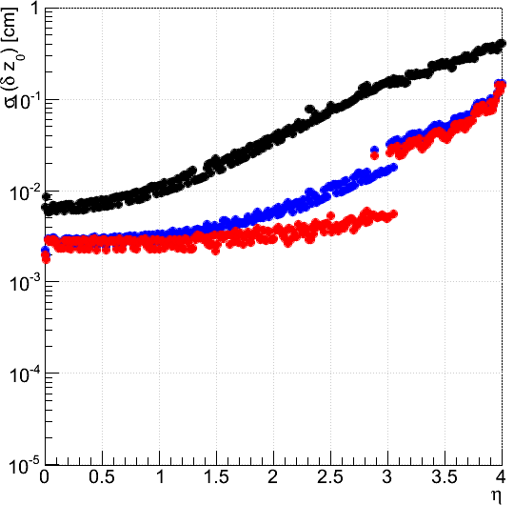
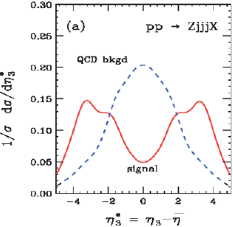
VERY forward tracking (CMS study)
Good resolution in Z₀ reco down to η=4
Courtesy of S. Mersi
Resolution < 1mm
for p_{T}>10 GeV/c down to η=4
σ(δZ₀)1 mm
Beneficial to VBF tagging as it provides coverage for Barrel/Endcap service cracks
Muon p_{T}
100 GeV/c
10 GeV/c
1 GeV/c

Slide 41
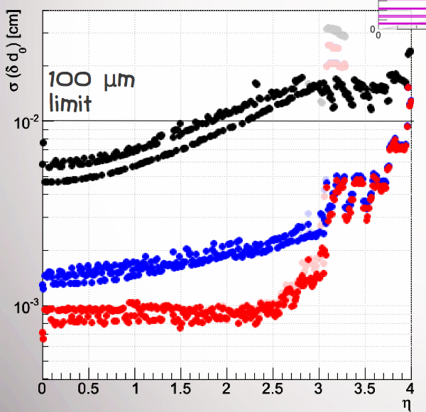
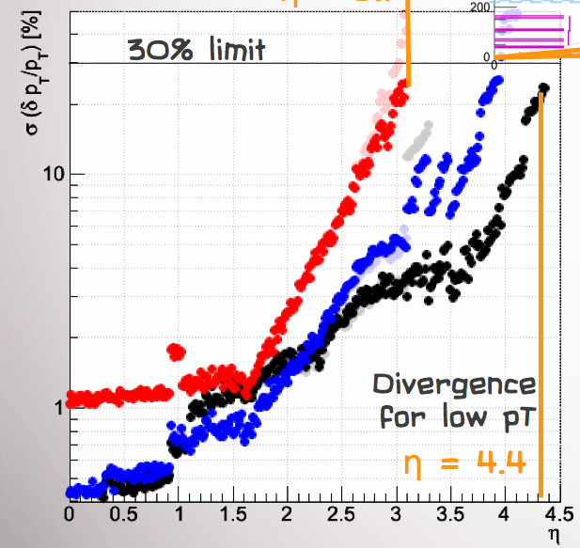
D0 and P_{t} resol VFPIXEL
Muon p_{T}
100 GeV/c
10 GeV/c
1 GeV/c

Slide 42
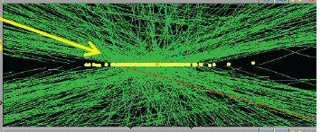
Fast timing: needs
For a luminous region distributed over ~ 10cm, collisions will be distributed over ~ 300ps
The TOF at the Calorimeter at η ~ 0 depends on the time of the specific collision
At Larger values of η the TOF depends both on the time and position of the specific collision

Slide 43
A dream for the moment
Consider (for example) an EM pre-shower with 10~20ps (i.e few mm resolution in Z position) TOF resolution for MIP’s and γ
  Tracking identifies Z location of interesting collision (high Pt)
  Preshower could deliver (TOF, η, φ) of cluster (can be a EM shower or cluster of jet particles) from that collision
  Could imagine to correlate at trigger level Preshower(TOF, η, φ), Calorimeter(E,η, φ) and Tracking (P_{t}, Z vtx) info
  At analysis level use Z location and time to select calorimeter clusters associated to interesting collision
Could result in similar effective pile-up conditions comparable to what we are handling today
  ! ! Neutral hadrons will need special attention ! !

Slide 44
An issue
At the time of LS2 the detector will have components ( e.g. forward calorimeters) whose manipulation might be rendered very difficult by the radiation problems.
This and the space constraints in the experimental hall can become a significant constraint of what can be done…and extensive study need to be done and possibly non trivial tooling developed.
E.g. HF calorimeter (300 tons object) on the + side of the experiment cannot be moved as a single piece ( crane can handle 80 tons at most) … and its wedges will be radioactive to a level that dismantling into manageable units might be a real challenge

Slide 45
Summary
CMS has been successful in exploiting the first LHC run and has a clear plan to maintain its excellent performance after LS1
A new era where commissioning of new components will happen in parallel to LHC operation will start after LS1
The experience from the past shows that we must have a clear idea of the CMS phase 2 detector within 2014, if we want to have it ready by LS3
In some areas ( e.g. calorimeters able to withstand a factor 10 of radiation compared to the first LHC phase, tracker/triggering, Very forward tracking…) vigorous R&D is necessary
The potential of High Luminosity LHC will be exploited only if we start preparing for it NOW

Slide 46
Backup

Slide 47
Fast timing: state of the art
Current state of the art for large scale systems is ~75ps: ALICE TOF
Fast RPCs (small prototypes) : 60 ps
Current State of the Art is 100~120ps for demonstrator TOF PET Calorimeter detectors
The goal of 10~20ps Calorimeter TOF resolution is beyond the current state of the art, and clearly ambitious
But so were many of today’s features of LHC detectors 10 years before beams….
Need to engage stakeholders : CERN, HEP laboratories, Universities into a focused R&D effort… and practical re-use of technology immediately obvious: PET scan.

Slide 48
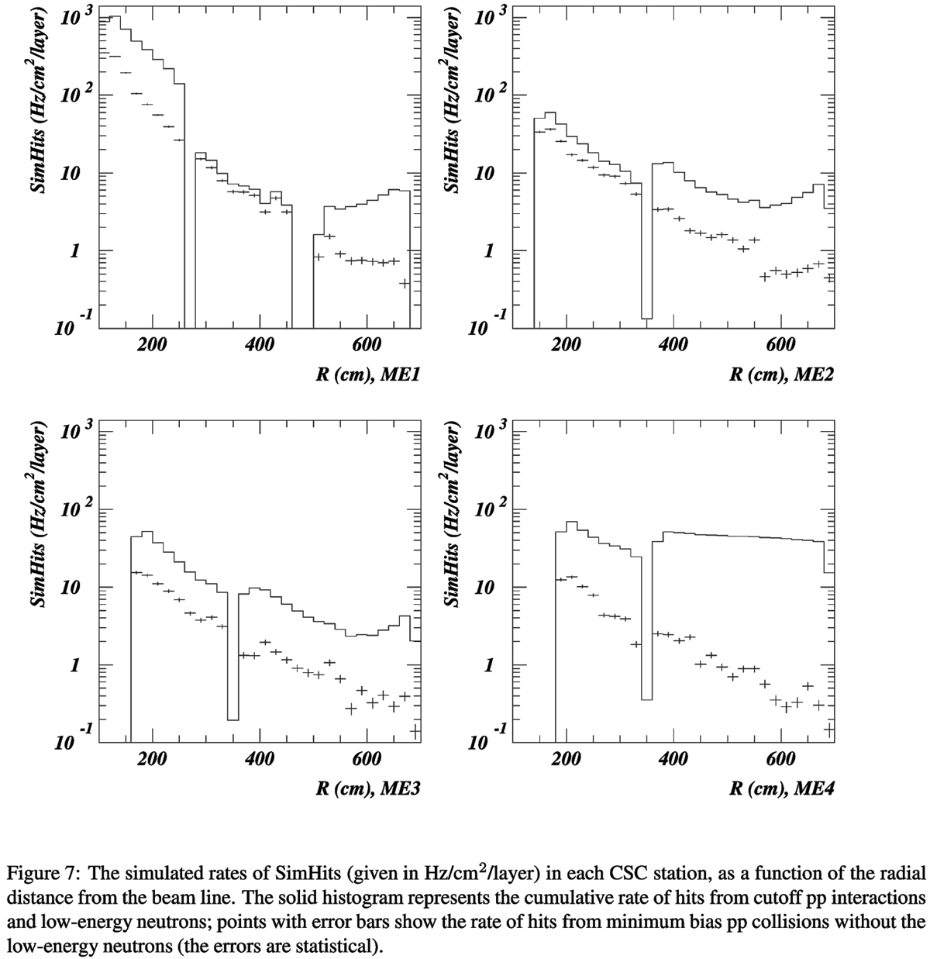
Muon hit rates – simulated, endcap
Curves w/wo neutron hits
  Slow n capture
  → N*
  → de-excitation γ
  → electrons
Highest rate/area in ME1/1
  Up to 10 kHz/cm² at 1E35
High total rates in ME4/2
  Large area
ME1/1
CMS IN 2002/007
ME2/1
ME1/2
ME1/3
ME2/2
ME4/1
ME3/1
ME4/2
ME3/2

Slide 49
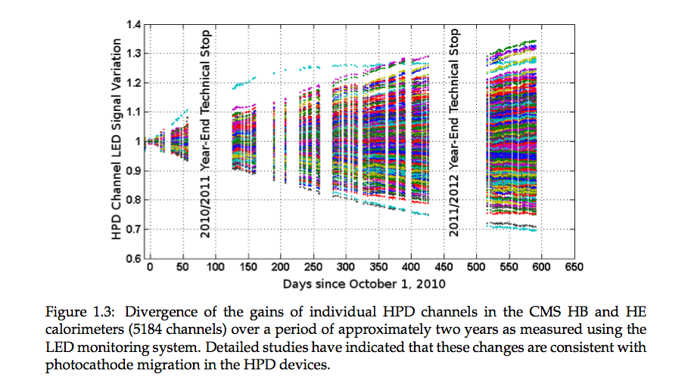
HPD gain drifts

Slide 50
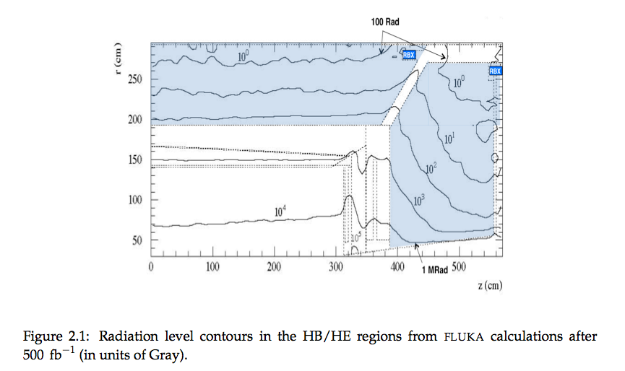
HCAL doses after 500 fb-1

Slide 51
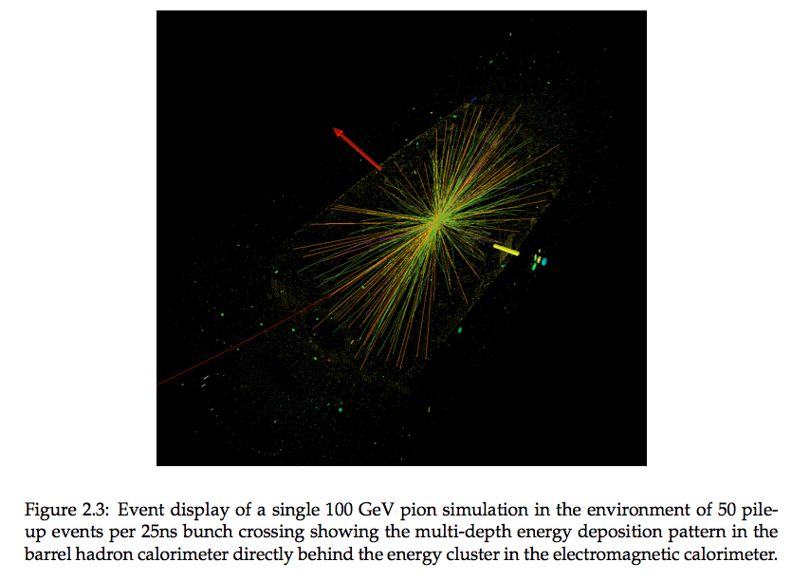
Depth segmentation

Slide 52

P flow with HCAl upgrade
<Pileup>= 50
Barrel
Endcap
Std pFlow @50 ns
Std pFlow @25 ns
pFlow(HCAL upgade) @25 ns

Slide 53
Pixel Parameters: Present & Upgrade
Parameter of Pixel System
# layers (tracking points)
beam pipe radius (outer)
innermost layer radius
outermost layer radius
pixel size (r-phi x z)
In-time pixel threshold
pixel resolution (r-phi x z)
cooling
material budget X/X₀ (η=0)
material budget X/X₀ (η=1.6)
pixel data readout speed
1st layer module link rate (100%)
ROC pixel rate cabability
control & ROC programming
Present
3
29.8 mm
44 mm
102 mm
100μ x 150μ
3400 e
13μ x 25μ
C₆F₁₄ (monophase)
6%
40%
40MHz (analog coded)
13 M pixel/sec
~120 MHz/cm²
TTC & 40MHz I²C
Upgrade
4
22.5 mm (LS1)
29.5 mm
160 mm
100μ x 150μ
1800 e
13μ x 25μ (or better)
CO₂ (biphase)
5.5%
20%
400Mb/sec (digital)
52 M pixel/sec
~580 MHz/cm²
TTC & 40MHz I²C
4

Slide 54

Calorimeter trigger upgrade

Slide 55

Muon trigger upgrade

Slide 56

Fast timing practical interest

Slide 57

Data parking: a + for next year
Parked data includes Core (will ‘reprocess’ only ‘parked’ with final ali/calib): i.e. 75% is Core and 25% new triggers

Slide 58
VBF tags

Slide 59

Higgs couplings

Slide 60


Material budget VFWD pixel

