Slide 1
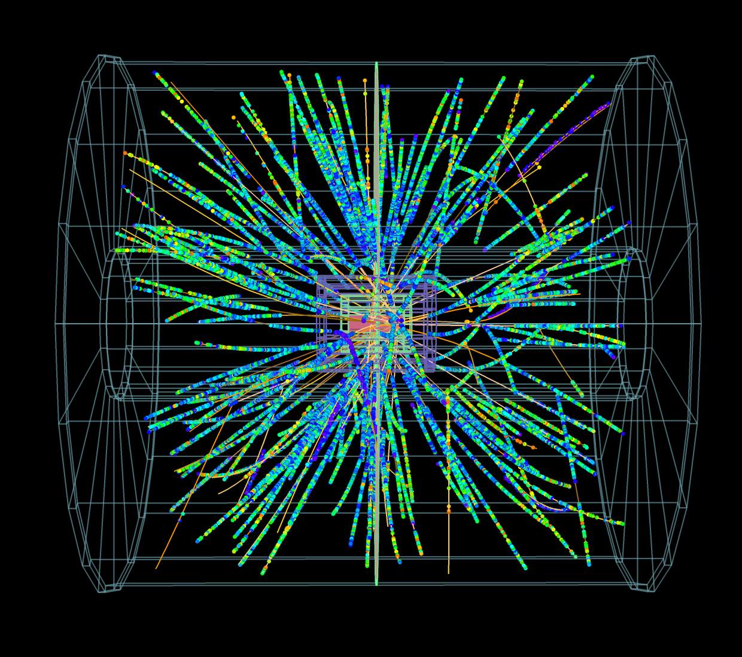
ALICE: diffraction studies, status and plans
Introduction
Summary of
measurements on
Diffractive Physics
Central Diffractive
studies
Plans to improve
performance of ALICE
in diffractive physics
Plans for Diffractive
studies in p-Pb
Conclusion
p-Pb 2013
LISHEP 2013, Rio de Janeiro , Brasil, March 17-24, 2013
Gerardo Herrera Corral

Slide 2
Introduction

Slide 3
ALICE=1200 members
132 institute
36 countries
Central Barrel
2 π tracking & PID
|η| < 1
ZDC
AD-R
AD-L
ZDC
VZERO (trigger)
η: (-1.7, -3.7), (2.8–5.1)
T0
ZDC (centrality)
FMD (N_{ch} -3.4<η<5)
PMD (Nγ, N_{ch})
Muon Spectrometer
(-4 < η < -2.5)

Slide 4
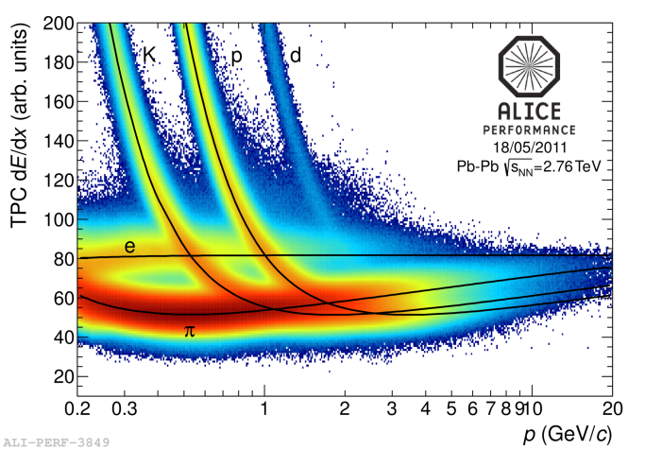
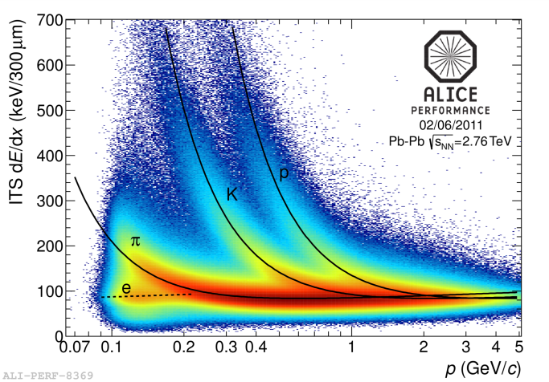
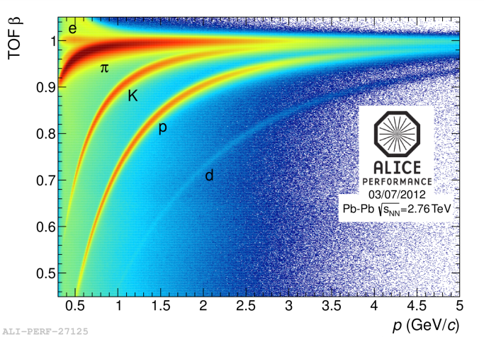
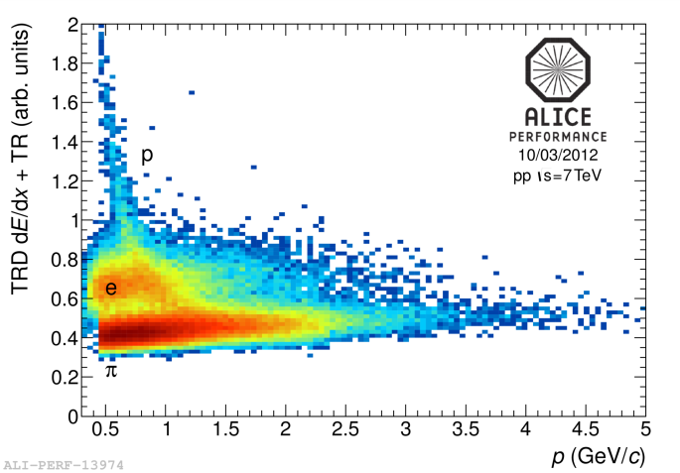
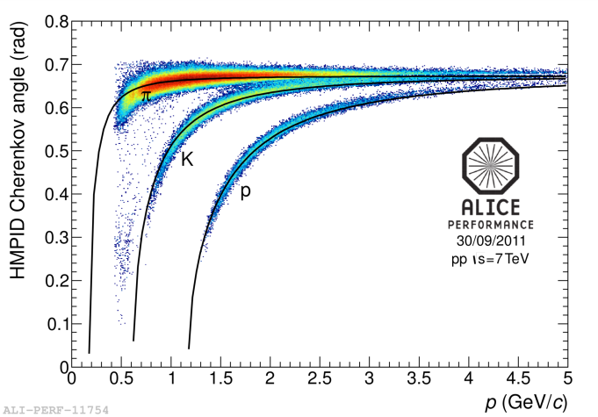
all known techniques for
particle identification:
inclusive and exclusive
particle production in
centrally produced
systems, in various
channels …
in progress
TPC
TOF
ITS
HMPID
TRD
5

Slide 5
LHC heavy ion runs
Two heavy-ion runs at the LHC so far:
  2010 – commissioning and first data taking
  2011 – above nominal instant luminosity
p–Pb & Pb–p - 2013
  Goal ~ 30 nb⁻¹
  pilot run September 13th 2012 4 papers submitted
Long Shutdown in 2013-2014
year | system | Energy √s_{NN _}(TeV) | integrated luminosity
2010 | Pb – Pb | 2.76 | ~ 10 μb⁻¹
2011 | Pb – Pb | 2.76 | ~ 0.1 nb⁻¹
2013 | p – Pb | 5.02 | ~ 30 nb⁻¹

Slide 6
Summary of measurements on Diffractive Physics
Measurements of Diffractive and Inelastic Cross Section

Slide 7
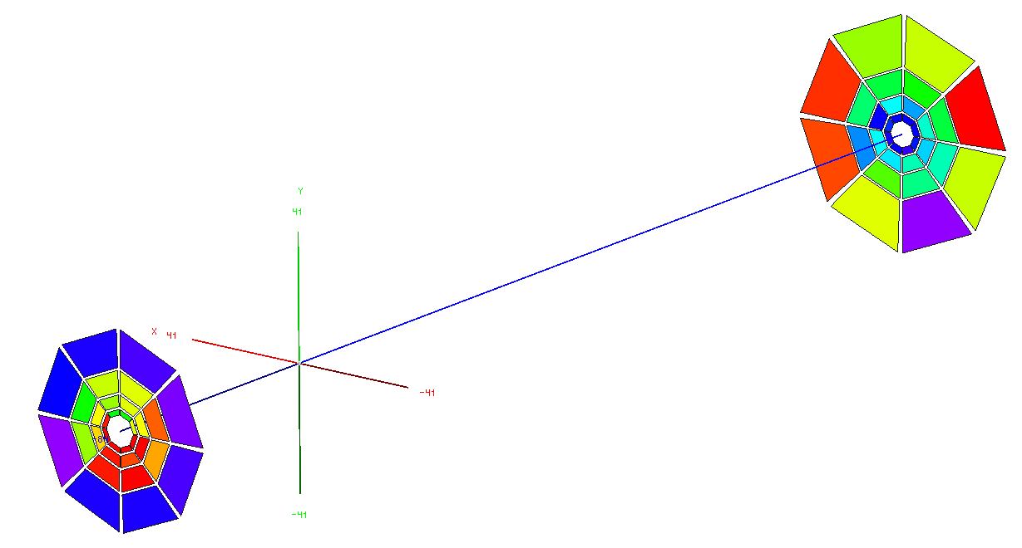
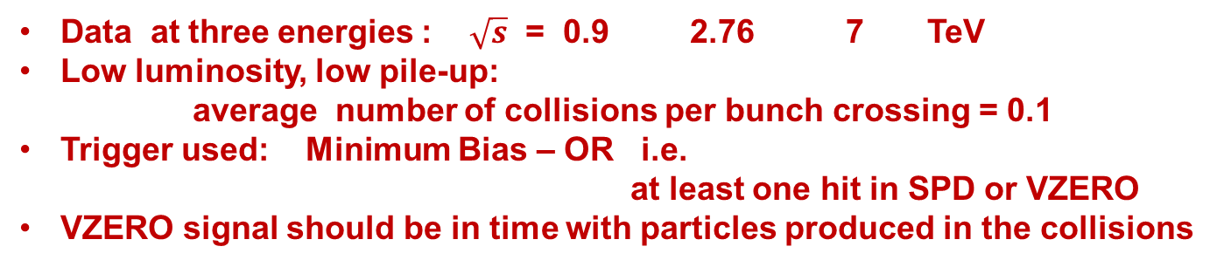
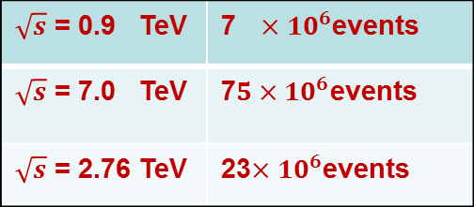
Event samples
Data at three energies : $\sqrt{s}$ = 0.9 2.76 7 TeV
Low luminosity, low pile-up:
average number of collisions per bunch crossing = 0.1
Trigger used: Minimum Bias – OR i.e.
at least one hit in SPD or VZERO
VZERO signal should be in time with particles produced in the collisions
2.8<η<5.1
-2.0<η<2.0
VZERO-R
-3.7<η<-1.7
DATA
SPD
$\sqrt{s}$ = 0.9 TeV | 7$×{ 10}^{6}$events
$\sqrt{s}$ = 7.0 TeV | 7$5×{10}^{6}$events
$\sqrt{s}$ = 2.76 TeV | 23$×{10}^{6}$events
VZERO-L
Filled and empty bunch buckets used to measure beam induced
background, accidentals due to electronics noise and cosmic showers

Slide 8
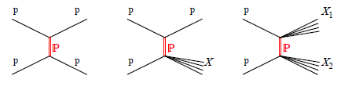

theory
elastic -
single -
double - diffractive proton-proton scattering
experiment

Slide 9
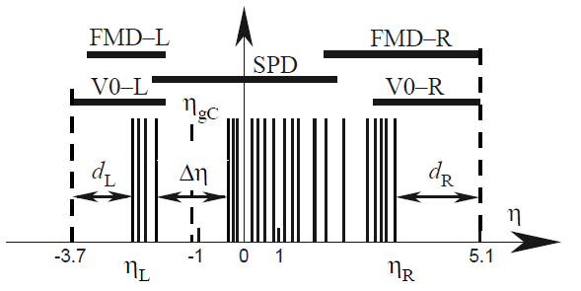




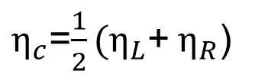

Silicon Pixel Detector
$\left|η\right|$<2
Forward Multiplicity
-3.4< $η$ <-1.7
Forward Multiplicity
1.7< $η$ <5.0
ALICE
V0-L
-1.7< η< -3.7
V0-R
2.8< η< 5.1
$η_{c}$=$\frac{1}{2}(η_{L}$+${ η}_{R}$)
$$η_{L}$$
$$η_{R}$$
lowest-
highest - pseudorapidity

Slide 10
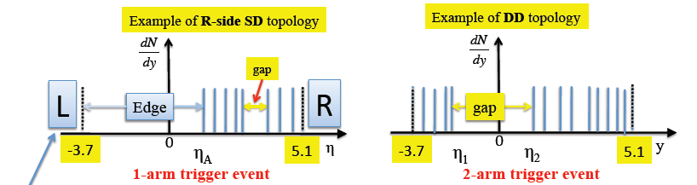





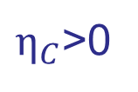


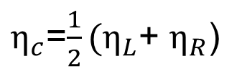
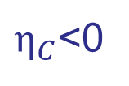





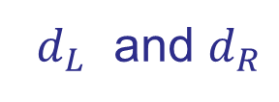

offline event clasification: “1 arm-L” “1 arm-R” “2 arm”
$$η$$
$$η$$
muon spectrometer
$η_{c}$=$\frac{1}{2}(η_{L}$+ $η_{R}$)
$η_{C}$<0
1-arm-L
$η_{C}$>0
1-arm-R
if largest $∆η >$
${ d}_{L}$ and $d_{R}$
2-arm
$$η_{L}$$
$$η_{R}$$
2-arm
if both $−1 and 1$
$$≤$$
$$≤$$
$$η_{R}$$
1-arm-L
If $< 1$
$$η_{L}$$
1-arm-R
If $>−1$

Slide 11
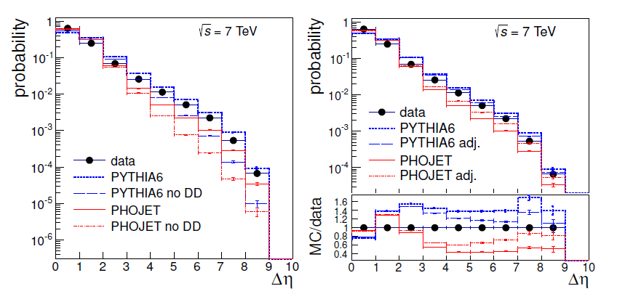

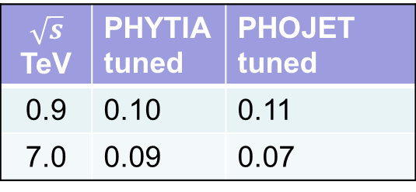
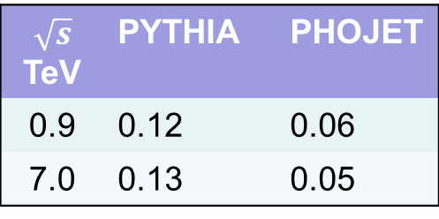
2-arm events
tuning PYTHIA and PHOJET double
diffraction to experimental width
distribution of two arm events
largest $∆η$
adjusted
arXiv:1208.4968 [hep-ex]
$$\sqrt{s}$$ TeV | PYTHIA | PHOJET
0.9 | 0.12 | 0.06
7.0 | 0.13 | 0.05
$$\sqrt{s}$$ TeV | PHYTIA tuned | PHOJET tuned
0.9 | 0.10 | 0.11
7.0 | 0.09 | 0.07
Once DD is chosen the ratios 1-arm-L and 1-arm-R to 2-arm
can be used to compute SD fractions.

Slide 12
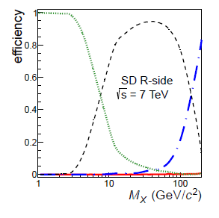
efficiency/in-efficiency versus diffractive mass for SD :
probability of not detecting
efficiency for a SD to be
classified as 1-armL(R)
PYTHIA 6
efficiency to be
classified as 2-arm
efficiency to
be taken as
the opposite
efficiencies used:
mean between
PYTHIA and PHOJET
efficiency of SD & NSD
to be classified as
1-arm L(R), 2-arm

Slide 13
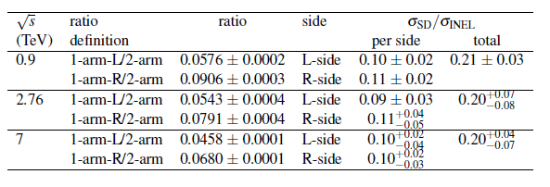



at high energy the ratio
remains constant
consistent with
UA5 $p$ $\overline{p}$
results symmetric despite different
acceptance from ALICE
corrected for acceptance, efficiency, beam background, electronic noise and collision pileup
DD events defined as NSD with large gap
with $∆η>3$

Slide 14
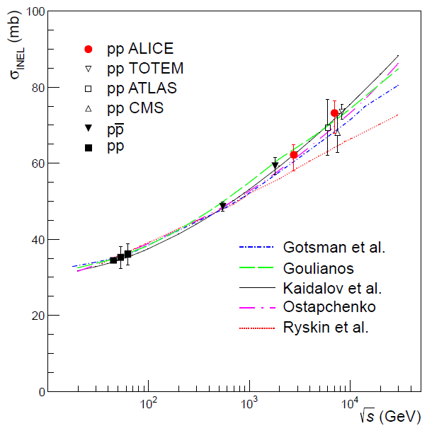
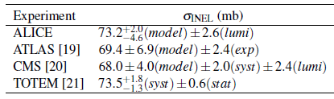
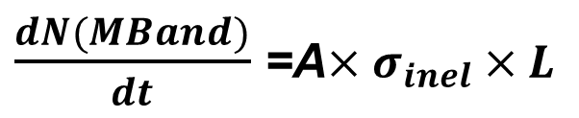
Measurement of Inelastic Cross Section
VZERO-R
SPD
VZERO-L
MB-and : coincidence of VZERO-L
and –R in a van der Meer scan
$\frac{dN(MBand)}{dt}$ =A$×σ_{inel}×L$
acc. and eff. determined
with adjusted simulation

Slide 15
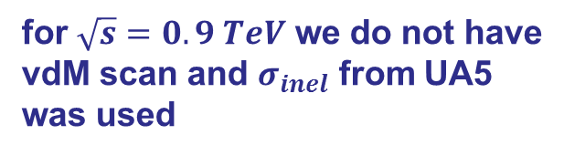
Measurements of
Diffractive
Cross Section
single diffractive
with inelastic cross section and
relative rates we obtain SD and
DD cross sections
for $\sqrt{s}=0.9 TeV$ we do not have
vdM scan and $σ_{inel}$ from UA5
was used
double diffractive
Gotsman et al.
Goulianos
Kaidalov et al.
Ostapchenko
Ryskin et al.

Slide 16
Central Diffractive Physics
Central diffraction in proton proton collisions at $\sqrt{s}$ = 7 TeV

Slide 17
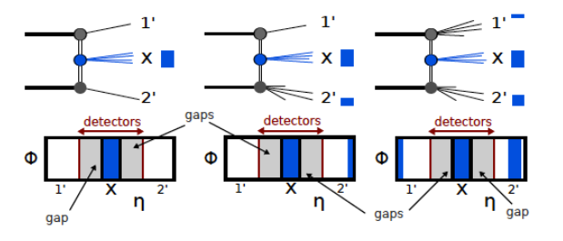
Double Gap topology as a filter for Central Diffraction
Central Diffraction
CD with single
Diffractive
dissociation
CD with double
Diffractive
dissociation

Slide 18
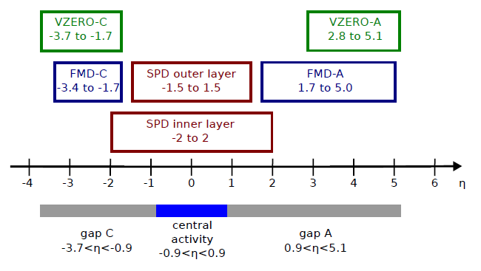

Double Gap topology
1.8 gap
2.8 gap
4.2 gap
$N_{DG}$ =
Number of Double Gap events
Number of VZERO-L –R coincidence
Potential measure of the amount of
Central Diffractive events in Minimum Bias data

Slide 19
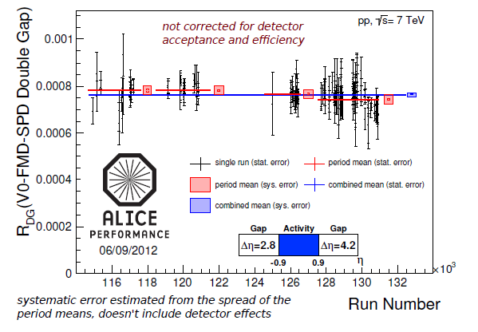


Double Gap fraction in proton proton
$$\sqrt{s }=7 TeV$$
fraction
uniform over
several data
taking periods
Next:
turn it into a
cross section
we are exploring the invariant mass distribution

Slide 20
plans to improve ALICE performance on
photon induced and diffractive physics

Slide 21
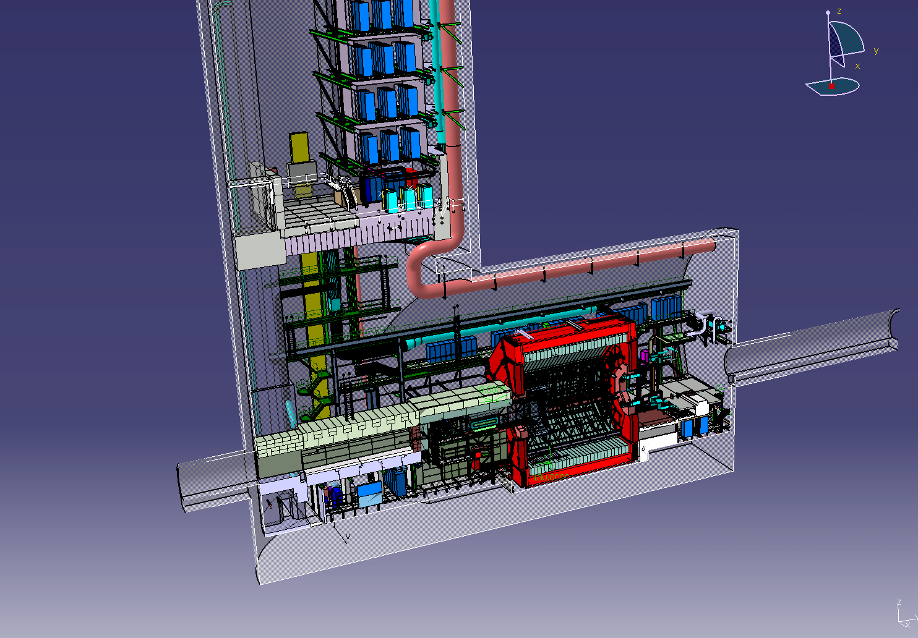

stations of scintillation detectors - Proposed -
AD-R & AD-L already installed
η coverage would increase from
8.2 to 15 units $→$ low diffractive mass
VZEROC
VZEROA
AD-L2
AD-L
AD-R
AD-R2
20m
55m
18m
Installed for beam diagnostic
55m
Installed for beam diagnostic

Slide 22
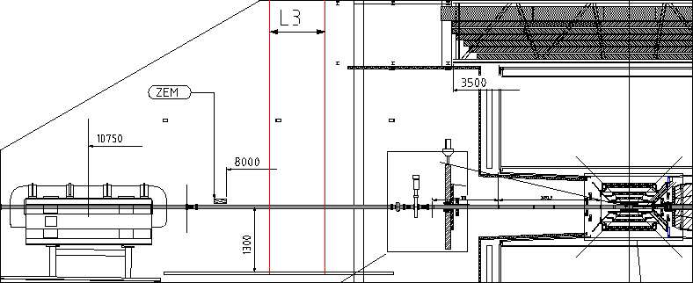
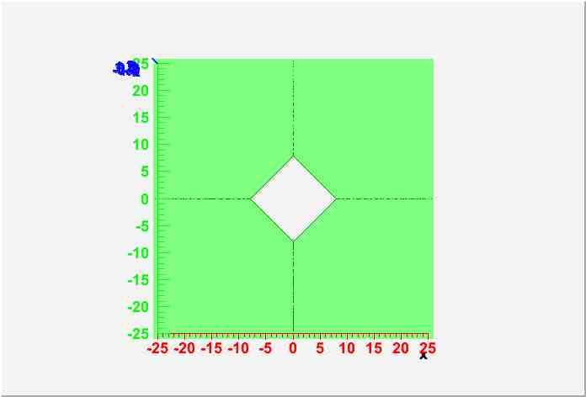
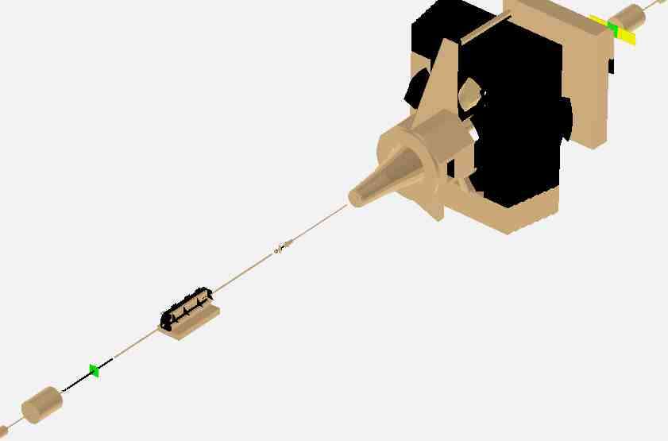
AD-R installed and operating as beam loss monitor
moved
17 m
IP
AD-R
8 m

Slide 23
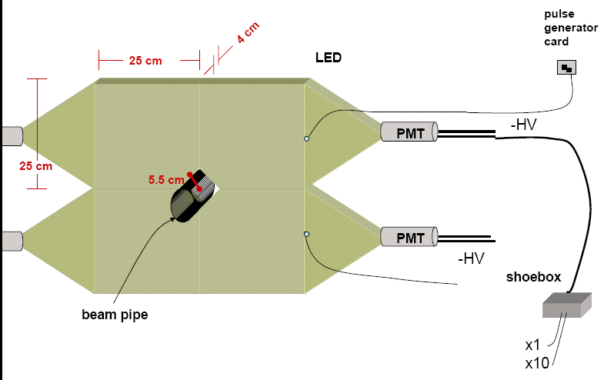
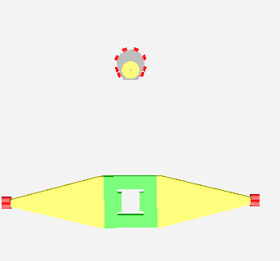

Diffractive Physics- Beam Loss Scintillator layout
AD-R
z = + 8 m
Two arrays of 4 scintillators 25x25x4 cm surrounding the beam pipe both sides of the interaction point, mounted on EMI9814B PMTs (gain 3x10⁷)
Conceived for diffractive physics
Readout board: Beam Phase Intensity Monitor
Bunch by bunch rates, collision and background.
AD-R
VZERO-R
VZERO-L
AD-L

Slide 24
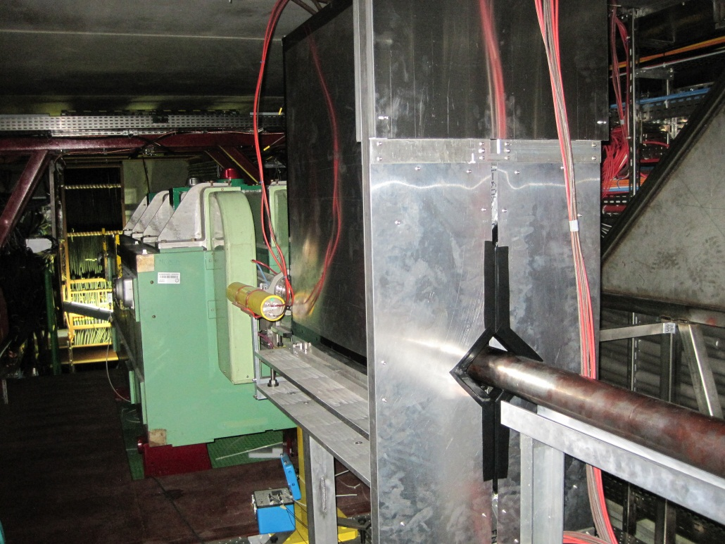
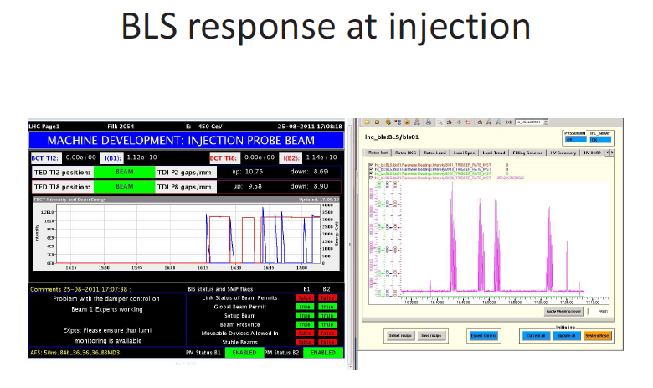
The only Beam radiation monitoring
system capable of detecting minimum
ionizing particles
Measures relative rates of
background particles and collision
products entering ALICE

Slide 25
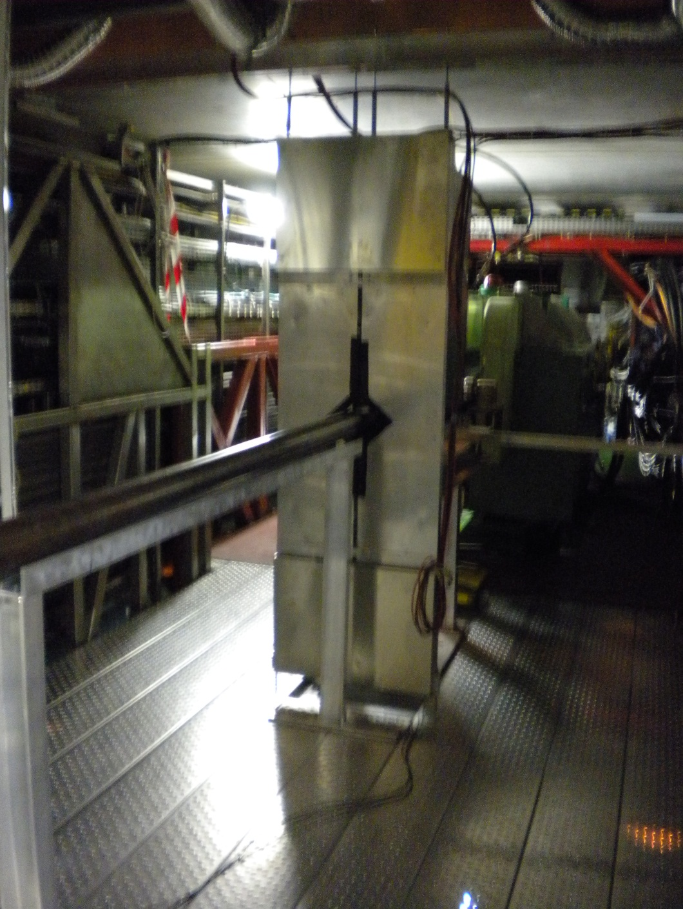
ALICE – Diffractive R
AD-R
Present:
beam monitor with
asynchronous read-out
of charge deposited in the
detectors → working
Future:
interesting diffractive
physics using the particle
identification of ALICE …
could be offline trigger

Slide 26
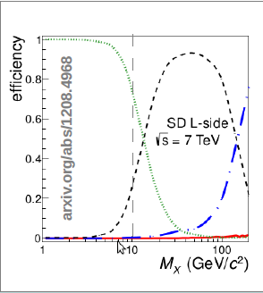
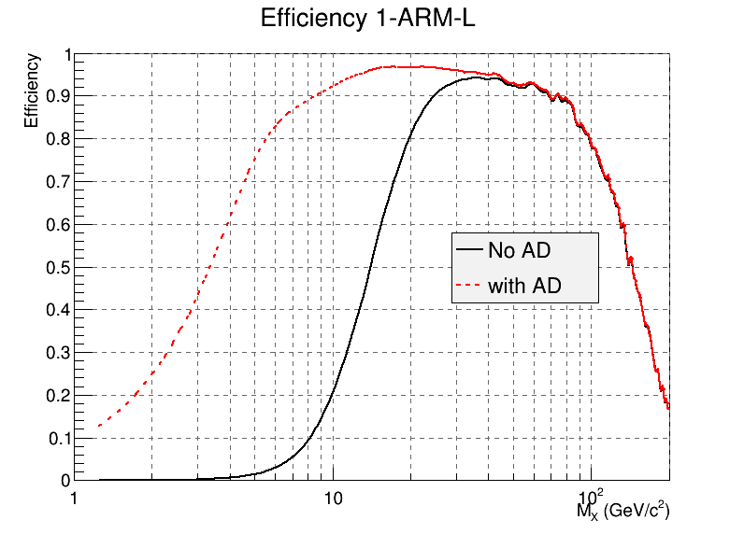
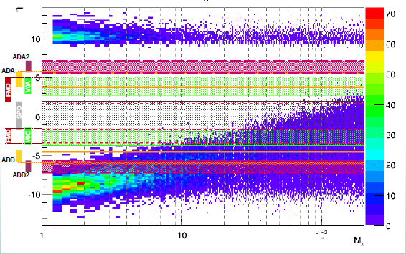
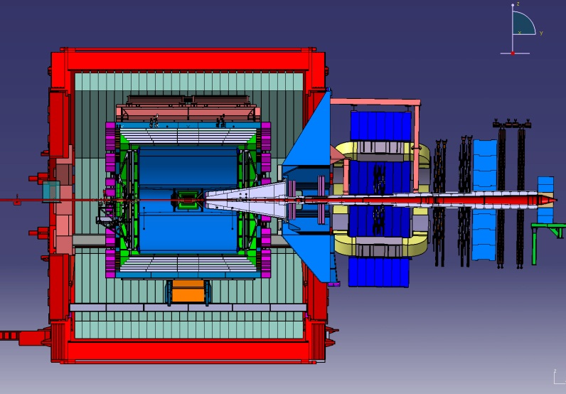
Integration of AD-L and AD-R in ALICE would enhance considerably the
efficiency at low diffractive mass.

Slide 27
Plans for Diffractive Physics studies in p-Pb

Slide 28
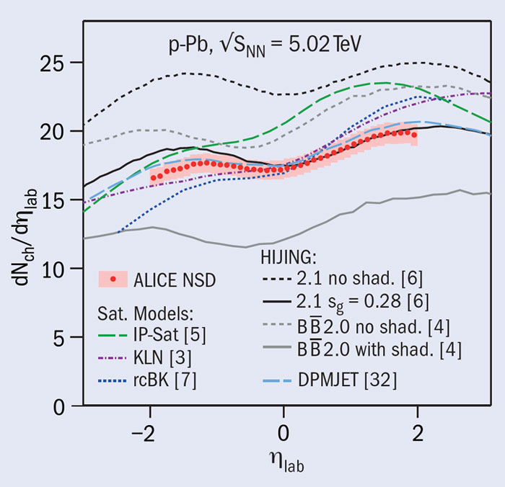
Pseudo-
rapidity
density
of
charged
particles
proton - Pb, 2 million events collected in september 2012
ALICE Collab. arXiv:1210.3615
nuclear
modification
shadowing
parameter
tuned to data
at lower
energy

Slide 29
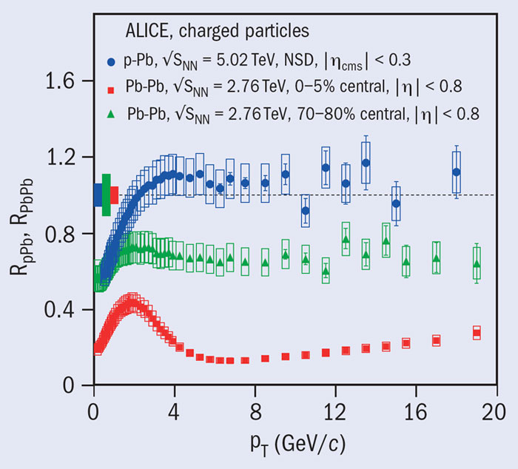
ALICE Collab. arXiv:1210.4520
Nuclear
Modification
Factor
the suppresion observed in PbPb is not the
result of cold nuclear matter

Slide 30




Diffractive physics in proton - Pb
diffractive physics in p A is almost completely unknown
One could analyze central diffraction processes searching
several final states :
$$ρ^{0}$$
$$J/ψ$$
$$f_{0}$$
$$f_{2} ….$$
Compare pp and pA
Trigger implemented, goal: 20000 good events in pion
channels
proton
Pb
Preliminar results may be ready for summer

Slide 31
Conclusions
  A rich program on Pb–Pb, proton-Pb and proton proton
  in the years to come
  Low p_{T} , photon induced and diffractive physics have started to produce results and will continue to do so
  In the long shutdown, the efficiency for Diffractive proton-proton could be enhanced by integrating to ALICE DAQ the information
  from new detectors, → AD forward detectors
  Thursday
  Overview of recent ALICE results on bulk and soft observation
  by Yiota Foka
  Meson production with ALICE
  by Riccardo Russo
  Flow of phi meson in Pb Pb collision at 2.76 TeV with ALICE
  by Ajay Dash
Notes:
31

Slide 32
back up

Slide 33
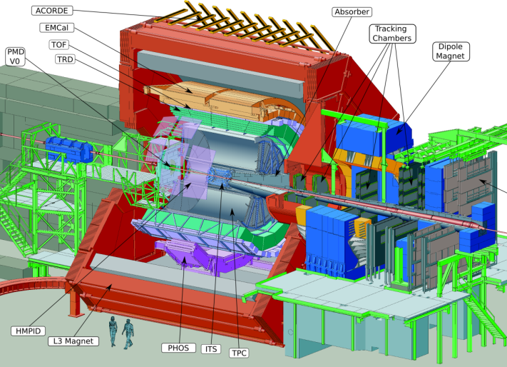
Detector location
ADA1
z = + 8 m
ADD1
z = -18.5 m

Slide 34
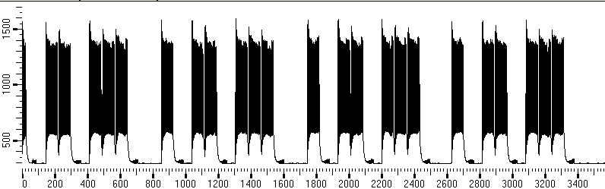
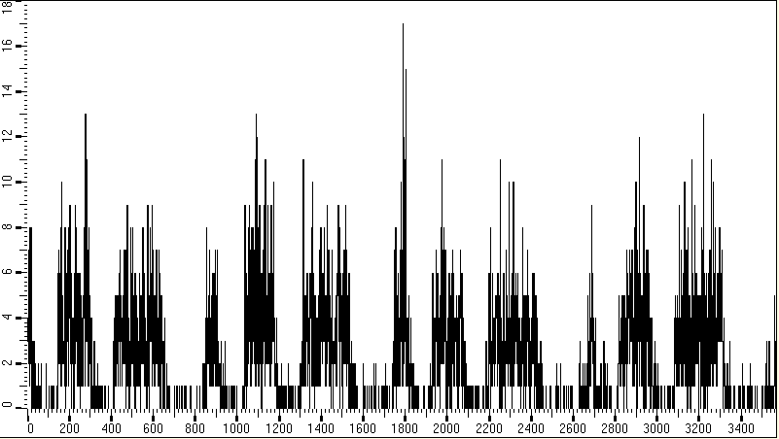
performance on April 12 2012
Bunches seen in the BPIM
Beam Phase
and Intensity
Monitor
Losses seen in the AD-L
Time →

Slide 35
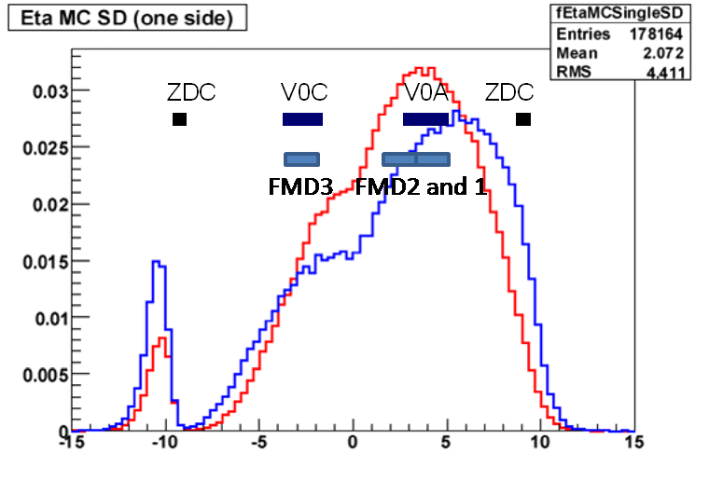
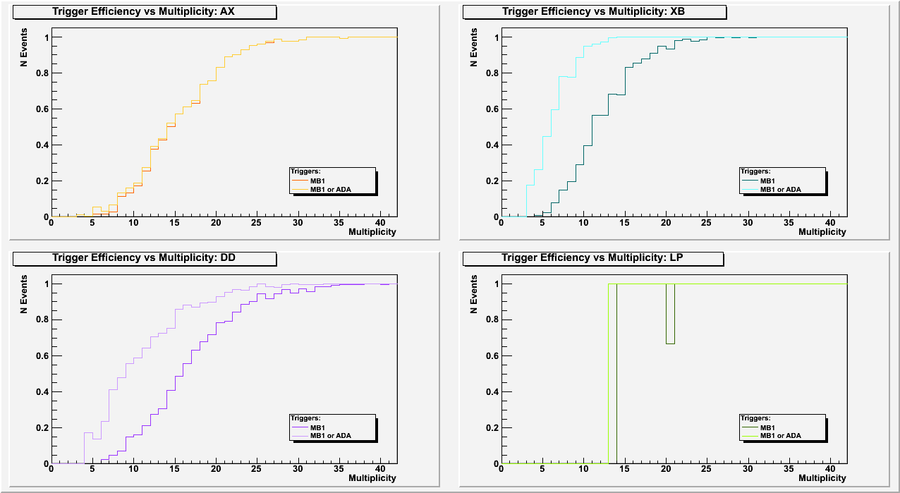
offline triggger
single diffractive
PYTHIA PHOJET
Gap tagger in a sensitive
region of pseudorapidity
to separate SD and DD
events.
arb. units
ADD2
AD-L
AD-R
ADA2
PHOJET PYTHIA
PHOJET | Default fractions | PYTHIA
0.134 | SD | 0.187
0.063 | DD | 0.127
low diffractive mass
SD
DD

Slide 36
ALICE upgrade
  luminosity upgrade – 50 kHz target minimum-bias rate for Pb–Pb
  run ALICE at this high rate
  improved vertex measurement and tracking at low p_{T}
  preserve particle-identification capability
  high-luminosity operation without dead-time
  new, smaller radius beam pipe
  new inner tracker (ITS) (performance and rate upgrade)
  high-rate upgrade for the readout of the TPC, TRD, TOF, CALs, DAQ-HLT, Muon-Arm and Trigger detectors
  target for installation and commissioning LS2 (2018)
  collect more than 10 nb⁻¹ of integrated luminosity
    implies running with heavy ions for a few years after LS3
  physics program – factor > 100 increase in statistics
    (today maximum readout ALICE ~ 500 Hz)
  for triggered probes increase in statistics by factor > 10
Notes:
36

Slide 37
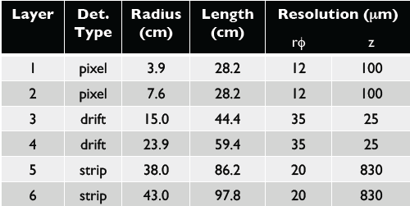
all known techniques for
particle identification:
SPD
SDD
SSD
TPC
TOF
ITS
HMPID
Inner Tracking
System
TRD
3 silicon technologies
low momentum
acceptance
high granularity
low material budget

Slide 38


all known techniques for
particle identification:
drift gas
90% Ne - 10%CO₂
for tracking and PID via dE/dx
- 0.9 < η < 0.9
TPC
TOF
ITS
HMPID
TRD
Time Projection Chamber
largest ever: 88 m³, 570 k channels

Slide 39
all known techniques for
particle identification:
Time Of Flight
Multigap Resistive
Plate
Chambers
for π, K, p PID
π, K for p <2 GeV/c
p for p <4 GeV/c
TPC
- 0.9 < η < 0.9
full φ
TOF
ITS
HMPID
DOUBLE STACK OF 0.5 mm GLASS
cathode pick up pad
Edge of active area
Resistive layer (cathode)
TRD
5 gaps
Resistive layer (anode)
anode pick up pad
5 gaps
Resistive layer (anode)
Resistive layer (cathode)
cathode pick up pad

Slide 40

all known techniques for
particle identification:
- 0.9 < η < 0.9
Transition Radiation Detector
for e PID, p>1 GeV/c for e and high p_{t} trigger, p>3 GeV/c
  Large (800 m²), high
  granularity (> 1M ch.)
TPC
fiber radiator
to induce
TR
(γ > 2000)
TOF
ITS
HMPID
TRD

Slide 41


7 modules, each ~1.5 x 1.5 m²
all known techniques for
particle identification:
High Momentum Particle Identification
TPC
TOF
ITS
RICH
HMPID
TRD

Slide 42
Process Efficiency | SD (%) XC XA | DD (%) | LP (%)
MB1 | 69.3 75.5 | 87.5 | 99.9
MB1.or.ADA1 | 69.9 88.8 | 94.5 | 100.0
MB3 | 35.1 39.8 | 43.1 | 97.8
MB3.and.ADA1 | 13.7 36.9 | 35.1 | 95.5
MB1 = V0C or SPD or V0A

Slide 43
MC studies
No ADA or ADD: GF0 && (!V0A) && (!V0C)
# | ND | SD | DD | CD
 | 276 | 531 | 125 | 2207
% | ND | SD | DD | CD
 | 8.8% | 16.9% | 4.0% | 70.3%
ADA and ADD: GF0 && (!V0A) && (!V0C) && (!ADA) && (!ADD)
# | ND | SD | DD | CD
 | 49 | 62 | 4 | 2123
% | ND | SD | DD | CD
 | 2.2% | 2.8% | 0.2% | 94.9%
pp 7 TeV PHOJET assuming 100% efficiency

