Slide 1

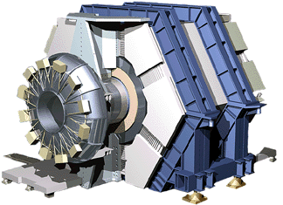

Observation of Time-reversal Violation at BABAR
Ray F. Cowan
Representing the BABAR Collaboration
CKM 2012
Cincinnati, Ohio, USA
September 28 – October 2, 2012
Notes:
Although CPV has been well-established in the B system, until recently there has been no direct observation of TRV.

Slide 2
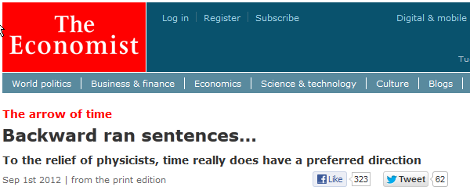
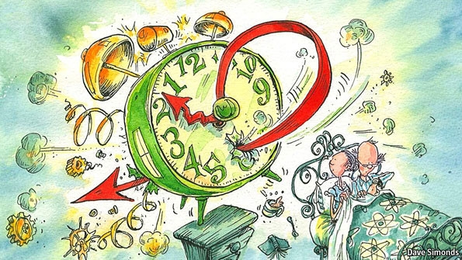
Outline
Goal
  Demonstrate time-reversal violation (TRV)
  independently of assumptions about CP or CPT violation or invariance
  Using variables sensitive to T violation alone
Introduction
  Time-reversal violation in stable and unstable systems
  Analysis overview
Analysis Procedure
  The BABAR detector and data sample
  Signal description and fitting strategy
  Systematics
  Results
Interpretation
  Confidence contours
  Significance and asymmetries
Summary
http://www.economist.com/node/21561111
Notes:
Occasionally physics shows up in the mainstream press.

Slide 3
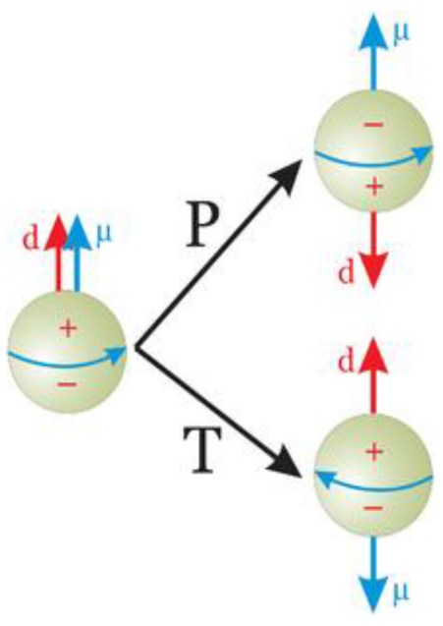
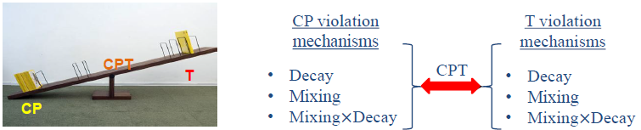
Time-reversal Violation (TRV)
Umkehr der Bewegungsrichtung*
In stable systems, T violation is implied by
  A non-zero value of a T-odd observable in a stationary state
    Example: electric dipole moment of neutron or electron (also violates parity, P)
      d_{n} < 2.9 £ 10⁻²⁶ e-cm; d_{e} = (0.7§ 0.7) £ 10⁻²⁶ e-cm (PDGLive.org)
  Different probabilities for a→b at a given time than for b→a
    Example: º _{e}! º_{¹} vs. º_{¹} ! º _{e} at a muon storage ring
In unstable systems
  Reversal of motion (t → −t) plus exchange of |ini, |outi states
  Experimentally challenging
*Reversal of direction of motion:
E. Wigner, Rev.Mod.Phys. 29, 255 (1957);
G. Lüders, Z. Phys. 133, 325 (1932).

Slide 4
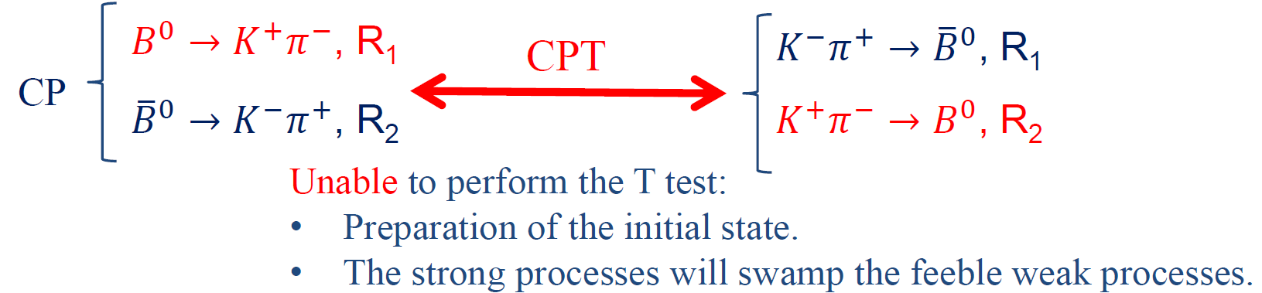
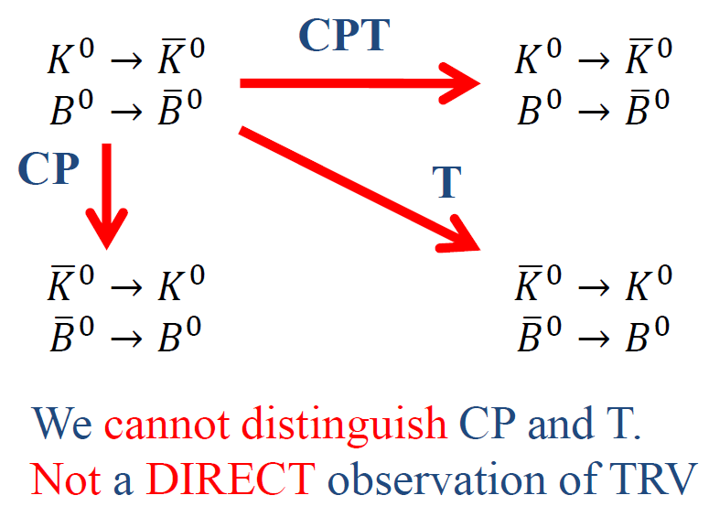
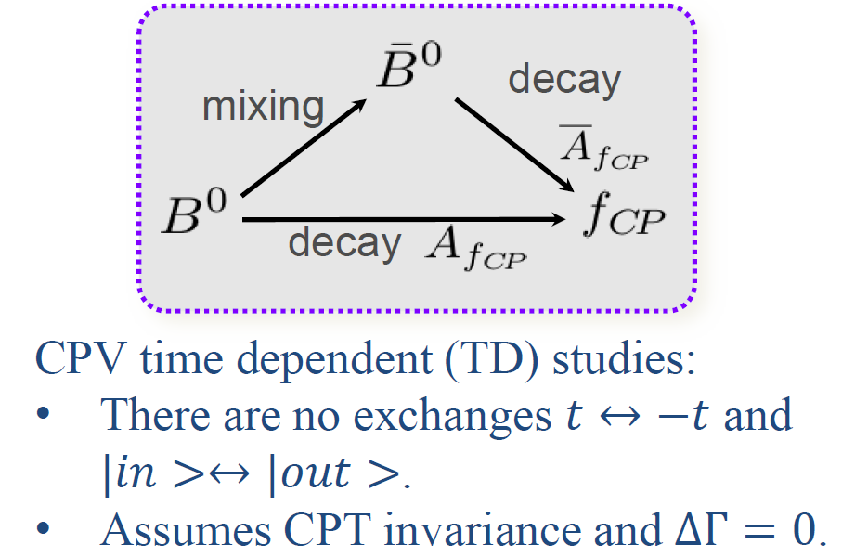
TRV in unstable systems
Searches in decay
Searches in mixing
Searches in interference
Kabir, Phys.Rev. D2 (1970) 540.
CPLEAR, Phys.Lett. B444 (1998) 43.

Slide 5



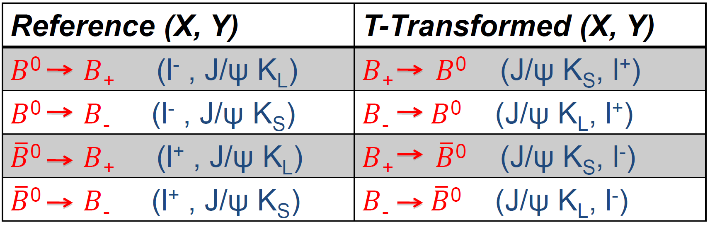
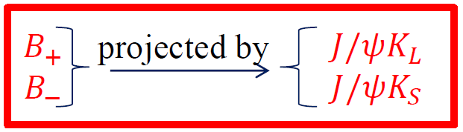
Analysis overview
Υ(4S) decay yields a coherent (entangled) quantum state
Define processes of interest and their T-transformed counterparts
  (X,Y) is the reconstructed final state
(l± = (lepton)±)

Slide 6
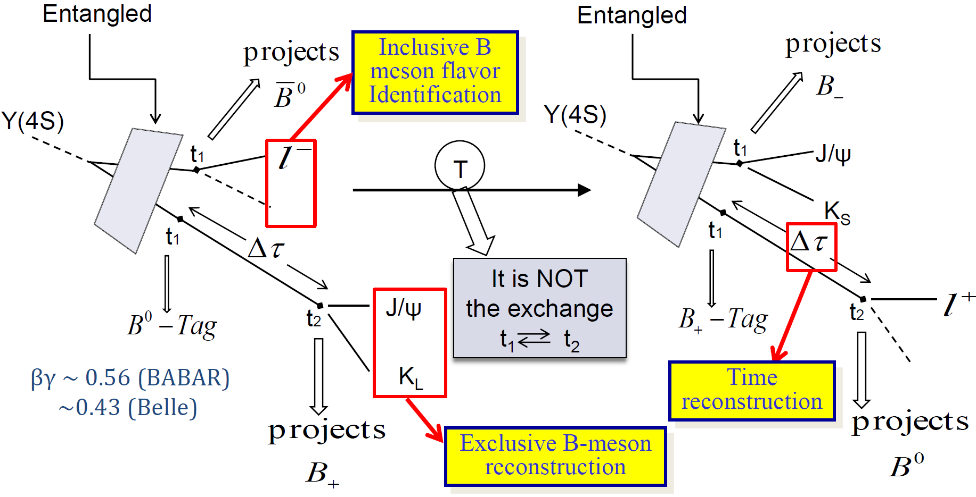
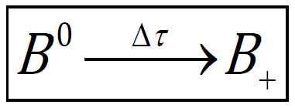
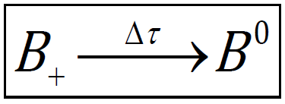
Analysis overview (2)

Slide 7
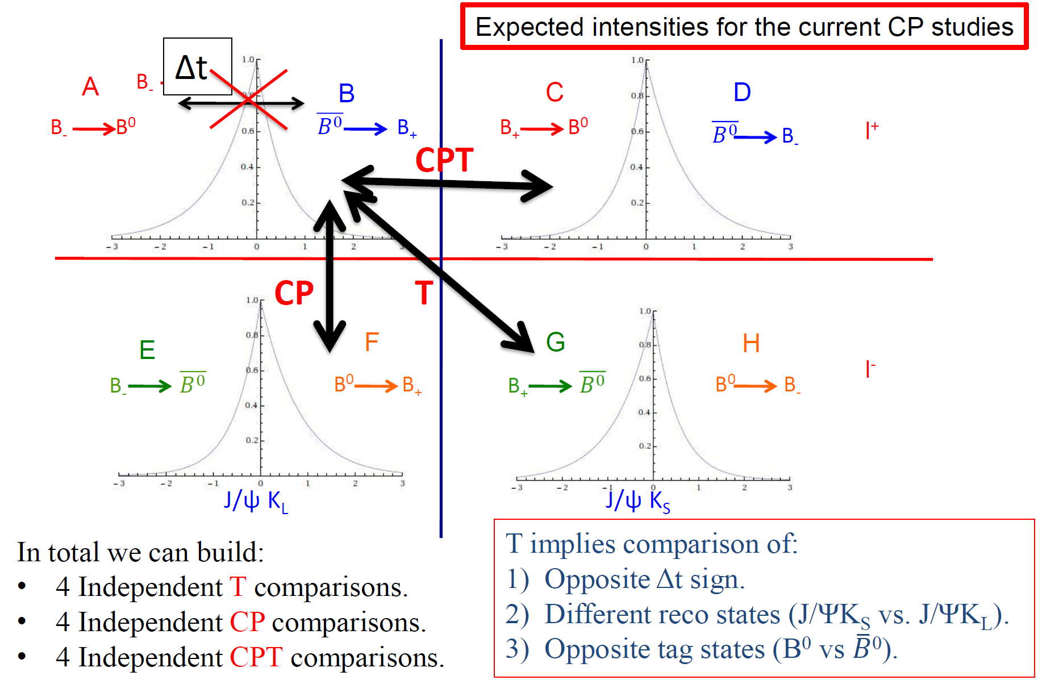
Analysis overview (3)

Slide 8
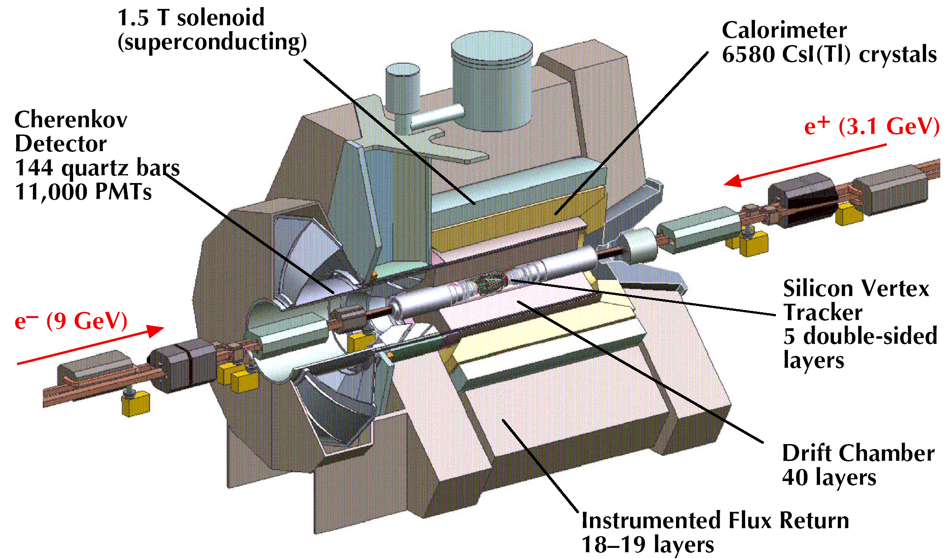
The BABAR detector at PEP-II
NIM A479, 1 (2002)

Slide 9
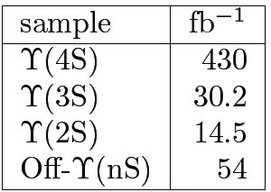
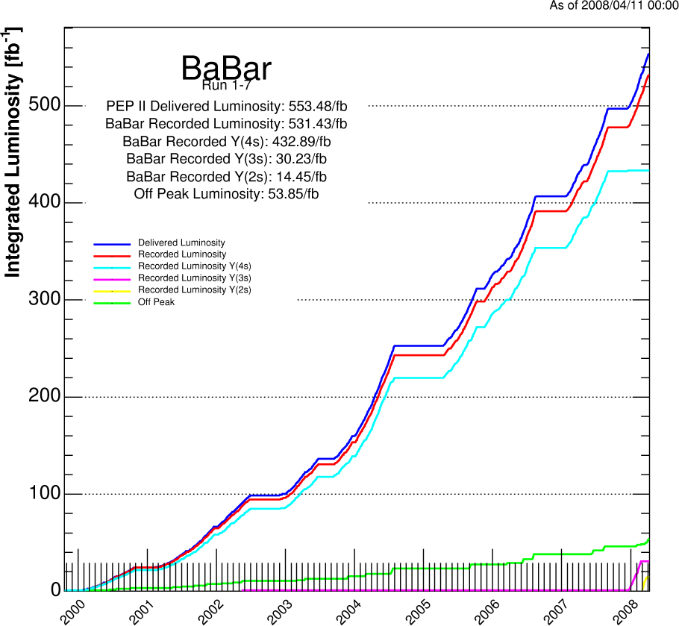
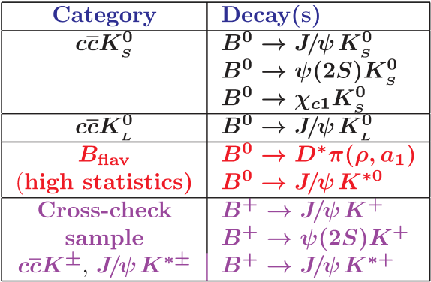
Datasets
PEP-II at SLAC is not only a B factory but also a charm factory
  470 x 10⁶ B anti-B pairs
  690 x 10⁶ c anti-c pairs
  500 x 10⁶ τ⁺τ⁻ pairs

Slide 10




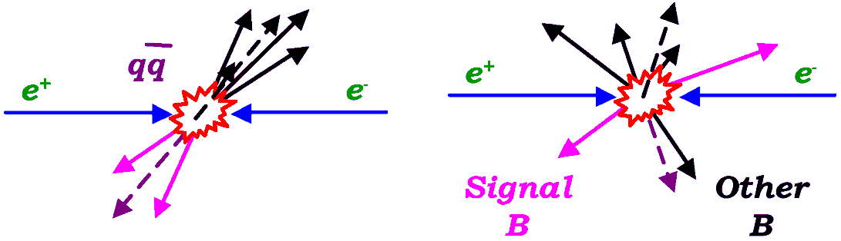
Signal and backgrounds
Select B candidates using
  Beam-energy substituted mass
  where and
    Beam energy spread determines resolution ≈ 3 MeV
    “*” denotes quantity in CMS
  Energy difference
    Resolution 10–50 MeV (depends on final-state neutrals)
  Choose best B candidates based on masses of daughters
Background rejection
  Depends on B decay channel
    Veto dangerous or significant backgrounds
  Suppress continuum u, d, s backgrounds
  using angular distributions and
  event shape variables
    Backgrounds are “jetty”
    Signals more isotropic

Slide 11
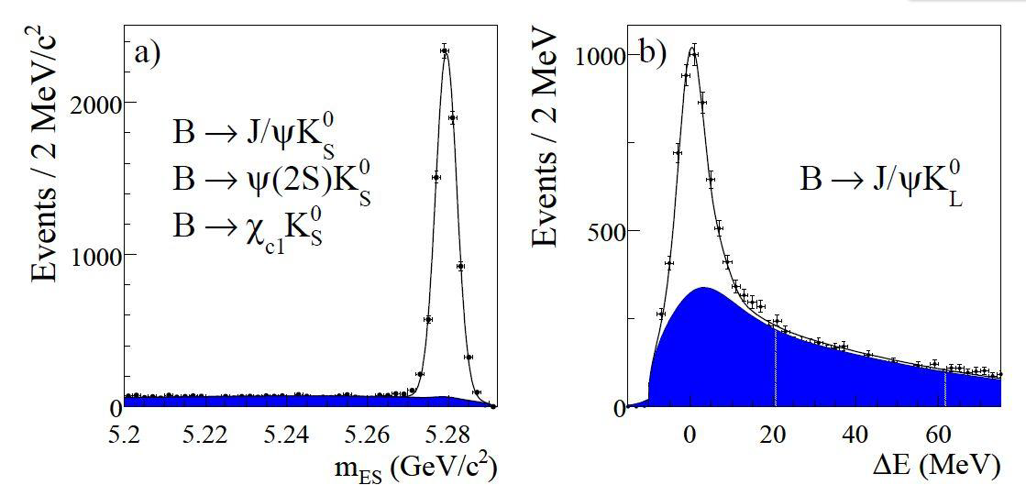
m_{ES} and ΔE for ccK_{S} and J/ψK_{L} samples
BABAR preliminary
BABAR preliminary
7796 events, purity 87–96%
5813 events, purity ≈ 56%

Slide 12
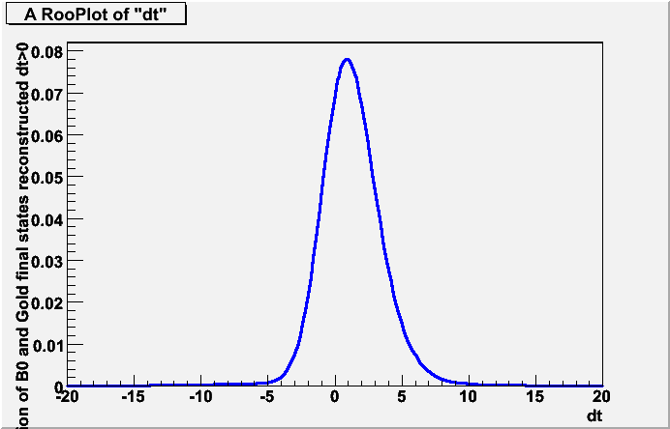
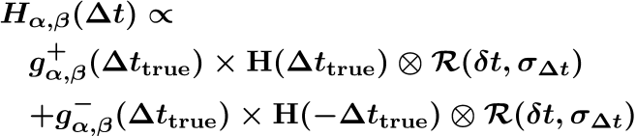
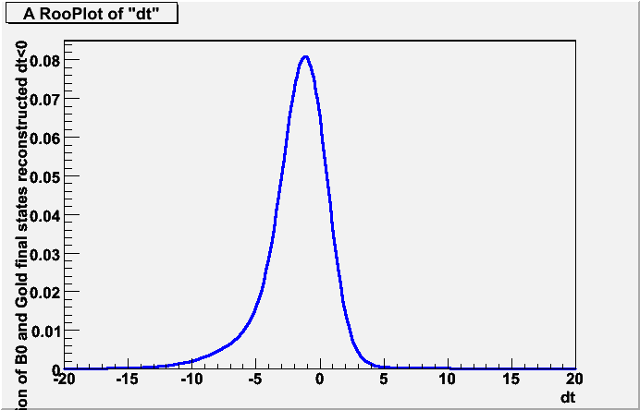
Signal model
PDF for the 8 signal intensities
  Fit model is the signal intensity combined with a step function H in ±Δt and convolved with a resolution function R:
  where
The signal model has 8 different sets of S, C parameters
  2 from (−Δt, +Δt), 2 from flavor (B⁰, B⁰), and 2 from (K_{S}, K_{L})
The standard CPV study* has one set of S,C parameters and assumes CPT is conserved and ΔΓ = 0
*Phys.Rev. D79 (2009) 072009

Slide 13
Fitting strategy
Use the B_{flav} sample to determine
  Time resolution parameters
  Wrong-flavor ID fractions
Plus another 27 T, CP, and CPT parameters
  Eight pairs of (S§®,¯ , C§®,¯ ) signal coefficients
  Eleven parameters allowing for possible T and CP violation in backgrounds
Perform simultaneous, unbinned, maximum-likelihood fits to B⁰, B⁰, ccK_{S} and J/ψK_{L} samples
  For Δt > 0 and Δt < 0
  PDF is normalized simultaneously for B⁰, B⁰ and Δt > 0 and Δt < 0
    Independently for ccK_{S} and J/ψK_{L}
Yields the 8 sets of (S§®,¯ , C§®,¯ ) parameters
  Define T, CP, and CPT asymmetry parameters ΔS§_{i}, ΔC§_{I}
    Where i = T, CP, or CPT

Slide 14
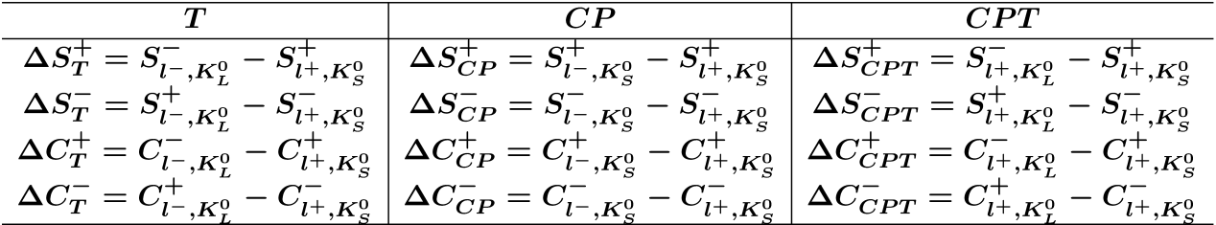
Asymmetry parameters ΔS§_{T}, ΔC§_{T}
Using the 16 signal coefficients (S§®,¯ , C§®,¯ ) construct six pairs of asymmetry parameters
  (ΔS§_{T}, ΔC§_{T}), (ΔS§_{CP}, ΔC§_{CP}), and (ΔS§_{CPT}, ΔC§_{CPT})
Non-zero values would indicate violation of the symmetries T, CP, or CPT
There are three additional pairs of asymmetry parameters
  But they are not independent

Slide 15
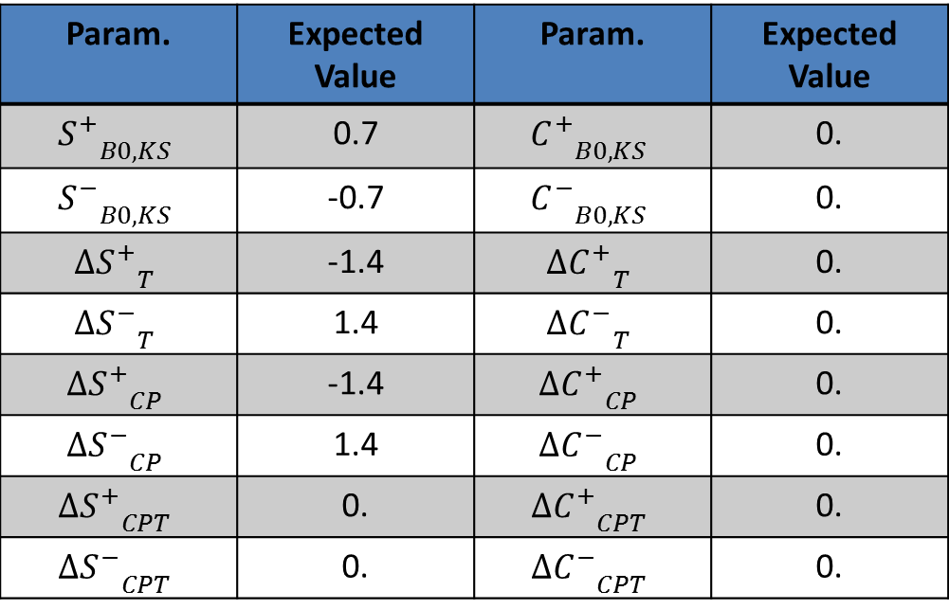
S±,C± and ΔS±,ΔC± parameters: expected values
Param. | Expected Value | Param. | Expected Value
$${S_{}^{+}}_{B0,KS}$$ | 0.7 | $${C_{}^{+}}_{B0,KS}$$ | 0.
$${S_{}^{−}}_{B0,KS}$$ | -0.7 | $${C_{}^{−}}_{B0,KS}$$ | 0.
$${{ΔS}_{}^{+}}_{T}$$ | -1.4 | $${{ΔC}_{}^{+}}_{T}$$ | 0.
$${{ΔS}_{}^{−}}_{T}$$ | 1.4 | $${{ΔC}_{}^{−}}_{T}$$ | 0.
$${{ΔS}_{}^{+}}_{CP}$$ | -1.4 | $${{ΔC}_{}^{+}}_{CP}$$ | 0.
$${{ΔS}_{}^{−}}_{CP}$$ | 1.4 | $${{ΔC}_{}^{−}}_{CP}$$ | 0.
$${{ΔS}_{}^{+}}_{CPT}$$ | 0. | $${{ΔC}_{}^{+}}_{CPT}$$ | 0.
$${{ΔS}_{}^{−}}_{CPT}$$ | 0. | $${{ΔC}_{}^{−}}_{CPT}$$ | 0.
Based on existing
measurements of
sin 2β
Example: T violation
If ΔS⁺_{T}≠0, ΔS⁻_{T} ≠0→ T is violated in the interference
If ΔC⁺_{T}≠0, ΔC⁻_{T} ≠0→ T is violated in the decay

Slide 16
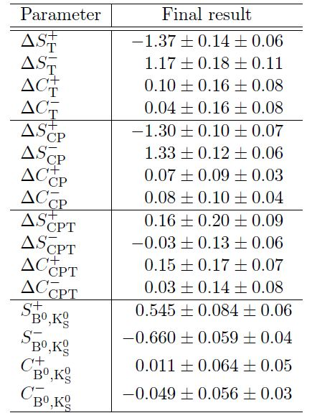
Results
BABAR preliminary
T
CP
CPT
REF.

Slide 17
Cross-checks and systematics
Cross-checks
  Study using simulation data shows asymmetry parameters ΔS§_{T}, ΔC§_{T} are unbiased and have gaussianly distributed errors
  Studies of data segmented by running period or flavor mode are consistent
  With appropriate constraints, obtain same S,C parameters as the latest BABAR CPV study
    Phys.Rev. D79, 072009 (2009)
  Fitting ccK§ and J/ψK*§ datasets yield asymmetry parameters consistent with zero
Systematics are evaluated similarly to the 2009 BABAR CPV study
  Include statistical uncertainties on flavor mis-ID probabilities, ¢t resolution function, and m_{ES} parameters
  Include differences in mis-ID probabilities and ¢t resolution between B_{flav} and CP final states, assumptions about resolution of signals vs. backgrounds, signal and background compositions, m_{ES} and ¢E pdfs , background branching fractions and CP properties.
  Include (add in quadrature) deviations between generated and fitted asymmetry parameters in simulated fits
  Include uncertainties in input parameters from world averages: ¡_{d}, ¢m_{d}, others
  Detector alignment
  Effect of treating ccK_{S} and J/ψK_{L} as orthogonal, neglecting CPV in flavor categories without leptons

Slide 18
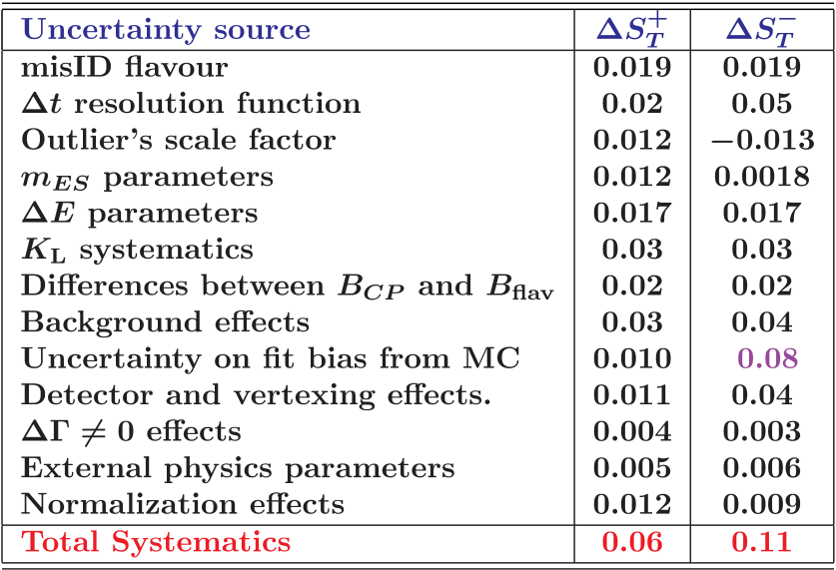
Systematics
BABAR preliminary

Slide 19
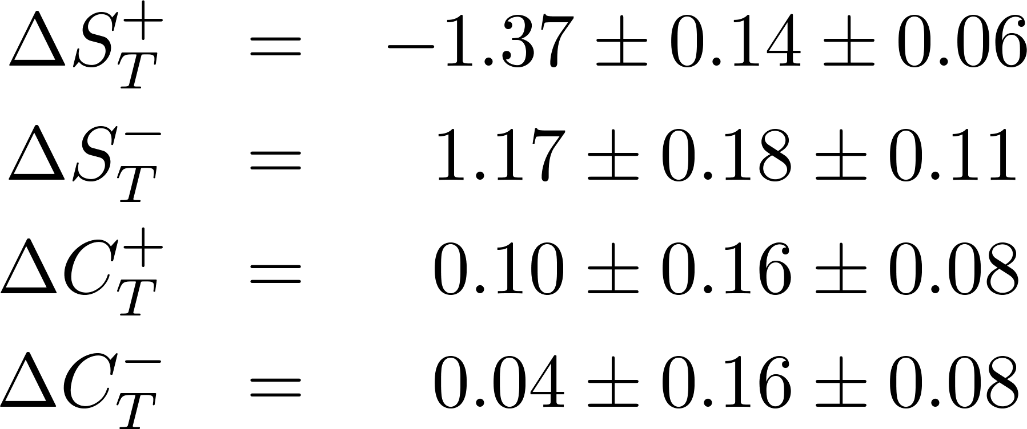
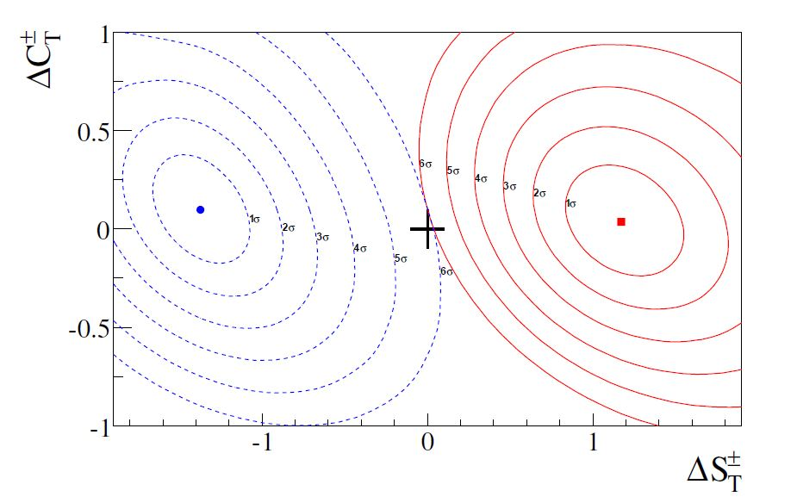
Interpretation of results: T violation
+
= no T violation point
BABAR preliminary

Slide 20
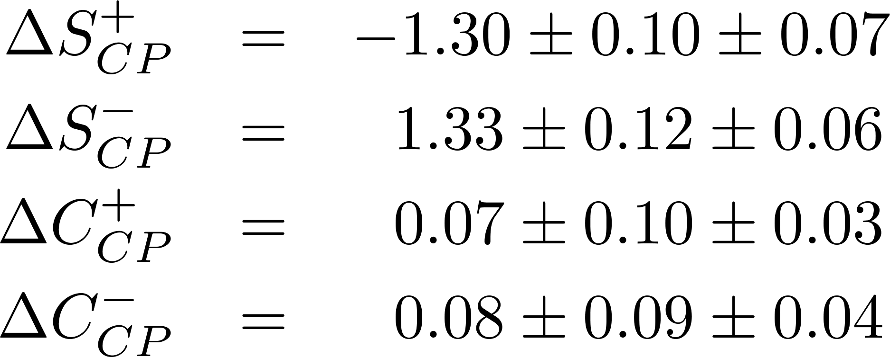
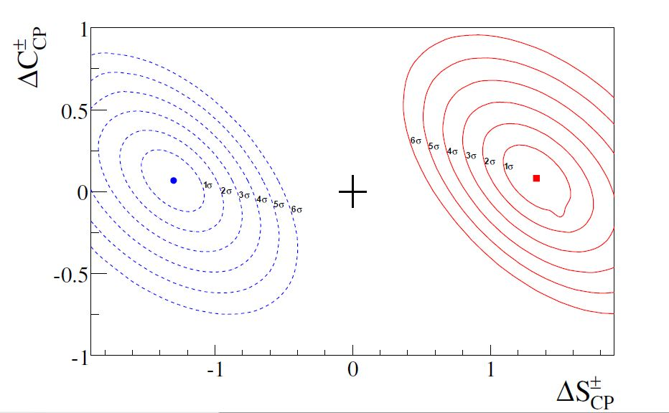
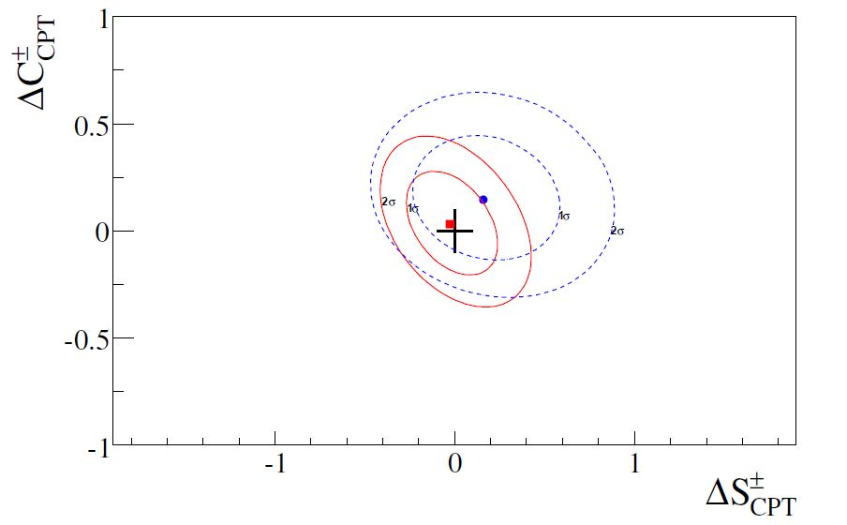
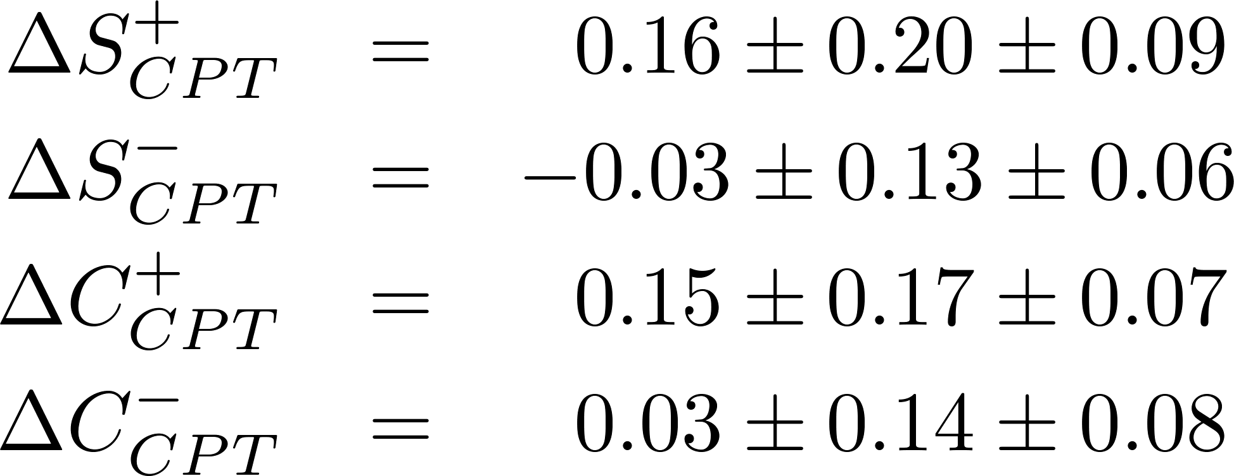
Interpretation of results
CP violating parameters
+
= no CPT violation point
CPT violating parameters
BABAR preliminary
+
= no CP violation point
BABAR preliminary

Slide 21
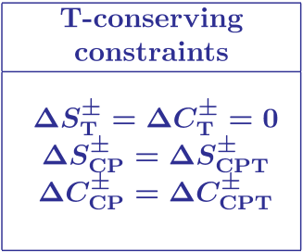

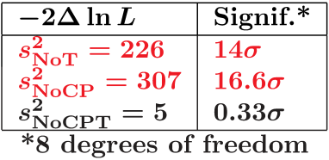
Significance of T violation
Standard fit yields a likelihood value for S, C using the 8 independent samples
Repeat the fit, applying constraints to the parameters for T-conjugate processes
Difference in likelihood with the standard fit yields the significance of T violation
Plot raw asymmetries and fit projections using
CP and CPT significance can be estimated this way using appropriate constraints
Include systematics variations in significance estimations
Take max(m_{j}²), scale significance by (1+max(m_{j}²))
  1+max(m_{j}²) = 1.61

Slide 22




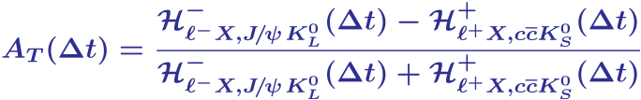

Building T asymmetries (time-dependent)
Construct an asymmetry for each of the four reference transitions
Define
Which, for the case of perfect reconstruction, is
Where

Slide 23
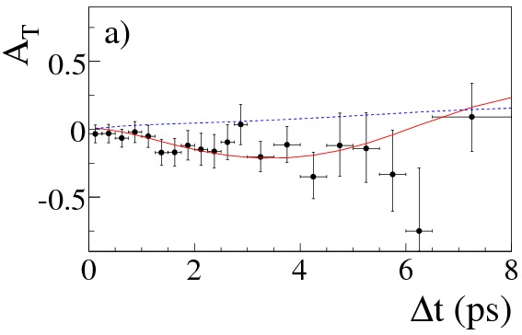
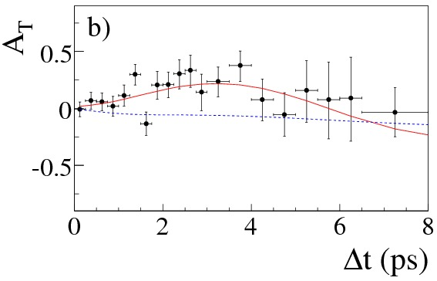


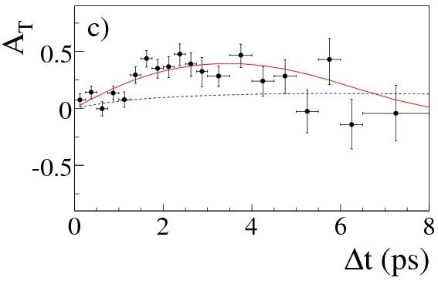
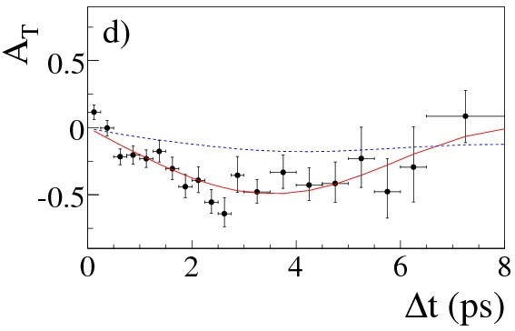


Four independent T asymmetries
BABAR preliminary
BABAR preliminary
BABAR preliminary
BABAR preliminary
Points: data; red (blue) curves are projections of fits with (without) T violation

Slide 24
Conclusions
BABAR has measured T-violating parameters in the time development of neutral B-mesons
  Without a priori assumptions about CP or CPT invariance
T violation is observed at the 14σ level
  CP violation is observed at the 17σ level
  CPT is conserved (significance of violation = 0.3σ)
Results are consistent with measurements of CP violation assuming CPT invariance
This is the first measurement of T violation in the B-meson system
  No experimental connection with CP or CPT
  First measurement in any system using exchange of initial and final states that can only be connected by a T transformation
Submitted to Phys.Rev.Lett.
  arXiv:1207.5832 [hep-ex]

Slide 25
Backup

Slide 26
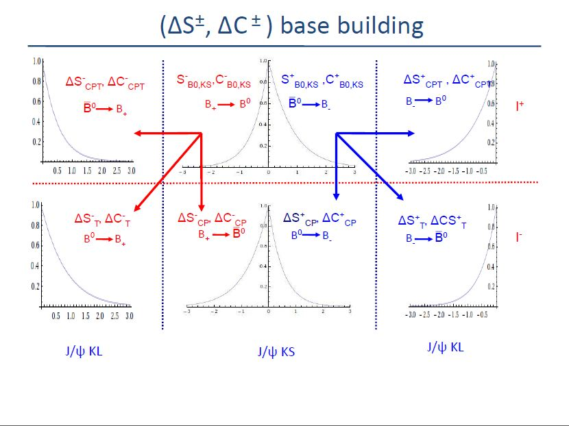
Constructing ΔS±, ΔC± parameters

