Slide 1
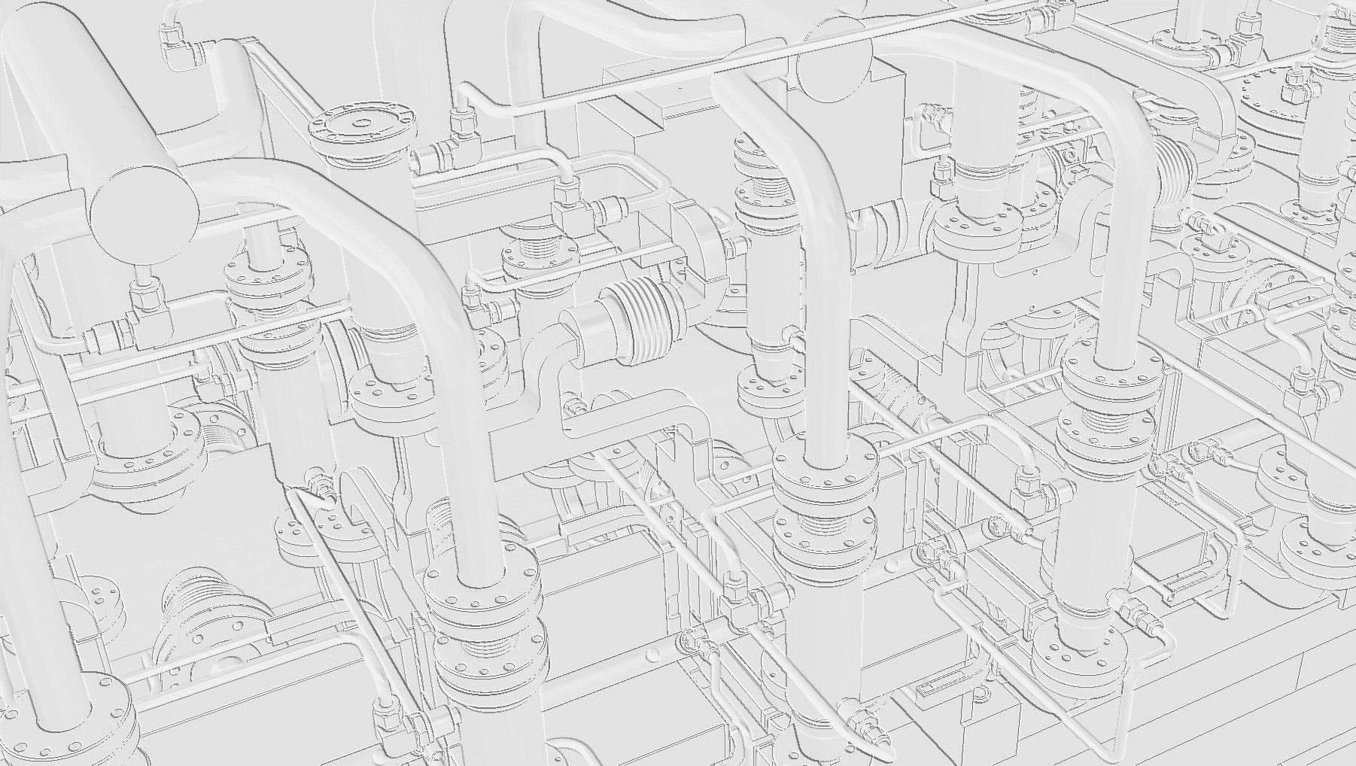
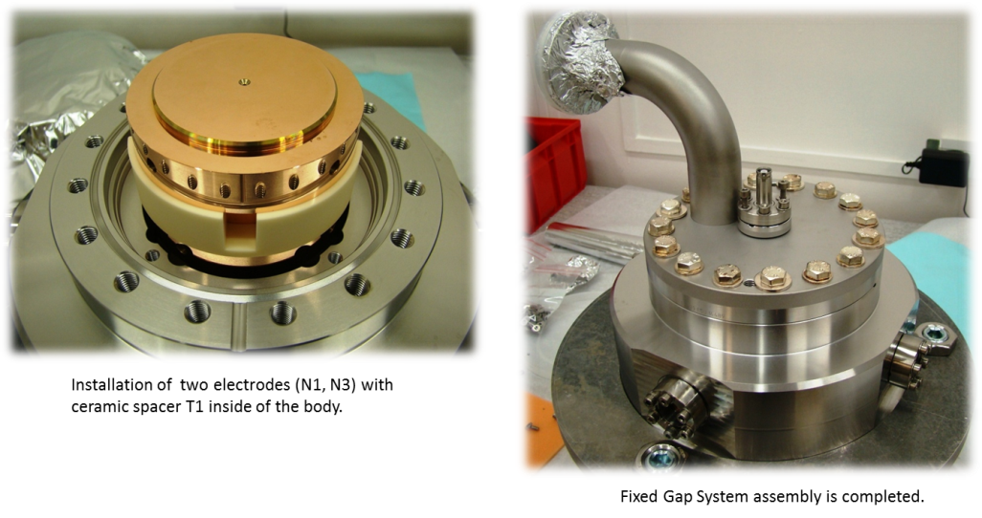
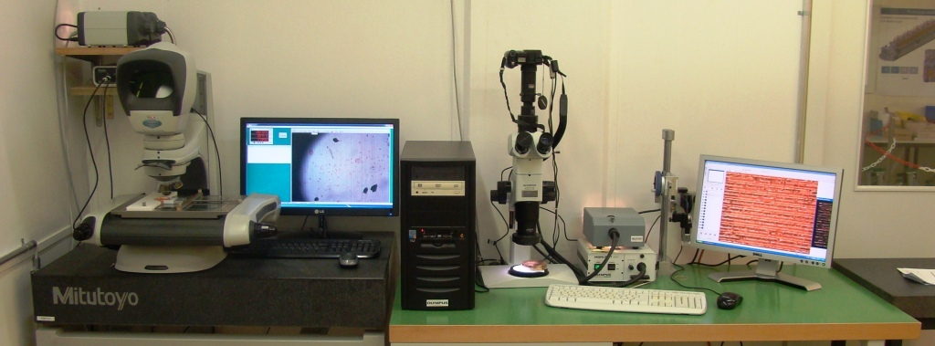
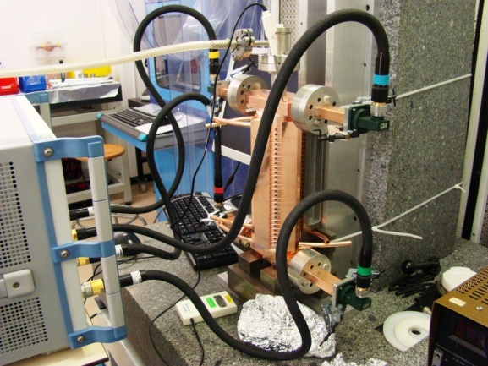
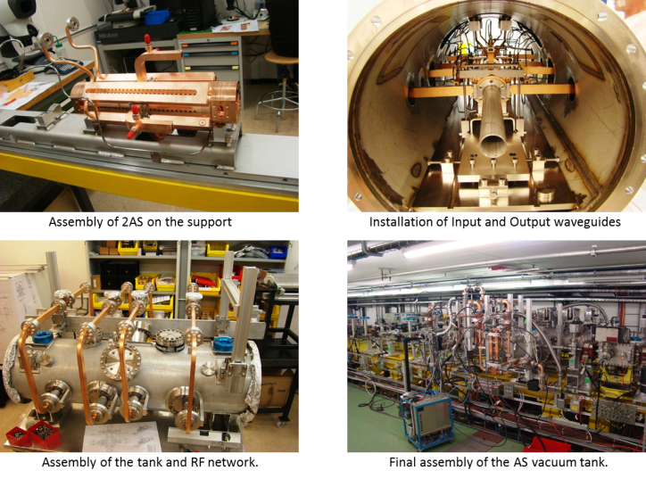
CLIC Activity of A. Olyunin
1. Inlet inspection.
3. Assembly of the fixed gap system.
Over the past period have done by me:
Inlet inspection of the 9 structures (2-TD26 R05 , 2- TD24 CEA,
2- TD24 R05 with SiC, 2- CLIC CRAB CAVITY, 1- Structure for mock-up.
Re-inspection after re-machining of 4 structures and 7 disks.
Inlet inspection of the double length PETS with damping material and components of the Fixed Gap System.
2. RF test setup and RF measurements
4. TBTS phase 2.3 preparation
Over the past period have done by R. Wegner, J. Shi, and me:
Tuning of the 4 structures (2-TD24 CEA, 2-TD24 R05).
RF check before bonding of the 7 structures (2-TD24 CEA, 3-TD24 R05, 2-TD24 KEK)
Phase calibration of input, output waveguides for TBTS, RF measurement of the TD24 CEA N1&2 after installation waveguides on the tank.
Tuning of the structure

