Slide 1
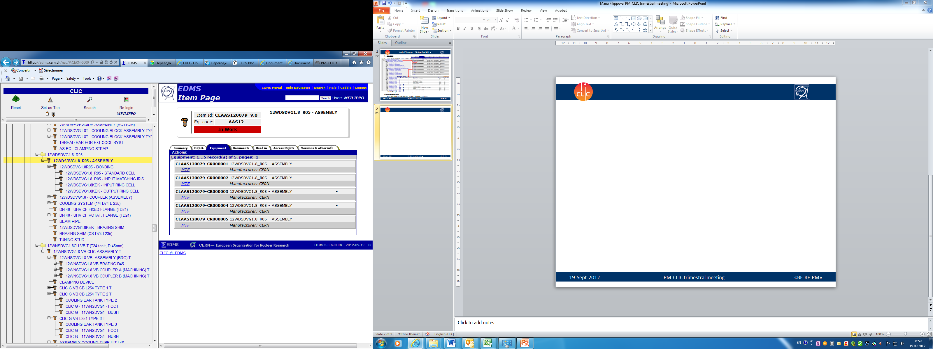
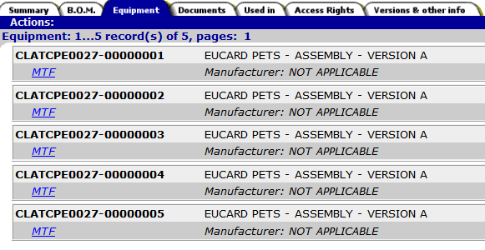
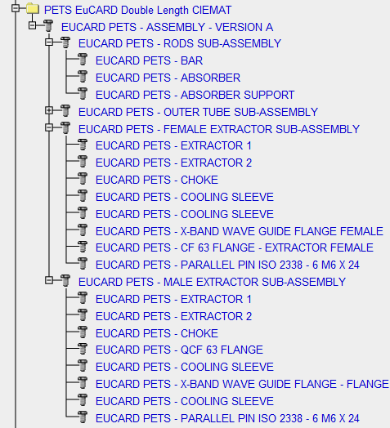
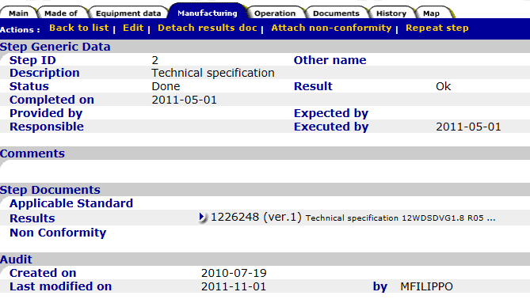
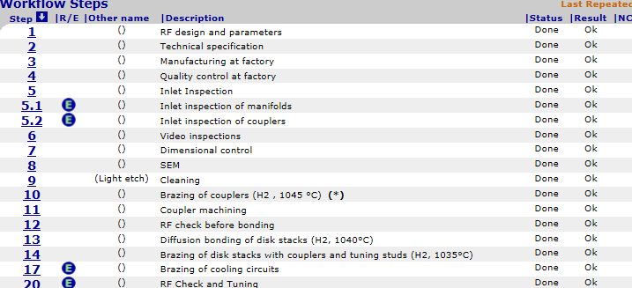
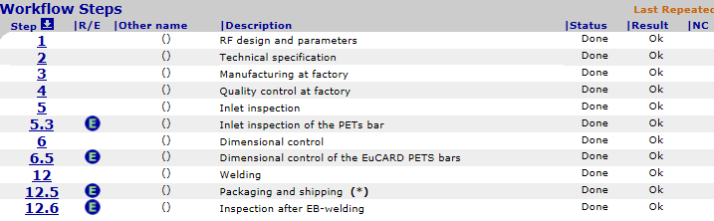
Maria Filippova – Status of activities
CLIC EDMS:
updating, changing of structure and co-administration of EDMS (Engineering & Equipment Data Management Services, https://edms.cern.ch) for the CLIC experiment (The Compact Linear Collider) in collab. with A. Antila
2. Component procurement:
Departmental Request (DR) – work in EDH (Electronic Document Handling System) https://edh.cern.ch
preparing of technical specifications for the supply of X-band RF components and start-up memo with the list of firms to be contacted for the related price enquiries
preparing of Purchase Requisition (DAI) – work in EDH in collab. with W. Zhou
contract follow-up: contacting companies concerning the status of the manufacturing process, the coordination of requirements and conditions of production manufacturing with firms.
3. RF component & SPS Inventory and Logistics:
Shipping requests (Expedition/Arrival) – in collab. with W. Zhou
Inter Departmental Transfer requests (TID)
4. Quality Assurance:
EDMS for RF structures and TBM, MTF (Manufacturing and Test Folder) in collab. with A. Antila and W. Zhou (PETS CIEMAT, AS TD24 R05)
5. Administrative work:
Contracts, Addenda, Memoranda: signature procedure workflow

