Slide 1
LEP cavities
L. Ulrici, B. Cellerier, DGS-RP-RW
EPPCN meeting, CERN, 29 Novembre 2012

Slide 2
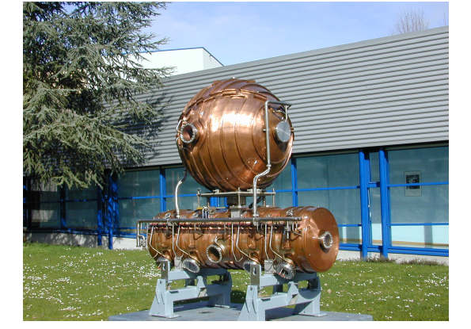
LEP CAVITIES
The copper cavities were installed in the LEP collider in 1983 and used until 1989
LEP: electron and positron beams
Energy during exploitation of these cavities: 50 GeV
The weight of the cylindrical cavity is about 2 tons
The weight of the sphere is about 1 tons

Slide 3
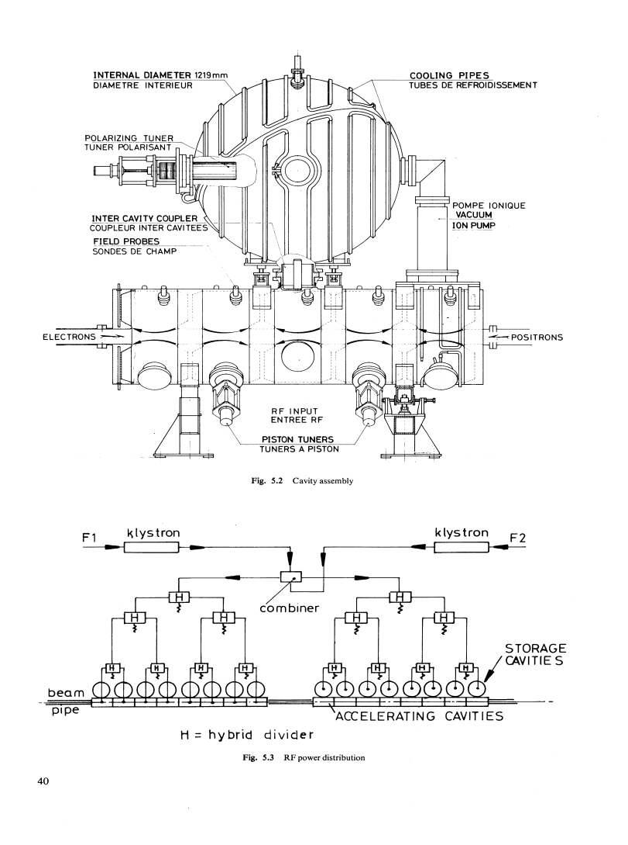
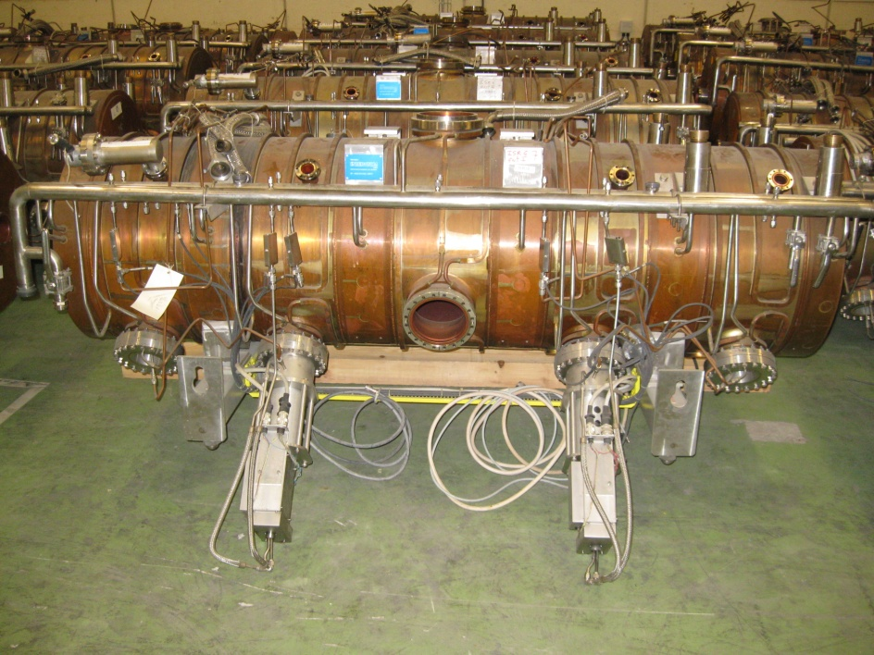
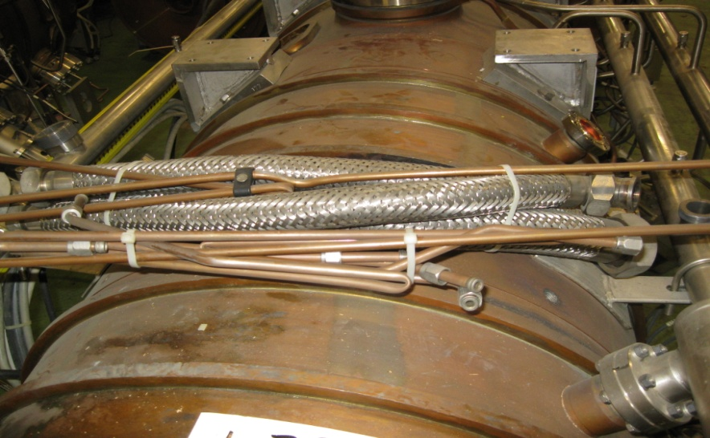
Details
Cavities in good status
Cavities in bad status (not suitable for physics/tests)

Slide 4
INVENTORY
Total of 55 cavities and 8 spheres are available
(1 cavity has been cut and dismounted for analysis)
number | Candidate free-release | Radioactive | Without tuner | Good status | Bad status
35cavities | 27 | 8 | 7 | 8 | 21
20 cavities | NA | NA | - | 16 | 4
8 spheres | 8 | -
Official confirmation of availability of the cavities foreseen for the end of the 1st quarter 2013

Slide 5

Free-release
A priori
A posteriori
Exemption
for practices
small amount of material
Regulatory control
Clearance
Result of practices
large amount of material
Exclusion
Cannot be regulated
e.g. K-40 in human body
Clearance from regulatory control: Swiss RP regulation
  Specific activity: clearance according to Swiss Ordinance (814.501)
  Dose rate: < 0.1 μSv/h in 10 cm distance
  Contamination: below nuclide specific levels listed in the Swiss Ordinance (814.501)

Slide 6
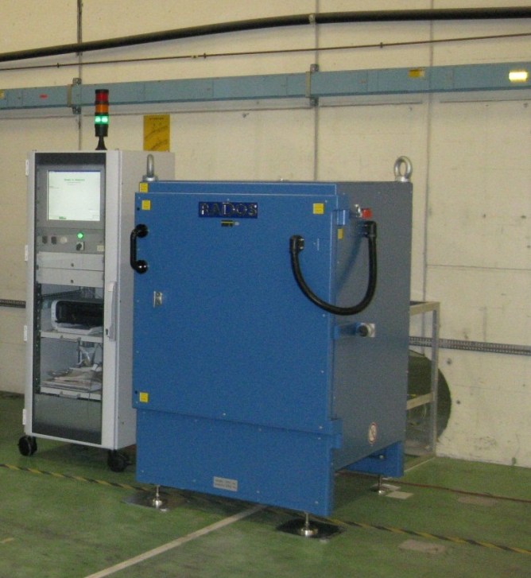
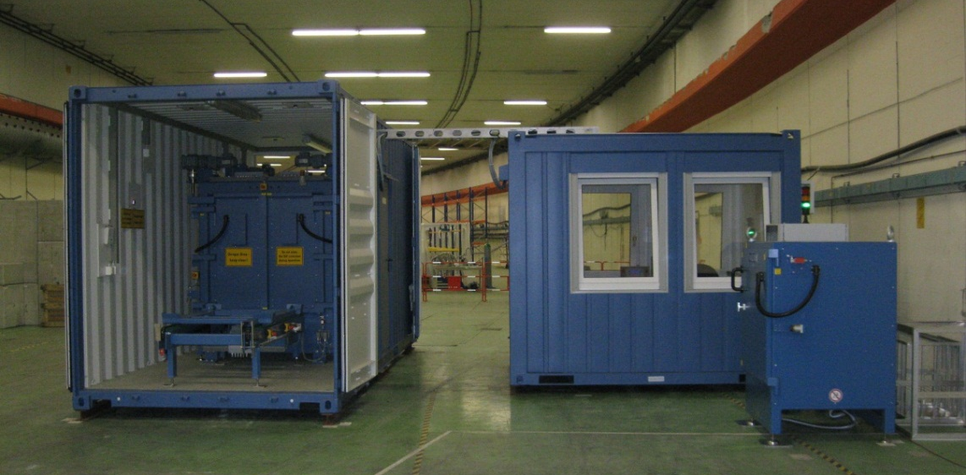
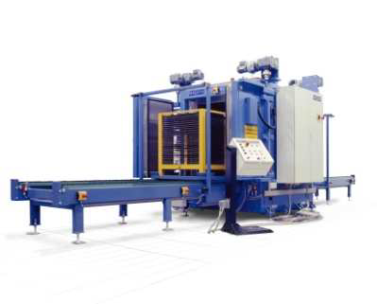
Present status Free Release
« Total gamma » monitors:
RADOS RTM 644
RADOS RTM 661
Procedures and measures to be revised and approved by the Swiss authorities ( Federal Office of Public Health)

Slide 7
Formalities for reception of these cavities
Notification of interest to receive one or more cavities:
  to be addressed to CERN’s press office
Emmanuelle.Carrier@cern.ch
+41 (0)22 767 9273
  Specifying:
    number of cylindrical basis and/or spheres
    the scope of the request ( re-use, exhibition, etc. )
In case of interest to receive only a part of a cavity (e.g. for exhibition), the costs for handling and cutting will be charged.
  Cost : a few hundreds to a few thousands CHF (depending on complexity of the requested cut)
  Delivery delay
The cavities are delivered together with a protocol certifying the type and results of the measurements and the Swiss limits for clearance. The comparison with the local radiation protection regulation and eventual local requests for authorization for transport/exhibition is not done by CERN.

