Slide 2
Communication for ICHEP 2012 Melbourne
Renilde Vanden Broeck and Arnaud Marsollier - EPPCN 29/11/2012
Notes:
The ICHEP2012 Organising Committee would like to thank all delegates for
attending the 36th International Conference on High Energy Physics held
at the Melbourne Convention and Exhibition Centre from 4-11 July 2012.

Slide 3
When did we start?
First contact October 2011
Communications and Outreach Coordinator ARC Centre of Excellence for Particle Physics at the Terascale (CoEPP) in Melbourne
Start brainstorming for media plan (Higgs!)
→ support : communication & technical
Notes:
Prof Geoff Taylor ; Director, ARC Centre of Excellence for Particle Physics at the Terascale, University of Melbourne
The parallel sessions run over Thursday 5th to Saturday 7th. and plenaries Monday 9th- Wednesday 11th.
The parallel sessions will shape up after we have the abstracts in May.We would expect to have sessions on various Higgs channels on the first day of the parallels (Thursday 5th).
We provided support in communication and technical support

Slide 4
1. Communication support : Media plan
Dedicated Press webpage
If/when Higgs press conference? What result will there be?
Daily media briefings before and after sessions (on parallel/plenary topics)
Social media : twitter account /pressichep
Press Release announcing conference
Live blogging by scientists on Quantum Diaries, ICHEP, Science 2.0, etc
Social events for media at ICHEP
Notes:
colleague, Arnaud Marsollier, who is also doing outreach and communication in our group and is responsible for communication for the French particle physics research laboratory IN2P3 (part of the CNRS group). Arnaud also has a role of representing the EPPCN/Interactions group in a session of the Outreach programme.
We can both help in looking after press for our DG, spokes etc. For any official announcements that CERN will make I will liaise with James Gillies here.Is there already any draft programme available we can have a look at for the pararellel sessions ? We discussed with Geoff not so long ago the agenda of the plenary ones - has this lay-out remained the same?Indeed we plan to organise press briefings after each day which will be webcast. However for the Higgs results we have to a proper press conference with the press present and Arnaud still has a twitter account we could use called https://twitter.com/pressichep.

Slide 5
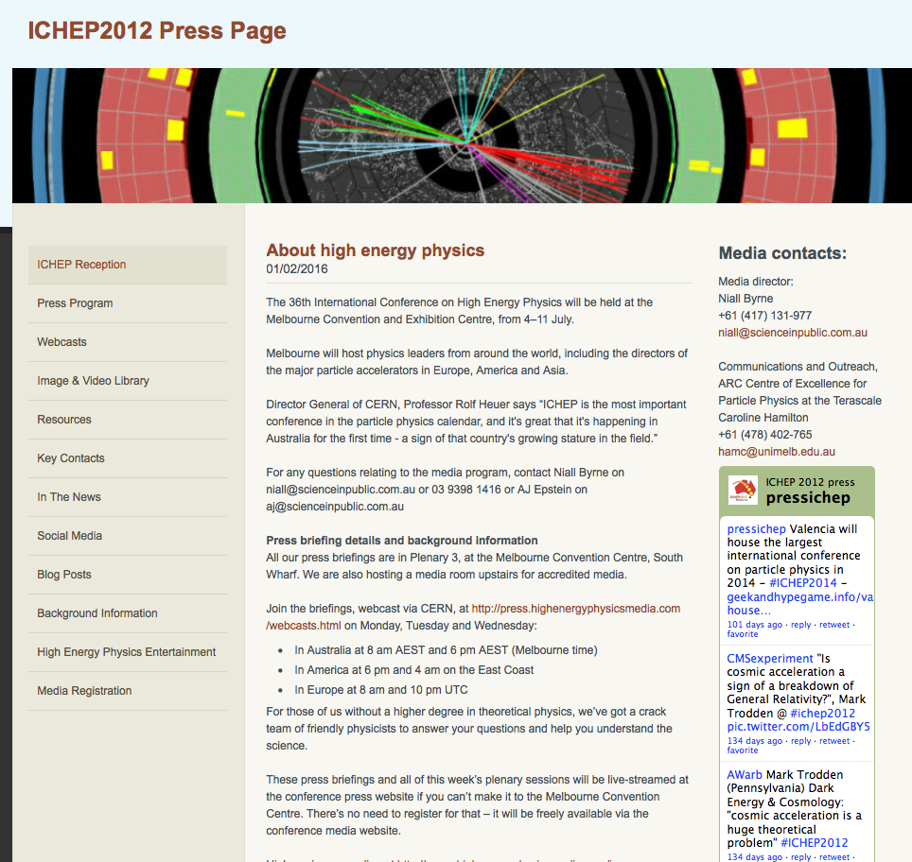

Slide 6
Local media consultant
June 1 : Melbourne signs for “Science in Public” run by Niall Byrne (maximum media exposure in Australia)
Use ‘Higgs(teria)’ for putting other stories in the spotlight.
Niall contacts plenary and parallel session speakers for views on good potential news stories

Slide 7

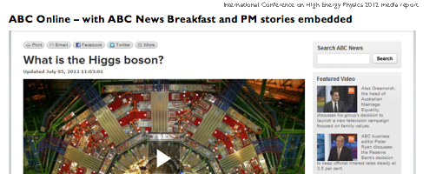



Slide 8
2.Technical support : Webcast
Two-way link with seminar (live from CERN)
Same planned for press conference but…
Had to take place in ICHEP media centre
Daily media briefings : morning & evening
One way webcast of all plenaries
→ CERN hosted the complete webcast capacity!

Slide 9
At ICHEP : CERN Media support & social media
Management of media enquiries for CERN’s directors and spokespersons (TIME)
Permanent link 24/24 to CERN’s press office inbox help for Geneva coordination of press requests
Consultancy for the local team on media management (CoEPP, Melbourne University, Niall’s team…)
Tweeting from @pressichep account launched for previous ICHEP conference
Identification of live twitterers & bloggers
Use of common hashtag #ichep2012
Use of @CERN account to promote the conference as a whole

Slide 10

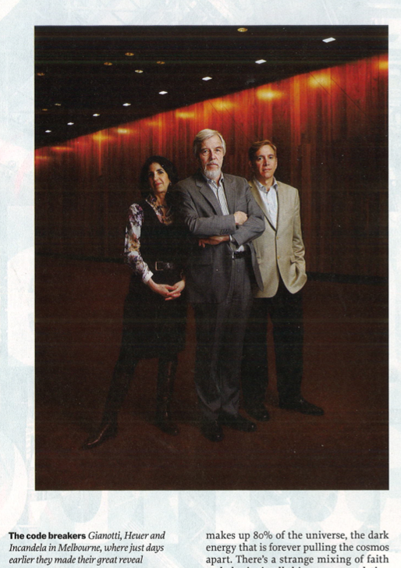

Slide 11
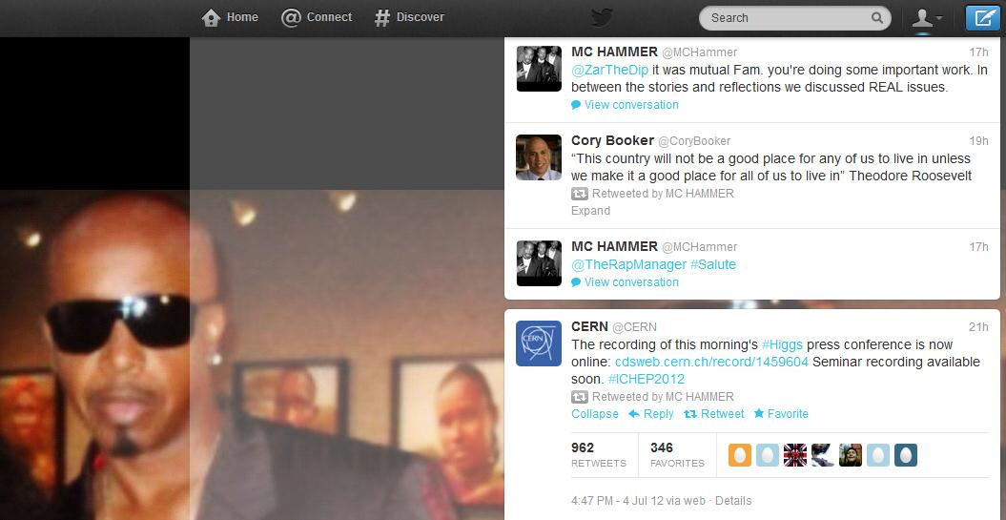


Slide 12
Outreach parallel session
Outreach & communication topic included for parallel session: 1st time!
Opening talk from CERN’s DG about importance of communication
Presentations : role of outreach global networks (EPPCN, IPPOG, Quarknet etc.)
Experiment Google+ hangout from Melbourne about social media & science communication
ATLAS & CMS organised local outreach events (ex. ATLAS lego in Science Museum Melbourne, masterclasses)

Slide 13
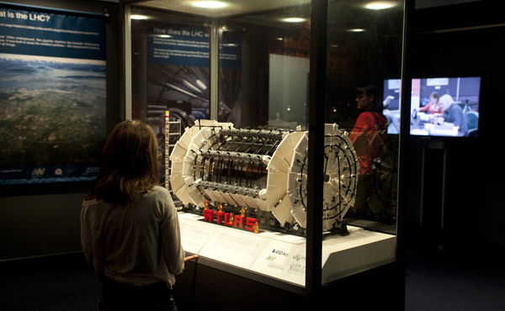
…at the Melbourne Planetarium at Scienceworks, where a special group of Lego® fans will build the ATLAS detector entirely from Lego® bricks…about 9,500 of them.

Slide 14
What went well…& didn’t
The hiring of Science in Public :
→ pitching new stories daily to local press : papers radio TV …
CERN press office being there
The webcast
Time difference for worldwide news
Press website not full part of conference site
No actual press room for journalists but only a media centre (too small)
The daily press webcast briefings (we cut the evening ones)

Slide 15




Suggestions for Valence
To find local science communication support with press from
Since in Europe : what role for EPPCN, Interactions ?
What presence there – announcement ?
To have a proper press room
Notes:
The Centre for Energy-Related, Environmental and Technological Research, Ciemat, formerly the Nuclear Energy Board (JEN), is located in Madrid and was one of the first and most important nuclear research centres in Spain.
The Spanish National Research Council (Consejo Superior de Investigaciones Científicas - CSIC) is the largest public institution dedicated to research in Spain and the third largest in Europe. Its main objective is to develop and promote research that will help bring about scientific and technological progress, and it is prepared to collaborate with Spanish and foreign entities in order to achieve this aim.
The Spanish Foundation for Science & Technology (FECYT) was created in 2001.
Acting like a non profit organisation, the foundation has a complete autonomy to provide continuous and flexible services to the Spanish science-technology-entrepreneurship system.
2 months before conference at least 6people were needed for planning , 10 on the day with big announcement and 2 from CERN

Slide 16
Thank you for listening and have a good joint meeting tomorrow!

