Slide 2
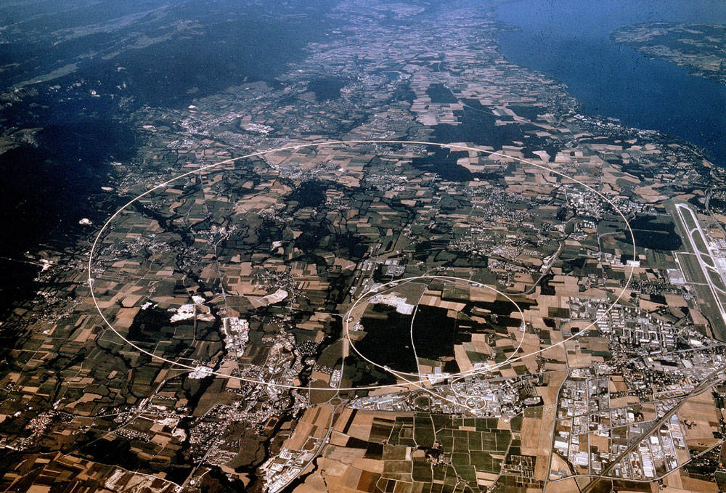
EPPCN MoU
James Gillies, EPPCN, November 2012

Slide 3
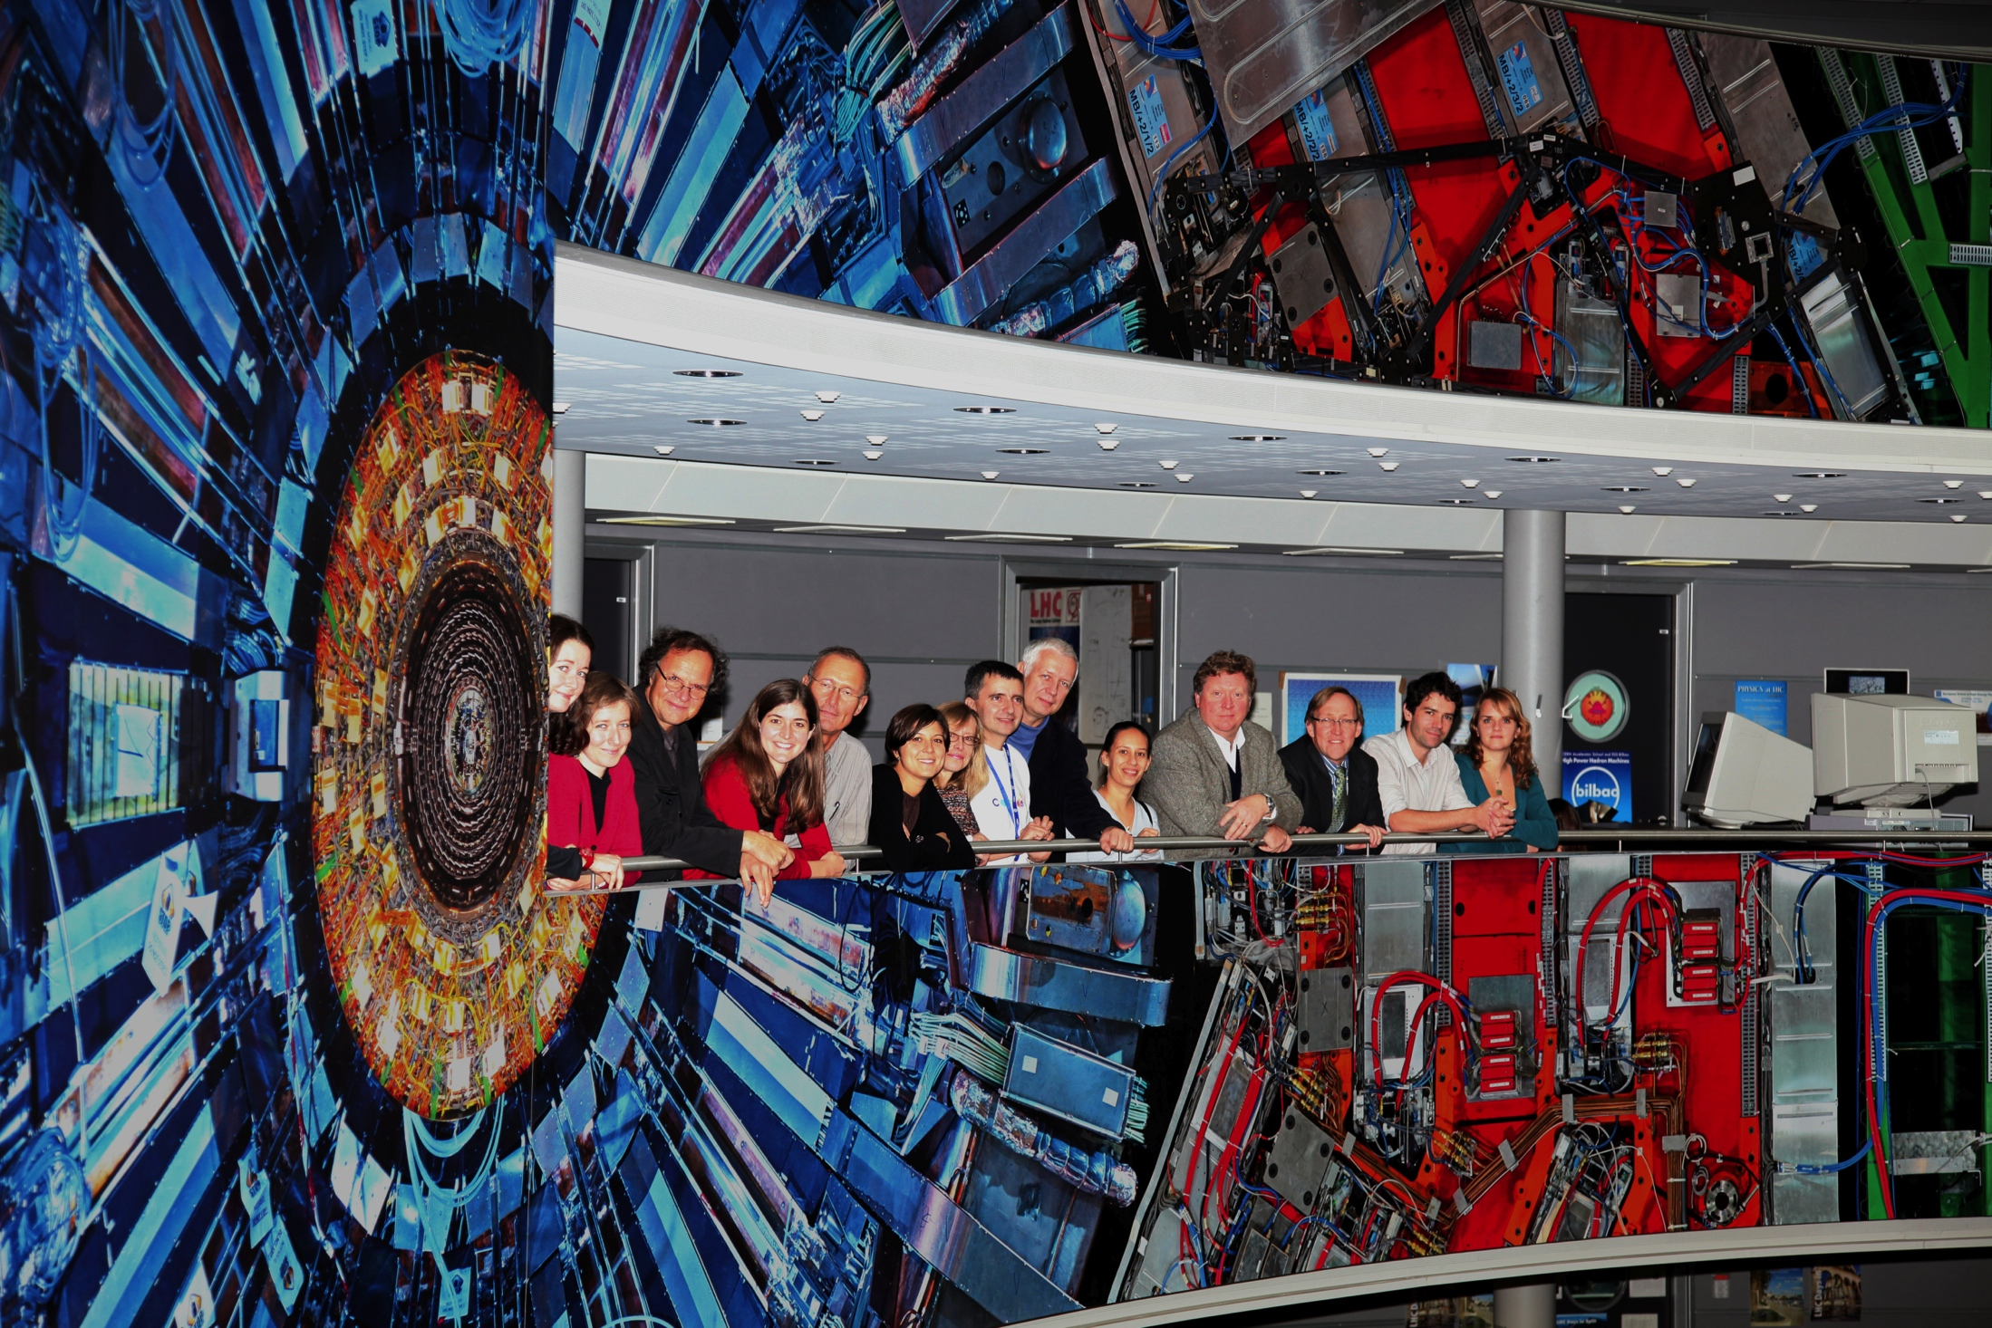
Motivation…
To formalise the network
To provide a modest discretionary budget for members

Slide 4
Key points…
The EPPCN Member acts as CERN’s communication point of contact in the Member State in which he/she resides, with the aim of promoting CERN’s mission and demonstrating the importance of CERN at the national level.
The EPPCN Member shall be expected to perform the following:
Be a point of contact for national target audiences (including media, public, opinion leaders);
Show the national benefit of CERN membership (scientific, industrial, societal);
Translation, adaptation, distribution and promotion of press releases where appropriate;
Occasional proof-reading/checking of translations done by third-party;
Provide regular updates for the national mini-sites under cern.org;
Contribute to the EPPCN report to the CERN Council, presented during each September session;
Provide a short annual activity report prior to the September session of the CERN Council.

Slide 5
Duration…
1 year

Slide 6
Cost…
5kCHF payable on invoice
Brief report required in return

