Slide 2
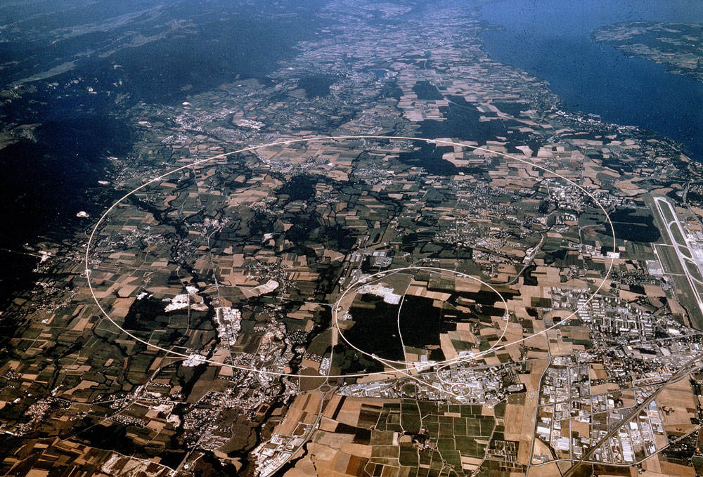
News from CERN
James Gillies, EPPCN, November 2012

Slide 3
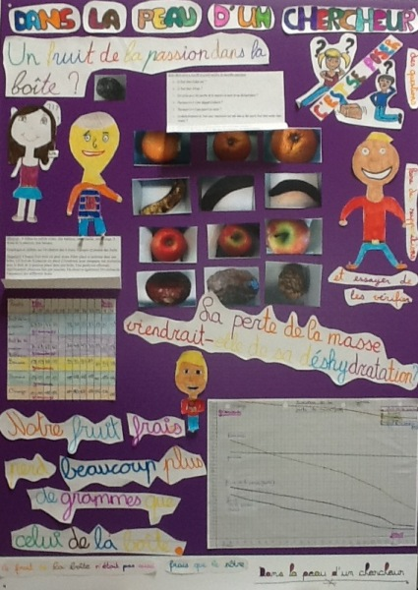
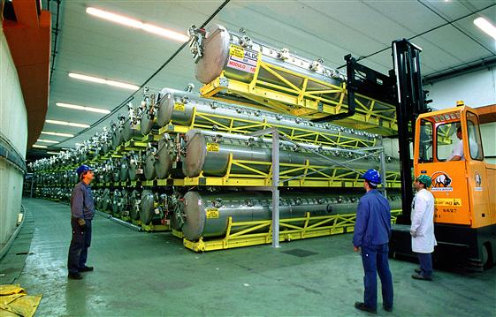
Welcome!
Dans la peau d’un chercheur
MoU valid from next year
4 July debrief – we want to hear from you!
Brussels event – need your agreement and help
Media plan for LS1
LEP cavities – getting there
Stakeholder survey – first results
60th anniversary – one project takes shape
Presentation from ERA
Planning for big conferences
Joint session with IPPOG

Slide 4
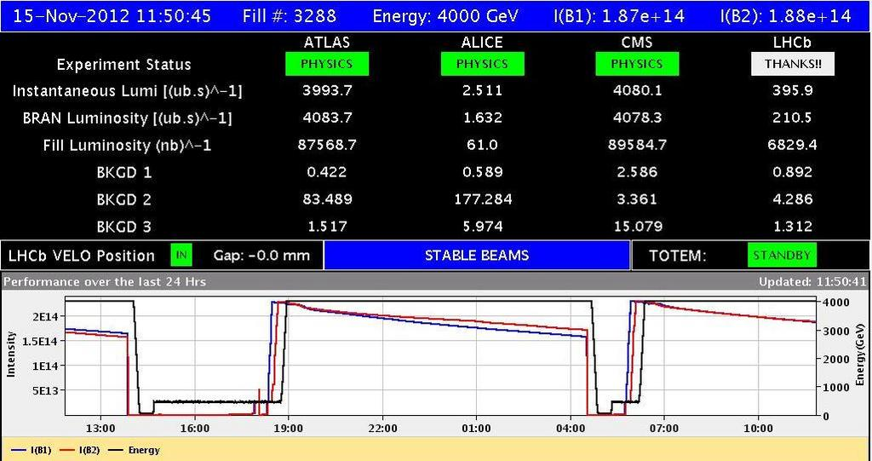
LHC
Delivered 21fb⁻¹ to ATLAS and CMS
Delivered 2fb⁻¹ to LHCb
Runs with protons to December
Runs with protons on ions to February
LS1 starts 11 March

Slide 5
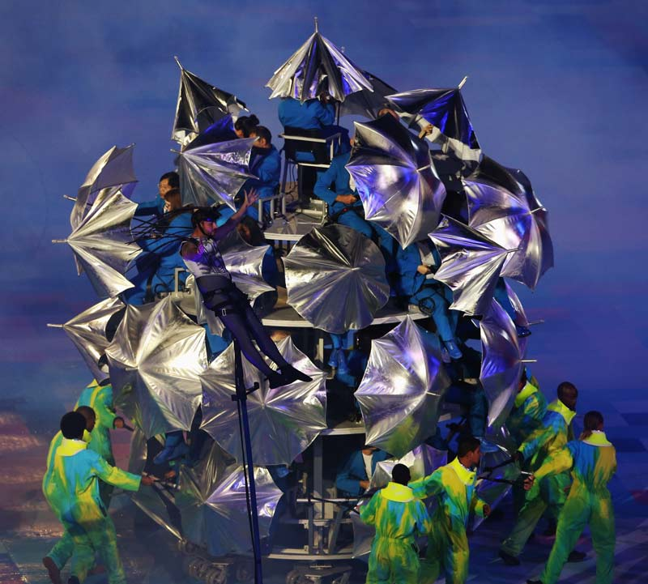
Olympics…
‘The Large Hadron Collider at CERN is the largest most complex machine in the world, possibly the universe. By smashing particles together at enormous energies,
it recreates the conditions of the Big Bang. The recent discovery of what looks like the “Higgs particle” is
a triumph of human endeavour and international collaboration. It will change our perception of the world and has the potential to offer insights into a complete theory of everything.’
^{Stephen Hawking}
Ian McKellen: The greatest adventure is what lies ahead.

Slide 6

Some people can teach elephants to dance…

Slide 7
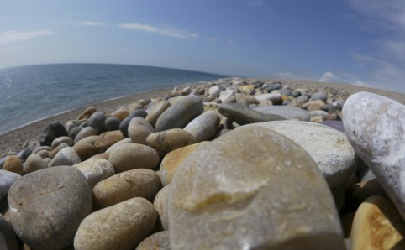
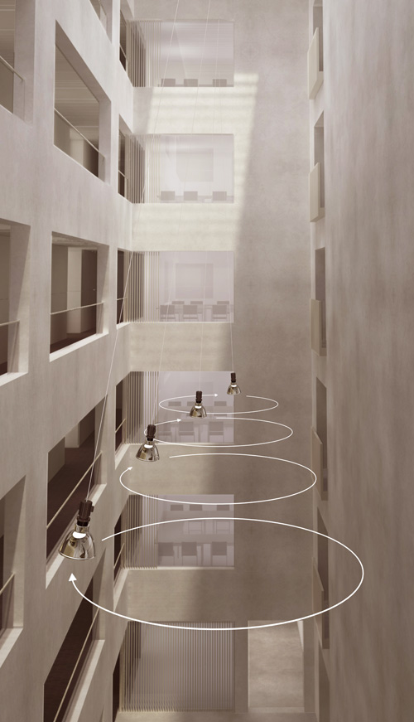
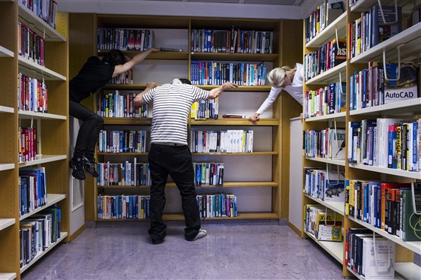
Collide@CERN
Julius von Bismarck
Gilles Jobin
Next:
Jobin-Von Bismarck co-production
ARS Electronica: Bill Fontana
Geneva: Film – call to be announced on Monday

Slide 8
Member Status
Israel – Associate Member in pre-stage to Membership
Serbia – Associate Member in pre-stage to Membership
Cyprus – (Associate Member in pre-stage to Membership)
Incase anyone asks – Turkey is applying for Associate Membership

Slide 9
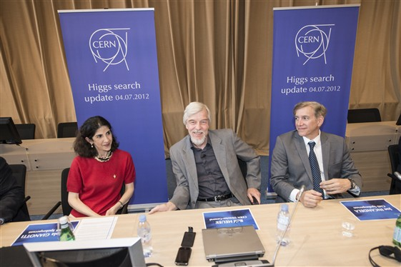
December 13
We won’t be doing this…

Slide 10
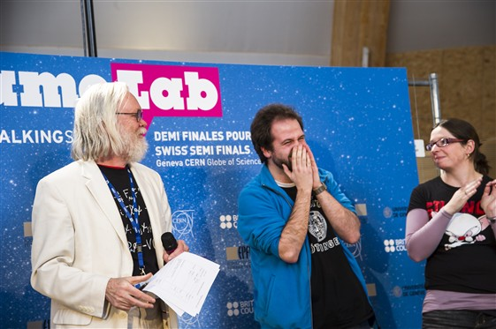
March 16
We will be doing this…

Slide 11

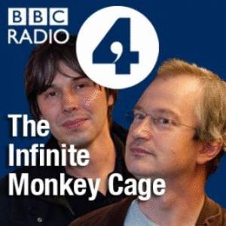
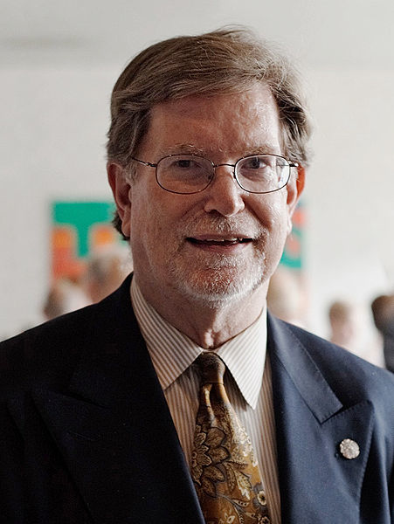
May 3 2013, 16:00-20:00
Help please!!
Organize a live event. Contact is Claudia.Marcelloni@cern.ch

Slide 12
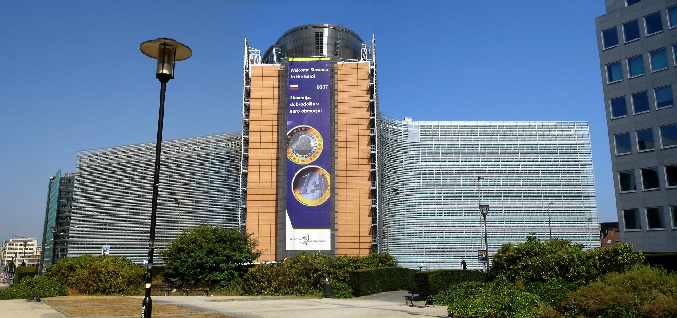
European Strategy update
May 21-24

Slide 13
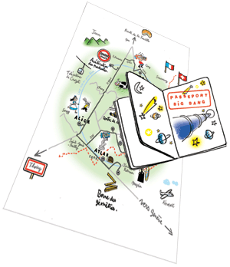
Passport Big Bang
June 2

