Slide 1

This project is the result of close collaboration between five entities from Geneva and the neighbouring area of France: the University of Geneva, CERN, the Department of Education of the Canton of Geneva, the French Education Ministry and PhysiScope.
For CERN : Sandrine Saison-Marsollier
Educational officer for local communities

Slide 2


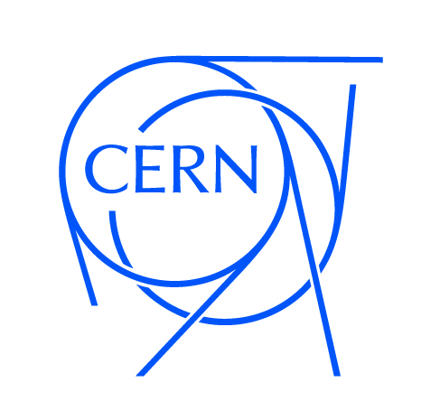

Five institutions :
« Avec le soutien du Service de la Coordination
Pédagogique de l'Enseignement Primaire".

Slide 3
An educational project for 9 to 12 years old pupils (About 1500 students since 2011)
Keywords:
Investigative procedure
Meetings between scientists and pupils Collaboration
Matter
Mystery boxes

Slide 4
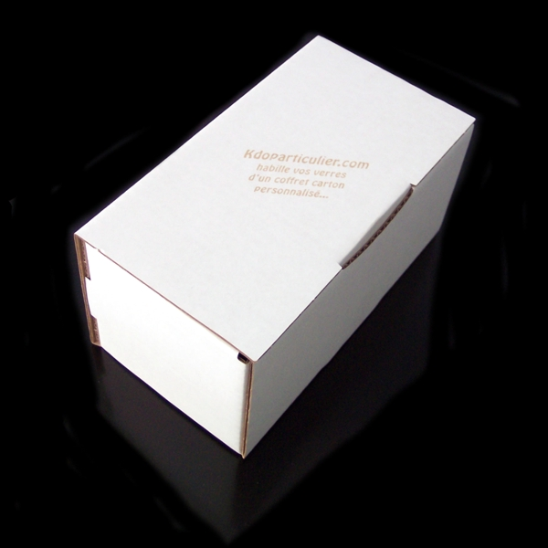

One analogy
Box
=
Matter

Slide 5
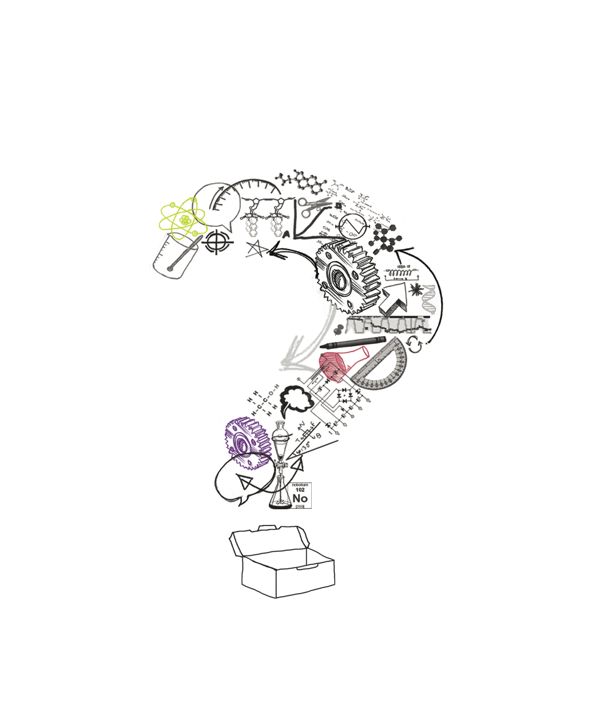
Pupils have to determinate what’s in the box without opening it.

Slide 6
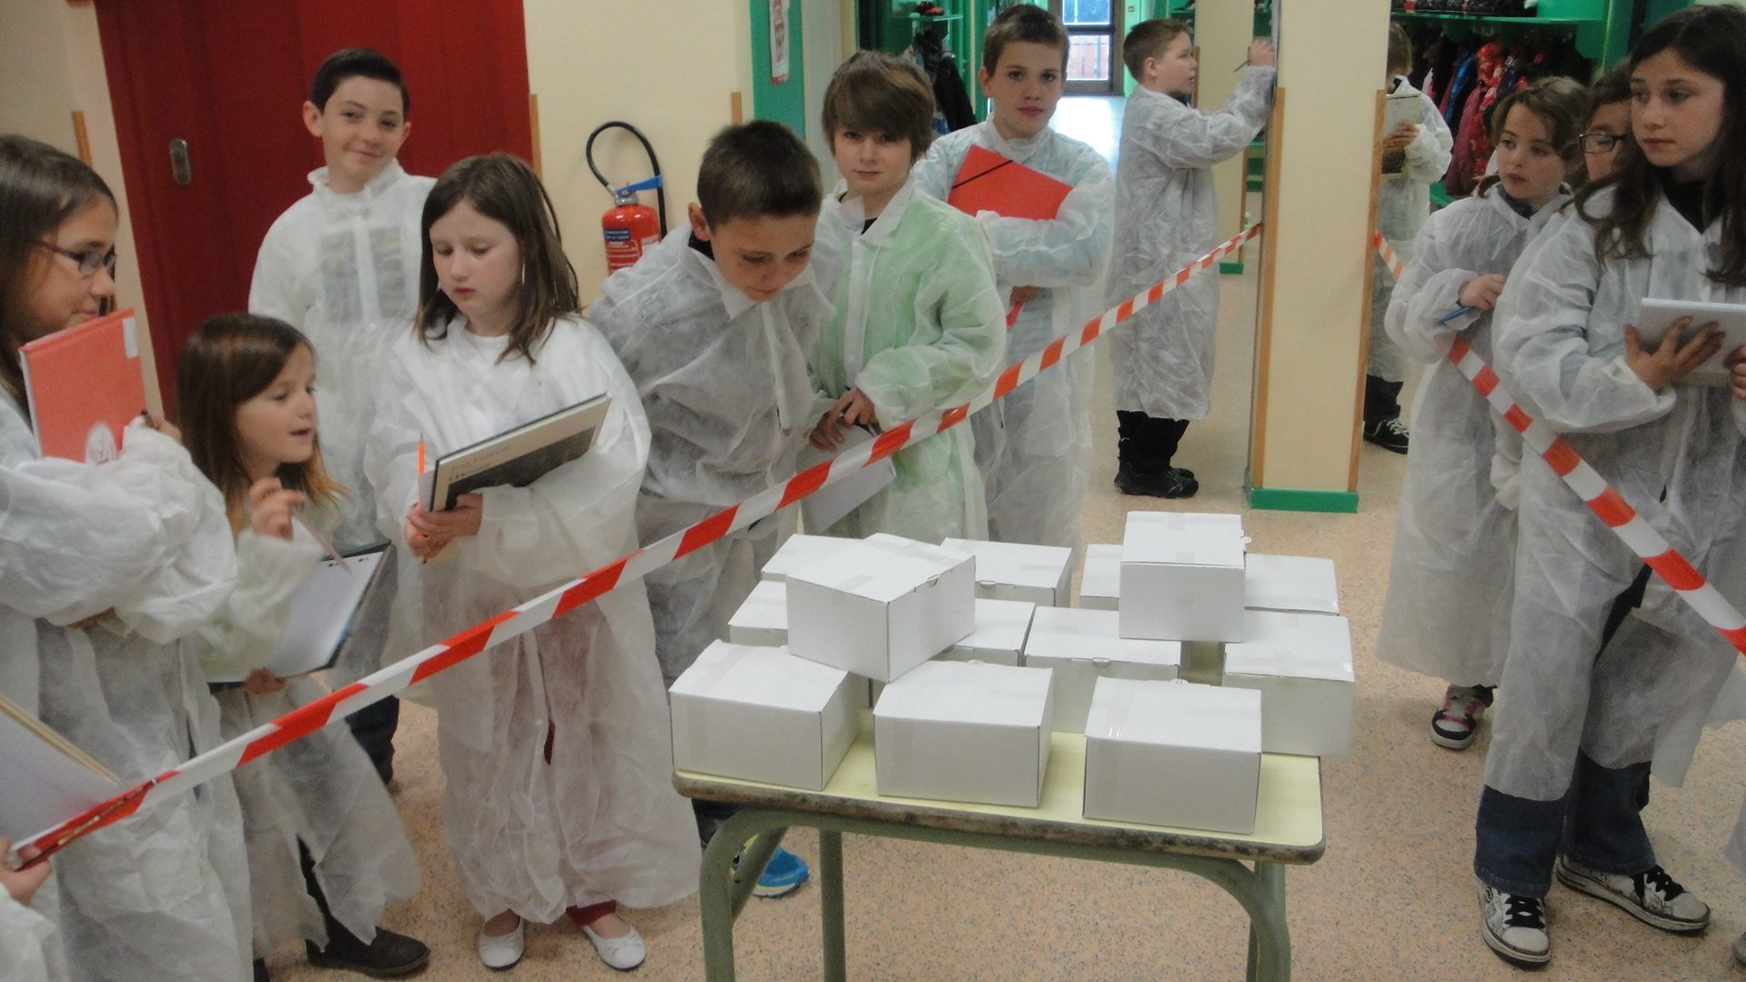

Slide 7
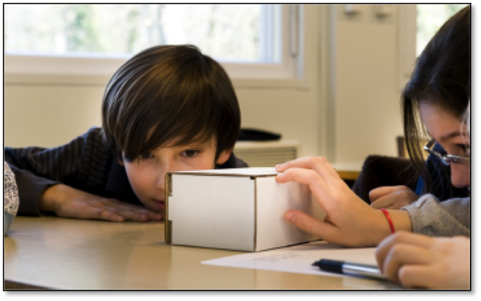
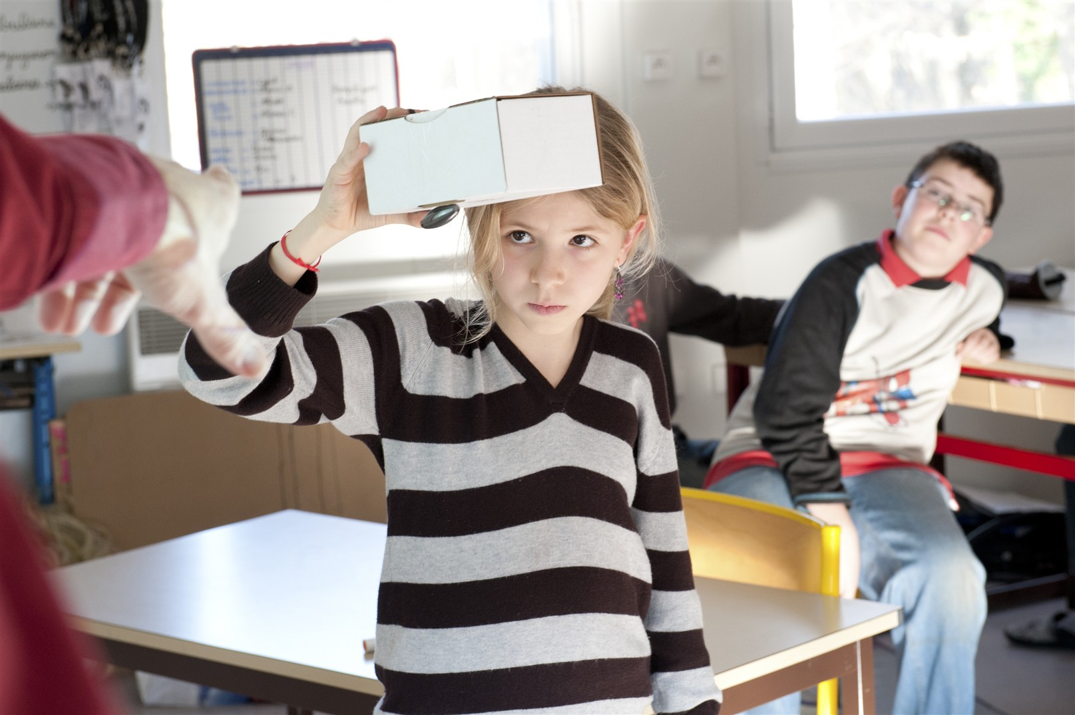
Two teachers’morning training
Investigations in the classroom
A visit to a science lab
An interview with researcher
A final conference and an exhibition of posters

Slide 8
2012’s Boxes

Slide 9
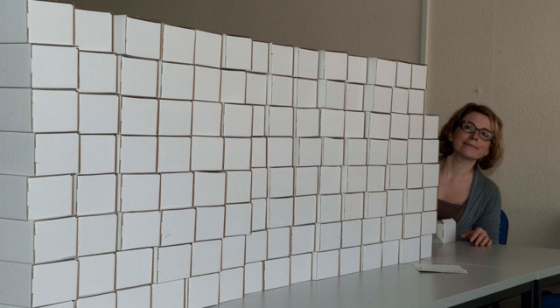
250 mystery boxes:

Slide 10
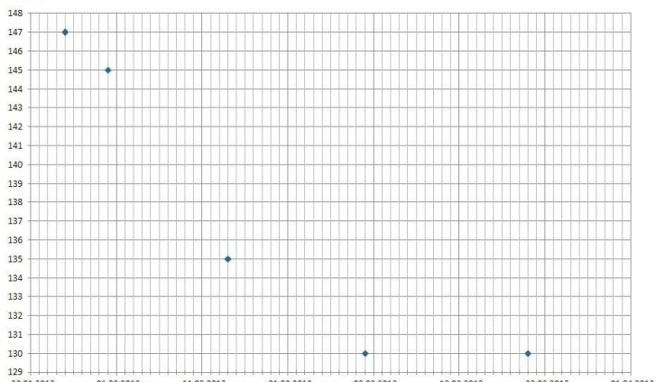
Weight evolution of the box with time:

Slide 12
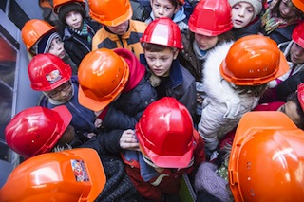
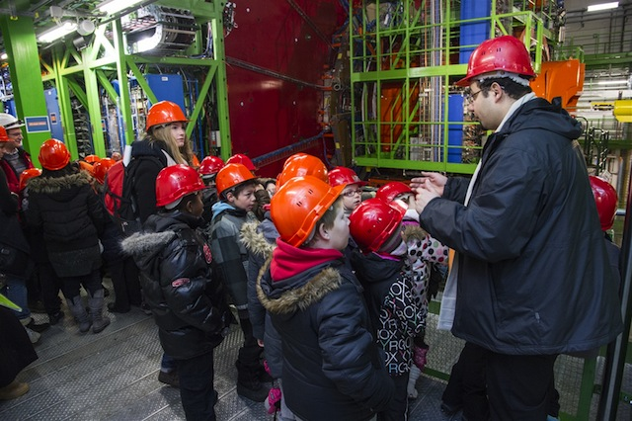
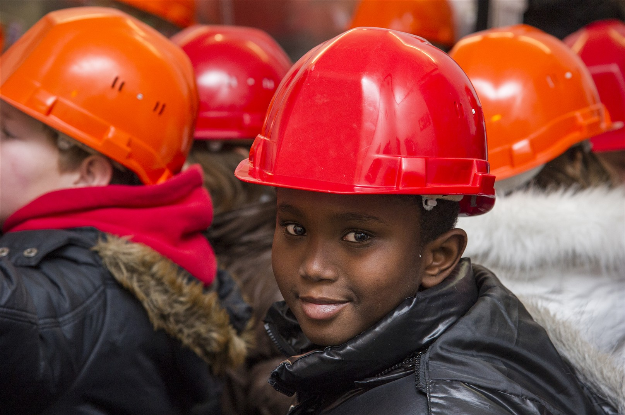
Visits:

Slide 13
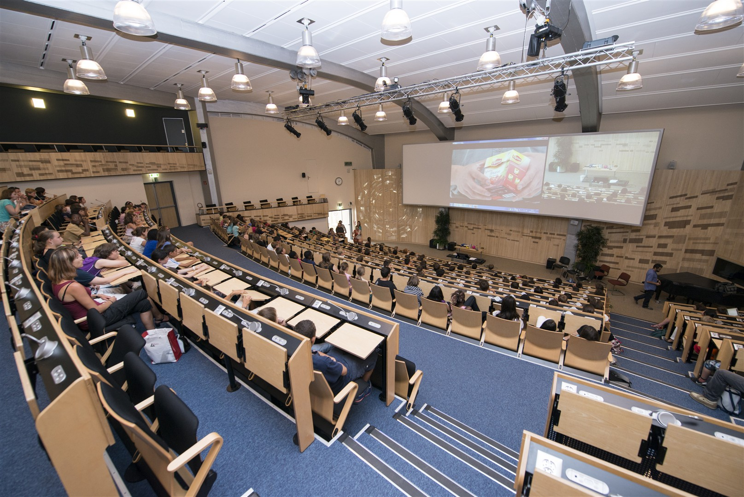
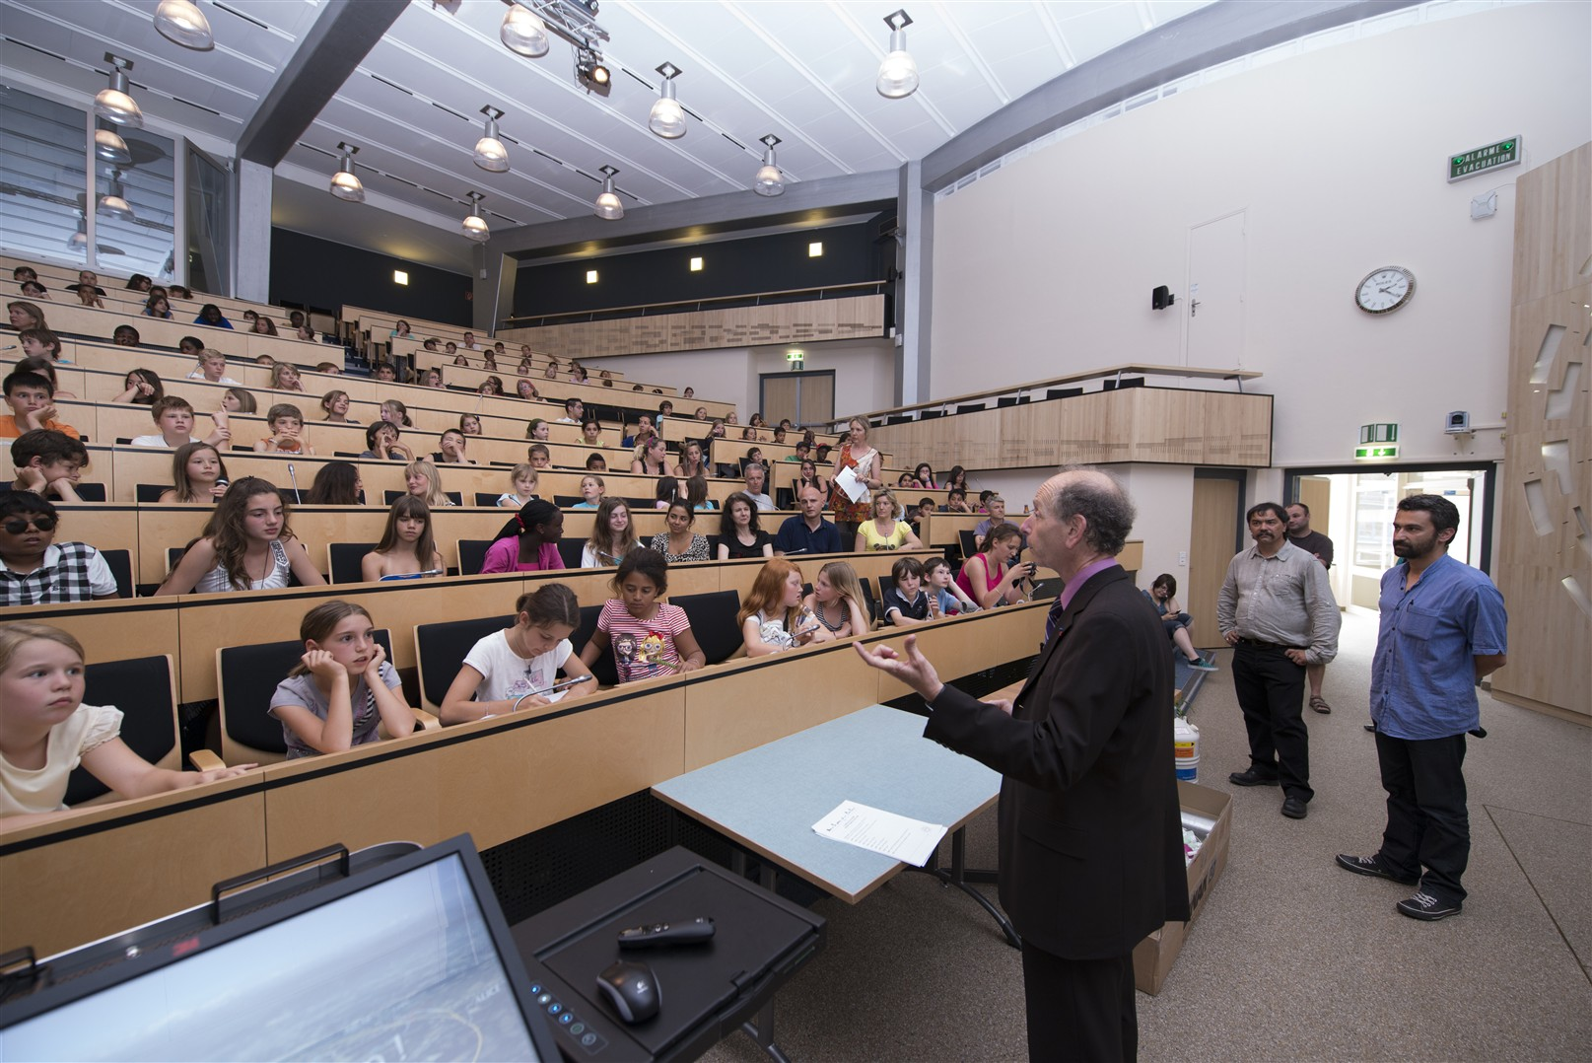
The conference

Slide 14
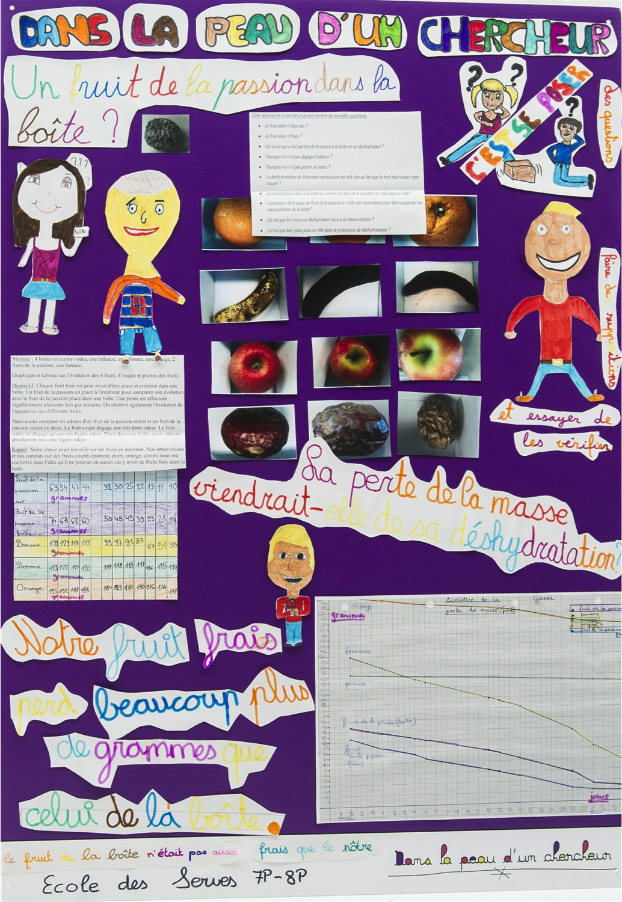
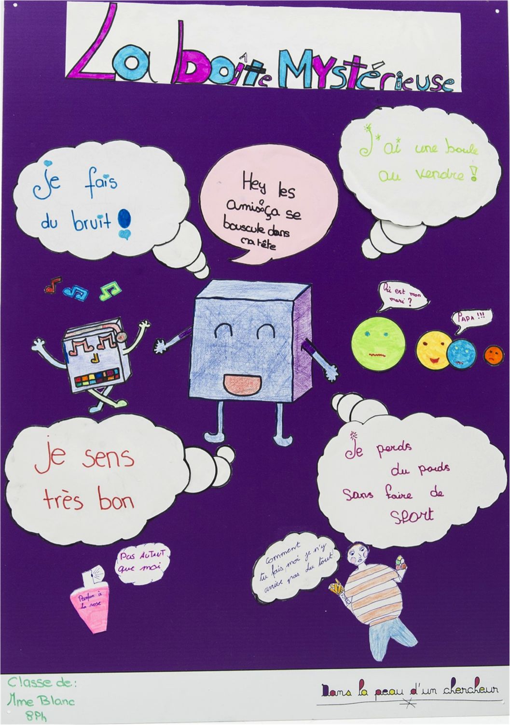
Posters session

Slide 15
Goals of this project:
  Tradition of openness
  Educational mission
  Promote science and scientific careers in:
        Showing science in the making
        Involving young people experience

Slide 16
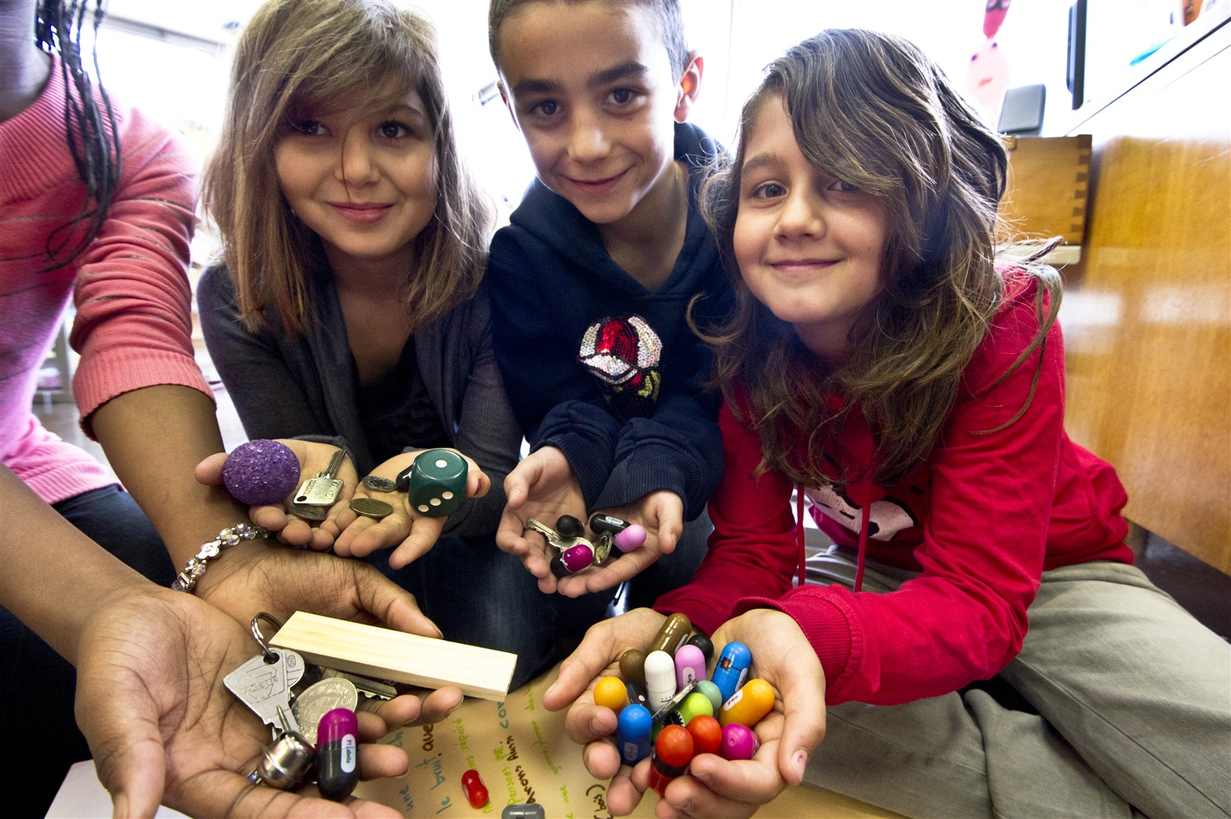
Some interest for this project?
Some propositions?

Slide 17
Available Tools:
One kit with:
5 boxes with objects inside
5 empty boxes for experiment
One book for teachers (nearly in English and Spanish)
peau.chercheur@cern.ch

Slide 18
THANK YOU!

