Slide 1
CMS Activities for 4th July 2012

Slide 2
CMS Activities for 4th July 2012
Prepared “CMS Statement” giving details on the result
  Translated into 24 languages by CMS collaborators in 1-2 days
  For the Press, but also for CMS Collaborators who would talk to the press!
Prepared static and animated event displays of Higgs candidates
Uploaded event displays, plots, photos to CDS
Participated in production of explanatory videos (e.g. CERN News, “What is the Higgs?” etc.)
Prepared texts to explain things such as “blinding”
Prepared CMS physicists to talk to the press/public/teachers, at CERN and at ICHEP
Used Social Media before/during/after seminar

Slide 3
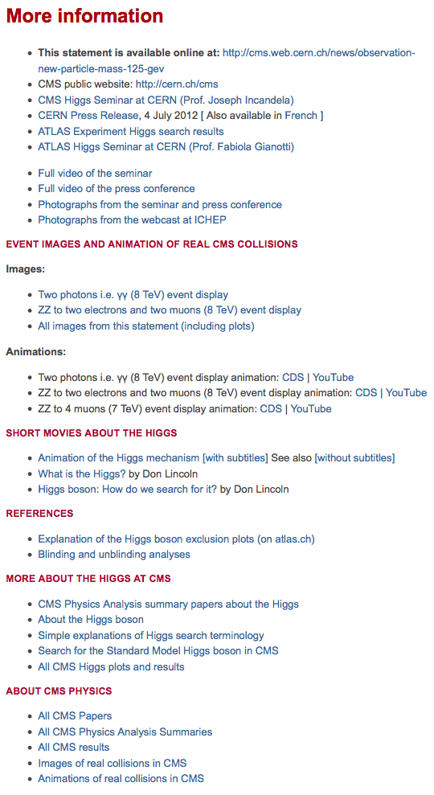
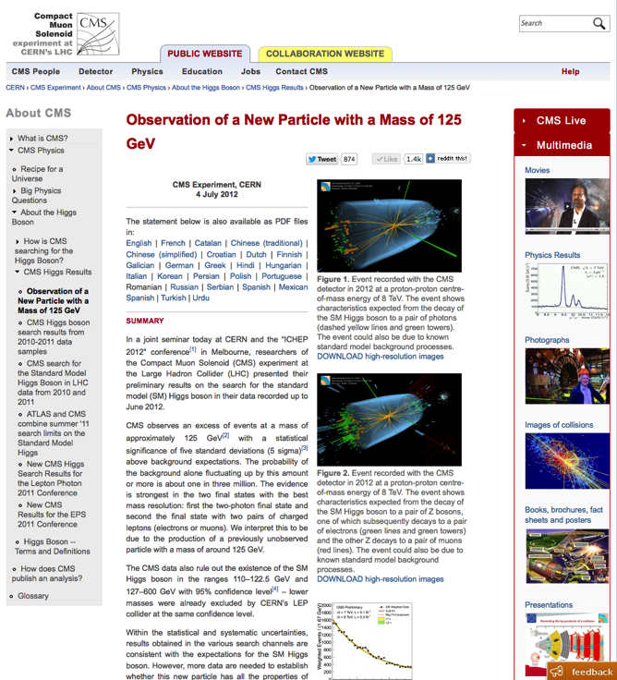
Prepared material
CMS Statement articles, images, videos, links …
65,000
Downloads of the CMS statement in
24
Languages
6,600
Press articles used text from the CMS statement
124,000
Web pages viewed
(in week of seminar)
http://cms.web.cern.ch/news/observation-new-particle-mass-125-gev

Slide 4
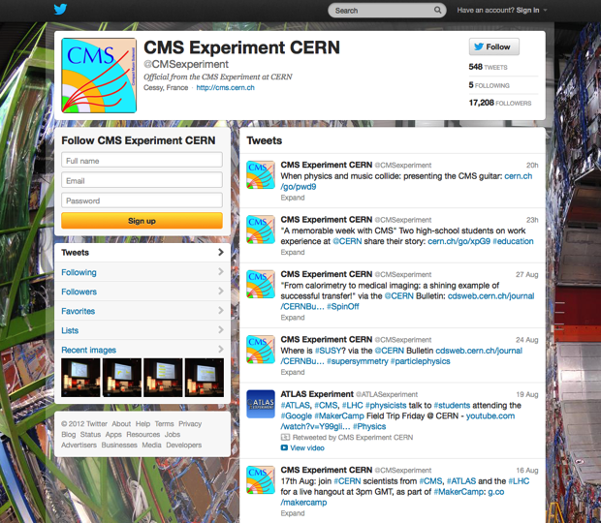
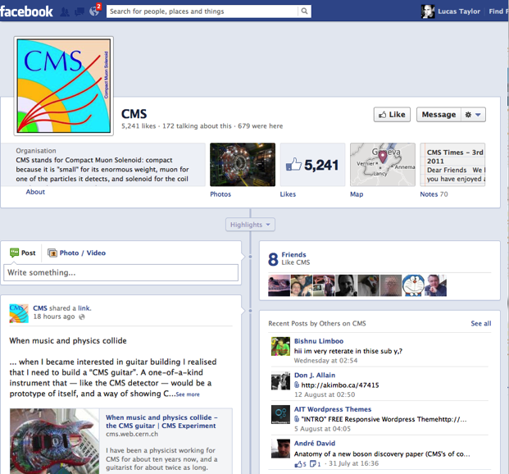
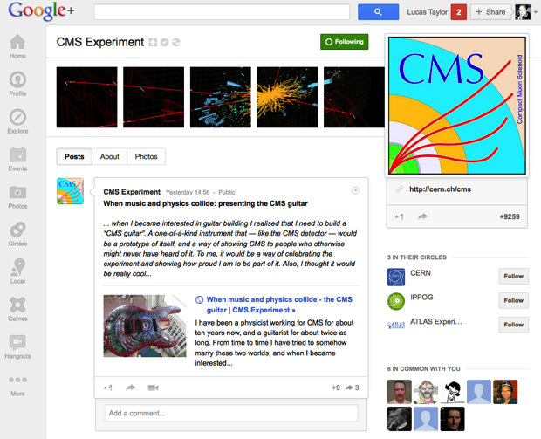
CMS made effective use of social media
http://www.facebook.com/CMSexperiment
https://twitter.com/CMSexperiment
5.1 million
people on Twitter received the CMS announcement:
“ We have observed a new boson […] ”
https://plus.google.com/+CMSExperiment/posts

Slide 5
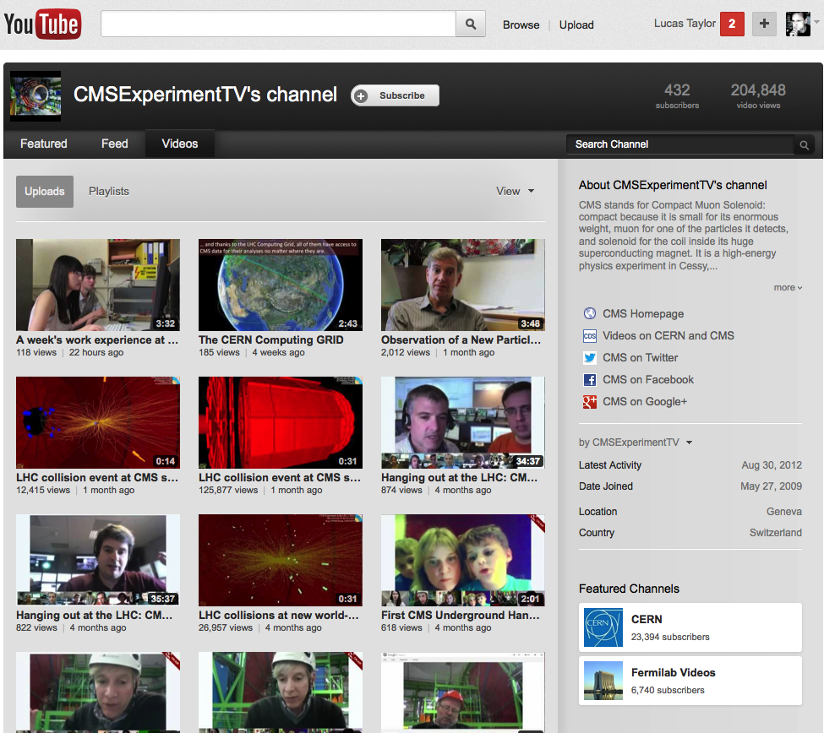
136,000
YouTube views of CMS collision animations
http://www.youtube.com/user/CMSExperimentTV/videos

Slide 6

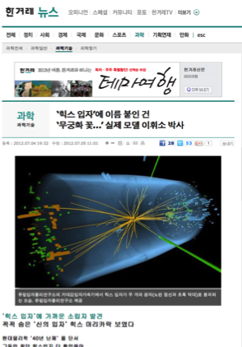
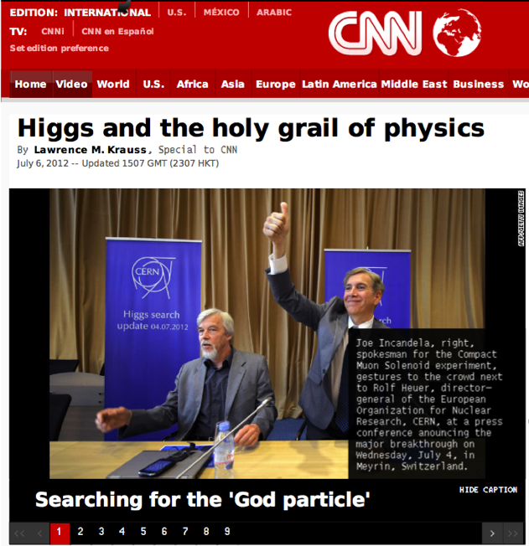
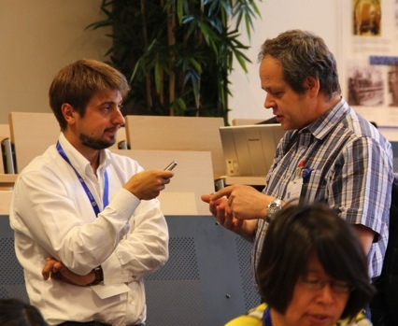
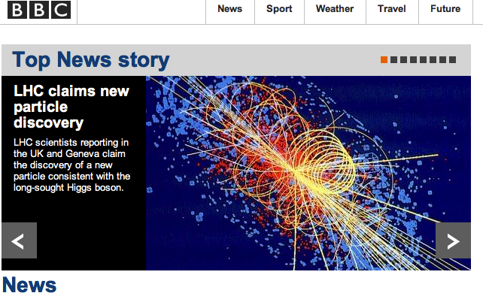
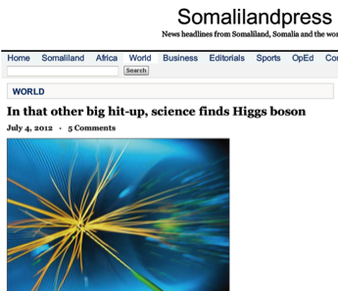
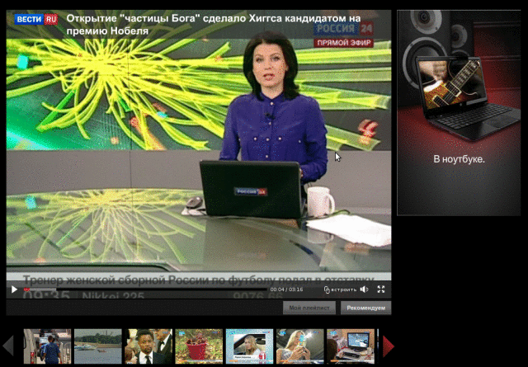
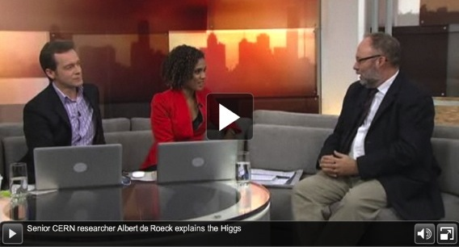
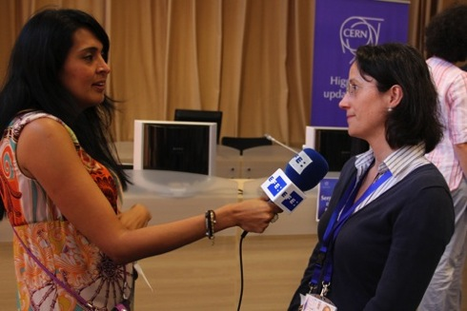

Slide 7
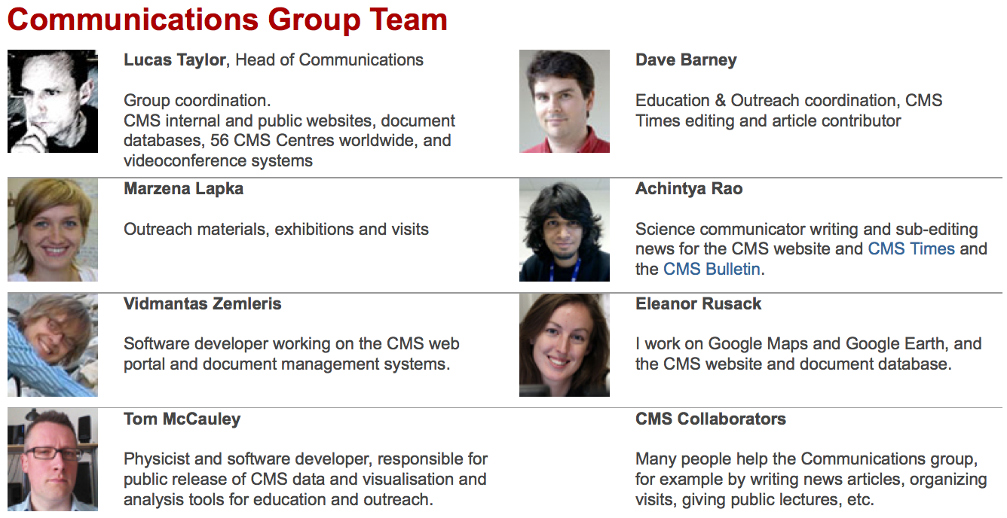
Many thanks to everybody in CMS who helped!
See the full media report on the 4th July seminar
https://cms-docdb.cern.ch/cgi-bin/PublicDocDB//ShowDocument?docid=6469

