Slide 2
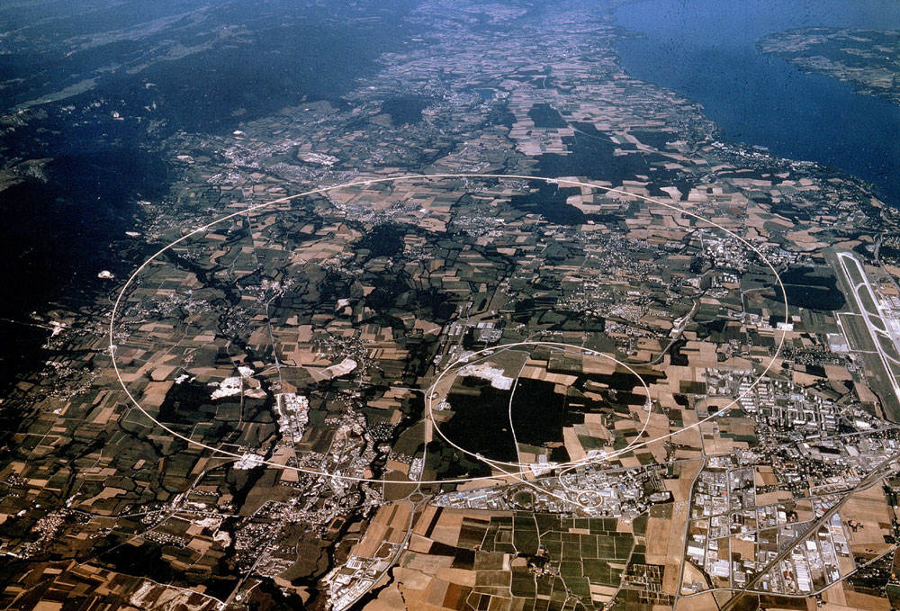
Higgs Update Seminar Debrief
James Gillies, EPPCN, November 2012

Slide 3
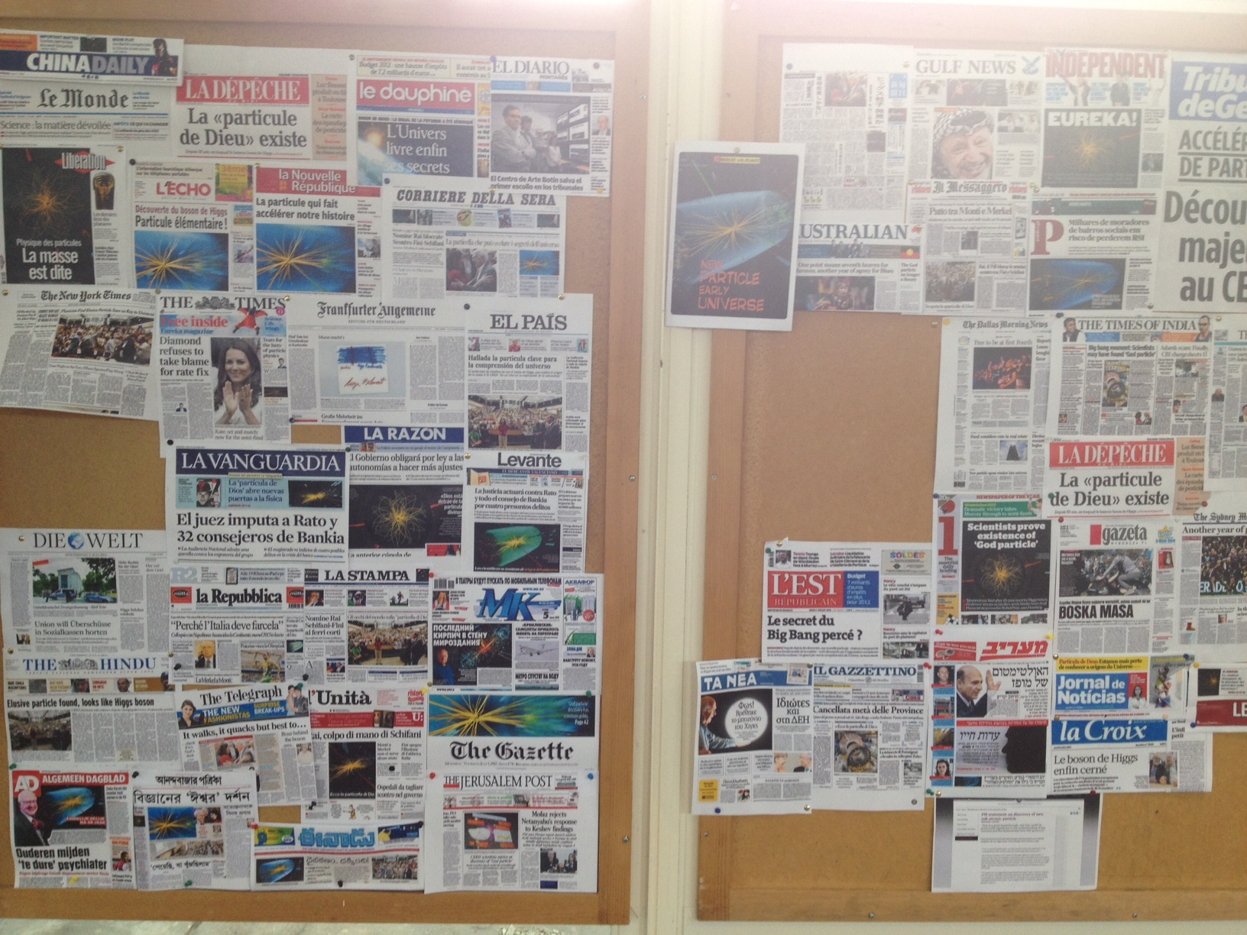
Global media coverage…
88 journalists representing 55 media
11 news agencies
1034 TV channels used footage
5016 news broadcasts
(2008: 550/3500)
17000 cuttings from 27 June – 10 July

Slide 4
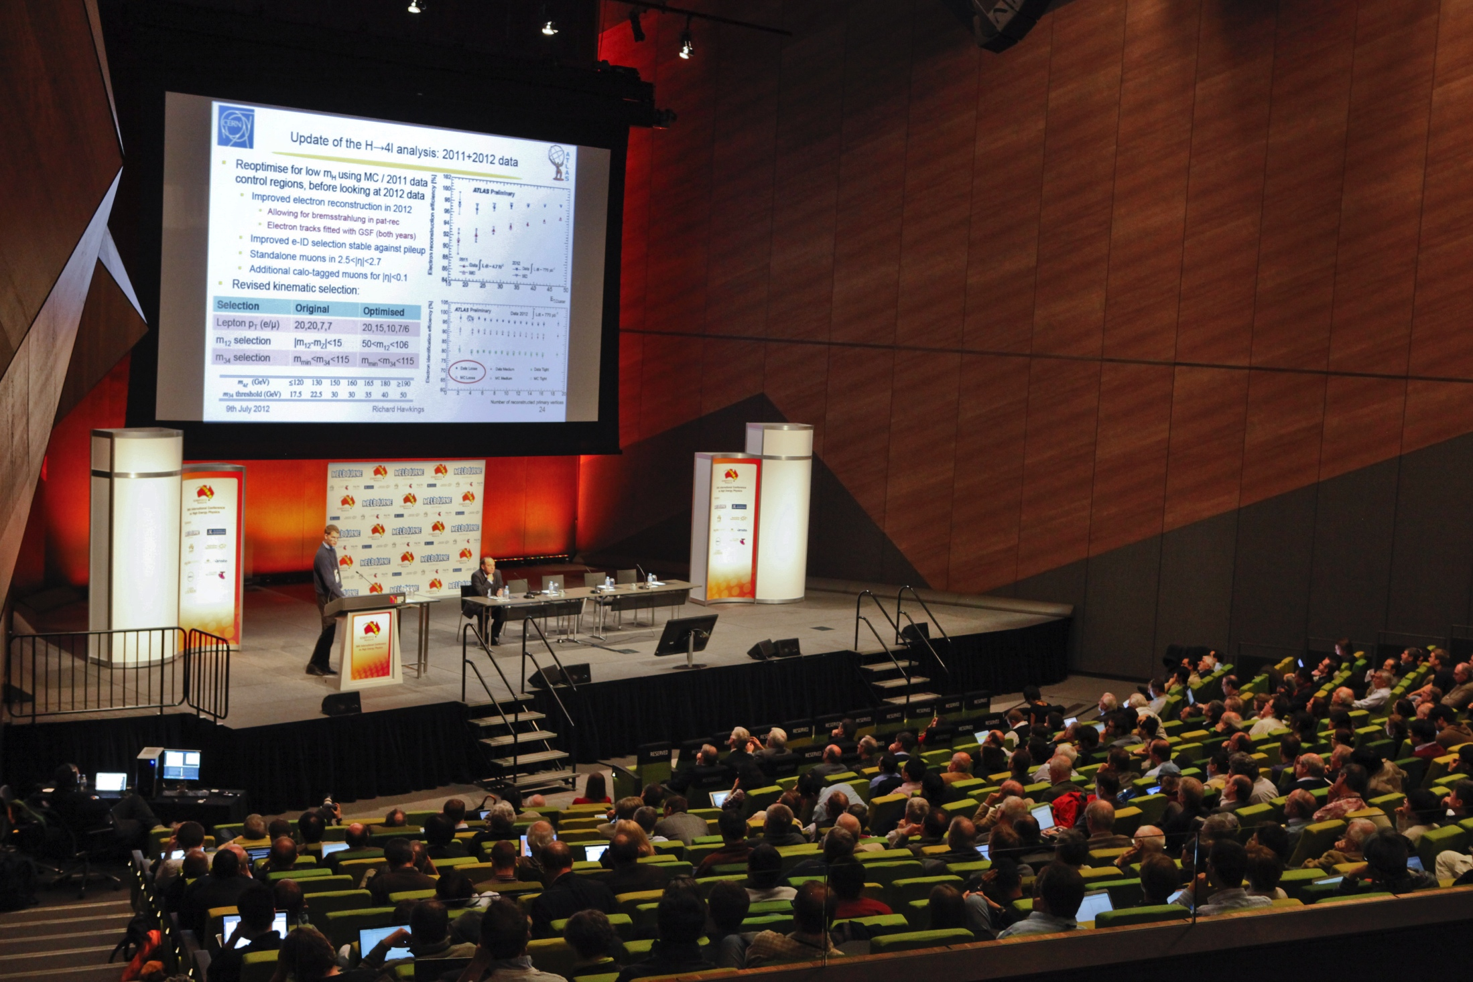
Global public coverage
Close to 500,000 IP connections to webcast
60,500 simultaneous
150 institutes guaranteed high quality connection
Estimated audience 10,000
Two-way connection to ICHEP in Melbourne

Slide 5
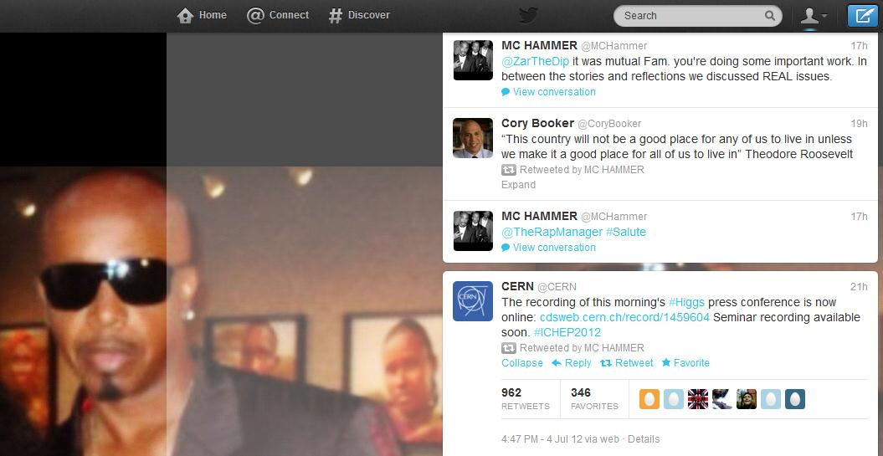
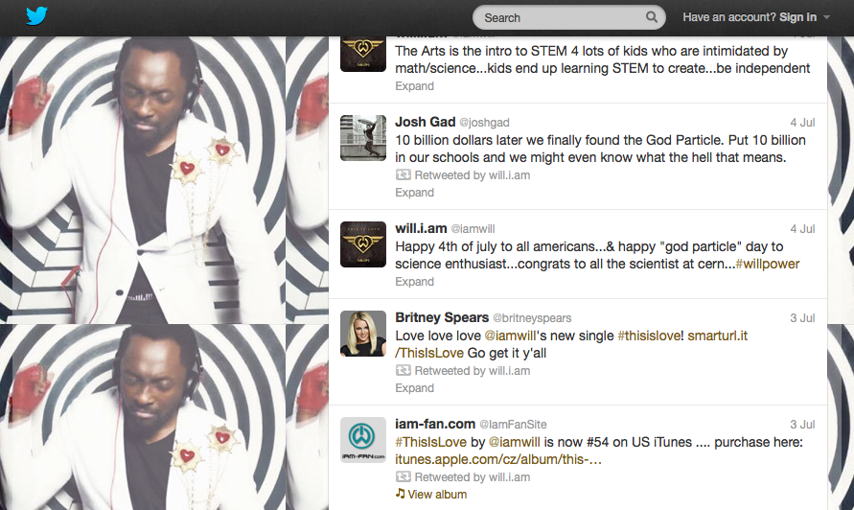
Global social media coverage
Live blogs, tweets
Chat room
Announced with webcast

Slide 6
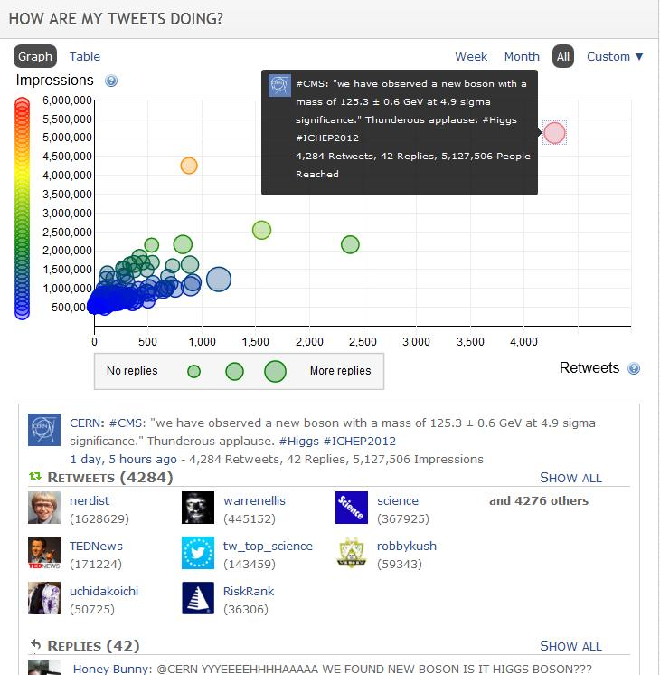

Slide 7
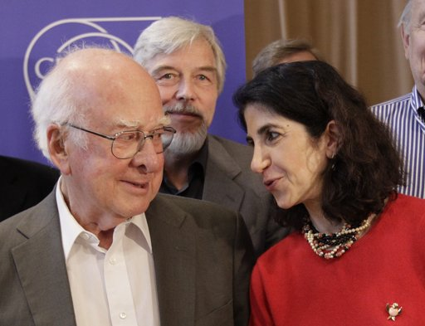
Most startling fact ?
This event was put together in 7 working days
Doing our science in public has become the norm for CERN

Slide 8
Lessons learned…
We need to be more systematic at linking scientists with journalists on site – set up media desk.
Provide permanent accreditation for the regulars.
Don’t trust the technology (video made public by ‘feature’ of CDS).
We’re winning the argument that we can trust key media outlets and should pre-brief them on important news.
Not ‘owning’ the star turn complicates matters.

Slide 9
Feedback from media…
“It created a fantastic feel-good factor and it was great PR for CERN and science in general - so well done for that.”
“But it was a mess.”
“I know the CERN physicists want to hear first. But they don't. It's always all over twitter, it's always all over the wires it's always on serious news websites (apart from ours because we play the game) and all your trusted officials always leak it before the seminars start.”
“As I say my message to Rolf and co is ‘in future listen to James Gillies and do everything he says’.”

Slide 10
How was it for you?

