Slide 1
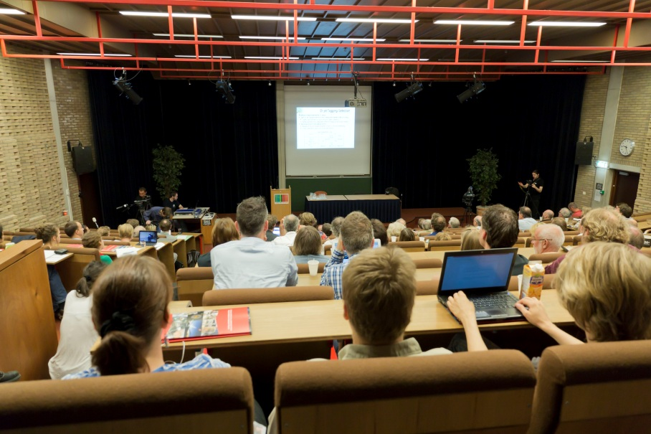
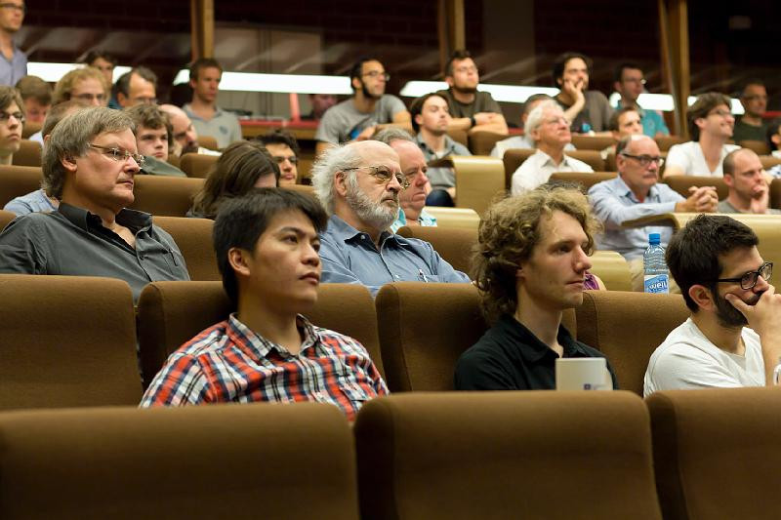
Nikhef on 4 July 2012
Webcast of CERN Higgs seminar at Nikhef
( more than 200 people attended / Nikhef researchers and media)
Nikhef press release with quotes (in Dutch)
including parts of CERN press release (in English) + link to CERN

Slide 2
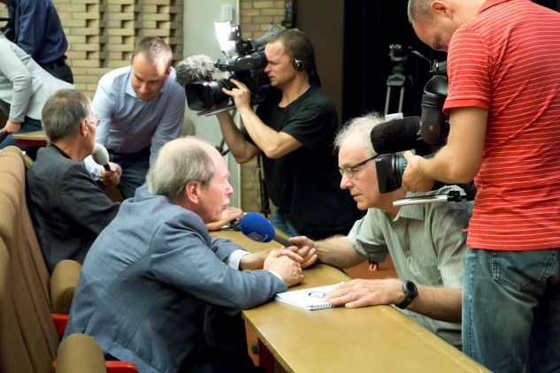
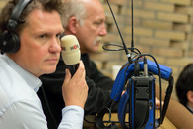
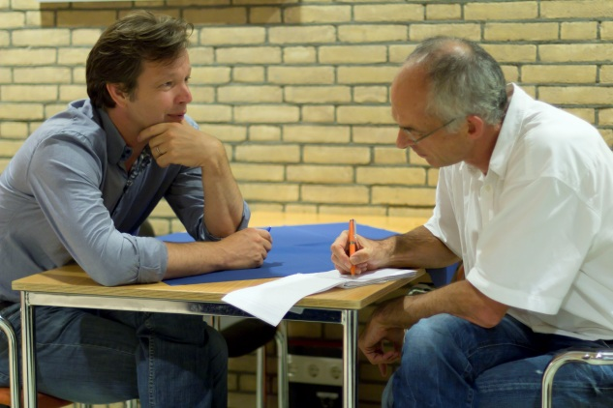
Media attendance on 4 July 2012
All Dutch media invited (print, radio, TV)
Media attendance of Higgs event at Nikhef:
  TV: 5 camera teams
  Radio: 1 live radio reporter, around 10 more by phone
  Print: around 15 journalists

Slide 3
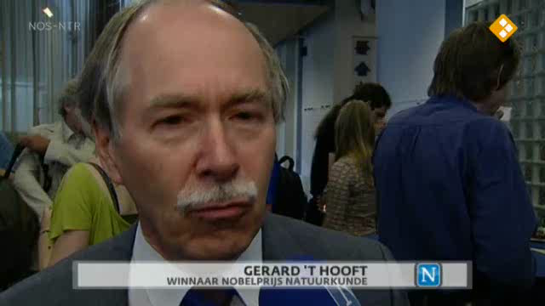
Media Coverage of Higgs Event
6 different TV channels/programmes (namely all main Dutch news programmes)
10 different radio channels/programmes
all of them with coverage from Nikhef and Nikhef-people
also updated version of Higgs documentary shown on TV

Slide 4
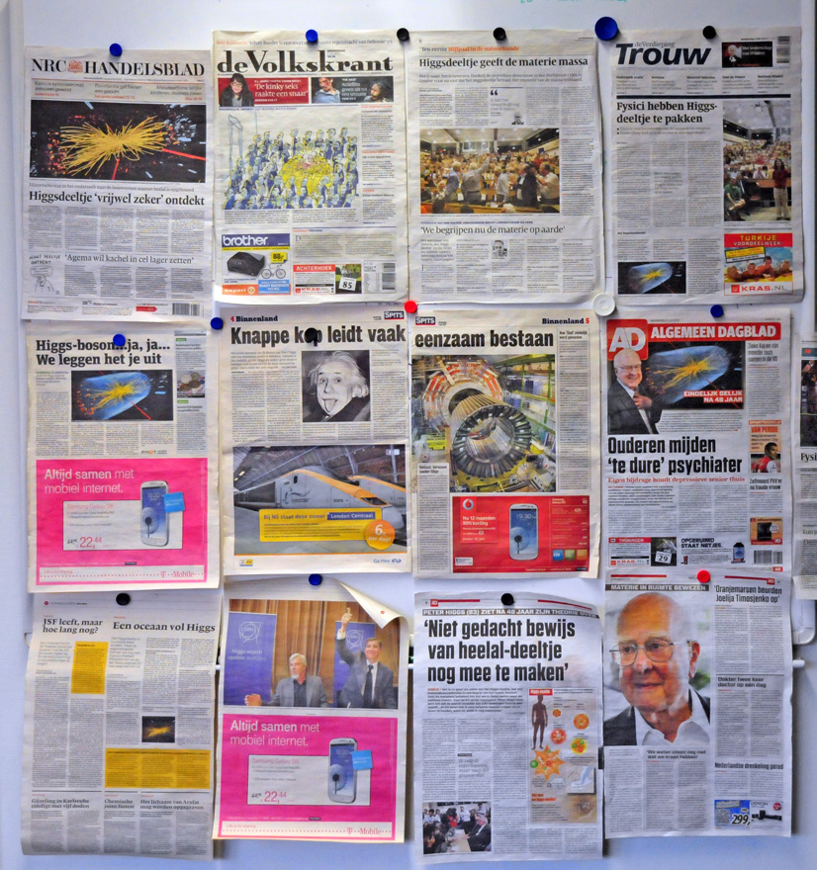
Media Coverage of Higgs Event
more than 80 articles
in Dutch newspapers
about 20 of which
with interviews/quotes
from Nikhef-researchers

Slide 5
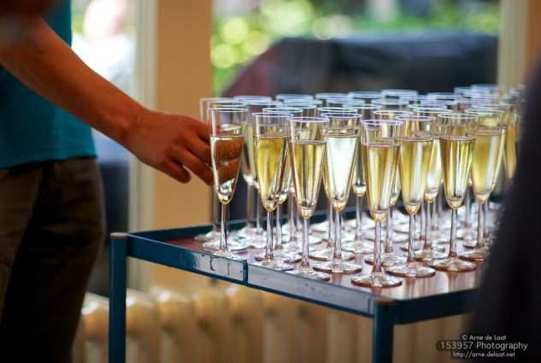
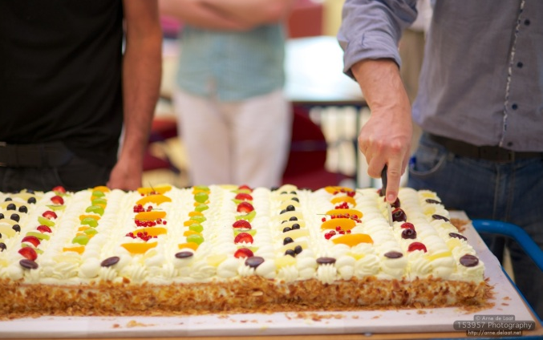
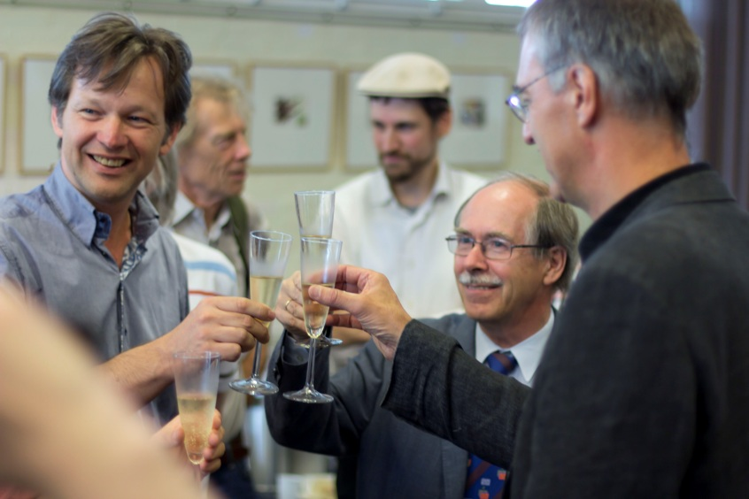
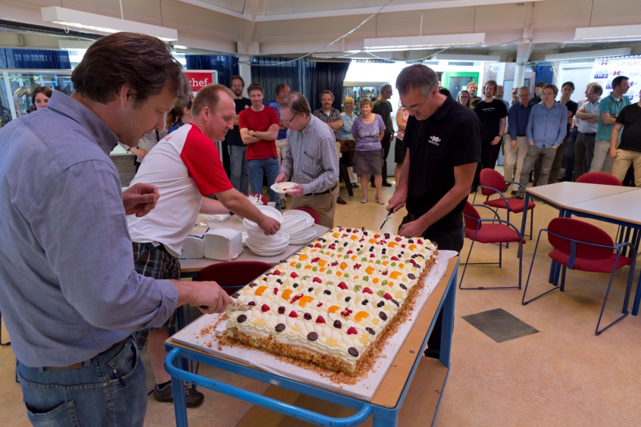
Higgs Celebrations at Nikhef
Champagne & Cake
for everybody

Slide 6
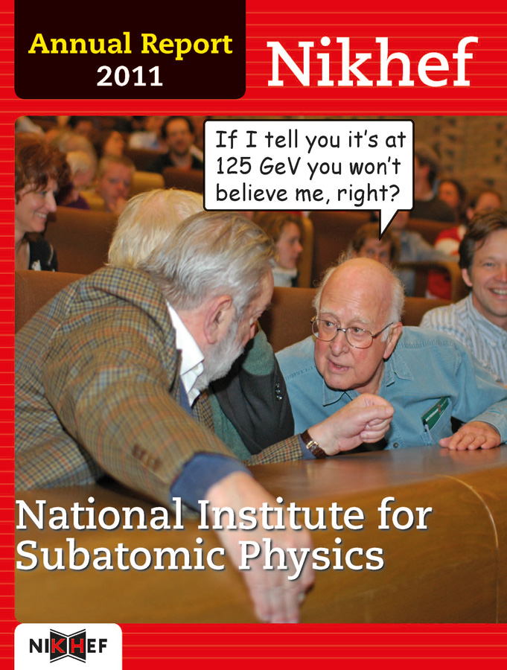
Appendix:
Cover of Nikhef Annual Report 2011

