Slide 1
Operations Coordination Team
Maria Girone, CERN IT-ES
Kick-off meeting
24th September 2012

Slide 2
Background & Mandate
Proposal for creating a WLCG Operations Coordination Team was presented and approved in July 2012
  Two long term teams were proposed out of the TEG process (Operations Coordination and Networking). Smaller scope transient teams were also proposed
    There should be strong interactions between the teams
This team will build on the existing experience to
  understand what services are actually needed;
  monitor health;
  negotiate the configuration, upgrade and roll-back;
  commission new services
  help in transition when services are decommissioned
  ensure and strengthen communication to sites

Slide 3
Coordination
Emphasis on this effort is coordination in scope of WLCG
  There are many operations activities (sites, NGIs, larger grid projects, and the communities)
  Total effort dedicated to the team will be limited
Value of the team will be in facilitating communication and ensuring smooth operations
  Integration and commissioning effort is vital for successful deployment of production quality services, following initial development/prototyping

Slide 4
Computing as a Service
Would like to arrive at a point where
  A small number of well-defined common services would be needed per site;
  Installing, configuring and upgrading these would be “trivial”
  All services would comply to standards, e.g. for error messages, monitoring;
  Services would be resilient to glitches and highly available;
  In case of load (or unexpected “user behavior”) they would react gracefully;
  In case of problems, diagnosis and remedy should be straight-forward and rapid.
A point where sites provide a defined service and experiments use it
  Increased expectations on the stability and quality of the service, but lower expectations on the need for customization and interaction

Slide 5
Team & Roles
Key body: core members + targeted experts from sites / regions, experiments and services
  Experiments representatives: M. Litmaath (ALICE), A. Klimentov & Ueda (ATLAS), I. Fisk & O. Gutsche (CMS), M. Cattaneo & S. Roiser (LHCb)
  Site/regions representatives: G. Merino (PIC), J. Coles I. Collier, A. Forti (GridPP), L. Dell’Agnello (CNAF), R. Santana (ROC-LA)
  Tiziana Ferrari (EGI/NGIs operations), OSG?
  T1 representatives (as for the daily meeting)
Integrate long-term goals with short-term task forces to address specific deployment / de-commissioning issue
  Recommends to the MB specific solutions
Interact with other WGs via representation of team members
    e.g. data federations, networking, information system, security, …

Slide 6
Meetings
Quarterly Operations Planning
  Reviews needs from experiments and sites
  Prepares plans and proposes them to the MB
  Creates and dissolves internal ops task forces
Fortnightly Operations Coordination (more by A. Sciabà)
  Monitors and coordinates on-going operations
  Thursday, 15:30-17:00 CET
  Chairs: M. Girone, G. Merino, M. Dimou, A. Valassi,
    minutes and action list
  Secretary: A. Sciabà, A. Di Girolamo, M. Litmaath,
  Mailing list
Daily Operations

Slide 7
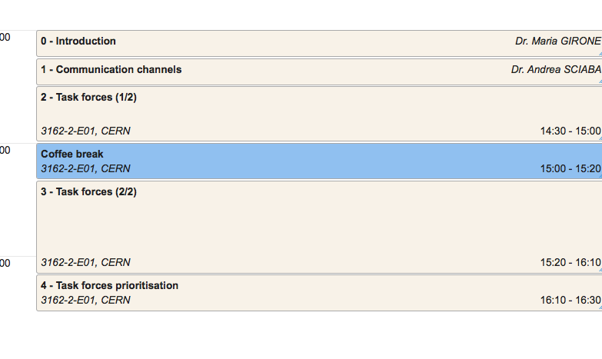
Agenda for the day

Slide 8
Initial Task Forces
Dedicated discussion later on priorities!
Please continue to sign up!!!!
CVMFS deployment completion
  S. Roiser, I. Collier, A. Da Silva (ATLAS), C. Wissing (CMS), …
gLExec deployment completion
  M. Litmaath, A. Di Girolamo, T. Wenaus (ATLAS), I. Sfilgoi and C. Grandi (CMS), S. Roiser, …
PerfSonar deployment
  S. McKee, (ATLAS), S. Campana, M. Zielinski, (CMS), S. Liu (CMS), …
Tracking tools evolution
  M. Dimou, B. Hegner & V. Diez (PH-SPI), H. Dres, G. Grein, O. Gutsche( CMS), Ueda(ATLAS), N. Hoimyr (JIRA), …
Operational aspects of middleware deployment
  M. Litmaath, O. Keeble, T. Ferrari, A. Forti & J. Coles (GridPP), A. Tiradani (OSG interoperability issues) , M. Cattaneo (LHCb), …

Slide 9
Initial Task Forces (2)
Squid monitoring
  D. Dykstra (CMS), S. Roiser, A. Valassi, S. Campana, A. Di Girolamo, A. Beche, …
FTS3 integration and deployment
  N. Magini, A. Di Girolamo, S. Roiser, Hiro, A. Lahif, …
SHA-2 migration
  M. Litmaath, S. Campana (ATLAS), M. Altunay (CMS), …
Xrootd deployment
  S. Campana, R. Gardner (ATLAS), B. Bockelman (CMS) & G. Donvito (CMS), D. Giordano, …
WMS future
  S. Roiser, A. De Salvo, A. Sciabà, A. Di Girolamo, M. Litmaath, …
…

