Slide 1
Elsevier in High Energy Physics
PDG Collaboration Meeting
CERN
Presented by: Eleonora Presani – e.presani@elsevier.com
Date: Saturday, October 06, 2012

Slide 2

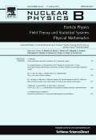
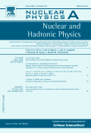

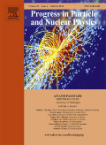




Elsevier in High Energy Physics
Physics Letters B
Nuclear Physics B
Nuclear Physics A
NIM A
Progress in Particle and Nuclear Physics
Physics Reports
Annals of Physics
Physics of the Dark Universe

Slide 3
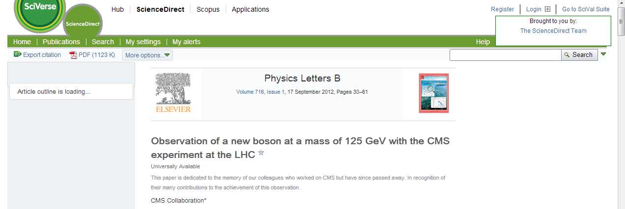
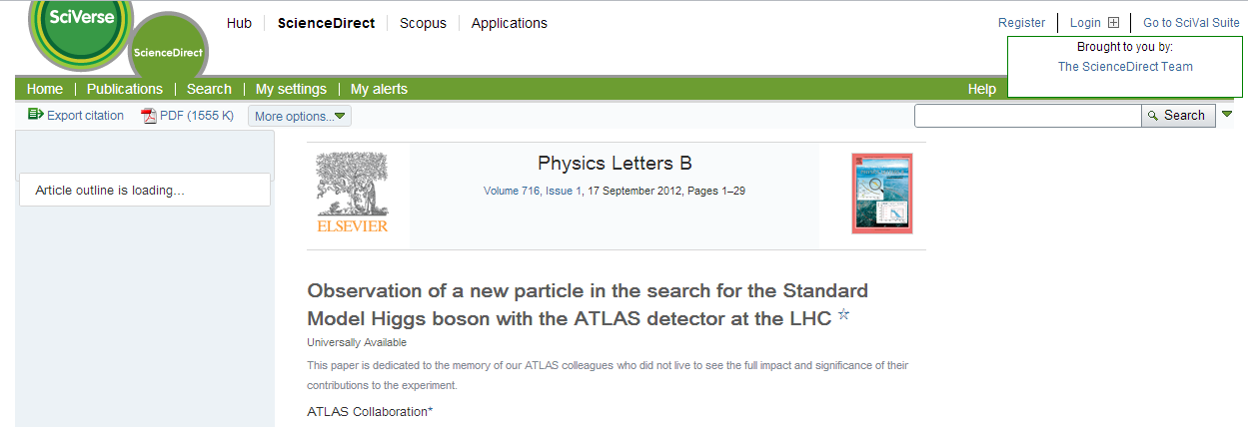
Physics Letters B
Since 1962 is a reference point for fast publications in high energy physics, until today:
http://www.sciencedirect.com/science/article/pii/S0370269312008581
http://www.sciencedirect.com/science/article/pii/S037026931200857X
LHC results are always

Slide 4


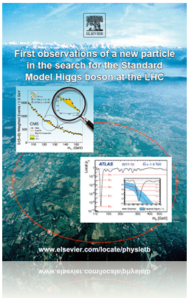
Physics Letters B
Reprint freely available at http://webshop.elsevier.com/campaigns/higgsParticle/

Slide 5

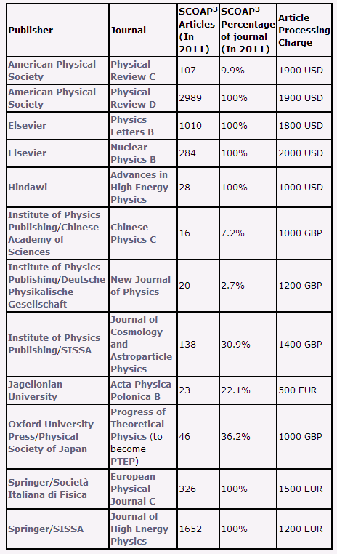
SCOAP3
CERN project to transform hep publications in OA
Physics Letters B and Nuclear Physics B to become completely Open Access from 2014
Elsevier actively involved in the reconciliation process with libraries and funding agencies

Slide 6
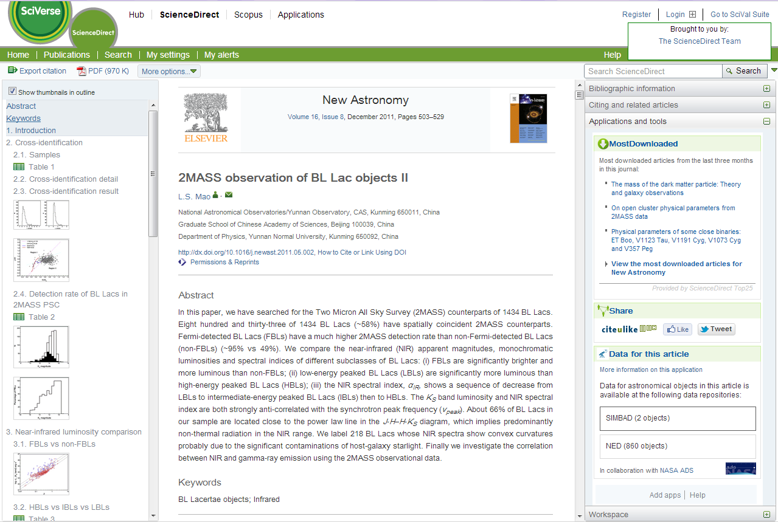
Article of the future
Right pane: collects additional content and tools. Shown here: figure browser
Left pane: efficient navigation & browsing
Center pane: “Traditional” full-text view, designed for optimal online reading experience

Slide 7
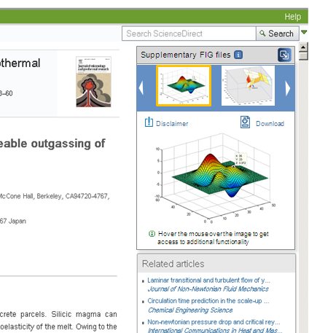
Interactive Content: MATLAB figure viewer
How does it work?
Authors using MATLAB save their figures in the MATLAB .FIG format.
Authors upload .FIG files as supplementary material through EES (may also be at revision stage)
Elsevier turns this into an Interactive Figure and includes this in the online article
4. Readers can better explore research in the context of the article, or download .FIG file
Just launched
MATLAB is one of the leading general-purpose software program for mathematical modelling, analysis & visualization
Elsevier is the first publisher to support interactive viewing of MATLAB files
Currently live for 5 journals
http://www.elsevier.com/matlab

Slide 8
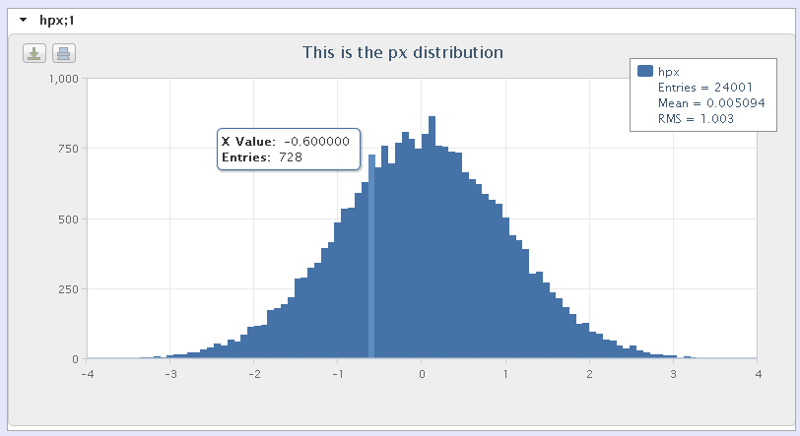
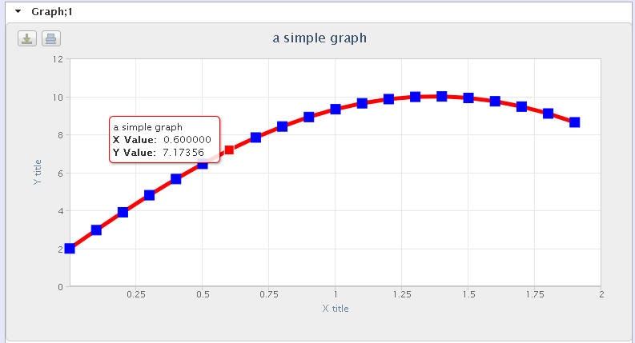
Idea for ROOT viewer
Brainstorming with Bertrand Bellenot
Browser for ROOT file inventory
Interactive viewer capabilities for:
  Histograms
  TGraphs
Based on existing JavaScript visualization tools for ROOT, developed by Bertrand Bellenot (http://root.cern.ch/js/)
Interactive histogram
TGraph
Screenshots from existing software, see http://root.cern.ch/js/

Slide 9
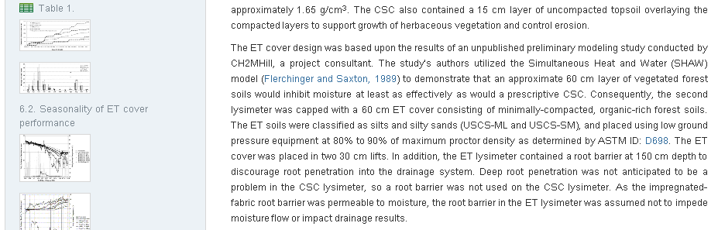
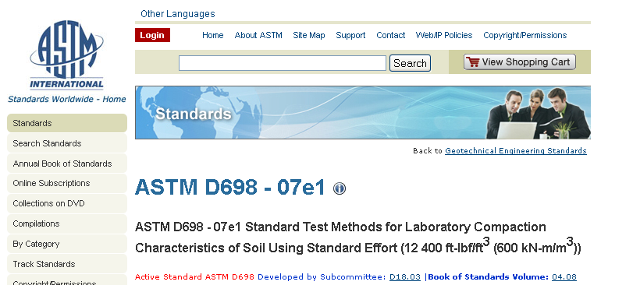
DB Linking Option 1: Entity Linking
For entities (concepts) mentioned in
an article – proteins, genes, standards
planets, cities, etc. etc.
Author-tagged in manuscript
http://dx.doi.org/10.1016/j.coldregions.2012.03.009

Slide 10
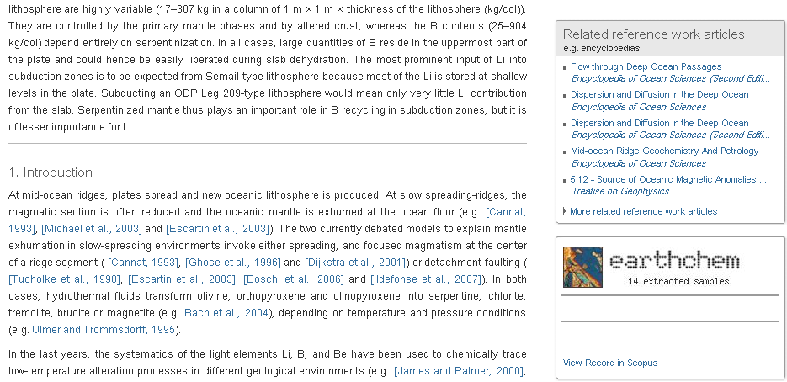
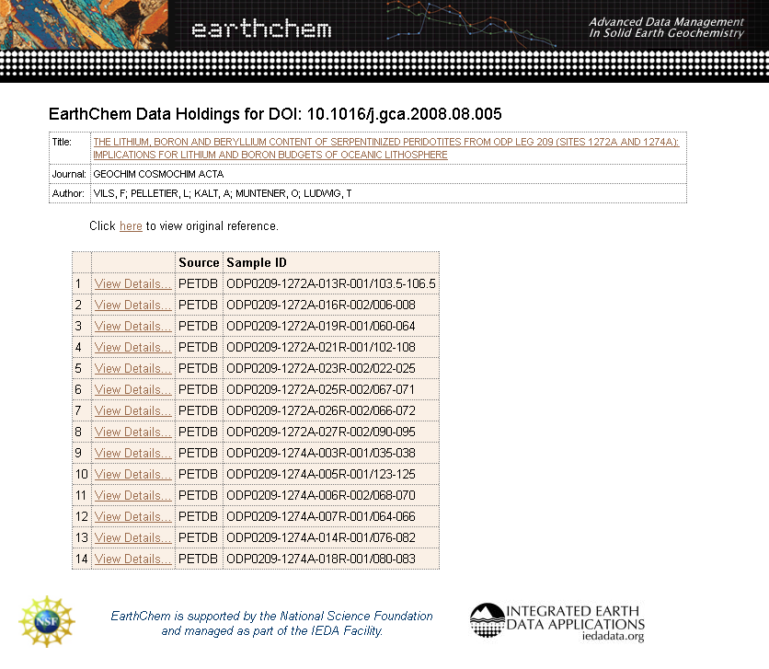
Option 2: Image-based (article) linking
For links between article as a whole and related data sets
No author involvement required on Elsevier side
Links managed by data repository
http://dx.doi.org/10.1016/j.gca.2008.08.005

Slide 11
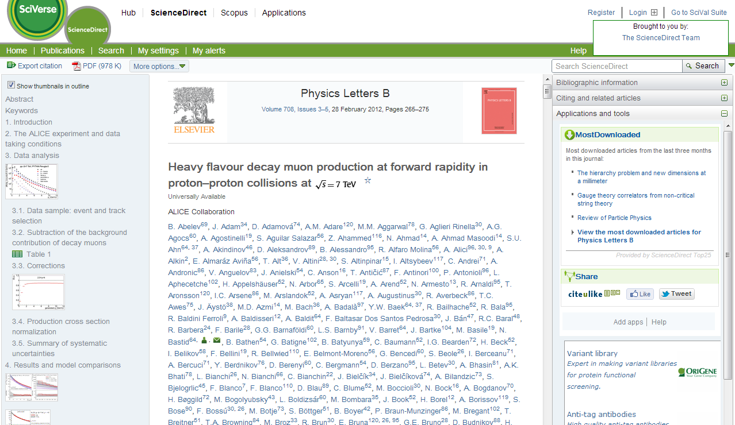
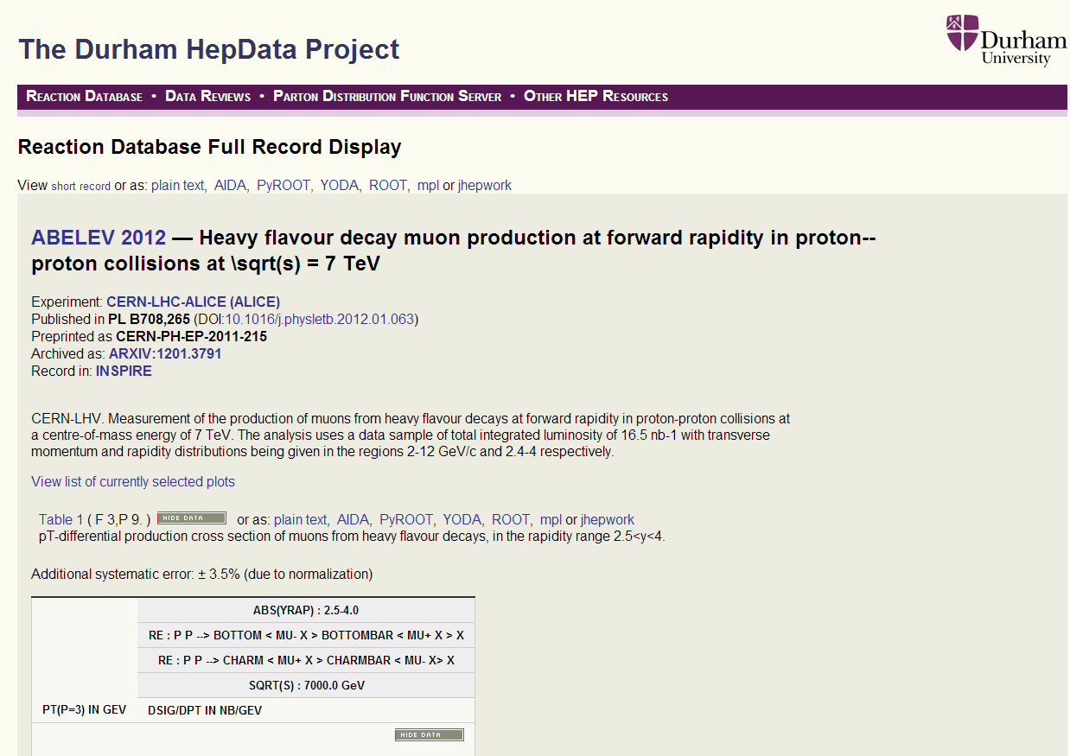
HEPData Linking
See talk from Mike Whalley

Slide 12
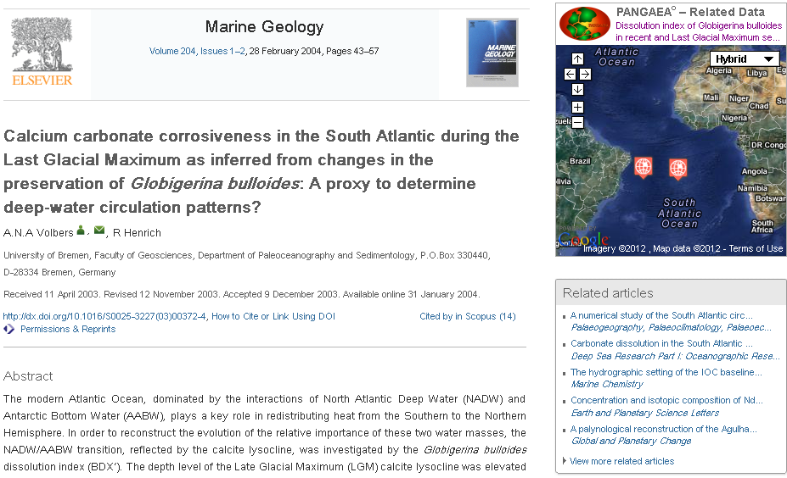
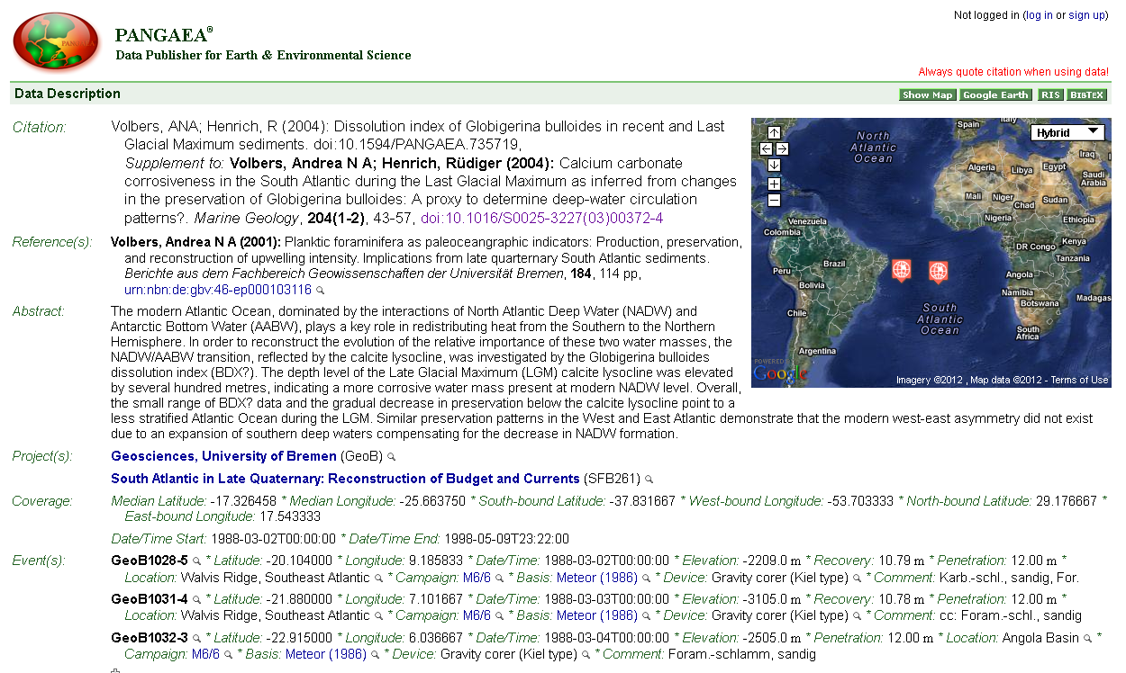
Option 3: Linking app
Pull data from repository to display with article
Interactive
App framework very flexible and versatile – many possibilities!
http://dx.doi.org/10.1016/S0025-3227(03)00372-4

Slide 13
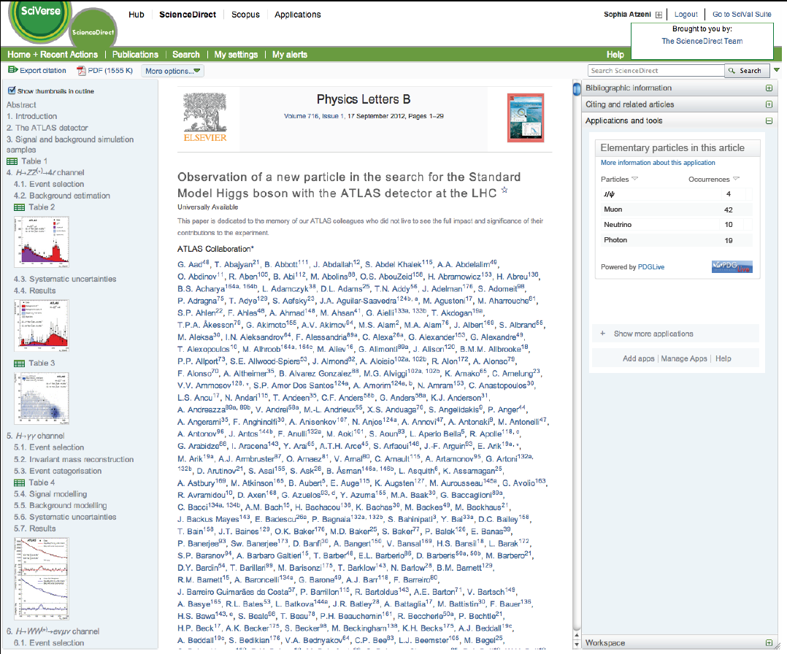
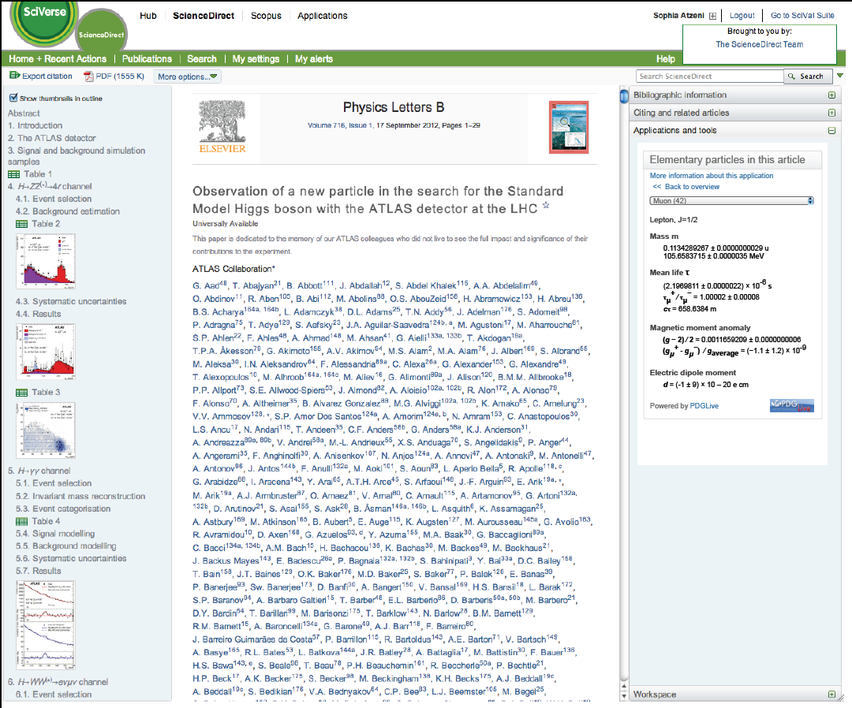
Example: PDGLive linking
MOCK-UP

Slide 14

Publishing the PDG Book?
With an increase in the content the choice is
High quality paper?
Lighter book?
A book for everybody?
Save on shipment?
High quality prints of the book available on demand
  Instead of prints, vouchers to order the book on demand from the WebShop (or similar)
All content available from everybody, everywhere from their mobile device

Slide 15
Outlook
Elsevier already engaged with the high energy physics community
  Open Access
  CC-BY license for hep publications
  A new dimension in scientific publishing
Many possibilities for the future of publications to explore together!
Thank you!!
Eleonora Presani – e.presani@elsevier.com

