Slide 1
The CKM quark mixing matrix
A. Ceccucci (CERN), Z. Ligeti (LBL), Y. Sakai (KEK)
Written for the RPP 2006
Regularly updated every two years
Structure:
Introduction
Magnitudes of CKM elements
Phases of CKM elements
Global fit in the Standard Model (SM)
Implications beyond the SM

Slide 2
Where are we now
During the past ten years we have witnessed the success of the CKM picture
All CP-violation manifestations in lab experiments are amenable to one single complex phase in flavour changing transitions of quarks
Now Look to deviations from overall consistency of SM
Updates mainly from new LHC results, Tevatron and B-factories full samples

Slide 3
Updates since the 2010 edition
Magnitude of CKM elements
  V_{cs}
    New measurements of D_{s} leptonic decays (muons and taus) & f_{Ds} from lattice
    |V_{cs}| = 1.008 +/- 0.024
    Combined with semi-leptonic:
    |V_{cs}| = 1.006 +/- 0.023
  V_{cb} (follow mini-review)
    Since the RPP 2008 version, the tension between exclusive and inclusive determinations lead to scaled errors about twice as large as previously quoted
    Only incremental improvements since RPP 2010
    |V_{cb}| = (40.9 +/- 1.1) × 10⁻³
  V_{ub} (follow mini-review)
    Persistent tension between exclusive and inclusive determinations
    Average |V_{ub} | = (4.15 +/- 0.49) × 10⁻³
    A determination (not included in the average) is obtained from
    B(B→ τ ν)=(1.67 +/- 0.30) × 10⁻⁴ and f_{B} = 190.6 +/- 4.6 MeV
    |V_{ub} | = (5.10 +/- 0.47) × 10⁻³

Slide 4
Updates since the 2010 edition
  V_{td} & V_{ts} not likely to be precisely determined in tree level processes, rely on neutral meson mixing and K and B rare decays
    New result from LHCB has reduced the error on Δm_{s} by about ×3
    Errors on V_{td} and V_{ts} dominated by lattice QCD inputs
    Several uncertainties are reduced calculating the ratio ξ = (f_{Bs} √B_{Bs}) / (f_{Bd} √B_{Bd}) = 1.237 +/- 0.032 (unquenched)
    |V_{td} / V_{ts}| = 0.211 +/- 0.001 +/- 0.006
  V_{tb}: new single top result from CMS
    Average with D0 and CDF : |V_{tb}| = 0.89 +/- 0.07

Slide 5
Updates on Phases of CKM elements
β / φ₁ New Belle result (full sampe), average of charmonium modes (Babar+Belle):
sin 2 β = 0.679 +/- 0.020
α / φ₂ LHCb first result on B→π⁺π⁻
γ / φ₃ new results from CDF, LHCb on B→DK. Combining GLW, ADS and Dalitz methods:
γ = (68 ⁺ ¹⁰ ₋₁₁)˚

Slide 6
Global Fit to Standard Model
Using frequentistic prescription (CKMfitter):
  λ = 0.22535 +/- 0.00065 A= 0.811^{+0.022}_{-0.012}
  ρ = 0.131^{+0.026}_{– 0.013} η = 0.345^{+0.013}_{– 0.014}
Using Bayesian prescription (UTfit):
  λ = 0.22535 +/- 0.00065 A= 0.817+/-0.015
  ρ = 0.131+/-0.018 η = 0.348+/-0.014

Slide 7
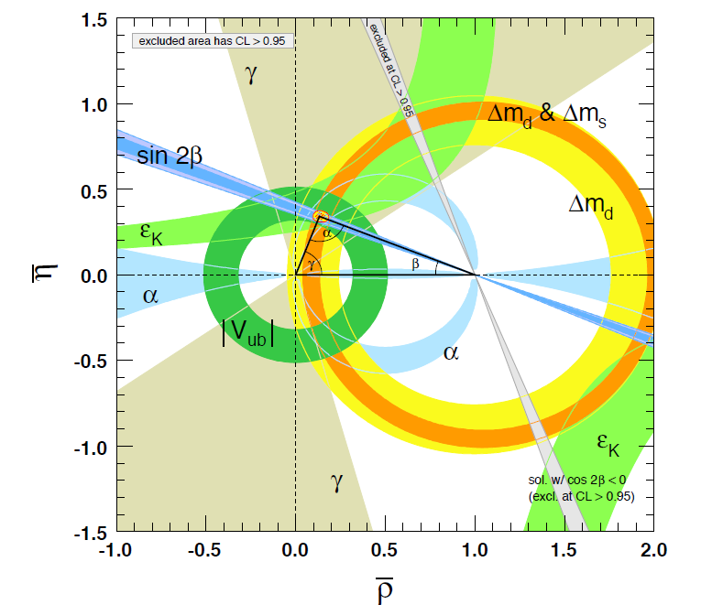
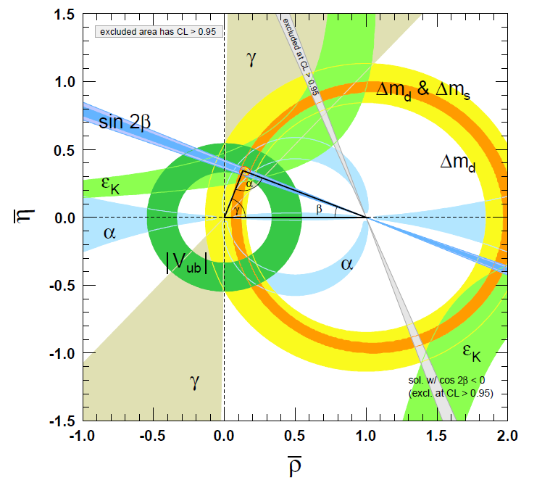
RPP 2012
RPP 2010

Slide 8
Implications Beyond Standard Model
Many key measurements sensitive to BSM are not useful to in terms of constraining the unitarity triangle
  For instance, from CP-asymmetries in semileptonic B⁰_{d,s} decays, D0 finds a 3.9σ deviation from SM
A key quantity in the B_{s} system is β_{s} = arg (-V_{ts} V_{tb} */V_{cs} V_{cb}*) which is the small λ²-suppressed angle of a squashed unitarity triangle (scalar product of second and third column)
φ_{s} = -2β_{s}
SM prediction: β_{s} = 0.018 +/- 0.001
LHCb measurement (1 fb⁻¹): β_{s} = 0.001 +/- 0.044
Uncertainty is still twice the SM prediction and ~40 times its uncertainties
Rare kaon decays clean tests of the standard model will be expected from the study of the K → π ν ν bar modes

Slide 9
A few comments
Several constraints/elements depend significantly on input from theory (decay constants, bag parameters, form factors…)
  Epsilon
  Δ m _{d}
  Δ m _{s}
  2+1 Flavor Lattice QCD averages
Average and error treatment of theory input not always straightforward
  f₊(0),f_{K,D,B}
  B, quark masses,…
Persistent tension on the determination of V_{ub}
  B→ τ ν ??

