Slide 1
LAGUNA/LBNO WP4: secondary beam line status report
LAGUNA/LBNO DS meeting --- 20/09/2012
M. Calviani, P. Velten, A. Ferrari, I. Efthymiopoulos, C. Lazaridis (CERN)
+ M. Zito, V. Galymov (CEA), A. Rubbia, S. Murphy, S. Di Luise (ETHZ)

Slide 2


Organization of the WG and activities
Started in April 2012 and focused (for the moment) on:
  Agreement on the main physics parameters
  Optimization of beam/target optimization
  Started analysing potential configurations of horn
  Muons in the ND and configuration of the decay pipe
CERN-oriented meetings held on a monthly basis to discuss the activities within the sub-WG
  Steering the activities on the LAGUNA/LBNO secondary beam line
Recently we have enlarged the participation to external members working on some aspects of the beam line in other institutes
  Important input from the experiment!

Slide 3
Summary
Target optimization and potential cooling configuration
Horn/reflector studies
Decay pipe main parameters
Muon fluence in ND
On-going work

Slide 4
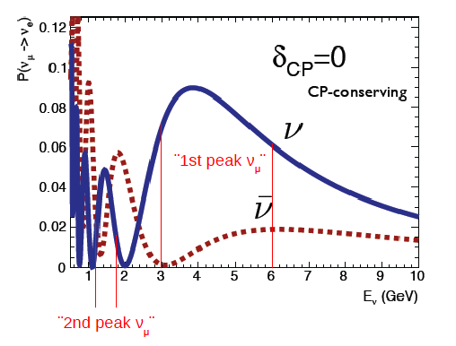
Physics optimization
Quite some effort was spent in clarifying the main driving parameter of the beam line optimization
As the phase-space for the physics goal is very broad --- we would need the highest fluence in the range of the two first oscillatory peaks
1st peak == [3÷6] GeV
2nd peak == [1.2÷1.8] GeV
Maximize the total (peak1+peak2)
peak1/total ~ 0.5

Slide 5
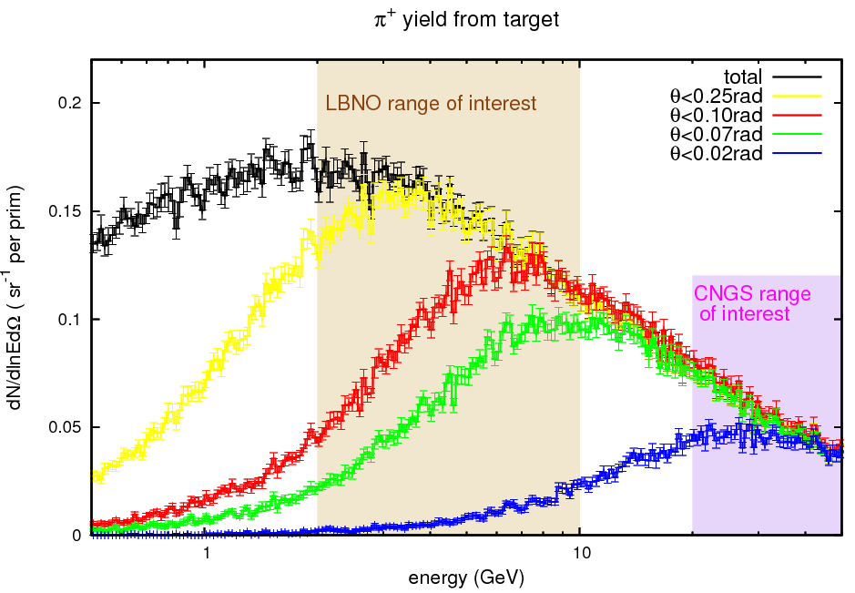
Neutrino production target optimization (1/2)
Objective:
  Produce as many π⁺ as possible in the required energy range
  Optimize their collection via magnetic horns (large angles)
CNGS case:
  E_{π} = [20÷50] GeV
    → θ < 20 mrad
LAGUNA/LBNO:
  E_{π} = [2÷10] GeV
    → θ < 70/100 mrad

Slide 6
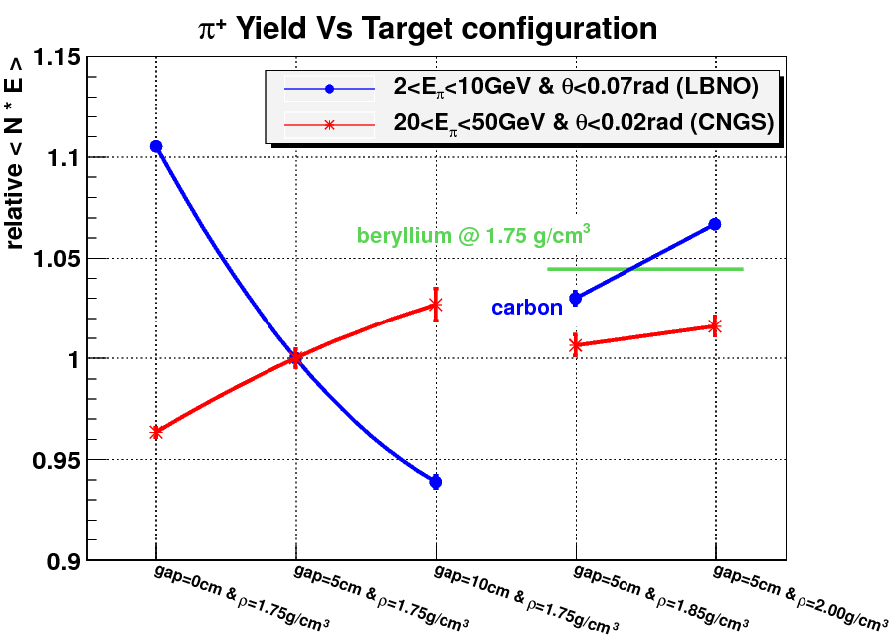
Neutrino production target optimization (2/2)

Slide 7
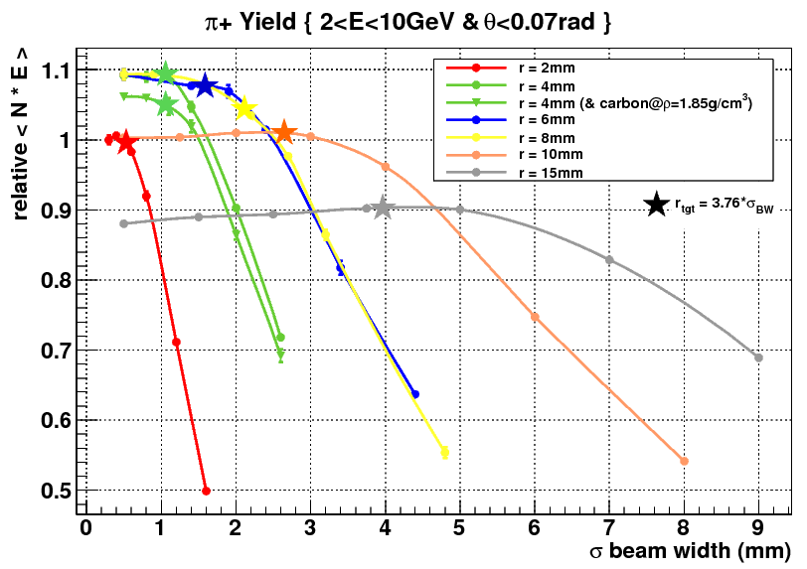
Target optimization: target/beam radius
Maximum yield for a r_{T}=4-6(8) mm
  Beam 1σ =1-2 mm
Larger radiuses:
  Advantage for low energy p+
  Reduction of thermal stresses on target
  Optics?

Slide 8
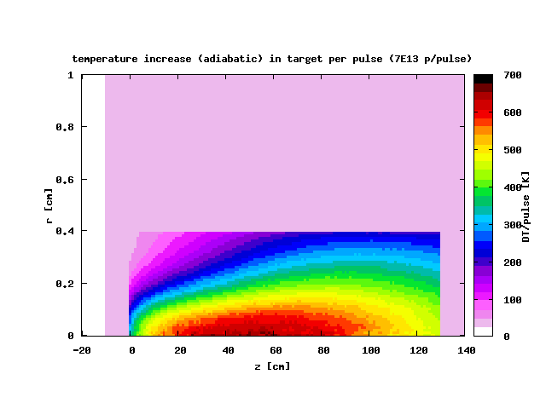
Energy dep and peak temperature
Evaluation:
  400 GeV/c
  Adiabatic, 7*10¹³ p/pulse
Peak ΔT/pulse comparable to CNGS case
  helped by larger beam size
4 mm radius
2.5 mm FWHM
Max ΔT~650 K
(450 K for 8 mm radius case)
Target outside horn is a major advantage
  Degree of freedom in target/horn design
  No problem of target/horn heat & electrical insulation
  Set as a design constraint
50 GeV (2 MW) phase will (probably) need a new optimization
Detailed studies to be conducted

Slide 9
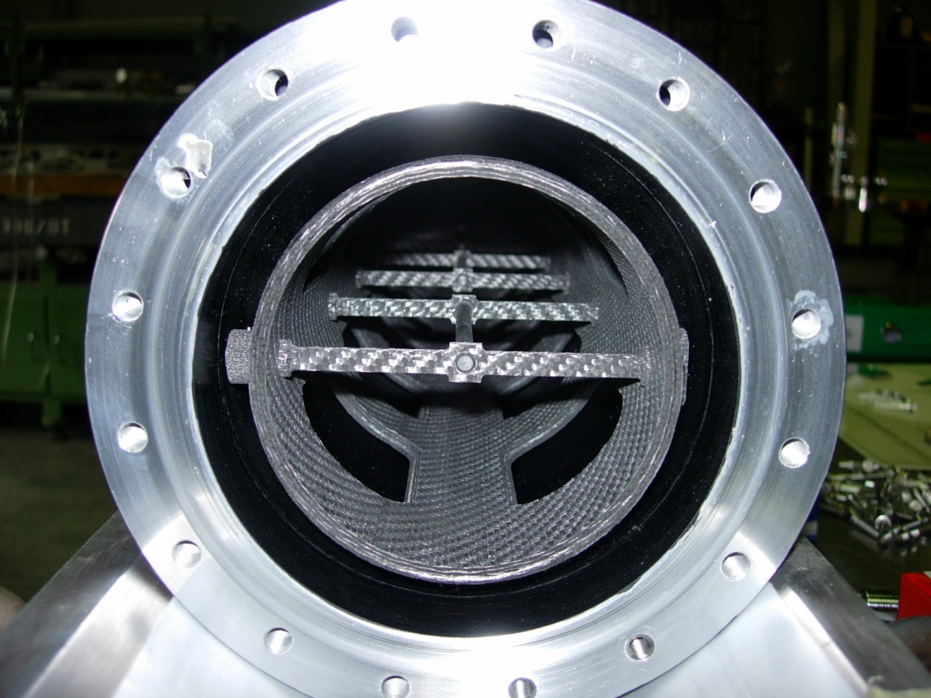
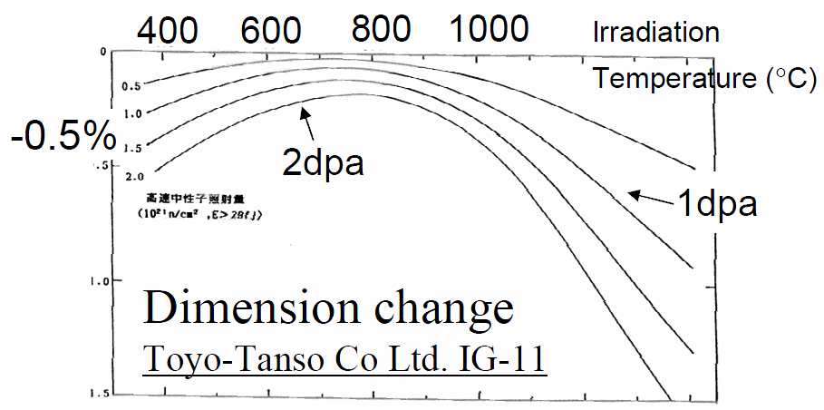
Ideas on target cooling and constraints
Target cooling possibilities for 750 kW phase
  Radiation cooling (a-la-CNGS)
  Forced He cooling and radiation cooling
  Target should be operating at 700/800 ºC
Radiation damage of graphite
  Expected ~0.3 DPA/y @750 kW
  At 600-1000 °C: dimension change and thermal conductivity are minimized
  Also reduce H embrittlement

Slide 10
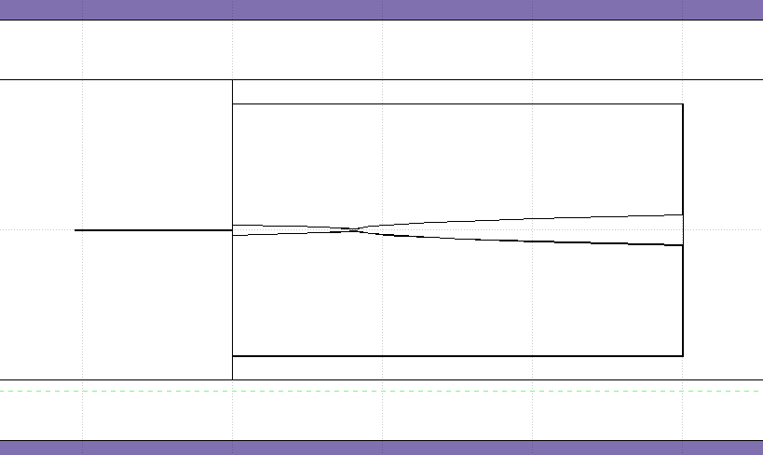
Summary on target optimization
Proposed configuration:
  Length: 130 cm
  Radius: 4-6 mm (8 mm possible)
  No segmentation
  Material: carbon @ ρ=1.85 g/cm³
  Target outside horn (or downstream part in “contact”)
horn
target
Stresses and heat evacuation to be studied in detail as a function of the general design of target area
Is there already a constraint from the beam optics point of view?

Slide 11
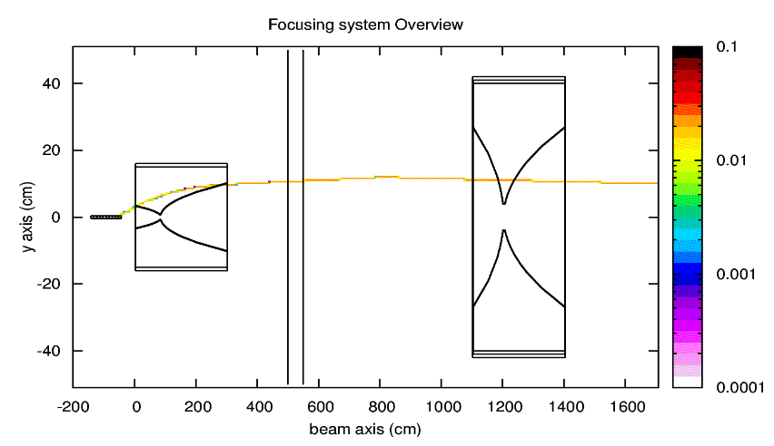
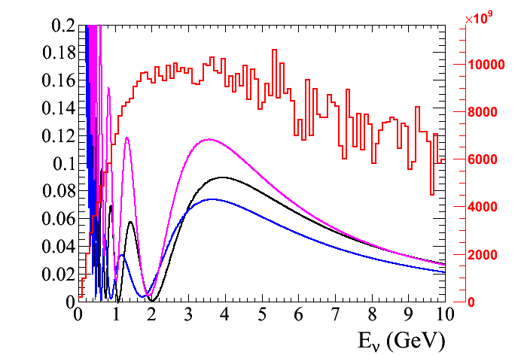
Horn/reflector studies
Initially started by optimizing relative element position and currents
  “standard” shape optimized for a 50 GeV primary beam (parabolic shapes)
Attempts to vary the inner conductor shapes (“vast” amount of degree of freedoms)
d_{TH}
d_{HR}
I_{H}
I_{R}

Slide 12
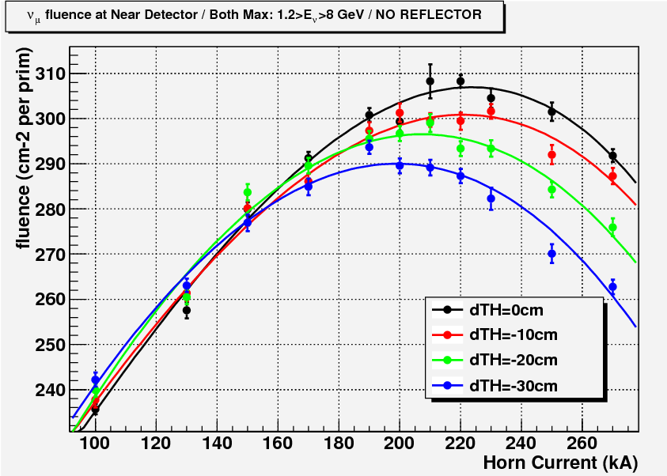
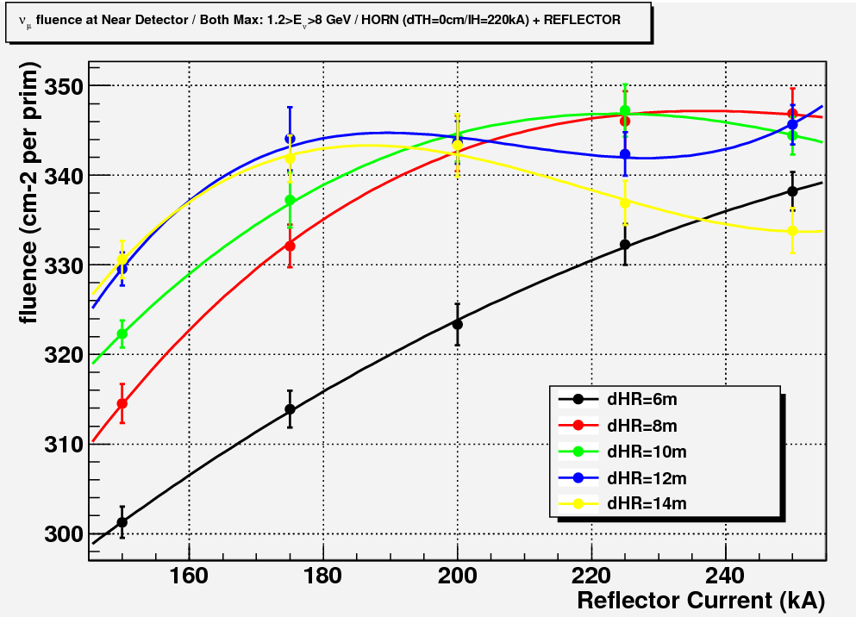
Horn/reflector studies
Effect of relative distance between target/horn
Optimal horn configuration:
d_{TH}=0 cm
I_{H}=220 kA
Both peaks optimization
Effect of relative distance between horn/reflector
Optimal reflector configuration:
d_{HR}=10 m
I_{R}=220 kA

Slide 13
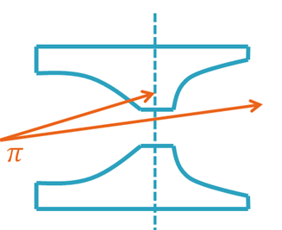
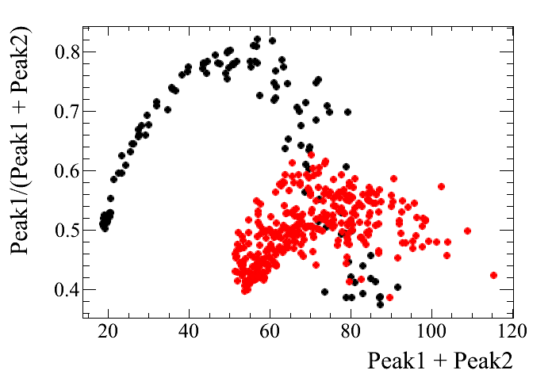
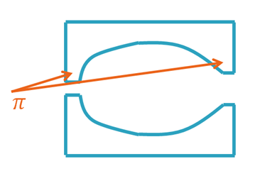
Horn/reflector shape studies
Different approaches are also done by scanning the phase space of inner conductor shapes
Example of scanning Bezier curve parameters for the horn design
Single neck, fixed diameter
Single parabola
Bezier
Double neck, different aperture for improved focusing
Bezier → improved fluence and improved balance!

Slide 14
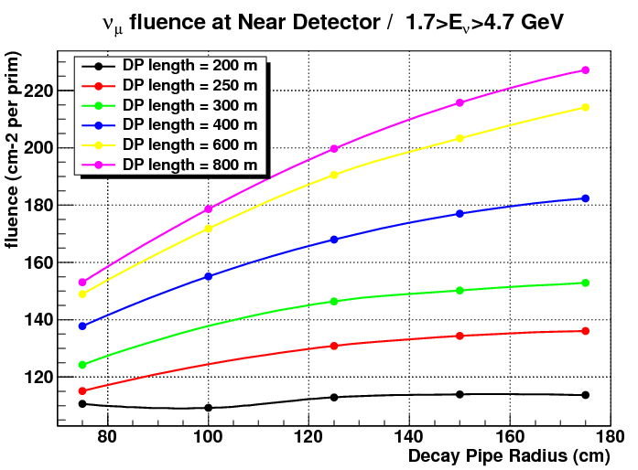
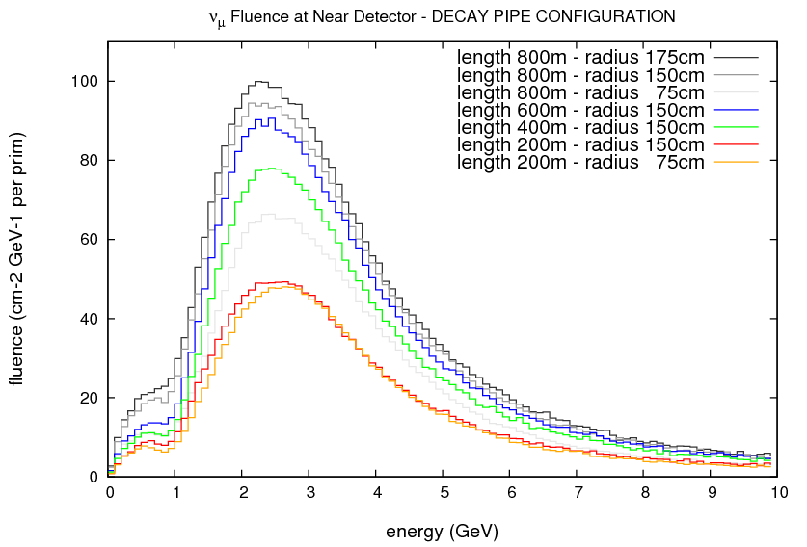
Decay pipe
600 m
2x
400 m
r=150 cm
200 m
Higher ν_{μ} fluence for longer DP (~saturation for r>1.5m)
DP length partly imposed by the μ fluence in the ND!
... And by costs!
Potential DP configuration
r_{DP}=1.5 m, L_{DP} ≤300 m
CNGS
r_{DP}=1.2 m, L_{DP}=1100 m

Slide 15
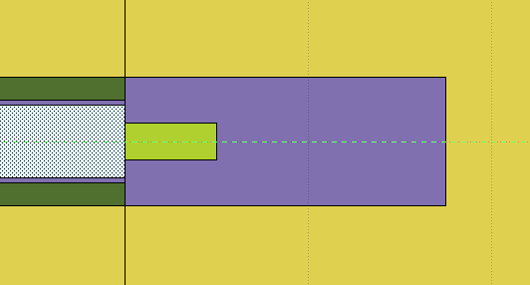
Muons in the near detector and constrains
The μ fluence (background for the experiment) in the ND is an issue which might contribute driving the
  HS design, DP length and ND distance from TS
In iron, dE/dx|_{μ} ~1.6 GeV/m → 16 GeV/10m
In molasses, dE/dX|_{μ}~460 MeV/m → ~50 GeV/100m
17.5 meters
HS in the present simulation setup:
  5 m carbon core
  12.5(17.5) m Fe shielding around
  WANF: 4x4.5x36 m³ + toroidal magnet (12 T*m, 10 m long, 6 m diameter)
C
5 m
Fe
Hadron absorber ~15 m long
Molasses assumed ~2.4 g/cm³

Slide 16
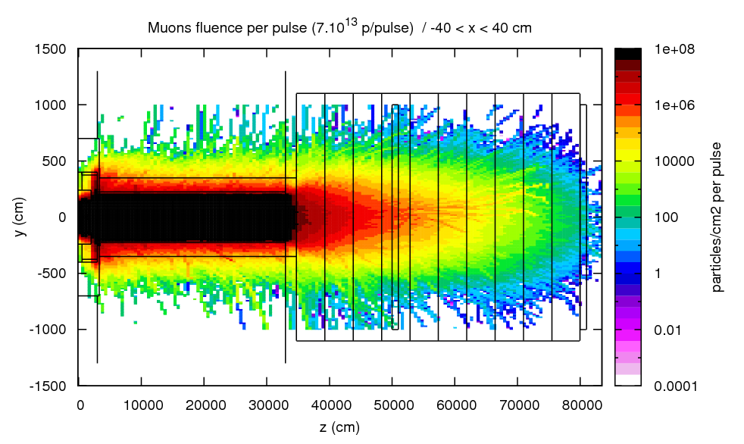
μ± fluence in the ND
At 500 m from TS
  10⁶ μ/cm²/pulse
At 800 m
  ~100 μ/cm²/pulse
  ~10⁵ μ/m²/10¹³ p+
350 m
ND 500 m
ND 800 m
Possible solutions being investigated:
  Reduction of primary beam energy to 350 GeV (equiv. to ~30 m of Fe)
  Massive increase of DP Fe blocks – costs?
  ND further away (much also deeper…)
    TOSCA was at ~700 m from μ pit (1800 m from TS) → 2.5 μ/m²/10¹³ p⁺

Slide 17
On-going work
Main medium-term objectives:
  Definition of an updated set of parameters for the installation
  Definition of a new “reference” neutrino fluence in the ND/FD
FLUKA modelling of target area based on a “chase” design
Energy deposition analysis
  750 kW/400 GeV/c and 2 MW/50 GeV/c beam
First radioprotection assessment of the area (with DGS/RP?)
  Prompt dose rate around TS (access/electronics?)
  Activation around the TS (+DP/HS)
  Air activation
Hadron absorber initial design
  Baseline design -- 2 MW beam

Slide 18
Potential configuration
Target station surface or underground building & services
Initial configuration for preliminary evaluation
~4/5 m concrete
Movable concrete blocks
Concrete/Molasse
Concrete/Molasse
Air volume for structural support services
He container (?)
~3.5 m Fe
Movable steel plates
DP collimator (Fe) – reduce load on structural part of DP
Primary beam zone
Decay pipe (DP)
baffle
target
horn
reflector
Beam window (He-jet cooled)
<30 meters

Slide 19
Marco.Calviani@cern.ch

