Slide 1
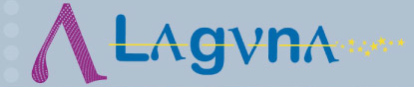
HP-PS design progress
Yannis PAPAPHILIPPOU, CERN
Thanks to G. Arduini, M. Benedikt, I. Efthymiopoulos, F. Gerigk, B. Goddard, R. Steerenberg, T. Zickler
`
LAGUNA-LBNO Design studies
General Meeting
20/09/2012

Slide 2
HP-PS parameters
Parameters | PS2 | HP-PSa | HP-PSb | HP-PSc | HP-PSd | HP-PSe
Circumference [m] | 1346.4 | 1256 | 1009 | 763 | 1256
Symmetry | 2-fold | 3 / 4-fold
Beam Power [MW] | 0.37 | 2.0
Repetition rate [Hz] | 0.42 | 2 | 2 | 2.6 | 1.3 | 1.0
Kinetic Energy @ inj./ext. [GeV] | 4/50 | 4/50 | 4/40 | 4/30 | 4/50
Protons/pulse [10¹⁴] | 1.1 | 1.25 | 1.6 | 1.6 | 1.9 | 2.5
Dipole ramp rate [T/s] | 1.4 | 6.1 | 6.0 | 7.5 | 4.0 | 3.1
Bending field @ inj/ext. [T] | 0.17/1.7 | 0.17/1.7 | 0.21/1.7 | 0.27/1.7 | 0.17/1.7
Fractional beam loss [10⁻⁴] | 35.1 | 6.5 | 5.0 | 4.0 | 6.5
Space-charge tune-shift H/V | -0.13/-0.2 | -0.2/-0.2
Lattice type | NMC arc, doublet LSS and DS | Resonant NMC arc, doublet LSS
Norm. emit. H/V [μm] | 9/6 | 6.8/6.7 | 8.6/8.5 | 11/11 | 10.5/10.3 | 13.7/13.4
Max. beta H/V [m] | 60/60
Max. dispersion [m] | 3.2 | 5
Dipole Gap height [mm] | 80 | 85 | 95 | 108 | 105 | 120
Rms electrical Power [MW] | 5.2 | 23.8 | 21.2 | 22.7 | 19.3 | 17.0
Getting 2MW power not straight-forward (even with a fully dedicated linac)
  Ramp rate, space-charge, losses, acceptance, space (cost)
The less constrained ring is the more costly one, i.e. high-energy, longest ring, with lowest repetition rate and with the closest parameters to PS2
Last parameter iteration to be done considering super-ferric magnets with around 2.T peak field
  Reduction in circumference, electrical consumption, normalized emittance, aperture, and thereby cost

Slide 3
Layout and lattice
Design based and adapted from PS2
3 or 4-fold symmetric ring to accommodate in separate LSS injection/collimation, extraction and RF
NMC lattice necessary to avoid transition and reduce losses
Use resonant NMC cells to increase filling factor (no DS)
Doublet LSS leave more space for BT equipment, collimation and RF

Slide 4
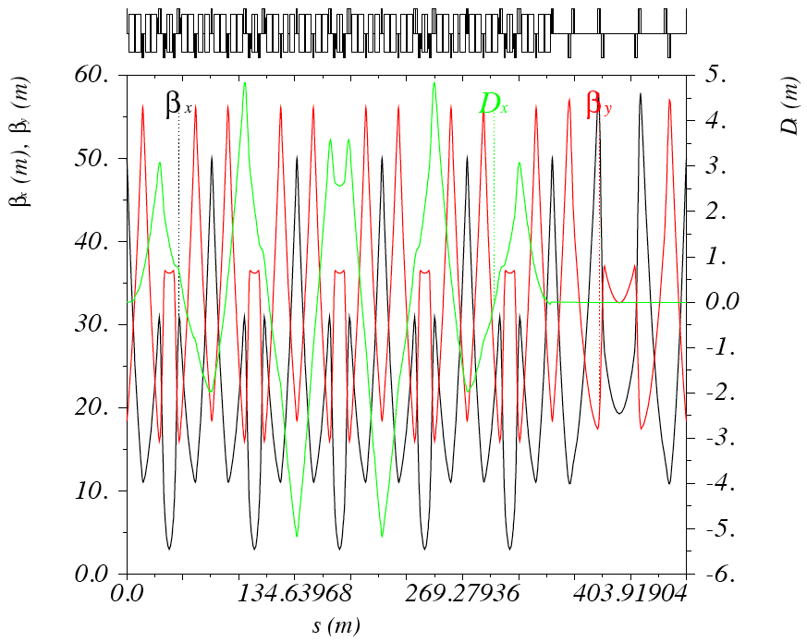
Example:
Resonant NMC
Starting from PS2 resonant arc
5 NMC arc cells with horizontal phase advance tuned to 8π
Due to space constraints can only achieve 46GeV for dipole field of 1.7T
  Not an issue for slightly shorter long straight sections and higher field magnets
Limited tunability (provided only by LSS in the horizontal plane)
Very good non-linear dynamics performance

Slide 5
Next steps for 2012
Finalize parameters for super-ferric magnet option
Produce a first order optics design and layout
  Arc, LSSs for injection/extraction, collimation and RF
  Tunes, chromaticity, correction
  Magnet parameters
  Start discussion on RF system parameters
  Adapt PS2 collimation
Design progress followed in monthly (or bi-weekly) meetings
The “players”:
  J. Alabau-Gonsalvo, A. Alekou, F. Antoniou, YP (ABP)
  B. Goddard, A. Parfenova (BT)
  I. Efthymiopoulos, C. Lazaridis (MEF)
  M. Benedikt, R. Steerenberg, Fellow (OP)
  F. Gerigk, E. Chapochnikova (RF)

