Slide 1
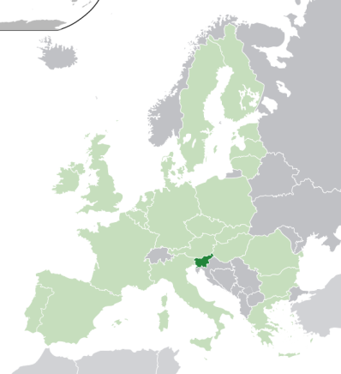
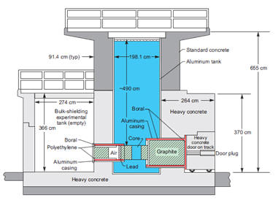
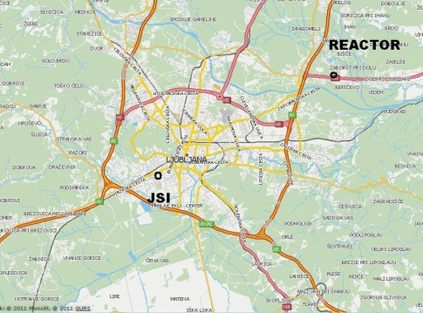
Irradiations with neutrons at TRIGA _Mark III reactor
The reactor research centre is a part of Jožef Stefan Institute,

Slide 2
Reactor: 250 kW maximum power, can be regulated to few W.
Total flux at maximum power is 4x10¹² cm⁻²s⁻¹ (central channel).
NIEL (in Si) damage constant is 0.9 for fast neutrons.
Several in-core and ex-core irradiation channels
Maximum uninterrupted irradiation time is 16h.
Highest fluence for AIDA 10¹⁷ cm⁻²
All irradiations done in two irradiation tubes.
Accuracy of fluence is ± 10%
1st year:
2nd year
-24 projects
-105 irradiations
- 270 units of reactor
16 projects
90 irradiations
140 units of reactor

Slide 4
2013
6 approved projects
5 projects already completed
30 irradiations done
190 units remained for next two years (410 used in 2 years)
All “problems” encountered in 2011 solved :
sometimes activation higher than expected (composition of samples not exactly known)
shipment of activated devices

