Slide 1
WP9.4 Summary
AIDA WP9.4 meeting

Slide 2
Baseline vs. Advanced Deliverable
Baseline
Deliverable
Two orthogonal layers of u-strips
HPK SiLC sensors
AVP25 based hybrid
Provide precise entry point to calorimeter
Advanced Deliverable
Integration with CaloDAQ
Deliverable 2nd QT 2014
Ultra-light strip layer of thin sensors (230 um)
Conventional mechanics
Demonstrator of ILD silicon tracker
Integrated PA or 2D-Poly silicon or short strip sensors.
APV25 based hybrid
Light mechanics with embedded Fiber Optic Sensors
Integration with caloDAQ
Offline software
Offline Software
No deadline

Slide 3
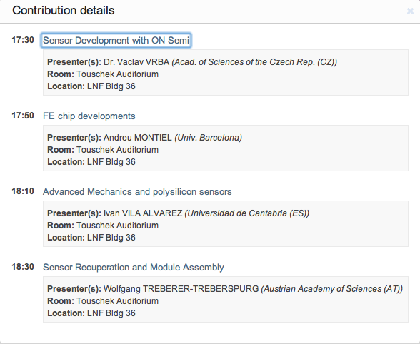
Schedule of yesterdays session

Slide 4
Advanced deliverable

Slide 5
ON Semiconductor
ON Semiconductor: 6” wafers
➔ stepping mask projection machines,
➔ the stitching technique is needed
„little“ problem with funding – delay
➔ problem with purchase 6“ P-type HiRes wafers ➔ big lead time (Topsil) ➔ received just recently
Purchase full ingot ➔ big lead time ➔ costly
➔ as a result we have quite good portfolio of wafers 6“: P-type, N-type, 300 micrometers thick.
Rushing with design – changing every day!! (not vaste time with details)

Slide 6
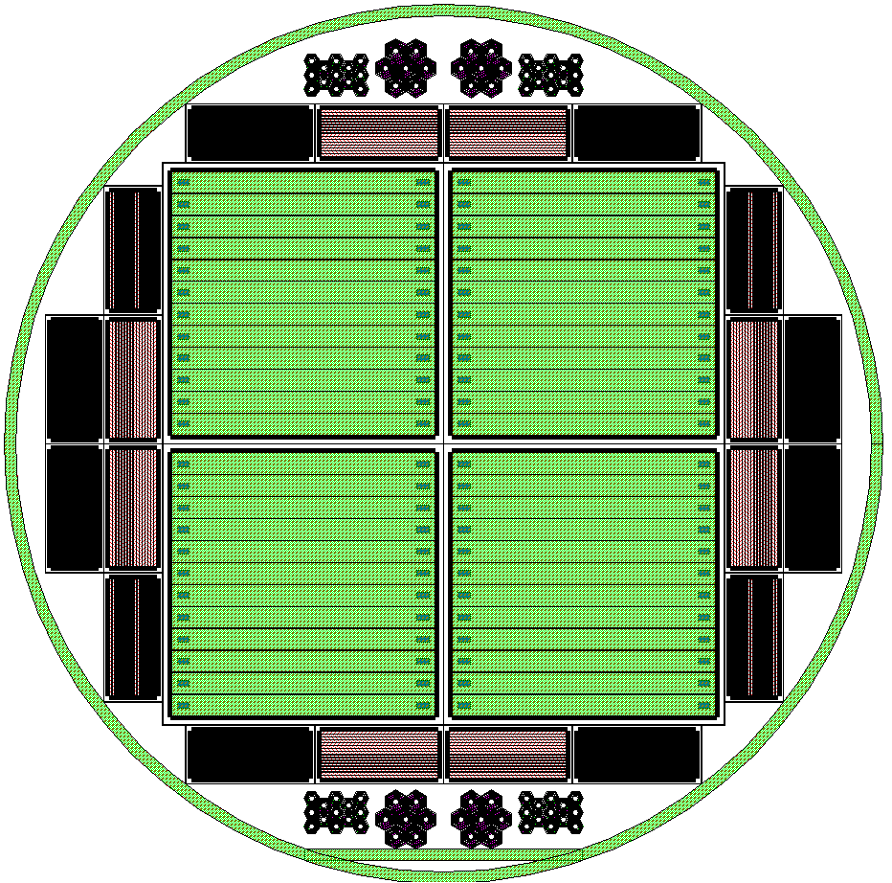
Sensor design
Strip layout
Wafer layout

Slide 7
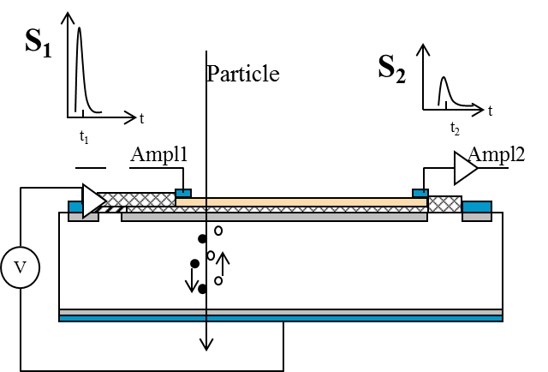



Charge-Division Concept in ustrip Sensors (1)
Charge division used in wire chambers to determine the coordinate along the sensing wire.
Same concept with conventional microstrips with slightly resistive electrodes (doped polysilicon)

Slide 8
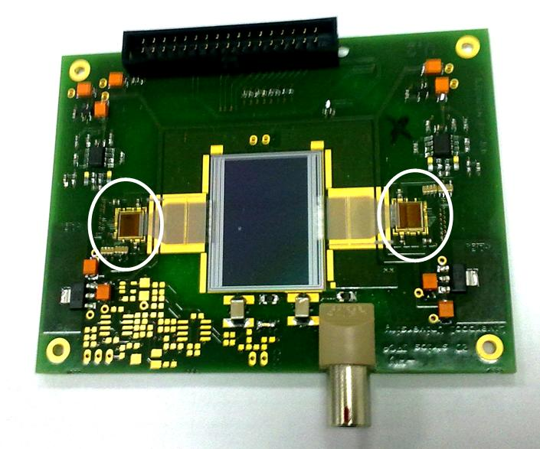
Prototypes from CNM
two new prototypes with double-end readout and different resistivity.
Beatle chip
Strip:
  length =20 mm
  width =20 um
Pitches:
  Implant=80 um
  readout= 80 um
Electrode:
  R/um = 2.8 Ohms/um
  R/um = 12.2 Ohms/um

Slide 9
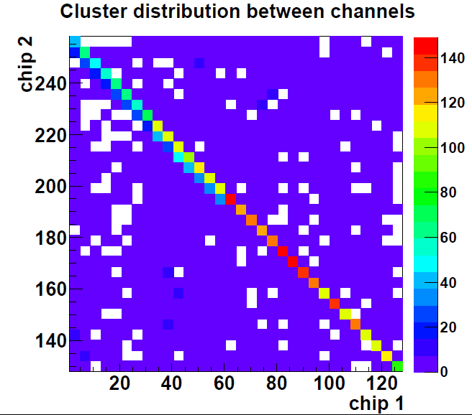
VERY Preliminary results (1)
Imaging of the SPS beam profile.
Cluster correlation between opposite ends

Slide 10
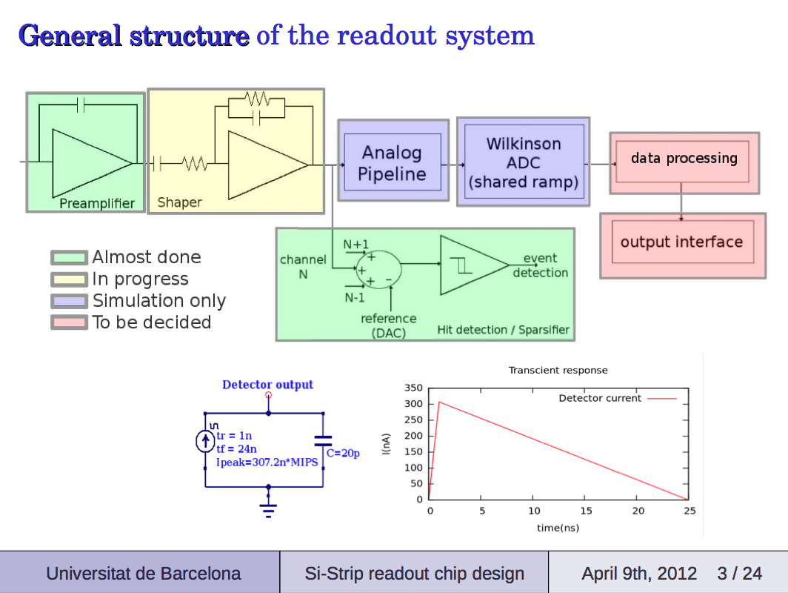

Slide 11
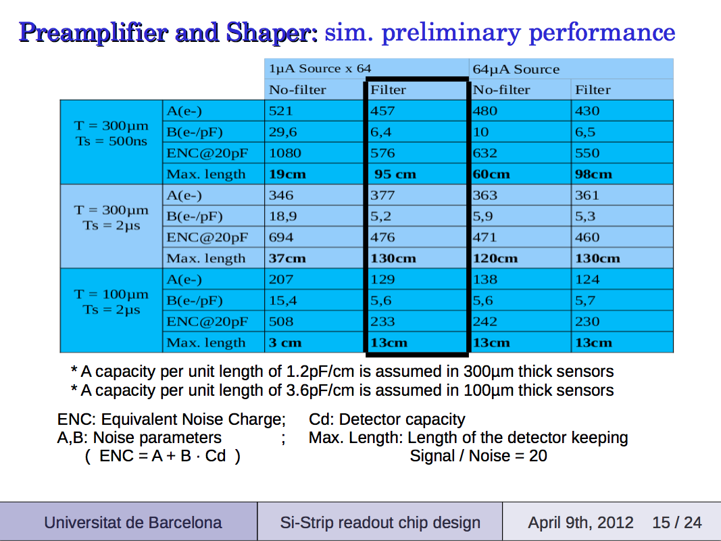

Slide 12
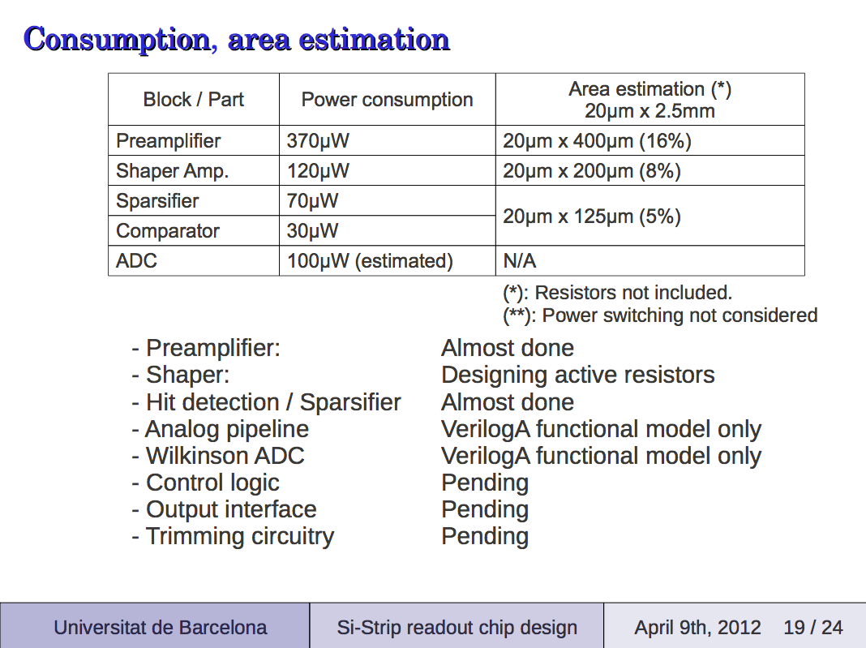

Slide 13
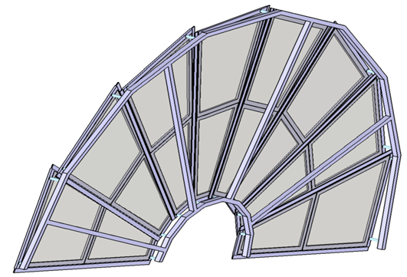
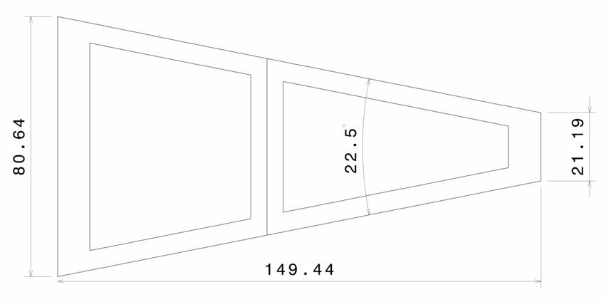
SMART Mechanics: Initial proposal
The aim is to manufacture a few ILD FTD support petals, both for real sensor support and thermo- mechanical mock-up
Petals matching the geometry of the 3th FTD geometry has been chosen, being the biggest one
Equiped with CNM manufactured sensors (four inches Wafers) , the structure will be scaled 0.65 :1
Petals mechanical and thermal behavior will be tested
Embeding of FOS sensors for selfmonitoring.

Slide 14
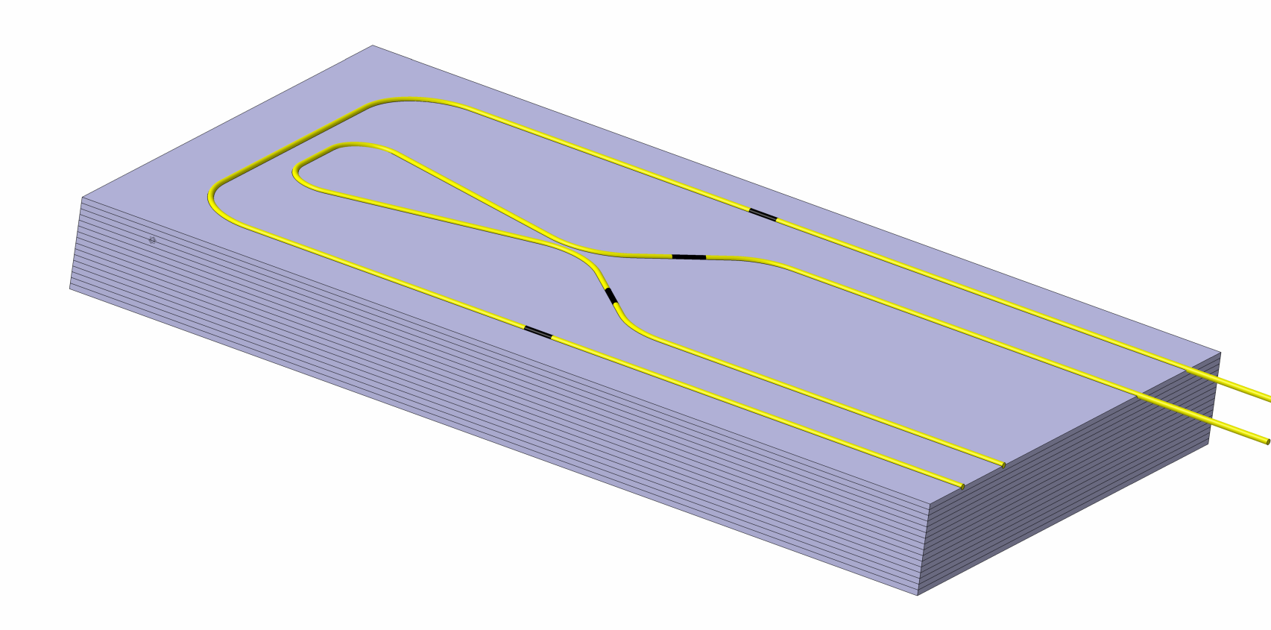
Demostrator plate demostrator @ DESY
,
The First step is to manufacture and test this self monitoring structures
This demonstrator is a CFRP plate with ten FBG sensors embedded at a define position, allowing us to measure deformations under Torsion and Flexion loads, and temperature
When a torsion or a flexion load is applied to the sheet, we know from simulations the expected measured value of each sensor.
Flexion sensors
Top layer
Torsion sensors
Botton layer

Slide 15
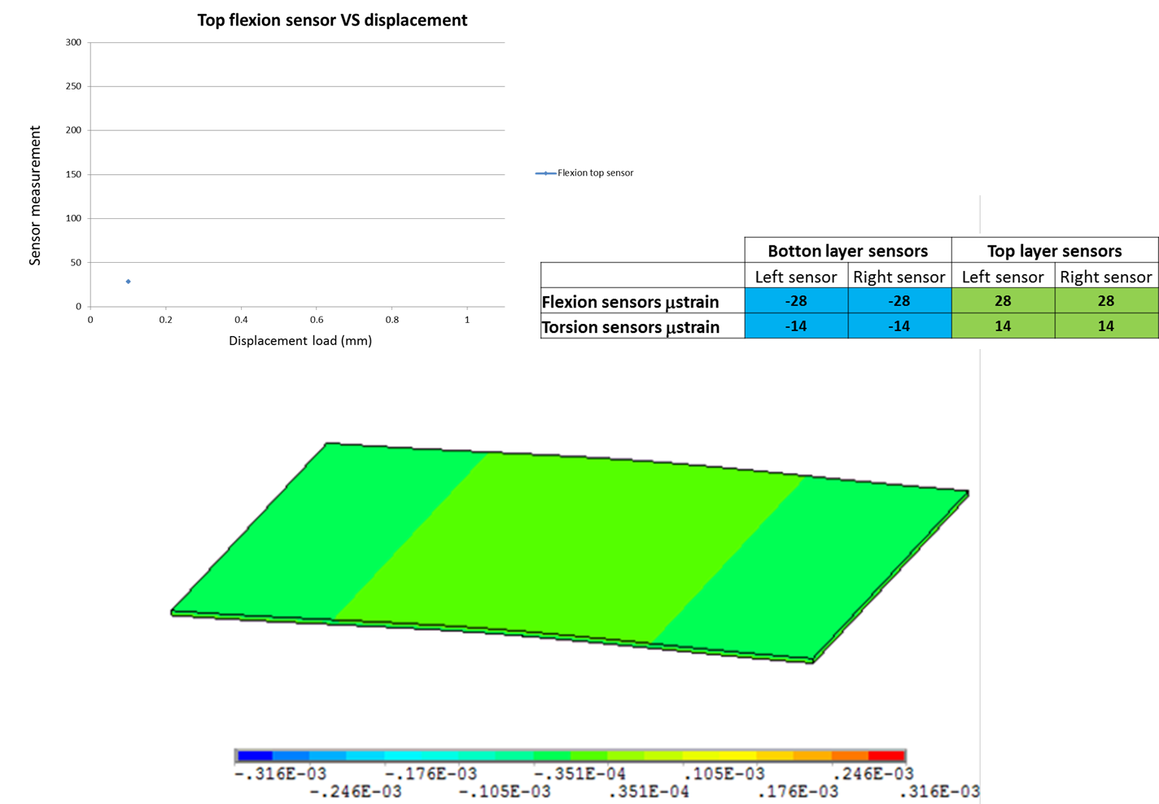
Demonstrator simulation under flexion loads
15

Slide 16
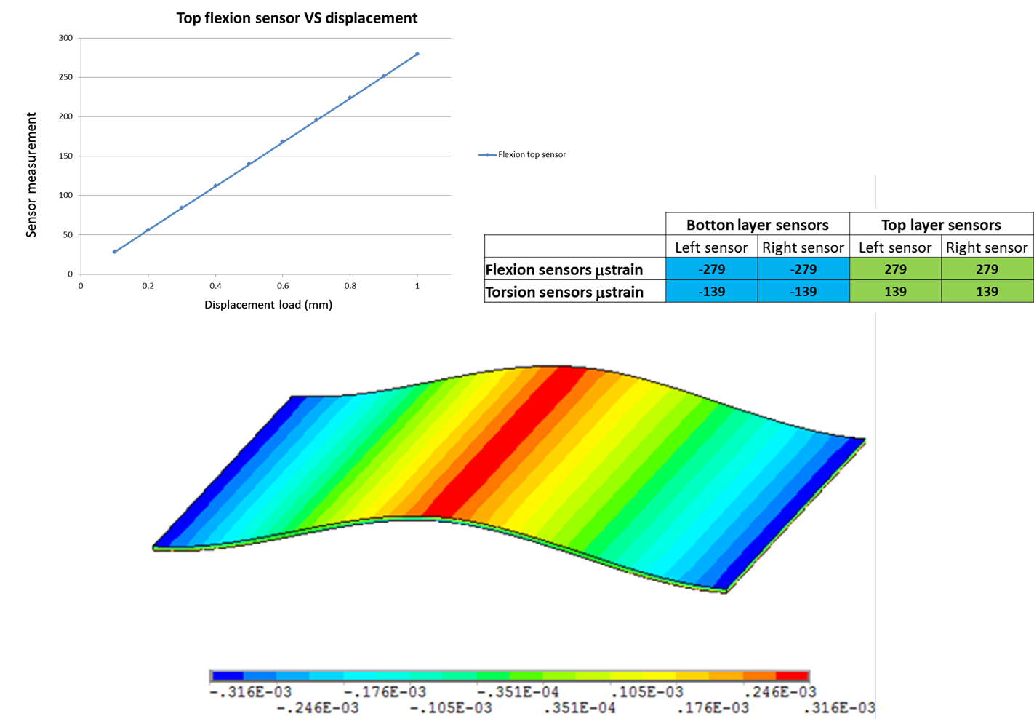
Demonstrator simulation under flexion loads
16

Slide 17
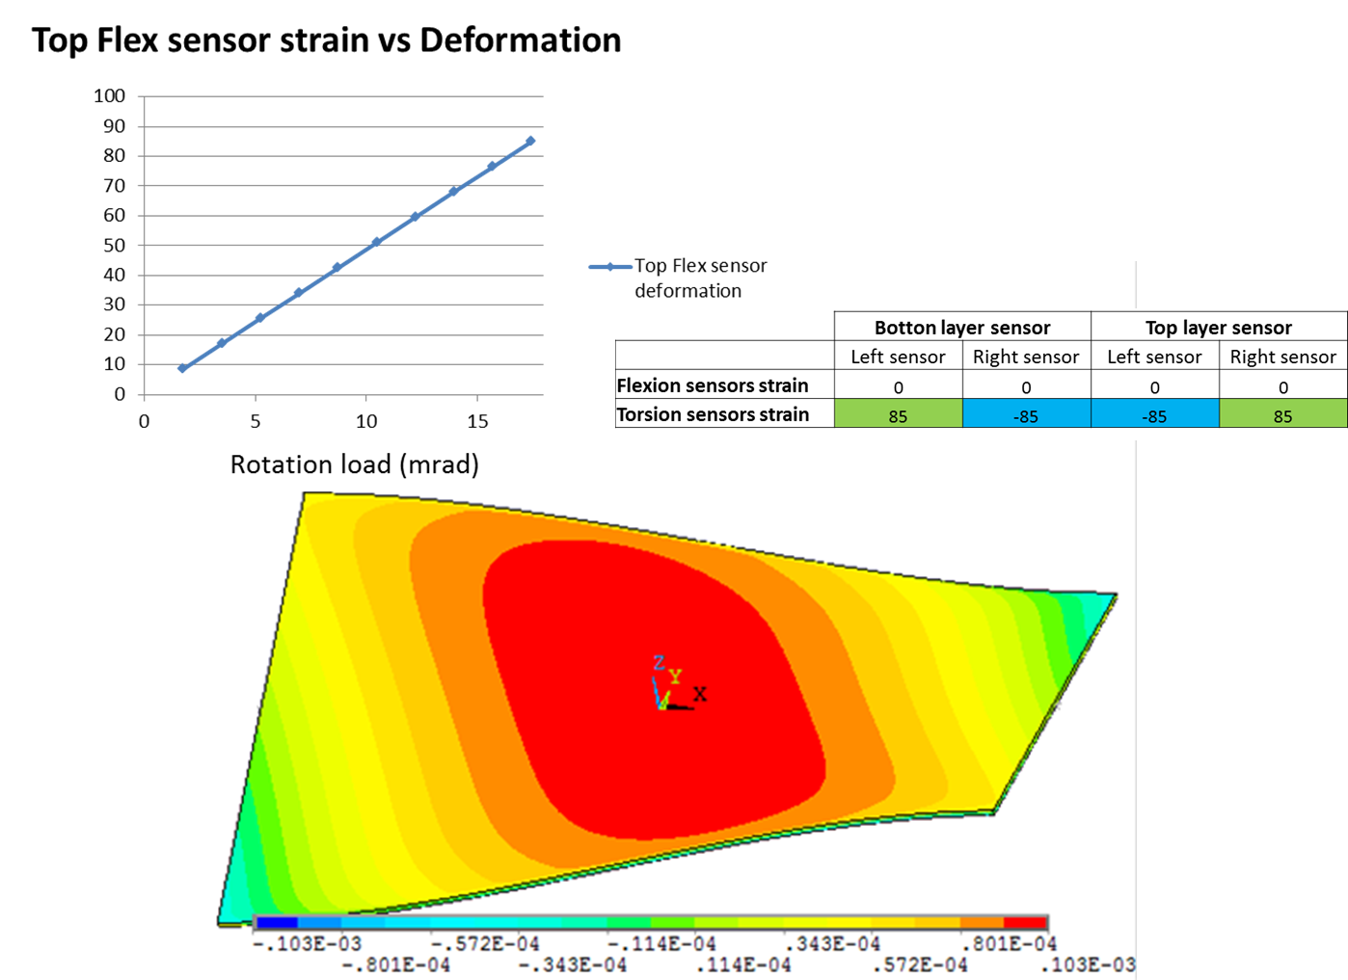
Demonstrator simulation under torsion loads
17

Slide 18
Baseline deliverable

Slide 19
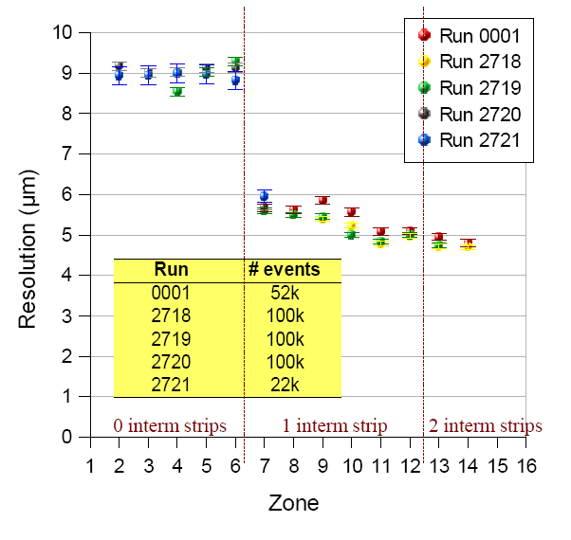
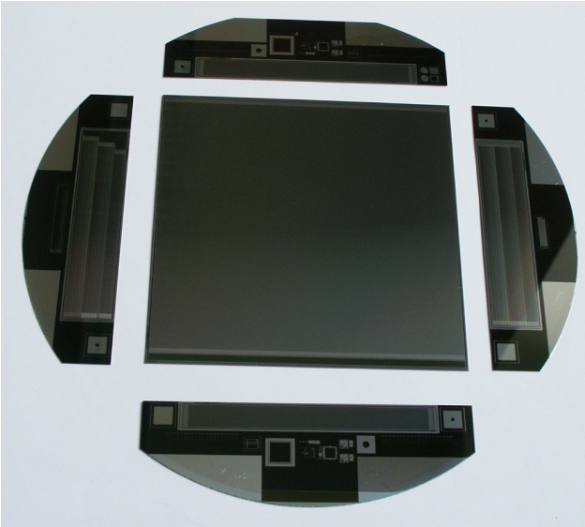
Re-using old SiLC Sensors
Specifications:
  Size: 95 x 95 mm²
  Very fine pitch: 50 µm pitch, 12.5 µm width, 1792 strips, 320 µm thickness
  Readout pitch: 150 µm pitch (512 channels), 2 intermediate strips
  Resolution studies have been performed with small structures of same wafer (but on 50 µm pitch)
  Expected resolution: due to analog readout better than 43 µm, due to inter medial strips approx. 15 µm (43/3)
Large sensor: 95 x 95 mm²
Structures for resolution studies

Slide 20
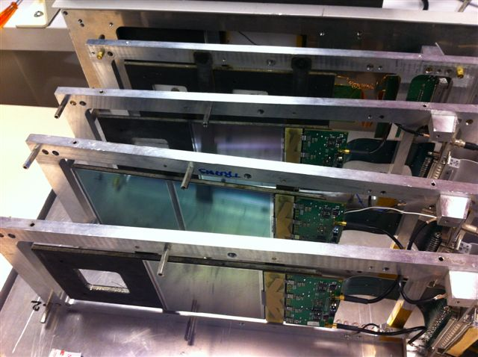
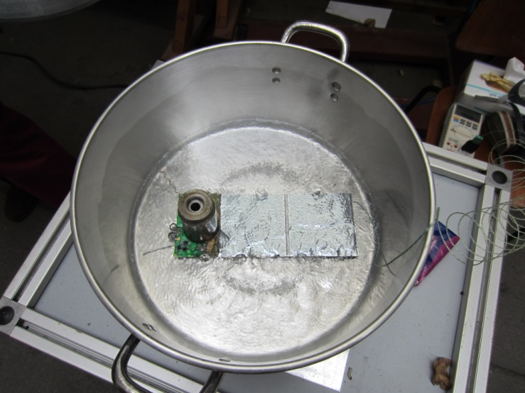
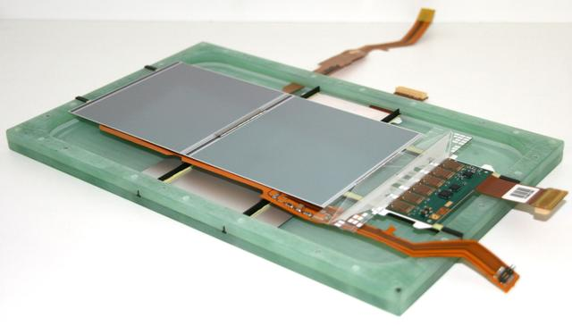
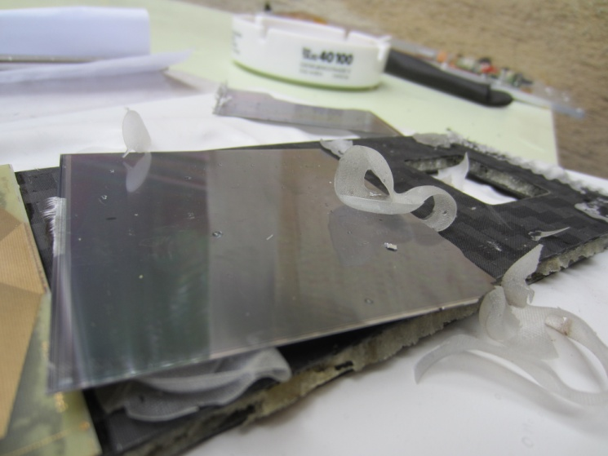
Recuperation of SiLC Sensors
Sensors glued
With stiff araldite:
Cook in toluene
At 100 degC

Slide 21
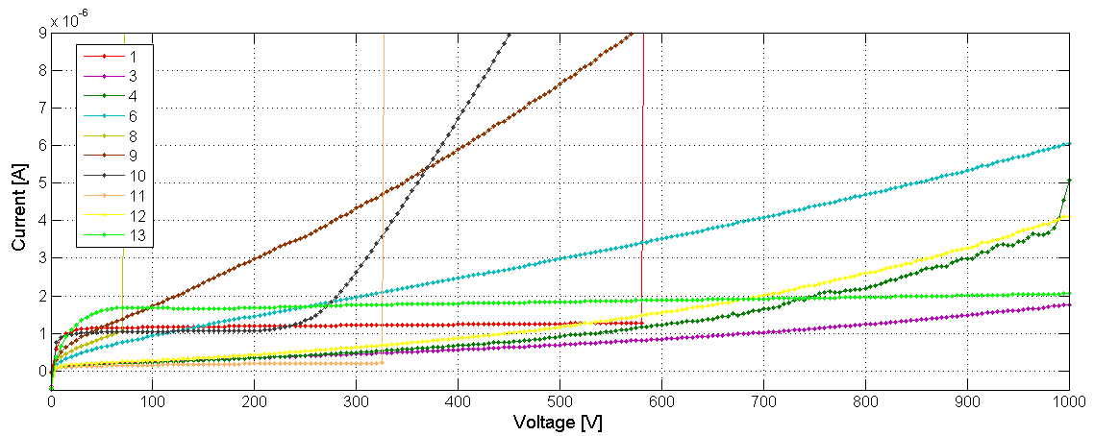
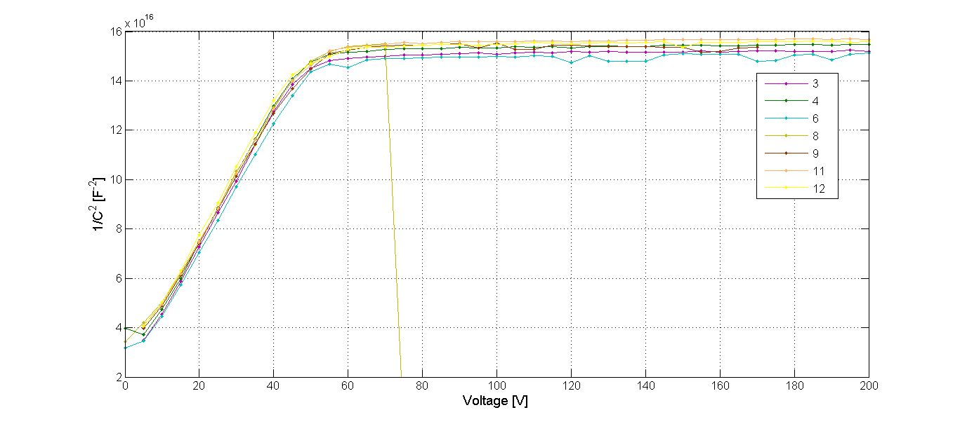
Sensor Performance after disassembly
  IV curves show acceptable behavior
  Sensors are fully depleted at about 50 V
  Sensor on module will be operated at about 70 V-80V

Slide 22
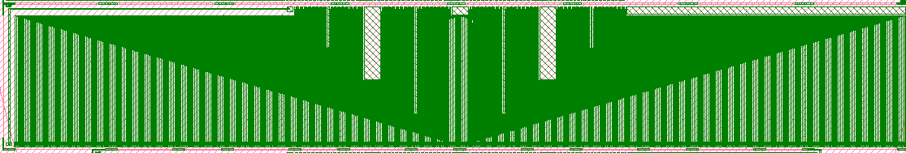
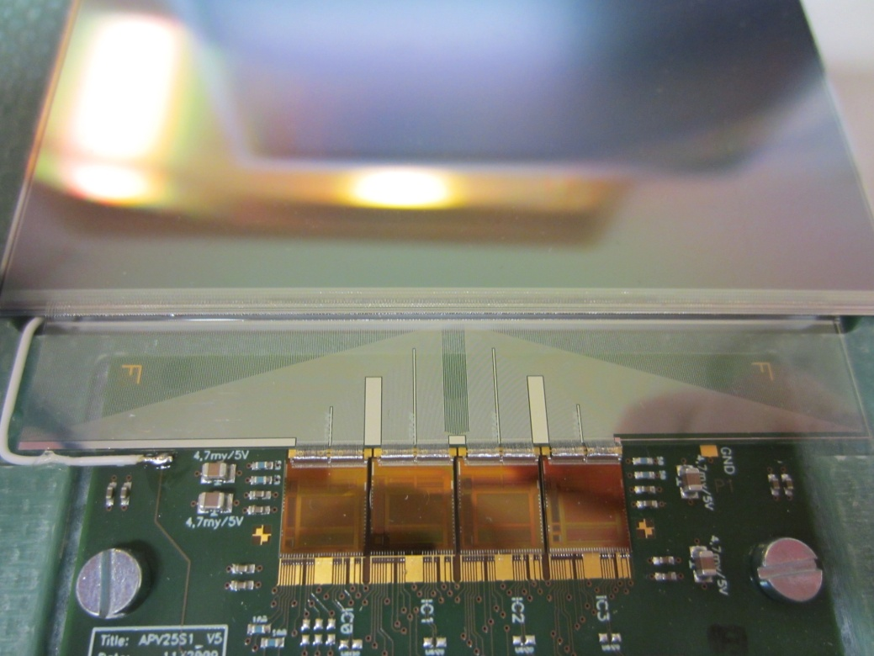
All components available:
Sensors
FE chips (APV 25 from CMS/Belle II)
Mechanics
Pitch adapters produced at CNM Barcelona

Slide 23
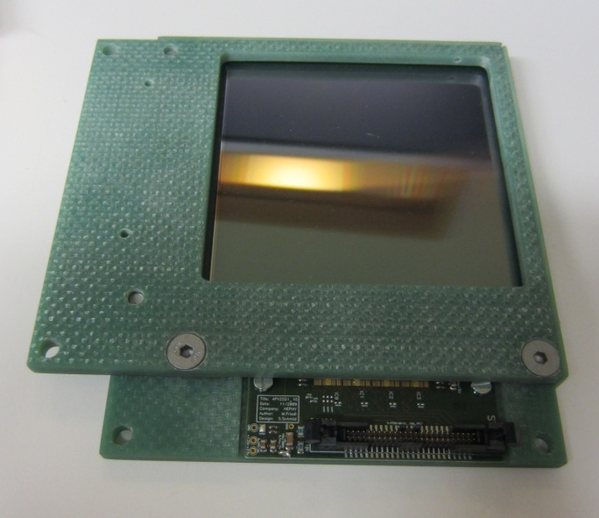
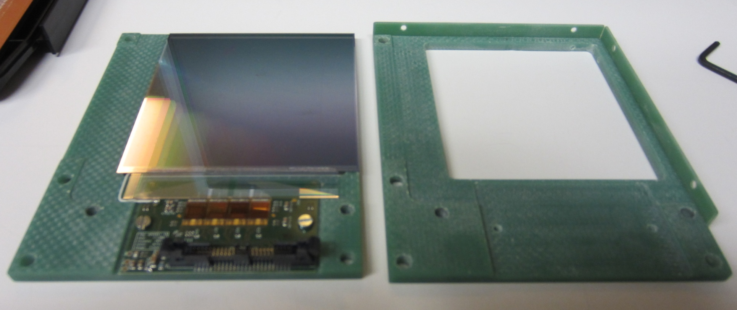
Module Status
One module (consisting of two orthogonal sensors, FE electronics) fully built and tested
Two further modules to be built within next few weeks
  No problems expected
  Source tests by summer

Slide 24
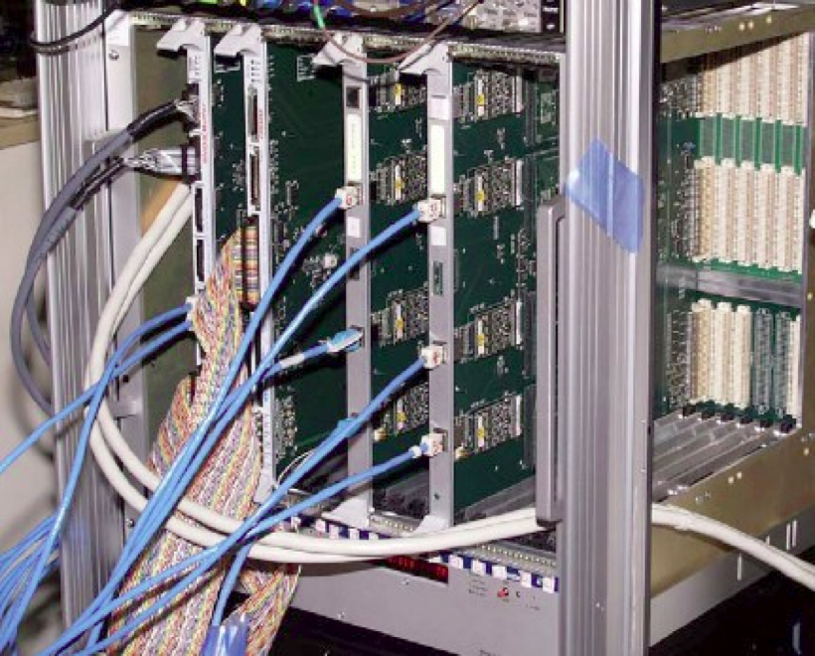
Data Acquisition System
VME boards
~2m
copper
cable
Junction
box
~10m
copper
cable
APV25
chips
Front-end
hybrids
Rad-hard
voltage
regulators
Analog level translation,
data sparsification and
hit time reconstruction
Status:
  DAQ system based on APV25 FE chip (developed for CMS), TLU compatible
  Three versions:
    APVDAQ: lab-system for 4 APVs/boards; 1kHz using 1 card
    SiTra DAQ: 16 APVs/board; 3kHz
    Belle II System: 48APVs/board; up to 20kHz

Slide 25
DAQ Details
Compatibility with (old) EUDET TLU box exists
  Has been used in previous testbeams with EUDET telescope
  offline merging of data streams
Interest to check possibilities with new AIDA TLU

Slide 26
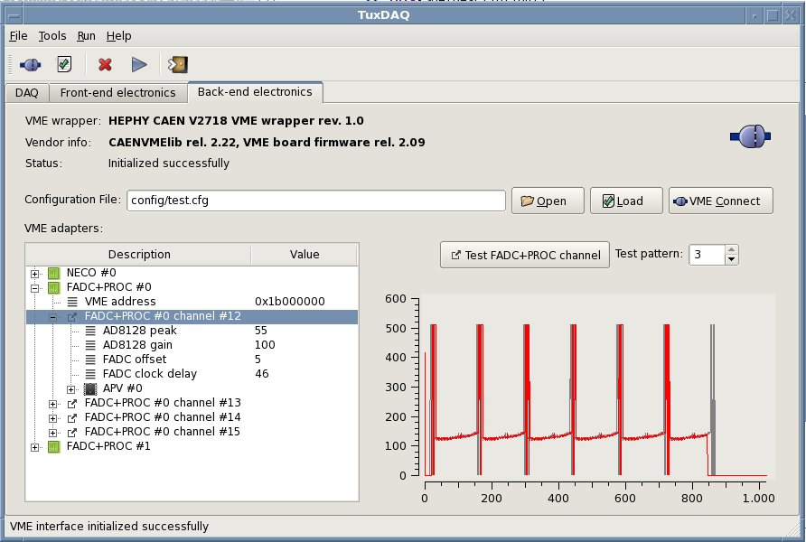
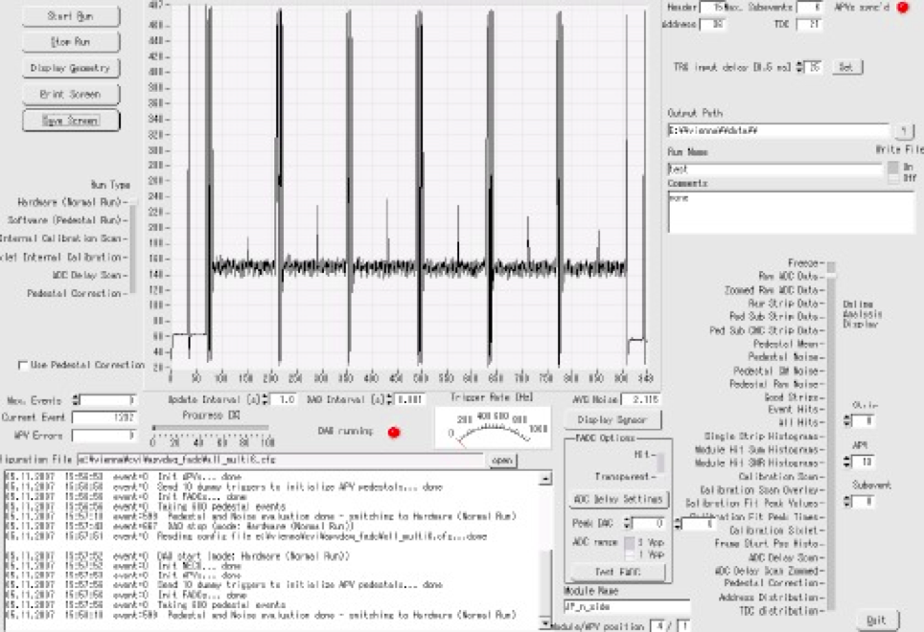
Status DAQ software
DAQ online software was ported recently from old Labwindows/CVI system to Linux/ROOT-based system
  Basic functionality available
  implementation of sophisticated run modes ongoing (ADC delay scan, calibration scan,…) to be done by the end of the year
  Offers modular system with online DQM
  Dummy EUDAQ producer exists, interface to new software seems to be possible

Slide 27
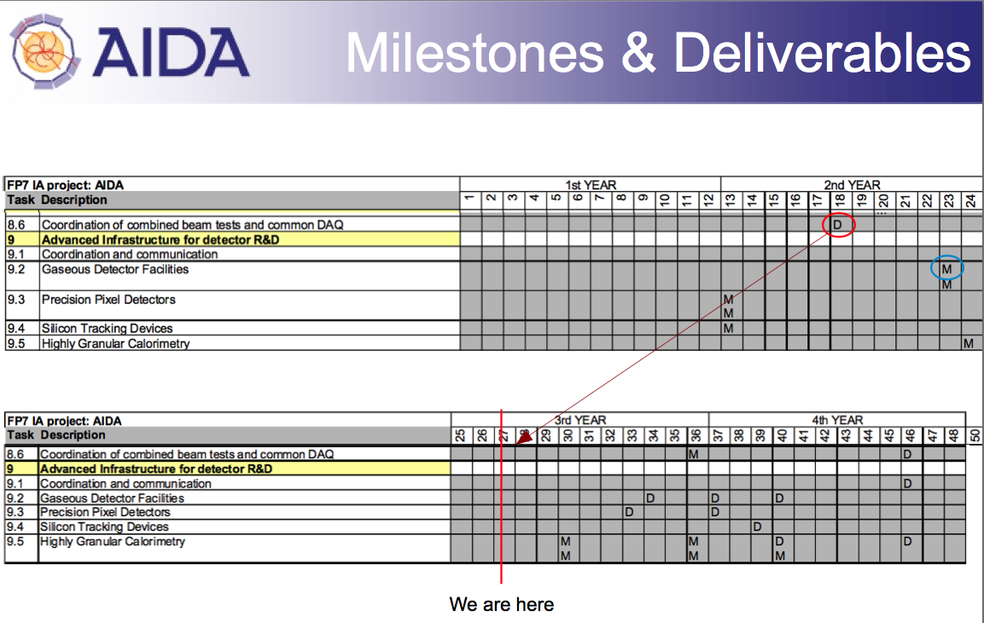
Schedule

Slide 28
Deliverable Month 39
D9.5) Silicon micro-strip ladders: The Silicon micro-strip ladders are installed in front of the Calorimeter stack delivered by WP9.5. The pointing precision and timing performance are characterized. The devices remain available for the study of the calorimeter performance in case of overlapping showers. [month 39: May 2014]

Slide 29
Deliverable status
Baseline Deliverable
Advanced Deliverable
Re-use old SiLC sensors done.
APV25-based front-end done.
Conventional mechanics done.
readout system hardware done.
Offline software done
Online (DAQ) software (re-implementation ongoing)
Integration with common DAQ missing
  Sensors with integrated PA and/or 2D polysilicon sensors ongoing
  New frontend chip ongoing
  Light mechanics with embedded deformation measurement (fiber bragg sensors) ongoing
  Integration with common DAQ missing

Slide 30
Summary
WP9.4 (one and only) deliverable will be available in summer this year
  Sensors, FE electronics, mechanics, offline software, DAQ Hardware (mid-size System, prototype of Belle II)
DAQ Software re-implementation ongoing
  Modular design
  Interface to EUDAQ possible
Testbeam in January 2014 at DESY (parasitically with Belle II beam test)
  DAQ software re-implementation finished then
  Common testbeam together with calorimeter has to be scheduled

